Slide 1
BUNKER SYSTEM
DOCUMENTATION
Critical Design Review (CDR)
5 December 2017
Mark Ridgley
Technical Documentation Coordinator
Bunker Project
europeanspallationsource.se

Slide 2
Bunker System Life-cycle
ConOps ESS-0123251
DESIGN
CONSTRUCTION
OPERATIONS
DECOMMISSIONING
2013
2016
2017
2019
2023
2065
TBD
PRELIMINARY ENGINEERING DESIGN
FINAL
ENGINEERING DESIGN
CONSTRUCTION & INSTALLATION
BEAM TEST & COMMISSIONING
GENERAL OPERATIONS
PLUS MAINTENANCE, UPGRADES & DEVELOPMENT
DECOMMISSIONING
& DISPOSAL
FIRST BEAM ON TARGET
HANDOVER
KICK-OFF
PDR
CDR
SAR
ORR
Preliminary Engineering Design | Final Engineering Design | Construction & Installation | Beam Test & Commissioning | General Operations | Decommissioning & Disposal
Purpose: Develop ConOps and draft SyR for desired solution from a broad spectrum of ideas and alternatives. Determine feasibility of desired system and identify potential technology needs. Define the selected solution in enough detail to establish an initial baseline capable of meeting user needs. Develop system structure end-product requirements and generate a preliminary design with documentation. | Purpose: Finalize design and generate final designs for each system end-product. Develop the engineering documentation for procurement of materials and of manufacturing. | Purpose: Procure materials and manufacturing of system end-products. Develop SIPr prior to installation and SVePr for post installation. Develop as-manufactured engineering documentation for manufacturing procurement. Assemble and integrate system end-products to meet requirements and document in SIR. Prepare transition to operations. Conduct system verification and document in SVeR. Develop as-built 3D engineering models. Develop SVaPr to prepare for system validation. | Purpose: Completion of the system integration and system validation i.a.w. SVaPr with results documented in SVaR. Finalization of the as-built 3D engineering models, SDD and SOMM. Closure of Bunker Project and handover of the Bunker System to ESS Facility Operations. | Purpose: Conduct normal operations as part of the ESS Facility Operations and meet the initially identified need and maintain support for that need as per SOMM. Training of operators and maintainers. Train replacement operators and maintainers. Maintain and approve operations and maintenance logs. Maintain and upgrade of system. | Purpose: The decommissioning, disassembly and disposal of the system i.a.w. SDDPr. Provide SCR and include the documenting of lessons learnt.
Output: Preliminary design definition in the form of simulations, analysis and 3D engineering models. Concept of Operations (ConOps). System Requirements Specification (SRS). System Architecture Description (SAD). System Validation Plan (SVaP). System Integration Plan (SIP). System Verification Plan (SVeP). | Output: Final design definition in the form of simulations, analysis and 3D engineering models. Final ConOps, SRS, SAD. Final SVaP, SIP, SVeP. System Operation and Maintenance Manual (SOMM). Systems Design Description (SDD). Safety Analysis Report. Structural Verification Status Report. Engineering documentation for manufacturing procurement. | Output: System Integration Procedure (SIPr). System Verification Procedure (SVePr). System Integration Report (SIR) System Verification Report (SVeR). System Validation Procedure (SVaPr). As-manufactured engineering documentation. As-built 3D engineering models. | Output: System Validation Report (SVaR). Final SOMM, SDD. Final as-built 3D engineering models. | Output: Operations logs Maintenance logs | Output: System Decommissioning and Disposal Plan (SDDP). System Decommissioning and Disposal Procedure (SDDPr). System Closeout Report (SCR).

Slide 3
Bunker Project Documentation
CDR
Final design definition in the form of:
  Neutronics simulations and analysis
  3D engineering models
  Engineering simulations and analysis
Engineering documentation for manufacturing procurement
Systems Documentation:
  Concept of Operations (ConOps)
  System Requirements Specification (SRS)
  System Architecture Descriptions (SAD)
  System Interface Description (SID)
  Systems Design Description (SDD)
  System Integration Plan (SIP)
  System Verification Plan (SVeP)
  System Validation Plan (SVaP)
  System Operation and Maintenance Manual (SOMM)

Slide 4
Bunker System Documentation w.r.t. PSAR and SSM
Preliminary Safety Assessment (PSAR) as presented to Swedish Radiation Safety Authority (SSM)
  Section 3.2. Radiation Safety Analyses & Methodologies
    Illustration of ESS design process as defined in the system engineering management plan
Notes:
Radiation safety analyses and methodologies are an integral part of ESS’s design methodology.
Radiation safety management is a sub-set of risk management activities performed at ESS.
The ESS design process starts by identifying the stakeholder needs and the operational context for the facility. From these, requirements for the facility are derived and required functions are defined. The facility is decomposed into system elements, based on use cases and functional analysis, and requirements are allocated to each system element. This process is then repeated for each system element in an iterative and recursive fashion, as illustrated in Figure 3-1, until a level of detail has been reached where detailed design and system realisation can occur.
The specific instance of a system or sub-system is referred to as the system of interest.

Slide 5
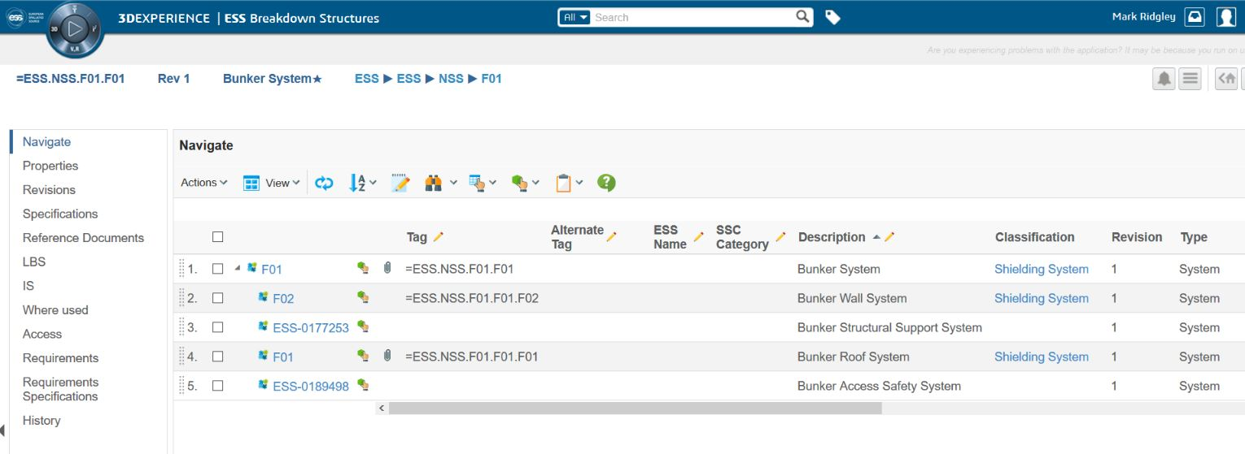
ESS Facility Breakdown Structure
CHESS
=ESS.NSS.F01.F01
Bunker System
Shielding & Safety System

Slide 6
Bunker System Documentation
ESS-0123251 - Concept of Operations (ConOps)
Primary purpose - provide a shared cavity shielding bunker at the target monolith to:
  Host Instrument Systems front-end elements.
  Attenuate the radiation emanating from the target monolith and generated in the first sections of the beam-lines (neutron and gamma rays) to safe levels external to the bunker.
Bunker System ConOps Scope:

Slide 7
Bunker System Documentation
ESS-0060210 - System Requirements Specification (SRS)
SRS specifies and describes the system requirements for the Bunker System (BS.SyR).
Derived from:
  high-level requirements allocated by the parent system - Shielding & Safety System
  ConOps for the Bunker System
  feedback from the evolving design development of the system
BS.SyR are defined according to the different categories and each is uniquely identified:
  Functional Requirements
  Constraint Requirements
  Seismic Safety Requirements
  Radiation Safety Requirements
  Interface Requirements
BS.SyR are applied to the requirements driven development of the system design.
Notes:
Bunker System Requirements will be presented in separate presentation.

Slide 8
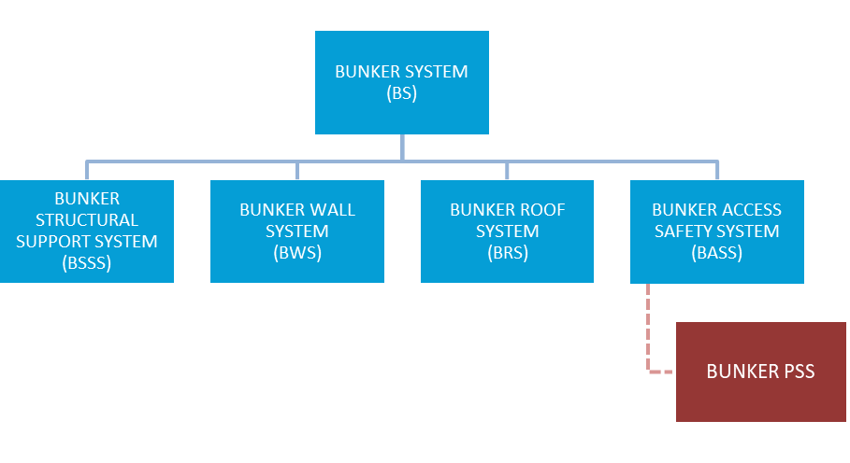
Bunker System Documentation
ESS-0123443 - System Architecture Description (SAD)
SAD describes the system architecture and allocation of BS.SyR to subsystems.
BS.SyR are allocated to at least one subsystem.
Bunker System Breakdown Structure
(simplistic)
Notes:
Logical system breakdown effectively describes the different functions that the specialized subsystems provide.
Note that the concrete base slabs that constitute the bunker base in D building D01 (Experimental Hall 1), D building D03 (Experimental Hall 2) and the Monolith Civil Structure (MCS) of D building D02 (Target Building) are not part of the Bunker System. They are part of Site Infrastructure (SI).

Slide 9
Bunker Subsystem Documentation
ESS-0123282 - ConOps for the Bunker Structural Support System
System purpose of the Bunker Structural Support System is to:
  provide the load paths through to the bunker base of the Monolith Civil Structure (MCS) in D-Building D02 (Target Building) and the bunker base in D01 (Experimental Hall 1) and D03 (Experimental Hall 2) to resist dead load, live loads and accidental loads.
  provide structural support for the bunker roofs.
  provide interfaces for the routing of required utilities within the bunker.
  provide the structure that ensures Bunker System requirements at H4 seismic event are fulfilled.
  allow for the allocation of reserved volume for each Instrument System (IS) along its designated beam-port central axis from the target to the bunker walls for its front-end system elements installed within the bunker.
Notes:
In doing so this system contributes to the fulfilment of the system purpose of the Bunker System which is to host Instrument Systems elements and associated equipment and attenuate the radiation emanating from the target monolith and generated in the first sections of the beam-lines (neutron and gamma rays) to safe levels external to the bunker.

Slide 10
Bunker Subsystem Documentation
ESS-0123283 - ConOps for the Bunker Wall System
System purpose of the Bunker Wall System is to:
  provide attenuation of radiation emanating outwards from within the bunker down to safe levels external to the bunker.
  ensure attenuation of radiation emanating from within the bunker through where the base of the bunker walls interface with the bunker base respectively in the Monolith Civil Structure (MCS) of D-Building D02 (Target Building), in D-Building D01 (Experimental Hall 1) and D-Building D03 (Experimental Hall 2) down to safe levels external to the bunker.
  modular in form to provide safe feed-through of Instrument Systems (IS) elements (e.g. instrument guides) from within the bunker into D01 and D03 respectively.
  modular in form to allow modification to suit installation or removal of IS elements (e.g. instrument guide).
  modular in form to provide safe feed-through routing of utilities into the bunker from D01 and D03 for IS elements within the bunker.
  impede access to the bunker.
  modular in form to provide restricted secondary access for the passage of large IS elements for installation or removal when access passage through the bunker roof is not sufficient.
Notes:
In doing so this system contributes to the fulfilment of the system purpose of the Bunker System which is to host Instrument Systems elements and associated equipment and attenuate the radiation emanating from the target monolith and generated in the first sections of the beam-lines (neutron and gamma rays) to safe levels external to the bunker.

Slide 11
Bunker Subsystem Documentation
ESS-0123286 - ConOps for the Bunker Roof System
System purpose of the Bunker Roof System is to:
  provide attenuation of radiation emanating upwards from within the bunker down to safe levels external to the bunker.
  modular in form to provide restricted personnel access to the bunker.
  modular in form to provide primary access for the passage of Instrument Systems elements, Target Systems elements and associated equipment for installation or removal.
Notes:
In doing so this system contributes to the fulfilment of the system purpose of the Bunker System which is to host Instrument Systems elements and associated equipment and attenuate the radiation emanating from the target monolith and generated in the first sections of the beam-lines (neutron and gamma rays) to safe levels external to the bunker.

Slide 12
Bunker Subsystem Documentation
ESS-0123281 - ConOps for the Bunker Access Safety System
System purpose of the Bunker Access Safety System is to:
  provide safe restricted authorised personnel access to the bunker roofs.
  provide safe restricted authorised access into the bunker.
Notes:
In doing so this system contributes to the fulfilment of the system purpose of the Bunker System which is to host Instrument Systems elements and associated equipment and attenuate the radiation emanating from the target monolith and generated in the first sections of the beam-lines (neutron and gamma rays) to safe levels external to the bunker.

Slide 13
Bunker System Documentation
System and Subsystems
Refer to:
BunkerSystem-doc.tif

Slide 14
Bunker System Documentation
ESS-0087572 - System Interface Description (SID)
SID captures and describes project specific interface agreements with neighbouring systems; Site Infrastructure, Target Systems and Instrument Systems:
  ESS-0062997, Bunker shielding roof seismic load on MCS
  ESS-0085422, Boundary interfaces definition; Bunker – CF
  ESS-0068165, Bunker layout – Interfaces – static load
  ESS-0084435, Bunker pillar loads calculation
  ESS-0086197, Bunker to the insert exchange tool interface
  ESS-0051975, Bunker base support pillars
  ESS-0062215, Feed-thru block assembly
  ESS-0062127, Short instrument wall feed-thru outline
  ESS-0062152, Long instrument wall feed-thru
  ESS-0086538, Utilities feed-through layout
  ESS-0086925, Bunker to Target interfaces
  ESS-0049906, ICD-R NBEX-NSS
The agreed to interface solutions at preliminary design stage and used as input into the final design engineering.
Notes:
Not an interface control document.
Used as input into the design engineering only.
The end design output is described in the System Design Description (SDD).

Slide 15
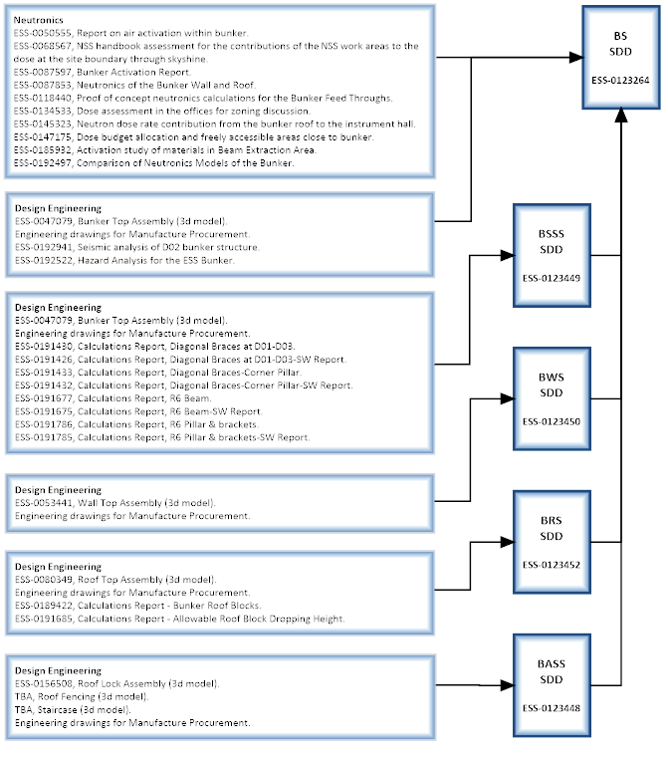
Bunker System Documentation
ESS-0123264 - System Design Description (SDD)
SDD provides the documented description of the design of the Bunker System that is to be built.
SDD is comprised of the SDDs of its subsystems.
SDD captures for subsystems and complete system:
  Design engineering
    3d models.
    Simulations & analysis.
    Engineering drawings for manufacture procurement.
  Neutronics
    Simulations & analysis.

Slide 16
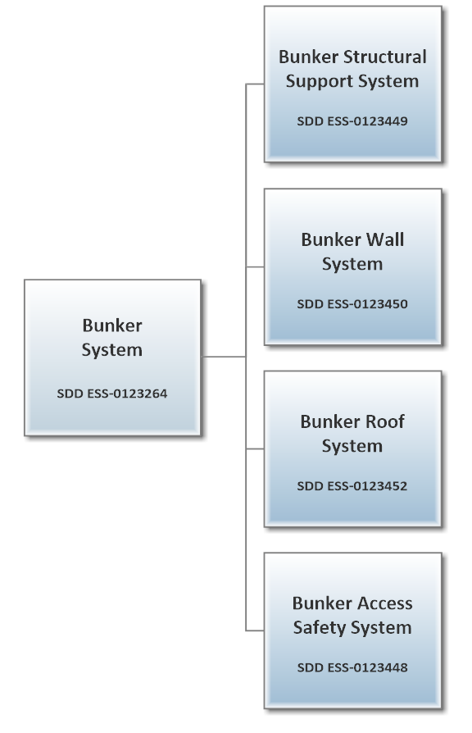
Bunker System Documentation
ESS-0123264 - System Design Description (SDD)
Bunker System
Product Breakdown

Slide 17
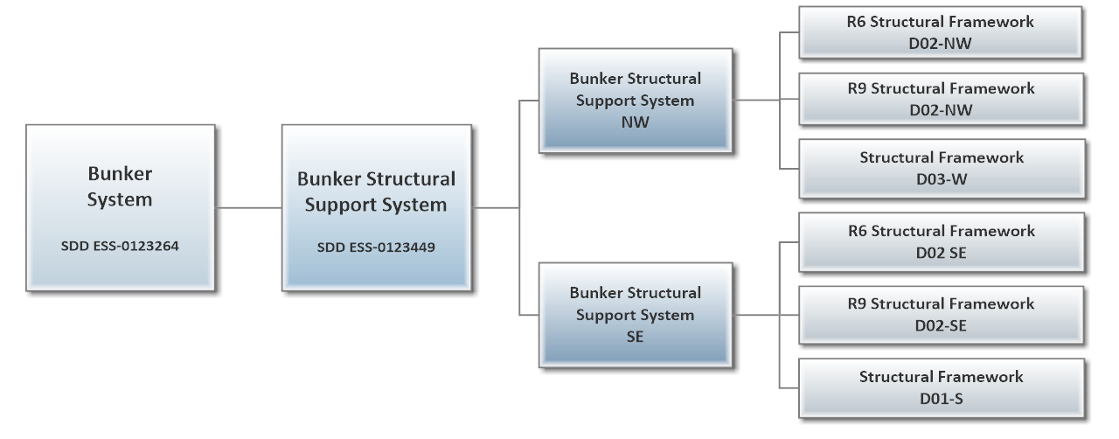
Bunker System Documentation
ESS-0123264 - System Design Description (SDD)
Bunker Structural Support System
Product Breakdown
ESS-0123449 SDD

Slide 18
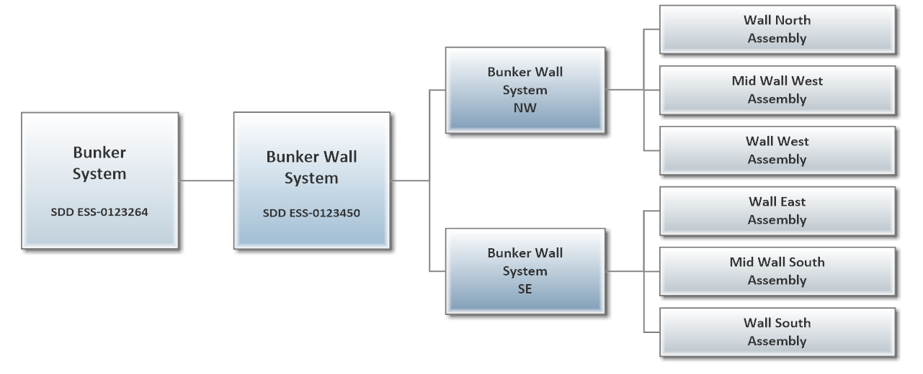
Bunker System Documentation
ESS-0123264 - System Design Description (SDD)
Bunker Wall System
Product Breakdown
ESS-0123450 SDD

Slide 19
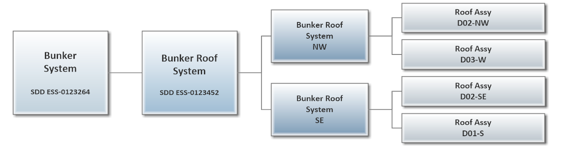
Bunker System Documentation
ESS-0123264 - System Design Description (SDD)
Bunker Roof System
Product Breakdown
ESS-0123452 SDD

Slide 20
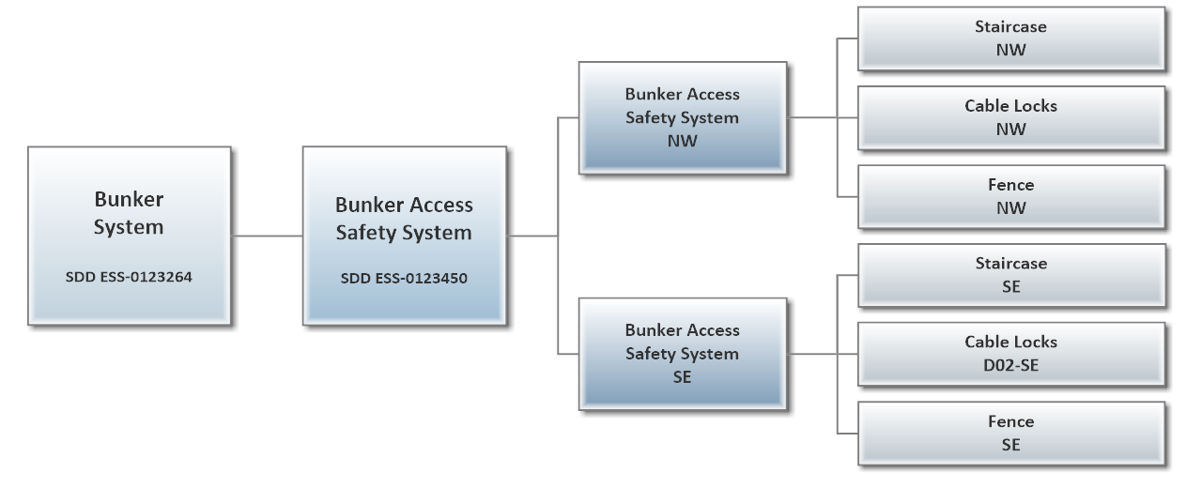
Bunker System Documentation
ESS-0123264 - System Design Description (SDD)
Bunker Access Safety System
Product Breakdown
ESS-0123448 SDD

Slide 21
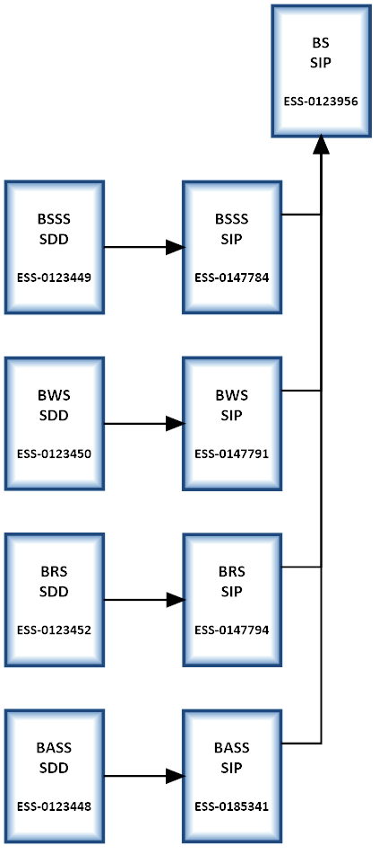
Bunker System Documentation
ESS-0123956 - System Integration Plan (SIP)
SIP provides the documented description of the plan for integration of the Bunker System into the ESS facility.
SIP is comprised of the SIPs of its subsystems.
Subsystem SIPs developed from respective subsystem SDD.
Captures the design engineers’ plan that is the input provided to the project installation plan.
Self-check of the system design.
Notes:
integration plan that defines the order in which you integrate lower-level components and subassemblies.
Plan your integration so pieces that need to work together are ready for integration at the same time, if possible.
At each integration step, verify the functionality of the subassembly against the appropriate set of requirements,

Slide 22
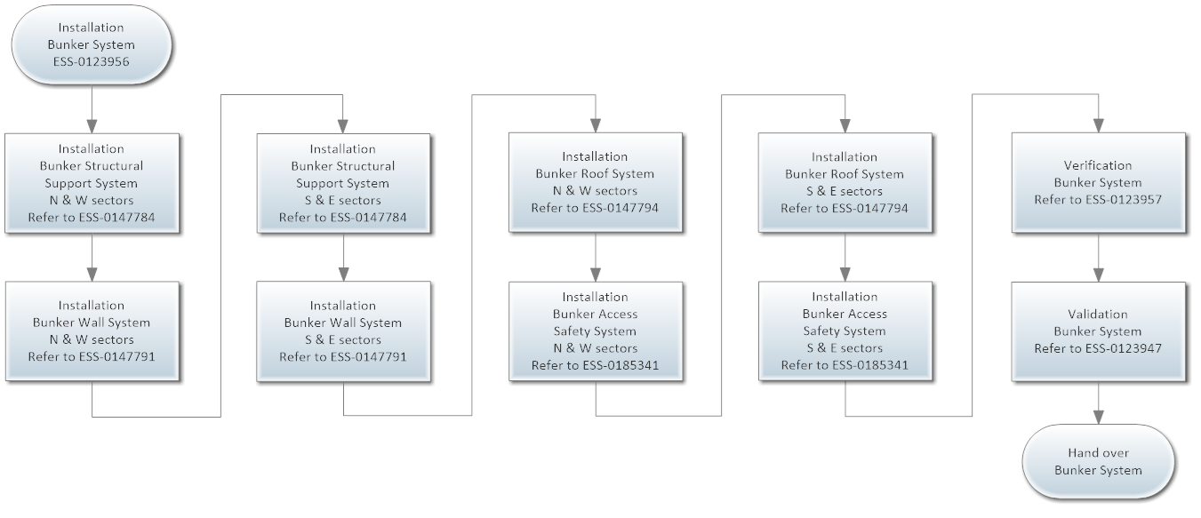
Bunker System Documentation
ESS-0123956 - System Integration Plan (SIP)
Bunker System Integration

Slide 23
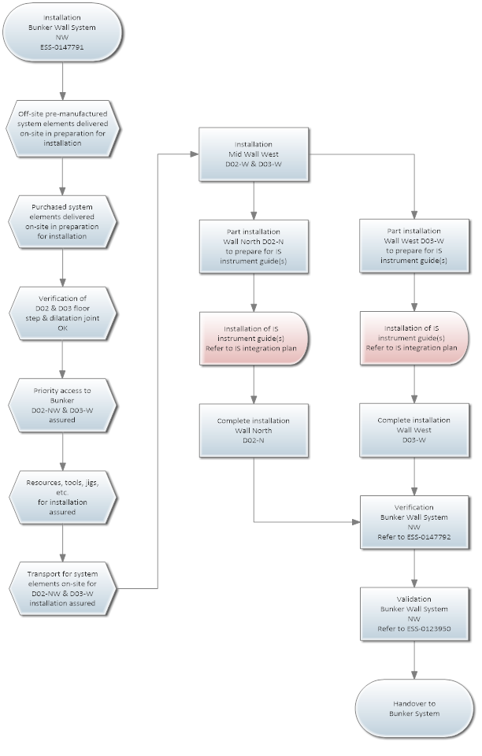
Bunker System Documentation
ESS-0123956 - System Integration Plan (SIP)
Bunker Wall System NW Integration

Slide 24
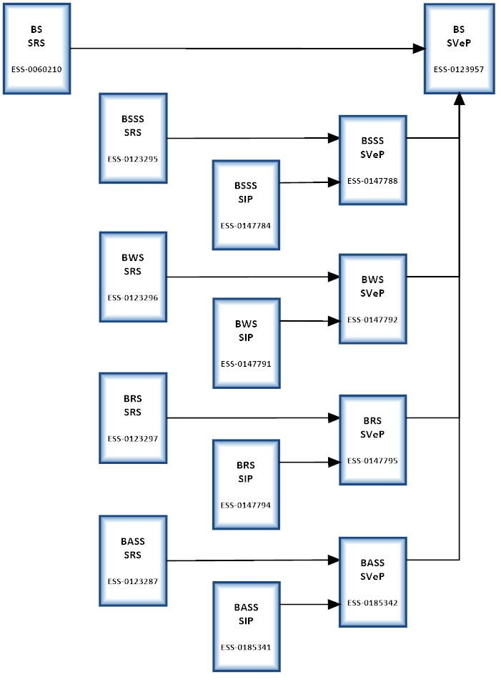
Bunker System Documentation
ESS-0123957 - System Verification Plan (SVeP)
SVeP provides the documented description of the plan for system verification of the Bunker System.
SVeP also comprised of the SVePs of its subsystems.
Subsystem SVePs developed from respective subsystem SRS and SIP.
Verification of the system design through verification of the system requirements as well as verification of the integration:
  Does the system design clearly represent the system requirements that drove the design?
  Does it fulfil ESS processes, rules, guidelines, etc.?
System verification can be carried out as the system integration progresses.

Slide 25
Bunker System Documentation
ESS-0123947 - System Validation Plan (SVaP)
SVaP provides the documented description of the plan for system validation of the Bunker System.
SVaP also comprised of the SVaPs of its subsystems.
Subsystem SVaPs developed from respective subsystem ConOps with input from respective SVeP.
System design validation through is to determine whether the system design, when integrated, will result in the intended system purpose being fulfilled in the operational environment and the stakeholder’s expectations and needs have been met.
Notes:
In doing so this system contributes to the fulfilment of the system purpose of the Bunker System which is to host Instrument Systems elements and associated equipment and attenuate the radiation emanating from the target monolith and generated in the first sections of the beam-lines (neutron and gamma rays) to safe levels external to the bunker.

Slide 26
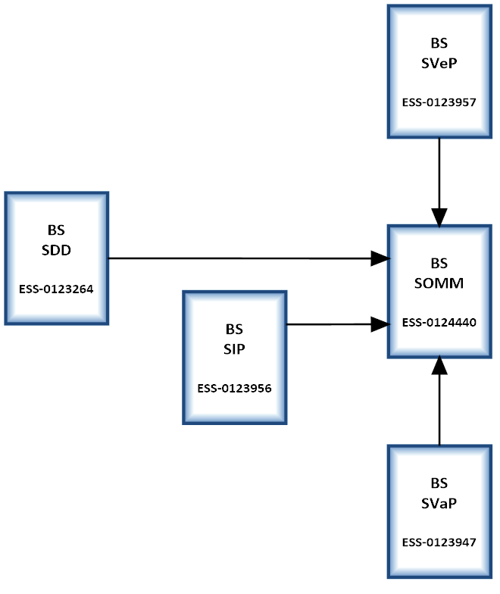
Bunker System Documentation
ESS-0124440 - System Operations & Maintenance Manual (SOMM)
In general, operation of the Bunker System is a sub-routine of another system’s process / procedure such as Instrument Systems (IS), Target Systems (TS) and Integrated Control Systems (ICS) installation / removal / maintenance activities.
Maintenance section is only regarding the Bunker System and does not address how elements of other systems that are located within the bunker cavity are maintained.
The operation of the Bunker System will only be a sub-routine within their maintenance routines.
Accessibility of personnel into bunker is addressed in the system design and is to be as timely and orderly as safety permits.
SOMM is developed based on the ConOps and SDD with input from the system integration, verification and validation.
Notes:
These system’s specific activities are not detailed in this document as they are not part of the Bunker System’s operations.
Refer to those relevant systems maintenance documentation for their maintenance information.

Slide 27
Bunker System Documentation
ESS-0124440 - System Operations & Maintenance Manual (SOMM)
ID | Title | Description
BS.OS-01 | Personnel Access Bunker NW R6-R15 | Personnel access through bunker roof for inspection / maintenance in north and west sectors within R6-R15 region.
BS.OS-02 | Personnel Access Bunker W R15-R28 | Personnel access through bunker roof for inspection / maintenance in west sector within R15-R28 region.
BS.OS-03 | System Element Access Bunker NW R6-R15 | Access through bunker roof for installation / removal of system elements in north and west sectors within radial region R6-R15. Note: Refer to relevant system documentation for other system element installation / removal operations.
BS.OS-04 | System Element Access Bunker W R15-R28 | Access through bunker roof for installation / removal of system elements in west sector within radial region R15-R28. Note: Refer to relevant system documentation for other system element installation / removal operations.
BS.OS-05 | System Element Access Bunker W R6-R28 | Access through bunker roof for installation / removal of system elements in west sector within radial region R6-R28. Personnel access through bunker roof in west sector within R6-R28 region. Note: Refer to relevant system documentation for other system element installation / removal operations.
BS.OS-06 | IS Guide Access Bunker Wall N | Access to IS instrument guide in north sector bunker wall for installation / removal / alignment. Note: Refer to relevant IS documentation for instrument guide installation / removal / alignment operations.
BS.OS-07 | IS Guide Access Bunker Wall W | Access to IS instrument guide in west sector bunker wall for installation / removal / alignment. Note: Refer to relevant IS documentation for instrument guide installation / removal / alignment operations.
Operational Scenarios
Notes:
These system’s specific activities are not detailed in this document as they are not part of the Bunker System’s operations.

Slide 28
Bunker System Documentation
ESS-0124440 - System Operations & Maintenance Manual (SOMM)
BS.OS-01 Personnel Access Bunker NW R6-R15.
Notes:
These system’s specific activities are not detailed in this document as they are not part of the Bunker System’s operations.

Slide 29
Bunker System Documentation
ESS-0124440 - System Operations & Maintenance Manual (SOMM)
BS.OS-07 IS Guide Access Bunker Wall W
Notes:
These system’s specific activities are not detailed in this document as they are not part of the Bunker System’s operations.

Slide 30
Bunker System Documentation
ESS-0124440 - System Operations & Maintenance Manual (SOMM)
CRITERIA | ORGANIZATIONAL MAINTENANCE | INTERMEDIATE MAINTENANCE | SUPPLIER MAINTENANCE
Where | On-site in-situ where system element is operated. | On-site in dedicated workshop. | Off-site at the supplier premises.
Who | ESS maintenance personnel. ESS sub-contractors. | ESS maintenance personnel. ESS sub-contractors. | Supplier.
Equipment | In use equipment. | Equipment owned by ESS. | Equipment owned by ESS. Supplier equipment.
Maintenance Activity | Visual inspection. System element. System element adjustment and alignment. System element removal and replacement. In-situ repairs. | Detailed inspection. System elements replacement build. System element repair. Overload of organizational maintenance. | Complex system elements replacement build. Overload of intermediate maintenance.
Levels of Maintenance
Notes:
These system’s specific activities are not detailed in this document as they are not part of the Bunker System’s operations.

Slide 31
Bunker System Documentation
ESS-0124440 - System Operations & Maintenance Manual (SOMM)
Maintenance routines for the Bunker System will be developed down to the lowest level element and will be categorized as preventive, corrective or predictive.
Preventive Maintenance
  Preventive maintenance is scheduled maintenance of system elements, in accordance with planned preventative maintenance routines, to maintain them in satisfactory operating condition with systematic inspection, detection and correction of incipient failures or malfunctions either before they occur or before they develop into major defects.
  Maintenance and monitoring requirements of system elements will be of consideration in the design and preventive maintenance will be limited to periods of scheduled operations shutdown of the ESS facility.
Corrective Maintenance
  In general, corrective maintenance is an unscheduled maintenance task performed to identify, isolate, and rectify a fault so that the failed system or system element can be restored to an operational condition within the tolerances or limits established for in-service operations.
  Corrective maintenance generally can be sub-divided into immediate corrective maintenance where maintenance activities are required immediately after a failure and deferred corrective maintenance where maintenance activities may be delayed in accordance with a pre-ordained procedure.
Predictive Maintenance
  Predictive maintenance evaluates the condition of the system element in-service by performing periodic or continuous condition monitoring in order to predict when maintenance should be performed. The main aim is to allow convenient scheduling of corrective maintenance to prevent unexpected system element failures when the maintenance activity is most cost-effective and before the system element loses performance within a threshold.
  This contrasts with preventive maintenance because maintenance activities are performed only when warranted during periods of scheduled operations shutdown of the ESS facility thus providing cost-savings. The potential advantages also include increased system element lifetime, less impact on environment, and optimized spare parts handling and thus increased system reliability, availability, maintainability and safety.
  The employment of predictive maintenance routines instead of preventive maintenance routines will be of consideration in the design where possible as part of cost and safety management.
Notes:
These system’s specific activities are not detailed in this document as they are not part of the Bunker System’s operations.

