Slide 1
Bunker Project
Integration/Interfaces
Zvonko Lazic; Mark Ridgley
www.europeanspallationsource.se
5 October 2017

Slide 2
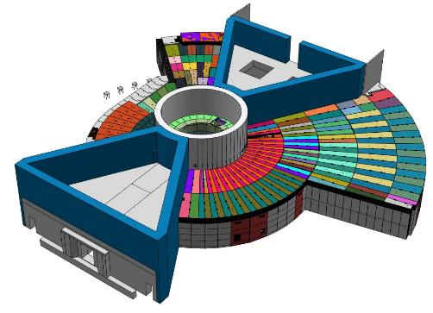
The Bunker - content
Design overview
  Frame
  Roof
  Walls
Interfaces
  Definition
  Bunker ↔ CF
  Bunker ↔ Target
  Bunker ↔ Instruments
  Installation considerations
  Operation considerations
Safety considerations

Slide 3
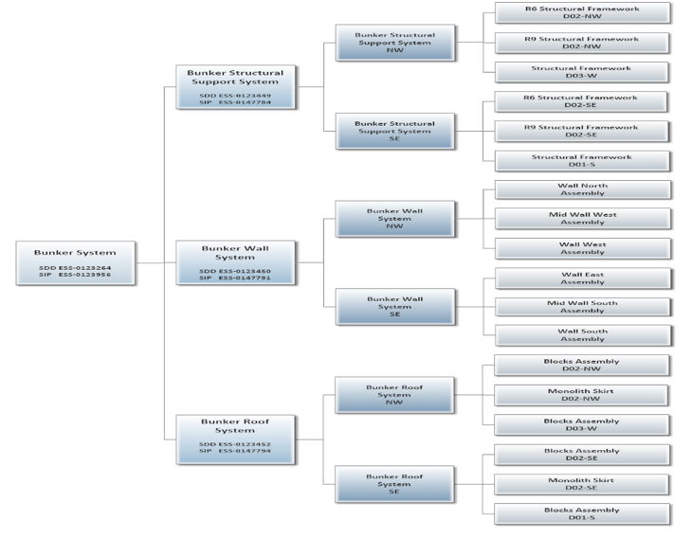
Bunker System End Product Breakdown
SDD ESS-0123264 (slide credit Mark R.)
Notes:
High-level (simplistic) end product breakdown structure of the Bunker System. Only to first assembly level.
System Design Description (SDD) for the Bunker System ESS-0123264.
System Integration Plan (SIP) for the Bunker System ESS-0123956.

Slide 4
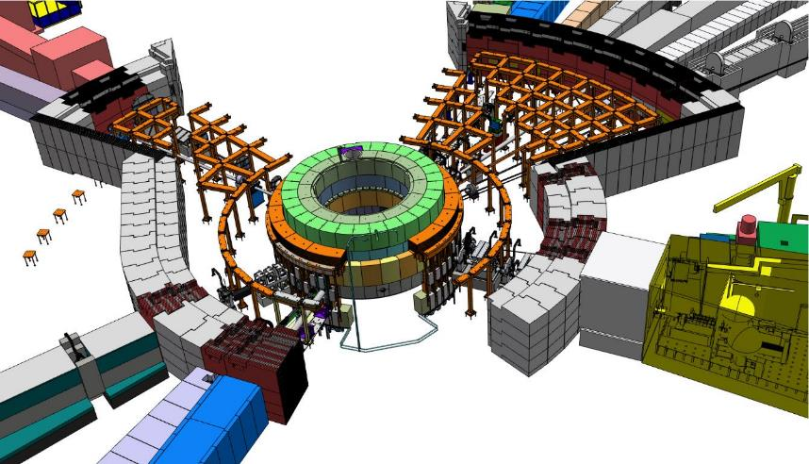
The bunker – Design overview
SUPPORT FRAME
The bunker frame has to:
Support the roof load;
Sustain seismic loads (up to H4);
Allow easy disassembly;
Ensure that blocks stacked on top, fit;
Ensure repeatability of stacking/unstacking of blocks;

Slide 5
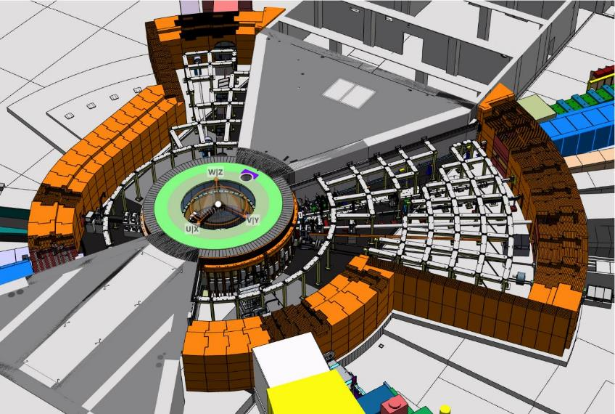
The bunker – Design status
WALLS
The bunker walls function is to:
Shield (from radiation);
Support (roof above);
Integrate (beam feed-throughs);

Slide 6
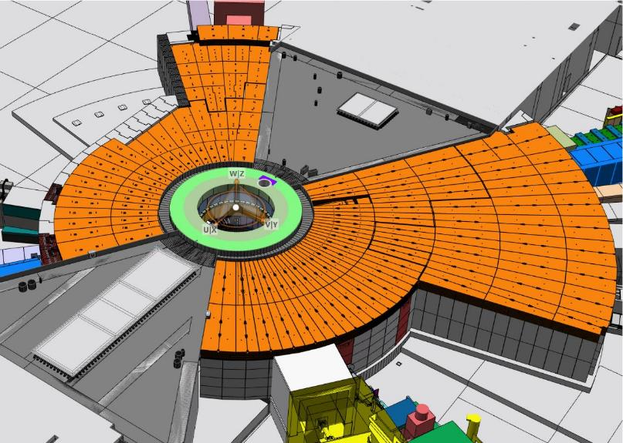
The bunker – Design status
ROOF
The bunker roof function is to:
Shield (from radiation);
It also has to allow for:
Reasonably fast access into the bunker cavity;
Ability to unstack and stack blocks repeatedly;

Slide 7
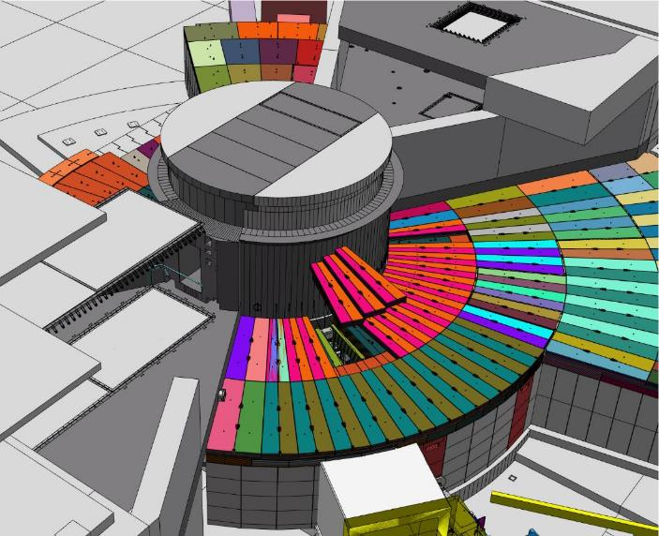
The bunker – Design status
ROOF
The bunker roof is made out of blocks;
The blocks are arranged in 3 overlapping levels;
Lifting times depend on the particular point of entry;

Slide 8
Interface types
  Boundary Interface [Bi]
…is an interface where the bunker system meets with a neighbouring system without any impact (no contact, no transfer of force, signal, power, goods or fluids)
  Contact Interface [Ci]
…is an interface where the bunker meets with a neighbouring system, and imparts/transfer a force to the neighbouring system.
  Service Interface [Si]
…is an interface where the bunker system meets with a neighbouring system, with an area/volume defined for transfer of goods or services (this encompasses access points, all supplies; water, vacuum, power,…)
  Hardware Interface [Hi]
…is an interface where the bunker system meets with a neighbouring system, providing a defined volume/surface reserved for passage of the neighbouring system (in the bunker system case, this happens when an instrument passes through the bunker wall).

Slide 9
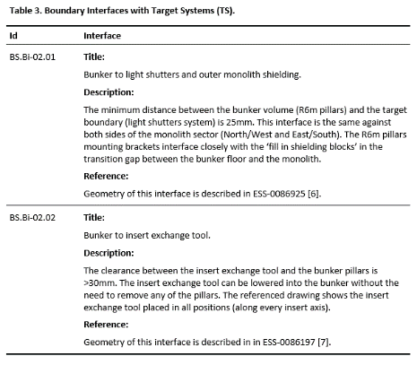
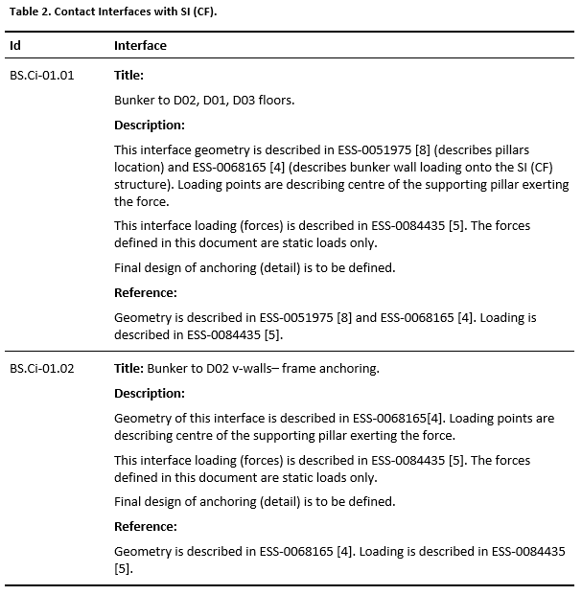
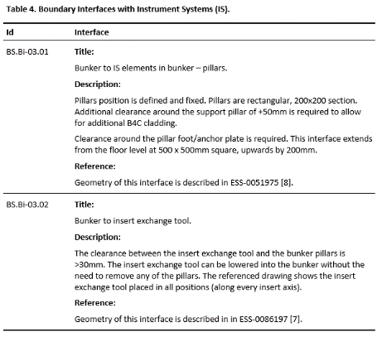
Bunker System Interface Description
SID ESS-0087572 (slide credit Mark R.)

Slide 10
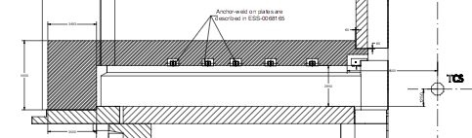
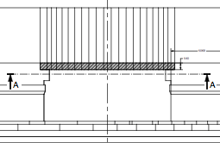
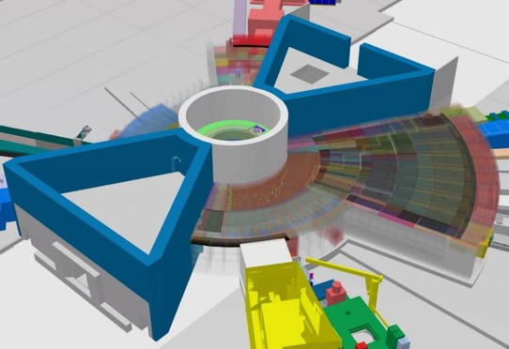
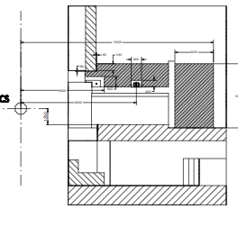
Bunker to CF – boundary (ESS-0085422)
Boundary against CF (W & S)
Boundary against CF (Monolith skirt)
Boundary against CF (N & E)
19 June 2016

Slide 11
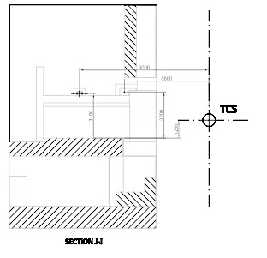
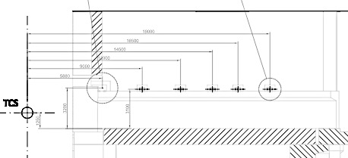
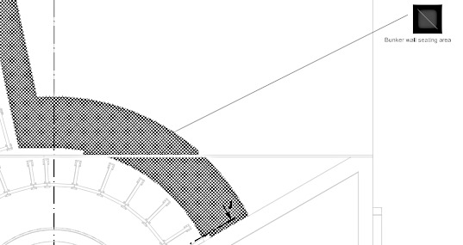

Bunker to CF – contact
(ESS-0068165; ESS-0084435)
Contact against CF (N & E)
Contact against CF (W & S)
Contact against CF (floor/base)

Slide 12
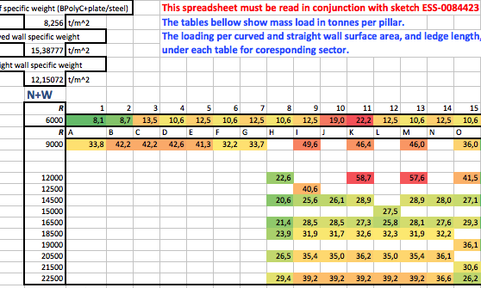
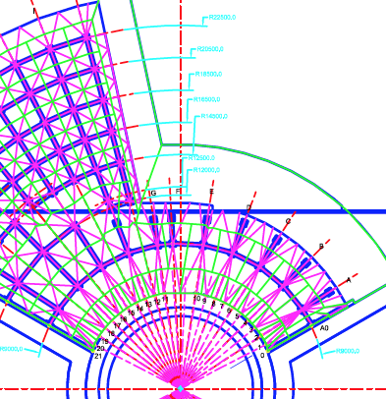
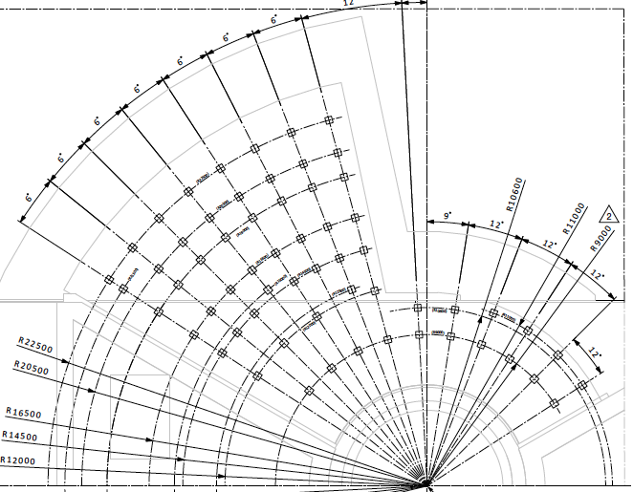
Bunker to CF – contact
(ESS-0084435; ESS-0084423)
16 Neutron Instruments

Slide 13
Bunker to instruments – boundary
Instruments envelopes pass through the bunker volume. Support pillars position has been frozen allowing firm definition of available volumes.
Bunker frame
Instrument beam guide
Monolith wall
Bunker roof
Bunker wall
Notes:
The bunker roof, part of NSS, has to be dismantled during insert changes.
The sequence when changing the insert will be more detailed in Naja’s presentation during the decommissioning of inserts.

Slide 14
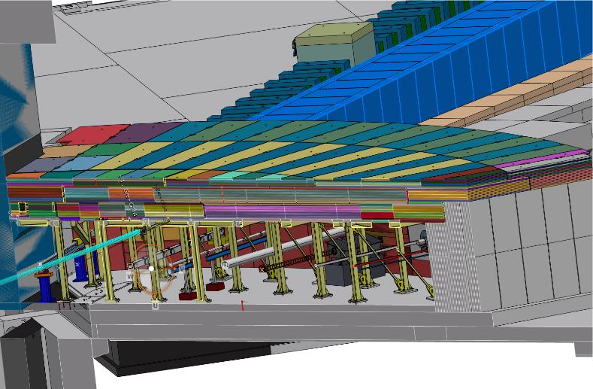
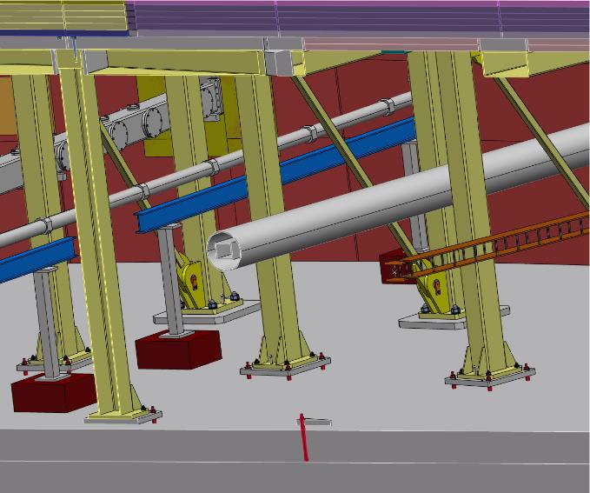
Bunker to instruments – boundary
1700
TCS-to-bottom of the roof
1500
TCS-to-bottom of the frame
TCS

Slide 15
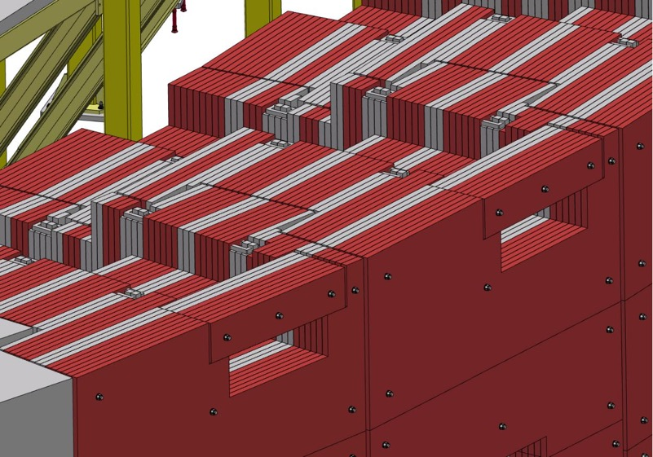
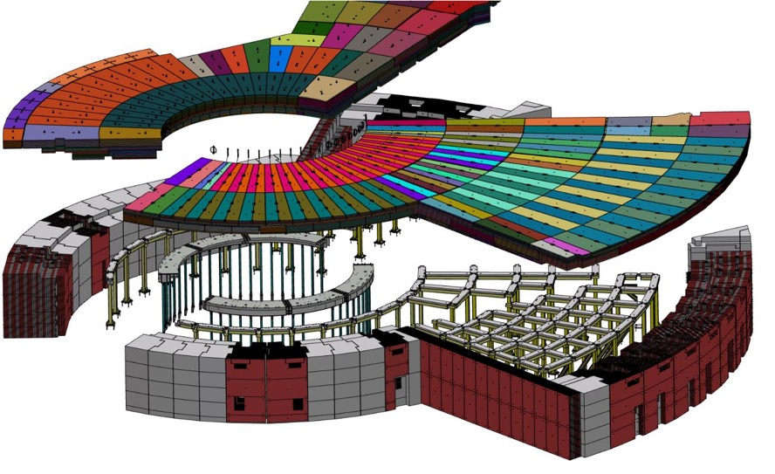
Bunker to instruments – service interface
Utilities feed-through

Slide 16
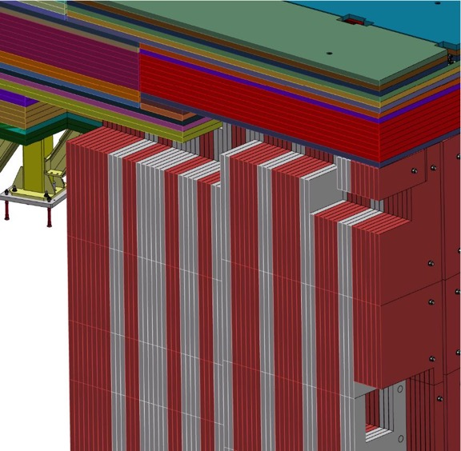
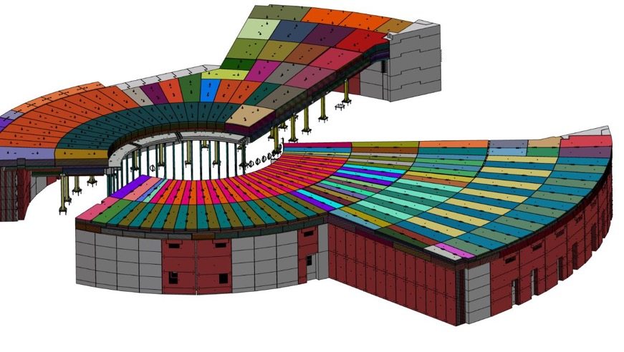
Bunker to instruments – service interface
Utilities feed-through

Slide 17
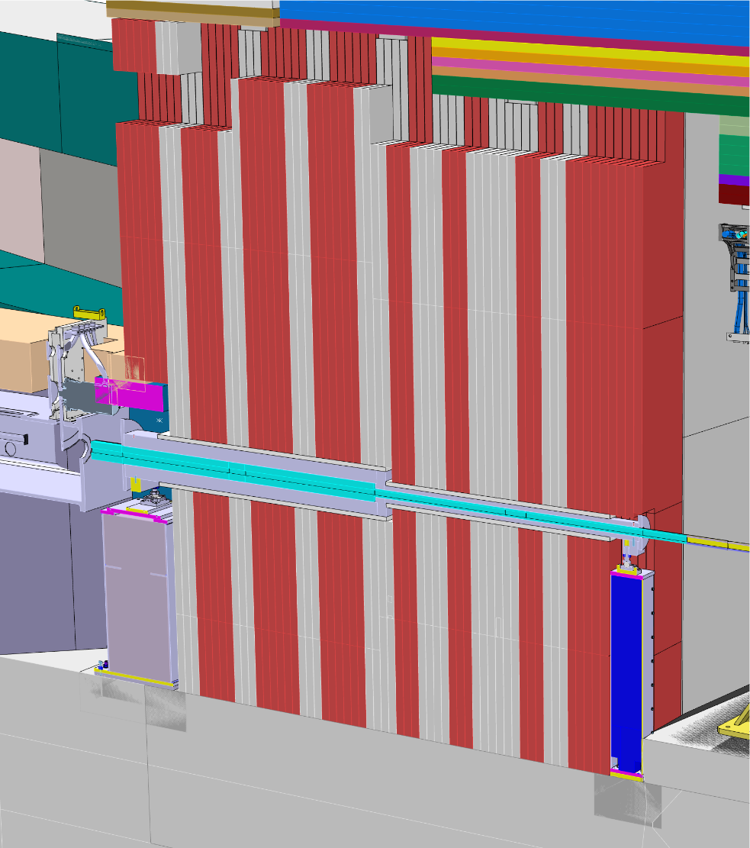
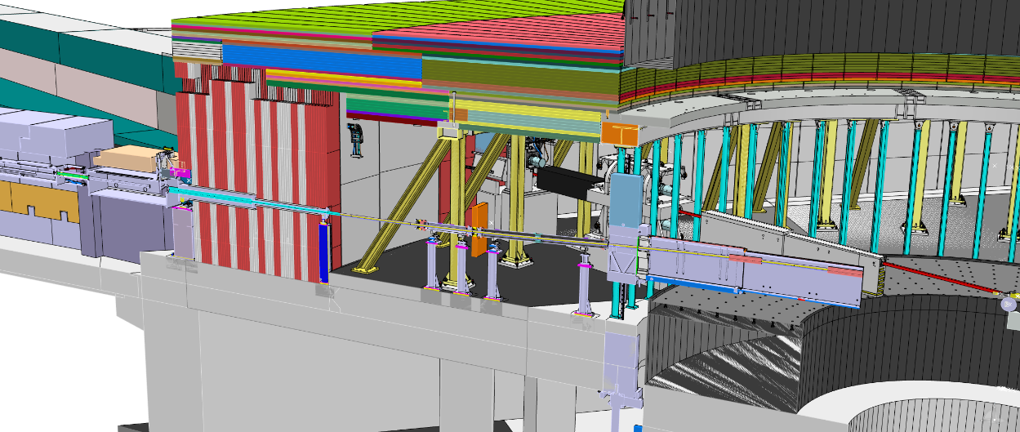
Bunker to Instruments – contact
E3 SKADI (image credit – Sebastian L.)
Upstream side – support pillar mounted to the concrete floor in the in-wall cutout space.
Downstream side – support pillar mounted to the concrete floor and instrument shielding interfaces with wall cutout.

Slide 18
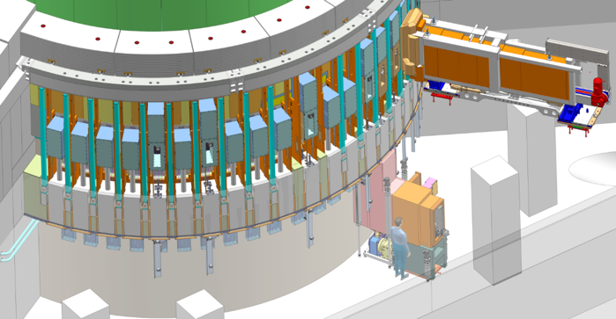
Bunker to Target – boundary image credit – Naja dlC
The bunker interfaces with the target systems at ~R6m where R6m bunker pillars are nested between light shutters; as well as with the Insert Exchange Tool.
R6m pillars (bunker)
Insert Exchange Tool
Light shutters

Slide 19
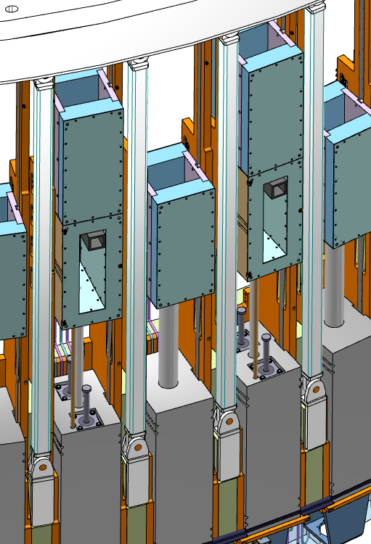
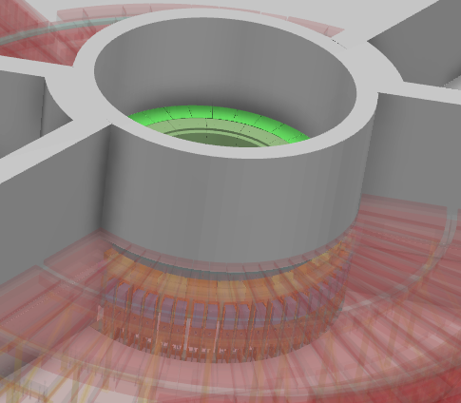
Bunker to Target – boundary
16 Neutron Instruments

Slide 20
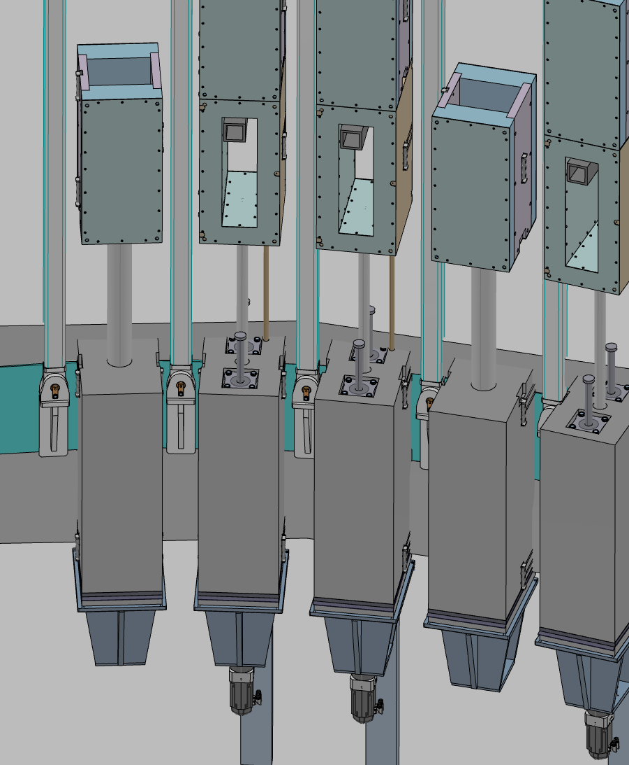
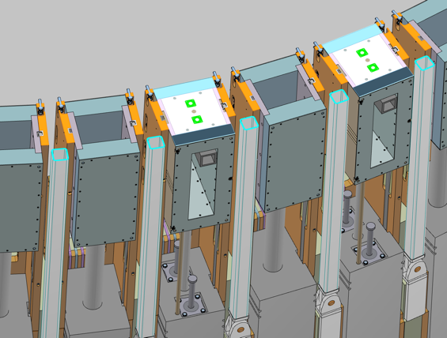
Bunker to Target – boundary
16 Neutron Instruments

Slide 21
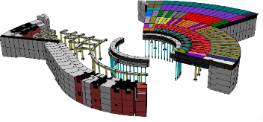
The Bunker Interfaces
Q/A
End of presentation
Q/A

