Slide 1
Mechanical design of B10 based technology neutron detectors
Isaak Lopez Higuera
on behalf of the ESS Detector Group
www.europeanspallationsource.se
November 28, 2017

Slide 2
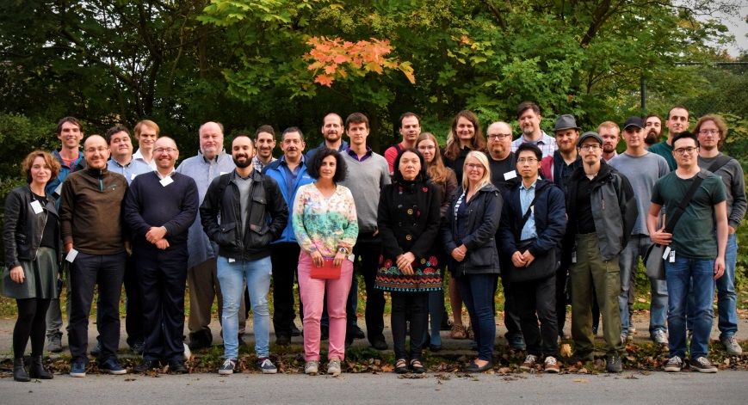
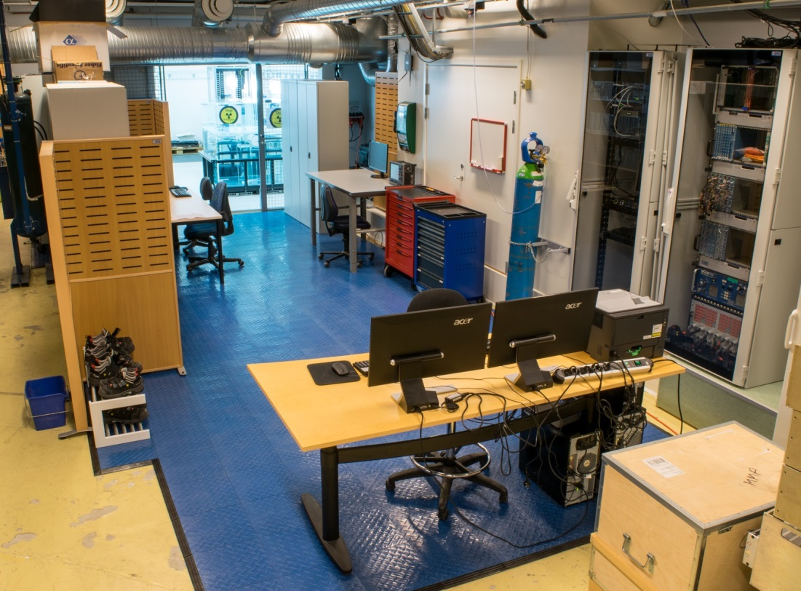
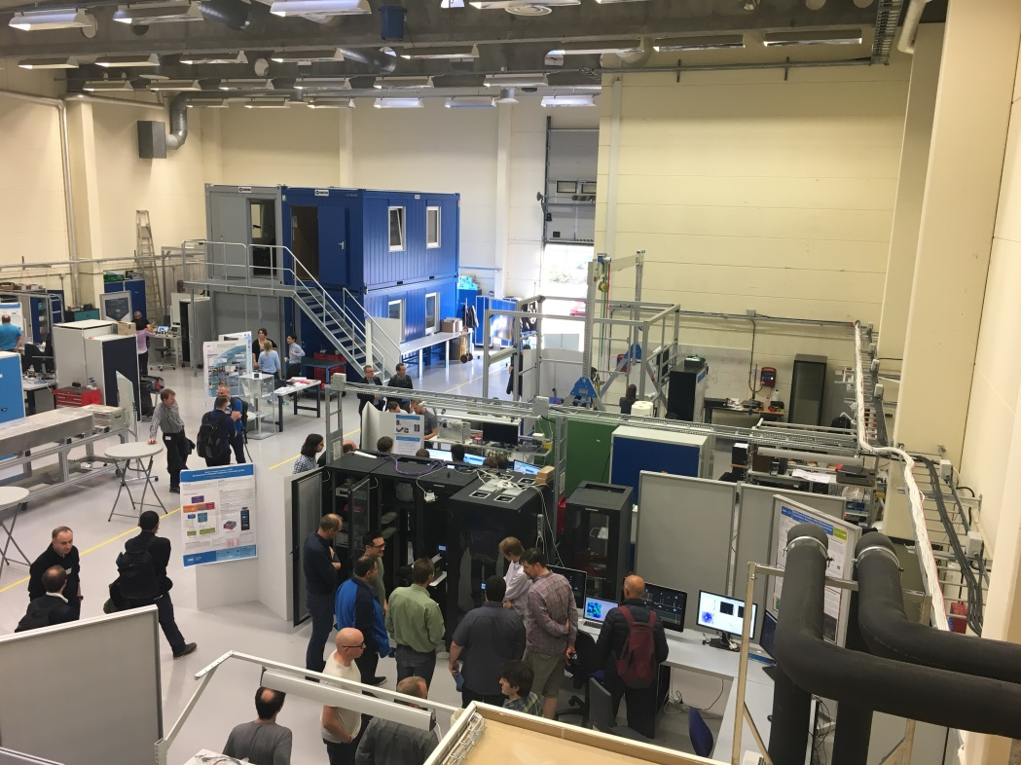
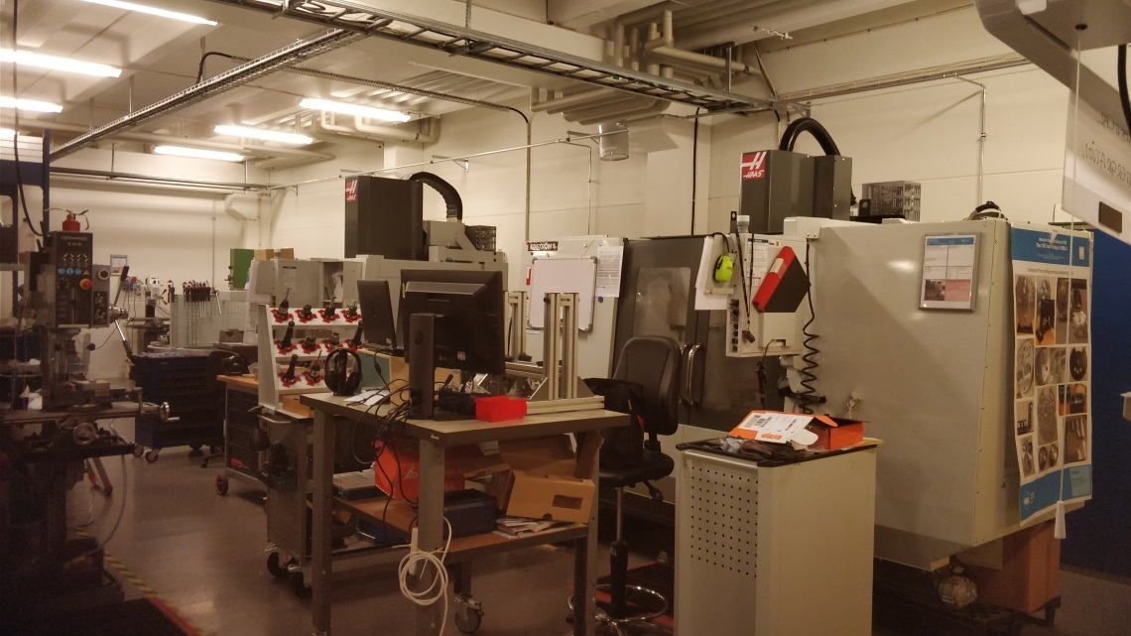
ESS Detector group and Event Formation Groups and Friends
People: Mostly funded by EU grants
ESS HQ Lund: 22 people
Linkoping: 4 people
Daresbury: 4 people
CERN: 1 person
Collaborations with 30 groups across EU
Facilities:
Mechanical workshop (Embla)
Detector workshop (Utgård, 790 m²)
Source Facility (at Lund University)

Slide 3
Outline
The need for a new detector technology
B10 technology
  Coatings
  Mechanical design engineering work
  Multi-Blade
  MB15
  MB16
  MB16SS and test at RAL
  MB future plans (Integration design for ESTIA/FREIA)
  Multi-Grid
  MG24 and iterations
  MG.CNCS
  MG.SEQ
  Integration design for CSPEC

Slide 4
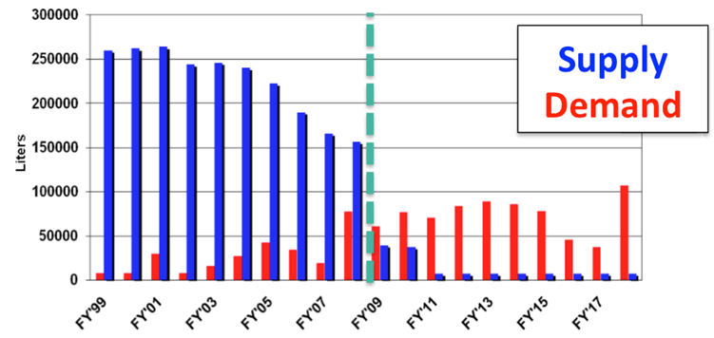
New detector technology
Why a new detector technology:
Shortage of He3 gas
Affordable large area detectors
Better counting rate capability
Best alternative...B10 detectors
Large area
Low cost
Modular
High total efficiency
Many layers – lower local rate
No need for resistive readout – low gain
He3 supply demand graphic
ESS detector’s rate capability needs graph

Slide 5
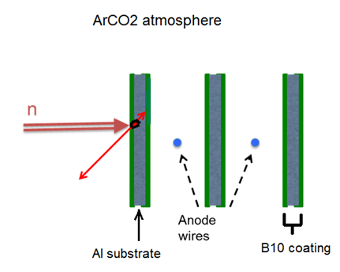


B10 detectors as alternative to He3
Several blades to increase efficiency
ArCO₂ atmosphere
blade
$\text{10}\text{B}\text{ + }\text{n}\text{ →}\text{7}\text{Li}\text{ + }\text{a}$ + 2.97 MeV
α
$$\text{7}\text{Li}$$

Slide 6
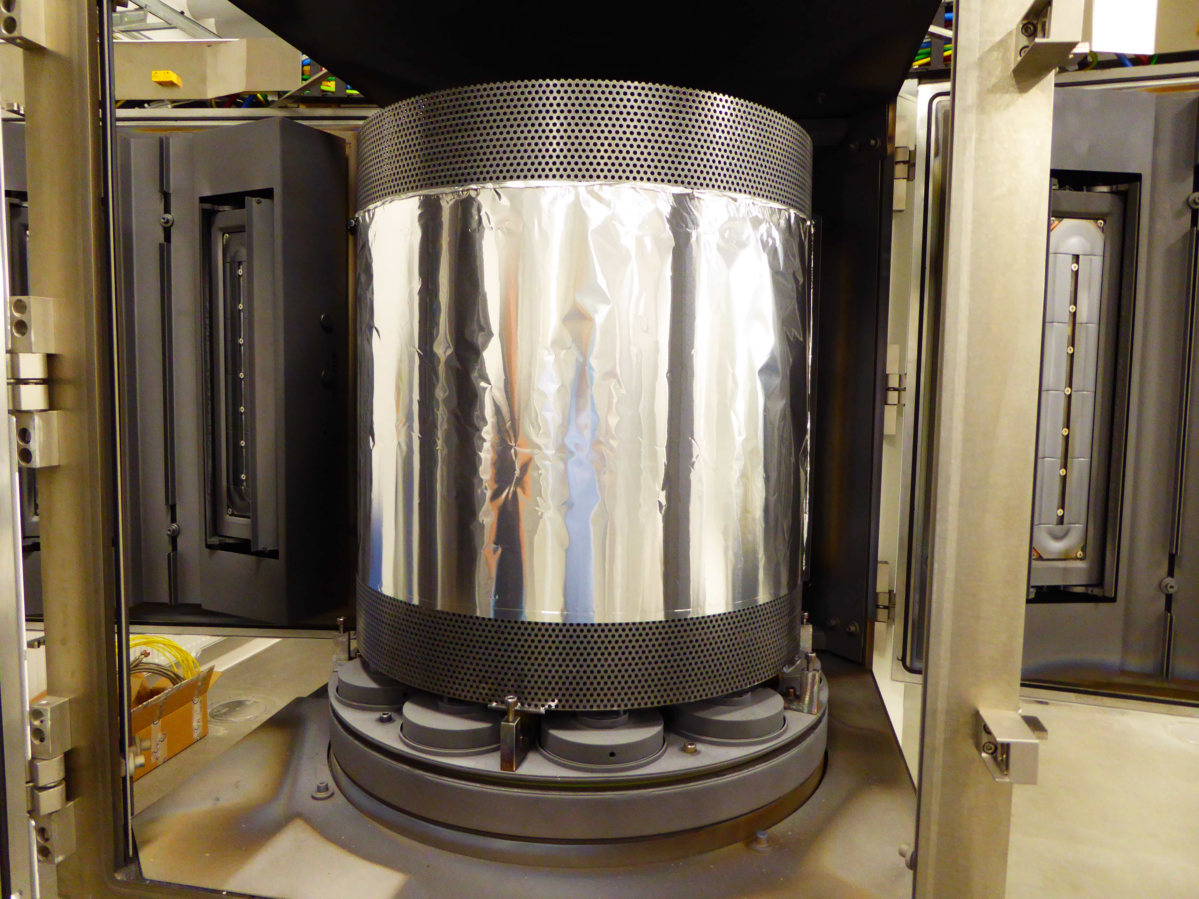
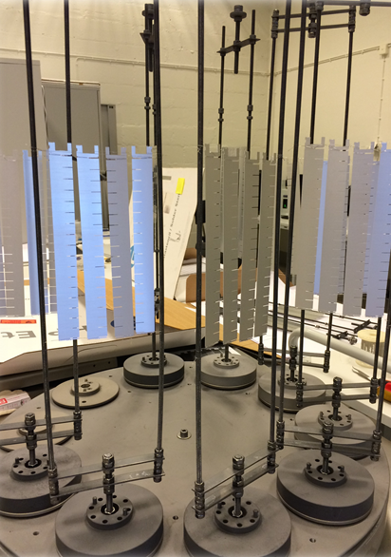
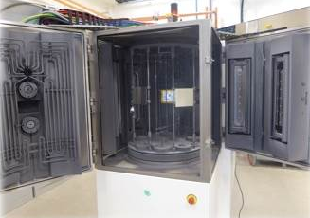
Detector Coatings Workshop - Linköping
CemeCon CC800/9 ”Chewbacca” – industrial DC magnetron sputtering machine
2 runs/day (~1.7 m² 1 μm ¹⁰B₄C/run ) 800 - 900 m² per year
Good adhesion | 0.5-10 μm on Al, Si, Al₂O₃
High Density | 2.45 g/cm³
High ¹⁰B content | 79.3%
Low residual stress | 0.09 GPa at 1 mm ¹⁰B₄C on Si
target
Linköping univ logo?
Multi-Grid inner blades hanging
Chewbacca opened view

Slide 7
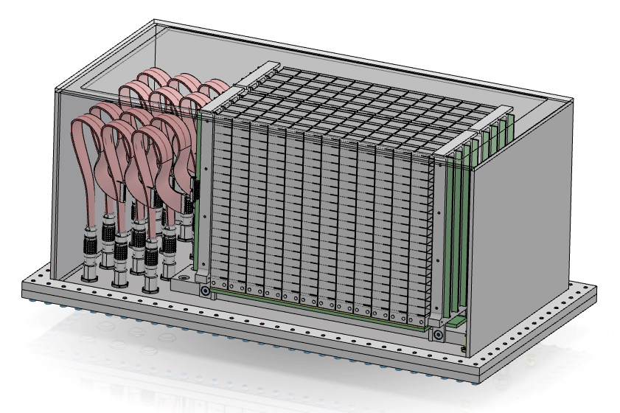
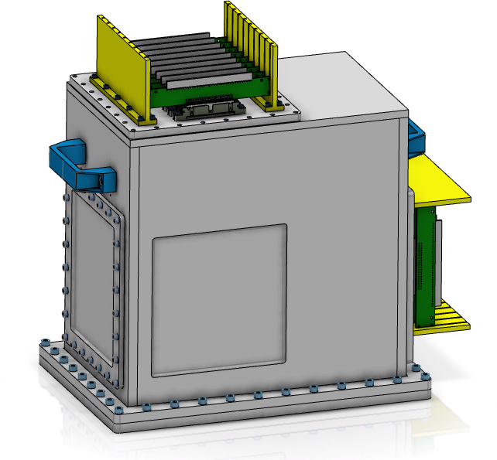
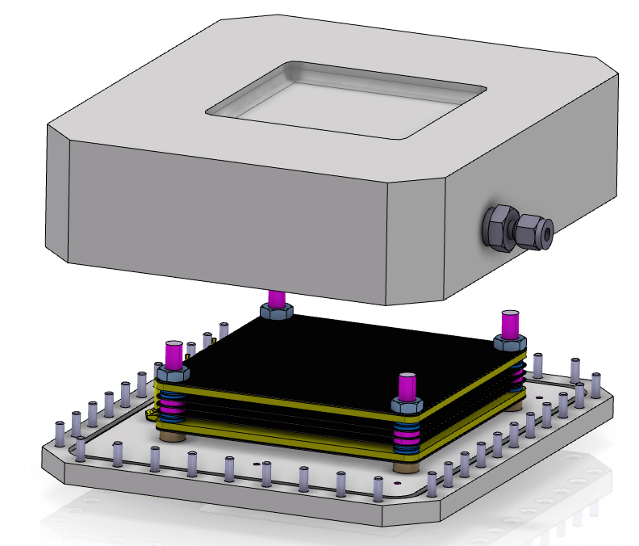
The mechanical design engineering work
B10 MWPC test
Multi-Blade
Multi-Grid
n
n
n

Slide 8
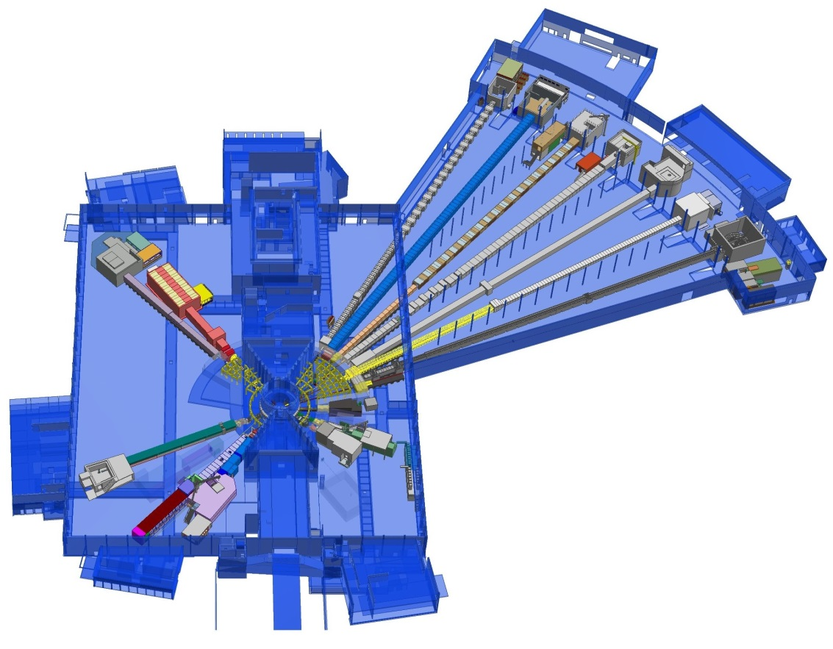
Multi-Blade
Multi-Blade detector technology for ESS instruments
The Multi-Blade will be used in the reflectometers ESTIA and FREIA
 | FREIA | ESTIA
Wavelength | 2.5-12 | 4-10
Sample-detector | 3m | 4m
Max instantaneous flux kHz/mm2 | 100-200 | 100-500
Size x (mm) y (mm) | 300 300 | 500 250
Detector requeriments:
High instantaneous rate capability: 100 kHz/mm²
High spacial resolution: 0.5mm
x100 state of the art
FREIA
ESTIA
Instruments layout at ESS
x3 state of the art

Slide 9

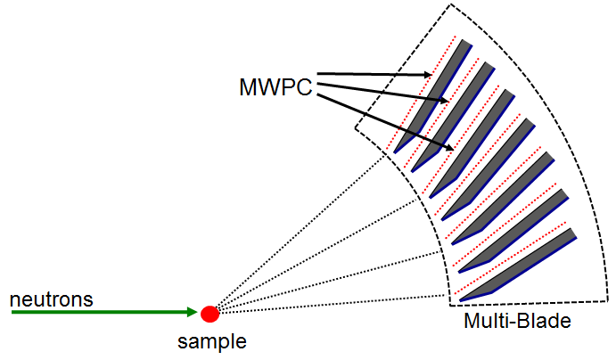
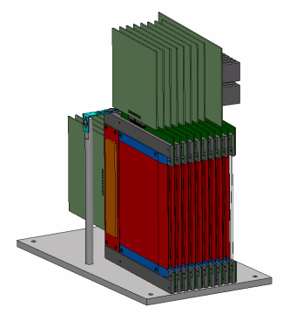
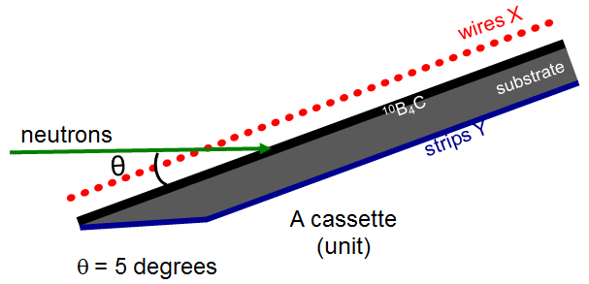
Multi-Blade
How it works: the physics behind the Multi-Blade
Blades oriented in a 4m radius and inclined 5˚
Knife shaped converter (coated)
n
Efficiency 45% at 2.5Å
Cassette assembly

Slide 10
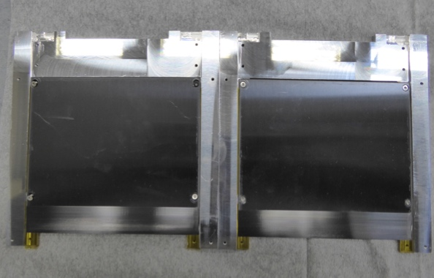
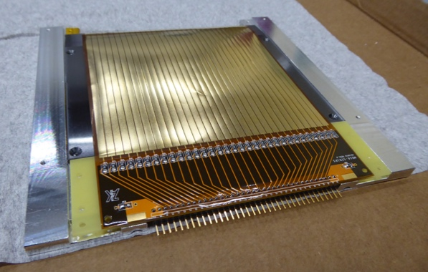
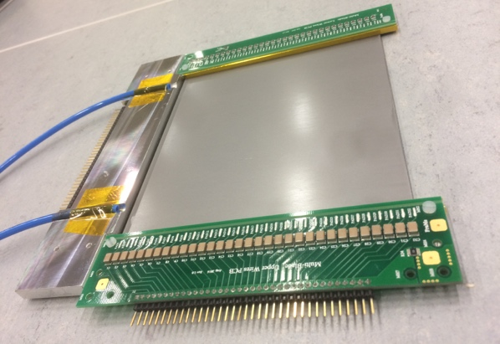
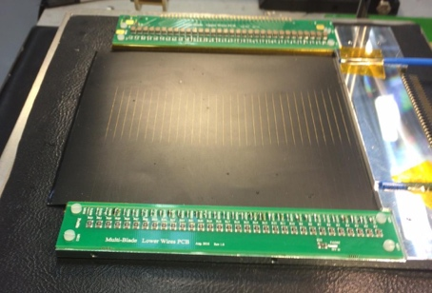
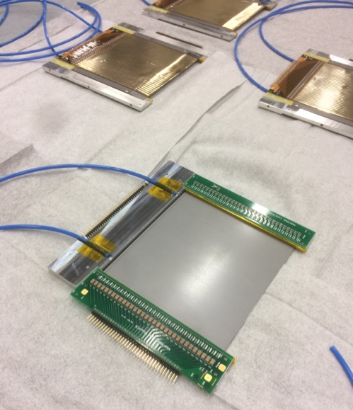
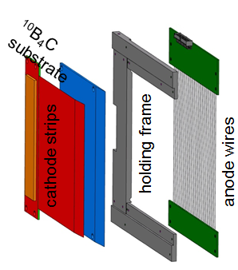
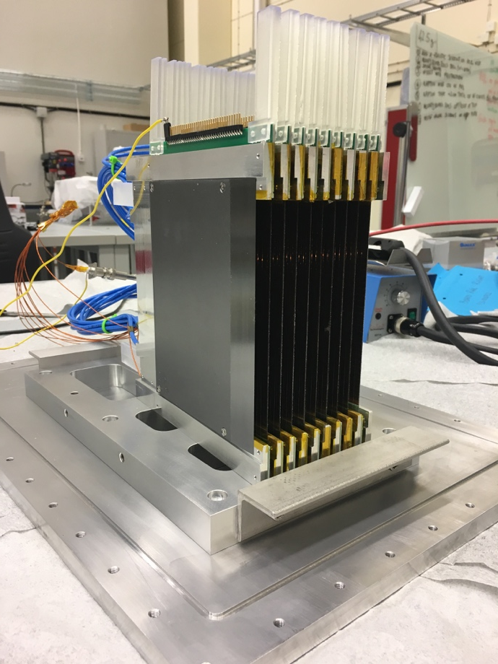
Multi-Blade
How it works: Cassette assembly

Slide 11


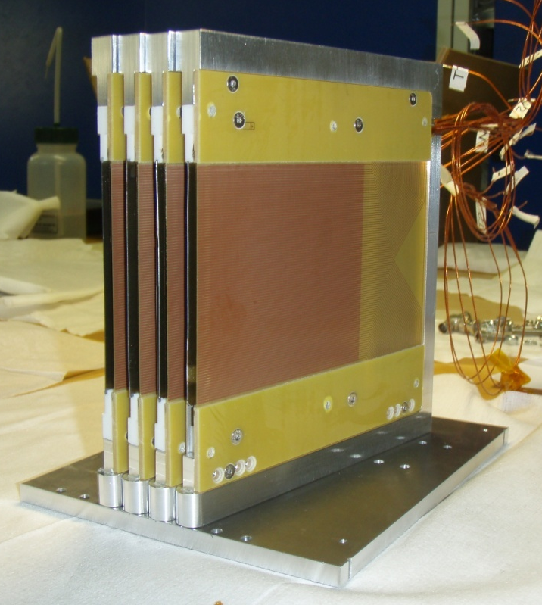
Multi-Blade demonstrators
Concept introduced in 2005
Proof of concept in 2012
Institut Laue-Langevin
Institut Laue-Langevin
University of Perugia
4 cassette demonstrator

Slide 12
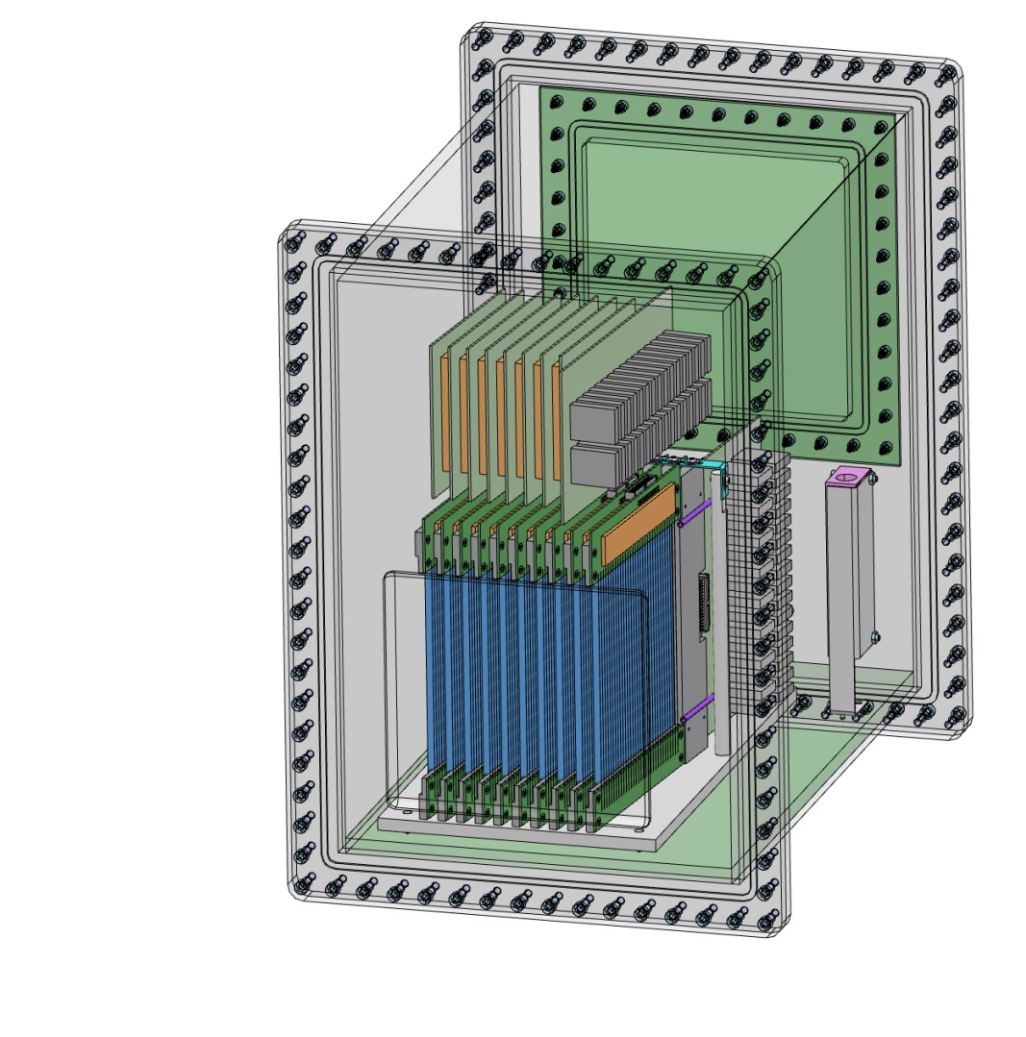
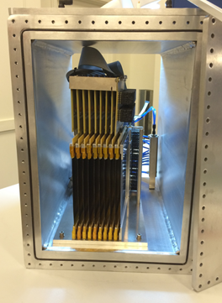
Multi-Blade demonstrators
MB15
First demonstrator at ESS
100x140mm active area demonstrator
Overall size 480x380mm
MB15 isometric view
MB15 without front lid

Slide 13
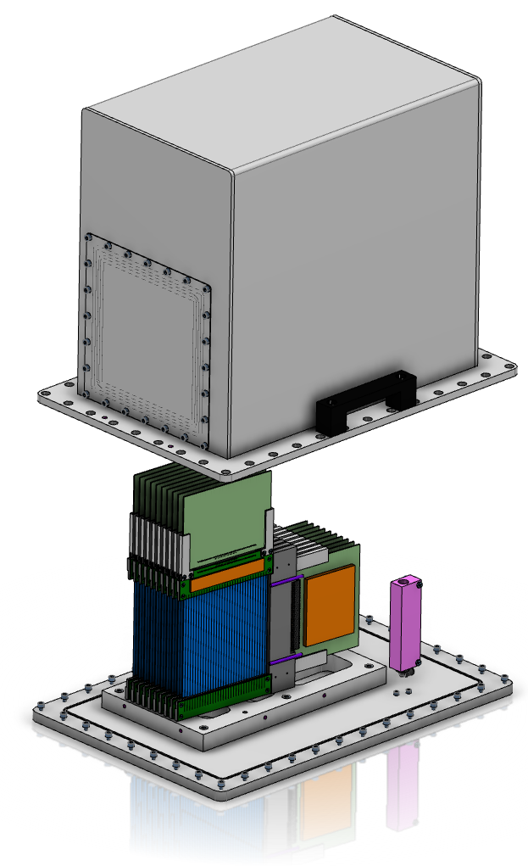
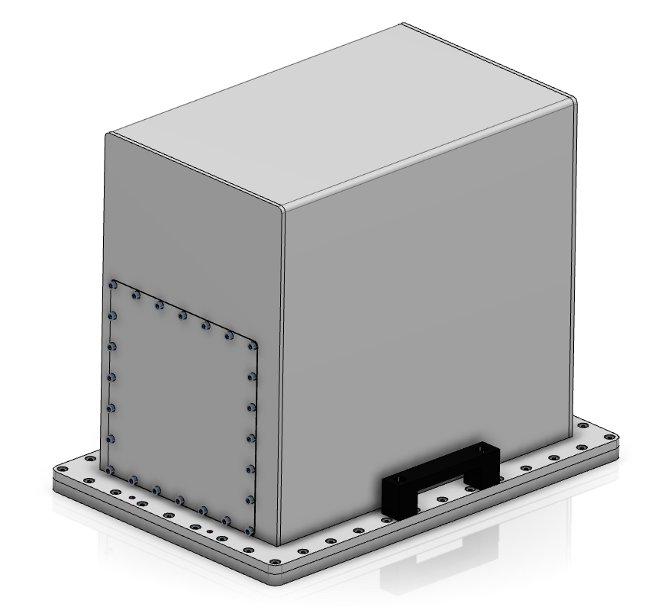
Multi-Blade demonstrators
MB16
360˚ access to the detector
Different thickness windows (0.5, 1, 2mm)
Overall size 420x260mm
MB16 vessel
MB16 expanded view

Slide 14
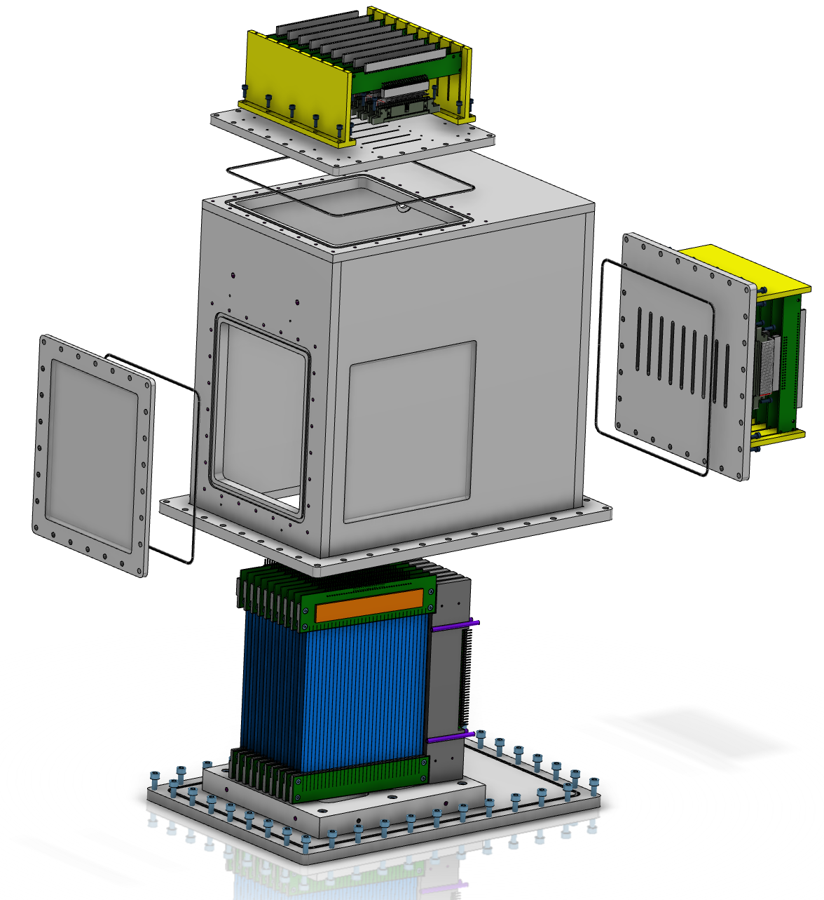
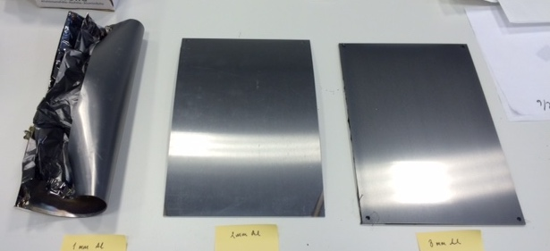
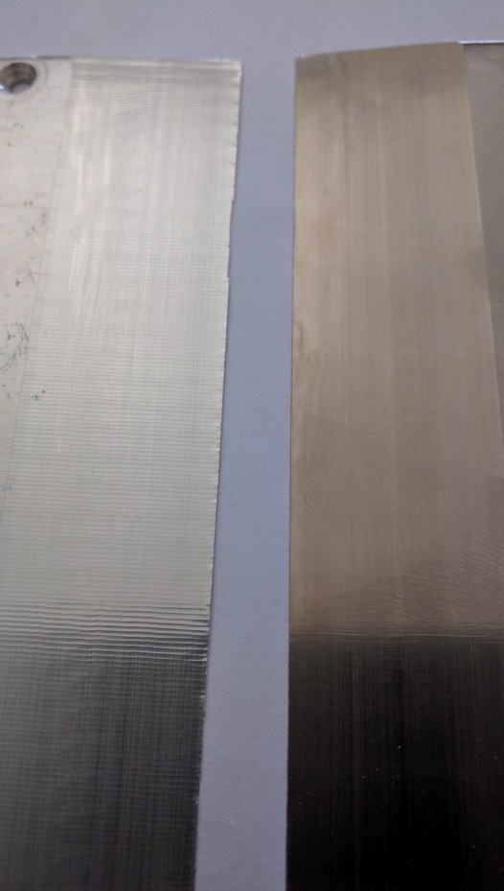
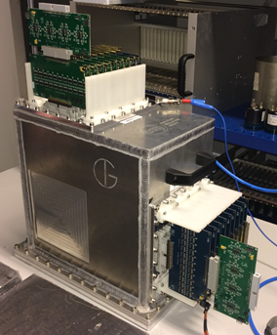
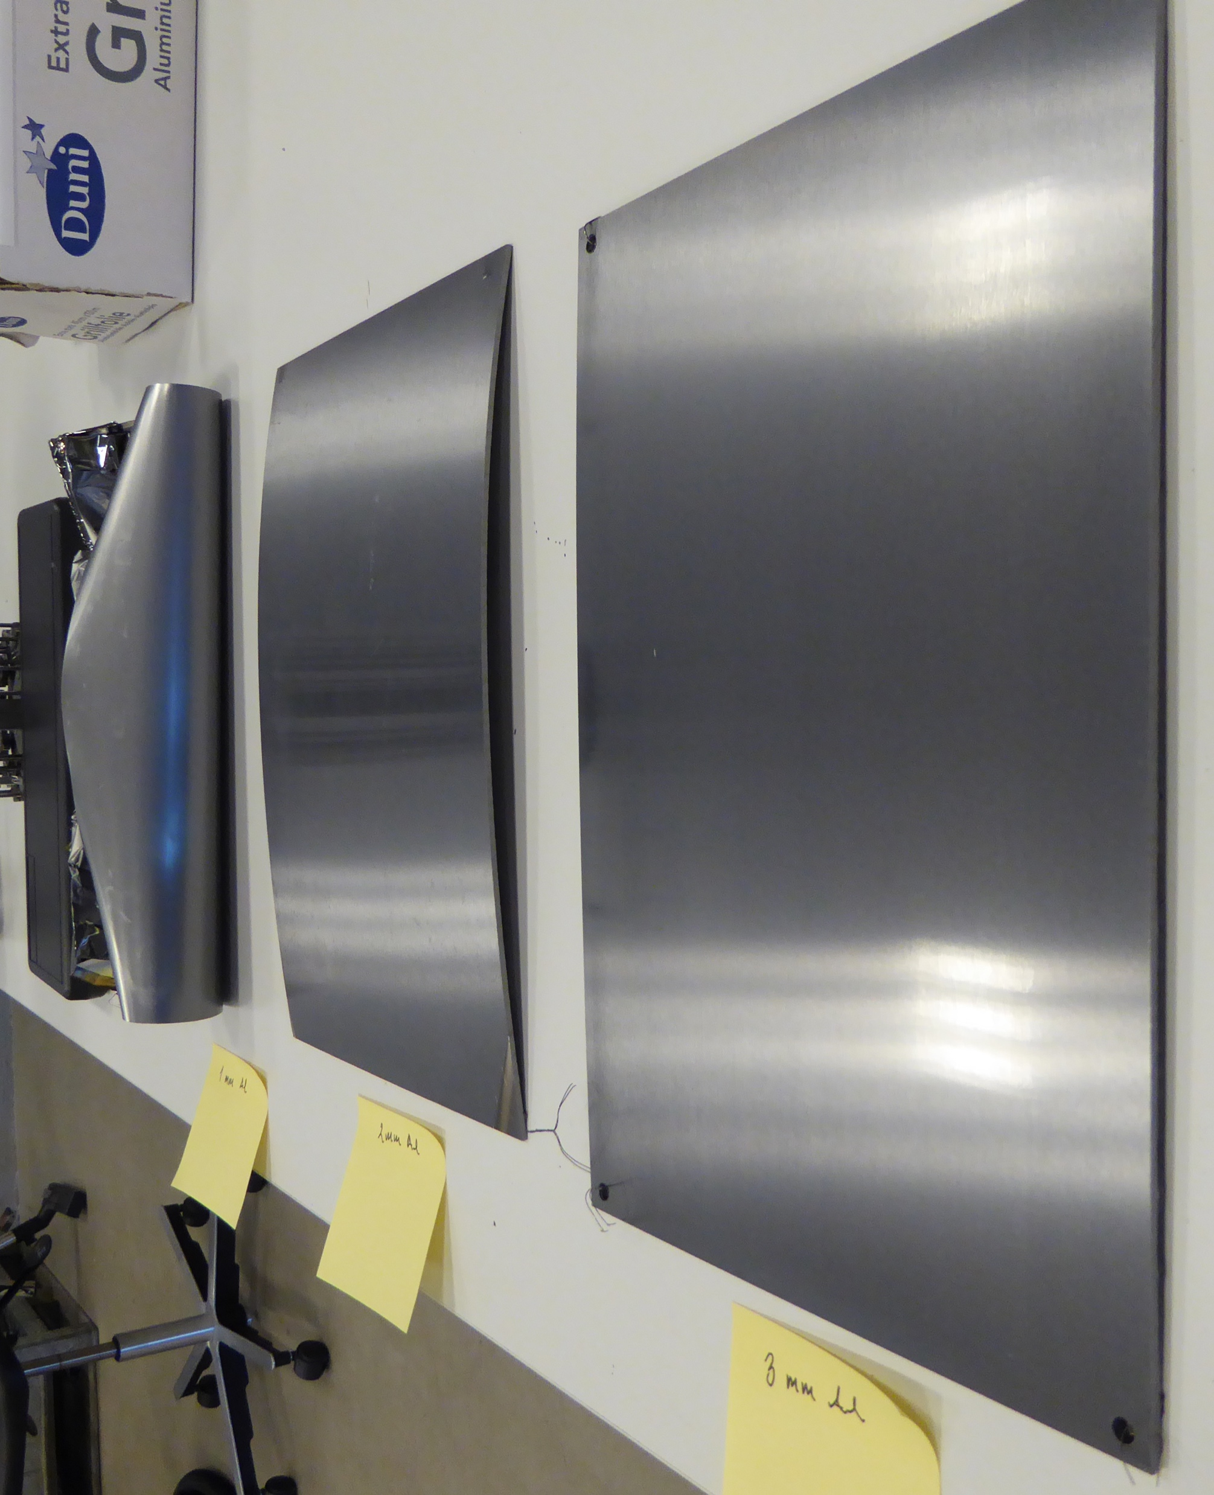
Multi-Blade demonstrators
MB16SS and test at RAL
More compact 300x190mm
Electronics outside:
- Easy access to hem
- Less pollution of Ar, heat generation
1mm 2mm 3mm
Titanium blades
MB16SS expanded view
MB16SS assembled

Slide 15
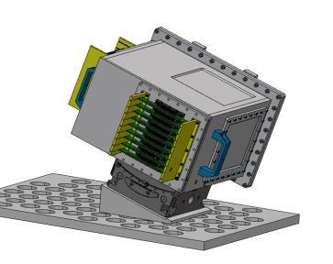
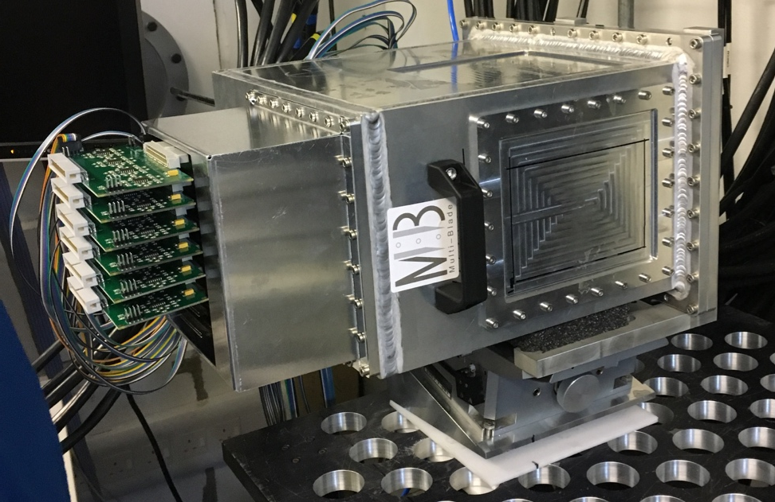
Multi-Blade demonstrator
MB16SS and test at RAL
Tested at RAL, in a horizontal reflectometer
Use of a goniometer, ±18˚ of rotation
MB16SS
n
Neutron beam
Wedge
Goniometer
18˚
Table
2.3m
Set up for the test at RAL
Installation for the test at RAL

Slide 16
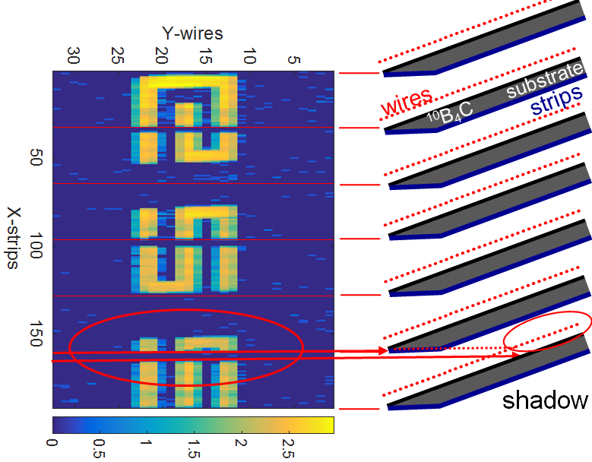
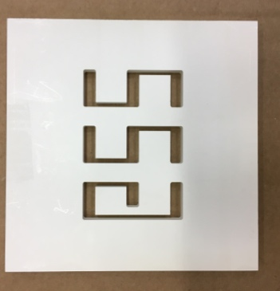
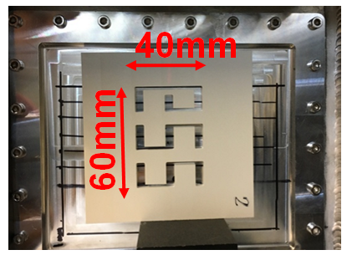
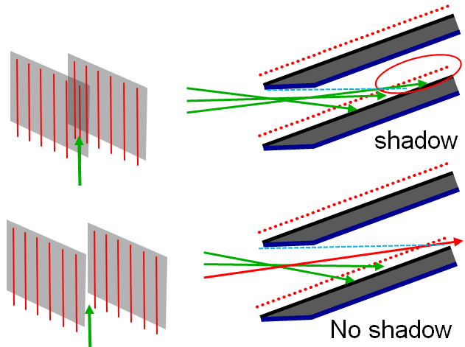
Multi-Blade demonstrator
MB16SS and test at RAL
BNi mask
Not a dead area but the overlap avoids dead zones

Slide 17



Multi-Grid
Multi-Grid detector technology for ESS instruments
CSPEC
The Multi-Grid technology will be used in the spectrometers: CSPEC and T-REX
T-REX
 | CSPEC (cold) | T-REX (thermal/bispectral)
Sample-detector distantce | 3.5m | 3m
Typical initial λ, Å (meV) | 2 to 15 Å (20 to 0.36 meV) | 0.7 to 6.4 Å (160 to 2 meV)
Detector coverage, deg | -30 to 140 +-26 | -30 to 150 -15 to +25
Detector area | 29m2 | 21m2
Instruments layout at ESS

Slide 18
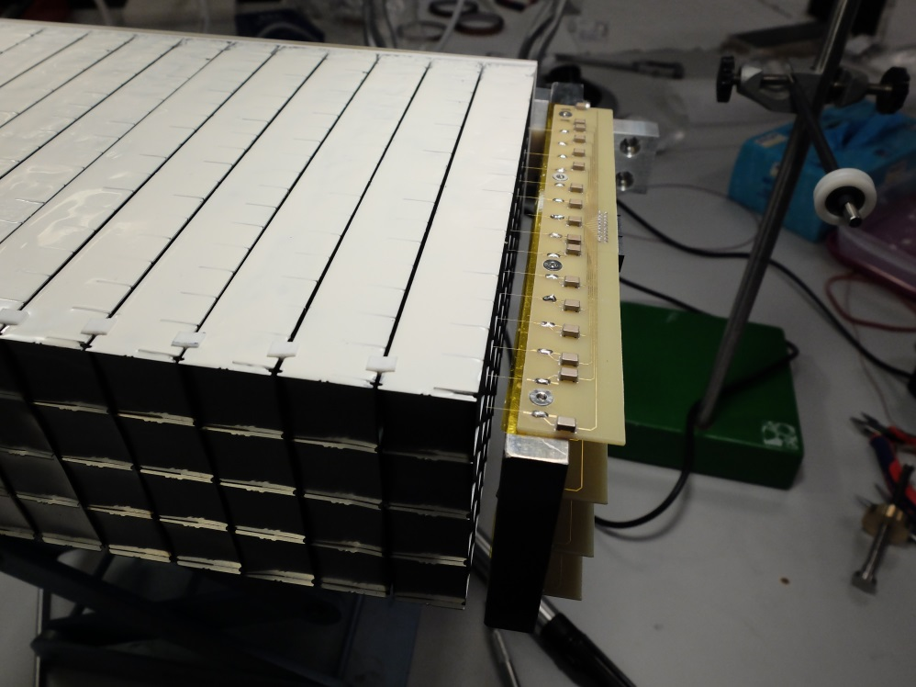
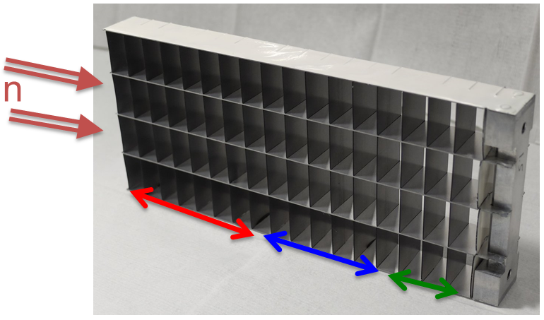
Multi-Grid
How it works: Grid
The MultiGrid detector design was invented by the ILL and is jointly developed by the ILL and ESS
Grid
Layer thicknesses for cold spectrometer optimization used at MG.CNCS and applies to CSPEC(16 blades):
7 blades 0.5μm,
7 blades 1.0μm,
3 blades 1.5μm
Column assembly
n
For thermal optimization 20 blades total:
4 blades 1.0μm,
10 blades 1.25μm,
6 blades 2.0μm.

Slide 19
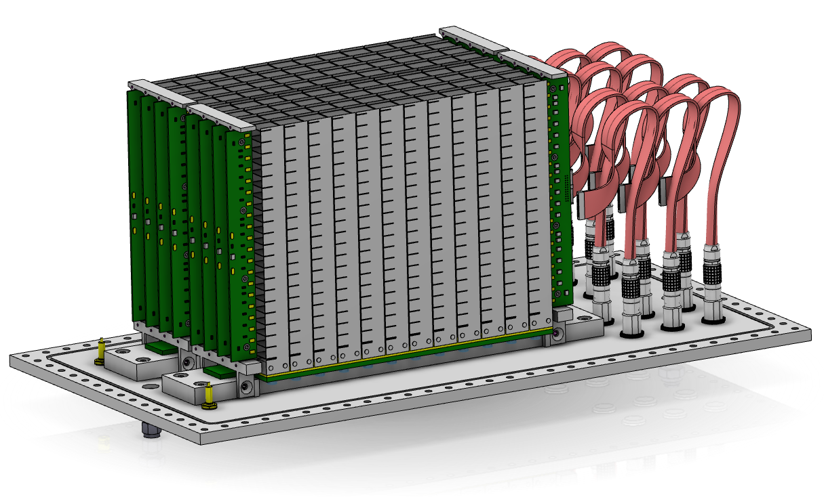
Multi-Grid
How it works: column assembly
n

Slide 20
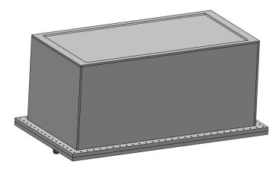
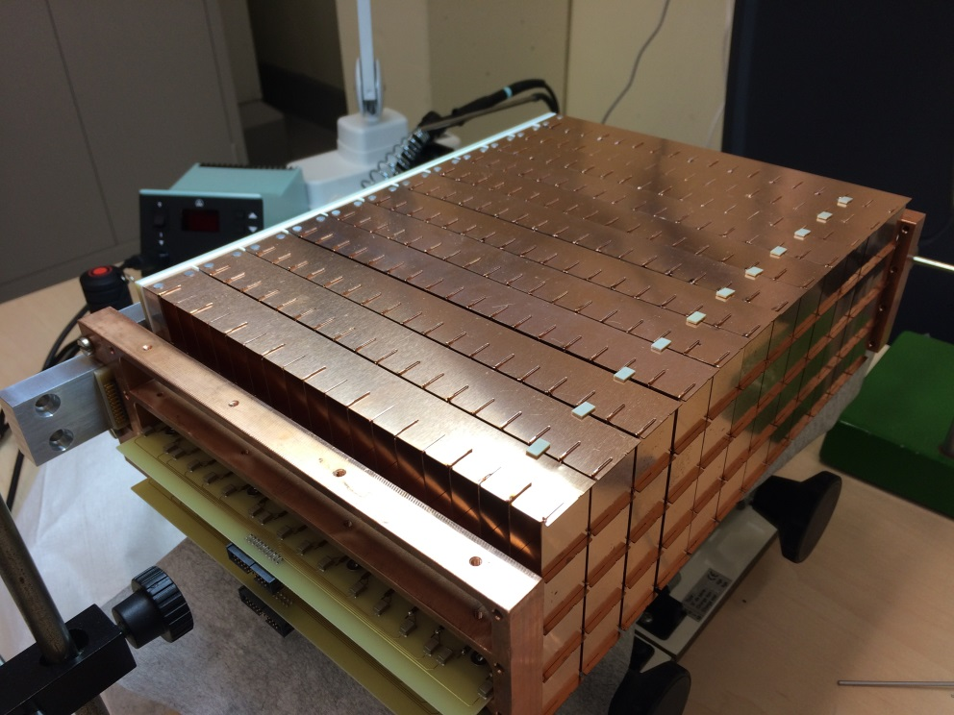
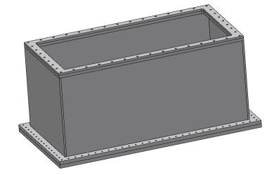
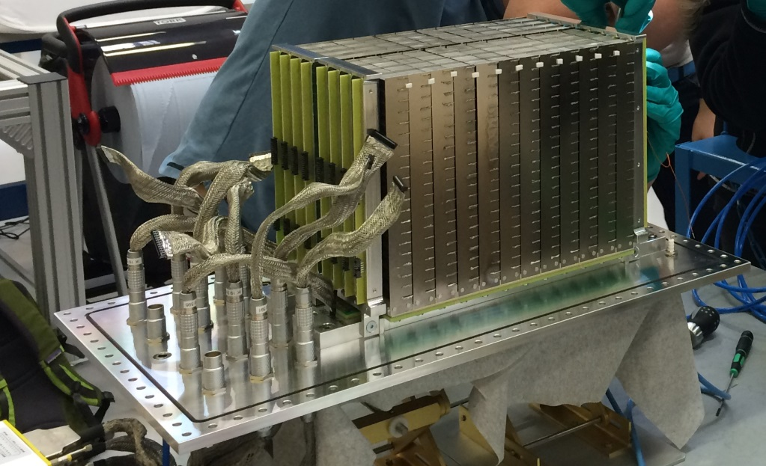
Multi-Grid demonstrator
MG24 and iterations
MG24: First demonstrator
MG24.Copper: Test with low α
MG24.T: Optimized for thermal neutrons
MG24.Alu foil: Test with foil window

Slide 21
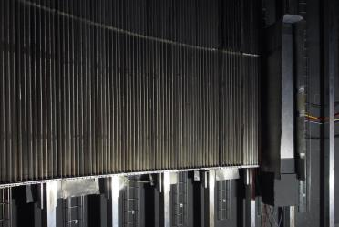
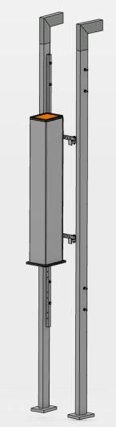
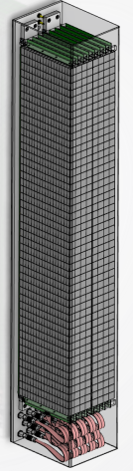
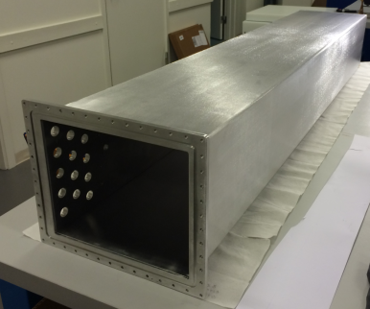
Multi-Grid
MG.CNCS and test at SNS
Tested in CNCS instrument at SNS
-2 columns of 48 grids
-3mm thickness window
-Detector area 1150x185mm²
3He tubes
n

Slide 22








Multi-Grid
MG.CNCS and test at SNS
He3
He3
MG
MG
Reflected beam at E_{i} = 17.20meV
Incident beam
Reflected beam at E_{i} = 13.74meV
Crystal
High rate
High rate

Slide 23


Multi-Grid demonstrator
MG.SEQ: Installation proposal at SNS in the SEQUOIA instrument
Test with thermal/epithermal neutrons
First large area detector under vacuum
Mounted in the lower bank ~5m and 25˚ from sample
˞ 1m² of detection area
View of SEQUOIA instrument with MG.SEQ in green
SEQUOIA instrument

Slide 24


Multi-Grid demonstrator
MG.SEQ: Installation proposal at SNS in the SEQUOIA instrument
neutrons
9 columns, 40 grids in each
Telescopic sliders to access grid assemblies
Use of inclined wedges so all grids are at the same distance from the sample
MG.SEQ top view
1050 x 914 x 450mm
MG.SEQ isometric view

Slide 25


Multi-Grid demonstrator
MG.SEQ: Installation proposal at SNS in the SEQUOIA instrument
n
3mm thickness window
8 rows of 17 rods, Ø3mm
Full access only from 1 side
Total deformation
MG.SEQ bottom view

Slide 26


Multi-Grid demonstrator
MG.SEQ: Installation proposal at SNS in the SEQUOIA instrument
Amplified 50 times
Max deformation: 1.2mm on the sides
Max equivalent stress: 176 MPa
Stress in the rods: 80 MPa
Equivalent stress in the vessel
Equivalent stress in the rods
Amplified 50 times

Slide 27


Multi-Grid
Detector for CSPEC
Vessel length: 3.5m
Detector configuration: 2 columns per vessel (column width 153.5mm)
Neighbour vessels configuration, minimizing dead spaces, 21mm from grid to grid
Integration of the detector vessels in the CSPEC instrument

Slide 28

Future steps
Multi-Blade
MB17 with 300mm converters, size of FREIA
- Already coated Titanium blades of this size successfully
Work in the integration with ESTIA
Multi-Grid
Finalize the design of MG.SEQ
Keep working towards the instrument specific design for the CSPEC and T-REX instruments

Slide 29








Thanks!!
Horizon 2020 grant agreement 676548

Slide 31


Slide 32






Reflectometry at ESS: FREIA and ESTIA
Horizontal Reflectometer
Vertical Reflectometer

Slide 33
Multiblade
MB16 SS and test at RAL: Results
 | Multi-Blade
gas gain | 20
efficiency | 45% @ 2.5Å 56% @ 4.2Å 65% @ 5.1Å
spatial resolution | 0.5 x 2.5 mm²
uniformity | 10%
overlap | 50% eff. drop in 0.75mm gap
stability | <1% in 12h
counting rate capability | >1.6 kHz/mm2 (lower limit) >17kHz / channel (lower limit)
gamma-ray sensitivity | < 10⁻⁷ (with 100keV threshold)

Slide 34

Multi-Grid demonstrator
MG.SEQ: Installation proposal at SNS in the SEQUOIA instrument
Intermediate PCB layer, separates both atmospheres
Groove in the cover to guide flat cables to the PCB layer
Electronics plugged to the PCB layer
    Mesytec 128 channel front-end
    Preamp, shaper, multiplexer
    60 x 140 x 20 mm³
    1 per detector module
    9 required in total
n
MG.SEQ section
n
3mm thickness window
8 rows of 17 rods, Ø3mm
MG.SEQ bottom view

Slide 35


