Slide 1
CDR1.1 of nBLM
December 4th 2017
nBLM based on Micromegas detectors: Status & Plans
Thomas Papaevangelou

Slide 2
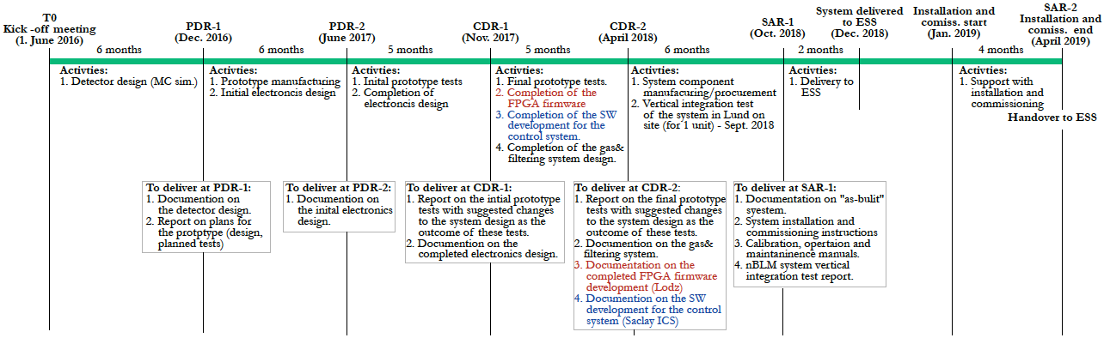
Project Plan
Time line for the nBLM project
Detector design
Electronics design
Production
Inst. &
Com.
Gas system design
Controls SW development
FPGA FW development

Slide 3
Project outline
The nBLM project:
  Detector system
  Controls system
  Acquisition system
Detector system:
  Detector design
    MC simulations
  Prototype fabrication
  Prototype testing & optimization
  Final design
    Frond-End Electronics (FEE)
    HV & LV
    Gas System
    Mechanical support
  Production
  Validation
  Vertical Integration Test
  Delivery, Installation & Commissioning

Slide 4
Milestones
# MS | Milestone WBS | Short description | Planned / Baseline date | Responsible | Comment | CAS [%]
1 |  | Kick-off meeting | July 2016 (T0) | ESS ERIC | Agreement on SoW | 0
2 |  | Technical Specifications of nBLMs | T1 Dec 2016 | ESS ERIC | Delivery of nBLM requirements and specifications and ESS ERIC standards | 0
3 |  | PDR 1.1 data package | T1 + 0.5 months Dec 2016 | CEA-ESSI | Delivery of the Conceptual design of the detector and tests planned. | 10
4 |  | PDR 1.1 | T2 = T1 + 1.0 months January 2016 | ESS ERIC | Acceptance of the completion of PDR 1.1 | 0
5 |  | PDR 1.2 data package | T2 + 6 months June 2017 | CEA-ESSI | Initial design report for electronics for nBLM system | 15
6 |  | PDR 1.2 | T3 = T2 + 0.5 months July 2017 | ESS ERIC | Acceptance of the completion of PDR 1.2 | 5
7 |  | Support interface document and the FW design deployed on the FPGA located in the nBLM BEE. | T3 + 0.5 months July 2017 | ESS ERIC | Interface document | 0
8 |  | CDR 1.1 data package | T3 + 4 months Nov 2017 | CEA-ESSI | Detailed design. Report on prototype results. Completed electronics design for nBLMs | 10
9 |  | CDR 1.1 | T4 = T3 + 0.5 months Nov 2017 | ESS ERIC | Acceptance of the CDR 1.1 completion | 5

Slide 5
Milestones
# MS | Milestone WBS | Short description | Planned / Baseline date | Responsible | Comment | CAS [%]
10 |  | CDR 1.2 data package | T5 = T4 + 6 months April 2018 | CEA-ESSI | Delivery of final tests report of prototype, Technical documentation on gaz & filtering system, software documentation for control system. Documentation on the completed FPGA firmware development. | 10
11 |  | CDR 1.2 | T6 = T5 + 0.5 months April 2018 | ESS ERIC | Note of acceptance for CDR 1.2 completion Milestone for completing the design of the whole of nBLM system. | 5
12 |  | Vertical test facility | T7 = T6 + 5 months Sept 2018 | ESS ERIC | Facility availability for vertical tests at Lund | 0
13 |  | SAR data package | T7 + 1 month Oct 2018 | CEA-ESSI | ‘As-built’ documentation. Installation and commissioning instructions documentation. nBLM vertical test report | 20
14 |  | SAR | T8 = T7 + 1.5 months Nov 2018 | ESS ERIC | Note of acceptance of the completion of the SAR. The nBLM system is manufactured | 5
15 |  | nBLM system delivered to ESS ERIC | T8 + 1 month Dec 2018 | CEA-ESSI | Delivery of the nBLM system | 5
16 |  | nBLM system acceptance | T9 = T8 + 1.5 months Dec 2018 | ESS ERIC | Acceptance note | 5
17 |  | Installation and commiss. | T10 = T9 + 1 month Jan 2019 | CEA-ESSI | Support to installation and commissioning on ESS premise. | 0
18 |  | Inst. & comm. end – Transfer of ownership to the ESS ERIC | T11 = T10 + 5 months April 2019 | ESS ERIC | Marks all completion of the nBLM system installation and commissioning | 5
TOTAL: |  |  |  |  |  | 100%

Slide 6
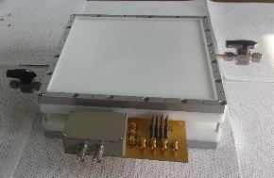
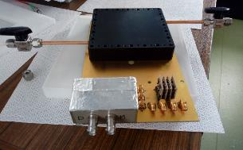
Detectors design status
MS simulations of different loss scenaria delivered by ESS (Sep. 2016)
Preliminary detector design based on MC simulations performed by Laura and Georgios reported in PRD1.1 (Dec 2016)
First Detector prototype with integrated FEE was delivered in June 2017 (Micromegas design and fabrication at CERN)
Versatile design:
  moderator thickness
  drift gap
  Possibility of double-sided micromegas

Slide 7
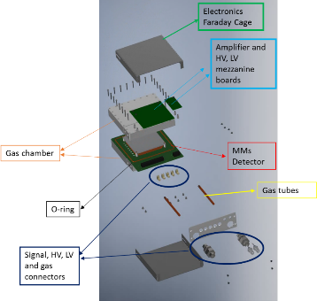
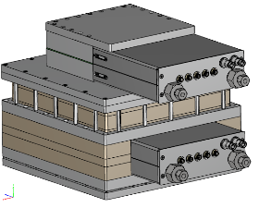
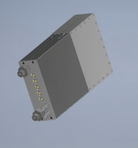

Detectors design status
Prototype tests
  IRFU/DEDIP Micromegas lab (July 2017 – Nov 2019)
  Birmingham University Cyclotron (28 MeV protons on Al target, 25-28 Nov 2017)
  Tests with IRFU cryomodules postponed for 2017 due to vacuum problems
New design (Oct 2017)
  FEE & HV filter in independent mezzanine cards
  Common design for slow/fast detector chamber
  Compact design + faraday cage
  Mechanical pieces for 2+2 detectors ordered this week
  Gerber files being finalized. Order expected this week
  Gas recirculation system for the testing being built
More in Laura’s talk

Slide 8
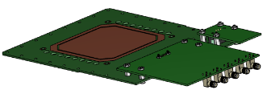
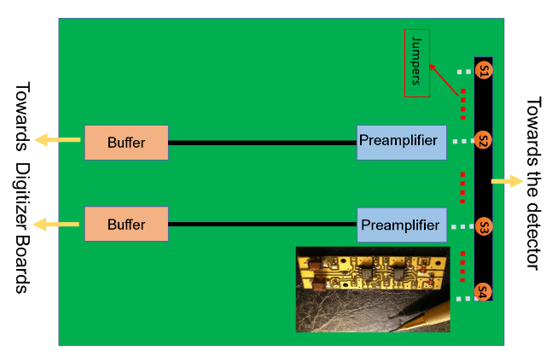
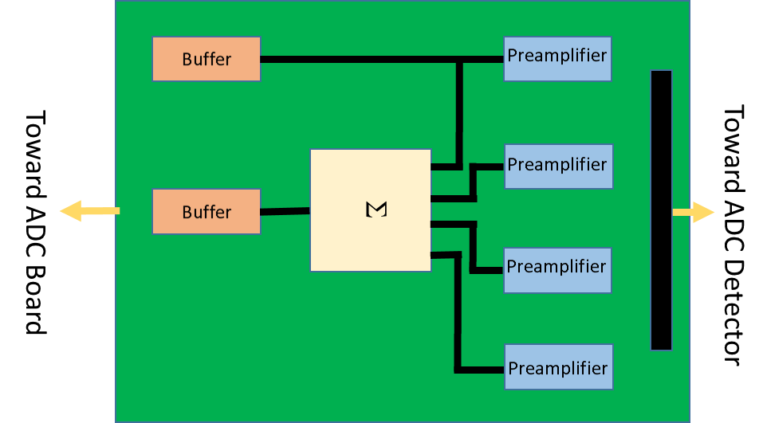
FEE status
Frond-End Electronics based on FAMMAS current amplifiers
Mezzanine card with LV filter + buffer
3 options:
  1 amplifier for all 4 detector strips + possibility to remove strips with jumpers
  1 amplifier per strip and signal summing (lower capacitance per detector)
  Possibility to apply bias on the strips for preamplification mode
Production to start soon (planned to have first cards for January 2018)
SMA connectors (signals + LV), SHV for HV
More in Philippe’s talk (by Laura)

Slide 9
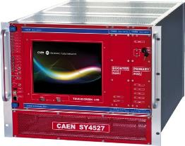
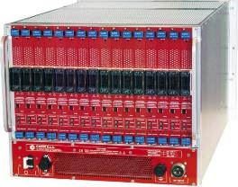



HV & LV
CAEN modules have been selected:
2 SY4527 crates
4+1 A7030N HV cards with 48 independend channels each +
4 R648 distribution rack have been acquired
2 (+?) A2512 LV cards (8 channel each)
1 SY4527 + 1 A7030N + 1 R648 already at CEA (Sep 2017)
Cabling
Decision taken (to be verified by Philippe!!! )
More in Laura’s and Irena’s talks

Slide 10
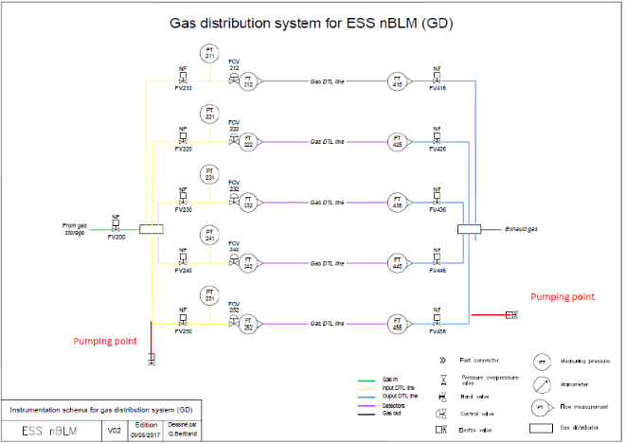
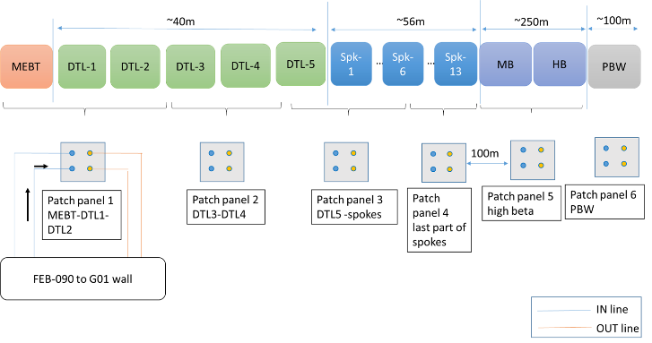
Gas system status
Design of gas system has been forwarded to match with ESS installation schedule
First version in PDR1.1
Revised version in CDR 1.1 in order to address possible system failure scenaria and to minimize commissioning and intervention times
Added possibility for complete manual bypass of PLC and electronic flow controllers
Detectors grouped in 10 distribution lines
Design practically completed, production planning to be defined soon
More in Laura’s talk

Slide 11
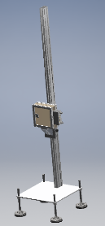
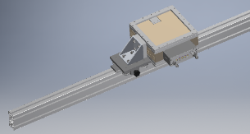
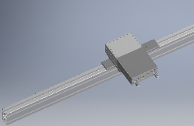
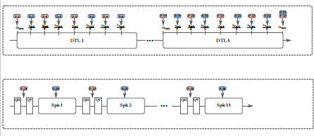
Detector distribution
Finalized the detector count and locations
Detector 3d models put in the EPL (ESS plant layout) model
First concept for mechanical support and cable + gas tube rooting along the linac elements
 | Total number of Detectors | Detailed distribution
MEBT | 4 | 2xFast + 2xSlow
DTL | 42 | (4xFast + 4xSlow)/DTL
SPK | 26 | (1xFast + 1xSlow)/SPK
MB | 2 | 1xFast + 1xSlow
HB | 2 | 1xFast + 1xSlow
PBW | 6 | 3xFast + 3xSlow
TOTAL | 82
More in Laura’s and Irena’s talks

Slide 12
Planning
Extended detector tests: winter – spring 2018
  CEA/IPHI Jan 2018
  AMANDA CEA Cadarache demand on Dec 7th
  Birmingham: flexible dates
  Linac4: installation windows January 2018 / summer 2018
  Gamma irradiation (CEA/PAGURE – other source @ CEA Saclay)
Validate the detector design for CDR1.2
Establish assembly and validation setups (May 2018)
Launch production June 2018
  Detector mechanics
  Micromegas
  FE Electronics & HV filters
  Patch-panels
  Mechanical supports
Vertical integration test Oct 2018
More in Laura’s talk
Detector validation:
  Gas tightness
  HV tests
  ²⁵²Cf irradiation
FEE validation
  Pulse generator
  Test with reference detector
  Irradiation at Birmingham

Slide 13
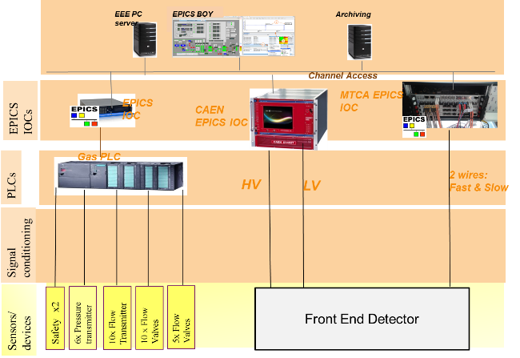
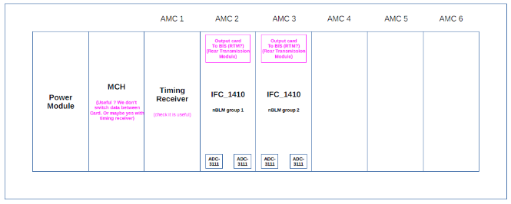
Acquisition & Control system
Talk by Yannick
IOxOS IFC1410 board
+
one or two ADC-3111

Slide 14
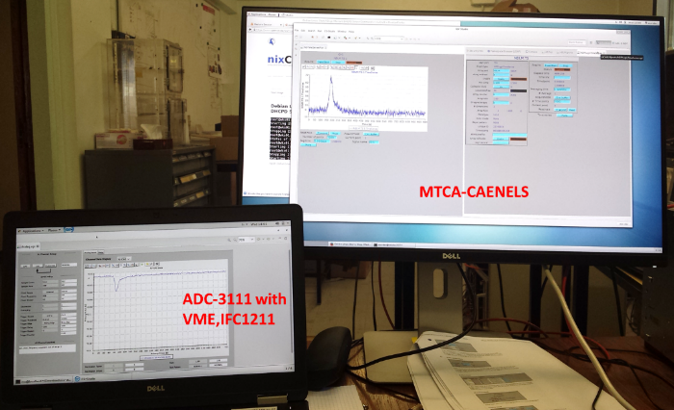
nBLM Acquisition SYSTEM
  Fast acquisition
ICS standardisation for fast acquisition is based on:
μTCA.4
IOxOS CPU IFC_1410
IOxOS ADC_3111 FMC boards.
  FPGA software
The FPGA will have 3main tasks:
Detection of neutrons and counting
Trigger an alarm on the Beam Interlock System if needed
Supply of debug and diagnostic data (neutron rates …)
The FPGA software design and development will be done by ESS ERIC
Requirements will be presented in the document :
“Requirements and functions to be implemented for the nBLM control system” [to be released soon].
See talks by Laura & Yannick

Slide 15
Status of μTCA + IOxOS card
Timeline:
Kickoff meeting July 2016: agreed that the Saclay ICS gets the board between Nov 2016 – Jan 2017 in order to start their work
Before the PDR1.1 (Dec 2016): a demo version was set up in Saclay:
  nBLM prototype exposed to neutron source was
  CAENels based readout board (DAMC, 500Msmpl/s) reading the data without any dead time.
  Test demonstrated that the fast continuous sampling without dead times is feasible.
The board was delivered to Saclay ICS team after several delays just before PDR1.2 in July 2017.
After the board was received by Saclay ICS, problems with setting up the IFC1410 were encountered - these were finally resolved after a short visit of an ESS ICS expert in Saclay (Nov 2017)
Current status:
the board is currently equipped with a FW providing simple scope mode readout,
➔ does not meet our requirements due to the limitation on sample size and trigger rate.
➔ The problems expected to be resolved by January 2018.
Plan B:
In case the board is not received in time for our system tests: the Struck board (8300ku, has ADC on board so no extra FMC needed, 125Msmpl/s) backup until the IFC1410 is available in order to support our test.

Slide 16
Thank you for your attention
 | Documents delivered with CDR1.1
 | Zone capteur étanche rapide V4-1 - dossier de plans Rev B.pdf
 | Capteur lent zone centrale V4-1 Dossier de plans rév B.pdf
 | nBLM_CDR11_SlowvsFast_nBLM_Detector.pdf
 | nBLM_subsystemsRiskAnalysis.pdf
[9] | nBLM control system design.pdf
Commissariat à l’énergie atomique et aux énergies alternatives
Centre de Saclay | 91191 Gif-sur-Yvette Cedex
T. +33 (0)1 69 08 76 11 | F. +33 (0)1 69 08 30 24
Etablissement public à caractère industriel et commercial | RCS Paris B 775 685 019

Slide 17
Why a new BLM?
Challenges:
RF cavities emit γ-rays. Those γ’s may pose a problem to ionization chambers used as BLMs
In the case of high intensity but low energy regions of an accelerator charged particles and γ’s do not even exit the accelerator vessel
Continuous monitoring of small losses is needed
Signature of beam loss: fast neutrons
  Thermal neutrons can come from moderation inside the walls, so must to be rejected
  Gamma’s and X-rays present during normal operation, so the detector must be insensitive to them
The nBLM should be:
sensitive enough to monitor small losses
sensitive & fast enough to react on
“catastrophic event”
appropriate for high rates
radiation hard
The “nBLM for ESS” consept:
Micromegas equipped with combination of appropriate neutron convertors & moderators

Slide 18
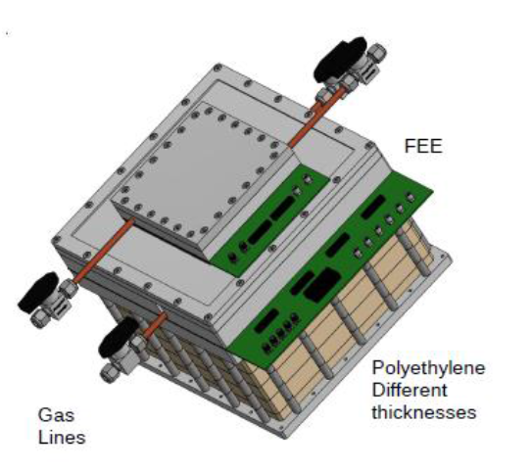
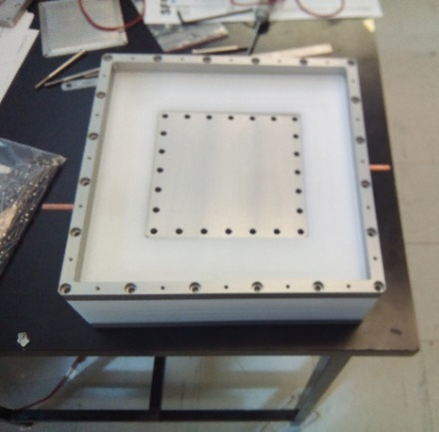
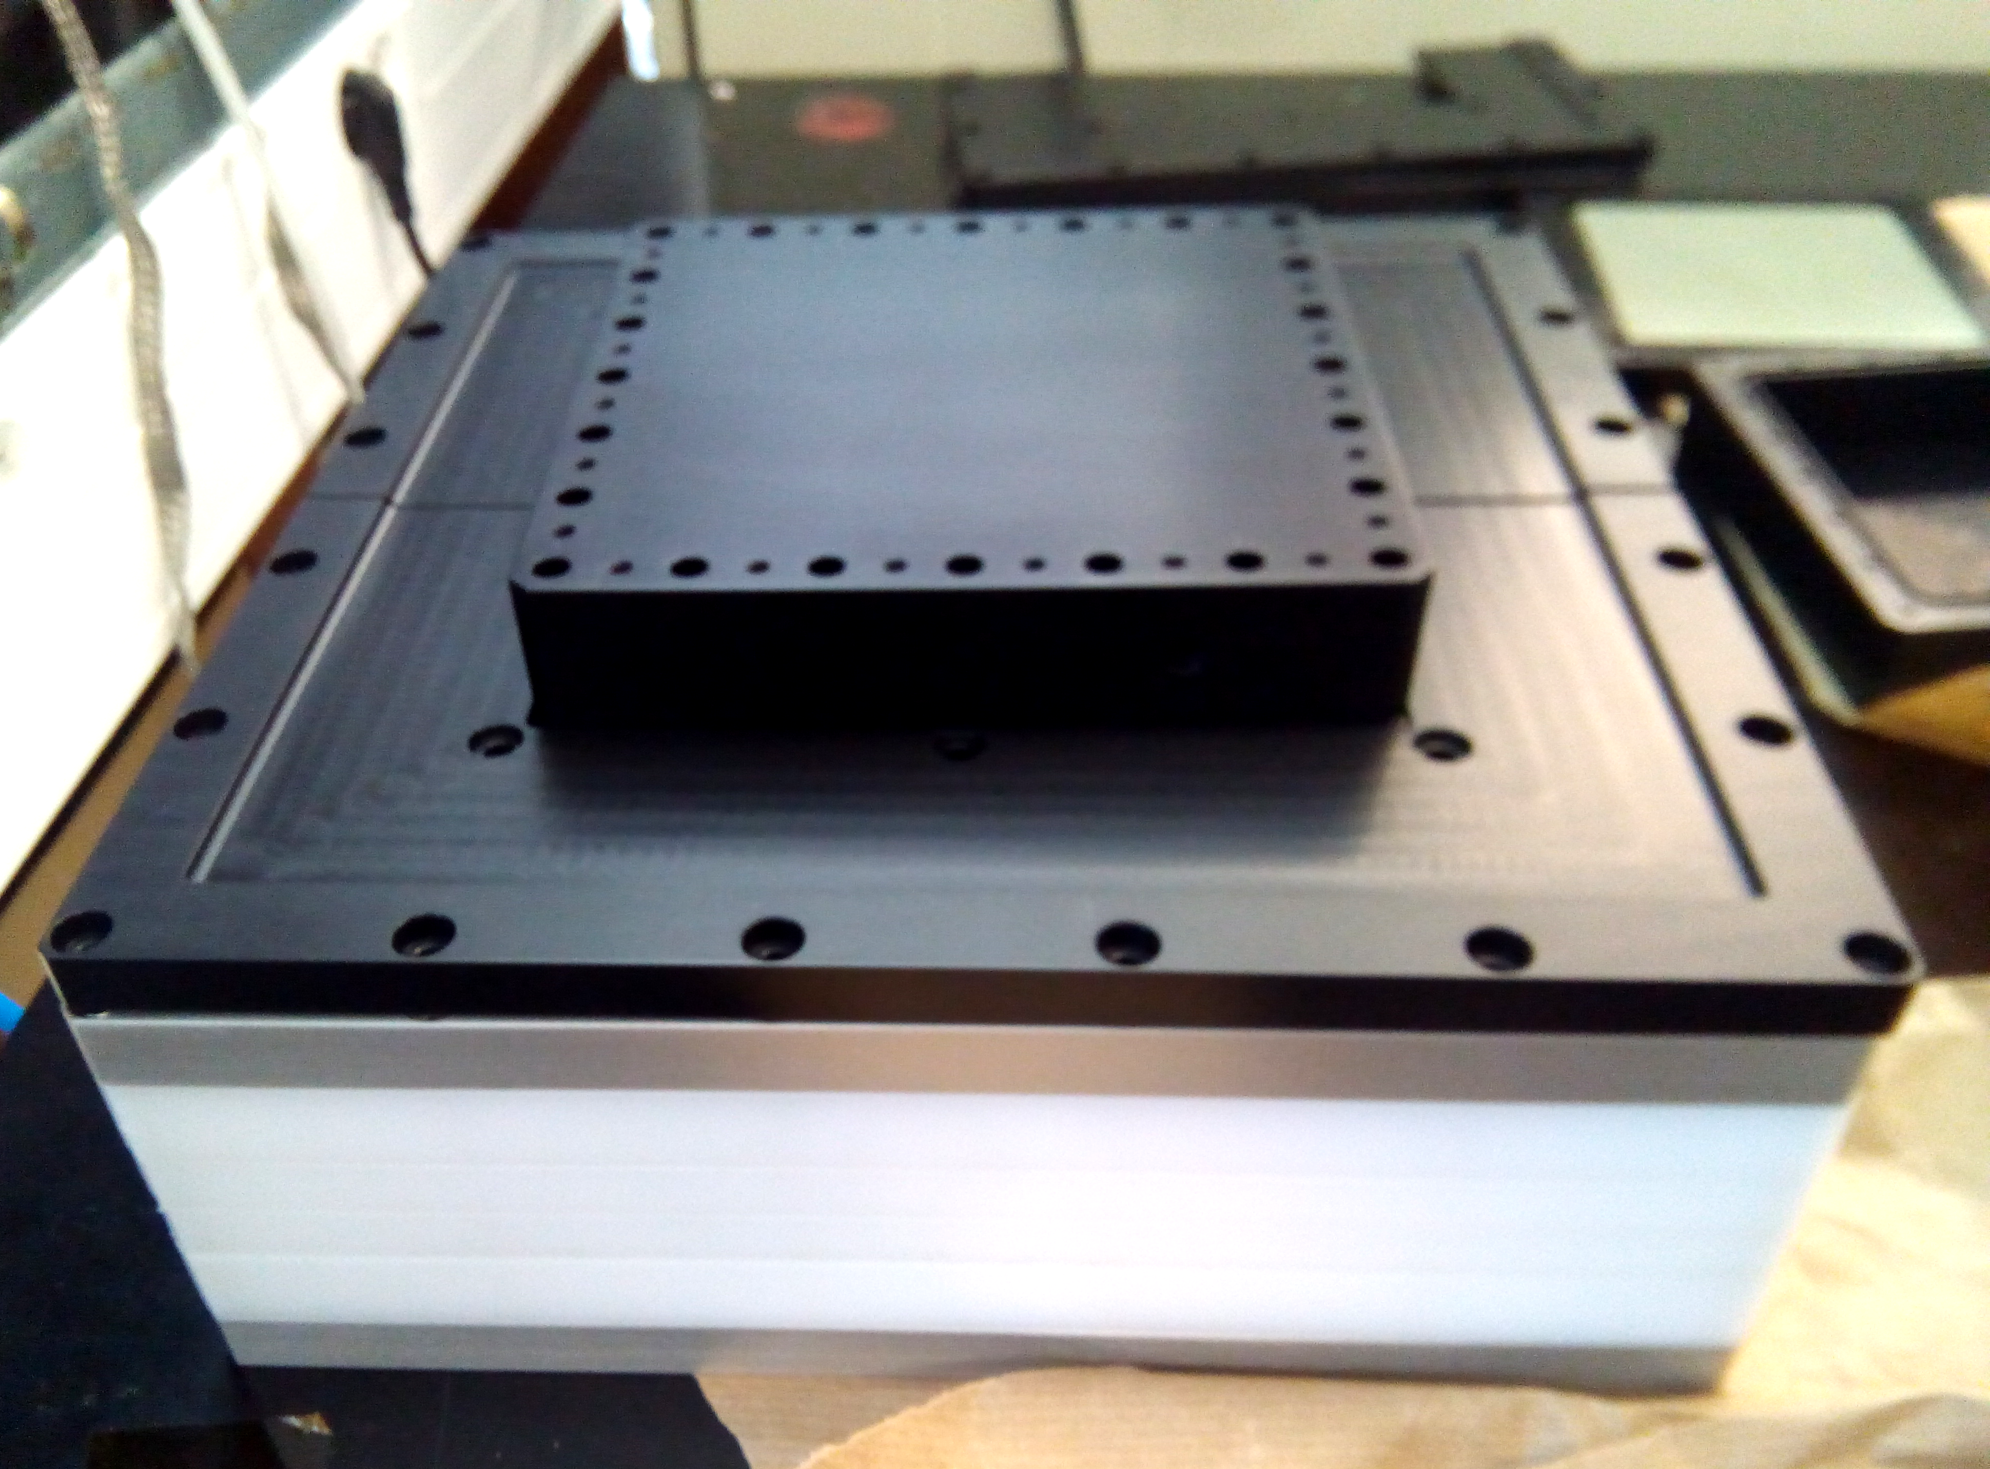
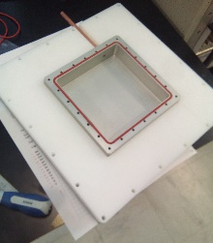

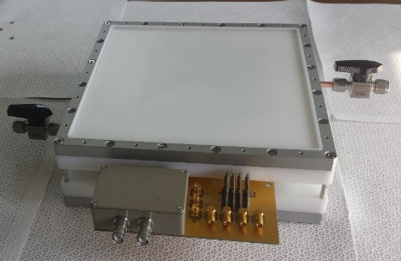
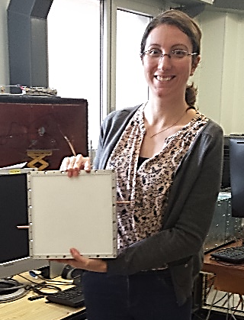
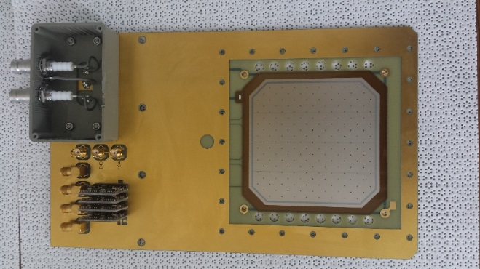
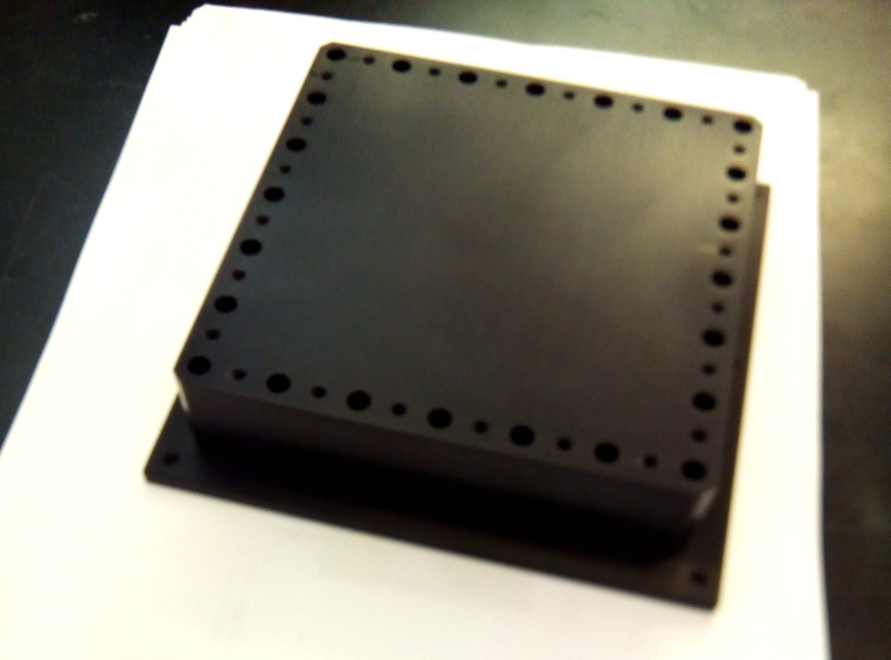

nBLM Detectors
SLOW
FAST
(n, α) ¹⁰B reaction
Detection of fast neutrons after moderation in polyethylene (~4cm)
More efficient, 4π, but slower response
Recoil protons produced by neutrons in polypropylene
High flux high energy n's (>0.1 MeV)
Faster response
Gas chamber
Different thickness of polyethylene can be added
Integrated FEE
Detector size
~30x30x30cm³
~3kg
Easy to transport
See talks by Laura

Slide 19
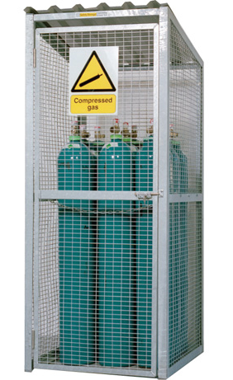
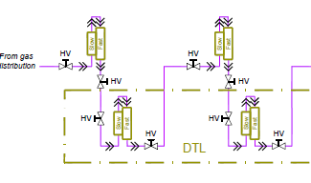
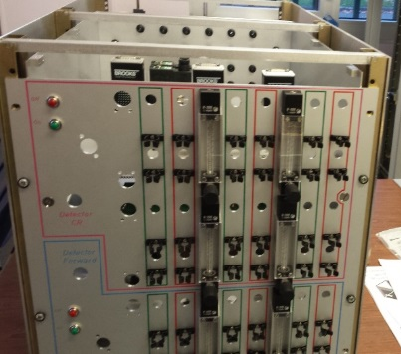
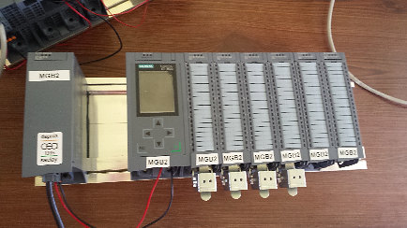
nBLM Gas System
Detectors are designed to operate in semi – sealed mode, however for long term stability some gas recirculation is necessary. The nBLM Gas System:
Provide a constant flaw of 0.2 - 2 l/h of He + 10% CO₂ to 10 independent gas lines
Each line feeds a group of detectors in series
Control / Monitoring of flow IN – flow OUT of each line ➔ assure tightness & gas quality
Warning to EPICs
Gas Distribution (GD)
In
Gas Detectors Line (GDTL)
Gas Storage (GS)
Out
Exhaust
See talks by Laura & Quentin

Slide 20
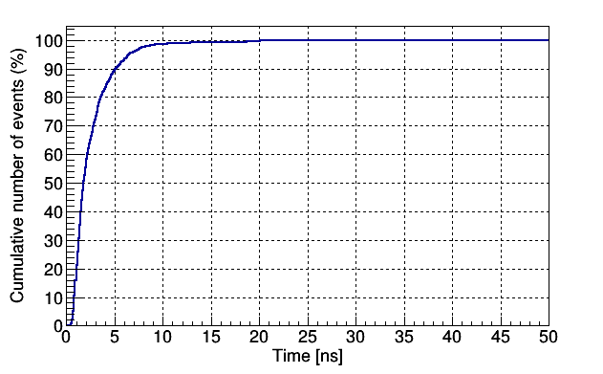
nBLM risks
  As a result of Unknown operational conditions of ESS accelerator
(N1) : Insufficient count rate
  there is a risk that Insufficient count rate for the desired system reaction time,
  resulting in Reduced alarm sensitivity
(N2) : Detectors saturation
  there is a risk that Detectors saturation
  resulting in redesign analysis software
(N3) : Neutron signal difficult to discriminate due to backgrounds
  there is a risk that Neutron signal difficult to discriminate
  resulting in Reduced alarm sensitivity
Mitigation strategy
Tests at LINAC4 and ESS cavities
  Backgrounds
  Response
Versatile design of prototypes
Efficiency can be reduced:
  Reducing the B₄C thickness
  Using natural Boron instead of ¹⁰B
  Detector segmented in 4
From the simulations with scenarios we have so far
Rates of >MHz in µs (slow detector)
in ns (fast detector)

