Slide 1
Plan for controls with the digital platform
Henrik Carling
Head of ICS division
www.europeanspallationsource.se
2017-12-04

Slide 2
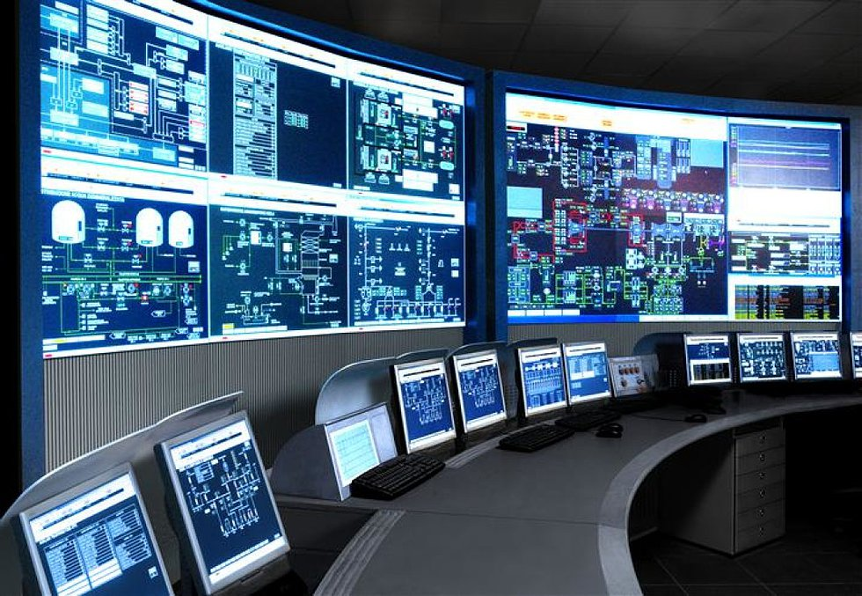
The ESS integrated control system
The ESS facility is a large and complex machine with very much and diverse
equipment that needs to work in synchronization and with well-known
configurations
For this purpose almost all equipment at the ESS facility is connected to the
Integrated Control System
Examples:
  Voltage supplies for magnets
  Vacuum systems
  Cryogenic equipment
  RF equipment
  Air conditioning in the tunnel
The control system is the ”central
nervous system of ESS”
An estimated 1.6 million
control points will be needed

Slide 3
nBLM plan/collaboration with CEA and Technical university of Lodz
nBLM CS Design Document (including the FPGA simulation)
nBLM FPGA firmware
Validation of FPGA
nBLM prototype detector control and acquisition
Acceptance Test Report of nBLM prototype control
Support
2017-12
2018-01
2018-02
2018-03
2018-04
2018-05
2018-06
2018-07
2018-08
2018-09
2018-10
2018-11
2018-12
Kick-off meeting
Specification and requirement analysis
Prototype version of the FW
Test report
Production FW

Slide 4
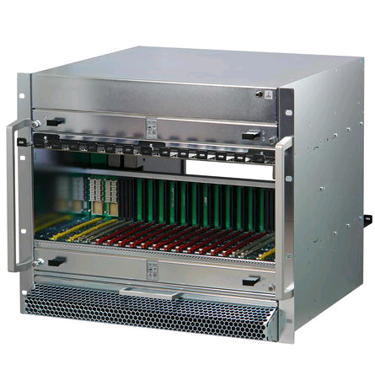
Control system infrastructure components
MTCA.4
  Crates, MCH, Cooling Units, PSU
    First batch procured delivery date TBD
I/O and processing
  Digital platforms IFC1410
    First production batch at ESS this week
Timing System
  EVG, EVR, Distribution System
    Procurement launched

Slide 5
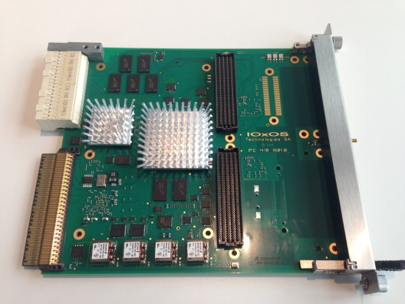
Digital platforms, status and support
IFC_1410 (and IFC_1420)
  In-kind contribution from PSI (boards + firmware + software)
    Generic packages of firmware, drivers, EPICS support
  Project delays due to in-kind issues
    Contractual issues with Switzerland
  Development kept going through ICS cash support
    Not optimal but hardware is now in good shape
    Tried to manage need with a 10-unit initial batch
    PSI support was limited until full approval
  But now: strong support from PSI
    1 FPGA engineer, 1 SW engineer full time
    Part-time support of 8+ people (controls, LLRF, instrumentation)
    Use of PSI resources for ADC performance characterization, etc.
    Production-quality kernel drivers (initial) release
    Procuremment launched
  Series production has started

Slide 6
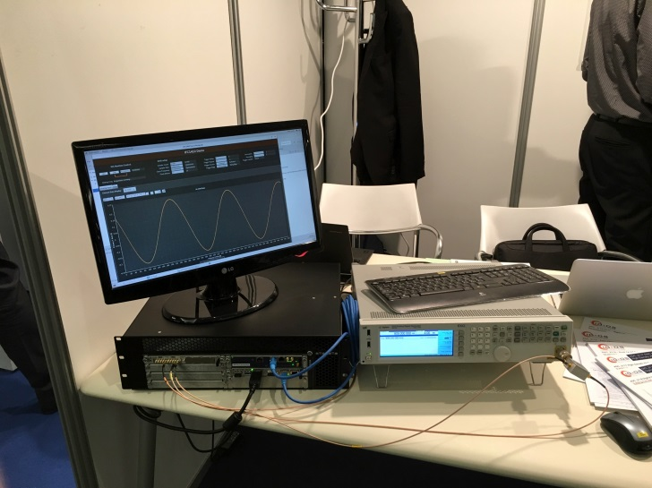
Digital platforms, status and support
IFC_1410 (and IFC_1420)
  Firmware status
    Generic applications (“oscilloscope”) running since a while
    ICS has prioritized RF support (RF-LPS firmware)
  Drivers (Linux, kernel)
    Worked so far on a version from the commercial partner
    This had a number of issues: thread safety, etc.
    A new, production-quality driver, supported by PSI and commercial partner released
  EPICS
    Moving support to the new driver
    Area Detector will be the main driver for ESS
    Also a generic driver from PSI will be supported (regDev). This is primarily for prototyping but has also been used in production.
      Like “streamDevice” but for register-based, memory-mapped devices
      No programming needed

Slide 7
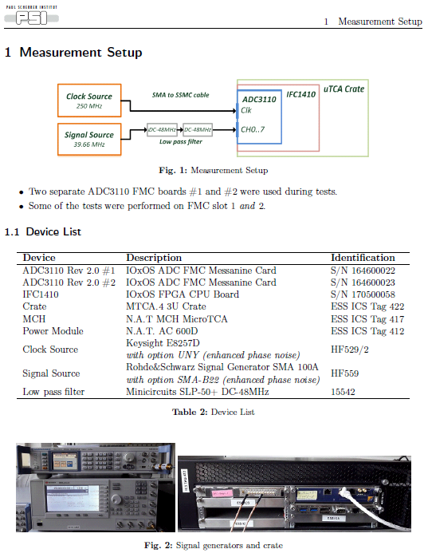
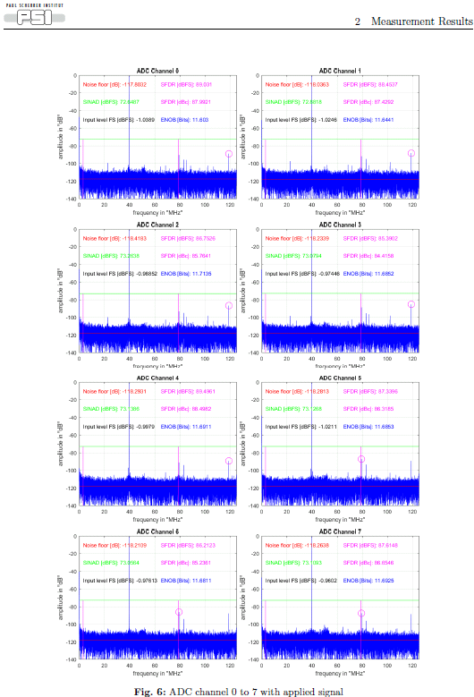
System characterization report available

Slide 8
ICS vision and mission statements
ICS vision statement
ESS operated efficiently, reliably and safely, with a control system that everyone loves
ICS mission
The ICS division shall provide and maintain world-class and cost-efficient control, protection and safety systems and services for the ESS facility.
The division shall develop competence and innovative solutions that can be shared in the community through open processes

