Slide 1

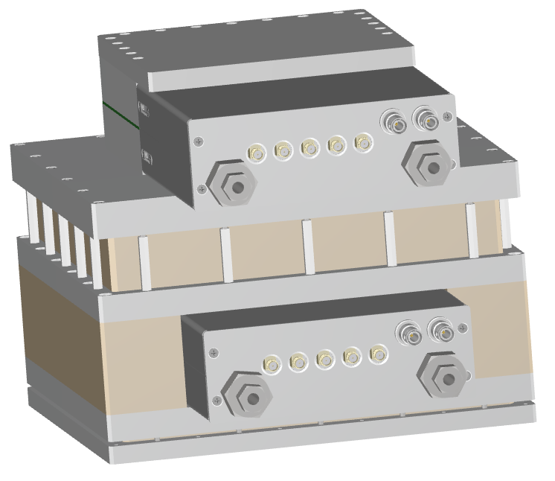
nBLM
Back End Electronics and Control System
CEA\DRF\IRFU\DIS | Yannick Mariette
2017/12/04

Slide 2
Outline
- Context
- Interface overview
- Control devices
- nBLM test stand in Saclay
- Detectors/devices distribution
- FPGA firmware specifications
- FPGA algorithm simulation
- Control system
- Detector stability and possible malfunctions
- nBLM CS Work status

Slide 3
Context
The purpose of a nBLM detector is to detect fast neutrons in order to measure the beam loss. The beam loss measurement is mandatory in order to:
Ensure the accelerator security with a fast beam stop in case of a beam loss accident
Contribute to the human safety with a low level line activation (<1 W/m)
A nBLM detector is a “fast” detector or a slow “detector”, few differences are set in the FEE and packaging (polyethylene for the slow detector).
Notes:
Originaly one nBLM module was a slow and a fast detector attached together. Now we do not talk about “module” but “detector” as it could be or not separated.

Slide 4
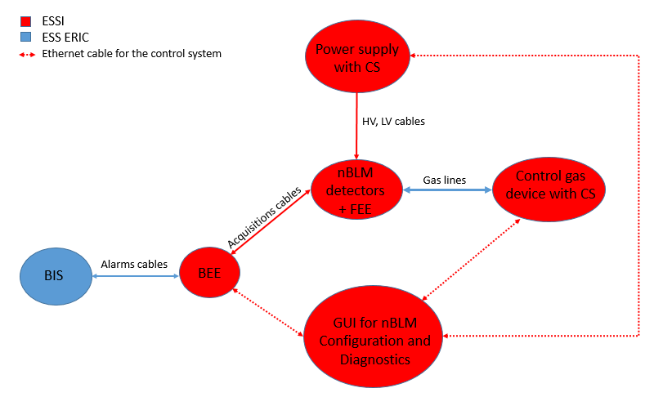
Interface overview
Notes:
nBLM detector is a Micromegas with a gas chamber. Thus the gas must be provided for each detector. (He+10%CO2)
Each detector also needs to be powered with 2 high voltage.
Moreover the preamplifier of each nBLM FEE needs to be powered with low voltage.
Fast Alarms generated by the BEE go the BIS.
The CS is based on EPICS, the GUI for nBLM is done with CSS BOY

Slide 5
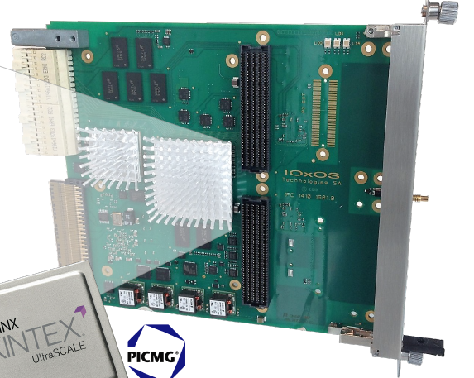
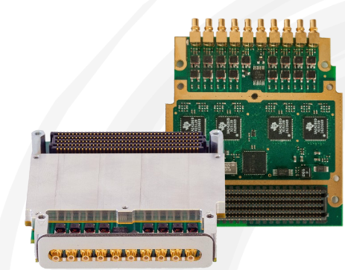
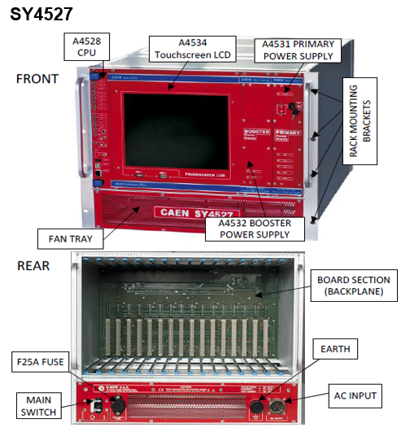
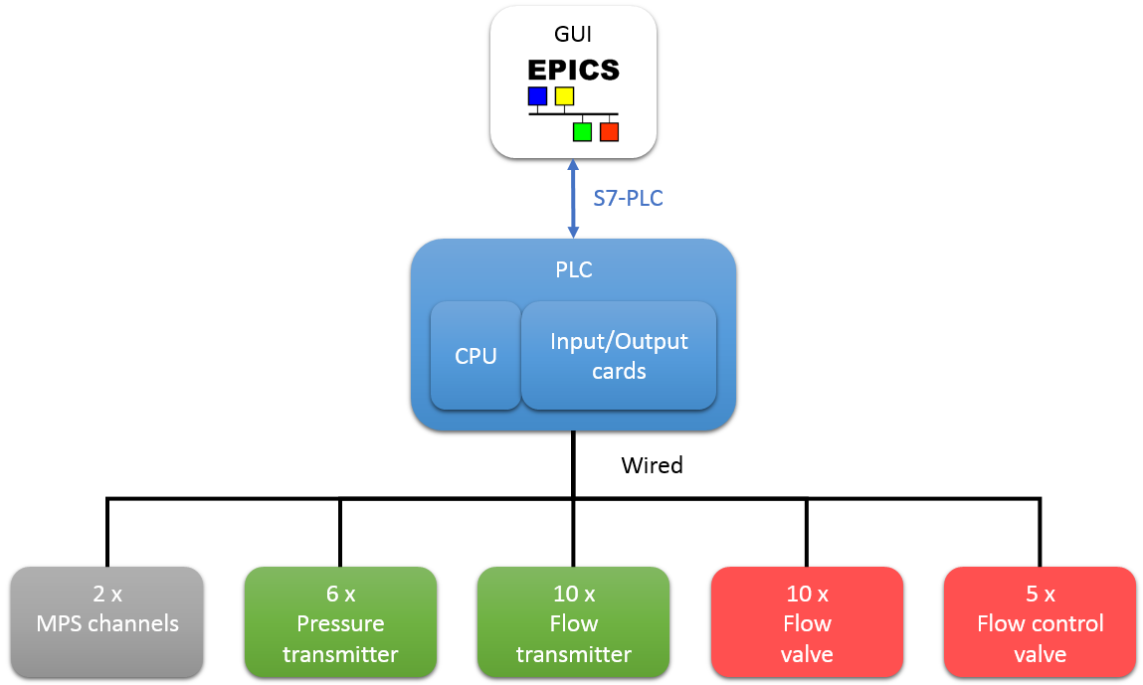
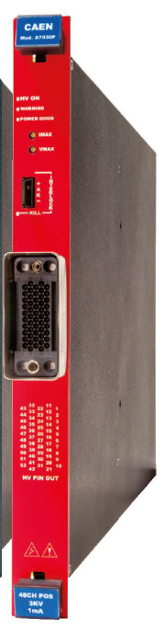

Control Devices
HV and LV crate
BEE boards
IFC1410
ADC3111
FMC DIO
A7030 + A2519
Gas
device
IOC
Kontron IPC
+
Gas CS facilities
Siemens PLC
Notes:
Devices involved in the control system are:
- A HV/LV crate with 16 slots, 4 HV and 1 LV boards
- For the gas : Kontron Industrial PC + Siemens PLC + Siemens Input/output cards.
- AMC board IFC1410 in MTCA crate. It’s a FMC carrier board with 2 slots
- ADC3111 the FMC aquisition module plugged in the IFC1410. 8 ADC channels, 250 Msamples/s
The Control system must manage the slow control of these devices. It also manages the data archiving and the detection settings for the FPGA firmware inside the IFC1410 board.

Slide 6
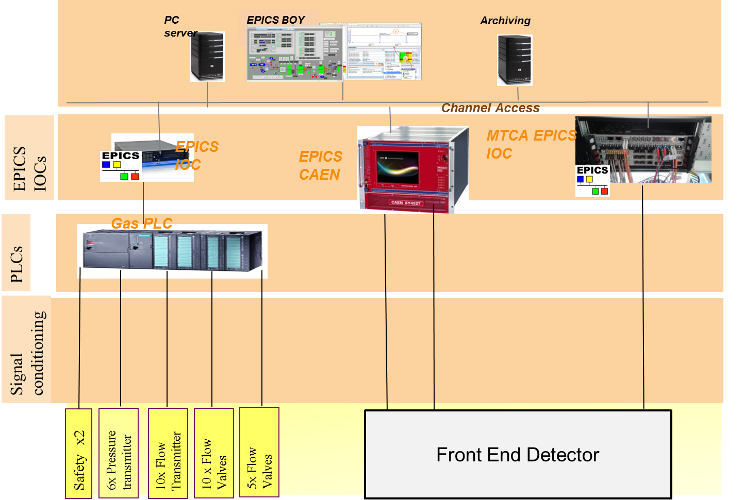
Control system for the NBLM test Stand in saclay
Notes:
Here is the control system test stand that we will set to test one nBLM in Saclay.
It is a layers view from HW to CS

Slide 7
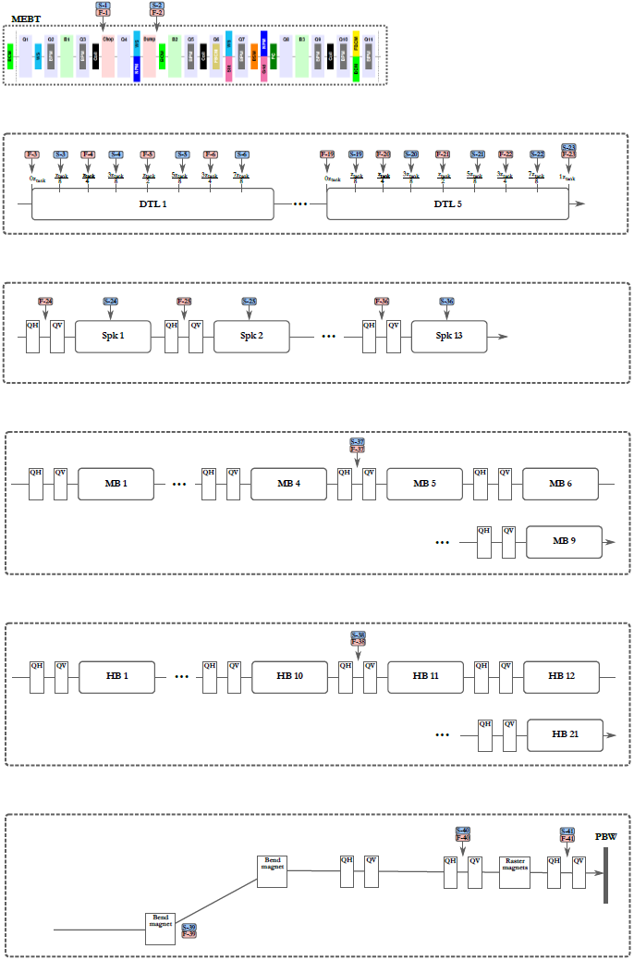
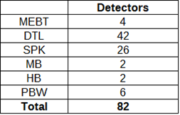
DETECTOR Distribution in the linac
Notes:
Along the Linac, the total number of nBLM detector is 82. But in the initial agreement, it was specified that 42 nBLM modules should be provided (so 84 detectors) . Thus the 2 detectors left will be spares.
Each times it is a pair of slow and fast detector

Slide 8
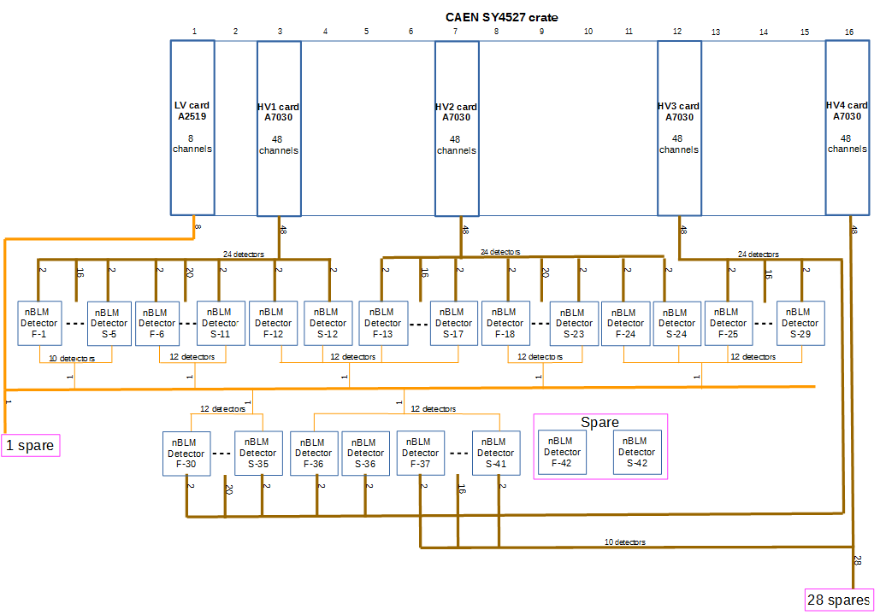
EXAMPLE of a LV and HV distribution
Notes:
2 LV/HV crate for the 82 detectors (in low and high NRJ parts)
1 LV board : 7 channels, 1 spare channel
4 HV boards : 164 channels, 28 spares channels

Slide 9
Gas distribution
10 gas lines will provide gas for the whole 82 detectors
Notes:
The distribution has been done to have a maximum of 12 detectors per gas line.

Slide 10
ACQUISITION distribution
In the BEE the acquisitions are done by the ADC3111 FMC module. There will only be one ADC3111 FMC board per IFC1410 board, hence 8 acquisition channels maximum.
We have decided to make pairs of fast and slow acquisition for software architecture convenience.
To avoid blind section in case of a hardware failure (IFC1410 or ADC3111), it has been decided to cross detector pairs on different ADC3111 modules.
ADC n°1 on the IFC1410 n°1:
  channel1: fast nBLM1 detector (F-1)
  channel2: slow nBLM1 detector (S-1)
  channel3: fast nBLM3 detector (F-3)
  channel4: slow nBLM3 detector (S-3)
  channel5: fast nBLM5 detector (F-5)
  channel6: slow nBLM5 detector (S-5)
  channel7: fast nBLM7 detector (F-7)
  channel8: slow nBLM7 detector (S-7)
ADC n°2 on the IFC1410 n°2:
  channel1: fast nBLM2 detector (F-2)
  channel2: slow nBLM2 detector (S-2)
  channel3: fast nBLM4 detector (F-4)
  channel4: slow nBLM4 detector (S-4)
  channel5: fast nBLM6 detector (F-6)
  channel6: slow nBLM6 detector (S-6)
  channel7: fast nBLM8 detector (F-8)
  channel8: slow nBLM8 detector (S-8)
Notes:
we need a minimum of 11 FMC modules and 11 IFC1410 boards to cover the 82 nBLM detectors (In case where all the 8 channels of each FMC module are used)

Slide 11
FPGA firmware requirements
Analyses the signal, detects neutrons/events and counting
Generates fast alarm if needed
Acquires post-alarm data for analysis
Provides oscilloscope functionnality
Generates warning/status
Notes:
Signal analysis is done from the detection parameters provided by CS

Slide 12
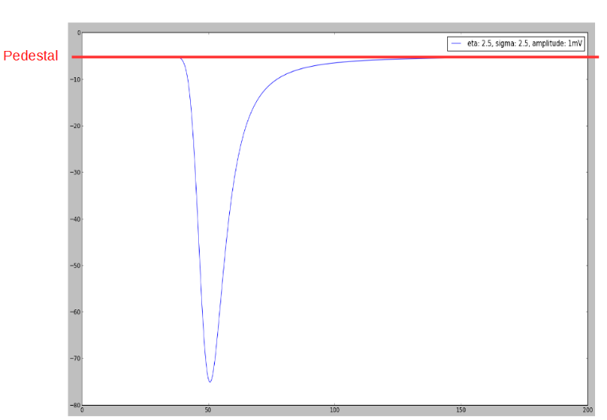
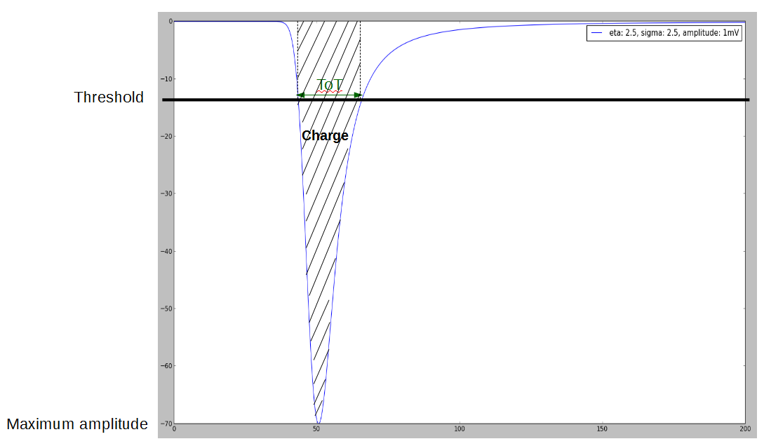
Signal characteristics for 1 neutron
Ideal shape or peak for one neutron (In the right figure the pedestal has been subtracted)
Maximum amplitude (A): it is the maximum amplitude of the peak after having subtracted the pedestal level
Charge (Q): it is the integral of the peak signal from the bin below the threshold to the bin above the threshold.
Time over Threshold (TOT): It is the duration time of the peak below the threshold.
Notes:
The neutron shape can be fitted using a Landau distribution, it gives a big negative peak under the noise.
For a slow detector, a peak is a neutron
For a fast detector, a peak is not proportional to a neutron energy (because the amplitude/charge distribution of neutrons is large, not a gaussian distribution). Thus a peak for a fast detector is called an event.
In case of a beam loss, several consecutive neutrons gives pile-up and not landau form.

Slide 13
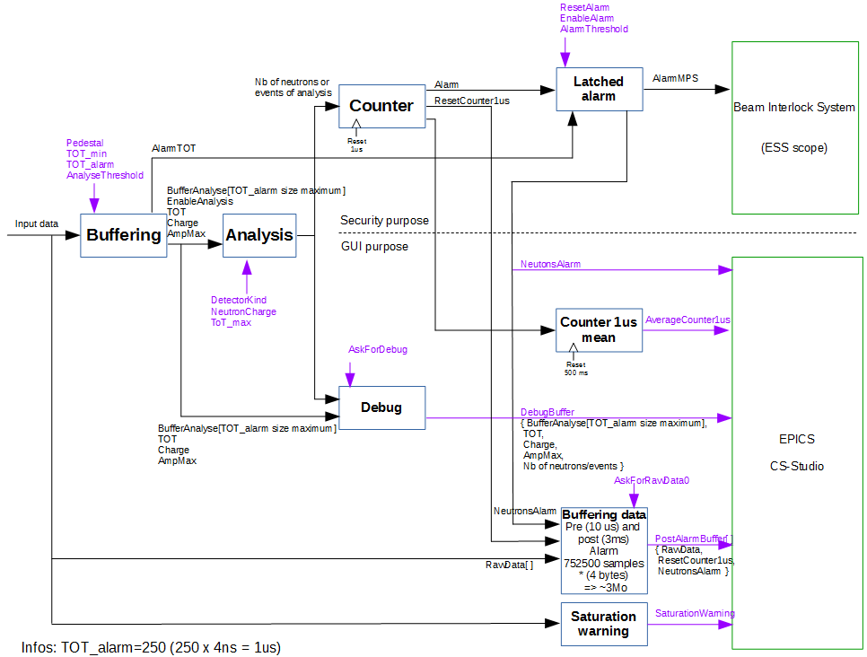
algorithm PROPOSITION for neutron detection
Algorithm coded in Python
TOT, Charge (Q) and Amplitude (A) are counted in real time when the signal is under the threshold.
TOT min: defines a minimum duration of a peak to consider that it is a neutron.
TOT max: defines a duration of a peak from where we consider that there is not only one peak (2 or more neutrons detection could be acquired at the same time)
TOT alarm: defines a maximum duration where the signal is below the threshold. We consider that there is not only one peak, many neutrons are acquired continuously during this maximum duration (pile-up).
Notes:
The algorithm specification is the same for fast or slow detector and the same for the 8 channels.
It is based on TOT analysis. (voir def)
Each block could be an FPGA IP.

Slide 14
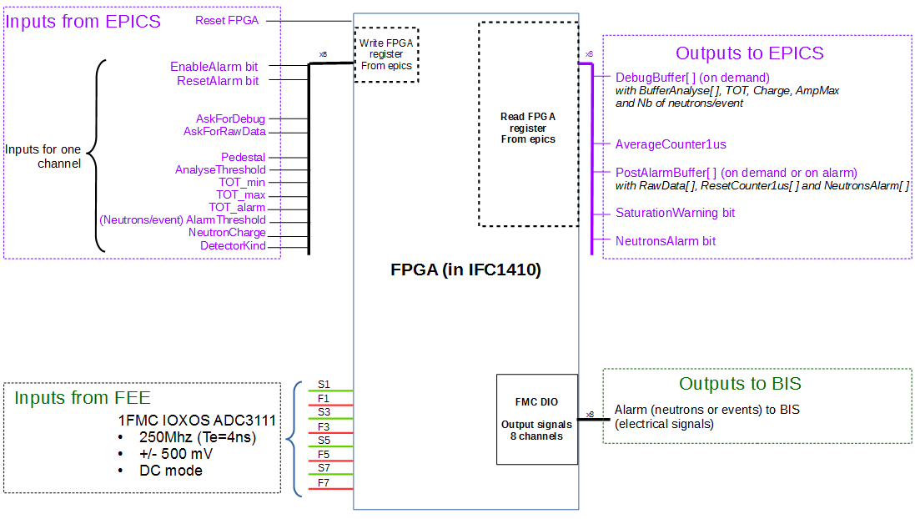
FPGA interface and data
Notes:
8 Acquisitions signals at 250 Msamples/s
8 fast Alarm output signals and 8 associated bits to inform the CS
AverageCounter1us = Monitoring data indicating an average of the number of neutrons detected per microsecond. An average is done every 500 ms
Input parameters for neutron peak detection
PostAlarmBuffer data : gives informations when neutrons alarms occur
DebugBuffer : informations used to set and adjust the detection parameters during detector configuration

Slide 15
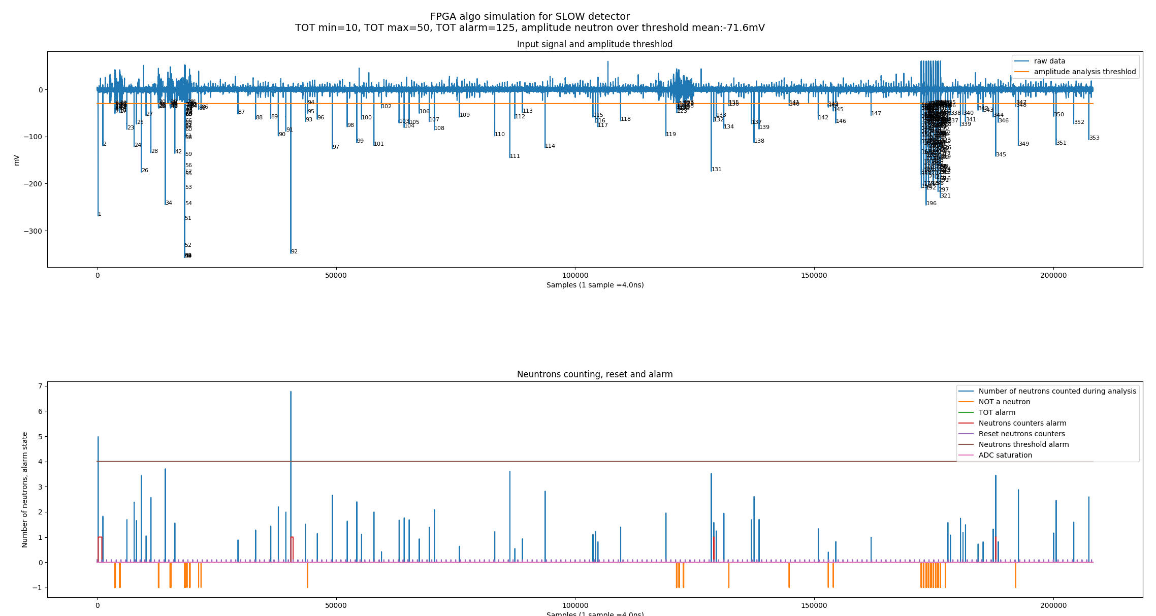
Simulation algorithm results
Data
Algorithm results
Notes:
For a slow detector
Above : Data
Below : Results
Green : under threshold but TOT < TOT min => sparks, noise

Slide 16
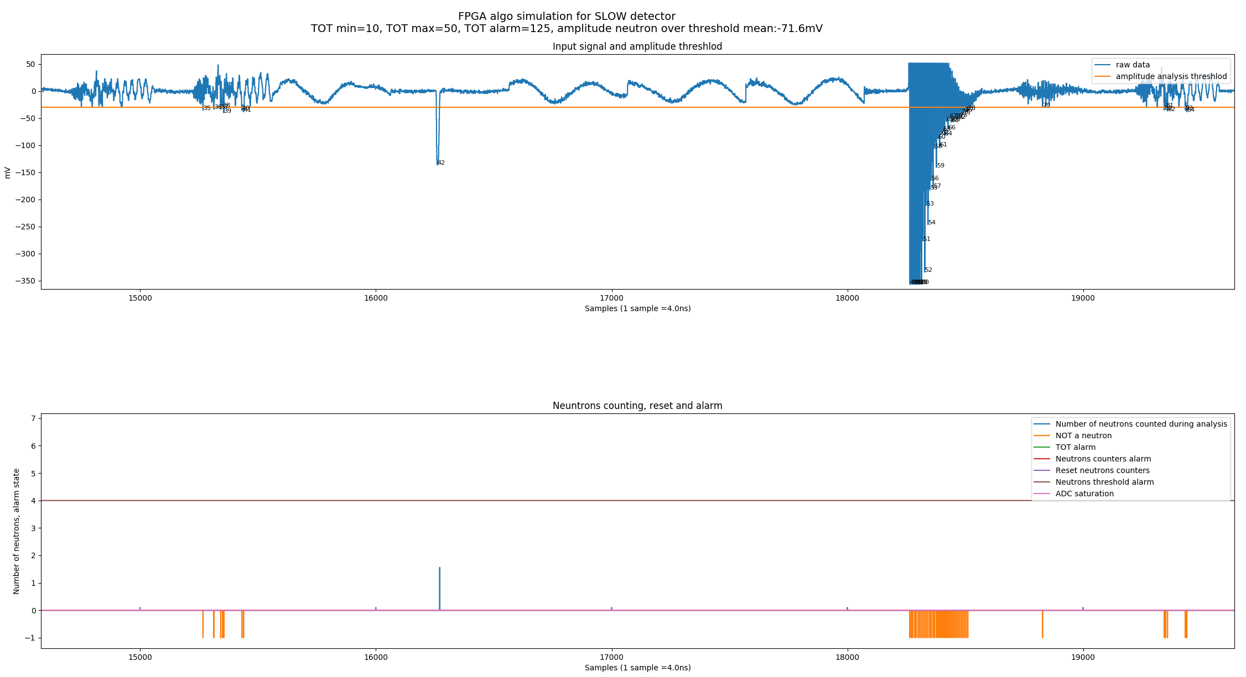
Simulation algorithm results
Data
Algorithm results
Notes:
Zoom in.
To validate the final FPGA implementation, we could compare results from the FPGA to the python script.

Slide 17
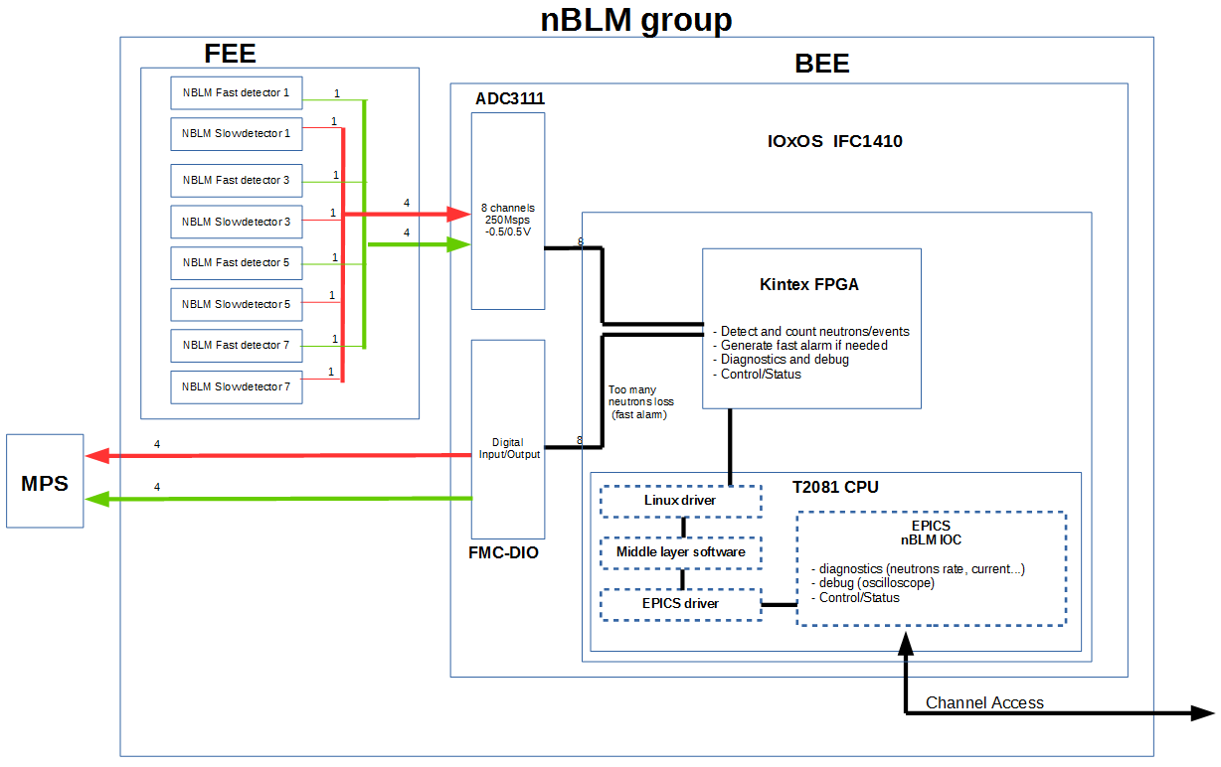
Architecture of a nBLM group
Notes:
A nBLM group manages settings and acquisition for 8 detector.
To accomplish this work each nBLM group has a BEE for the control with its IOC
The IOC run on a Linux operating system inside the CPU T2081. The IFC1410 has a framework for the communication between the FPGA and the IOC

Slide 18
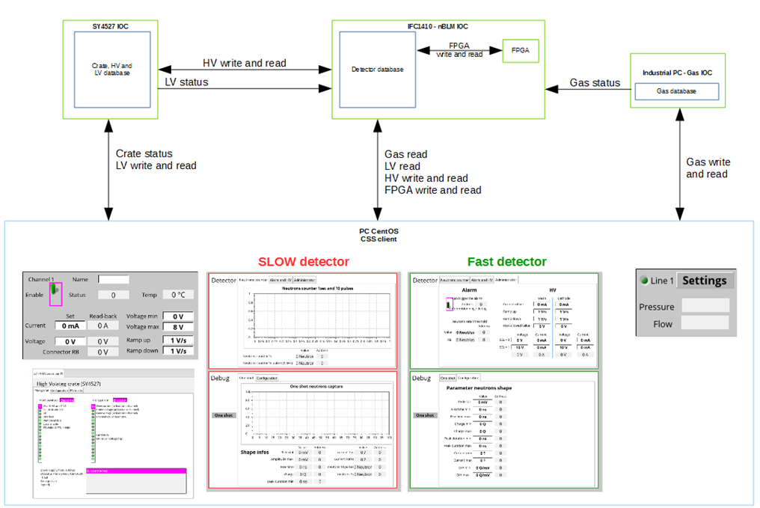
EPICS database exchange
Notes:
The HV/LV crate provides an EPICS service to access to Process Variables using the CA protocol. The EPICS IOC is integrated in the CPU of the crate.
The industrial PC has also its own IOC for gas data management.
For a nBLM group, one nBLM IOC inside the IFC1410 manages the settings of HV data, gas/LV/HV status and acquisitions.

Slide 19
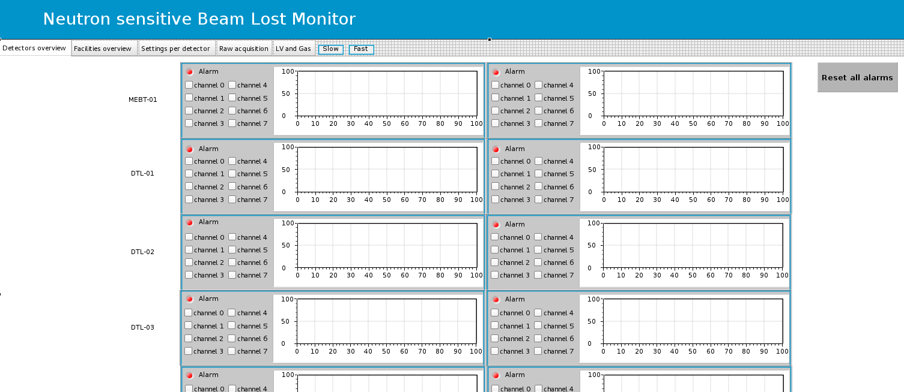
GUI for the CS of all nBLM
Detector overview
Notes:
CSS BOY view
3 main tabs:
Detector overview : global view of neutron counting and Alarms for each detector

Slide 20
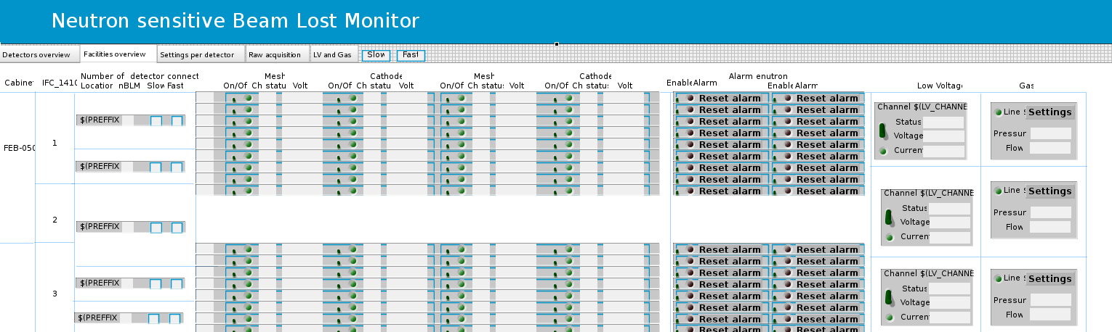
GUI for the CS of all nBLM
Device overview
Notes:
Device overview : global view of the 10 lines gas status, 7 LV channels and 164 HV channels

Slide 21
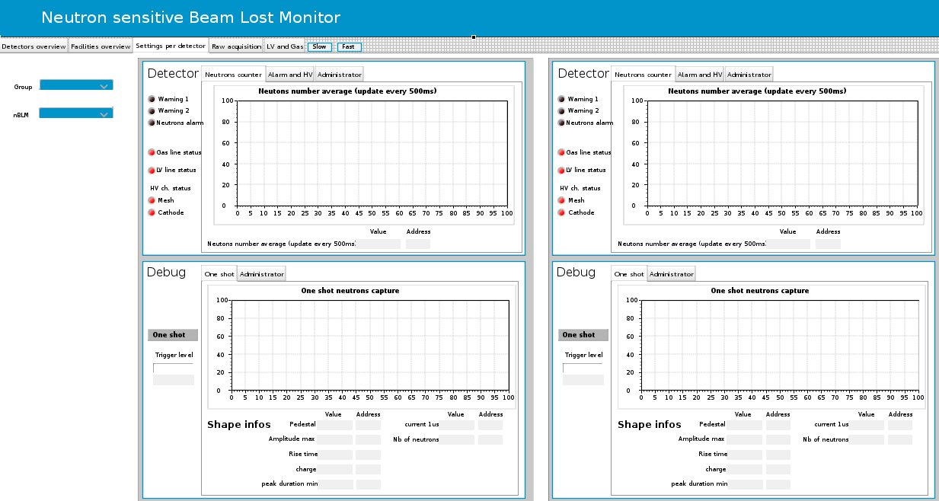
GUI for the CS of all nBLM
Settings per detector
Notes:
Settings/monitoring for a pair of fast and slow detector
Upper view : alarm parameters (rate) and monitoring per detector
Lower view : oscilloscope tool and detection parameters setting per detector used by the FPGA firmware (TOT min, TOT max, Q, etc.)

Slide 22
Detector stability
We want to qualify each detector over the time to check if the neutron detection is still performant
- For slow detectors: Make a mean TOT, a mean Amplitude and mean Charge distribution (for residual neutron). Check the stability of these values over the time and the width of the distribution
- For fast detectors: TBD. Count the events (or charge) per second to verify the stability of the residual neutron rate

Slide 23
Possible malfunctions
Possible Malfunctions:
- Gas flow problem (drop in, too much, slow leak)
- No Gas
- No pressure meter or flowmeter measure
- Gas pollution
- Front End Electronic failure
- Back End Electronic failure: MTCA, IFC1410, ADC3111, FMC-DIO
- HV/LV problem (crate or board failure, HV/LV down, HV/LV instability)
- Detector problem (bad signal due to noise, sparks, gammas, ageing etc.)
- Software/firmware crash
- Bad/No detection settings
Continuous process to detect problems:
- Gas flow and pressure monitoring
- Remaining gas measure from pressure and flow
- Detector stability over the time (previous slide)
- HV, LV Monitoring
- IFC1410 alive counter
Notes:
As seen before, the cross acquisition distribution limits the BEE failure impact.
Actions:
EPICS alarm
EPICS warning
Watchdog

Slide 24
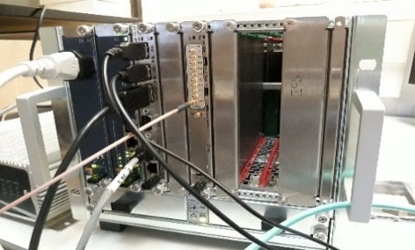
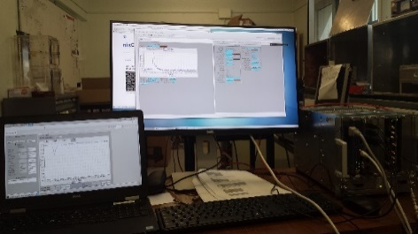
nBLM CS work Status
- Test of the oscilloscope application on a MTCA with IFC1410+ADC3111 and the EEE inside the Concurrent Technology mother board
- Version 1.0 of nBLM control system design document with the FPGA specification in progress
- Simulation under Python for neutron detection algorithm
- nBLM CSS displays
- Test and integration of the HV/LV IOC, PV added in the nBLM module
- nBLM PC with virtual EEE server installation for nBLM test stand
- Gas devices chosen (PLC, Control valves, flow meters, pressure meters, I/O board)

Slide 25
Thank you for your attention

Slide 26
nBLM tasks
FPGA specifications, tests and support
Simulation/configuration tool
IOC/CSS development (HV, Gas, acquisition)
Tests/Validations
Missions :Reviews-meeting/Installation/Support/configuration

Slide 27
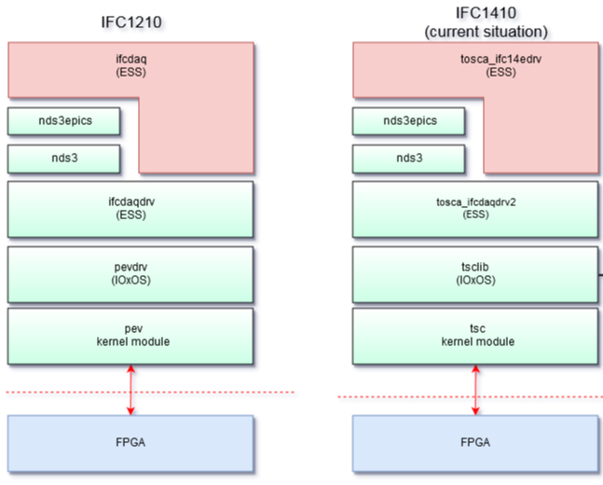
framEwork for IFC1410
ESS
IOxOS
Notes:
- Tsc kernel module and tsclib are Linux drivers
- Tosca_ifcdaqdrv2 is a middle layer
- Tosca_if14edrv is an EPICS driver
With tsc kernel module and tsclib, the FPGA registers can be accessed via PCIe.
The tosca_ifcdaqdrv2 driver contains high level process function (set decimation, gain, etc.). It manages different kind of FMC board.
Tosca_ifc14edrv is the EPICS driver. The nBLM IOC will use this driver.
When the firmware FPGA will be modified with new registers, modification must be applied in the middle layer and in the EPICS driver to add new process function and new process variable.
In the IFC1410 framework, the middle layer software named “ifcdaqdrv2” and the EPICS driver named “Tosca_if14edrv” are under the responsibility of ESS-ERIC (ICS). Therefore ifcdaqdrv2 and Tosca_if14edrv modifications will be done by ESS-ERIC from the FPGA interface specification and the process variable definition provided by CEA ESSI.

Slide 28
Detector type and functionality
Slow detector:
This detector is very efficient for neutron counting. It will be monitored to detect small beam loss during long time, commissioning, etc.
=> More dedicated to the acquisition control system
Fast detector:
This detector is very efficient for fast detection of a big number of neutrons. A fast alarm will be generated in case of a consequent beam loss.
=> Dedicated the fast Alarm to the MPS
DRAFT

Slide 29
Installation/configuration
Settings/calibration:
Setting/calibration will be necessary for each detector.
We will need to identify very precisely landau shape.
Each channel settings could be different. It will depends on the nBLM location (high or low energy section), preamplifier settings, detector type etc.
DRAFT

Slide 30
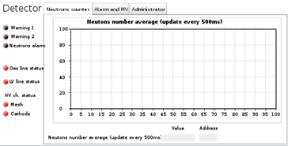
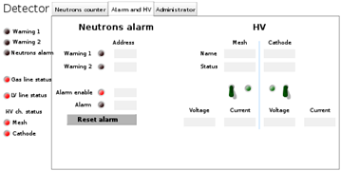
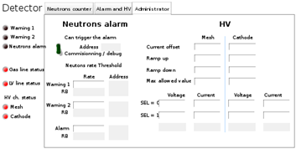
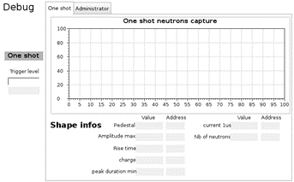
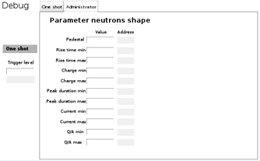
GUI for the CS of all nBLM
DRAFT
Notes:
Inside the “Settings for a pair of fast and slow detector” tab there are sub-tabs. The following figures are the view of these sub-tabs:
For neutron counting : Alarm/warning settings/status for each detector
Oscilloscope functionality
Detection parameter settings

