Slide 1
Safety Readiness Review (SRR) 2017-11-30 Thomas Hansson, ESH
www.europeanspallationsource.se

Slide 2
Outline
ESS Review Framework
ESS Process for Safety Readiness Review
ESS System Documentation needed prior to a SRR

Slide 3
ESS Review Framework, based on the Project Management Plan _{ESS-0091812}
SRR
Graphical Workflow based
on draft ESS-0093443

Slide 4
ESS Process for Safety Readiness Review
ESS-0123091 “ESS Process for Safety Readiness Review”
to review the readiness to safely commission any system (and sub-systems), which could be a part of the facility or the whole facility.
the scope is safety, both conventional and related to ionizing radiation.
a process by which hardware, personnel and procedures associated with commissioning of the system are verified.
an independent review of the safety aspects, performed after the Test Readiness Review (TRR) or corresponding activity to be performed by system owners.
For instance, it is relevant to perform a Safety Readiness Review prior to the commissioning of the Ion Source (IS) and Low Energy Beam Transport (LEBT), preliminary in March 2018.
involving the p-beam

Slide 5
ESS System Documentation needed prior to a Safety Readiness Review
ESS-0177837 “ESS System Documentation prior to a SRR”
Design descriptions (purpose, technical solution)
Architecture description (the specific system, involved equipment, devices, etc.)
Concept of Operations (scope of proposed testing, operators & disciplines, etc.)
Req. Spec (test envelope limits & conditions, hazards, safety systems, etc.)
Interface descriptions
Integration Plan (intermediate demonstrations of supporting & safety systems)
Operation & maintenance documents (the specific operator perspective)
Verification Plan (detailed steps to be followed, sequence, who, when, etc.)

Slide 6
Example of how to describe the structure of involved systems
System of interest
Supporting systems
HV power supply ……
……
Ion source
gas delivery system, plasma generator/microwave system, extraction system, isolation transformer, cooling system, vacuum systems …..
LEBT
magnetic solenoids, steering magnets, slit IRIS, deflecting chopper, beam collimator, beam diagnostics instruments, gas injection system …..
Safety systems
IS HV cage fence and gate
…..
Shielding against ionizing radiation against electromagnetic fields …..
PSS0 detectors sensors logic circuits/equipment actuators interlocks …..

Slide 7
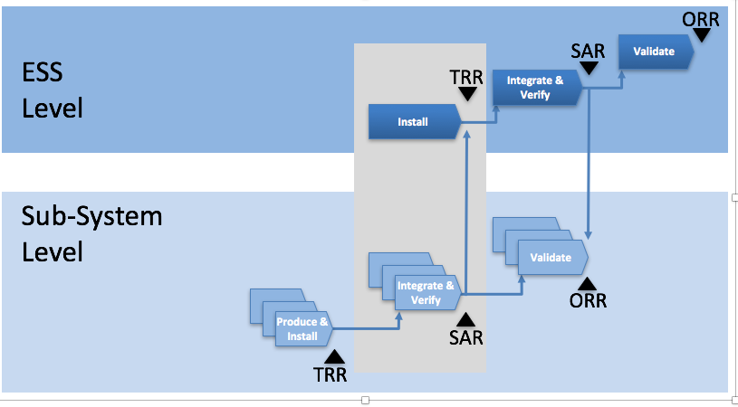
Safety Readiness Review vs. other Reviews
Relevant system owners are responsible for
Test Readiness Review (TRR), or corresponding, for the specific system level
System Acceptance Reviews (SAR), or corresponding, for all concerned sub-systems
SRR
System
ORR = Operation Readiness Review

Slide 8
Thank You!
Questions?

Slide 9
ESS Review Framework, based on the Project Management Plan _{ESS-0091812}
SRR
Graphical Workflow based
on draft ESS-0093443

