Slide 1
CE marking approach
Mattias Skafar
Head of Quality Division
www.europeanspallationsource.se
1 December, 2017

Slide 2
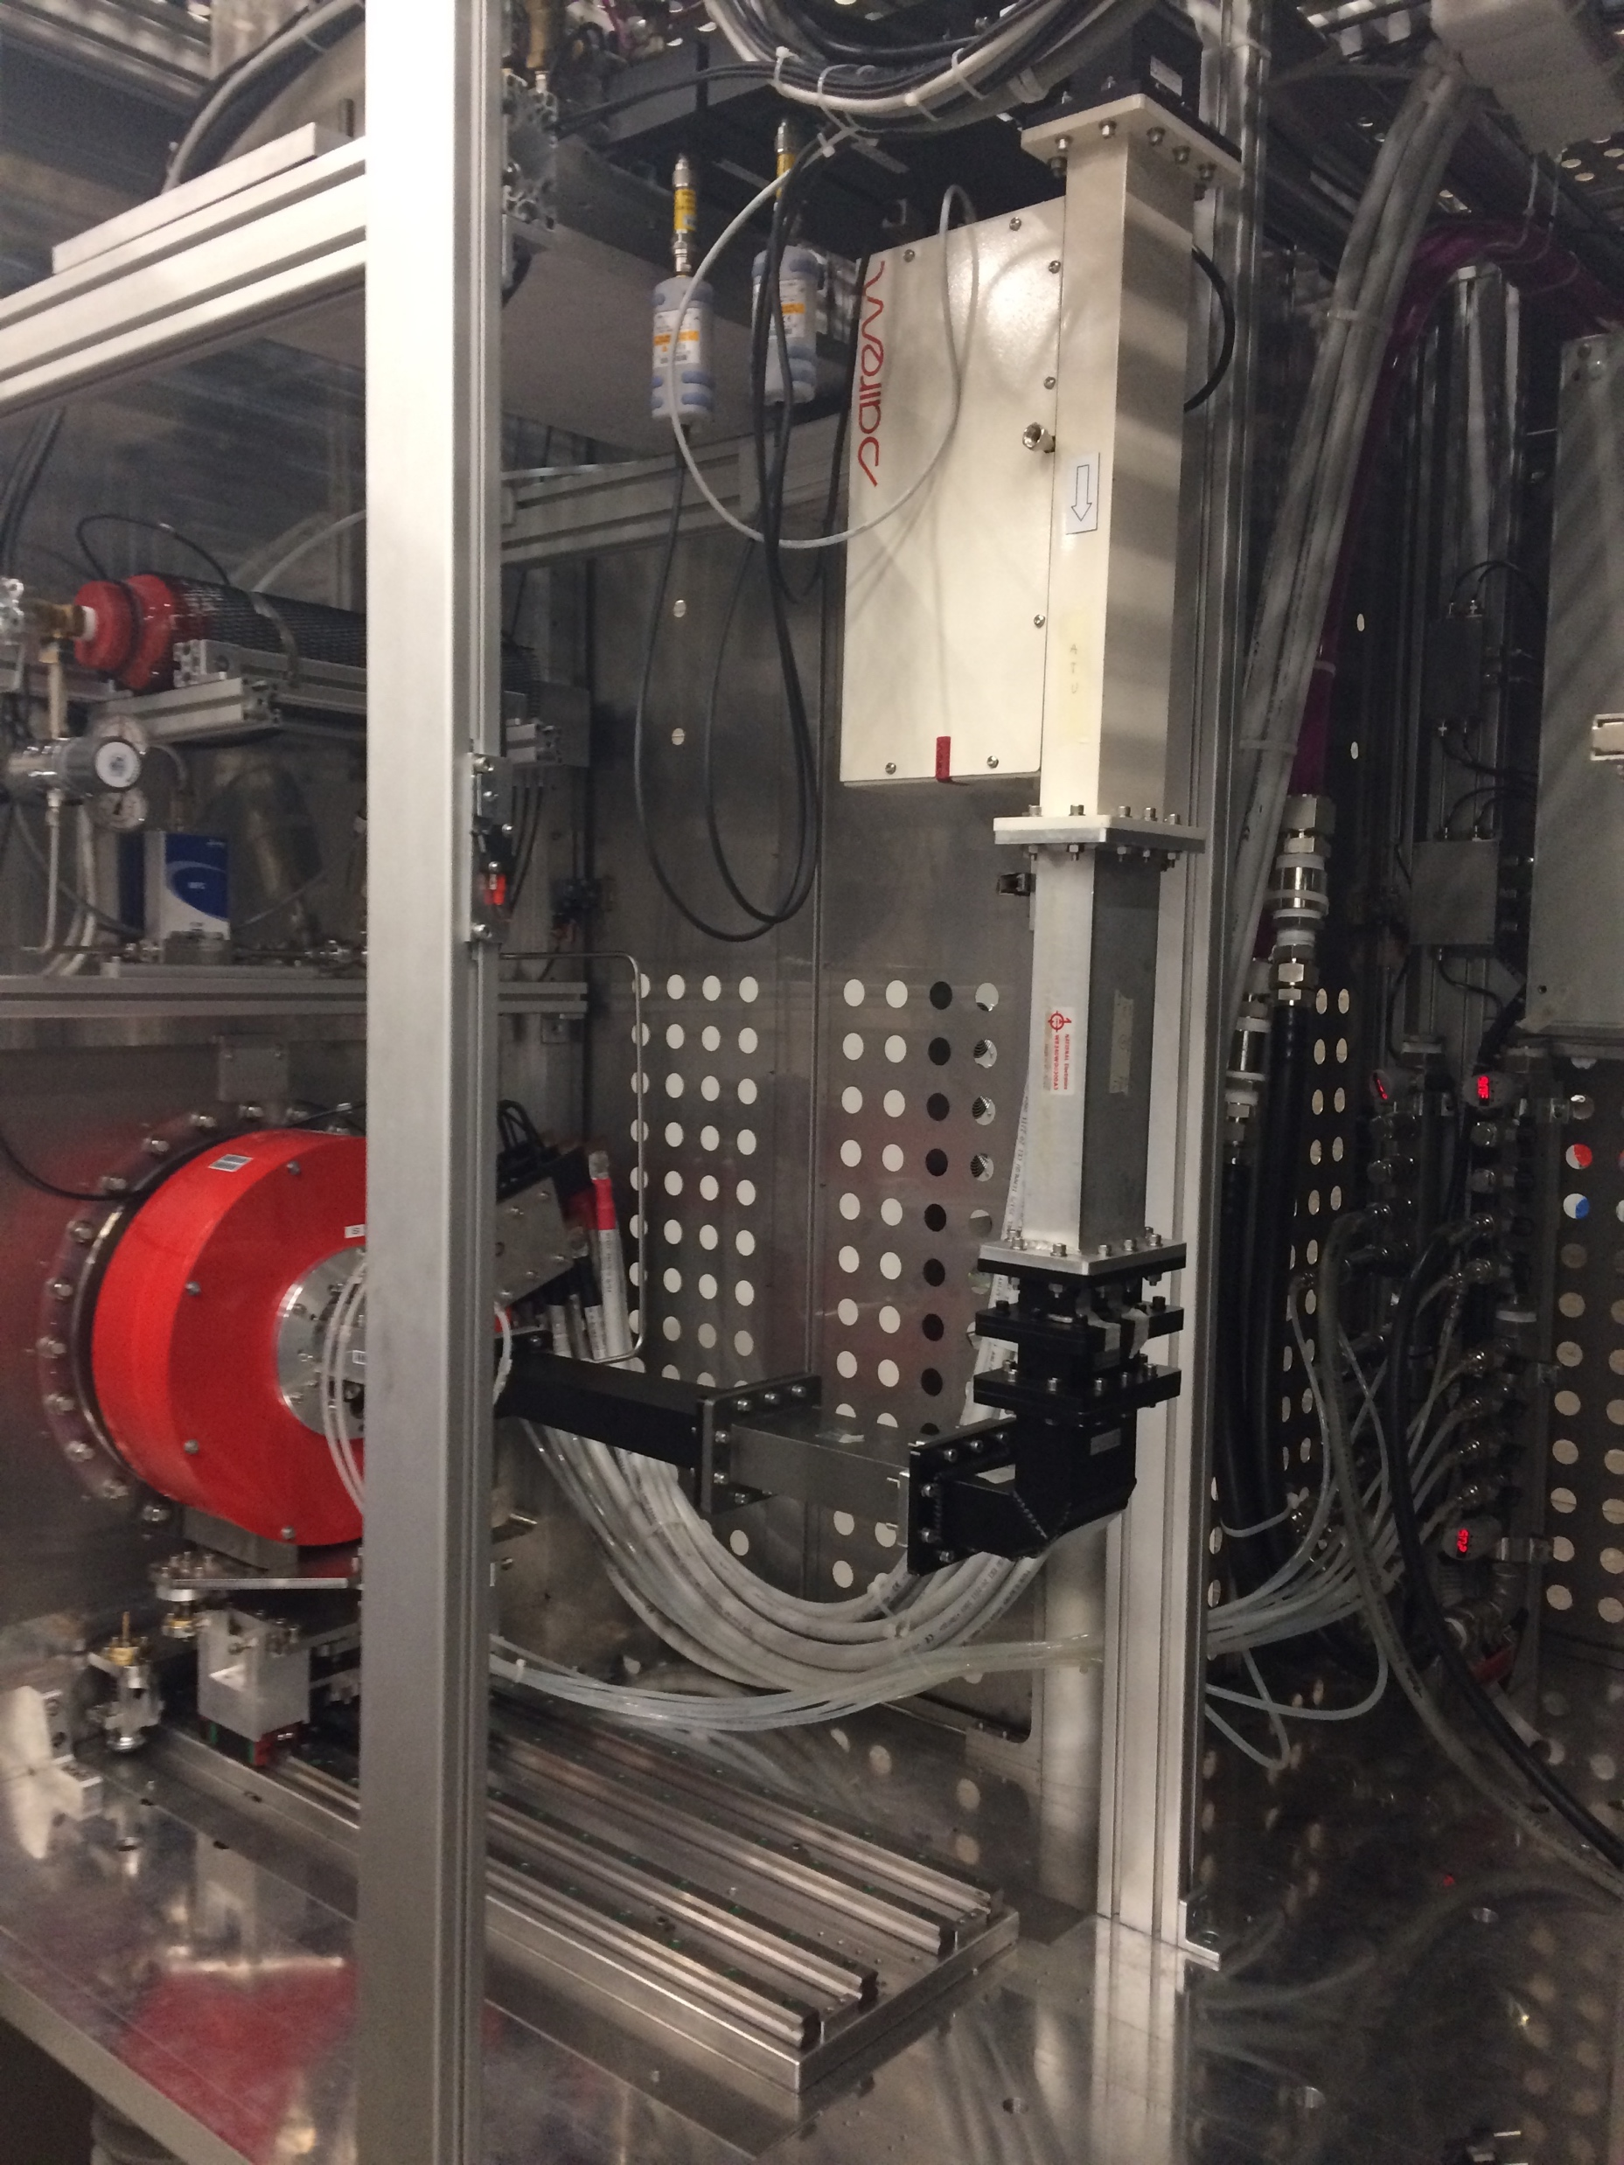
ESS Strategy for CE Marking
Approved by DG and ESS Management Team
The Strategy (ESS-0103087) applies to:
Internal deliverables
Commercial contracts
In-Kind Contributions
CE marking is mandatory.
when there is an applicable European Directive.
The delivery shall include:
Risk assessment (ISO 12100)
Technical File, drawings, wiring diagram, P&ID, etc.
Operational Manual, in English
Declaration of Conformity
Ion Source INFN - LNS
CE marking Rule + 4 templates

Slide 3
What does CE marking mean?
The CE mark is a mandatory conformity marking for certain products placed on the market within the European Economic Area (EEA) since 1985. Sweden was adopting to the EU Directives in 1994.
CE marking signifies that the product conforms with all EU Directives or EU regulations that apply to it.
Machine Directive, 2006/42/EC
Pressure Equipment Directive, 2014/68/EU
Low Voltage Directive, 2014/35/EU
The manufacturer of CE marked goods has to verify that the product complies with all applicable EU requirements, such as safety, health and environmental protection.

Slide 4
On the market…
According to the CE directives, a product has to comply with the EU Directives and have a CE-marking from the moment it is:
placed on the Community market for the first time;
put into service(use) in the Community market for the first time.
Placing on the market is the initial action of making a product available for the first time, either for payment or free of charge.
Putting into service(use) takes place at the moment of first use within the EEA by the end user.
Notes:
EEA = European Economic Area

Slide 5
Definition – USE
With regard to mechanical devices, the term „use” covers all of the activities shown in the diagram below, arising in connection with the use of the mechanical device.
USE
Assembly
Testing
Putting into service
Defined intended purpose
Transport
Conversion Dismantling
Incidents
Inspections
Maintenance
Repair
Its clearly defined intended use is specialised in the operating instructions or manual.

Slide 6
Workflow
Product
Identify Relevant EC Directives e.g.
2006/42/EC
2014/35/EU
2014/30/EU
Identify and apply applicable provisions
Compile Technical file
Description, Technical reports, Test reports, Construction plans, Circuit diagrams, Part lists etc.
Issue
User manual
in English
Create a EC - Declaration of conformity
(Machine or part of a machine)
Award of the EC-Conformity mark (CE)
(If applicable)
Notes:
42 Machine
35 Low voltage
30 Electromagnetic compatibility

Slide 7
Machine Directive 2006/42/EC
Machine
Partly completed Machine
Machine not in Annex IV
Technical file
Annex VII A
Instructions
Machine in Annex IV
Technical file
Annex VII B
Assembly Instr.
Annex VI
Designed according to Harmonised standards
Not designed according to Harmonised standards
Internal conformity checks
Annex VIII
Full Quality Assurance
Annex X
EC-type examination
Annex IX
Internal check
EC declaration of conformity
Annex II 1A
Declaration of incorporation
Annex II 1B
CE mark
Article 16
Annex III

Slide 8
Notified Body needed when…
Annex IV Machines, examples:
Various wood working tools
chain saws, circular saws, band saws etc.
Press tools for metal/plastic
Injection or compression plastics- or rubber moulding machinery
Heavy machinery for various work
Under ground (mining)
Compression of waste, etc.
Lifting equipment: person, goods
Protective devices designed to detect the presence of persons
Power-operated interlocking movable guards
Logic units to ensure safety functions
Roll-over protective structures
Falling-object protective structures
Red = Potentially applicable to ESS

Slide 9
Declaration of Conformity – DoC
Contributions needs to be delivered with a DoC*
Verifying that applicable directives and requirements have been applied by the supplier/IKC.
This will ease the integration process and secure that the Manufacturer of a deliverable have taken their responsibility for the delivery in terms of:
Safety requirements
Quality requirements
Technical requirements
Compliance to European and Swedish legislation
Applies for commercial and In-Kind deliveries
* According to ISO 17050

Slide 10
Example
Declaration of Conformity*
IKC
Declaration of Conformity*
Declaration of Conformity*
Partner institute
Supplier
Type of delivery:
In house design
In-kind Contribution
External provider
Of the shelf, CE marked
* Declaration of Conformity for part of machine (to be incorporated) or a complete machine

Slide 11
Divide in Logical packages
ESS level
* Declaration of Conformity for part of machine (to be incorporated) or a complete machine
Declaration of Conformity
IKC A
IKC B
IKC C
IKC D
IKC E
Declaration of Conformity*
Declaration of Conformity
Declaration of Conformity
Declaration of Conformity
Declaration of Conformity

Slide 12
ESS – Steering documents
ESS is issuing a steering document describing the approach:
ESS Rules for CE Marking
ESS-0127031
Supported by four templates:
EU Declaration of Conformity (machine)
ESS-0145024
EU Declaration of Incorporation (part of a machine)
ESS-0145023
Signature card for EU Declaration of Conformity
ESS-0145020
Checklist for formal assessment of the EU conformity procedure
ESS-0145018
In review workflow

Slide 13
Thank you for your attention!
and now…

