Slide 1
ICS Status
Wojtek Fabianowski
ICS In-kind manager
www.europeanspallationsource.se
2017-12

Slide 2





ICS Project scope
Work package 01 Management and administration
Work package 02 Software Applications
Work package 03 Software core
Work package 04 Hardware core
Work package 05 Machine protection
Work package 06 Equipment
Work package 07 Control system infrastructure
Work package 08 Physics
Work package 09 Personnel safety systems
Work package 10 Integration - Accelerator
Work package 11 Integration - Target
Work package 12 Integration - Instruments
Work package 13 Integration - Conventional facilities
Work package 14 Test Stands
Work package 20 Installation
Software
Electronics
Infrastructure
Safety & protection

Slide 3
Technology scope for ICS
Applicatoins (GUI, Web, Services)
Databases
Industrialization, maintenance
Development environments
Availability, performance
Kernel drivers
EPICS
Digital communication
Operating systems (RT)
CSS/Eclipse
PCB, packaging
Test and validation
Analog electronics
Digital electronics
Test and validation
FPGA firmware
Electronics hardware
Software
PLC
Infrastructure
Safety and protection
Notes:
The span of technical scope and the competencies needed in ICS is enormous
From analog signals to Java-based high-end, big-data GUI:s in high performance, high availability
PLC systems
Safety and protection systems
Infrastructure: networking, data centre, control room
Systems integration, Installation
Project management and administration

Slide 4
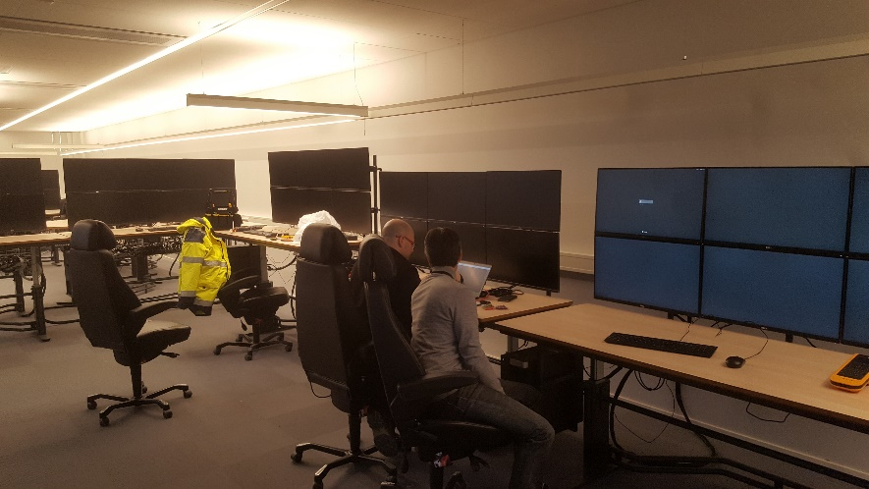
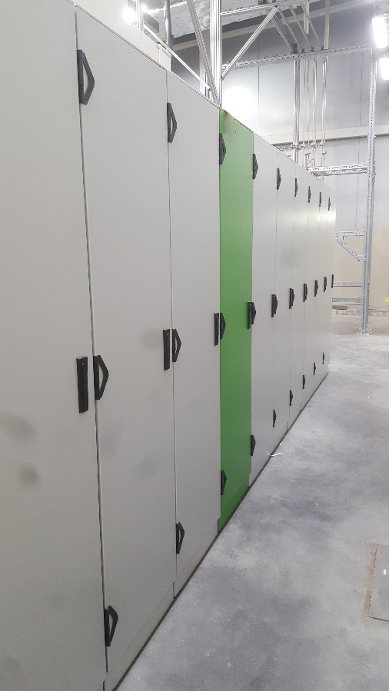
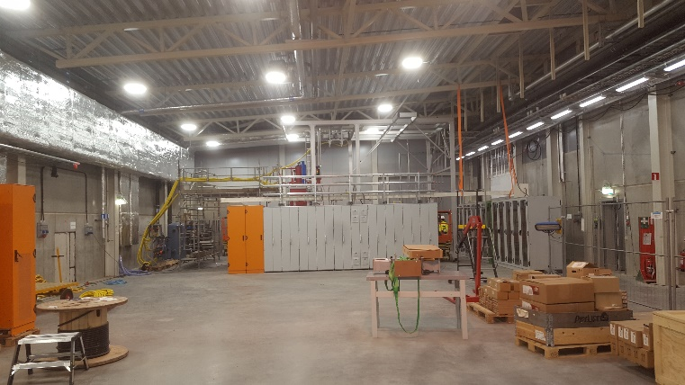
Installation Status
Network and data infrastructure installation ongoing in the klystron gallery and tunnel
Personal Safety System racks, cabling sensors are installed
Work for the Test Stand 2 progressing
Installation and setup of the local control room is progressing

Slide 5
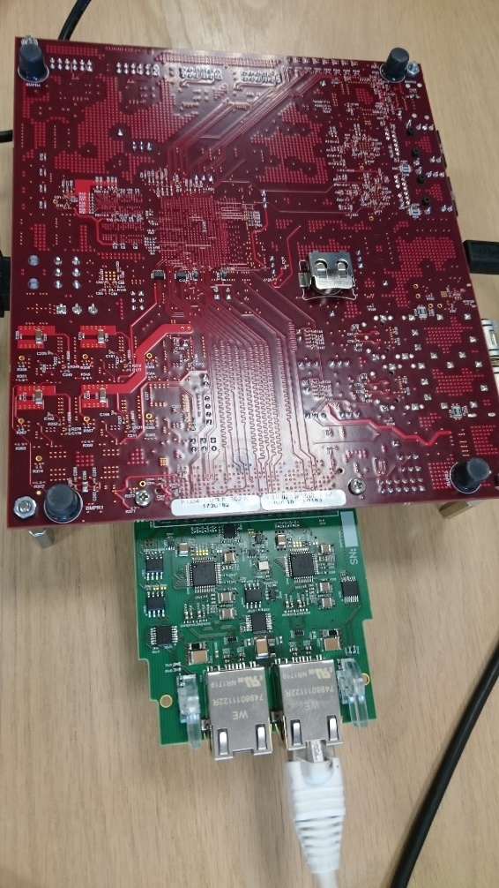
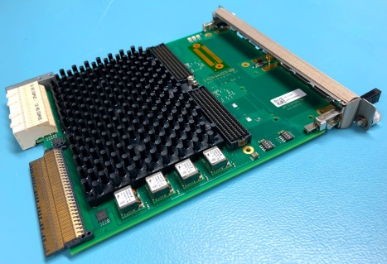
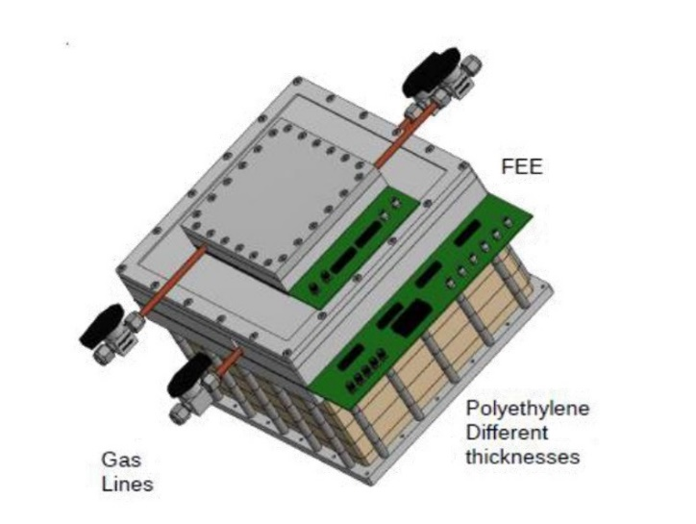
Achievements
  First batch of pre-series of IFC 1410 boards shipped to Lund from Switzerland (IOxOS) w1749
  First prototype of the EtherCat FMC module ready from TUT Estonia, production will start w1750
  Technical contract agreed on with CEA for nBLM implementation and controls

Slide 6
In-kind activities
ICS In-kind activities
Contracts to be signed
Future opportunities

Slide 7
ICS In-kind partners
Partner Institutes
Atomki, Hungary
CEA, France
CNRS/IPNO, France
Elettra, Italy
ESS Bilbao, Spain
IFE, Norway
INFN Catania, Italy
INFN Legnaro, Italy
PSI, Switzerland
STFC, UK
Tallinn Technical University, Estonia
ÚJV Řež, Czech Republic
University of Łódź , Poland
Uppsala University, Sweden
ZHAW, Switzerland
Agreement signed
Agreement waiting for signature
Early discussions
Collaboration/other agreement

Slide 8
ICS in-kind portfolio development
ICS is now in project in execution phase
Future in-kind opportunities are identified for the initital operation phase (commissioning, tests, fine tuning)

Slide 9
Planned in-kind activities
Cryo distribution system controls - CNRS/IPNO
  Advanced discussions
  Extent of scope/cost is being balanced
  Work is ongoing in the context of Accelerator activities
  Signature planned for Q5 2017 (IKRC # 15)
Controls for Drift tube linac - INFN Legnaro
  Contract being reviewed
  Cost book value agreed
  Signature during 2017-12
Detector control system - STFC
  Contract for Detector controls is ready, awaits the high level agreement between UK and ESS
  Work planned for the instruments control technical annex with STFC - RAL

Slide 10

Integrated control system
Thank you for your attention
If you want more information, subscribe to the ICS weekly report

