Slide 1
Status of the
European Spallation Source
Roland Garoby
Technical Director
www.europeanspallationsource.se
December 6, 2017

Slide 2
Construction progress
Project status
Plans for completion submitted to ESS Council
Summary

Slide 3
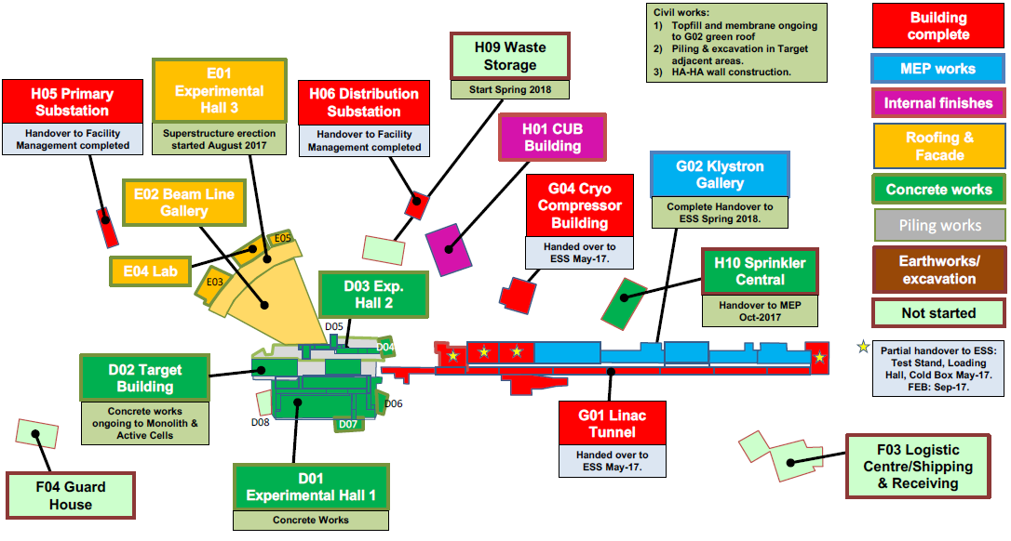
Civil construction status

Slide 4

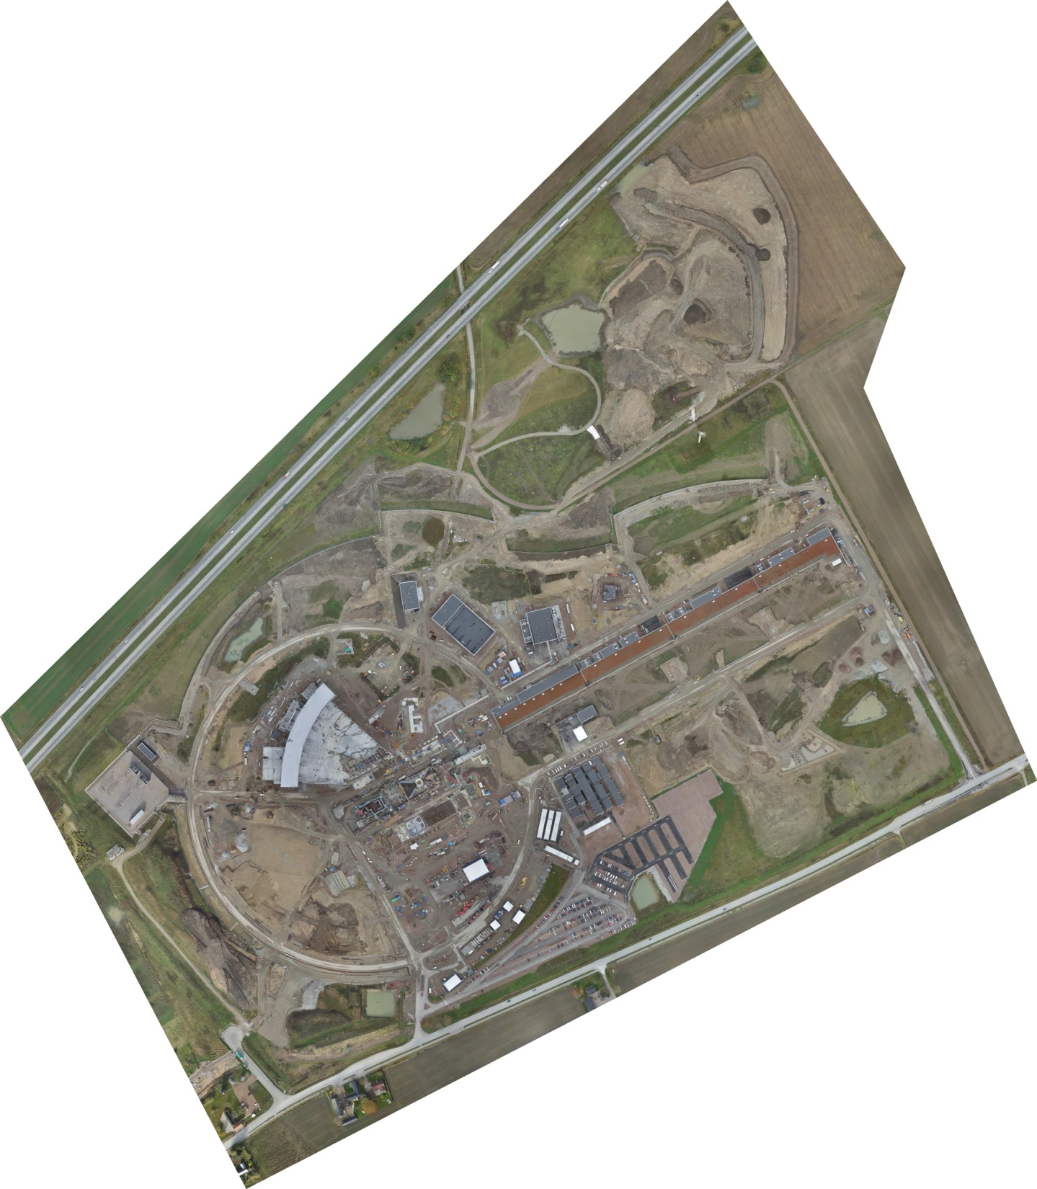
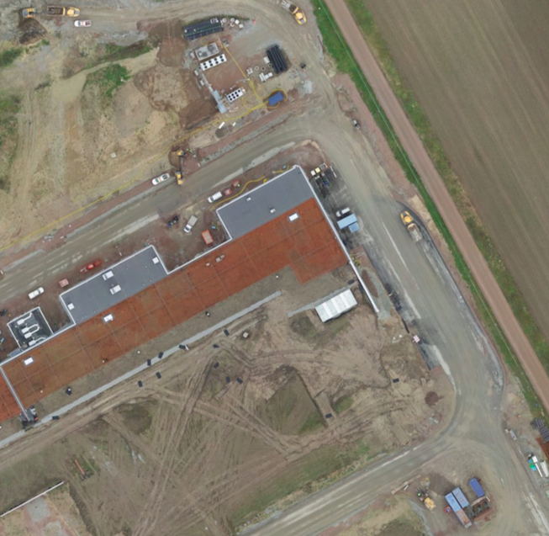
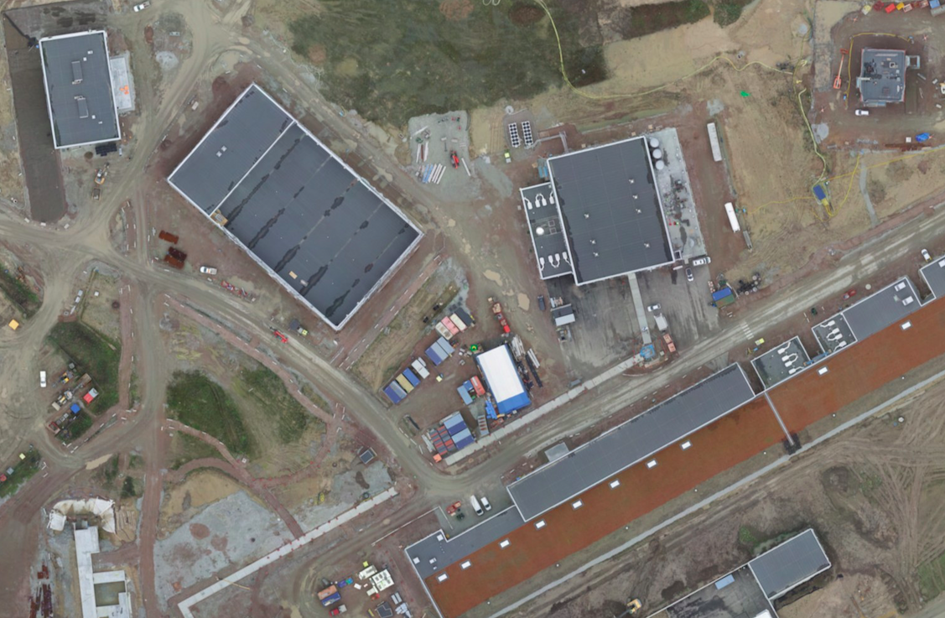
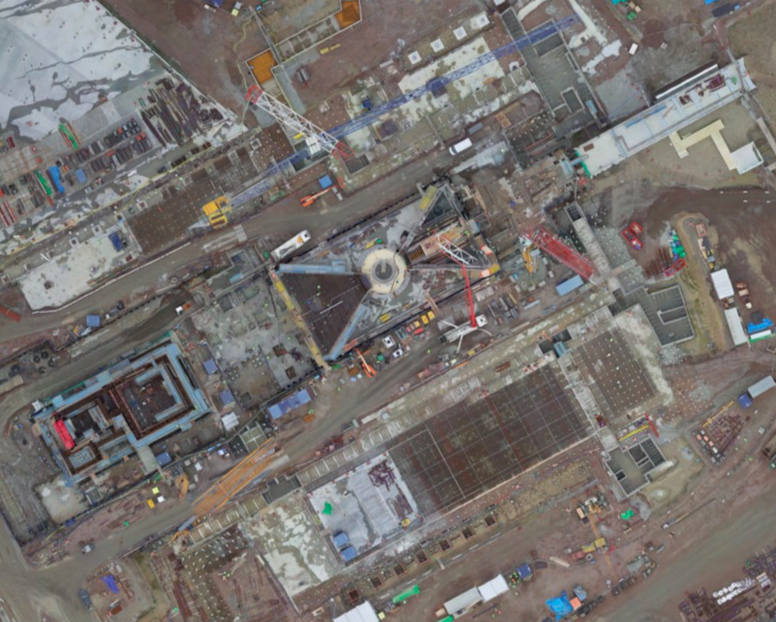
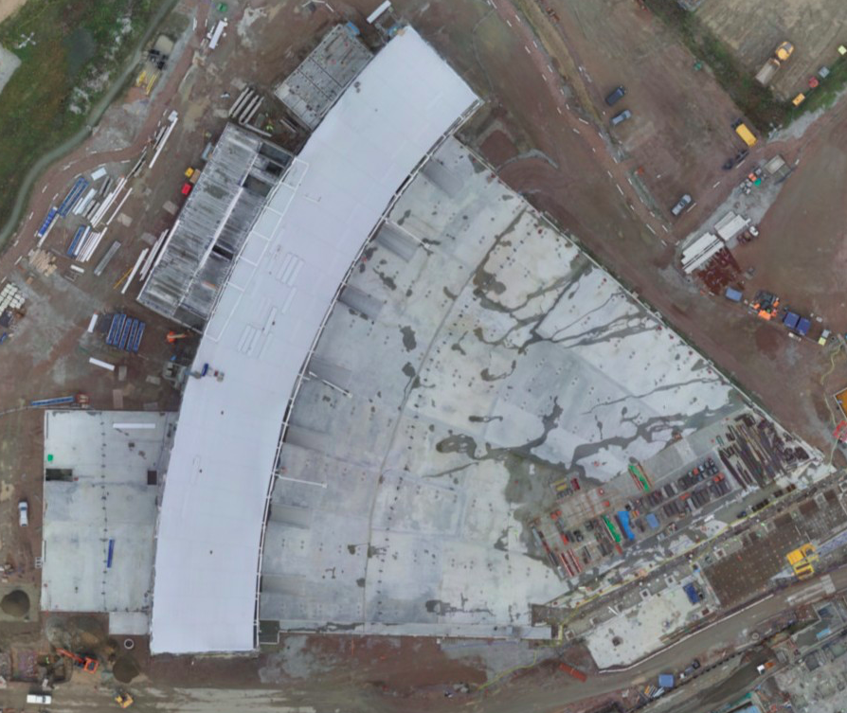
Orthophoto October 2017

Slide 5
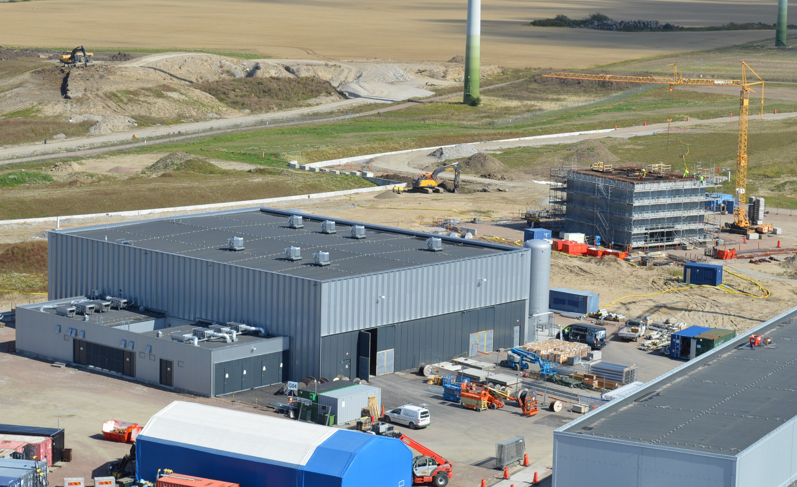
Cryo and Sprinkler Buildings
H10
G04
H01
G02

Slide 6
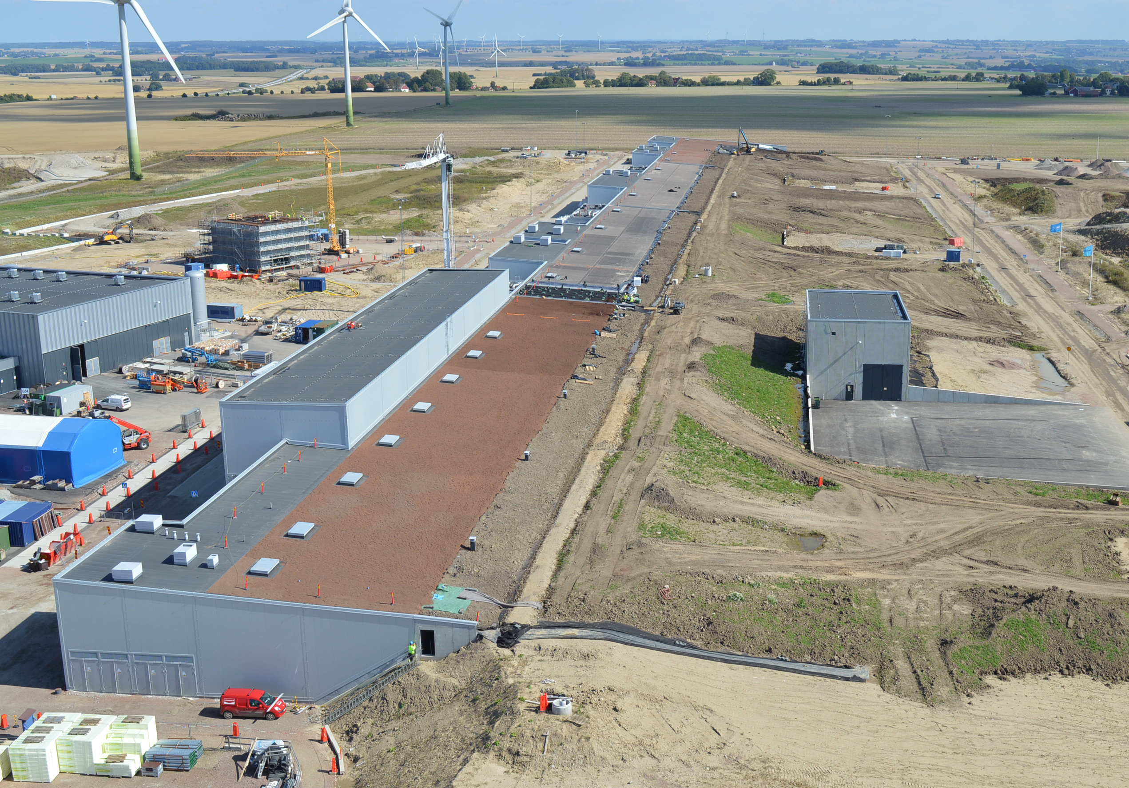
Accelerator & Klystron Gallery

Slide 7
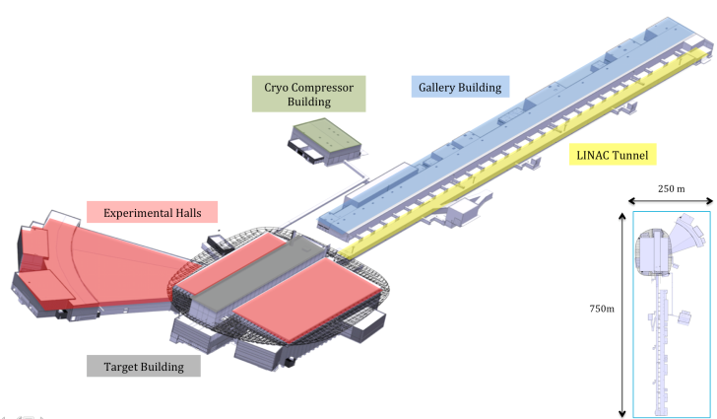
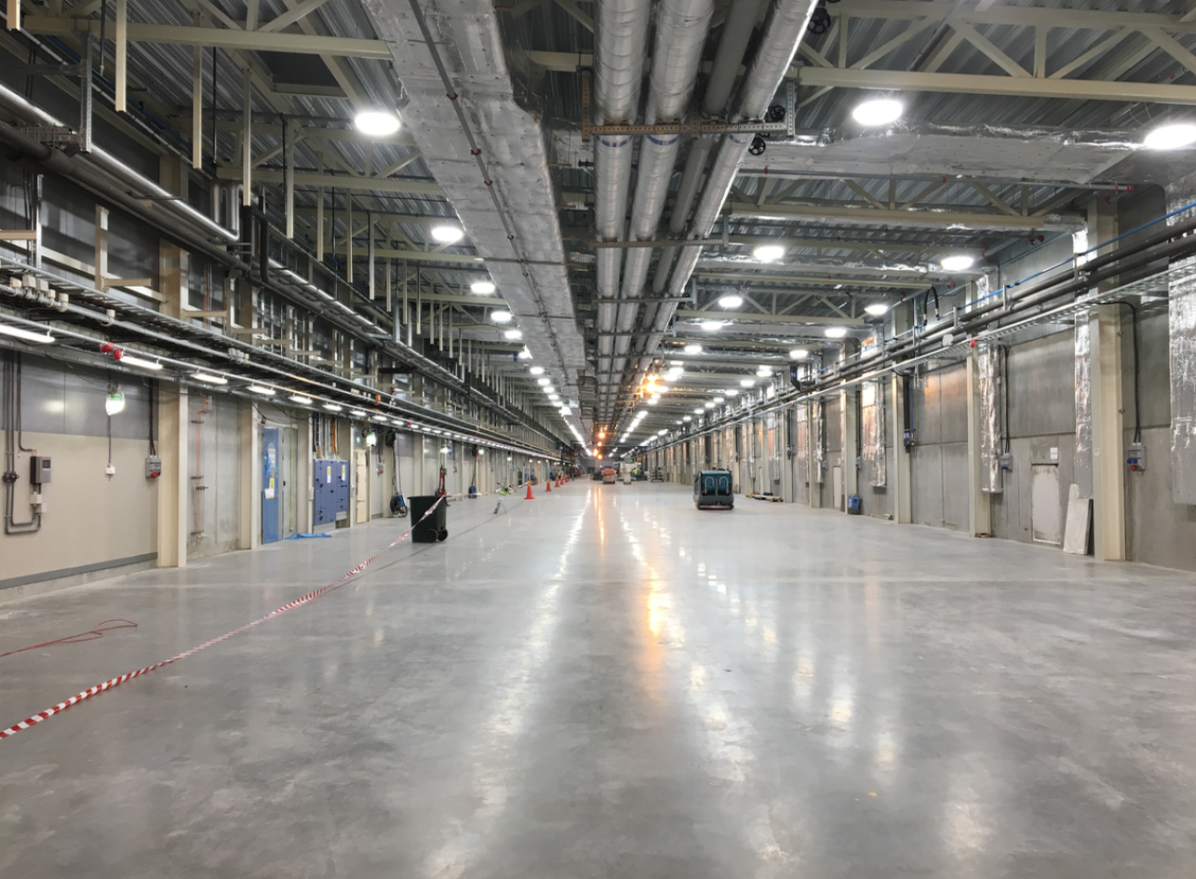
Major Achievements
G02 – Gallery Building:

Slide 8
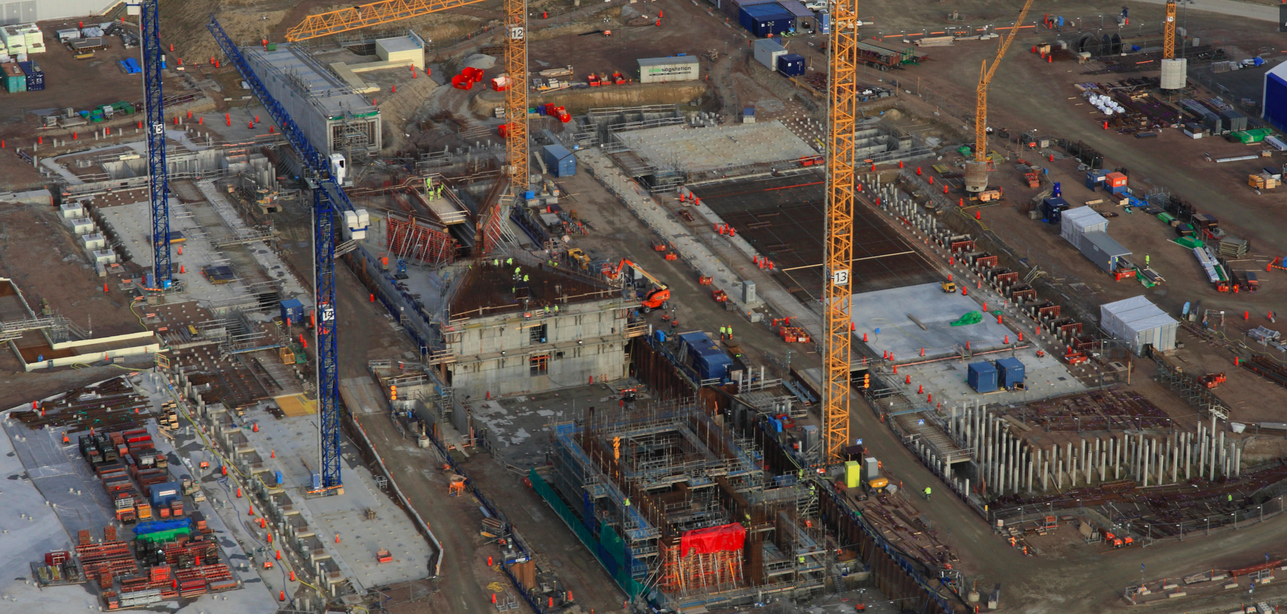
Major Achievements
Target Buildings

Slide 9
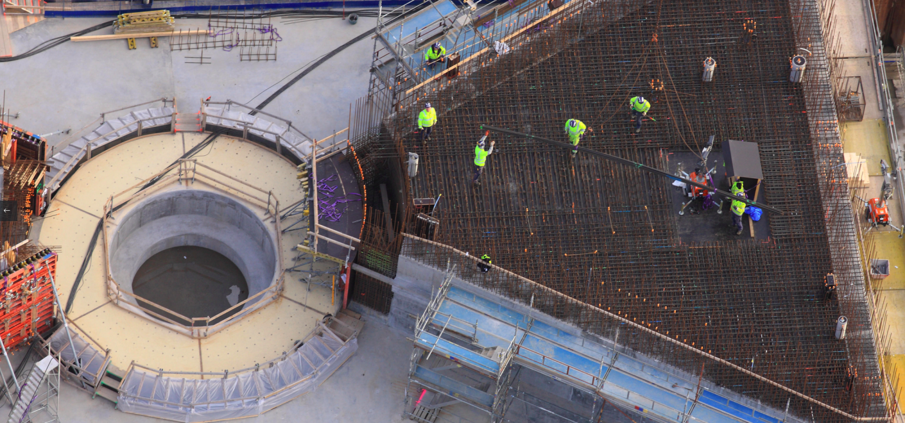
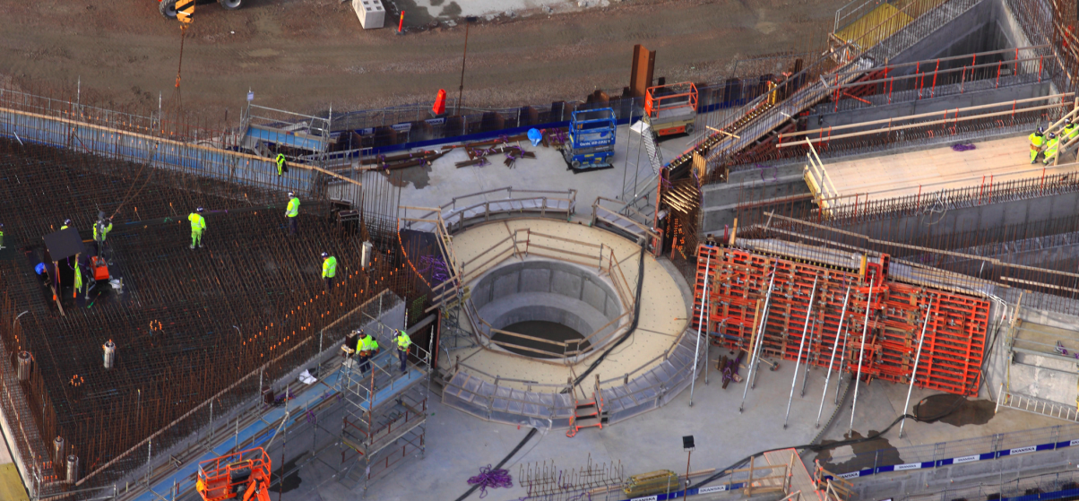
Major Achievements
Target Buildings

Slide 10
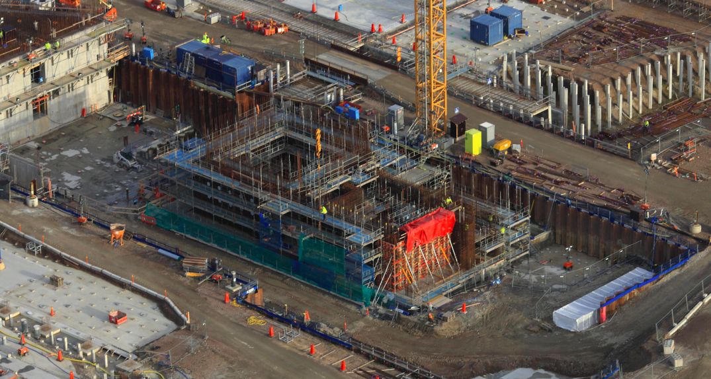
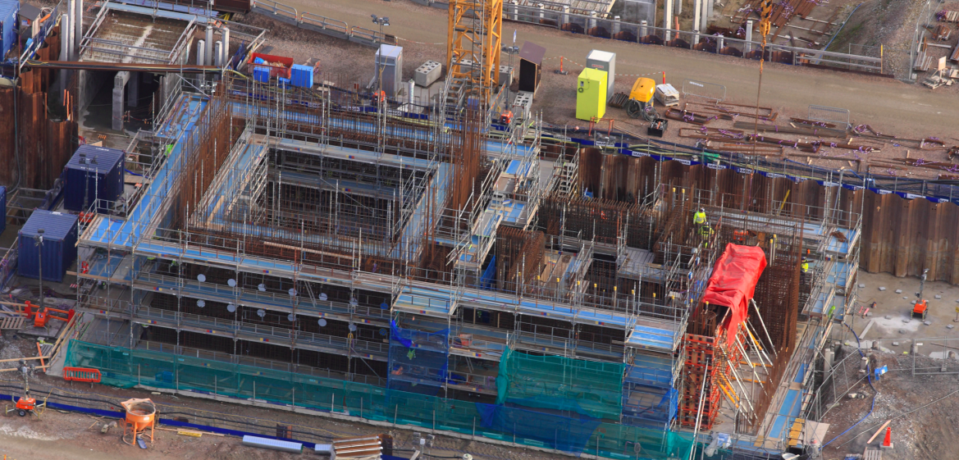
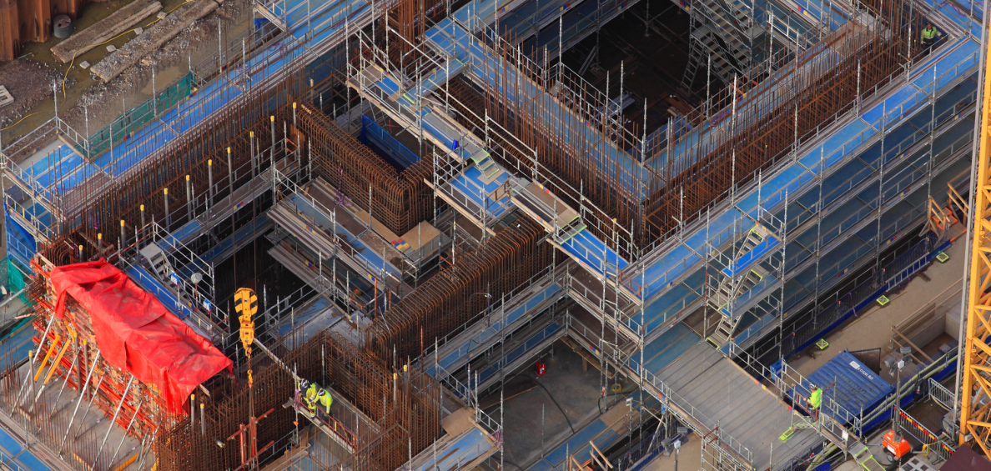
Major Achievements
Active cells

Slide 11
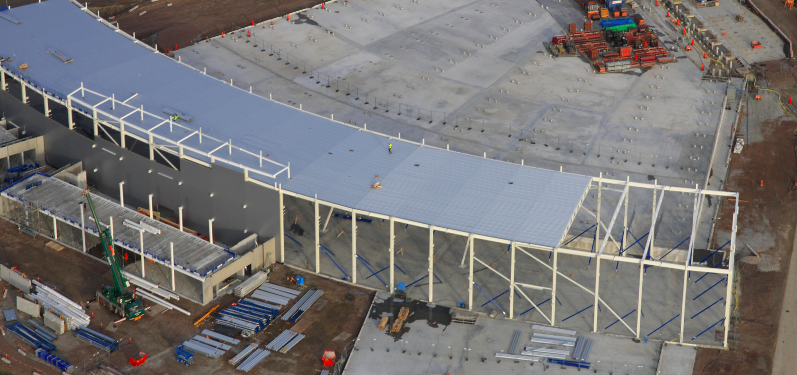
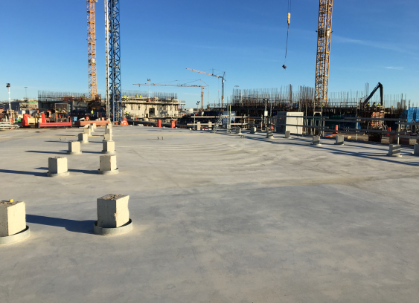
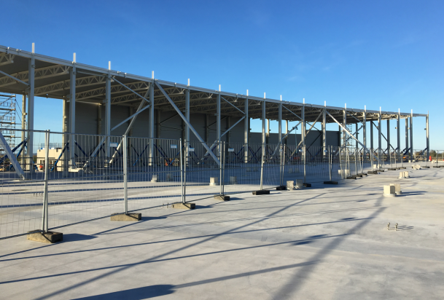
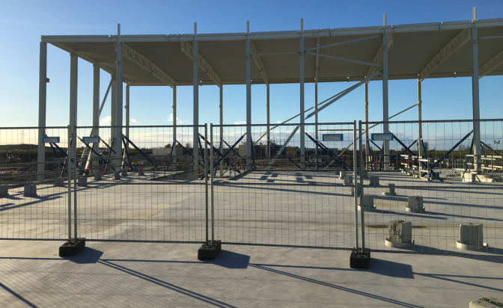
Major Achievements
E buildings: Experimental Halls

Slide 12
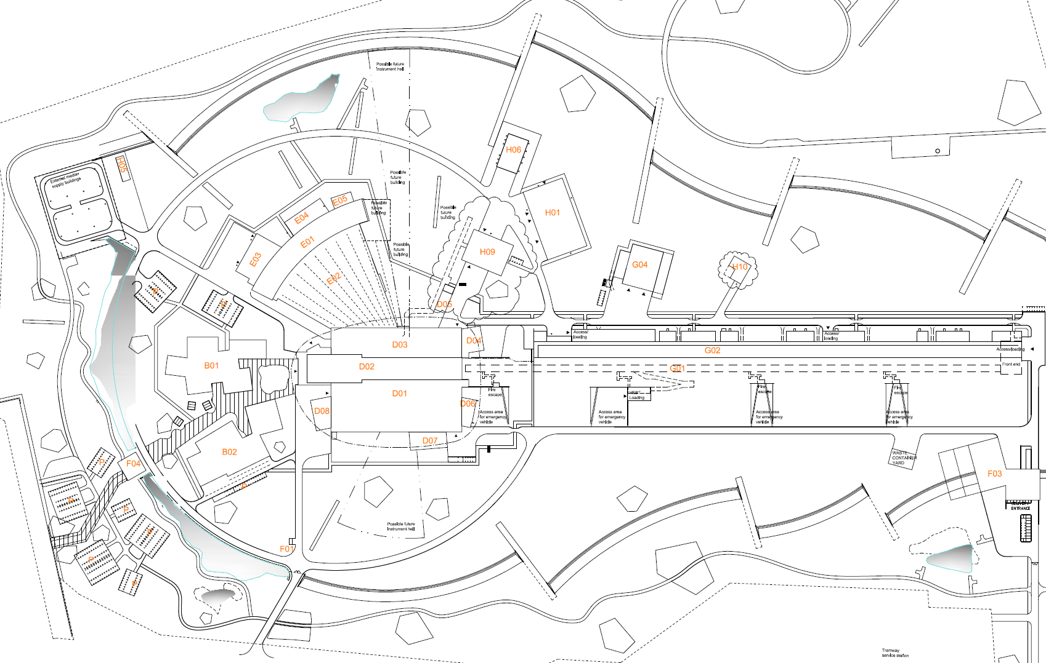
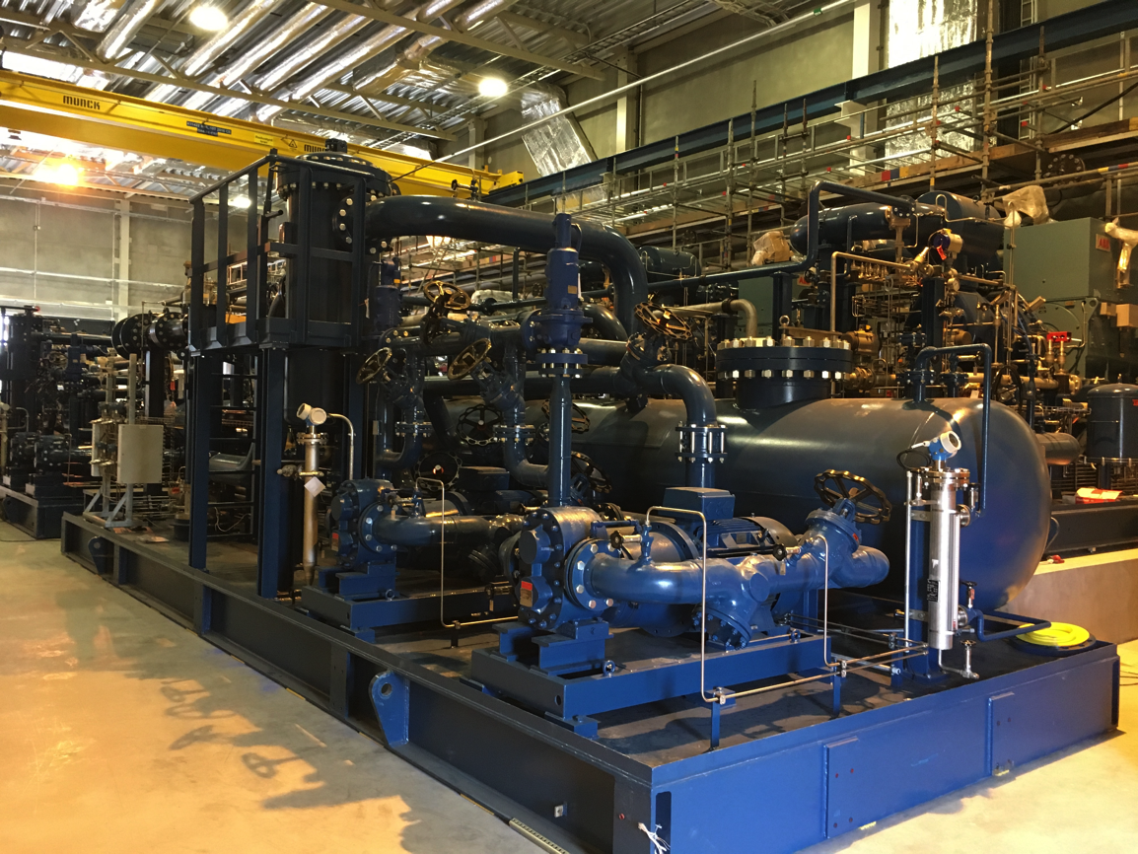
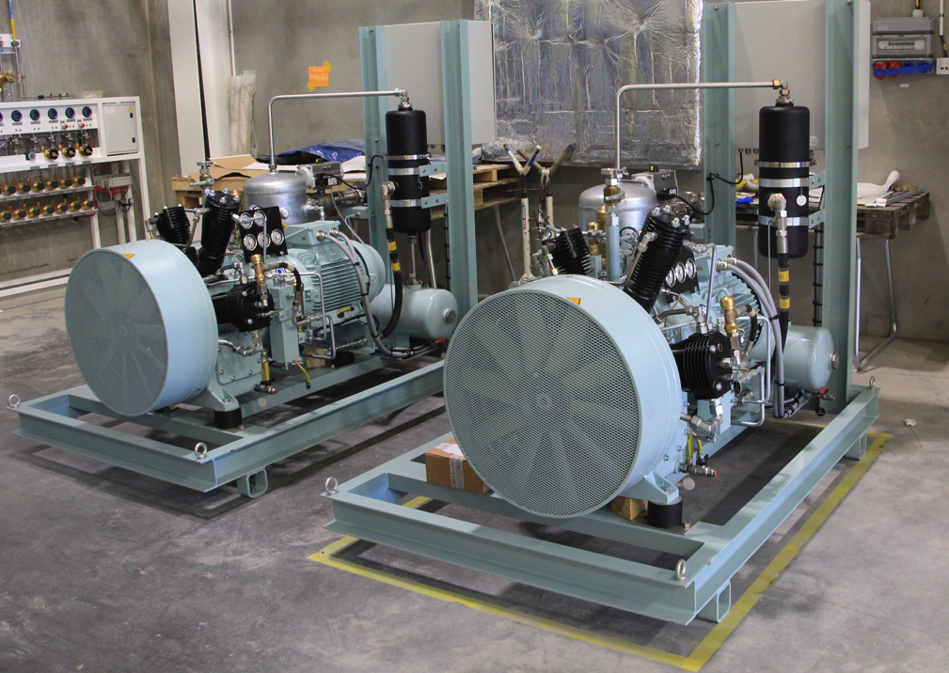
Cryogenic systems are installed in G04
Helium Recovery System Compressors
Helium compressors
and recovery system
ACCP compressors and oil removal system

Slide 13
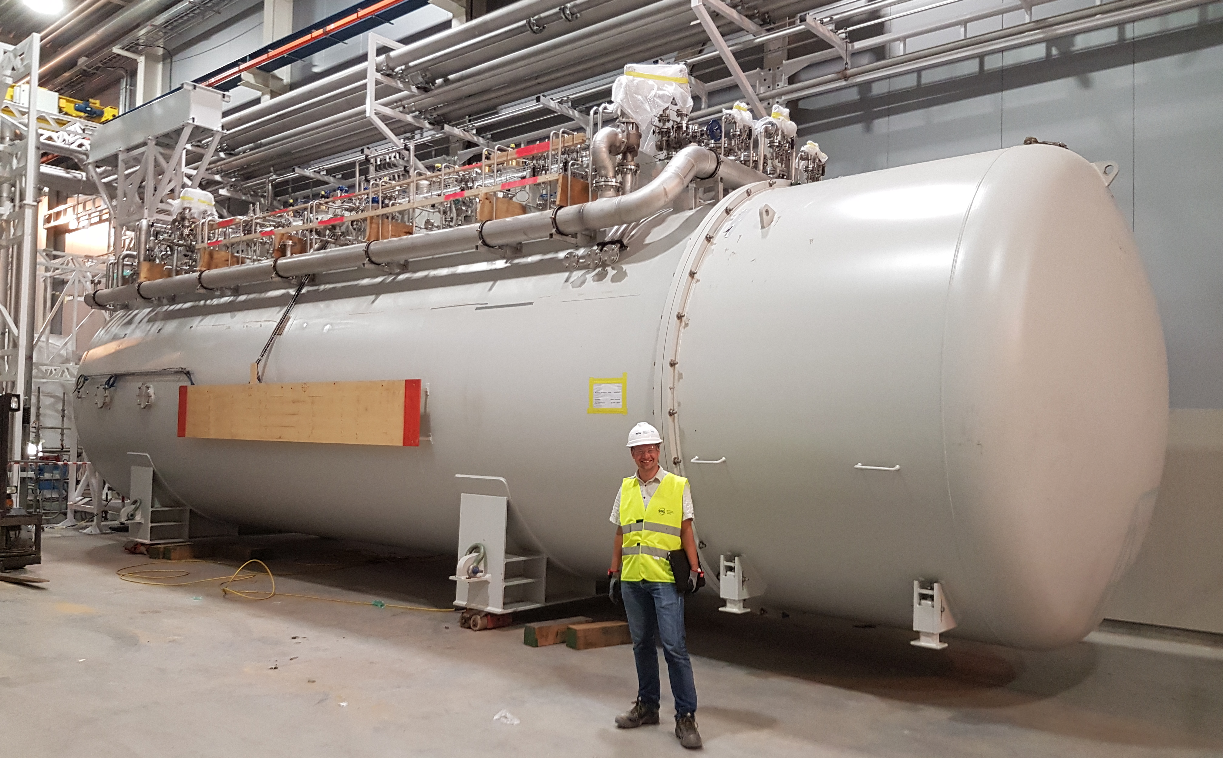
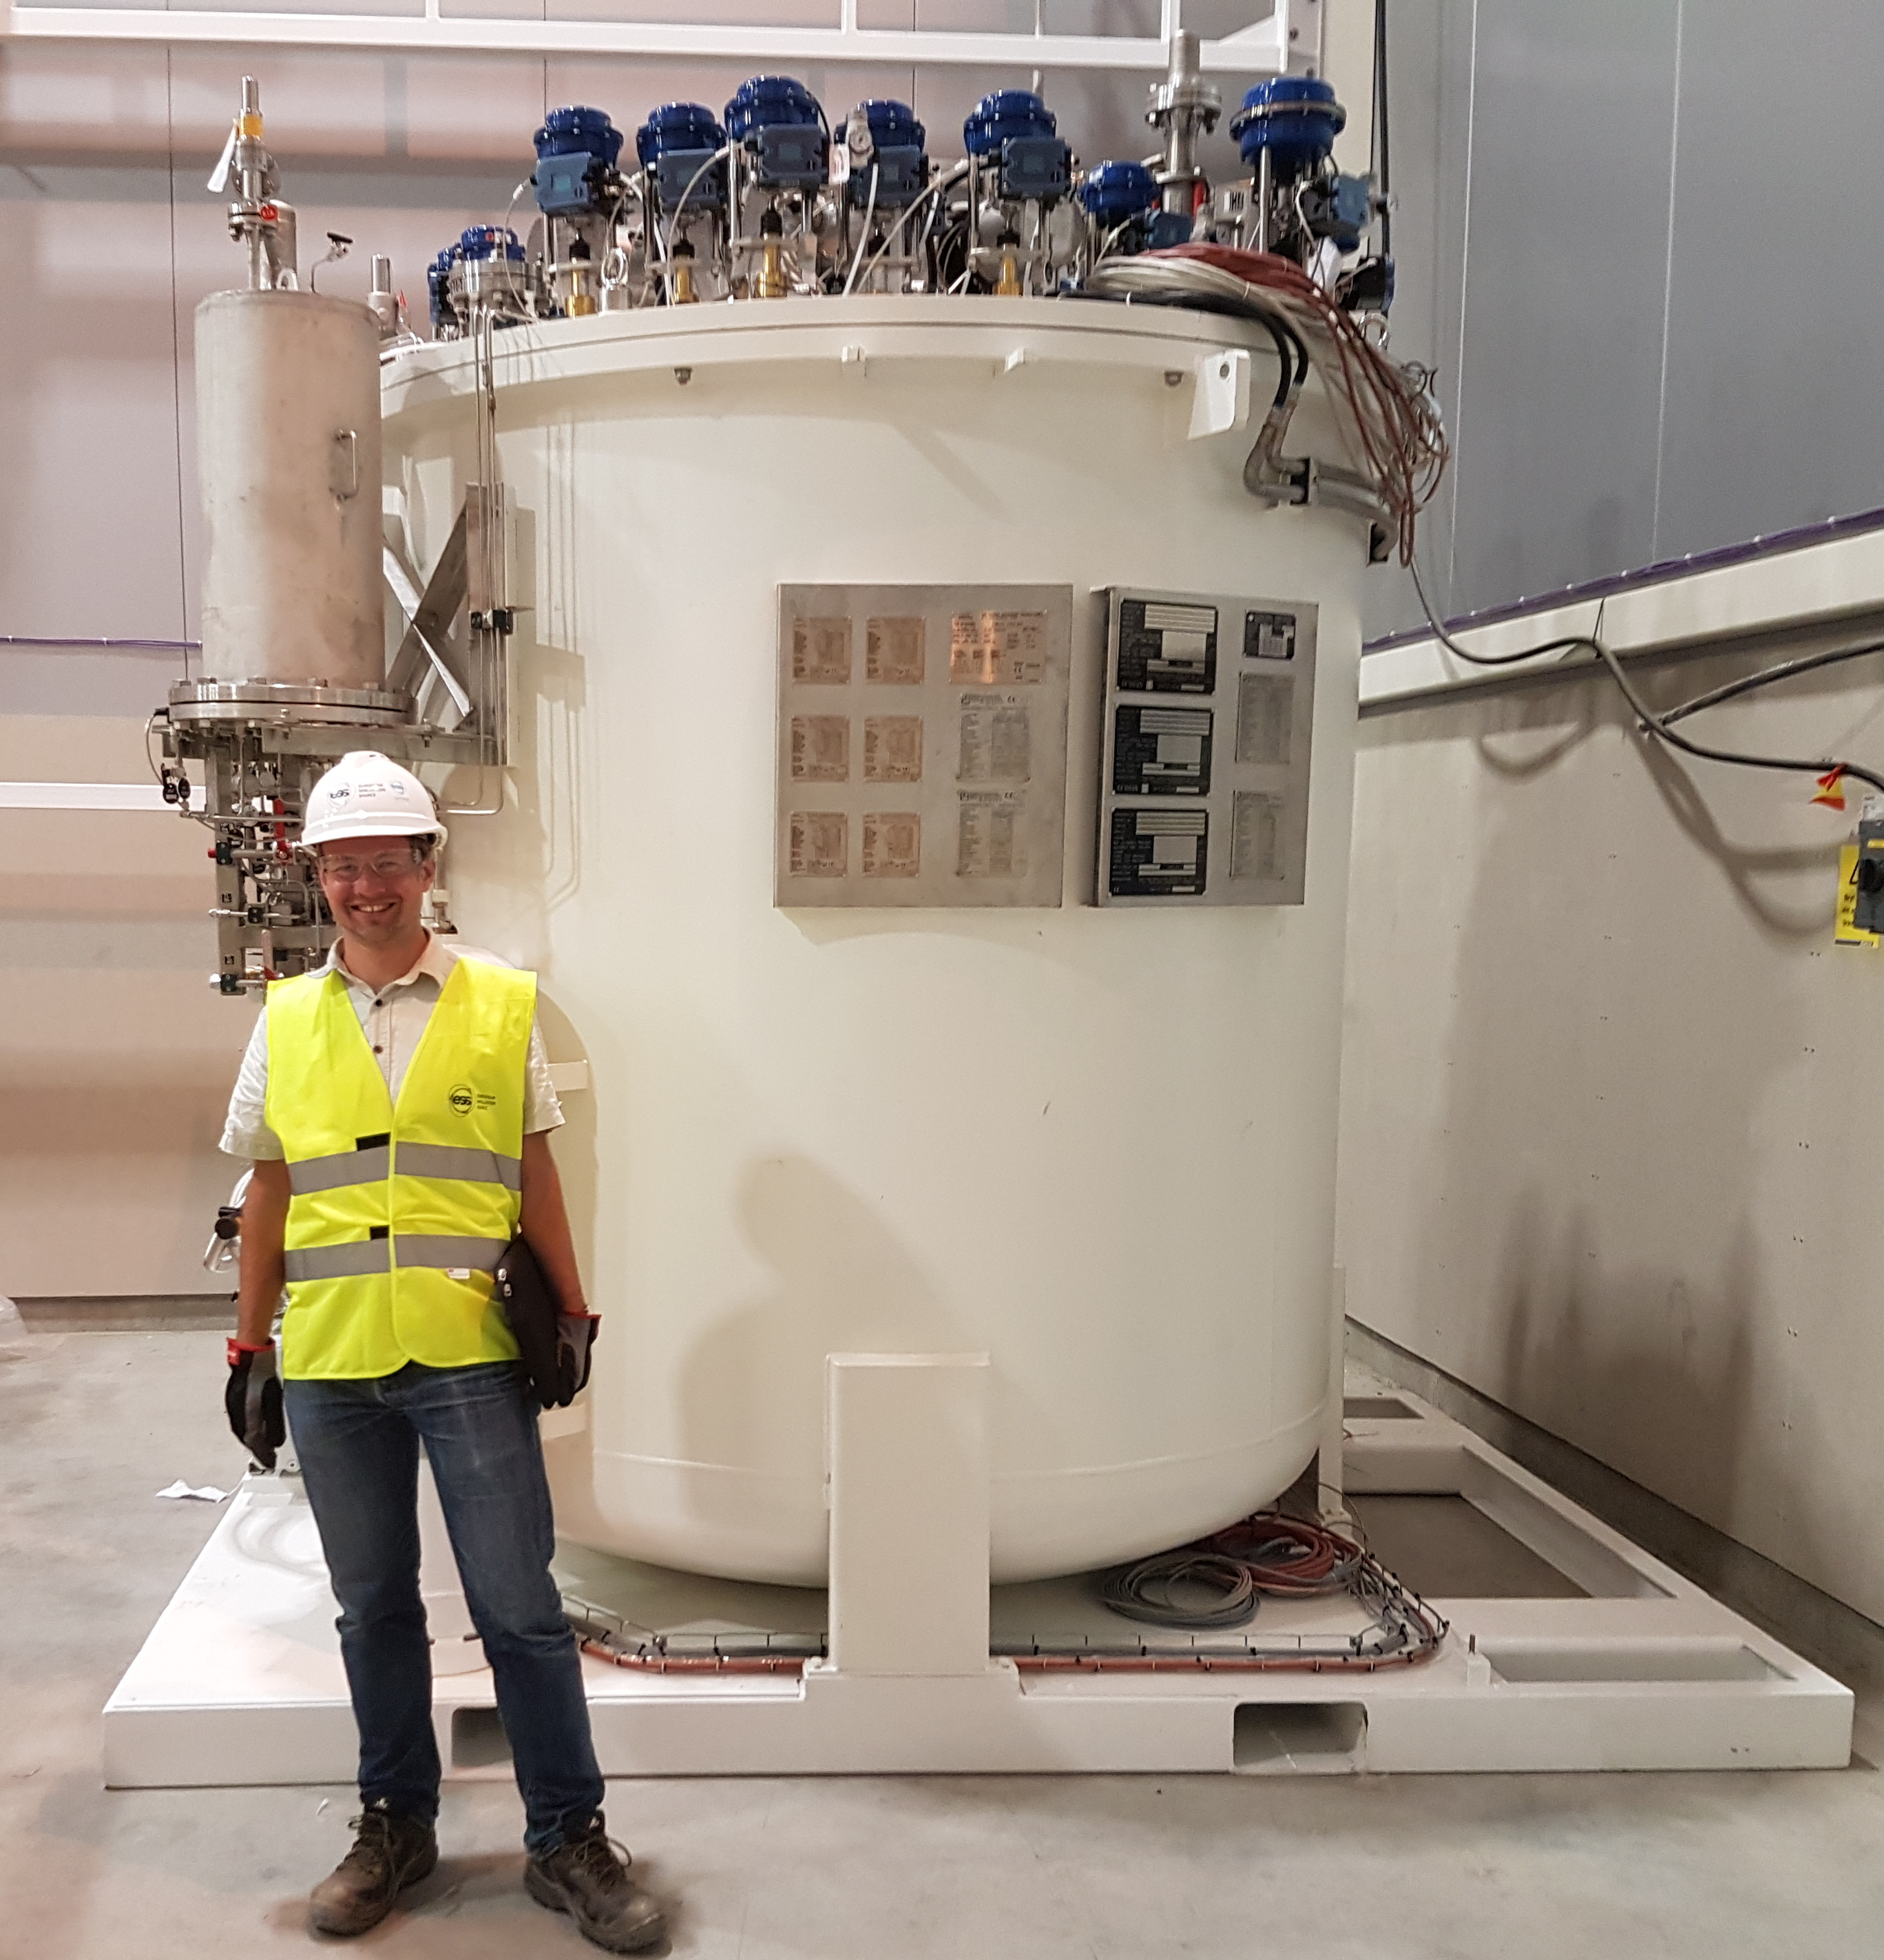
Cold Boxes are installed in G02
TICP cold box
Cold boxes
ACCP cold box

Slide 14
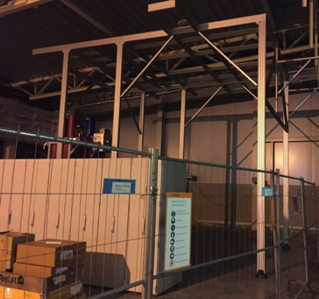
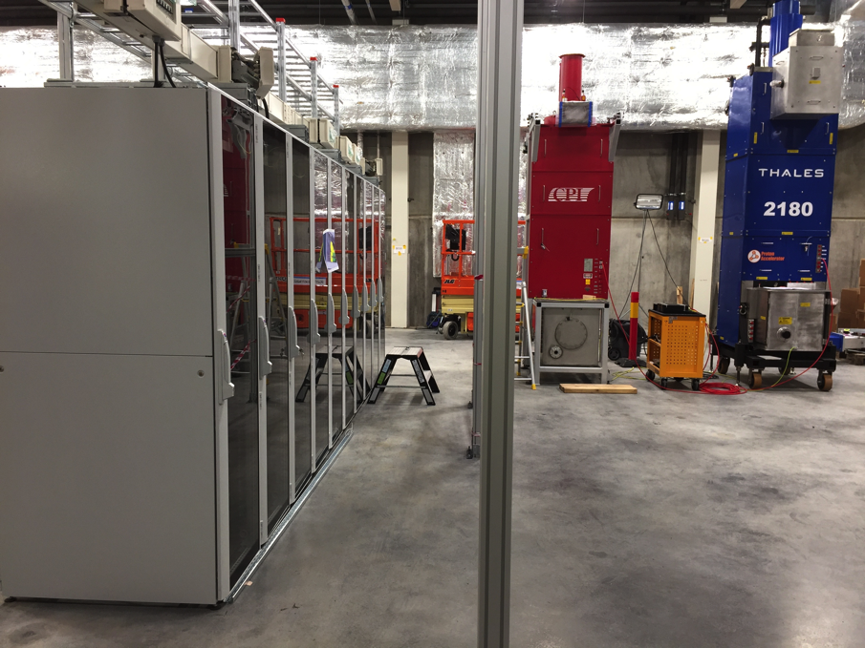
Installation of RF Test Stand 2 in G02
Installation of Racks, Cable Trays and Power Distribution
RF test stand 2
Support structure for RF Distribution System and Water Piping

Slide 15
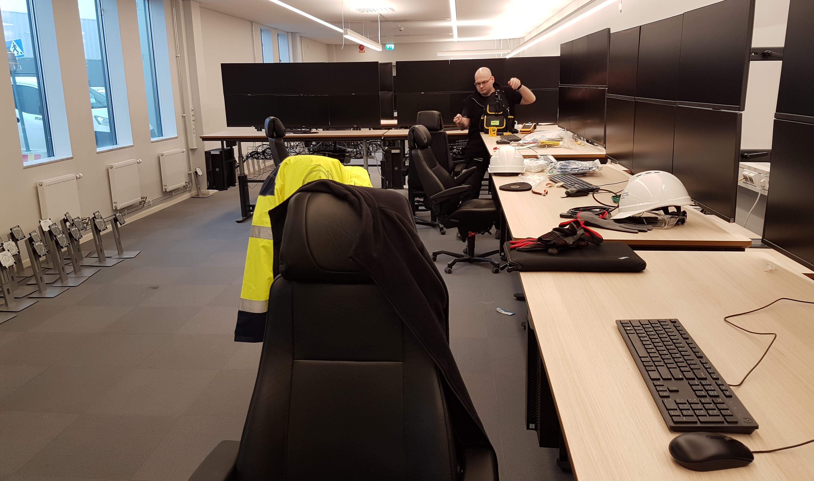
Temporary Control Room
Temporary Control Room

Slide 16
Construction progress
Project status
Plans for completion submitted to ESS Council
Summary

Slide 17
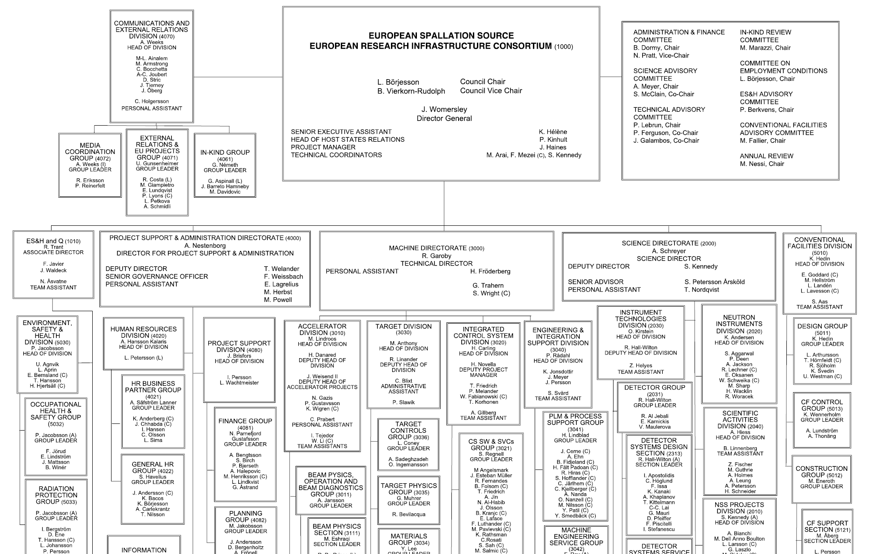


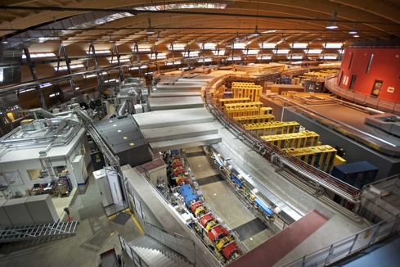
ESS employees (as of 31 Oct. 2017)
426
Employees
50
Nationalities
> 45
Collaborating Institutions

Slide 18
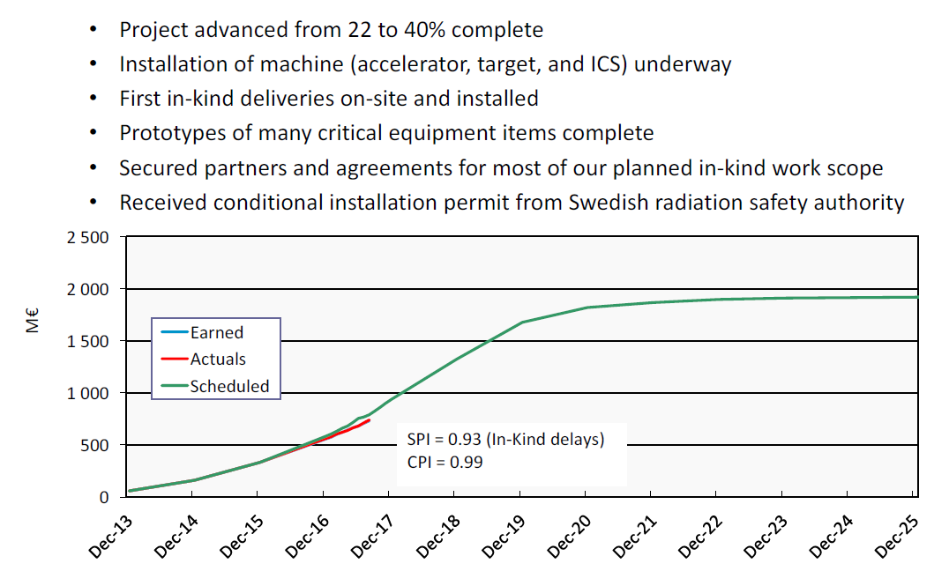
Project progress (EVM)

Slide 19
Construction progress
Project status
Plans for completion submitted to ESS Council
Summary

Slide 20
Comparison of completion scenarios
1843M€₂₀₁₃
1843 + 810M€₂₀₁₃
Scenario 2
Funding in place
Scenario 3
Approved budget
Scenario 1B
Scenario 1A
Scenario 1B
+ 10% additional operations
Scenario 3
+ % upgrades
+ % new instr.
Scenario 1A
Scenario 2
+ upgrades
+ new instr.
Construction
Initial operations
Upgrades and completion of construction

Slide 21
Annual Review conclusions
(similar to SAC’s)
Scenario 1A… “is not only extremely unlikely to deliver “early scientific success”, it is incapable of achieving long-term scientific success without additional funds to develop the ESS.”
Scenario 1B… “has no clear path to achieving the long-term vision articulated by the ESS and these minimal capabilities would undoubtedly disappoint the scientific community.”
Scenario 2B… “provides a clear path to a sustained program of instrument construction and upgrades that the Committee believes is crucial to a successful scientific facility…but a very challenging ramp-up of the accelerator power would likely stress the resources of ESS and its partners, which may in turn impact the reliability that the community expects from a neutron facility.”
Scenario 3B …”supports the early scientific and technical goals of the ESS, and provides sufficient resources to attain reliability goals. Importantly, this scenario also provides a program of continuous improvement that is an Essential attribute of a successful scientific facility.”

Slide 22
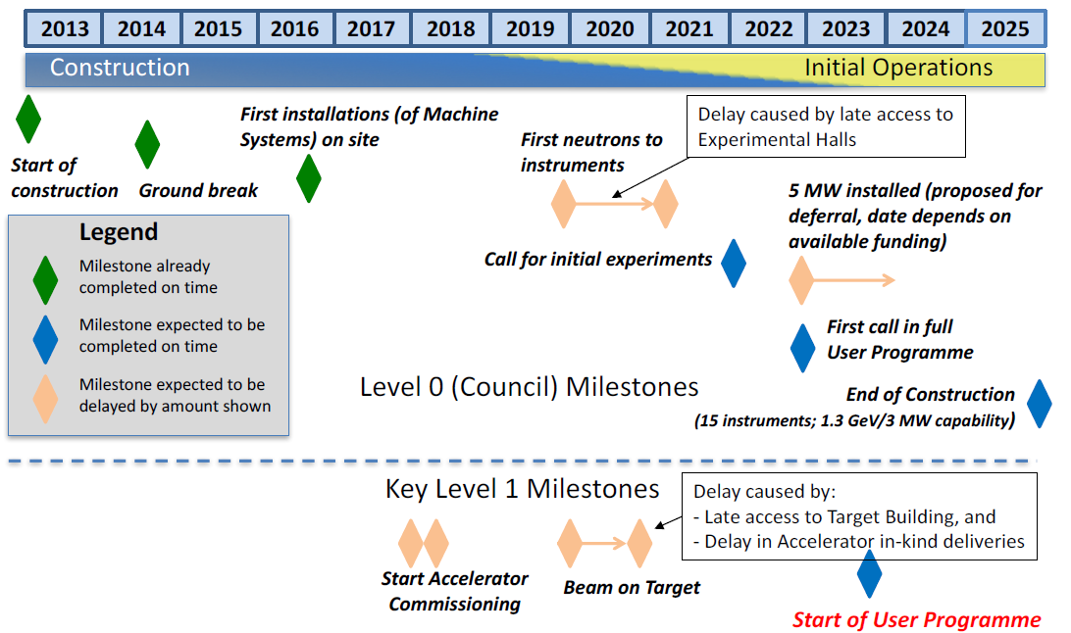
Updated schedule (Oct. 2017)

Slide 23
Construction progress
Project status
Plans for completion submitted to ESS Council
Summary

Slide 24
Summary
Construction continues to make excellent progress
  ~ 40% complete
High tech equipment is arriving and installation is beginning
Conditional permit has been granted by SSM for installing equipment capable of producing ionising radiation
All ESS staff will move to the construction site in 2018
On track for:
  Start of initial operations in 2019
  Instrument commissioning in 2021
  User access for science beginning in 2023

Slide 25
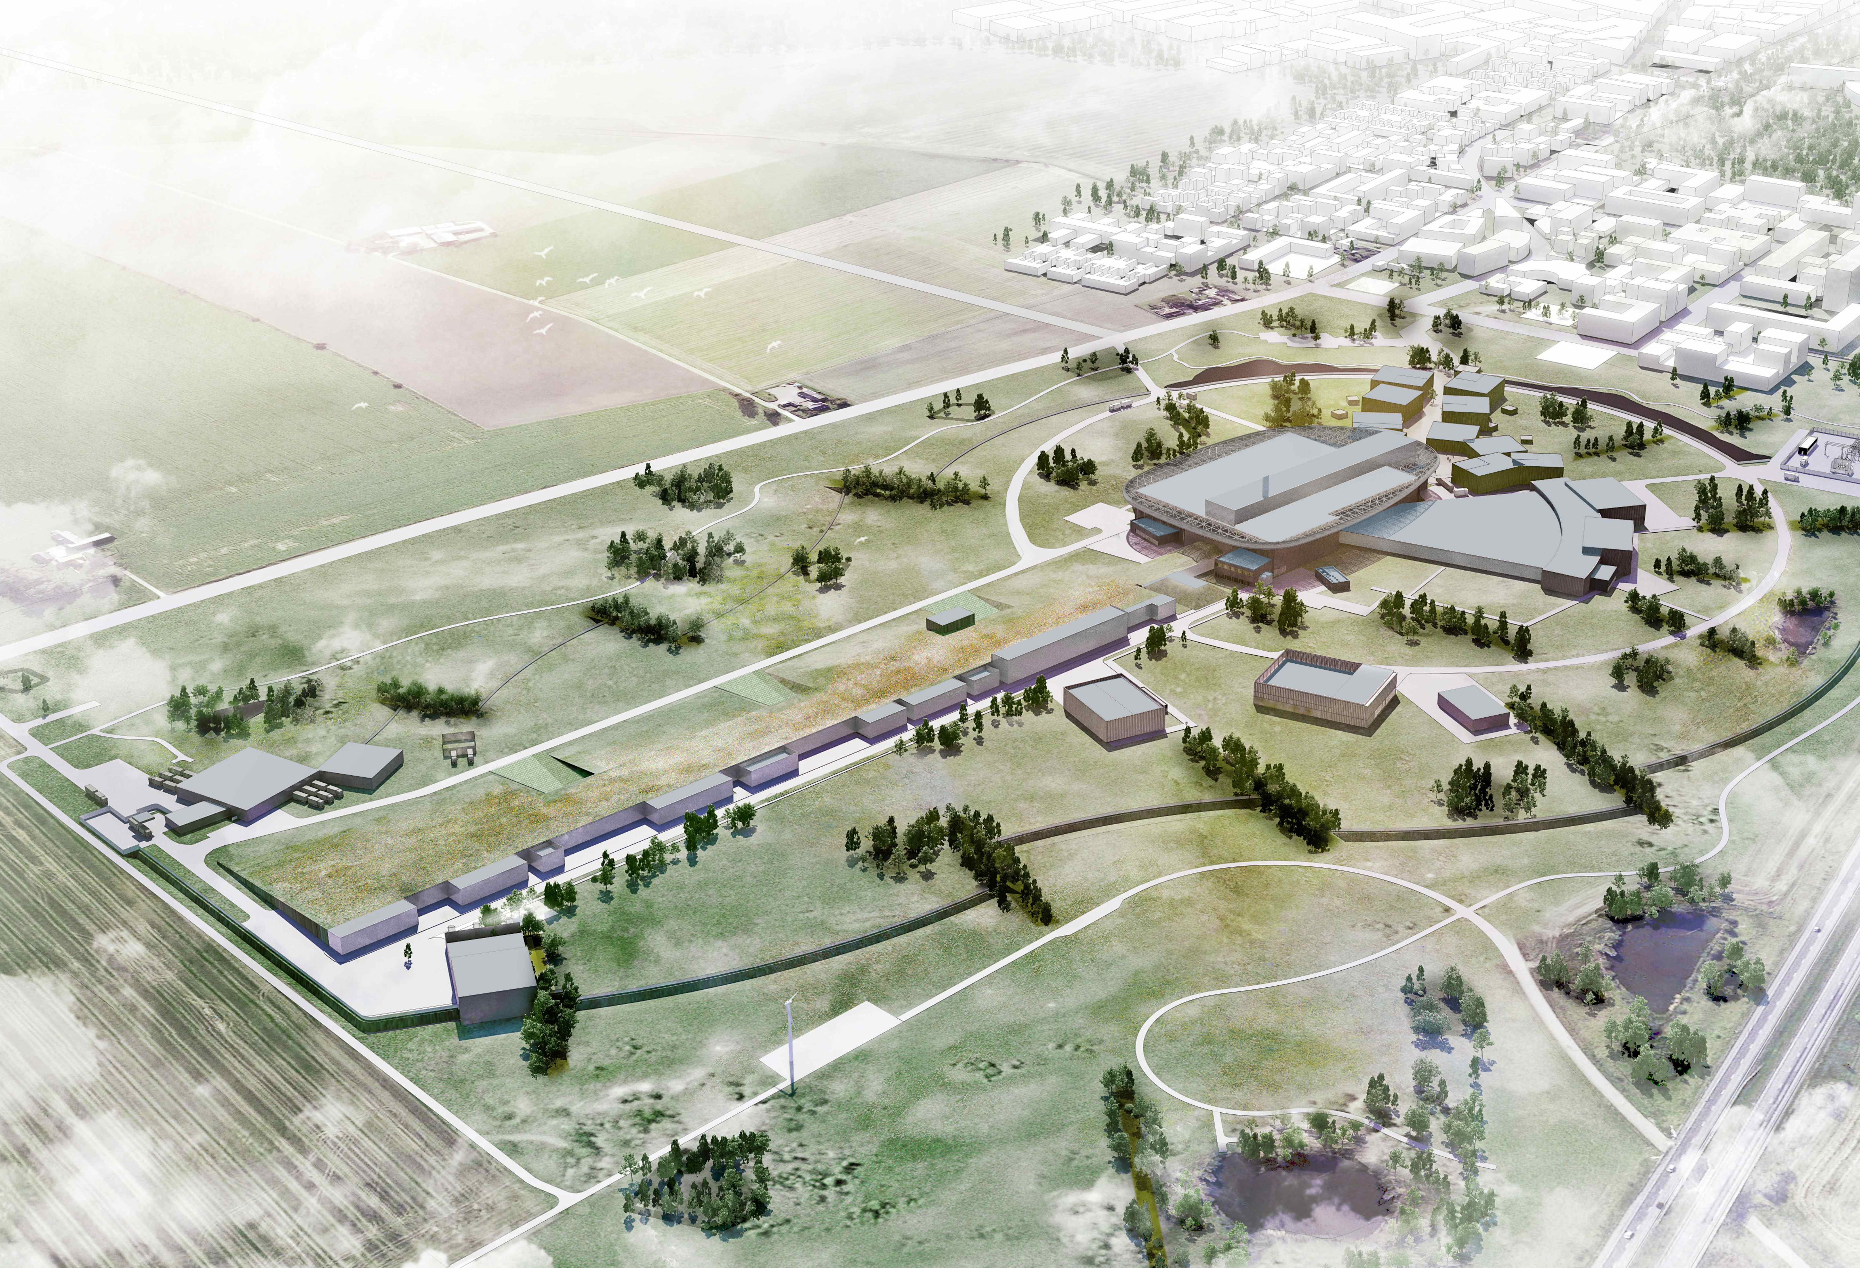
Thank you
for your attention!

