Slide 1





Status of MultiGrid Detector Development for CSPEC and TREX
Anton Khaplanov
Isaak Lopez Higuera
www.europeanspallationsource.se
Sep 28, 2017

Slide 2

Outline
B10 detector development
Multi-Grid detector Characterization highlights
  Intrinsic background suppression
  Gamma sensitivity
  Current development
Multi-Grid ToF results from CNCS, SNS
Engineering the Multi-Grid
MG.CNCS
MG.SEQ
Conceptual design for CSPEC

Slide 3


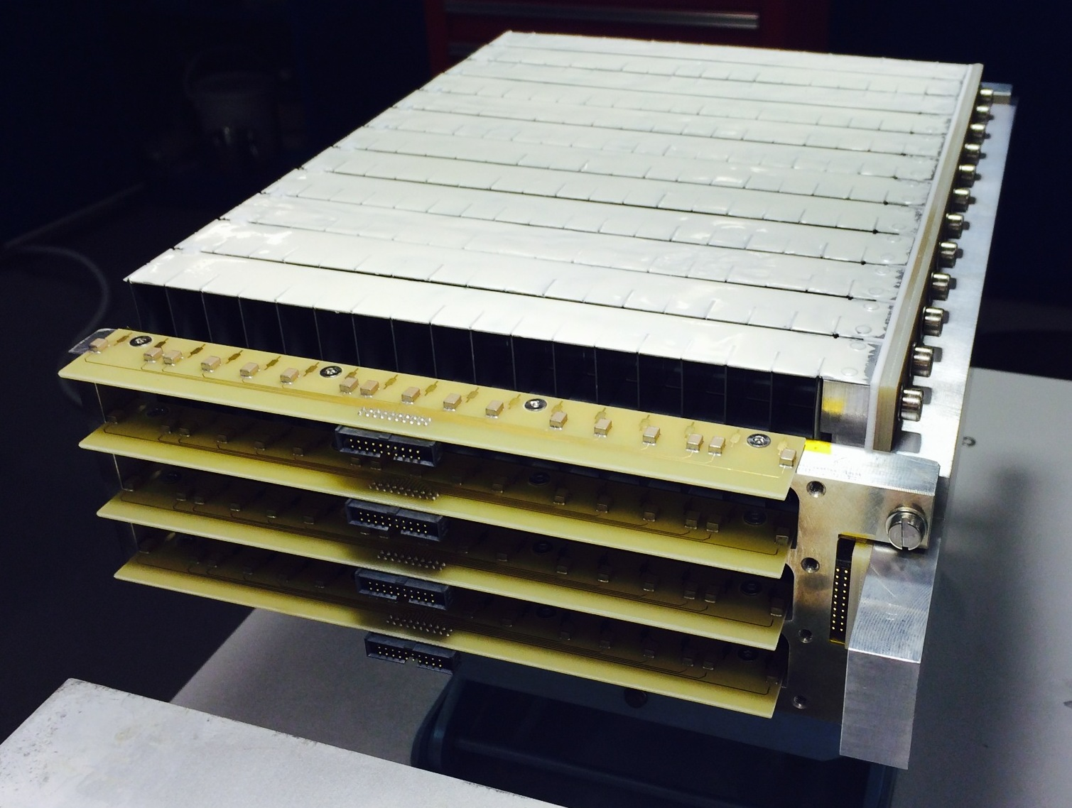
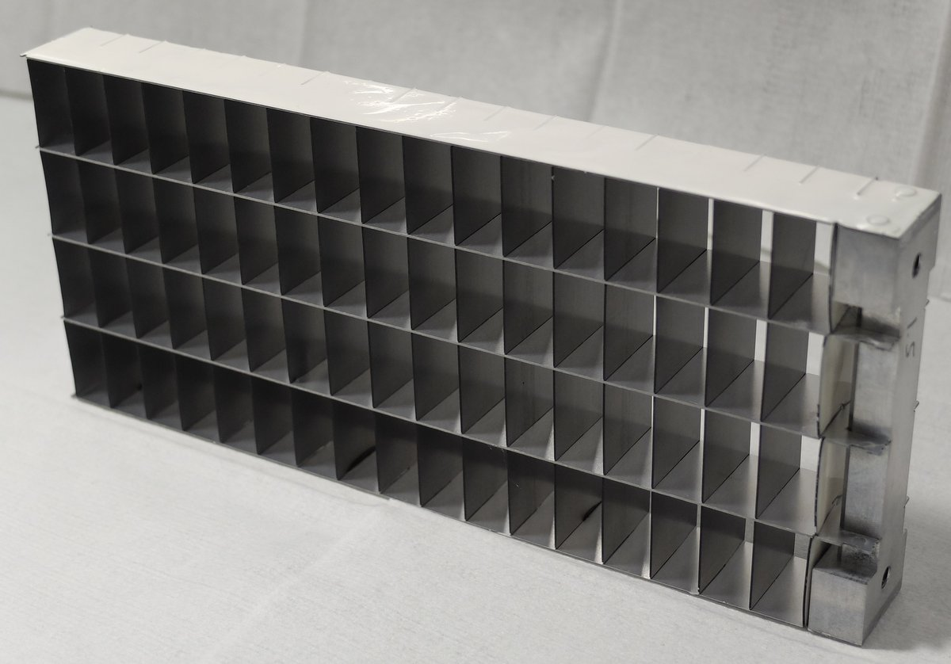
B10 Detectors as Alternative to He3
gas
n
conversion
fragment 2
n
fragment 2
fragment 1
~5% efficiency
in 1 layer
fragment 1
gas
Multi-Grid:
Multiple layers at normal incidence
B-10 film
on both sides
Anode wires
Al substrate
n
n
Large area
Low cost
Modular
High total efficiency
Many layers – lower local rate
No need for resistive readout – low gain
Introduced at ILL, jointly developed by ILL and ESS under CRISP project,
now under BrightnESS

Slide 4
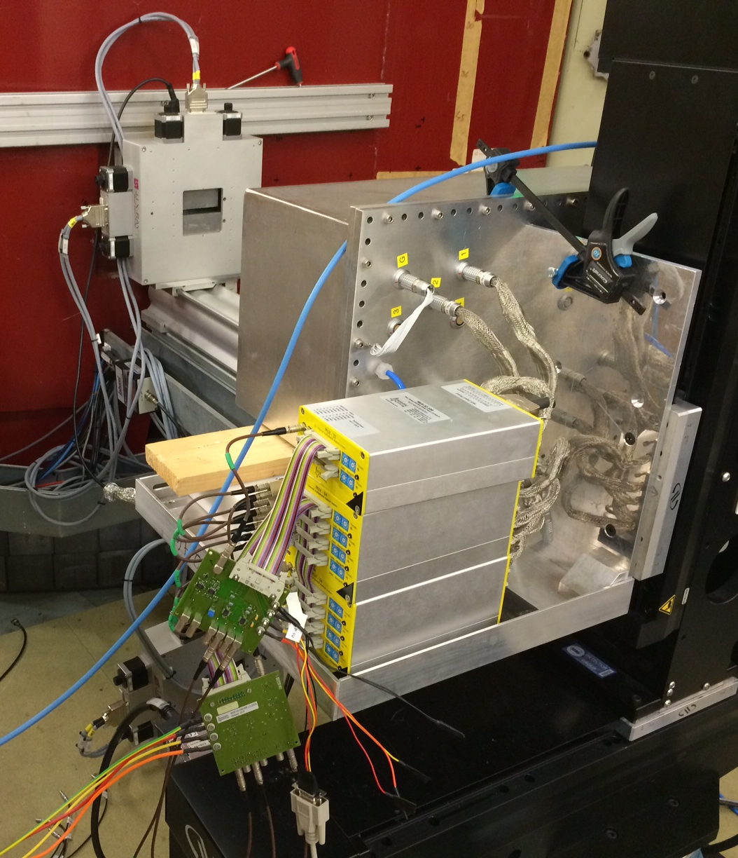
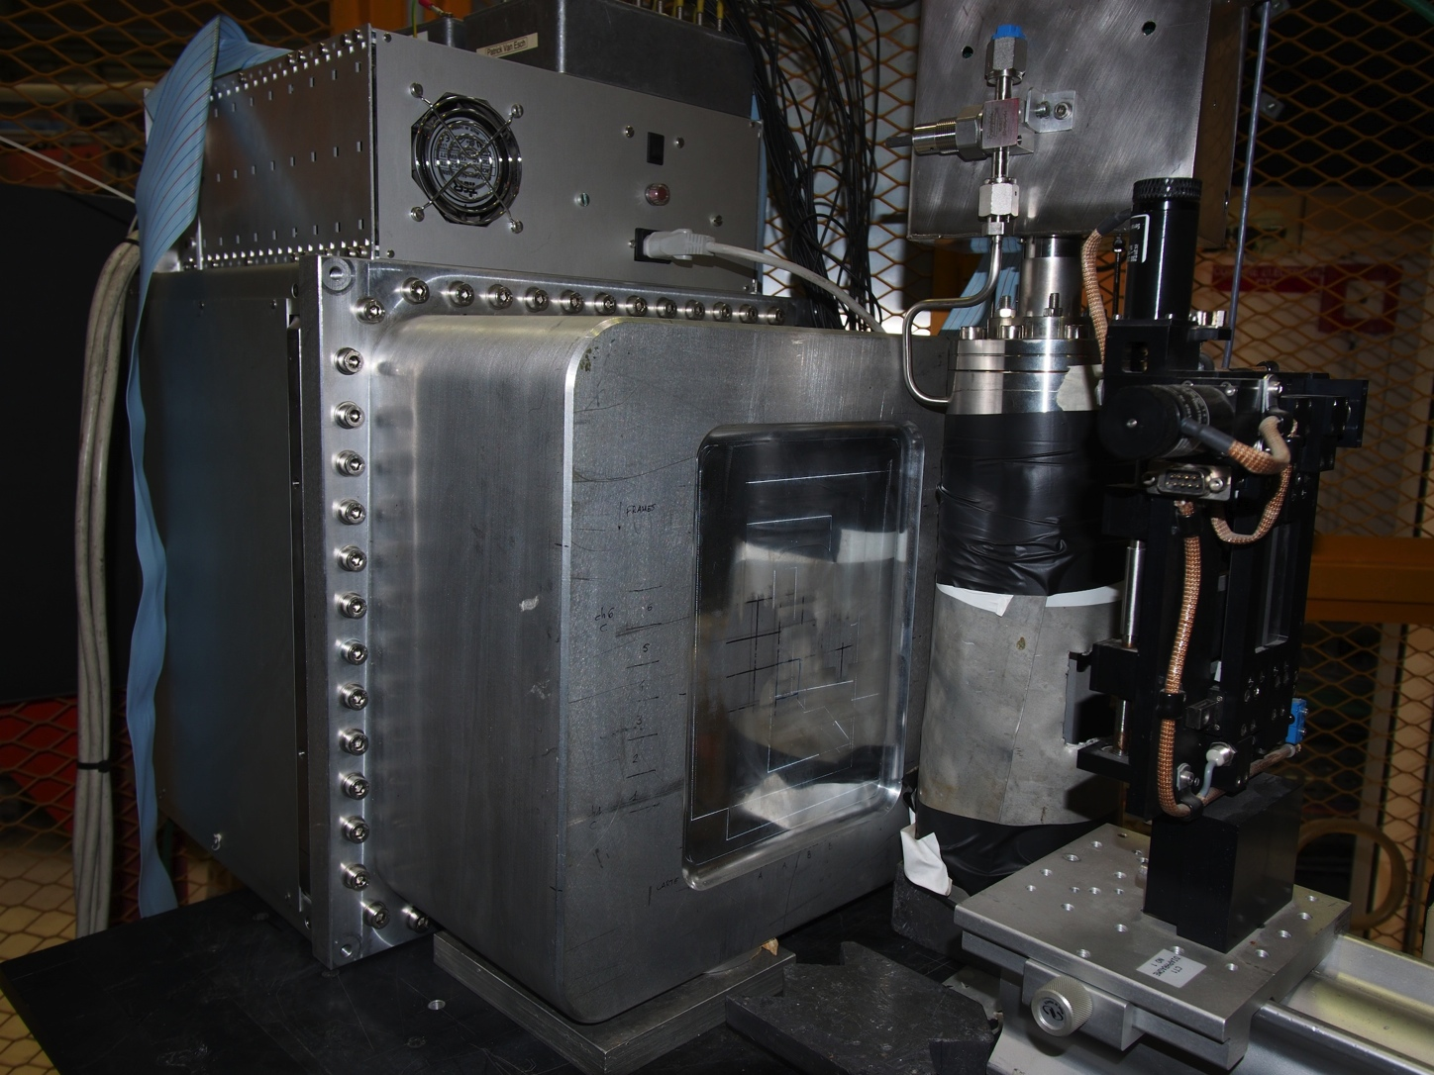
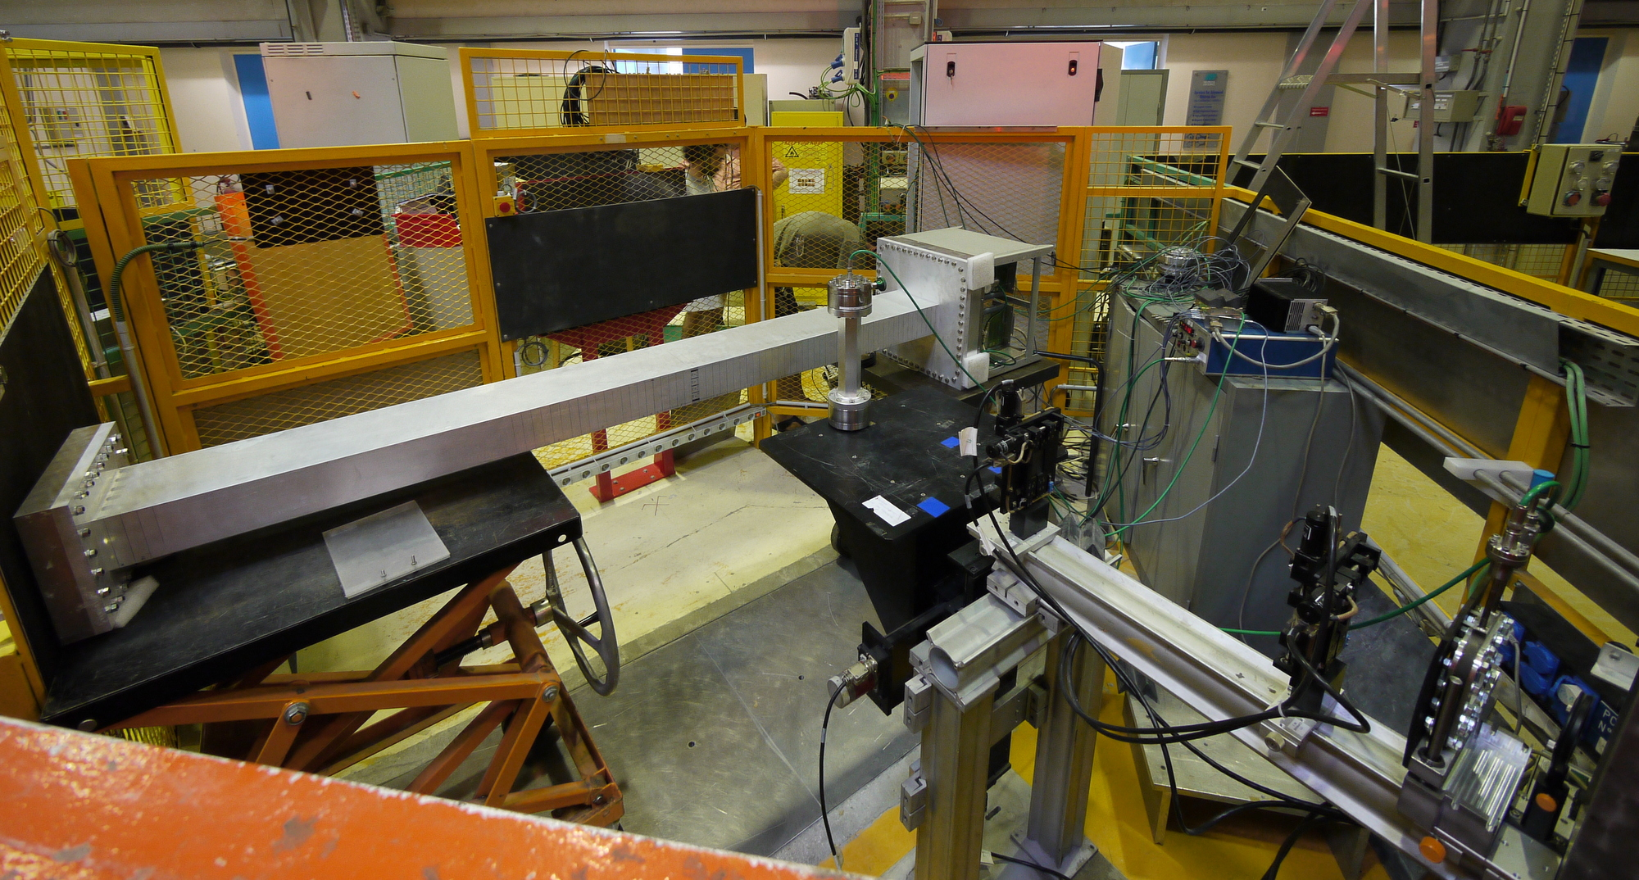
Multi-Grid Prototypes for Characterization
Measurements:
Absolute efficiency
Uniformity
Position reconstruction
γ sensitivity
Rate tests
Ageing
MG.24 @R2D2 @IFE
Proto 1 at CT1 @ILL
Proto 2 at CT2 @ILL

Slide 5
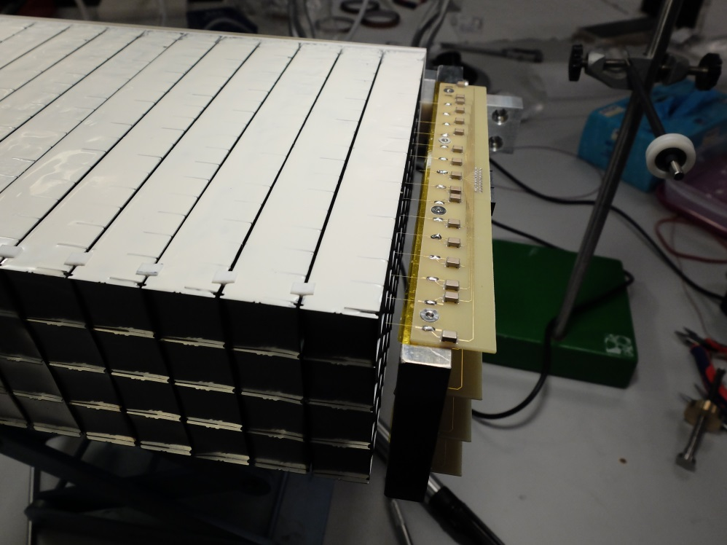
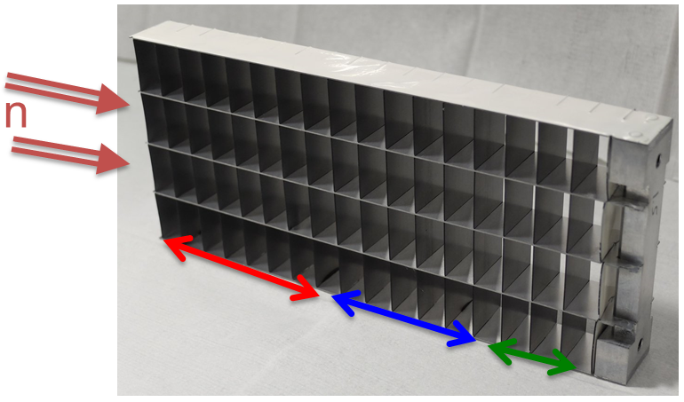
Multi-Grid
How it works: Grid
Grid
Column assembly
n
Layer thicknesses for cold spectrometer optimization used at MG.CNCS and applies to CSPEC(16 blades):
7 blades 0.5μm,
7 blades 1.0μm,
3 blades 1.5μm
For thermal optimization 20 blades total:
4 blades 1.0μm,
10 blades 1.25μm,
6 blades 2.0μm.
Notes:
In the Multigrid, rather than a casette we have grids, each grid has 17 voxel per column and 4 columns. Each voxel is 22.5x22x11mm. In case we aim for thermal neutrons, we would have 21 voxels. The vertical blade of each voxel is coated, so the neutrons travel perpendicularly to that blade. The layer thickness is optimized for the position in the grid, so not all blades have the same thickness, this allows us to increase effectivity. In the middle of every voxel we have the wire (composition of the wire, microns, resistive?). So when we have the signal, we will know exactly in which position we are with the 2 coordinates, wire and voxel, X and Y.

Slide 6
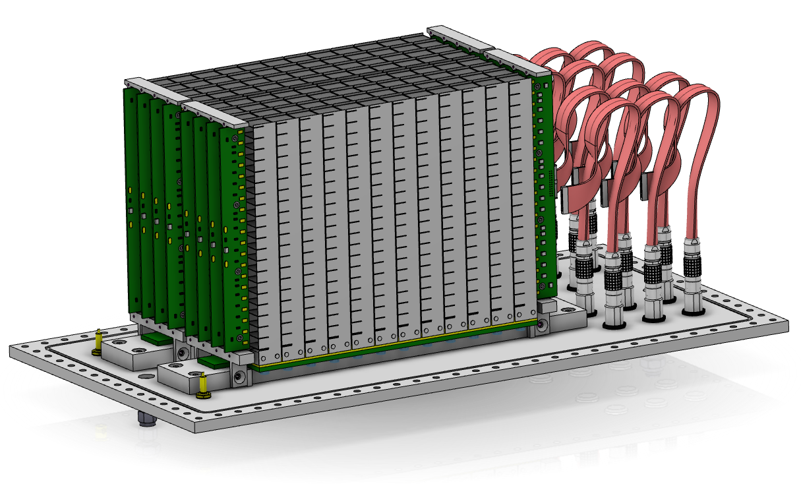
Multi-Grid
How it works: column assembly
n
Notes:
All the grids are mounted onto a bottom insulator, usually made in PEEK, and these onto a PCB that reads the grid signals. On both sides of the grids, we have the end-grids. These hold the PCBs with the pads where we solder the wires. All this is mounted into the backplate, where we also have the HV input, gas inlet and outlet and the readout feedthroughs.
Explain the readout models.

Slide 7
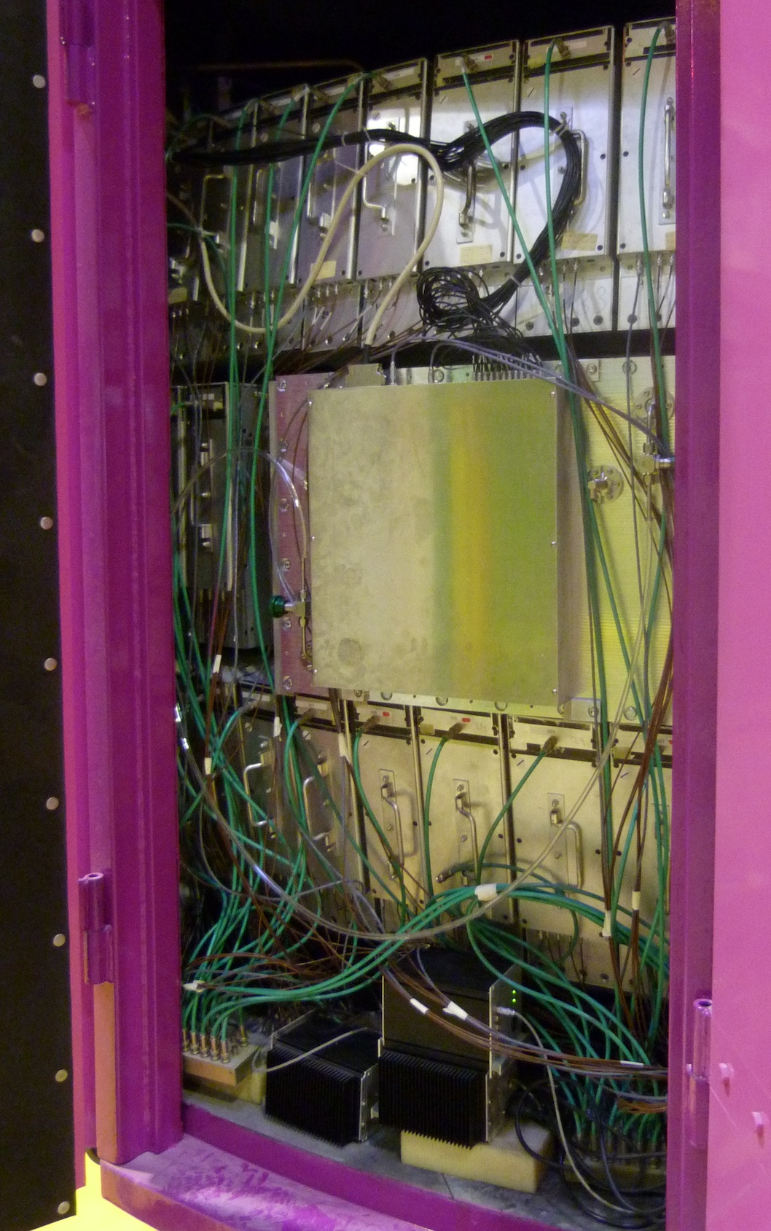
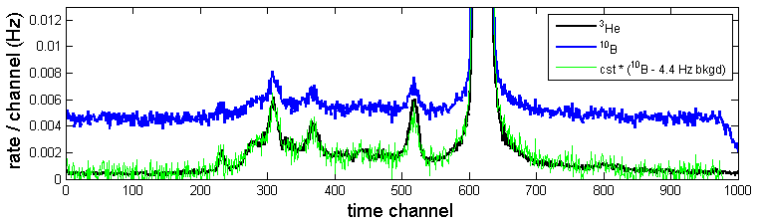
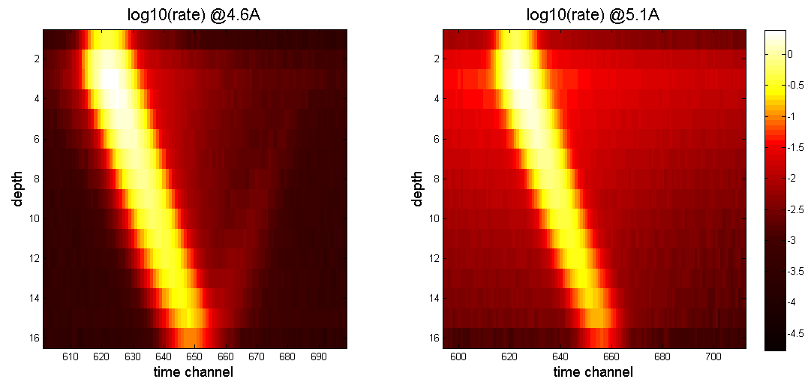
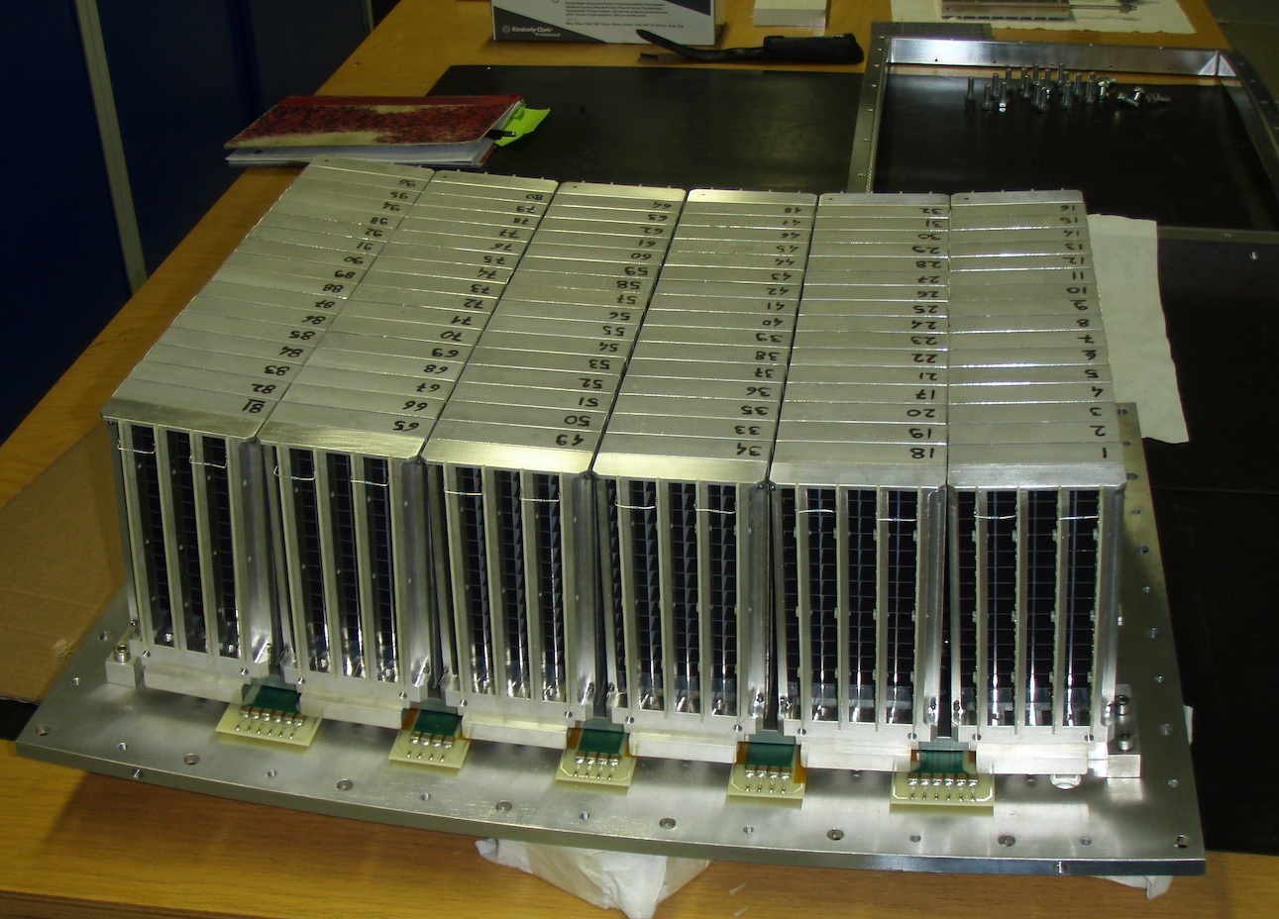
First Multi-Grid tested on an Instrument
Detector tested on cold chopper spectrometer IN6 @ILL
Active Area 30 x 45 cm2
96 grids in 6 modules of 16 grids, 360 anode wires
Operated for ~2 weeks, replacing 25 He3 tubes
@ 4.1, 4.6 and 5.1 Å incoming wavelength
Main topics of the test:
First ToF spectra
Background investigation
Elastic line shape
*A. Khaplanov et al. 2015 JINST 10 P10019
*A. Khaplanov et al. J. Phys: Conf Ser 528 (2014) 012040

Slide 8
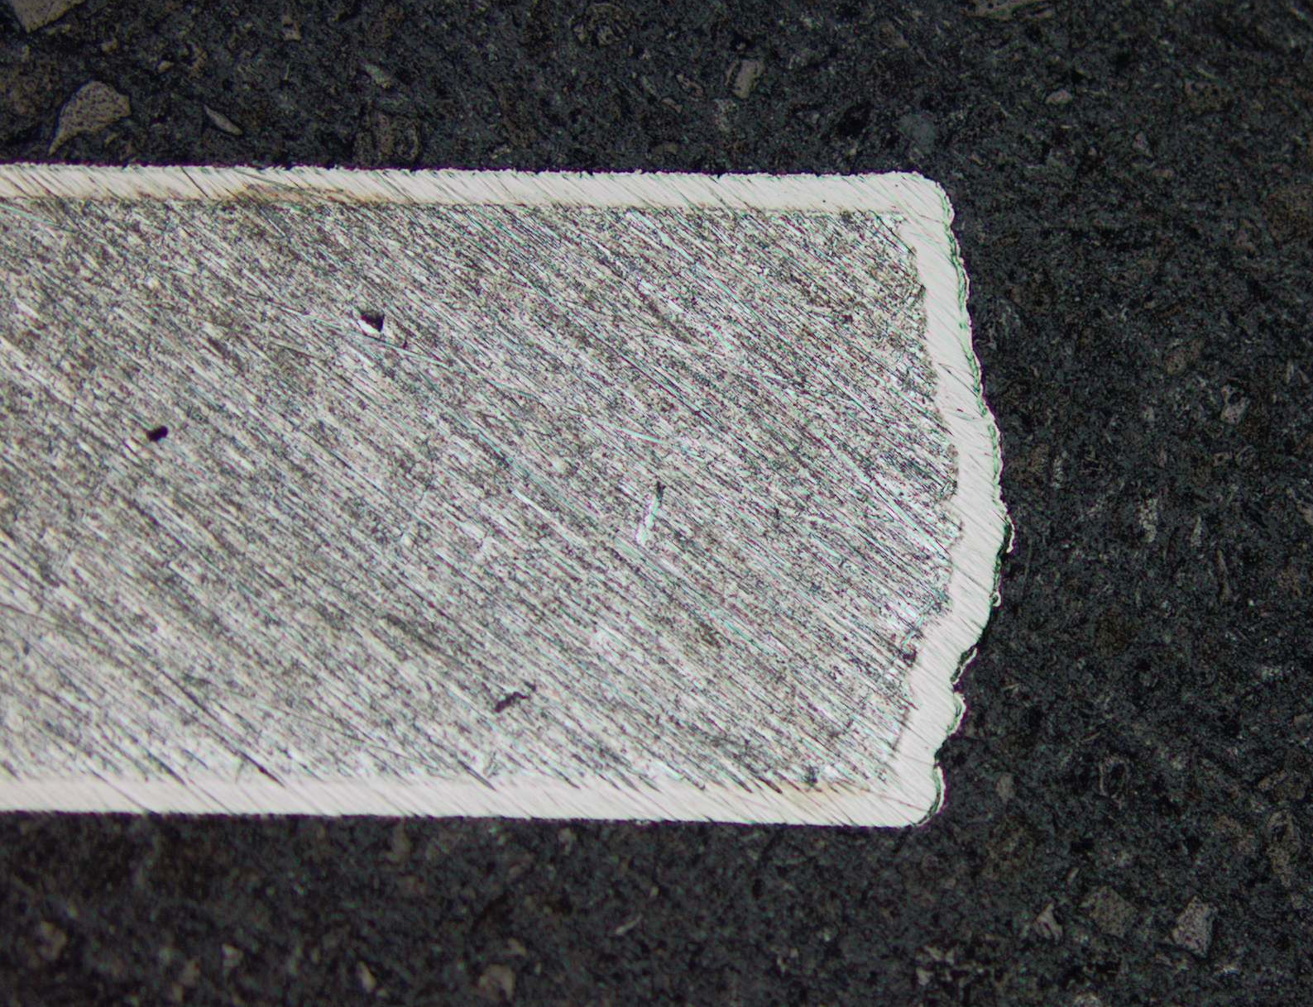
Intrinsic background
Spectrometers work with a very large dynamic range → very high signal-to-noise is required.
Intrinsic background often found in Al due to α emitter impurities (U and Th).
x50-x100 background reduction using:
high-purity Al
Ni-plating
Spectrum from standard Al
Ni-plating on a 0.5mm Al blade
⁷Li α
N + ¹⁰B→⁷Li + α
α decay U, Th
A. Khaplanov et al. 2015 JINST 10 P10019

Slide 9
γ Sensitivity Investigated
Beam + source setup for γ sensitivity measurement
High statistics ¹³⁷Cs measurement
Operation HV, can choose γ sensitivity 10⁻⁶ – 10⁻⁹
Plateau for γ and n measurement
γ rejection demonstrated in ToF @IN6
* A. Khaplanov et al., JINST 8, P10025 (2013), arXiv:1306.6247

Slide 10
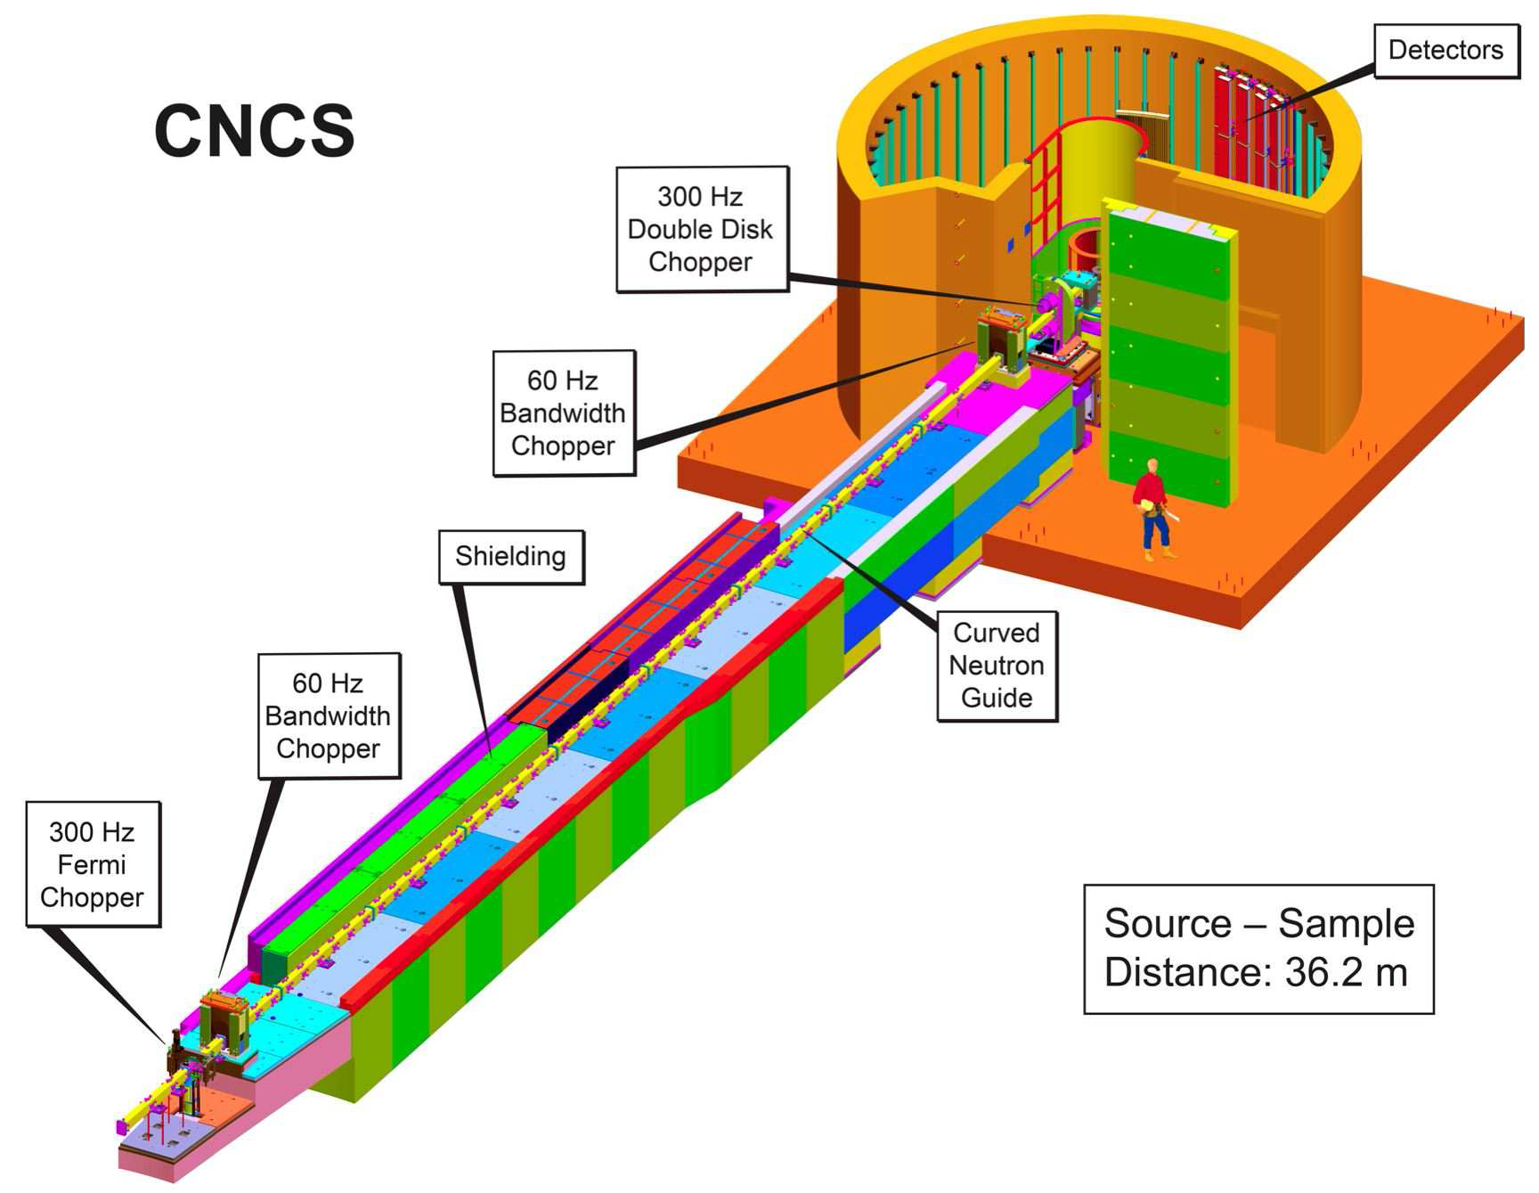
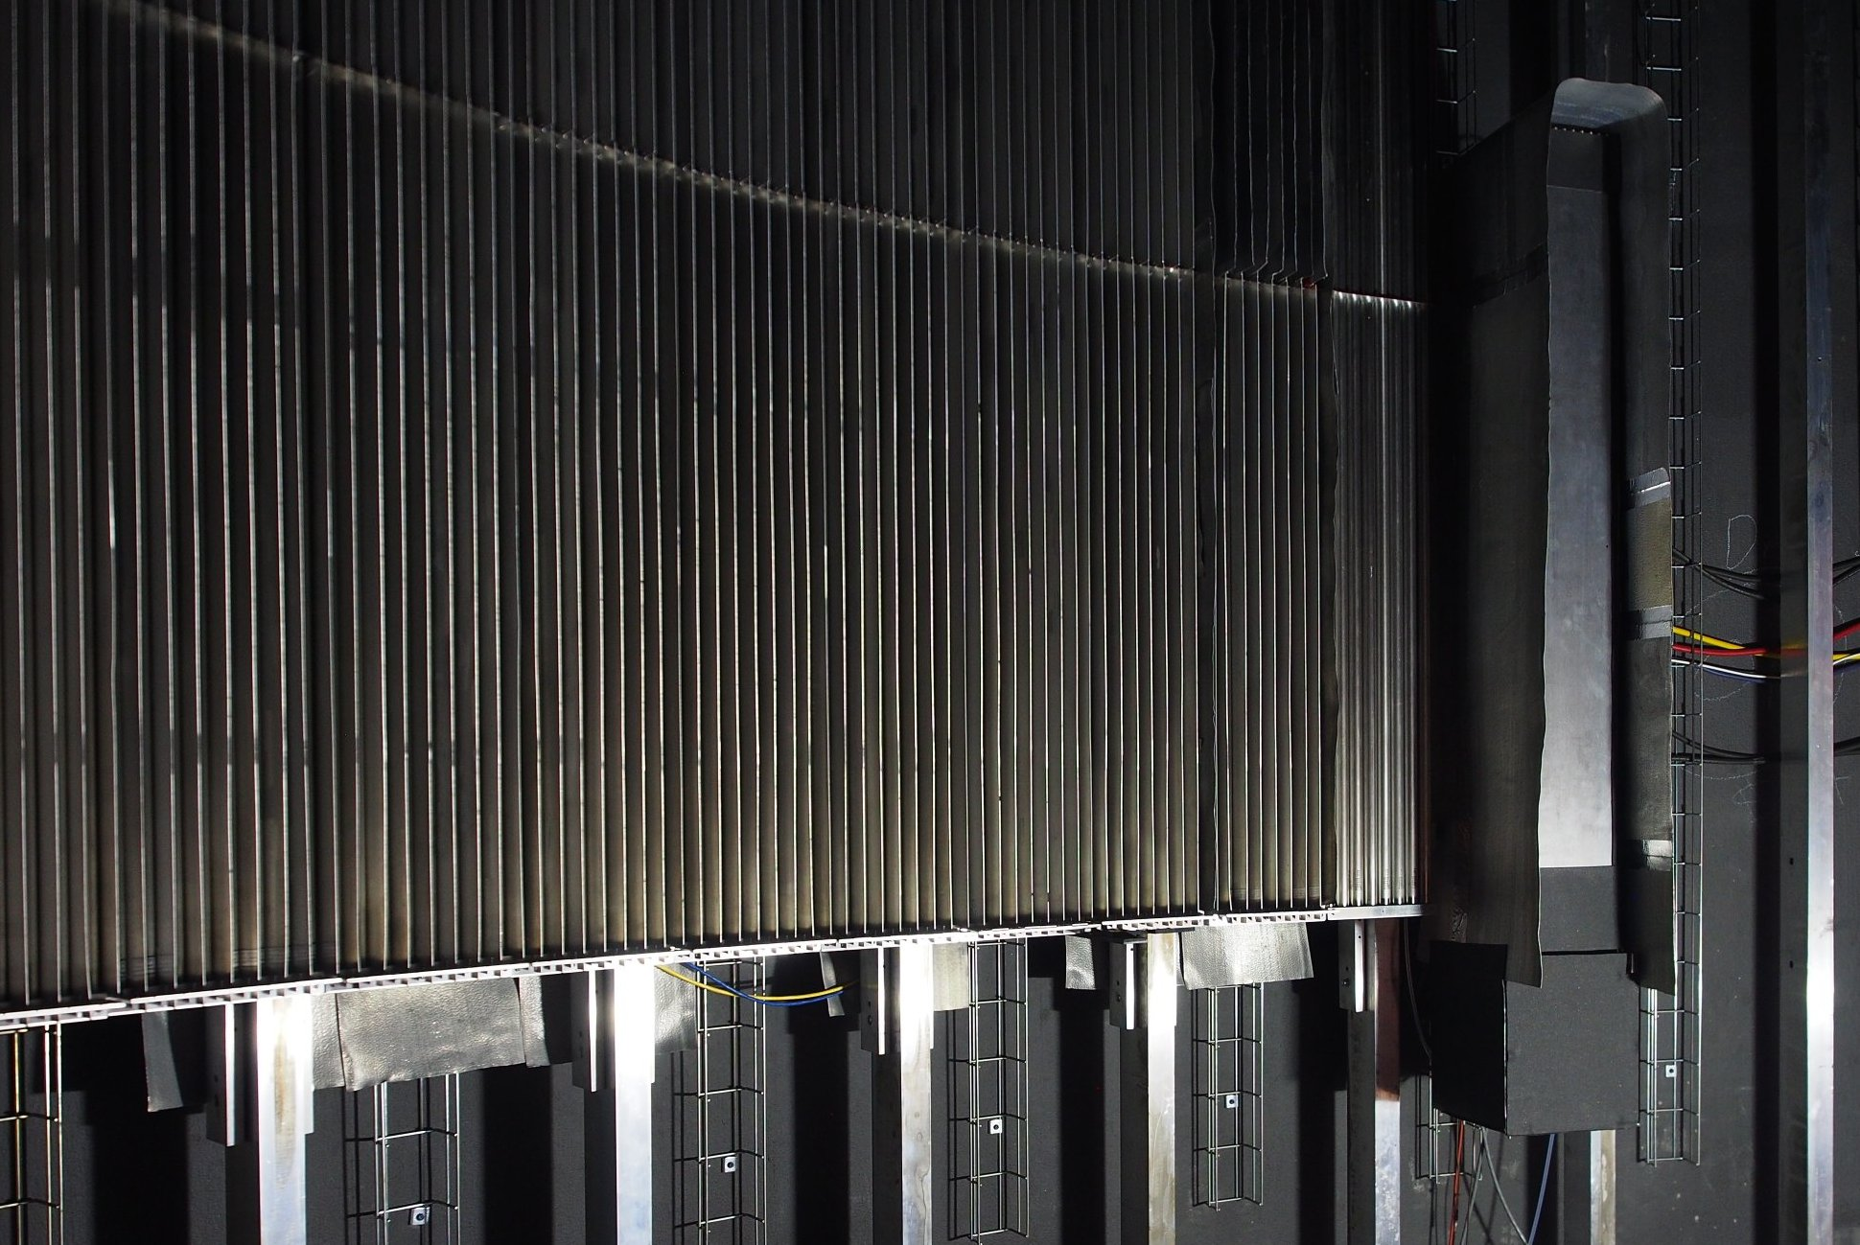
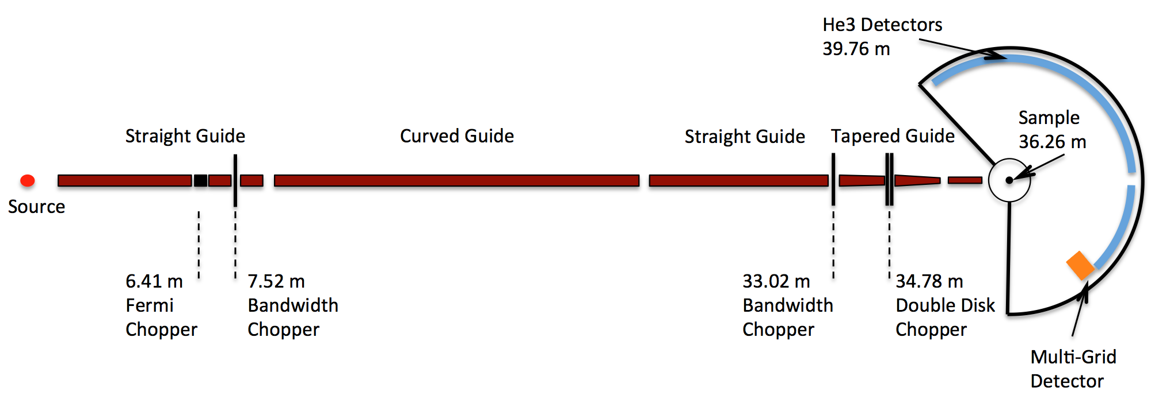
Test on CNCS, Cold Neutron Chopper Spectrometer
A kind offer by K. Herwig to test MG at SNS
Recommendation of 2015 ESS annual review
Goals:
Test at spectrometer
Side-by-side comparison to He3
In parallel with user experiments
Dedicated tests
Solution:
Size = half of “8-pack” module – 1.1m x 19cm
Installation June-July 2016
Operated July 2016 to June 2017

Slide 11
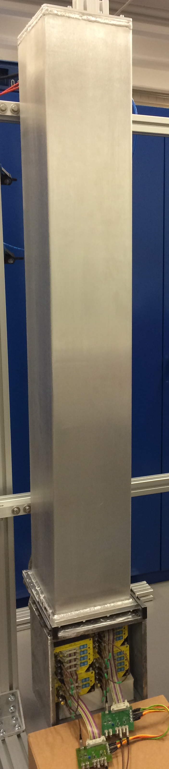
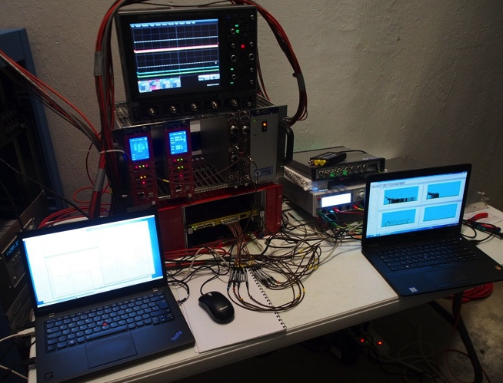
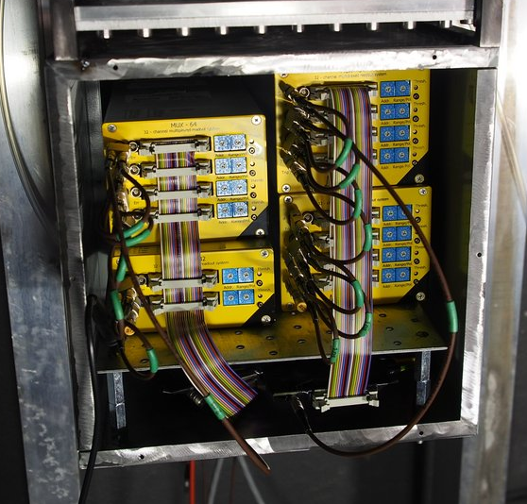
Multi-Grid installed at CNCS
DAQ
outside detector tank
He-tubes
MG
View from sample
Detector installed at 57° scattering angle
Inaccessible between summer and winter shutdowns
DAQ setup outside, accessible remotely
³He 8-packs
M-G
2m
1.1m
Front-end
electronics, Mesytec
20cm
19cm

Slide 12
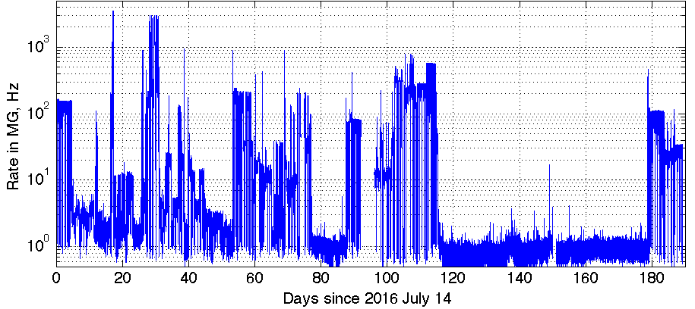
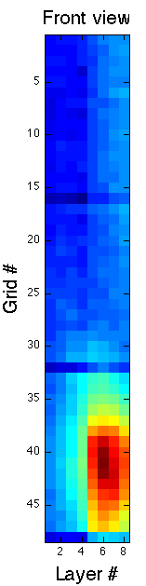
Methods Used for Tests
Vanadium
Counts over time, background
Long term operation
Single crystal
High local rate
Water, Ice
Fast neutrons (fission, prompt)
Gamma background
(NaI detector)
x2 lower fast n counts in MG
Allowing to measure:
Energy resolution – efficiency, scattering – background sensitivity – saturation

Slide 13
Elastic Energy Resolution

Slide 14
Efficiency
Counts from integral of the elastic peak in dE
Efficiency measured relative to the nearest He3 tubes
Error bars: 5-8%, agrees with prediction

Slide 15
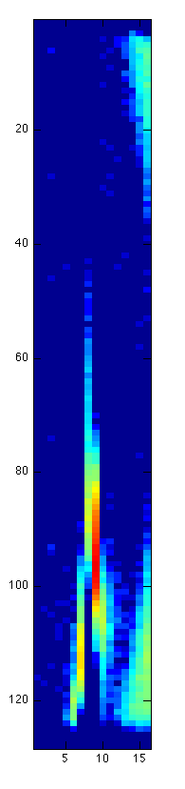
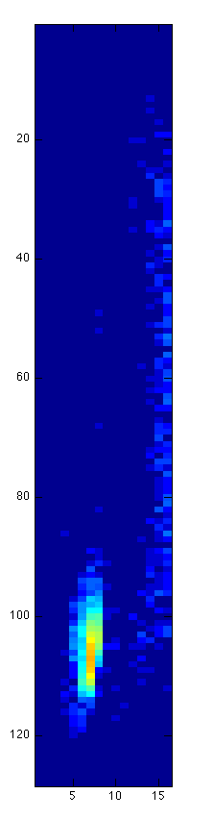
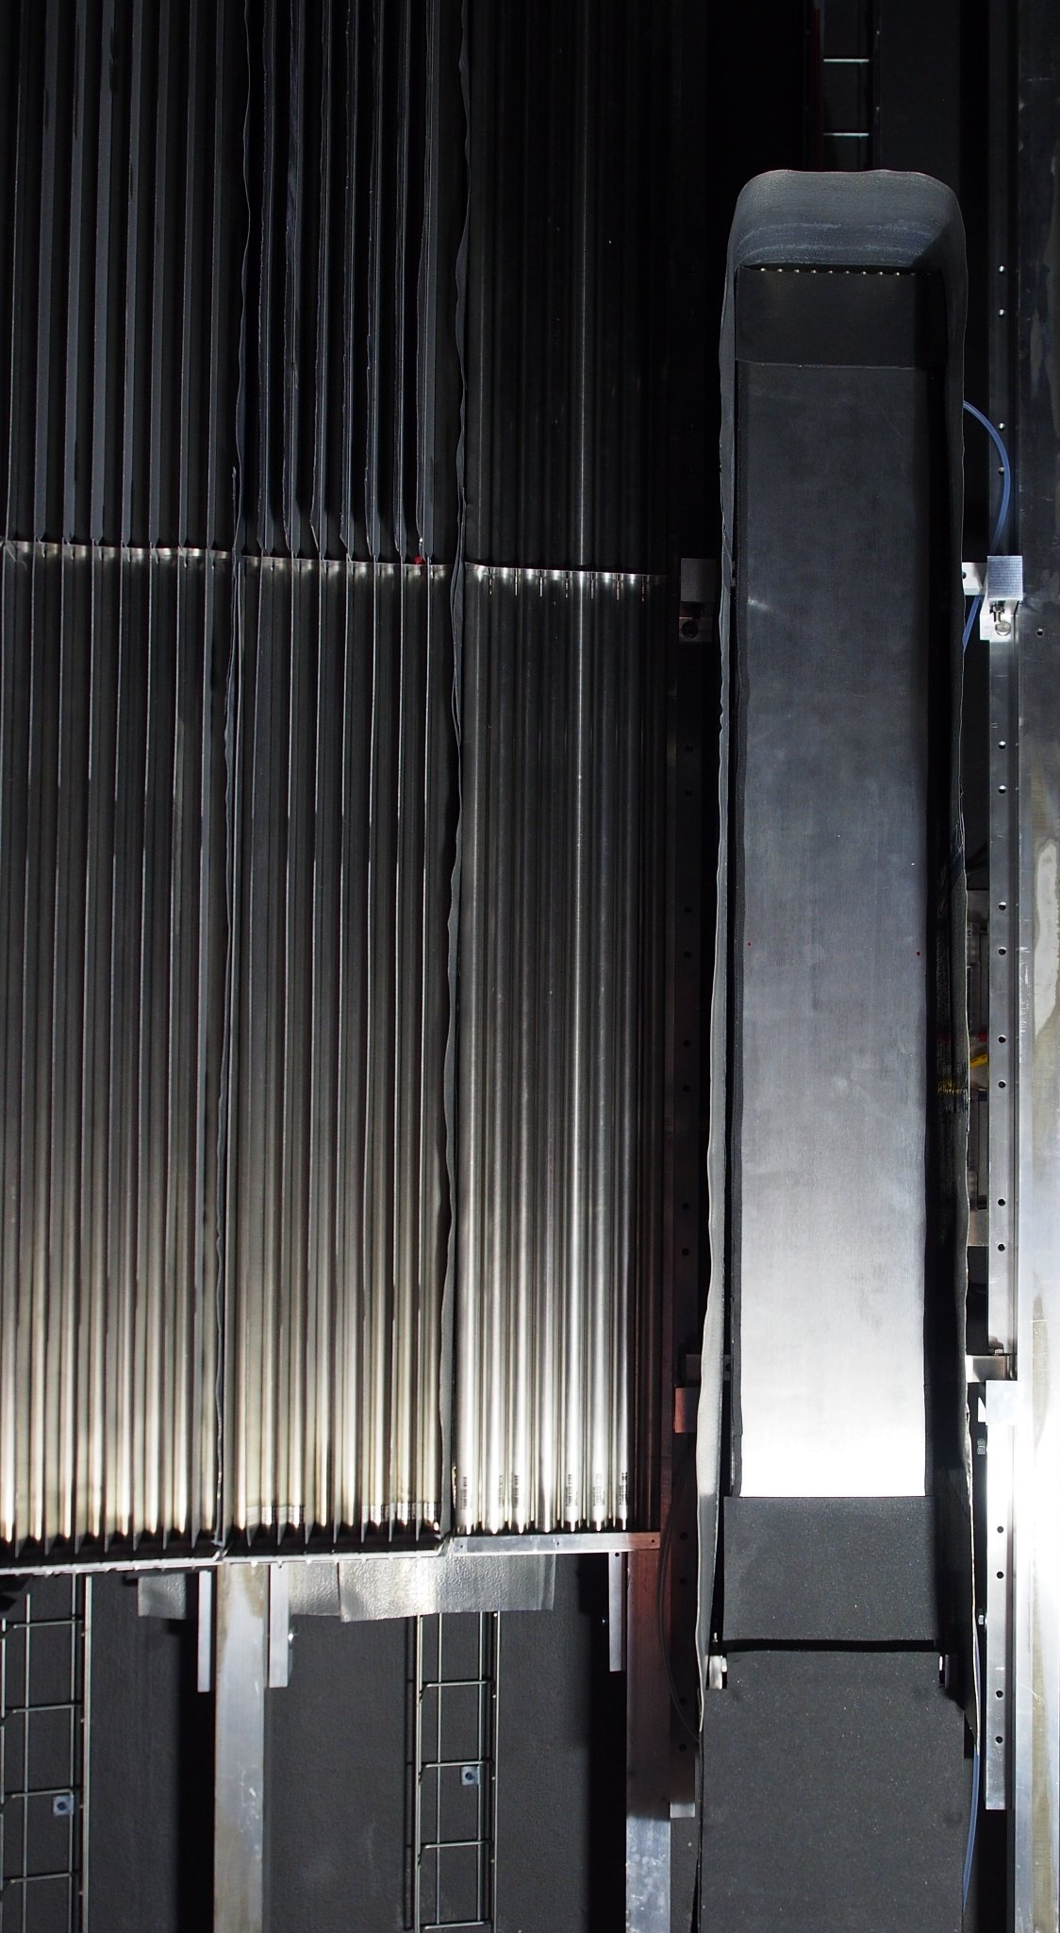
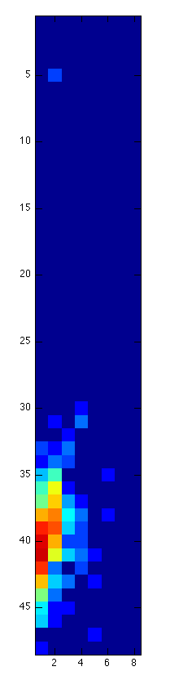
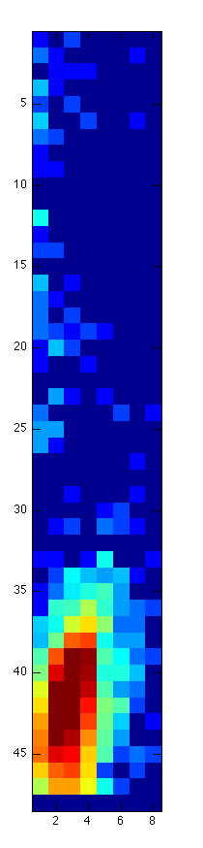
Single Crystal Reflection
He3
He3
A single crystal reflects neutrons according to Bragg’s law:
Resulting in an intense spot seen by detector
MG
MG
Reflected beam at E_{i} = 17.20meV
Crystal
Reflected beam at E_{i} = 13.74meV
Incident beam
No loss of position resolution or saturation observed in Multi-Grid

Slide 16
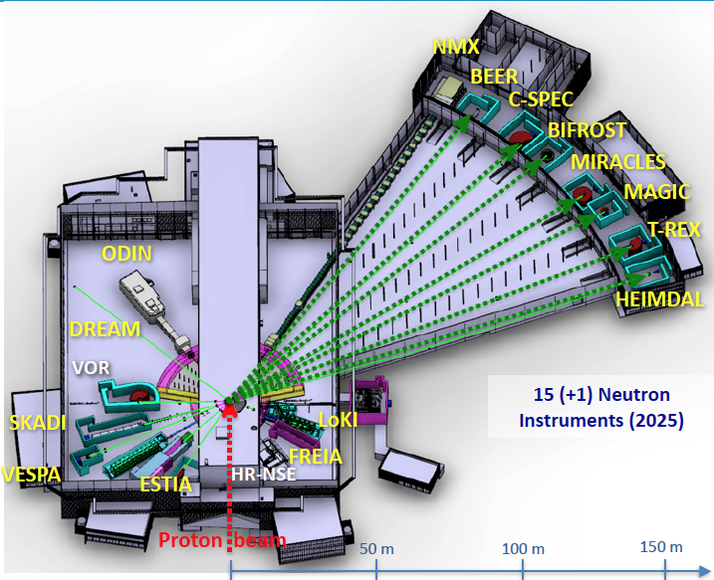
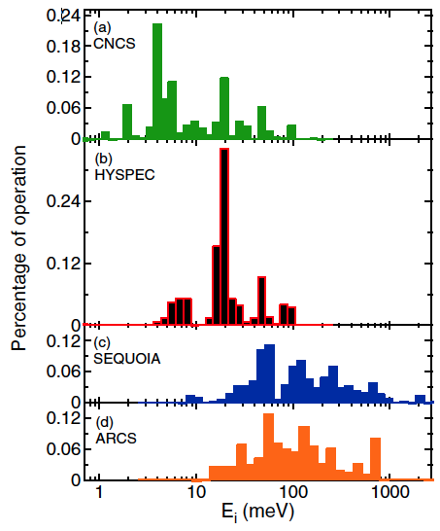
Energy Ranges for ESS Spectrometers
Energy ranges of the first ESS ToF spectrometers
 | CSPEC | T-REX
Typical initial λ, Å (meV) | 2 to 15 Å (20 to 0.36 meV) | 0.7 to 6.4 Å (160 to 2 meV)
Measurements needed for thermal range, up to 160 meV
Cold range, 0.76 to 15 meV measured
Incident energies used at CNCS and SEQUOIA (M. Stone et al.)

Slide 17
Efficiency Optimizations
Optimized grid
n
Efficiency as a function of wavelength for MG optimized for cold vs. thermal spectrum
Tested at MG.CNCS
Thermal Optimization
0.5μm
1.0μm
1.5μm
Layer thicknesses in MG.CNCS (16 blades):
7 blades 0.5μm,
7 blades 1.0μm,
3 blades 1.5μm
Thermal optimization
20 blades total:
4 blades 1.0μm,
10 blades 1.25μm,
6 blades 2.0μm.
Cold – optimization centered on 4Å
Thermal – optimization centered on 1Å
*F. Piscitelli, P. van Esch, 2013 JINST 8, P04020

Slide 18
Multi-Grid Thermal Demonstrator test
Proposal made to do the test at SEQUOIA, at SNS
In addition to what was done for CNCS test:
Performance in thermal (and epithermal) flux
Efficiency optimization
Energy resolution
Line shape
Scattering
Detector construction
Vacuum compatibility
Online data acquisition, visualization and diagnostics
(to be developed by DMSC)

Slide 19
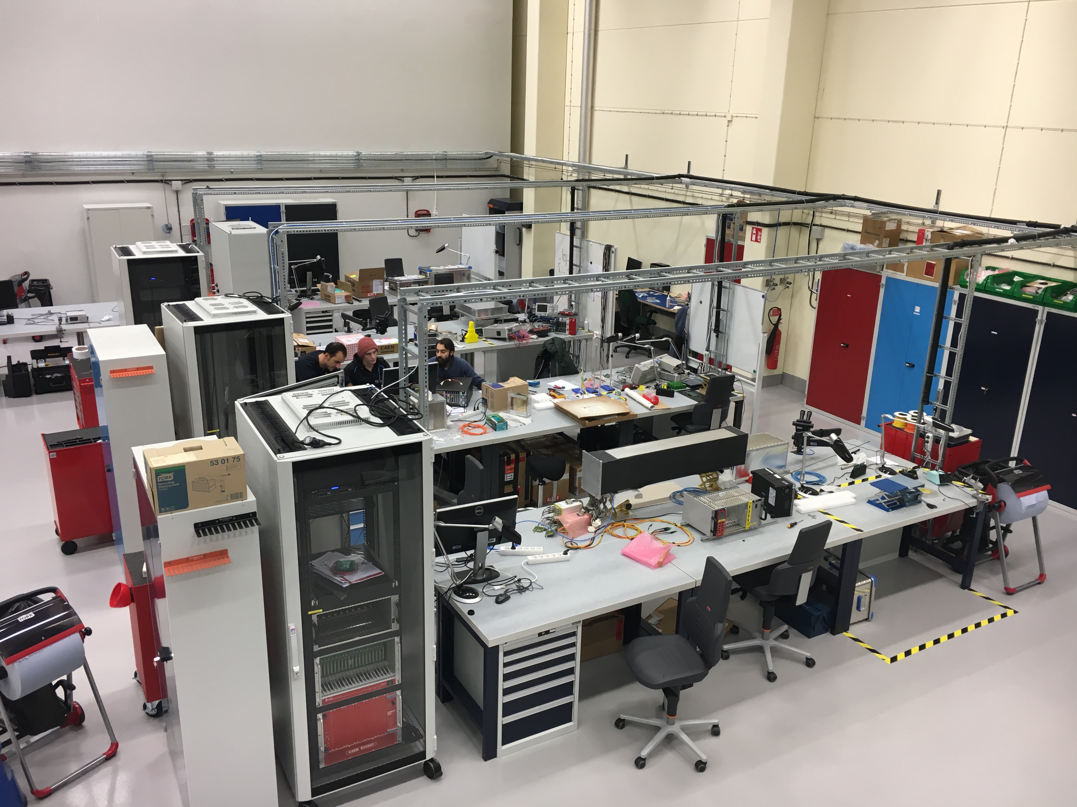



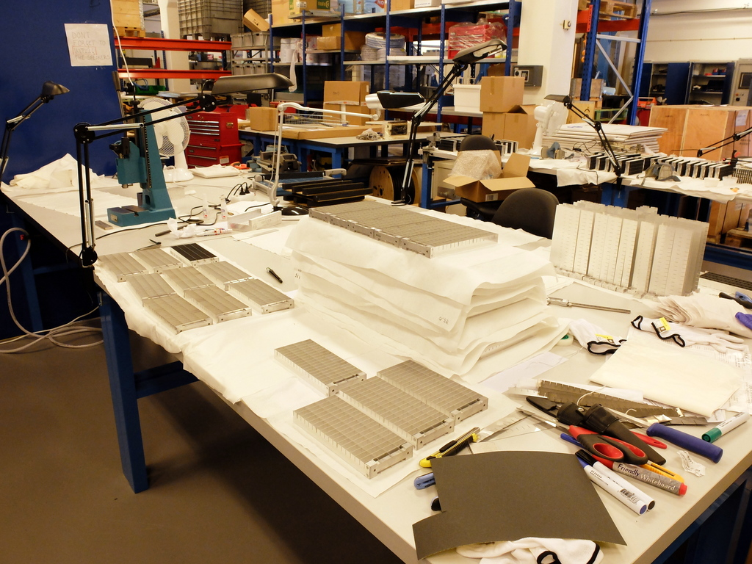
Designing and Building Multi-Grid
Utgård facility in Lund
ESS Detector Group Engineers:
Michail Anastosopoulos
Isaak Lopez Higuera
Ioannis Apostolidis
Embla facility in Lund

Slide 20
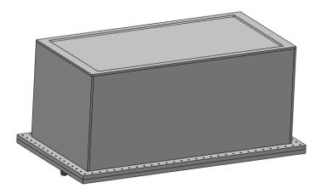
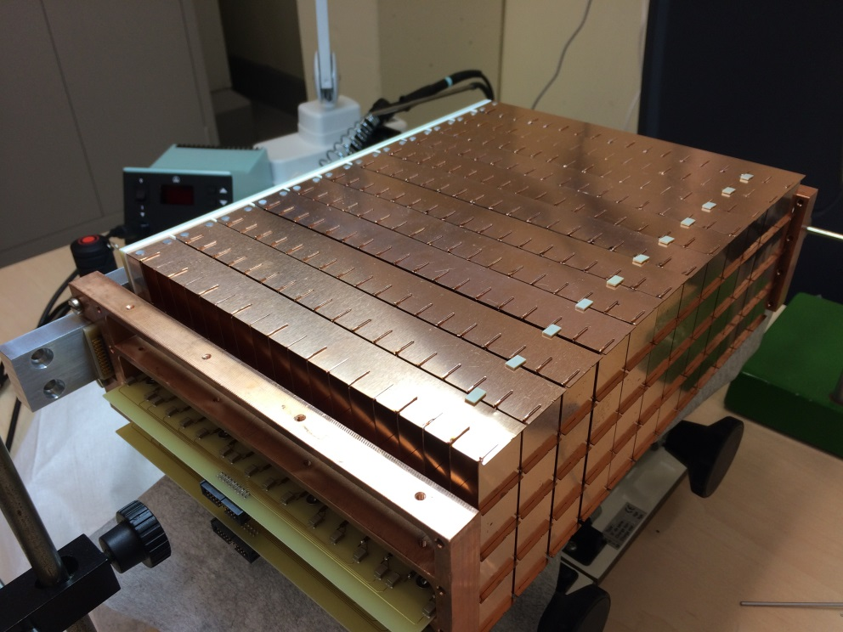
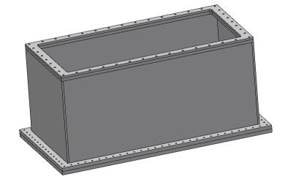
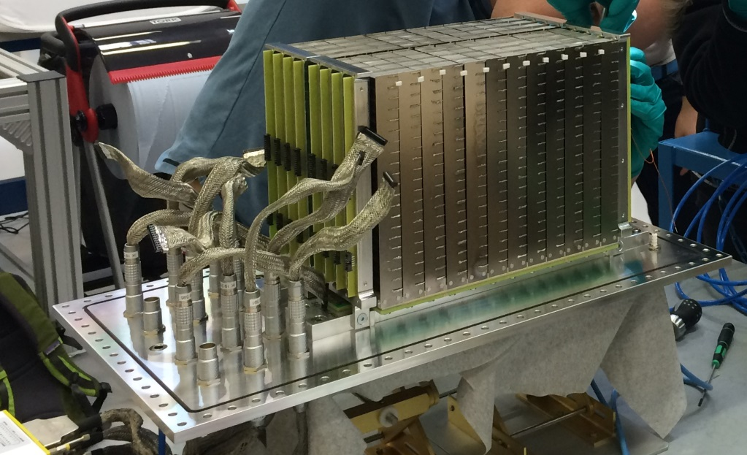
Multi-Grid demonstrator
MG24 and iterations
MG24: First demonstrator
MG24.Copper: Test with low α
MG24.T: Optimized for thermal neutrons
MG24.Alu foil: Test with foil window
Notes:
This is the first test demonstrator we built, it was 2 columns of 12 grids each. The window thickness was 2mm. We tested it for XXX
We did the same test but with copper blades.
And then we did the same but for thermal neutrons, so 21 voxels.
Also, we have another vessel with interchangeable windows, so we can put aluminum foil.
Explain the basics of MG24, columns, gaps etc
The needs of MG.Copper and thermal versions
Tests done
Need for aluminum foil...probably not tested yet

Slide 21
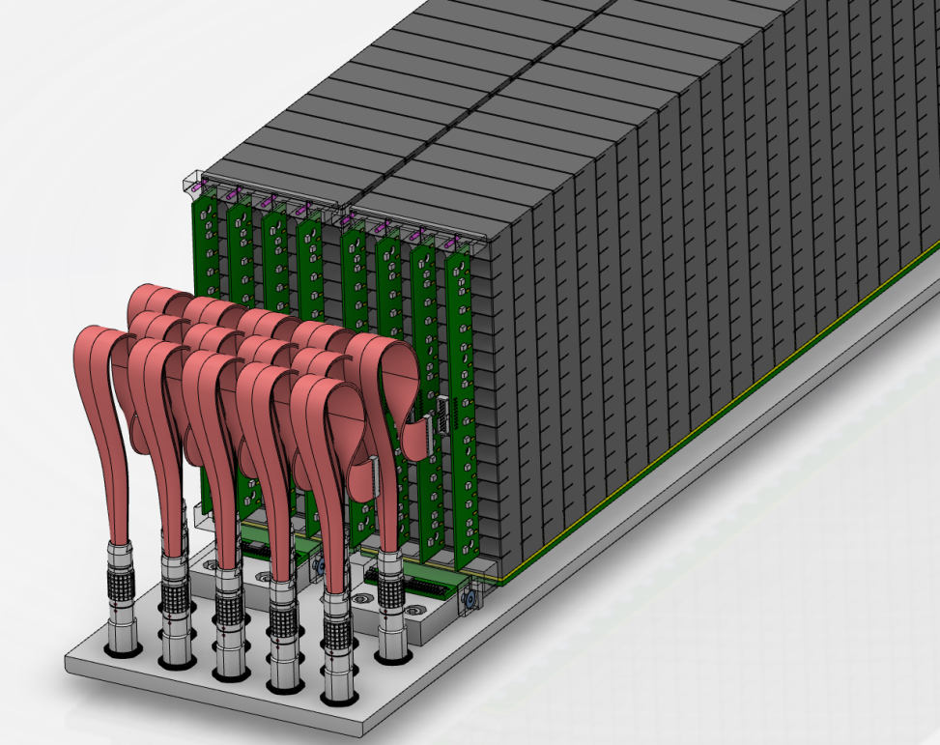
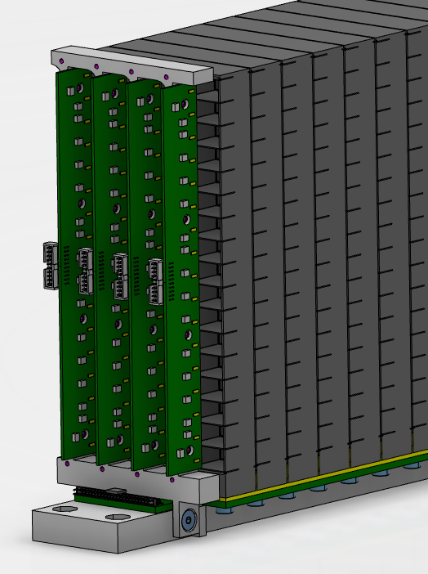
MG.CNCS
End-Grid
Grid assembly
Bottom insulator
Backbone
Bottom PCB

Slide 22
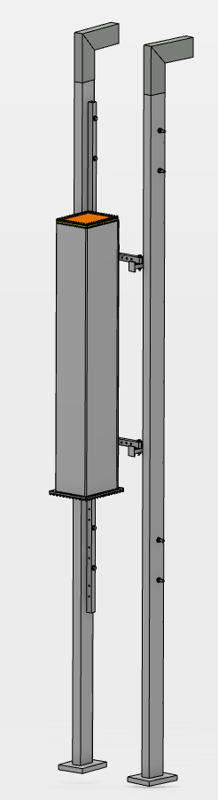
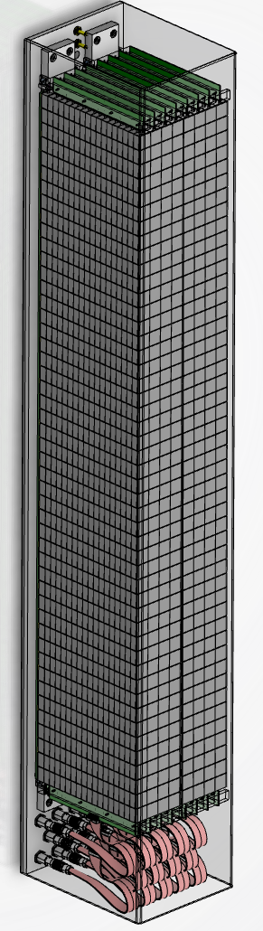
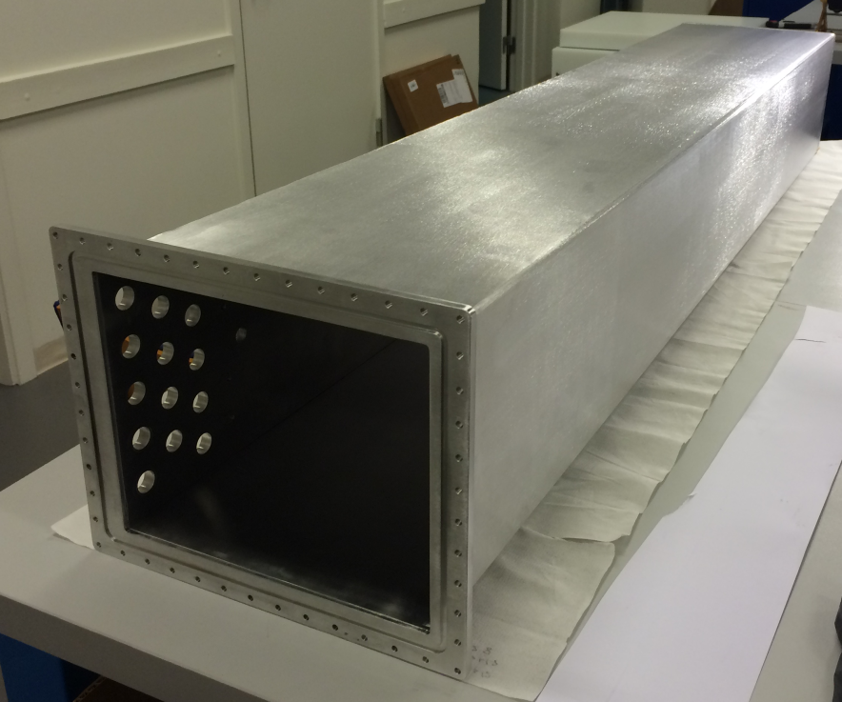
MG.CNCS
Installed at SNS in the CNCS instrument during June 2016
Optimized for cold neutrons
2 columns of 48 grid each
Active area 1100 x 185 mm
Voxel volume 22.5 x 22 x 11 mm
1394 x 200 x 250mm

Slide 23
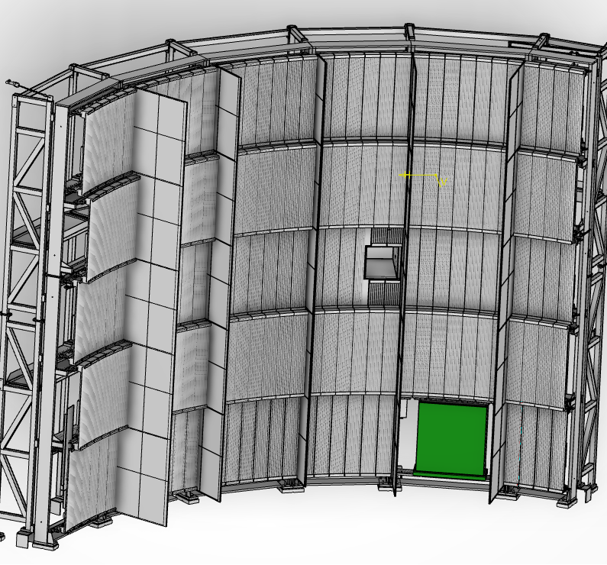
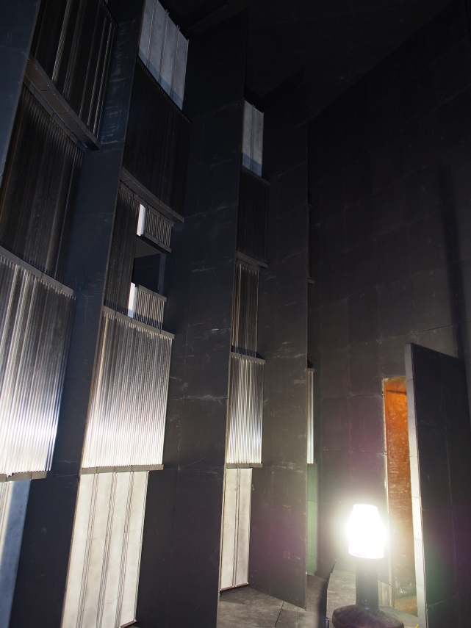
MG.SEQ
Installation proposal at SNS in the SEQUOIA instrument
Test with thermal/epithermal neutrons
First large area detector under vacuum
Mounted in the lower bank ~5m and 25˚ from sample

Slide 24
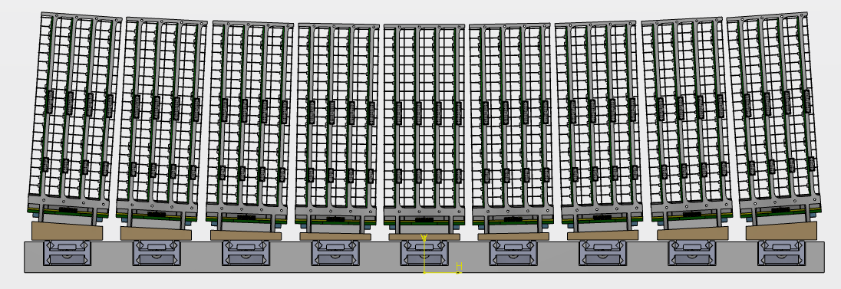
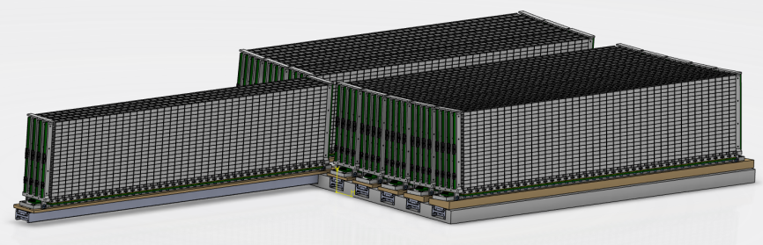
Multi-Grid demonstrator
MG.SEQ: Installation proposal at SNS in the SEQUOIA instrument
neutrons
9 columns, 40 grids in each
Telescopic sliders to access grid assemblies
Use of inclined wedges so all grids are at the same distance from the sample
MG.SEQ top view
1050 x 914 x 450mm
MG.SEQ isometric view

Slide 25
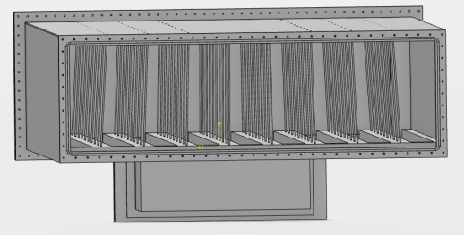
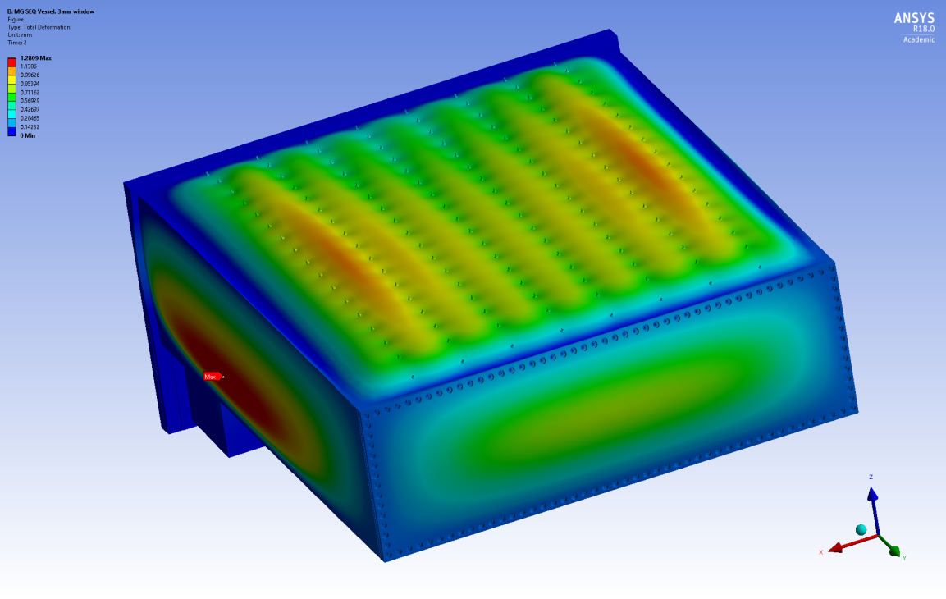
Multi-Grid demonstrator
MG.SEQ: Installation proposal at SNS in the SEQUOIA instrument
n
3mm thickness window
8 rows of 17 rods, Ø3mm
Full access only from 1 side
Total deformation
MG.SEQ bottom view

Slide 26
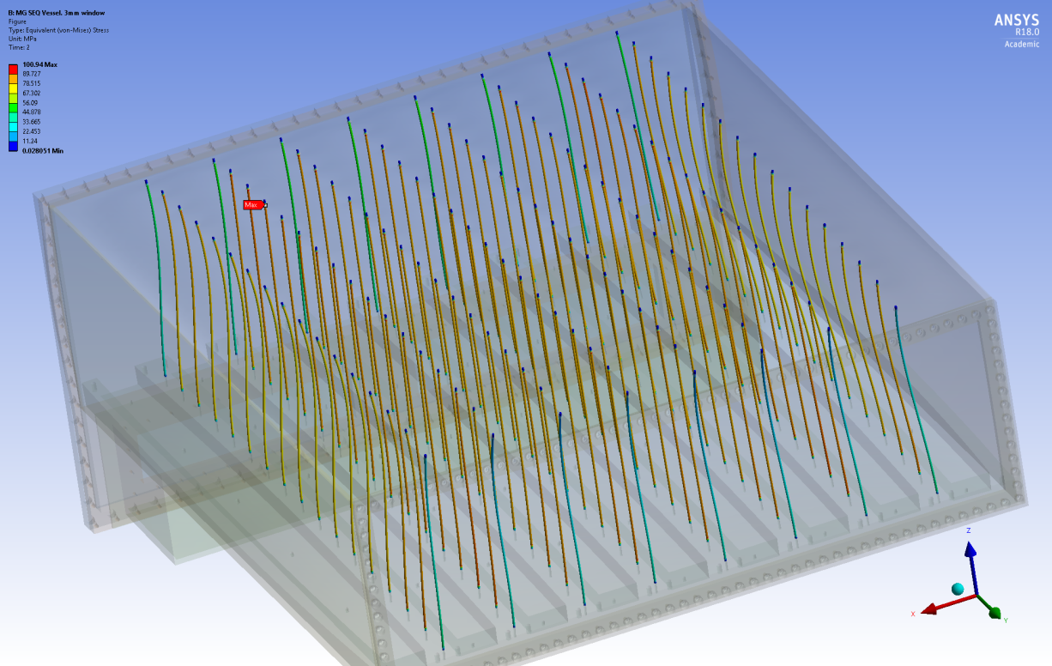
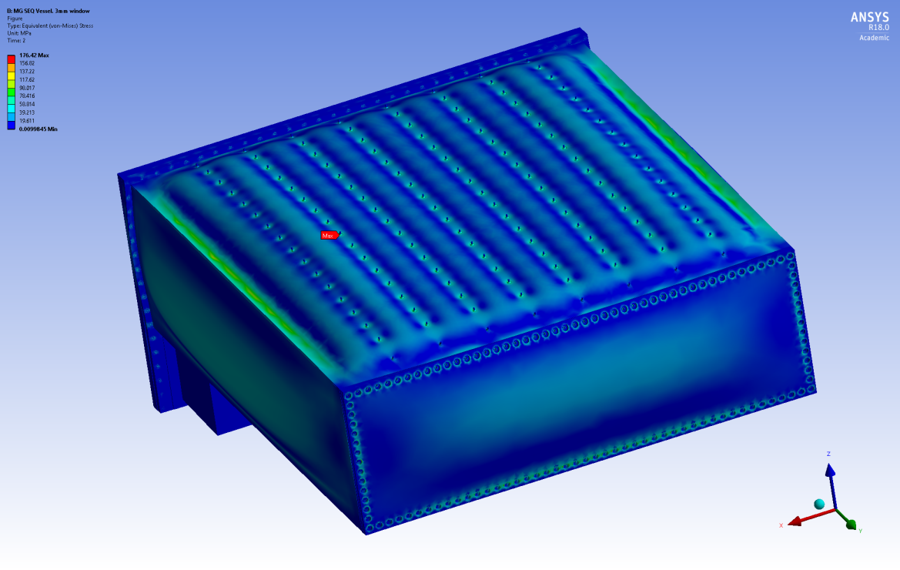
Multi-Grid demonstrator
MG.SEQ: Installation proposal at SNS in the SEQUOIA instrument
Amplified 50 times
Max deformation: 1.2mm on the sides
Max equivalent stress: 176 MPa
Stress in the rods: 80 MPa
Equivalent stress in the vessel
Equivalent stress in the rods
Amplified 50 times

Slide 27


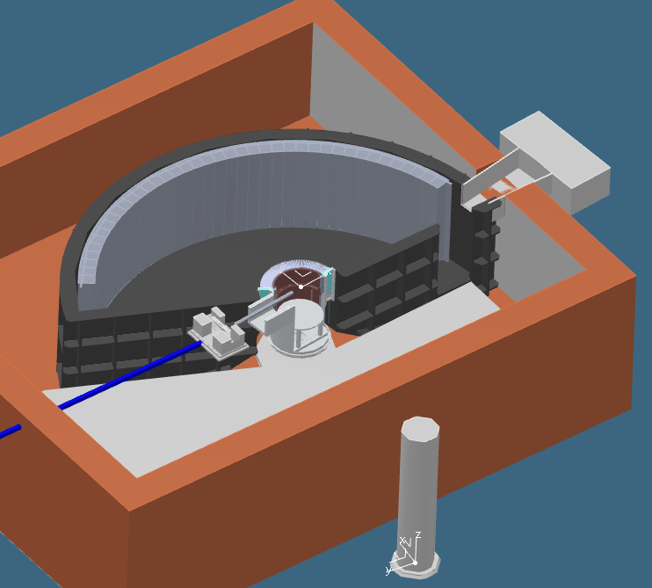
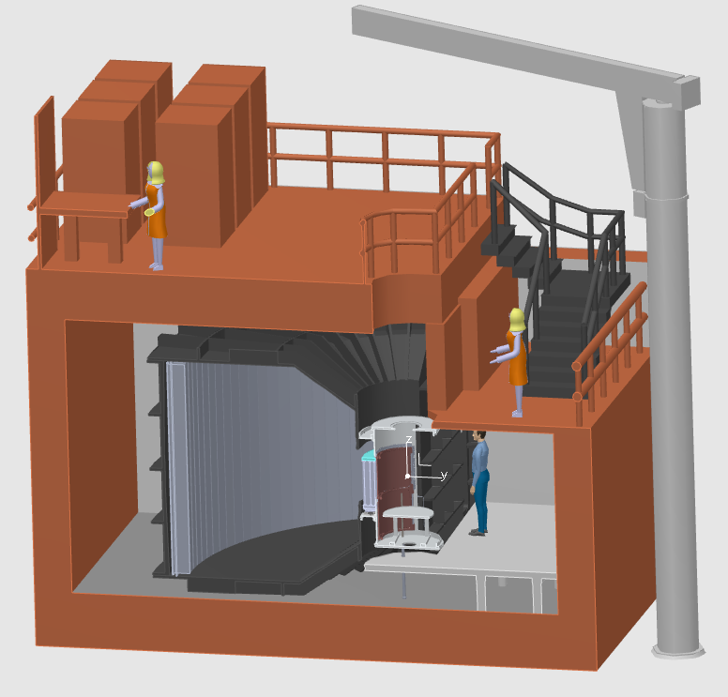
CSPEC at ESS
Cold spectrometer
0.2 meV < E_{i} < 20 meV
29m² detector
Horizontal coverage 5° to 135°
Vertical coverage -25° to 25°

Slide 28
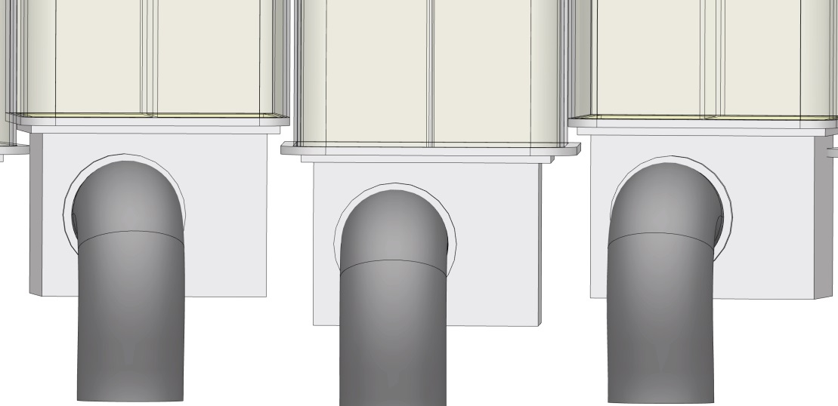

Multi-Grid
Detector for CSPEC
Vessel length: 3.5m
Detector configuration: 2 columns per vessel (column width 153.5mm)
Neighbour vessels configuration, minimizing dead spaces, 21mm from grid to grid
Integration of the detector vessels in the CSPEC instrument

Slide 29

Conclusion
Multi-Grid developed and characterized.
Large-Area detectors possible again
Operated at CNCS over 11 months.
Multi-Grid baseline detector for
    CSPEC and T-REX at ESS
Test at SEQUOIA proposed
Instrument-focused design is underway
Horizon 2020 grant agreement 676548
WP 4.3: Large-Area Detectors
Thanks to the colleagues at SNS for this opportunity and cooperation!
2017 JINST 12 P04030
(https://arxiv.org/abs/1703.03626 )

Slide 30
Acknowledgements and Publications
ILL:
Bruno Guerard, Jean-Claude Buffet,
Jean-Francois Clergeau, Anthony Leandri ,
Victor Buridon, Fabien Lafont
ESS:
Anton Khaplanov, Richard Hall-Wilton, Oliver Kirstein, Tomasz Brys, Michail Anastasopoulos, Isaak Lopez Higuera, Carina Höglund*, Linda Robinson*
Centre for Energy Research (Hungary):
Eszter Dian
Linköping University:
Jens Birch, Lars Hultman, (also *)
SNS:
Ken Herwig, Georg Ehlers, Michelle Everett, Kevin Berry
Earlier – the participants of the CRISP project on Large-Area detectors.
Horizon 2020 grant agreement 676548
WP 4.3: Large-Area Detectors
Earlier publications:
B4C layers:
*C. Höglund et al, J of Appl. Phys. 111, 104908 (2012)
Characterization:
*A. Khaplanov et al., arXiv:1209.0566 (2012)
*B Guerard et al., NIMA, 720, 116-121 (2013), http://dx.doi.org/10.1016/j.nima.2012.12.021iJ
*J. Correa et al., Trans. Nucl. Sc. (2013), DOI: 10.1109/TNS.2012.2227798
*A. Khaplanov et al., (2014) J. Phys.: Conf. Ser. 528 012040 doi:10.1088/1742-6596/528/1/012040
Gamma sensitivity:
*A. Khaplanov et al., JINST 8, P10025 (2013), arXiv:1306.6247
Alpha background:
*A. Khaplanov et al., JINST 10, P10019 (2015); doi:10.1088/1748-0221/10/10/P10019
Latest publication:
A.Khaplanov et al. “Multi-Grid Detector for Neutron Spectroscopy: Results Obtained on Time-of-Flight Spectrometer CNCS" https://arxiv.org/abs/1703.03626 2017 JINST 12 P04030

Slide 31
Extra slides

Slide 32




IN5 Demonstrator – Large-Scale
Module x8:
wire-frame coincident readout
3 m
Grid x1024:
low activity,
minimal dead material
Blade x18432:
enriched B4C coating
good adhesion, uniformity,
80cm
Detector:
2.4 m² active area

Slide 33

Aluminium Bragg Edge
Scattering effects from SE and detector
Sample
Sample environment
Detector
Incident n

Slide 34

Energy Reconstruction
Energy transfer: E_{f}-E_{i}
Raw ToF spectrum:
no information on geometry used
dE spectrum: Including information on position of each detected neutron.

Slide 35


Single Crystal Reflection
Image recorded in each detector as a function of time during elastic peak
Each frame advances 30 μs
Multi-Grid
He3
No loss of position resolution or saturation observed in Multi-Grid

Slide 36


C-SPEC
Neighbour vessels configuration, minimizing dead spaces

