Slide 1
ESS Linac Integrated Planning for the Installation, Testing and Commissioning
Ciprian Plostinar
ESS – J-PARC Workshop
19 January 2018

Slide 2
The ESS Linac

Slide 3
The ESS Linac

Slide 4
The J-PARC Linac: 2005
http://j-parc.jp/

Slide 5
The J-PARC Linac: 2007
http://j-parc.jp/

Slide 6
Topics for Discussion and Collaboration
Accelerator installation challenges
The experience at J-PARC
Lessons for ESS
Installation Sequence
Opportunities for optimisation
Beam commissioning
Lessons learned at J-PARC
Schedule priorities
Ramp-up to design parameters
What are the main challenges of a staged beam commissioning approach?

Slide 7
The ESS Linac: The Big Picture

Slide 8
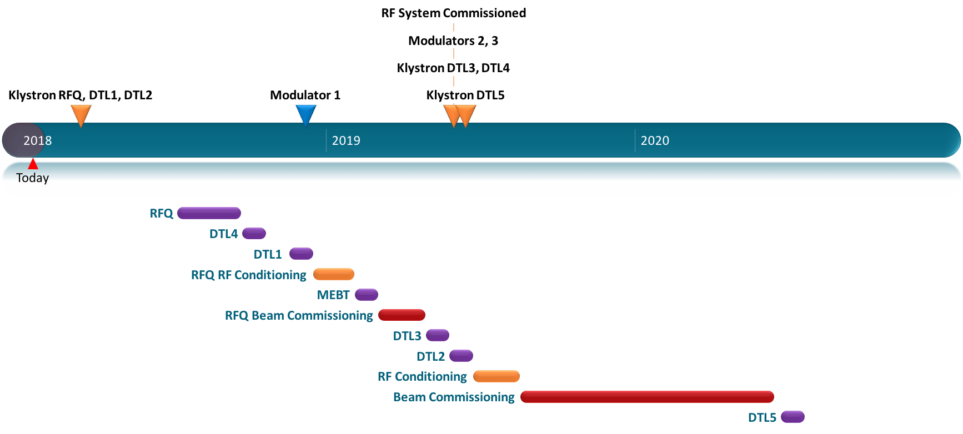
The Normal Conducting Linac Timeline

Slide 9
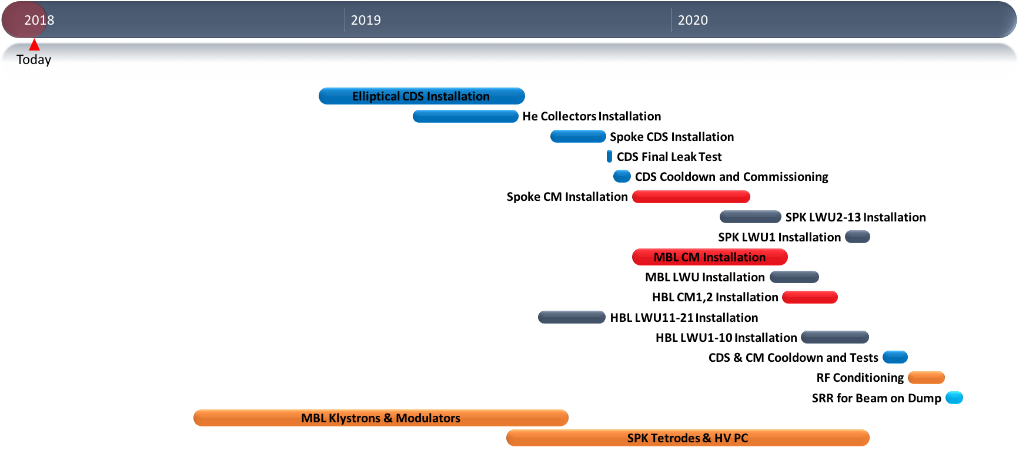
The Superconducting Linac Timeline

Slide 10
RF Cell Installation Illustration
Courtesy of Daniel Lundgren

Slide 11
RF Cell – Cable Trays

Slide 12
RF Cell – Racks

Slide 13
RF Cell – Cable Trays Racks

Slide 14
RF Cell – RFDS WG on Walls

Slide 15
RF Cell – RFDS Supports

Slide 16
RF Cell – Water Cooling for RF

Slide 17
RF Cell – RFDS WG, Loads Circulators

Slide 18
RF Cell – Cable Trays RF

Slide 19
RF Cell – Klystrons

Slide 20
RF Cell – Modulators

Slide 21
Assessment
Ion Source and LEBT installation ongoing
Beam early 2018 (soon!)
RF condition the RFQ late 2018/early 2019
RFQ Beam: Potentially early 2019
Extended time for NC linac beam commissioning in 2019 and 2020
Simultaneous installation (in the cold linac) and beam commissioning (warm linac) activities
Installation will be a major learning curve
Heavy installation load in 2020
Aiming to be ready to send the first beam to the tuning dump late 2020.

Slide 22
Topics for Discussion and Collaboration
Accelerator installation challenges
The experience at J-PARC
Lessons for ESS
Installation Sequence
Opportunities for optimisation
Beam commissioning
Lessons learned at J-PARC
Schedule priorities
Ramp-up to design parameters
What are the main challenges of a staged beam commissioning approach?
Notes:
Utilities Installation/Shift work/Collaboration with contractors

