Slide 1
Potential Collaboration Subjects for Beam Physics
R. Miyamoto
M. Eshraqi, Y. Levinsen, C. Plostinar
ESS - J-PARC Workshop
18-19th of January, 2018

Slide 2
Introduction
We made last min changes on the subjects, to suite to the expertise of the participants.
Beam Dynamics Error Studies of the ESS Linac (Y. Levinsen)
ESS neutrino beam studies (M. Eshraqi)
ESS Linac Integrated Planning for the Installation, Testing, and Commissioning (C. Plostinar)
At the moment, beam physics has no active collaboration.
Except for occasional email exchanges and discussions during conferences and workshops.
I will list potential collaboration subjects in 1 page.

Slide 3
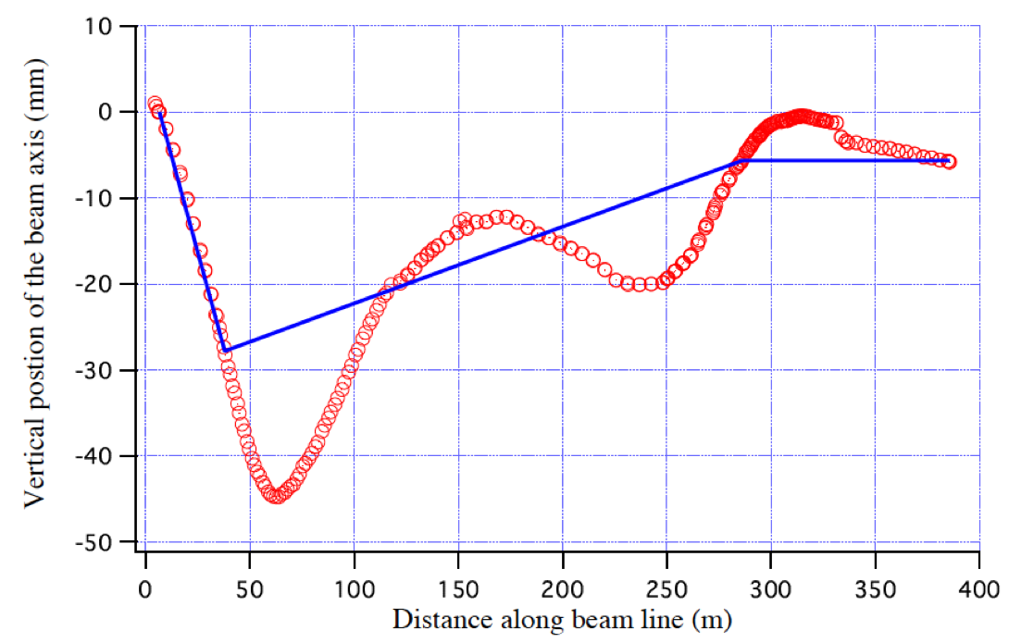
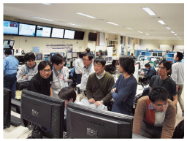
Past relation (1): Miyamoto’s visit to the start-up in 2011
R. Miyamoto made a ~2 weeks visit in Dec 2011, to observe the start-up after the earthquake.
The experience has provided useful inputs to the ESS beam commissioning planning.
Sharing experiences in the linac commissioning/tuning and operation are useful for ESS. It is even better if we could send more physicists/operators to observe the J-PARC start-up.
IPAC11 MOOCB01
http://j-parc.jp/ja/news/2011/news-j1112.html

Slide 4
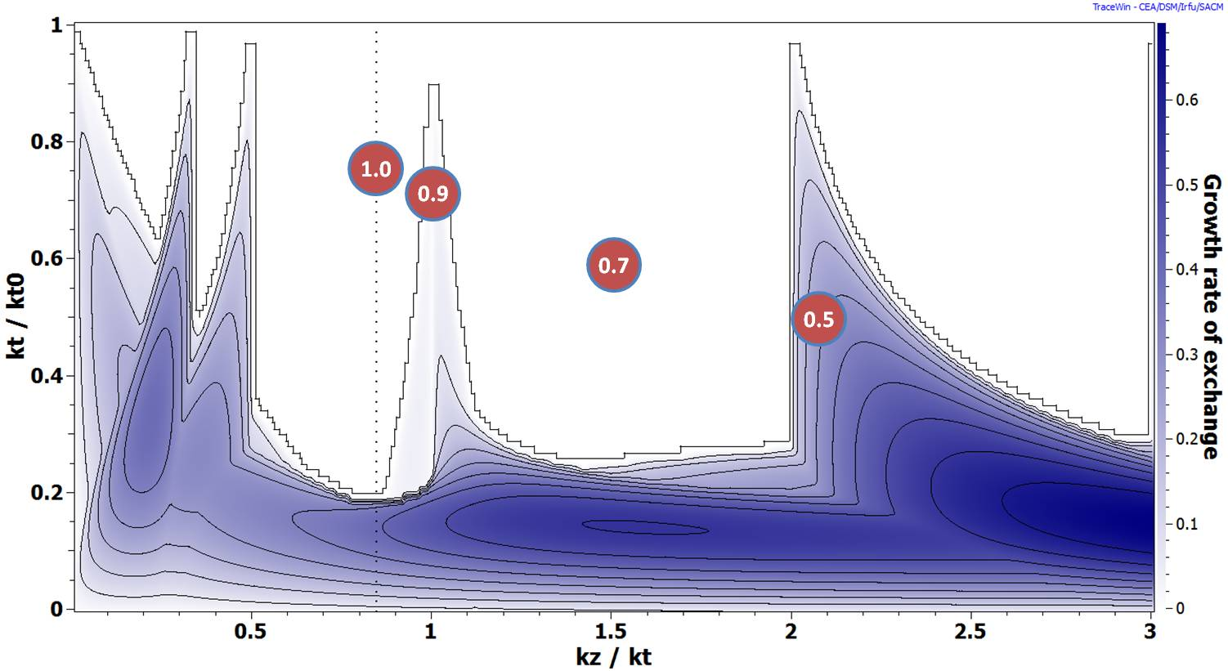
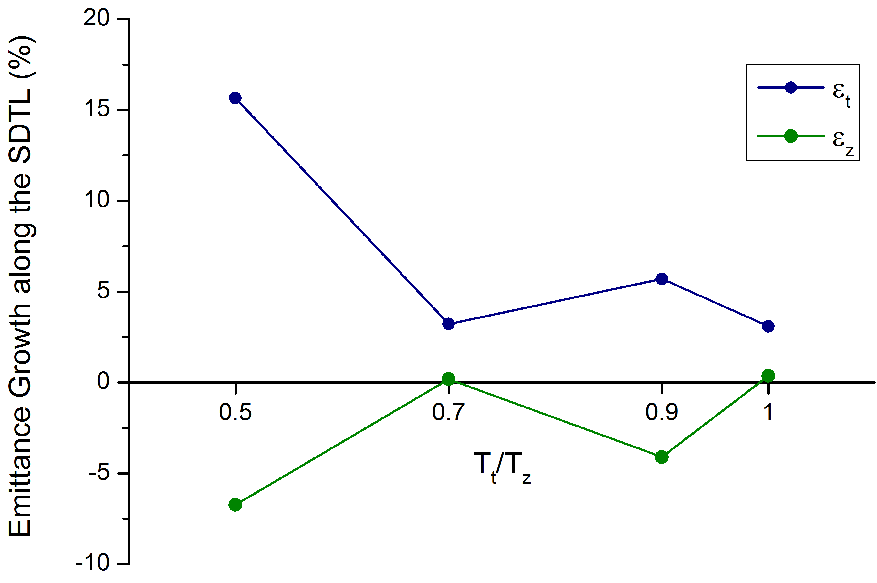
Past relation (2): Plostinar’s collaboration in beam dynamics study
Before arriving to ESS, C. Plostinar made several visits to J-PARC to do an experimental beam dynamics study.
The space-charge resonance and equipartitioning conditioning were studied in great detail. (IPAC13 THPWO087)
The study in 2012 changed the “temperature” ratio (Tt/Tz ~ k_{t}ϵ_{t}/k_{z}ϵ_{z}) in SDTL to 4 different values: 1.0, 0.9, 0.7, and 0.5.
Some cases were consistent with the simulations and the other cases were not…
This type of study is useful for further machines, but do we have time and resources to conduct this type of detailed study together?

Slide 5
Potential future collaboration subjects
Expertise transfer during commissioning and operations
Sending people each other?
Beam commissioning and tuning
Algorithms and applications for the machine tunings.
OpenXAL and online model.
Beam dynamics study
As the main tracking code, J-PARC use IMPACT and ESS dose TraceWin. We can do a cross-check of the machine and code.
Beam dynamics studies along the line of the C. Plostinar’s study, for pushing the limit of the beam current.
ESSνSB collaboration is studying a neutrino program upgrade and could use expertise in H- linac. (More info in https://indico.esss.lu.se/event/965/).

Slide 6
ESS linac vs J-PARC linac (backup)
J-PARC
(Equipartitioned)
ESS
(Equitunedepression)
Ion Species | H⁻
Output Energy | 400 | MeV
Frequency | 324/972 | MHz
Pulse Length | 0.5 | ms
Peak Current | 30/50 | mA
ions per Pulse | 9.4 x 10¹³/ 1.5 x 10¹⁴
Repetition Rate | 25 | Hz
Duty Cycle | 1.25 | %
Average Beam Power | 80/133 | kW
Accelerating Structures | RFQ, DTL, SDTL, ACS
Accelerator Length | ~244 | m
Ion Species | Protons
Output Energy | 2 | GeV
Frequency | 352.21/704.42 | MHz
Pulse Length | 2.86 | ms
Peak Current | 62.5 | mA
Protons per Pulse | 1.1 x 10¹⁵
Repetition Rate | 14 | Hz
Duty Cycle | 4 | %
Average Beam Power | 5 | MW
Accelerating Structures | RFQ, DTL, SC Spokes/Elliptical
Accelerator Length | ~365 | m

