Slide 1
Moderator Neutronics Development at ESS
L. Zanini, K. Andersen, K. Batkov, E. Klinkby, F. Mezei, T. Schoenfeldt, A. Takibayev
ESS
ESS-J-PARC Workshop, 18 January 2018

Slide 2
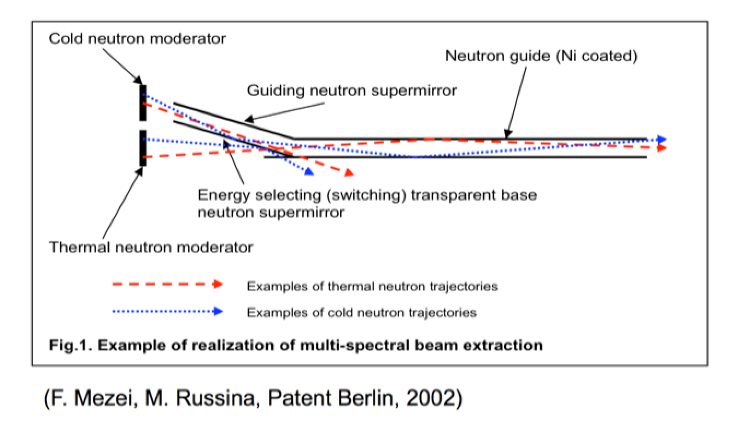
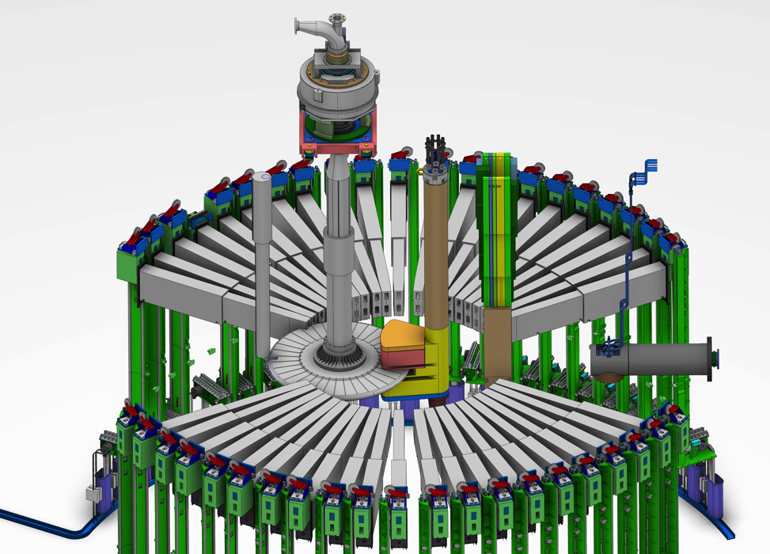
The European Spallation Source will be the most powerful spallation neutron source in the world for neutron scattering experiments. It will have 42 beam ports as a grid available for a variety of instruments.
Double decker for n extraction above and below moderator

Slide 3
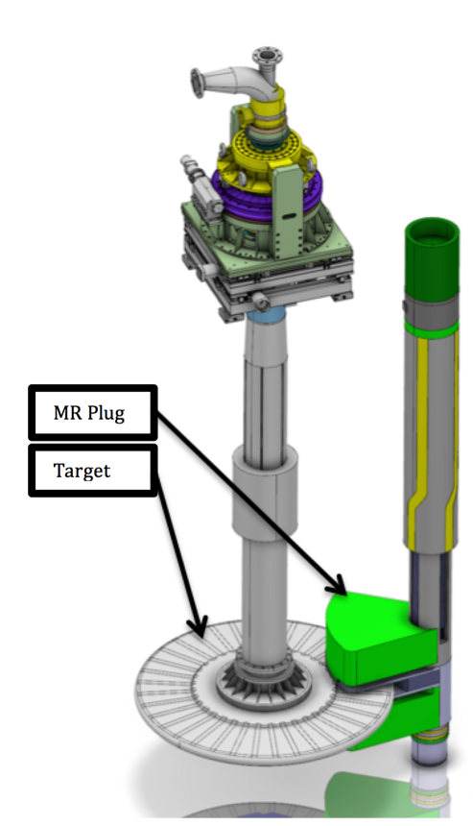
Moderator-reflector plug
Reflector
Cold Moderator
Thermal Moderator
Lower Steel Frame
(courtesy D. Lyngh)

Slide 4
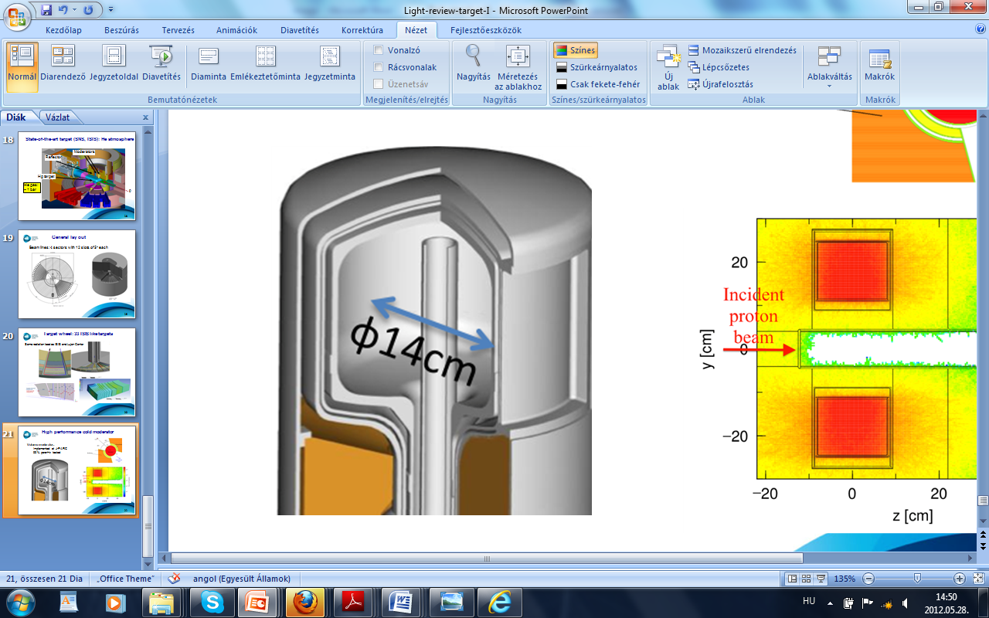
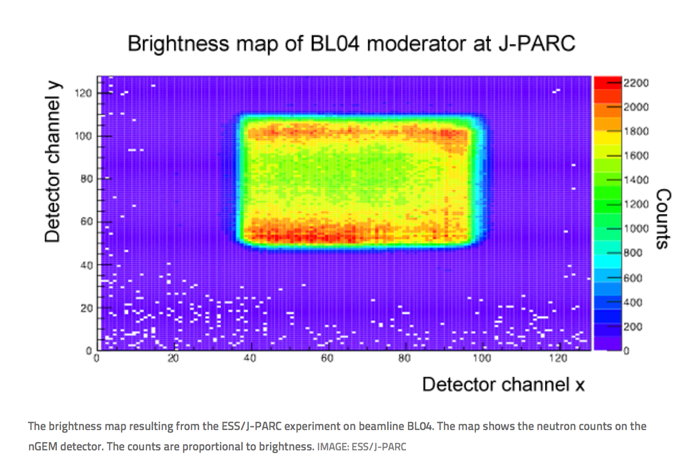
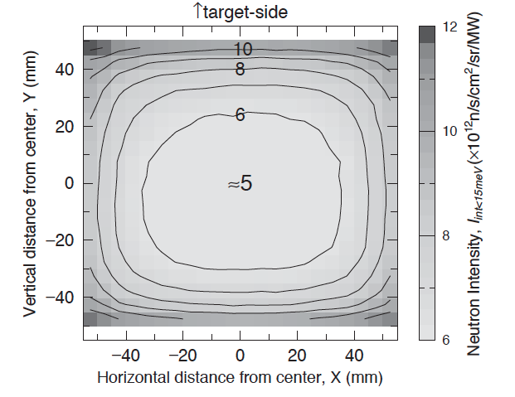
Experimental confirmation at J-PARC of physics effects behind flat moderator concept
- Brightness distribution of cold coupled moderator performed at MLF at J-PARC in April 2015 by J-PARC-ESS team
- results give full confirmation of the brightness distribution across the moderator: higher in target and reflector side
- Experimental confirmation of physics
principles of flat moderators
>99% para-H₂
J-PARC
(Kai, 2004)

Slide 5
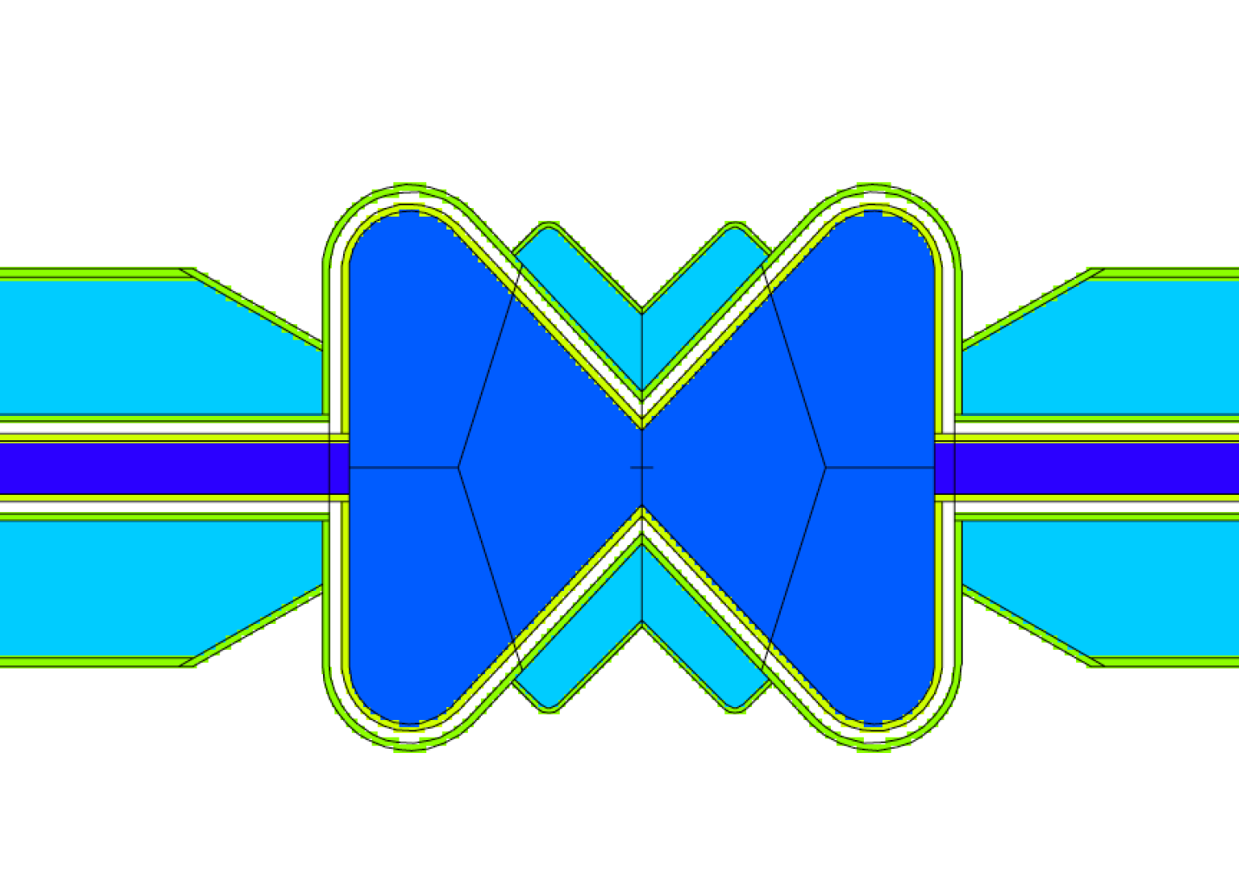
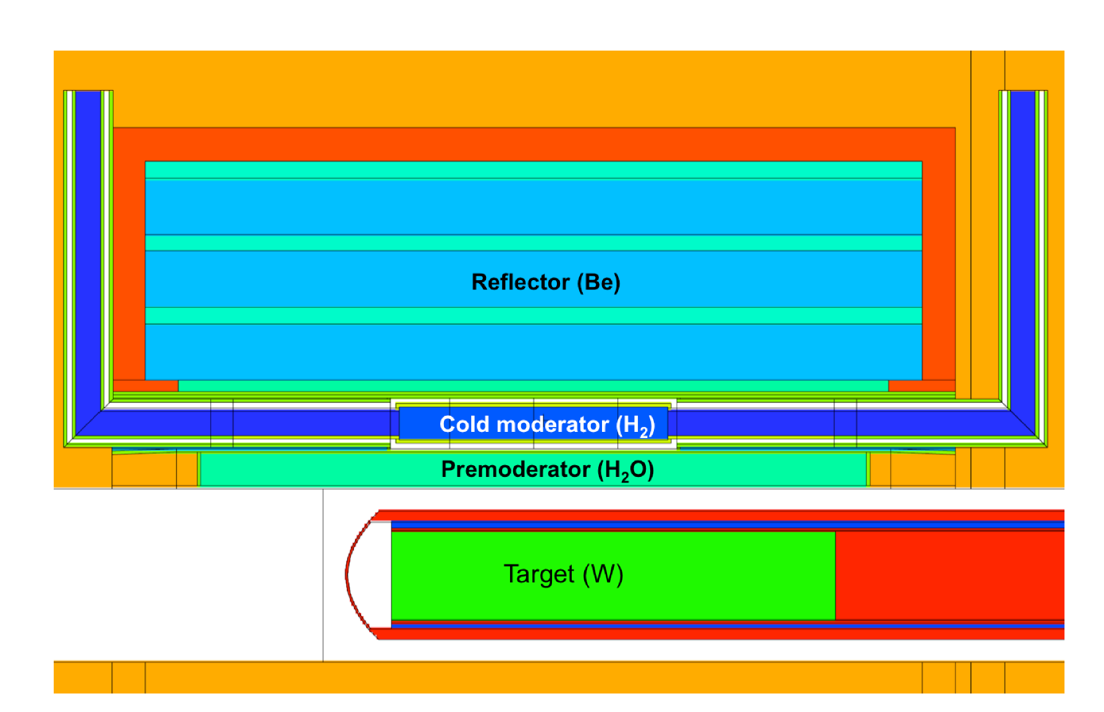
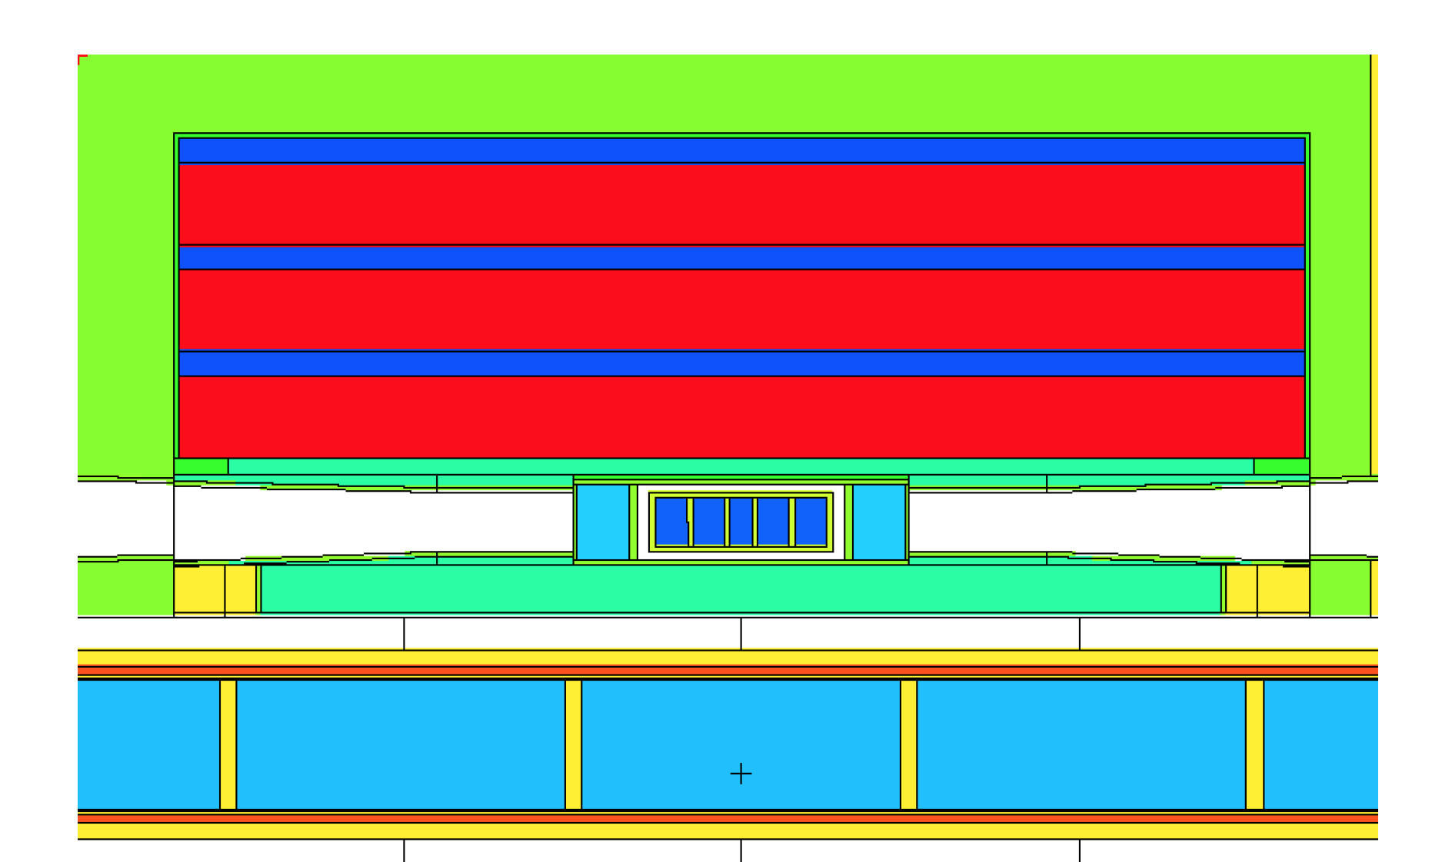
“Butterfly” geometry gives the best design for:
Cover 2 × 120° sector uniformly
3 cm flat as selected with instruments
Ease bispectral extraction
High cold and thermal brightness in a single moderator
H₂
H₂O

Slide 6
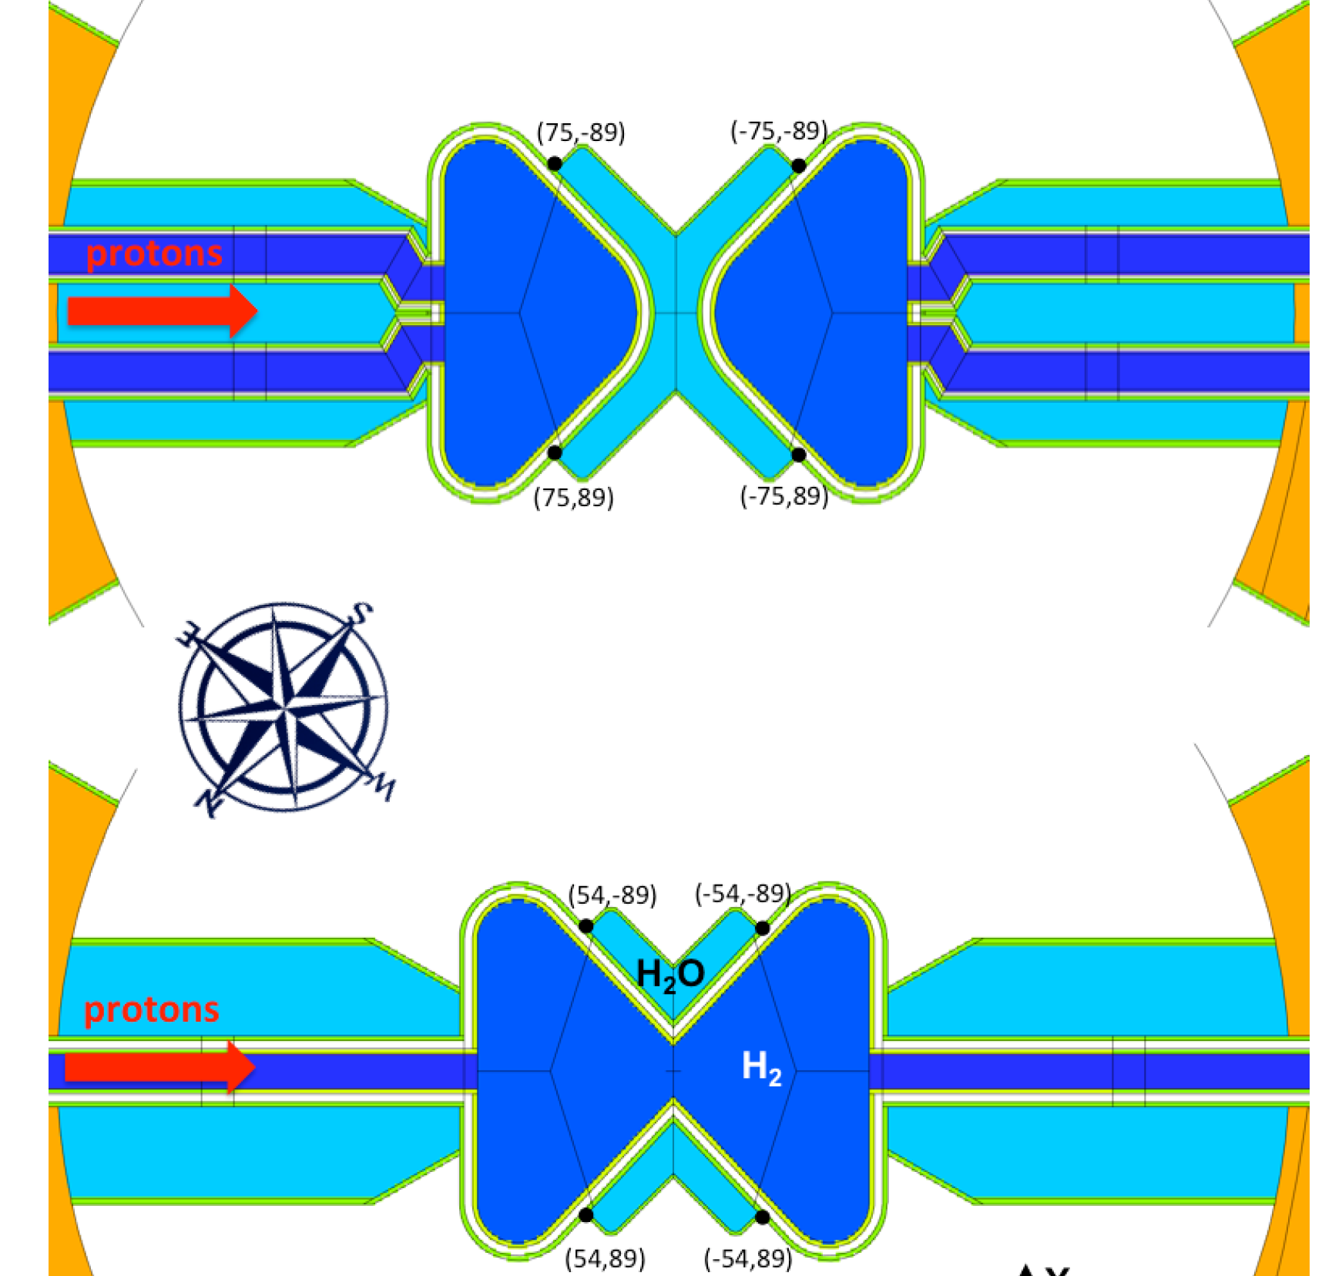
2016: focal point change
Mark I
Mark II

Slide 7
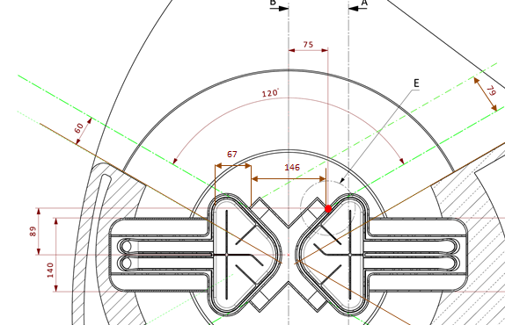
2016: focal point change
7cm beam width
(K. Andersen)

Slide 8
Proposed new geometry
7cm beam width
focal point moves by 21 mm
(K. Andersen)

Slide 9
Advantages
most intense part
of water visible
additional cold width
for edge beamlines
~25% higher cold
brightness for edge beamlines

Slide 10
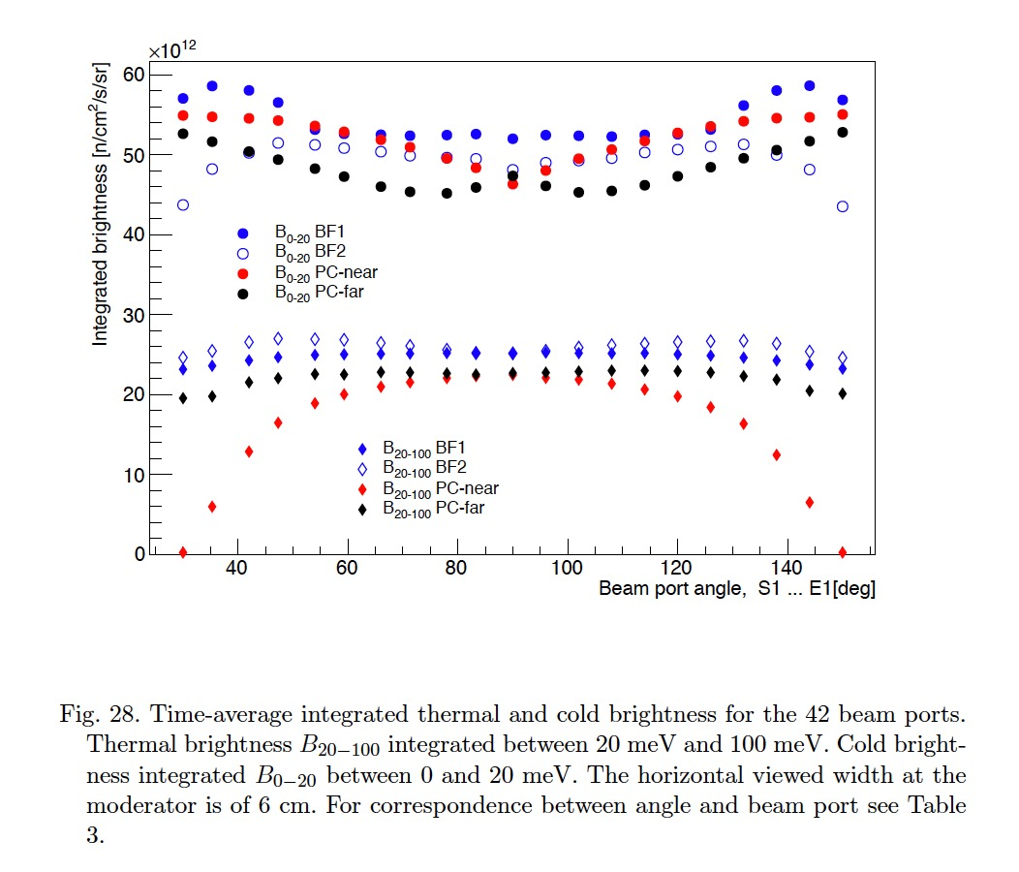
BF1 is the best choice for bi-spectral moderator for ESS
Brightness calculations including real beam extraction configuration (beamline orientation) show the advantage of BF1 over the other options
BF2 thermal extraction very difficult
pancake with two beam extraction options gives either too low cold or thermal brightness
Cold brightness 2.5 times higher than TDR
14% to 42% effect

Slide 11
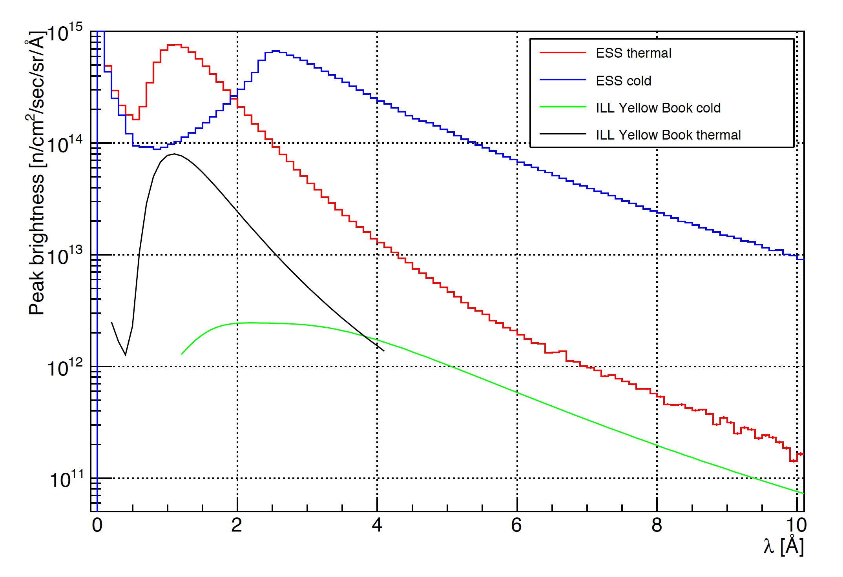
Brightness spectra comparison to ILL
ILL Yellow book: Institut Laue-Langevin. `ILL Yellow Book 2008.' http://www.ill.eu/?id=1379 , 2008.

Slide 12
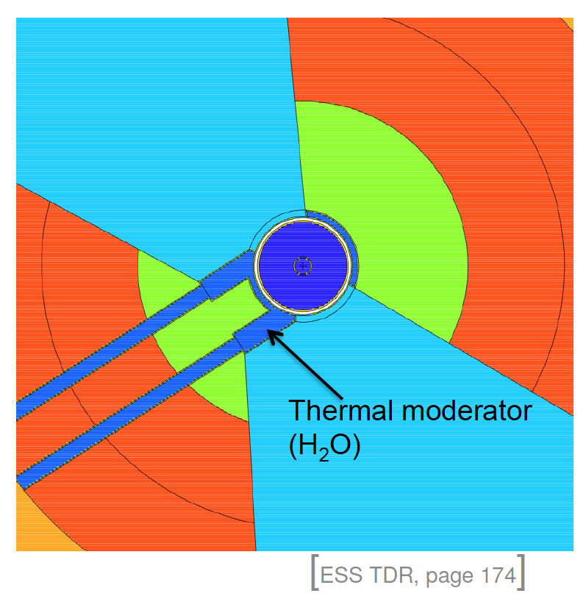
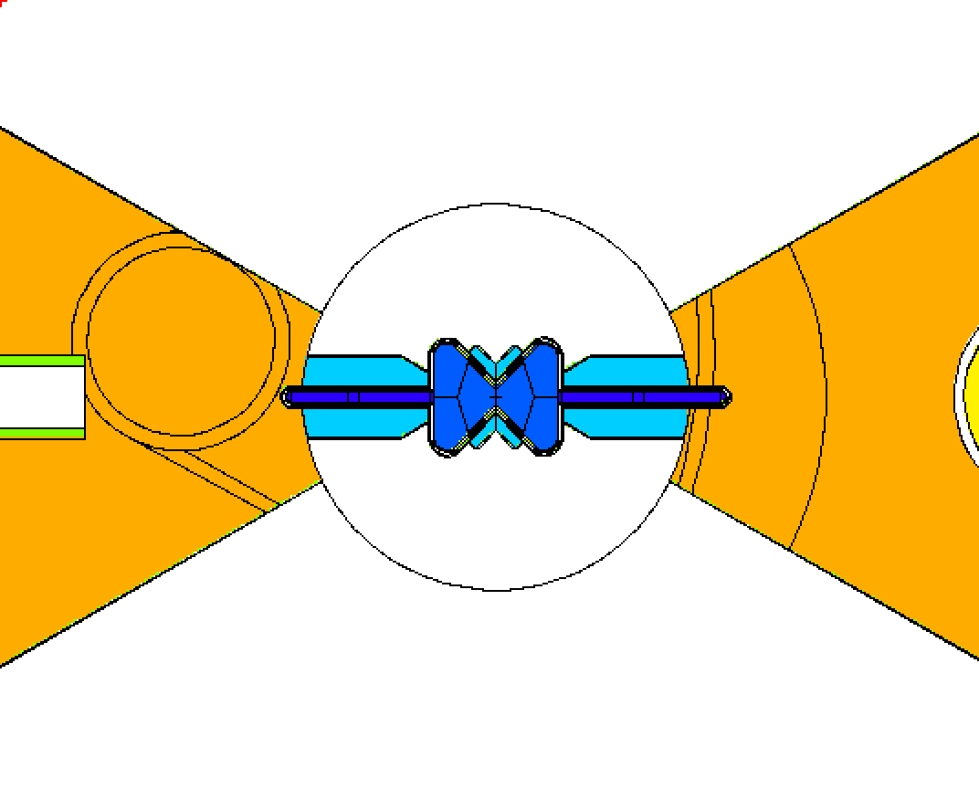
Six years long moderator design and decision process has come to an end…
2012-13: TDR volume moderators
  Two identical high-intensity moderators above and below the target
  2X60 openings
2014: Pancake moderator
  Factor 2.5 in cold brightness
  Difficult bispectral extraction
  Several options considered for bottom moderator
2015: Butterfly BF2 moderator
  Double-decker beam extraction in 2X120 sectors both above and below target
  3 cm on top, 6 cm on bottom
  Higher thermal brightness than pancake
2016: Butterfly BF1 moderator
  Maximum cold and thermal brightness
  Better beam extraction
  All instruments look at top moderator
  Steel reflector at the bottom
  Keep double decker, bottom moderator space available for future upgrades and novel ideas.
2012
2017

Slide 13
… The available space for the bottom moderator should be used for something good at something different
Some possibilities:
High-intensity D₂ moderator for e.g. fundamental physics (nnbar)
Extreme brightness moderator (e.g. small cross section tube moderator) for only a few beam lines
VCN moderator
  low-T materials for VCN production
  use of nanodiamonds to increase the high-wavelength range

Slide 14
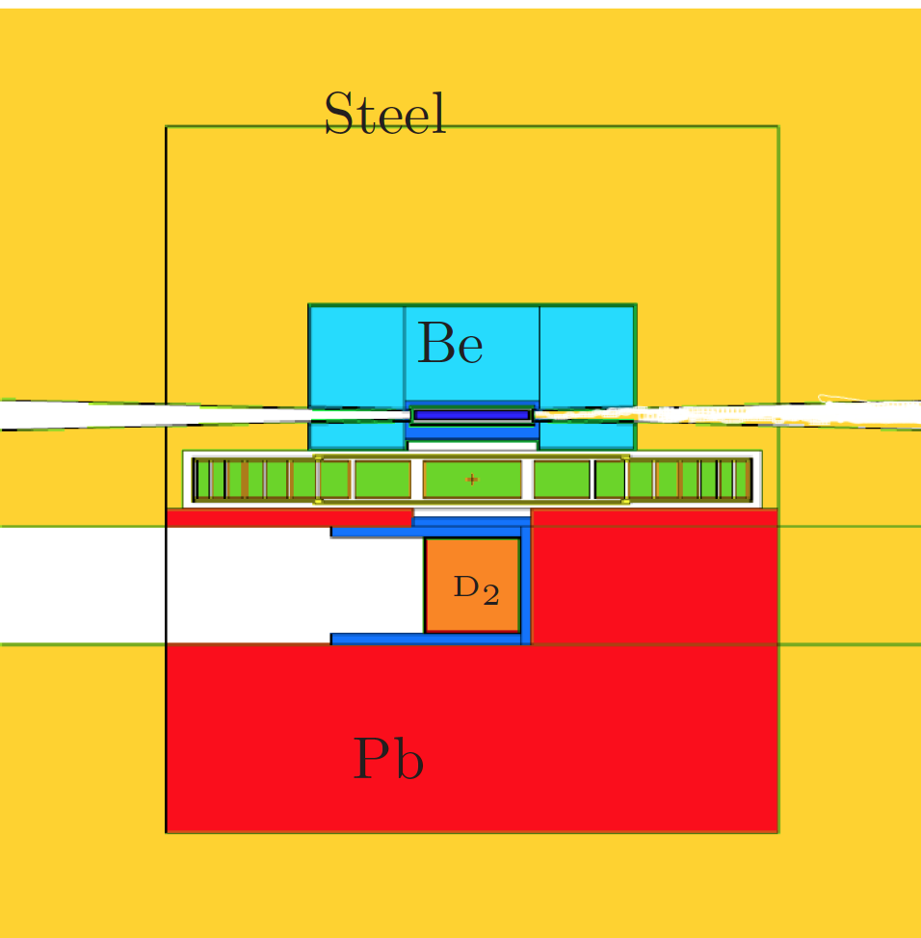
Example: nnbar
High-intensity D₂ moderator for e.g. fundamental physics (nnbar)
Factor 3 gain in intensity
Neutron-antineutron oscillation experiment
Large international collaboration
Letter of intent - 2015
E. Klinkby et al., https://arxiv.org/pdf/1401.6003.pdf

Slide 15

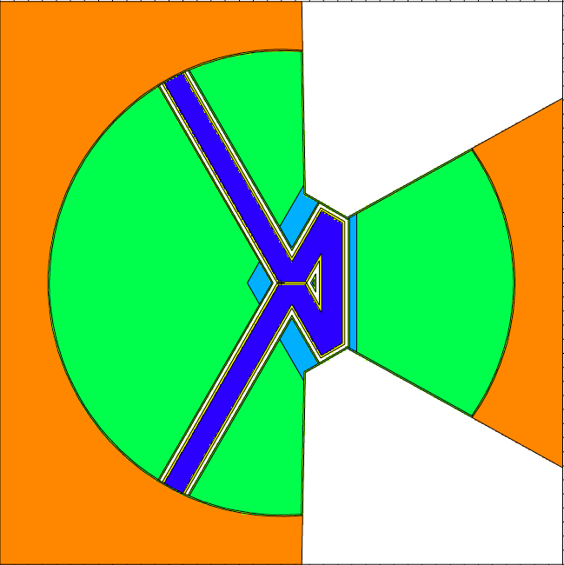
Example: tube moderators
0-5 meV Brightness:
50-100% increase comparing with BF2
F. Mezei et al. Journal of Neutron Research 17, 101-105 (2014)
See also UCANSVI, Xian, China (2016)

Slide 16
Cold moderator mechanical development at ESS
Bessler, Yannick (FZJ)
Lyngh, Daniel; Kickulies, Marc (ESS)
ESS-J-PARC workshop, 18 January 2018

Slide 17
Butterfly Cold Moderators
Neutronic Design
Mark I
Mark II

Slide 18
Mark I: Heat deposition and temperature

Slide 19
Mark I: Temperature analysis u.cM
(q ≠ con.)

Slide 20
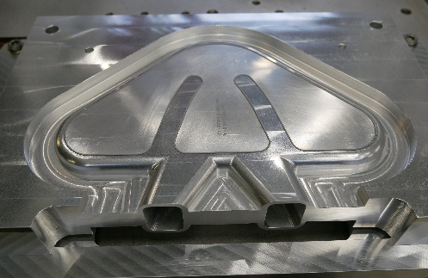
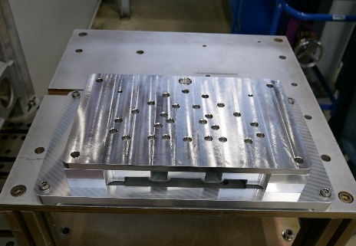
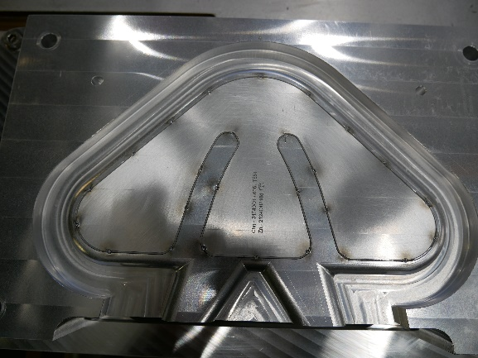
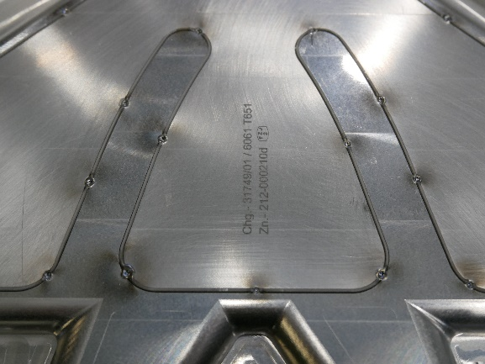
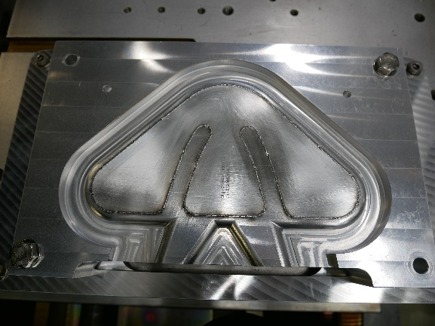
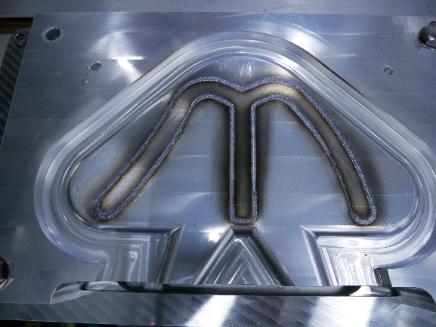
Electron-Beam Welding of the Cold Moderators
Resp. engineers: FZJ: Y. Beßler, F. Hanusch, ESS: Daniel Lyngh, Marc Kickulies
Assembly while the outer part is still part of the original aluminium block
Spot welding the four components to each other in a specialized fixture
Spot welding of two fillers and two moderator parts completed
Stamped assembly for material traceability purposes
Seam welding of filler completed
Welding completed, before removing the Mg vapor by pickling
January 2018

Slide 21
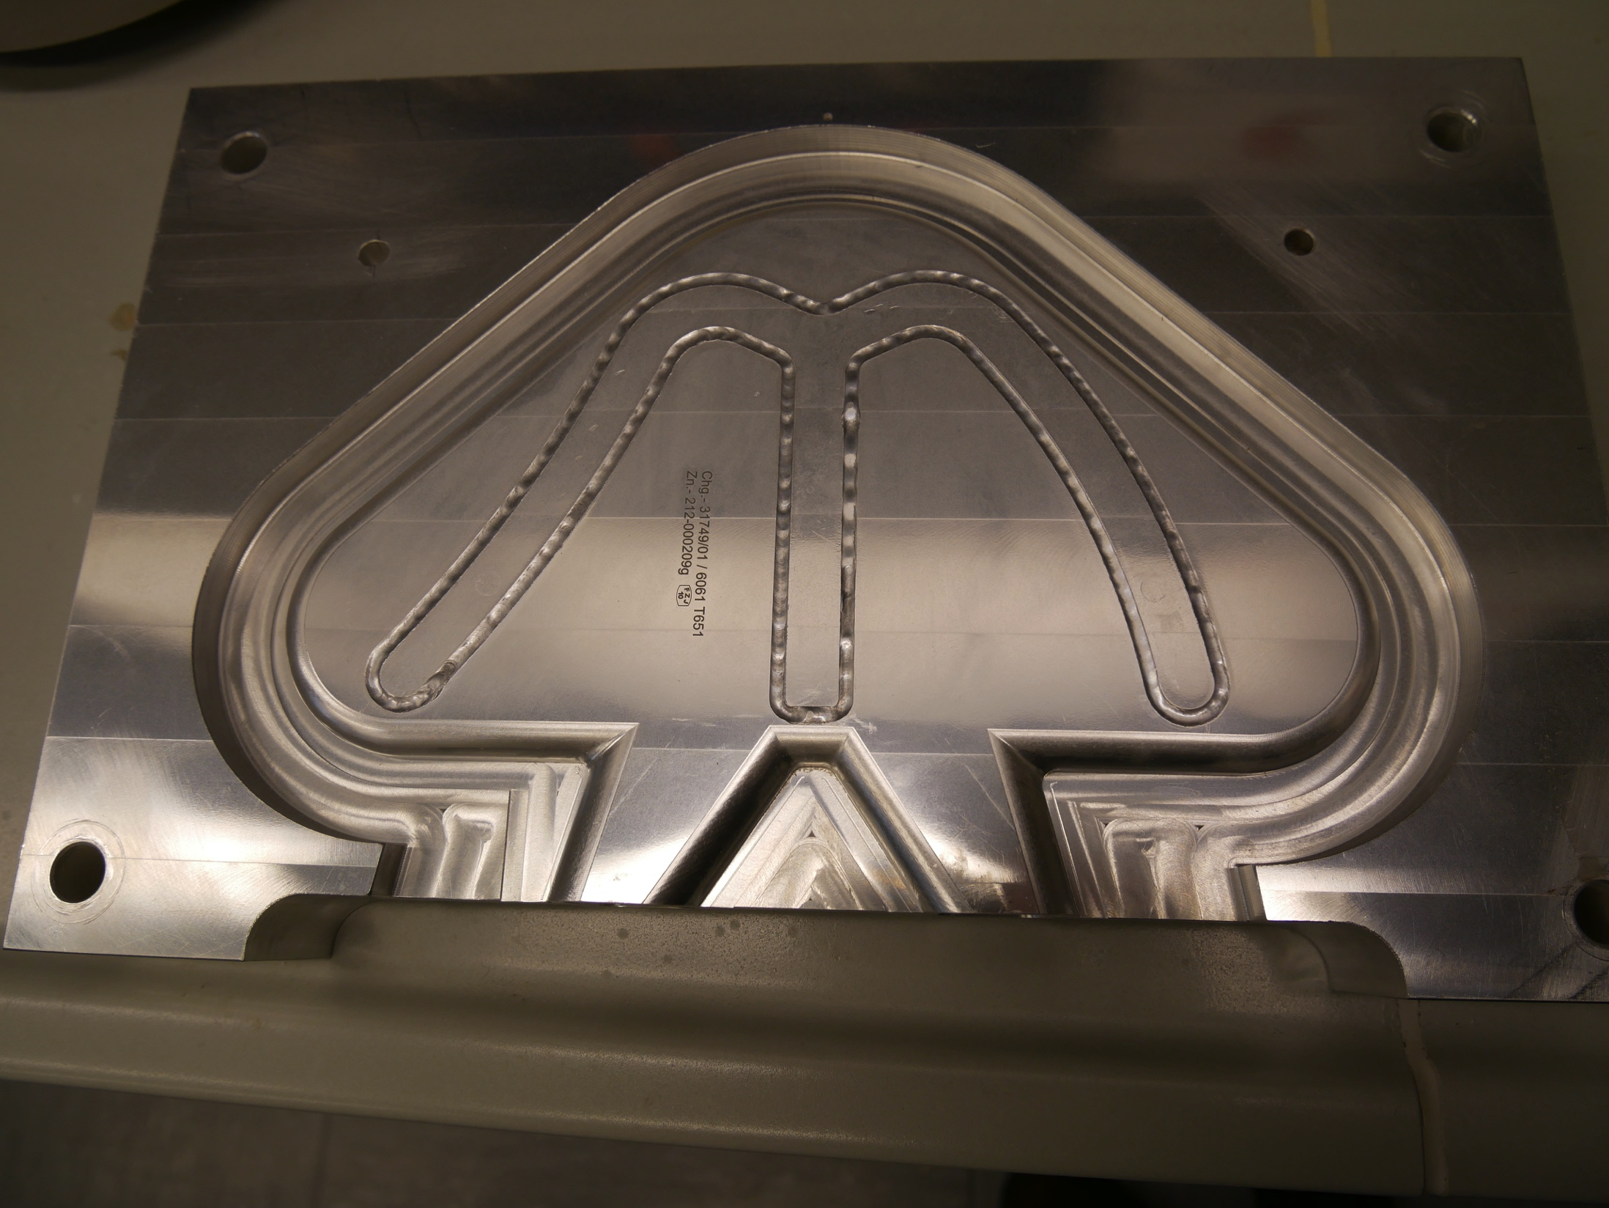
Mark 1: Welding Complete

Slide 22
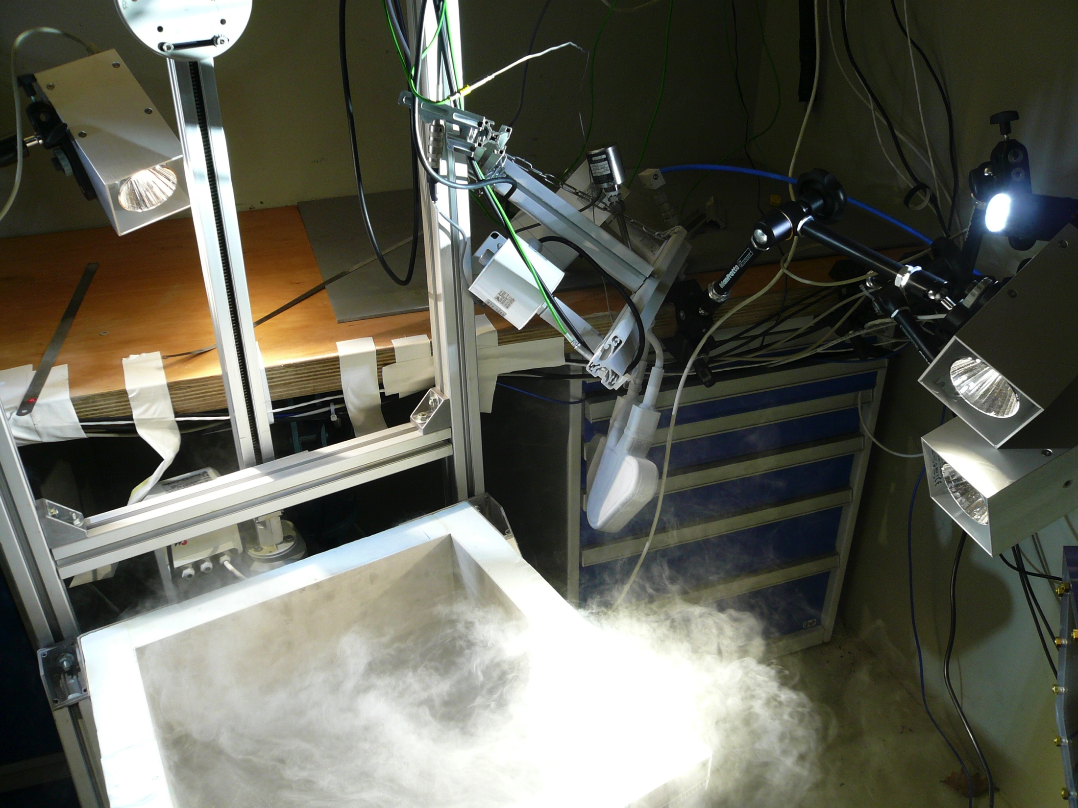
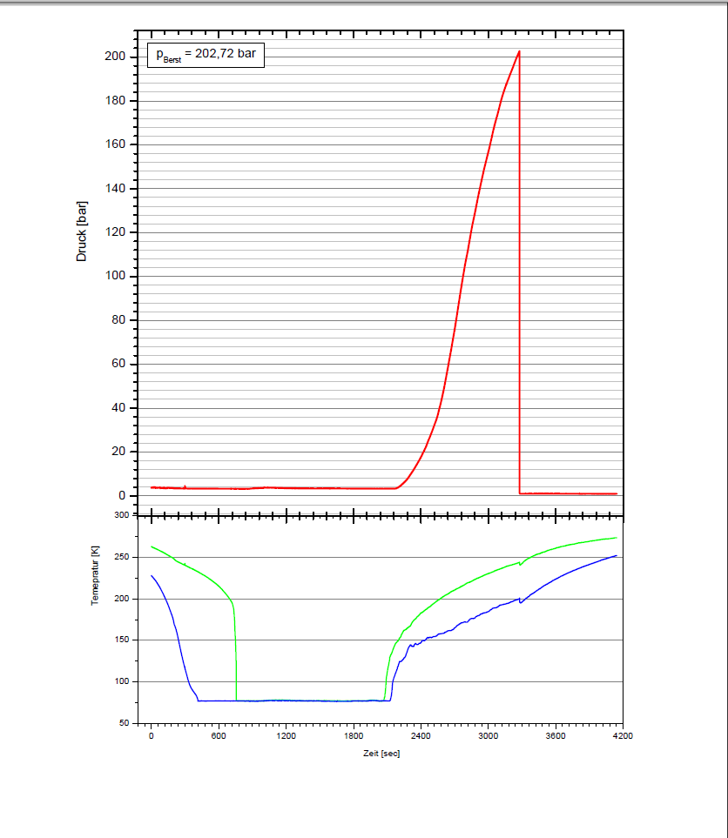
Mark I: Cold Burst Test

Slide 23
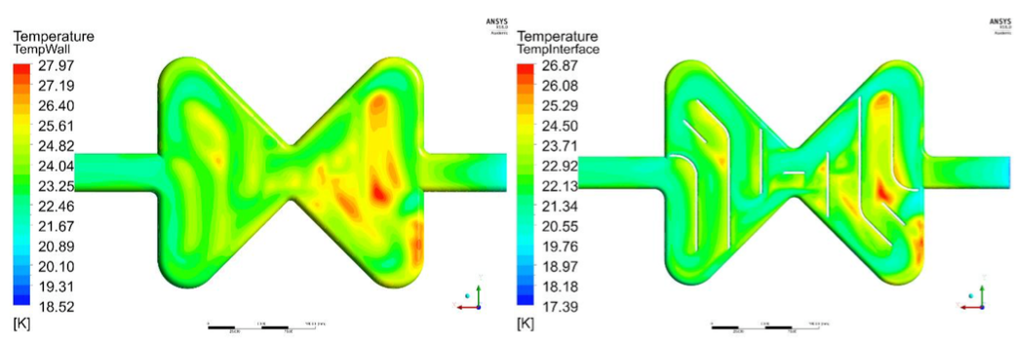
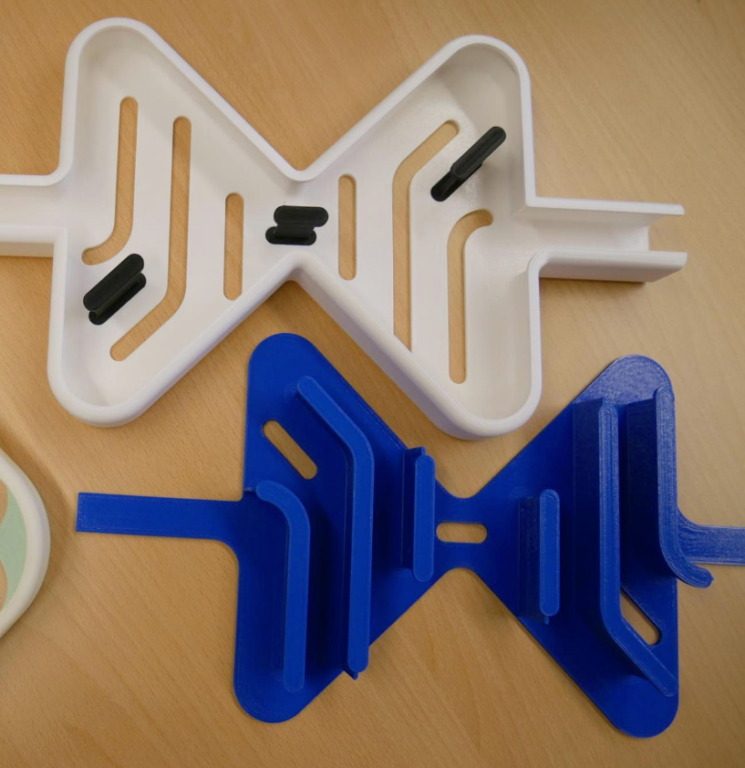
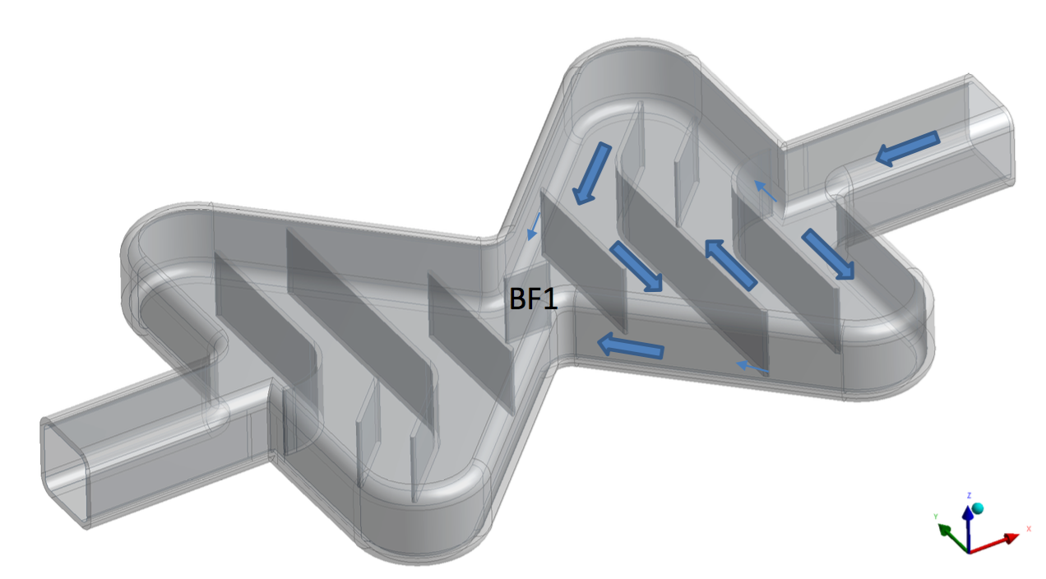
Mark II: Temperature and Geometry

