Slide 1



Status of choppers (Fast Chopper, To chopper) and Shielding Performance
K. Aizawa
Technology Development Section
MLF Division
J-PARC Center
JAEA

Slide 2
Outline
Chopper
  maintenance history and management
  developing fast and T0 choppers
Shieldings
  regulation
  examples
Summary

Slide 3
Chopper

Slide 4
History and schedule of chopper maintenance
JAEA BL

Slide 5
Record of maintenance history
We use this format to manage maintenance records for individual chopper.
・Machine name
・Manufacturer
・Purchase/install date
・Maintenance day / period
・Maintenance content
regular / emergency
We can judge the individual chopper performance.
・Low speed disk chopper
good performance
・Fermi chopper
good performance
・T0 chopper
necessary for development
・High speed disk chopper
(fast chopper)
necessary for development

Slide 6
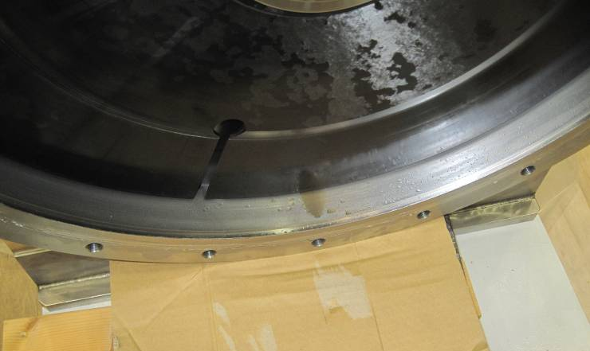
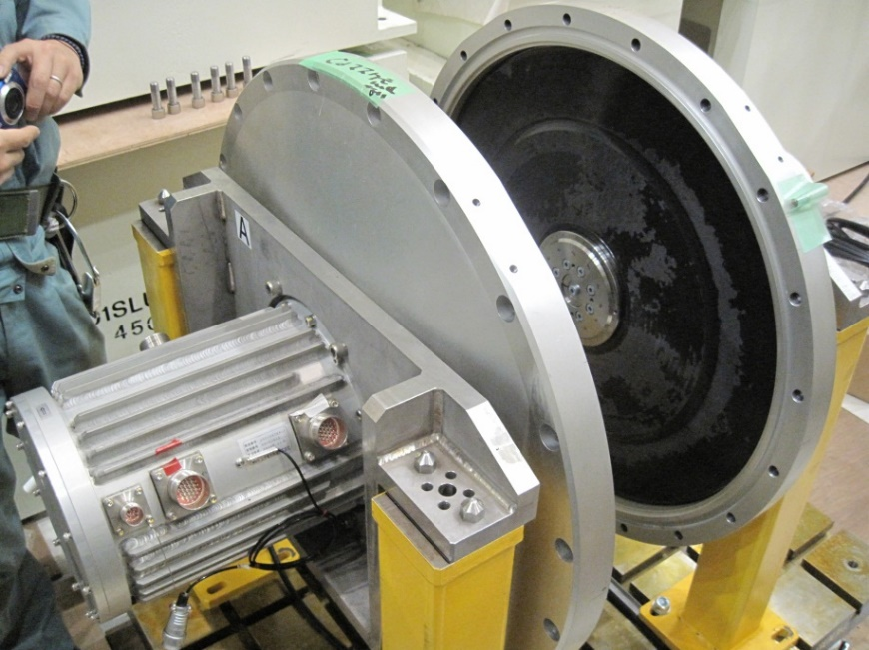
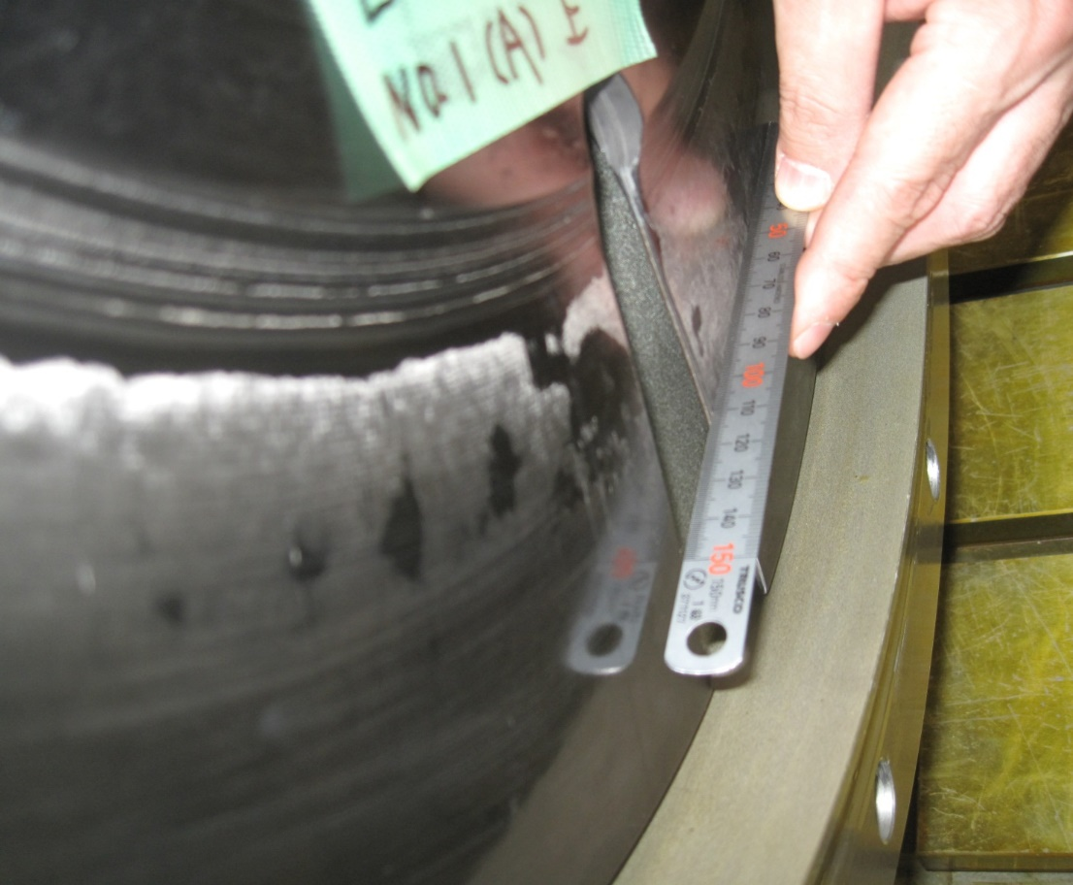
Our experience for fast chopper
AMATERAS, BL14
downstream
Unknown liquid
Unknown liquid
upstream
upstream disk
Deformation of slit part with several mm step

Slide 7
Fast and middle speed chopper of BL02
DNA, BL02
No. | role | Pos. L [m] | Freq. f [Hz] | Discs | Slits | designed value
1 | Pulse shaping | 7.75 | 225-50 | Double (counter rotating) | Quad: 1, 3, 3, 3 cm | 225 Hz ← 300 Hz
2 | Frame separation | 11.625 | 150-50 | Single | Quad: 24.7 deg. each | 150 Hz ← 200 Hz
3 | Frame separation | 23.25 | 150-50 | Single | Double: 56.6 deg. each | 150 Hz ← 200 Hz
Current
No.1
No.2
No.3

Slide 8
Problem of 1st generation ｆast chopper
Speeding up
  Maximum speed of 1 slit blade is 300 Hz at BL14
  Maximum speed of 4 slit blade is 225 Hz at BL02
2. Durability
  Due to aging change of blade during operation, the vibration increases, so it is necessary to lower the rotation.
3. Control
  Insufficient control performance of magnetically levitated bearings
Development and target of new fast chopper
  Our goal
  350Hz
  High durability
  High vibrational resistance

Slide 9
History of Fast chopper development
Improvement of existing fast chopper
2013 Start of development of speeding up of blade
2014 Prototype of peripheral connecting shape blade
2016 Change of blade thickness and adhesive, trial blade
fabrication, rotation test
2017 BL14 blade (CH03) fabrication, installing and
stable 300Hz operation
2018 BL02 multi-slit blade fabrication and installing
new type of fast chopper
2019 BL14 high performance prototype of 350Hz blade
and rotation test : adhesive, thickness of blade, carbon
type of prepreg
2020 Actual machine

Slide 10
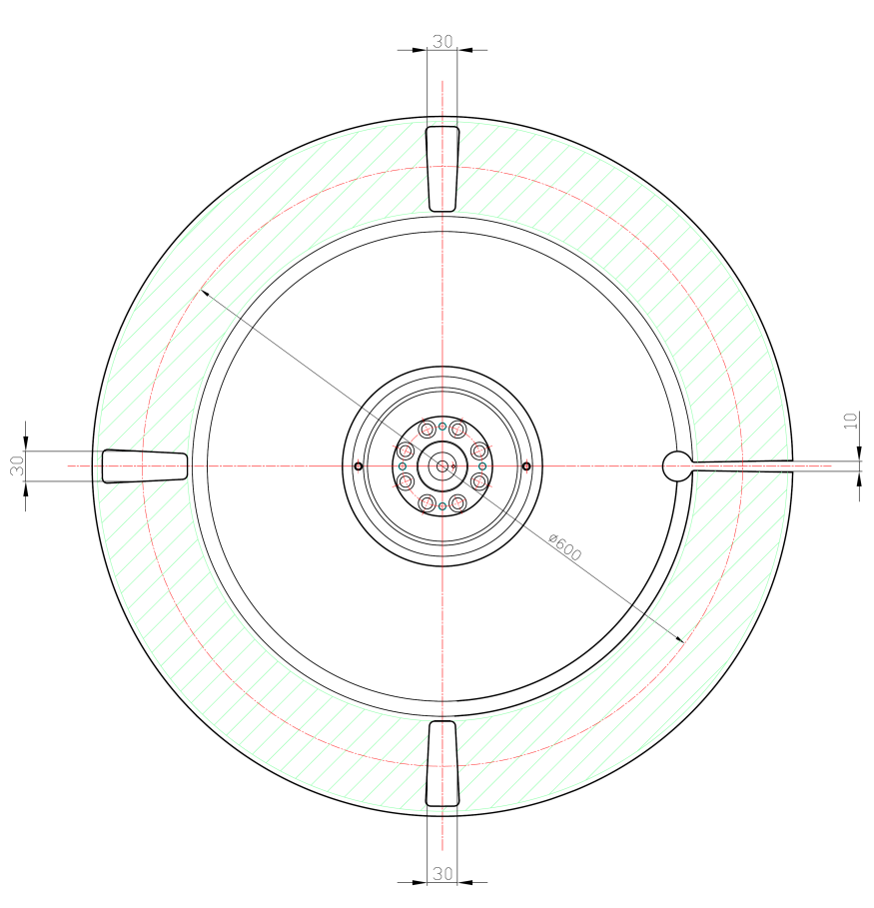
Improvement of existing chopper blade : BL02
Prototype of peripheral connecting shape blade
Existing blade
open-end slit type
New blade with B4C impregnation not 10B
closed-end slit type
same diameter
offline test is under consideration

Slide 11
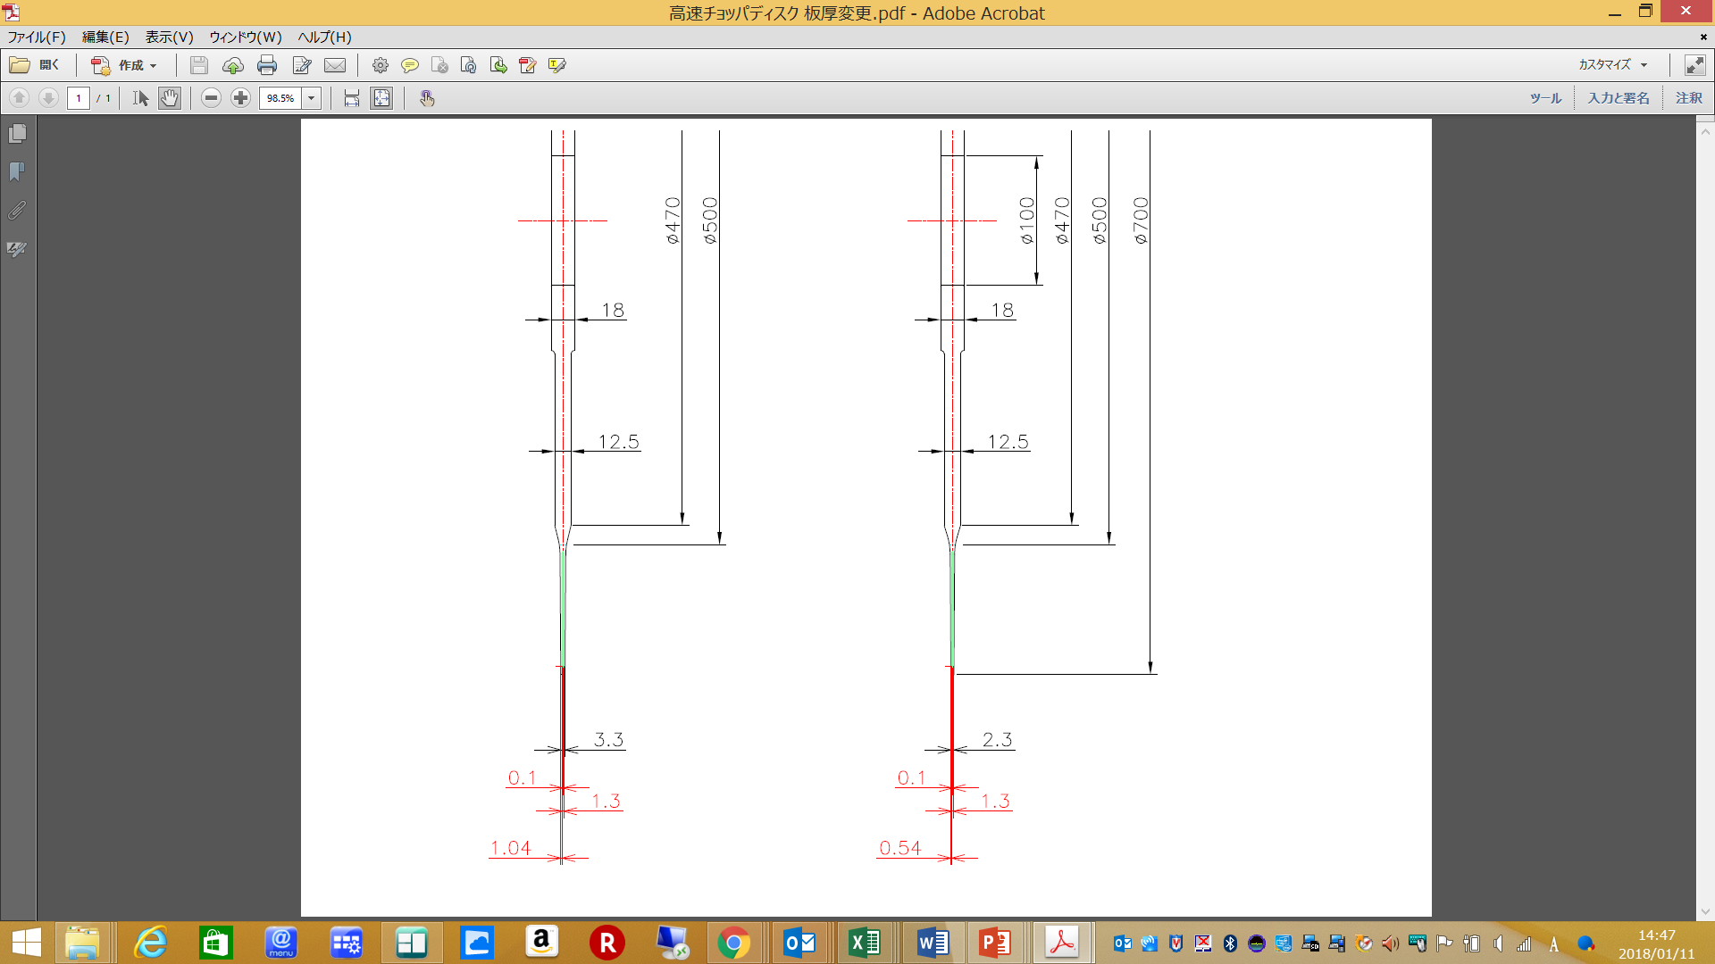
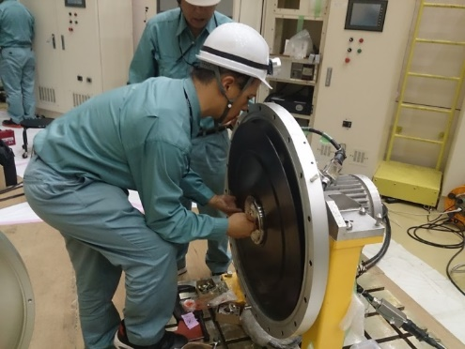
Improvement of existing chopper blade : BL14
Thicker type
New blade :
・Change of adhesive
higher strength
・Thicker thickness of CFRP
0.1 mm thickness for 1 layer
0.54×2 → 1.04×2=2.08 mm
・Carbon type of prepreg
0.1 mm thickness for 1 layer
・same diameter
CH01
CH02
CH03
stable 300Hz operation
Fast chopper of BL02 will be changed to this type blade in 2018.
Installing new CH03 blade at BL14 in 2017

Slide 12
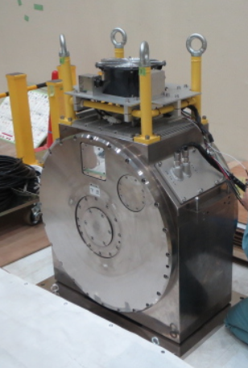
T0 chopper
Long length type
BL04, BL12, BL21, BL22,
BL23
Max. 100Hz
Long length
Water cooling
Manufacturer : MTC
(Metal Technology Co.).
Our experience
water leakage due to
insufficient coupling design at BL04 in 2017
Coupling was replaced for all T0 chopper.
500meV
beam
1587mm
BL12
Compact type
BL01, BL09, BL11, BL15,
BL17, BL18, BL20
Max. 50Hz
Short length
Air cooling
Manufacturer : KSL
(Kobe Steel , LTD)
Our experience
troubles due to vacuum
burst signal
T0 Chopper OFF
BL15
T0 Chopper ON
beam
500mm
25Hz

Slide 13
Most used existing T0 chopper
Compact type
Specification
Manufacturer : KOBE STEEL, LTD. (KSL)
Type : horizontal axis
Rotation speed : 25,50Hz
Hammer : 70～84mm square, single
Materials of Hammer : Ni alloy
Diameter : 600mm
Bearing : ceramics ball bearing
Motor : outer rotor, induction motor
Cooling : air cooling
Experiences
Discharge problem : motor state coil in vacuum
power cable terminal in vacuum
power cable covering in vacuum
Rotation speed : unstable 50Hz operation
Compact inside motor type T0 chopper did not work well.
16 July 2009
Goal of new T0 chopper
Rotation speed : Max. 100Hz
(original designed specification)
long term maintenance period : > 50,000 h
High reliability
2015 | 2016 | 2017 | 2018
・designing ・element trial production | ・prototype machine | ・long term operation test ・prototype machine | ・operation test ・actual machine
Notes:
T0 Chopper : JAEA,KSL 7, KEK,MTC 6

Slide 14
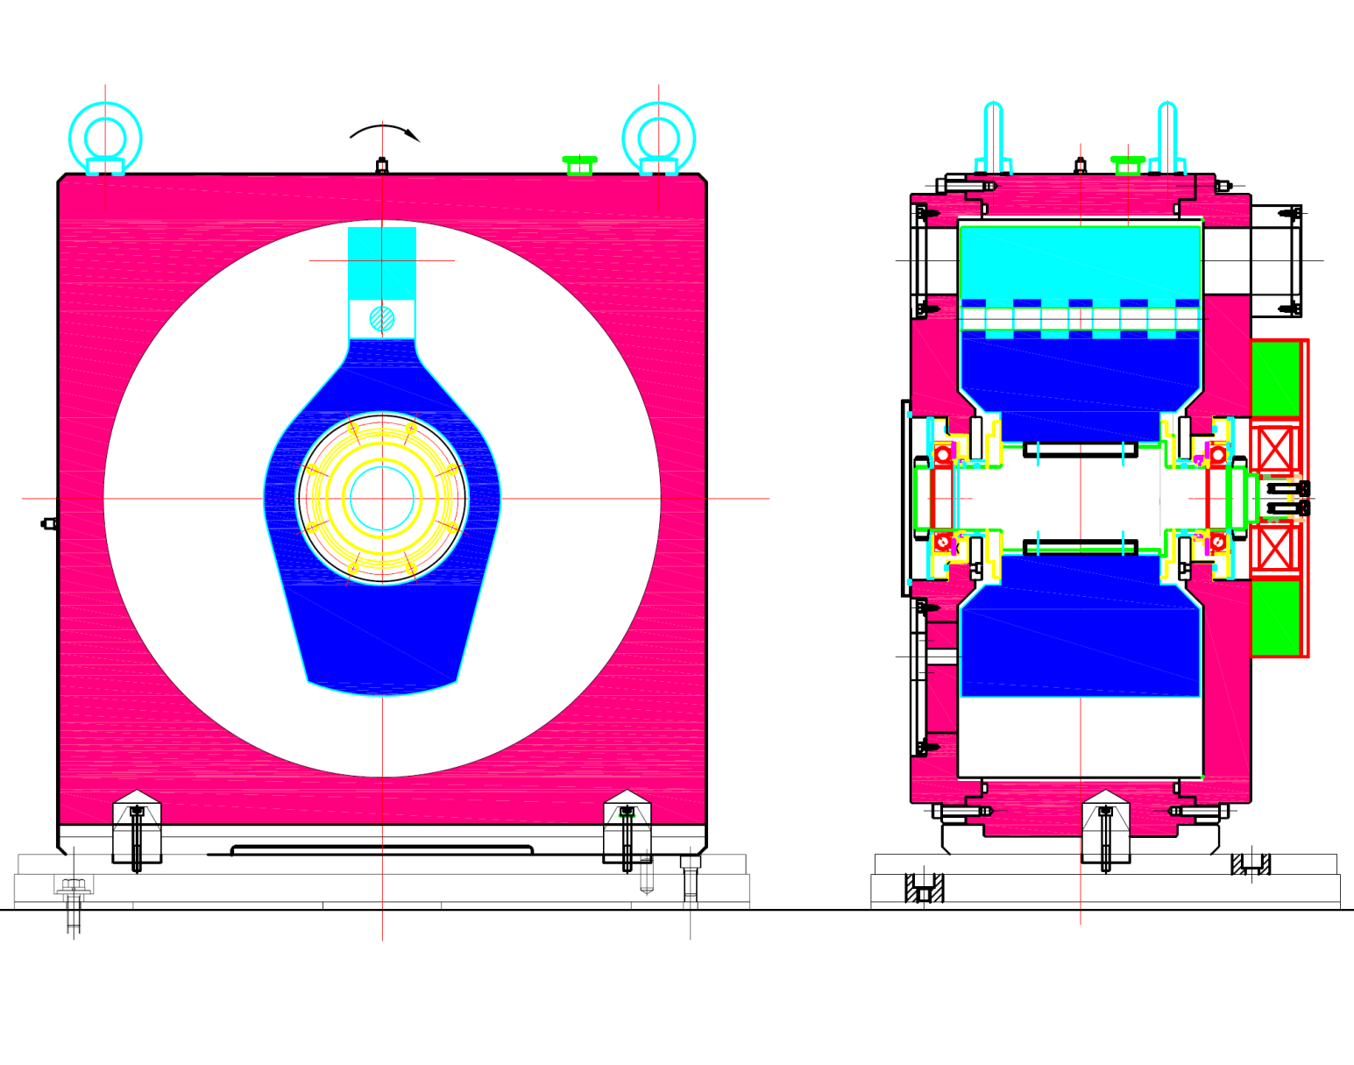
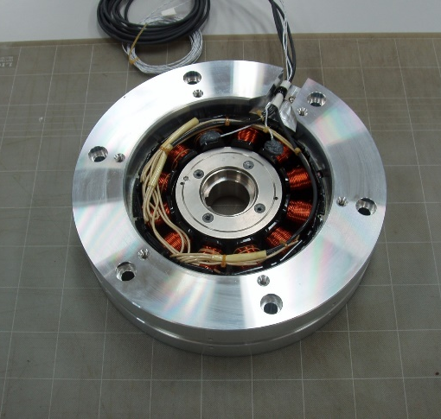
New high durability T0 chopper
Thin permanent magnet (PM) motor
No resolver
Single hammer
Air cooling
High rotation speed : 100Hz
High durability : 50000 h continuous operation
Mount compatibility (same length and attachment)
Single hammer
Brazing
Canned thin PM motor
Power : 5.8kW
Max. rotation speed : 60000rpm
Max torque : 9.2Nm
Thickness : 80mm
Same mount attachment

Slide 15
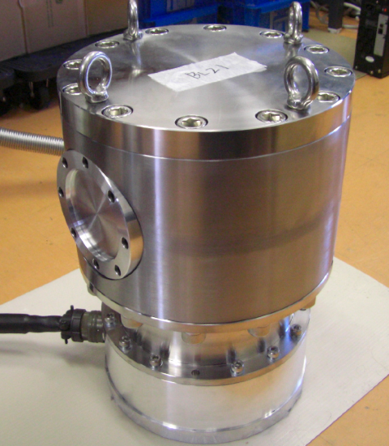
Fermi chopper
Low speed disk chopper
Works well
Max. 600Hz
MTC , SKF, Mirrotron
Works well
various type
single
double
aperture angle
KSL
single disk type
double disk type

Slide 16
Shieldings

Slide 17
Radiation Protection Concept in J-PARC
Requirements on External Dose
Contributions of all facilities in the site, including the research reactors, which are not J-PARC facilities, need to be counted.
J-PARC contribution should be less than 0.05 mSv/3 month.
Site Boundary : 0.25 mSv / 3 months
(0.115 μSv/h)
3 months => 2,184 h
Buffer Area Boundary : 20 μSv / 1 week
(0.5 μSv/h)
Controlled Area Boundary : 1.3 mSv / 3 months
(2.6 μSv/h)
3 months => 500 hours
Region of Regular Access: < 1 mSv / week
(25 μSv/h)
1 week => 40 hours
Neutron instrument outer surface
Restricted & Forbidden Area

Slide 18
Radiation Controlled Area of MLF
Controlled Area
< 0.25 μSv/h
< 25 μSv/h
Experimental Hall
Proton Beam
Muon Target
Neutron Target
Experimental Hall
The external dose outside of the secondary beamlines in the Experimental halls need to be less than 25 microSv/h for keeping regular access of users.

Slide 19
Guideline of Shieldings
Prefabricated piece
  Basically, because neutron instrument is assumed to be occupied individual beamline in ten years period, so it must be easy removable capability.
  Max weight is approx. 10 t
Shielding materials
  If shielding criteria, 0.25 μsV/h, is satisfied , choice of materials are free.
Tolerance of fabrication and streaming blocking
  Basically, standard tolerance for civil engineering structure is adopted.
  Overlapped structure between pieces is necessary.
Assessment of radiation dose is performed by using ray trace software, PHITS.
  We doubled the evaluated value obtained by PHITS as the likelihood and use it to assess radiation dose.
Installation
  3 beamline-position-markers on the individual beamline, and beam position marker of the flight tube are used.

Slide 20
Examples of Shielding materials

Slide 21
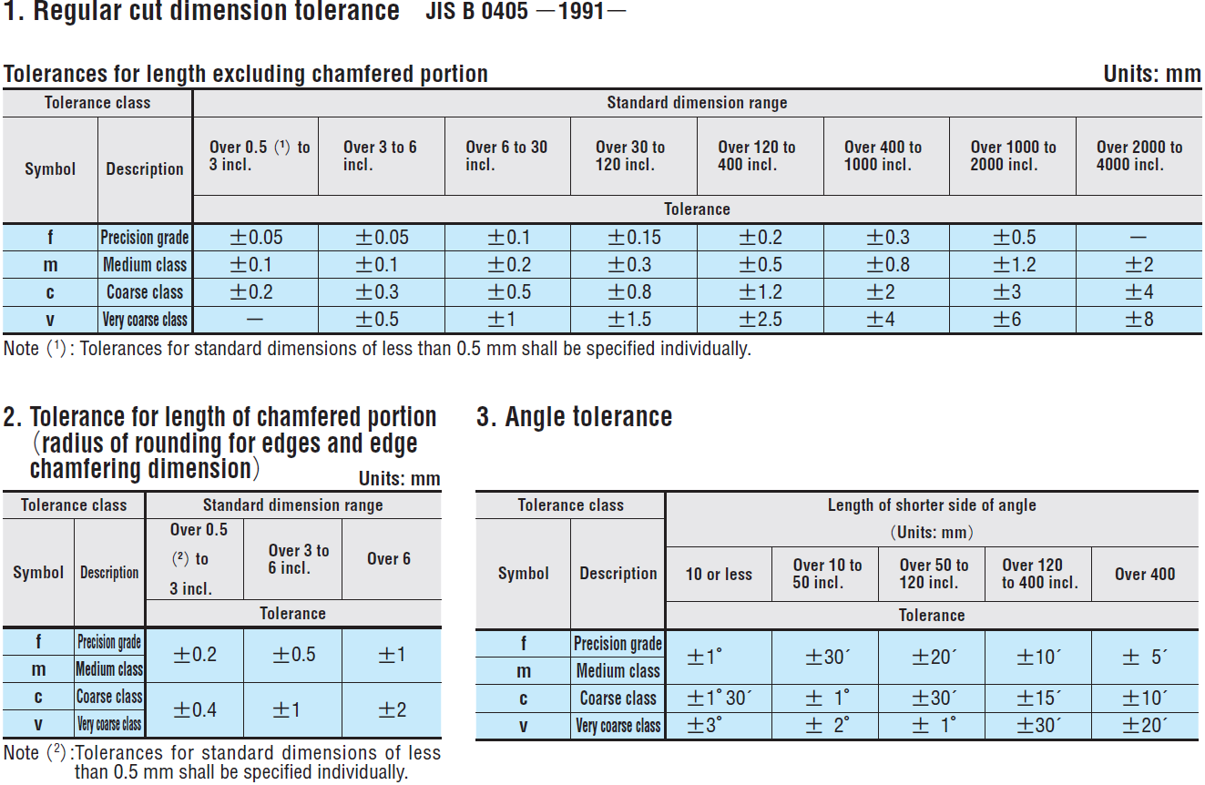
Standard tolerances for shieldings
Basic regulation :
Machining : JIS B 405 m , Medium class
Welded structure : JIS B 405 c , Coarse class
Concrete structure : JIS B 405 v , very coarse class

Slide 22
Fabrication of BL10 shieldings at workshop
Delivery to workshop
Fe plate
Machining
Piece assembly
Piece measuring test
Measuring test
Grinding
Rainforcement
Concrete placement
Trial assembly
Trial assembly
Borax resin placement
Shipment to MLF

Slide 23
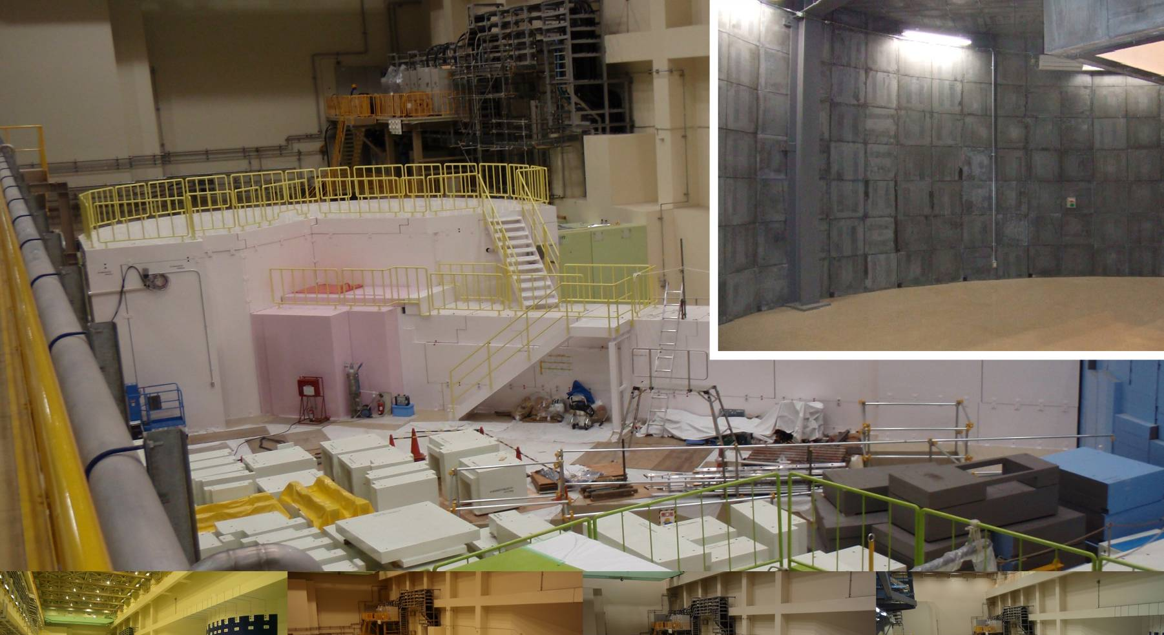
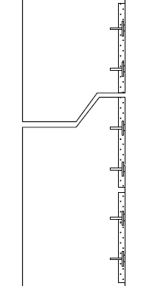
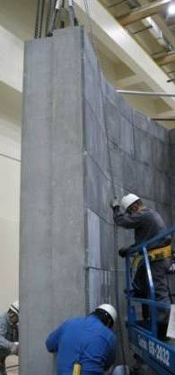
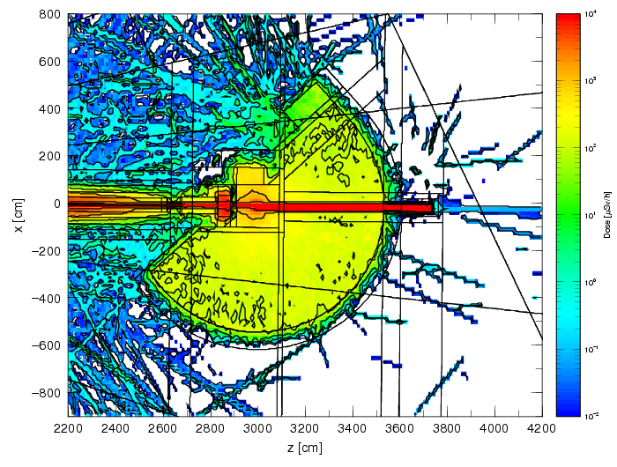
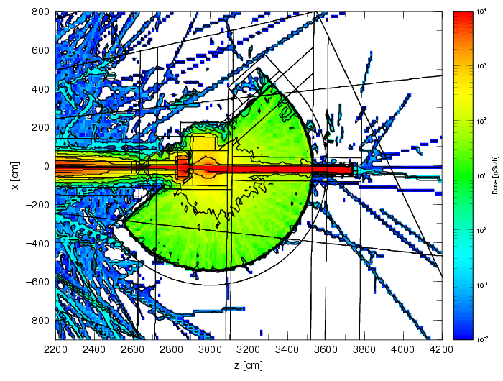
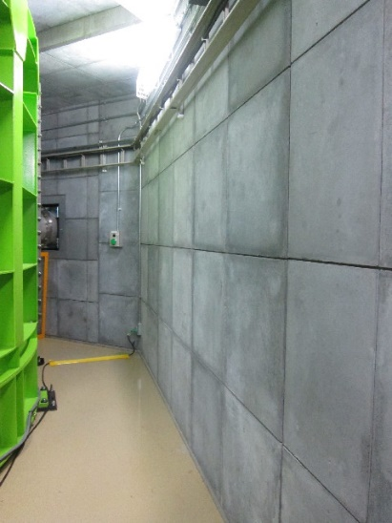
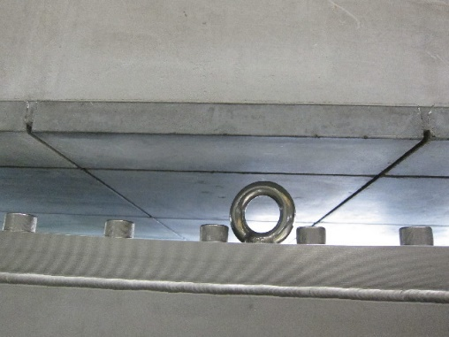
Boron mortar shielding
Precast Concrete Panel with B₄C Mortar, FUJITA
BL02, BL14, BL17, BL18, BL22
BL14
Normal Concrete Panel
B₄C Mortar Panel
Neutron dose by PHITS
BL02
Concrete
Boron mortar
without boron mortar
with boron mortar

Slide 24
Borax resin shielding at BL20
Casing for preventing flaking
Beam dump

Slide 25
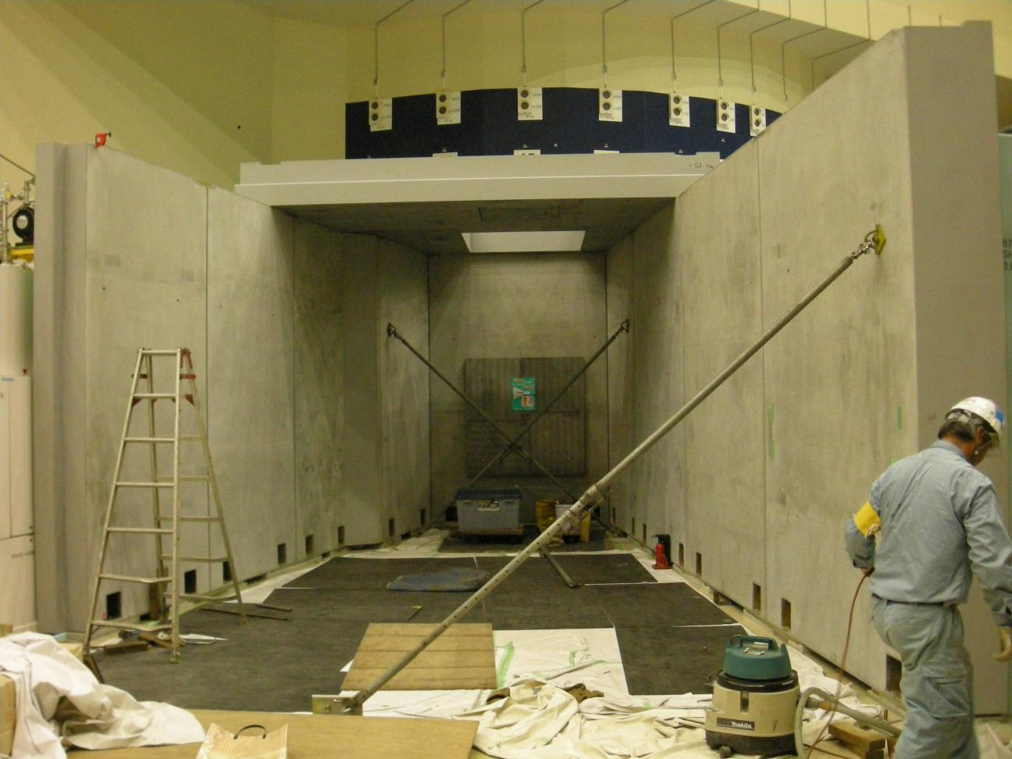
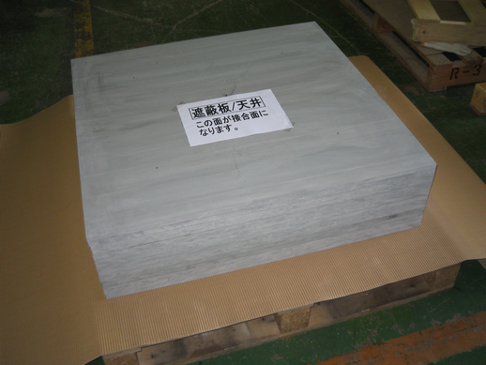
Eponaite and colemanite concrete shielding
HAZAMA ANDO
colemanite concrete
BL09, BL15, BL21
BL15
Eponaite
Example of streaming blocking
Overlapped structure to prevent streaming
BL02

Slide 26
Summary
Chopper
  Based on our experiences of operating choppers, T0 and fast choppers are necessary for development. New T0 chopper will be fabricated 2018. Improvement of fast chopper blade is ongoing.
Shieldings
  Our strategy of shieldings installation is to adopt prefabricated shielding piece, and we use many neutron absorbing materials.

