Slide 1
Temperature and Fields
Update on Suite and day 1 priorities
Alex Holmes
TEFI platform leader
www.europeanspallationsource.se
5 March, 2018

Slide 2
15 Instruments selected so far
8 to be in user operation by 2023
Version 24/10/2017
ODIN Imaging Instrument
SKADI General Purpose SANS
LOKI Broadband SANS
Surface Scattering
FREIA Horizontal Reflectom.
ESTIA Vertical Reflectom.
HEIMDAL Powder Diffract.
DREAM Powder Diffract.
Monochromatic Powder Diffract.
BEER Engineering Diffract.
Extreme Conditions Diffract.
MAGIC Magnetism Diffract.
NMX Macromolecular Diffract.
CSPEC Cold Chopper Spec.
Broadband Spectrometer
T-REX Thermal Chopper Spec.
BIFROST Xtal Analyser Spec.
VESPA Vibrational Spec.
MIRACLES Backscatt. Spec.
High-Resolution Spin-Echo
Wide-Angle Spin-Echo
Particle Physics Instrument
Large-Scale Structures
Spectroscopy
Diffraction
life sciences | magnetism & superconductivity
soft condensed matter | engineering & geo-sciences
chemistry of materials | archeology & heritage conservation
energy research | particle physics

Slide 3
1st 8 Instruments with significant TEFI requirements
ESTIA Vertical Reflectometer
BIFROST Horizontal scattering Xtal Analyser Spectrometer
MAGIC Single crystal Magnetism Diffractometer
CSPEC Cold Chopper Spectrometer
DREAM Powder Diffractometer
+LOKI (SANS), ODIN (imaging), BEER (Engineering)
T-REX, SKADI, HEIMDAL also important TEFI requirements
All/many want standard cryostats, dilution units, furnaces.

Slide 4
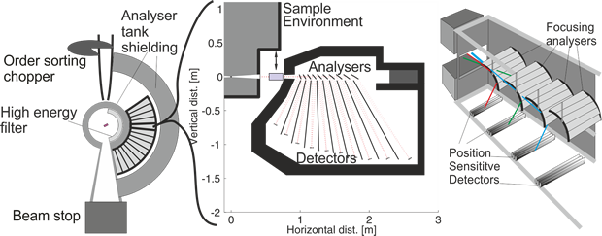
Particular Instrument constraints
BIFROST - horizontal scattering – extreme conditions

Slide 5
Particular Instrument constraints
BIFROST - horizontal scattering – extreme conditions
ESTIA - High throughput, low field sufficient

Slide 6
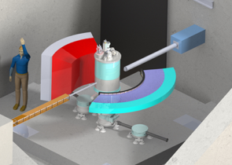
Particular Instrument constraints
BIFROST - horizontal scattering – extreme conditions
ESTIA - High throughput, low field enough
MAGIC – large aperture

Slide 7
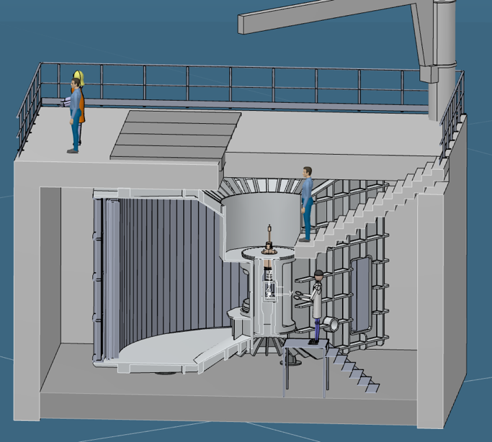
Particular Instrument constraints
BIFROST - horizontal scattering – extreme conditions
ESTIA - High throughput, low field sufficient
MAGIC – large aperture
CSPEC – top loading vacuum/atm, low background

Slide 8
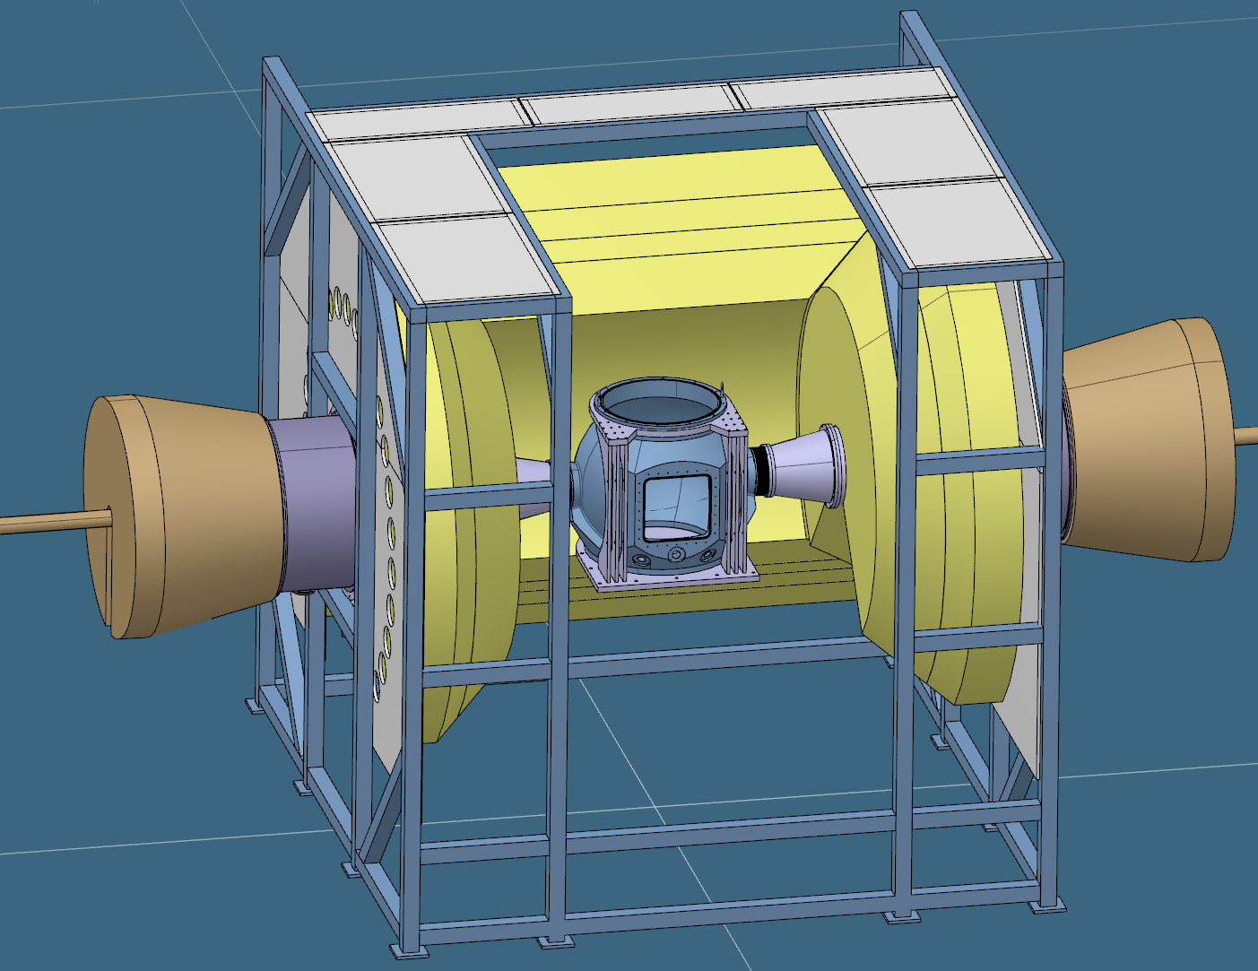
Particular Instrument constraints
BIFROST - horizontal scattering – extreme conditions
ESTIA - High throughput, low field sufficient
MAGIC – large aperture
CSPEC – top loading vacuum/atm, low background
DREAM – Al powder lines in tails – radial collimation?

Slide 9
Particular Instrument constraints
BIFROST - horizontal scattering – extreme conditions
ESTIA - High throughput, low field sufficient
MAGIC – large aperture
CSPEC – top loading vacuum/atm, low background
DREAM – Al powder lines in tails – radial collimation?
T-REX – vacuum tank, low background, large aperture
HEIMDAL – Two guides, combined SANS/Diffraction
SKADI – SANS – homogeneity requirements for flux lattice studies
MIRACLES – 400mm max diameter
All have detectors on left hand side
Horizontal field not in great demand (except for SANS)
Little significant demand for vector fields.

Slide 10
Magnet priorities across instruments
Horizontal field
Highest field, small vertical opening
BIFROST
ULT Inserts
SKADI
DREAM*
HEIMDAL
ESTIA
Warm bore
MIRACLES*
(400 mm diam.)
Large Aperture 1st priority
Field 2nd
Flow/CCR inserts
MAGiC
CSPEC*
T-REX*
*sample in vacuum

Slide 11
Magnets
Priority | SYSTEM | DETAIL | UNIT COST (k€) | INSTRUMENTS |  | READY BY
=1 | 2.5T Warm bore cryomagnet | Similar to MLZ design MAG-2.2T-HTS | 335 | ESTIA +EVERYONE |  | 22/Q1
=1 | Vertical 10 8T cryomagnet | large opening, assymetric (<100K?) | 1000 | MAGIC CSPEC DREAM TREX HEIMDAL |  | 20/Q4
=1 | Vertical 15T cryomagnet | split coil | (1000) | BIFROST DREAM HEIMDAL |  | 21/Q1
2 | 5T warm bore cryomagnet | Cryo-free | 300-400 | ALL (-MIRACLES)
3 | 2.5T warm bore small footprint | No bottom access | 250 | ALL incl MIRACLES
4 | Horizontal 11T cryomagnet | SANS MA11+ | 500 | SKADI ESTIA MAGIC DREAM HEIMDAL |  | 22
5 | Medium field cryo | Assym. large opening |  | MAGIC CSPEC DREAM TREX HEIMDAL
6 | 1T electromagnet |  | 50 | LOKI ESTIA SKADI FREIA |  | 21/Q1
7 | Horizontal medium field large opening |  |  | BIFROST DREAM HEIMDAL |  | 23
 | Pulsed field |  |  | MAGIC DREAM HEIMDAL |  | 24

Slide 12
8
Thinned Al on beam out
-> Dedicated magnet
for spectroscopy?

Slide 13
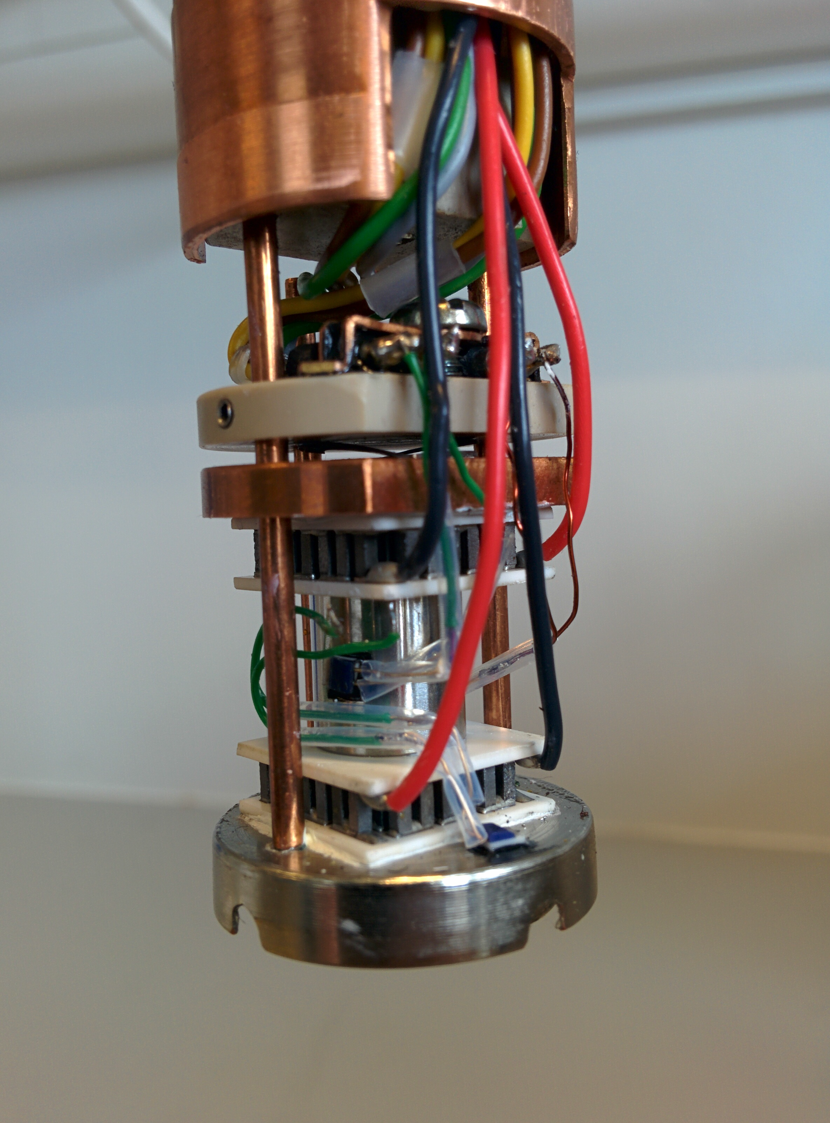
Temperature and Fields – suite for 8 by 2023 incl. infrastructure
 | # | Cost k€ | Ready | Start | In-kind partner
Vertical cryomagnet 8T large opening | 1 | 1000 | 20 Q4 | 17 Q4 | ‘agreed’ (FR)
Vertical cryomagnet 15T (HZB) | 1 | (1000) | 21 Q1 | 17 Q4 | re-used (DE)
Warm bore cryomagnet 2x 2.5T, 1x 5T | 3 | 1000 | 22 Q1 | 19 Q1 | ‘agreed’ FR
Horizontal cryomagnet 11T | 1 | 500 | 22 Q1 | 19 Q1 | not identified
Cryostat incl PTR, wet, flow, cryostream | 4 | 350 | 21 Q1 | 19 Q2 | ‘agreed’ FR
CryoFurnace (4K – 500K) incl. changer | 3 | 500 | 21 Q1 | 18 Q4 | MAGIC, DREAM, CSPEC
Dilution | 2 | 500 | 21 Q1 | 18 Q3 | ‘agreed’ FR
High Temperature Vacuum Furnace | 2 | 80 | 21 Q1 | 19 Q1 | ‘agreed’ FR
Infrared Furnace | 1 | 50 | 21 Q2 | 19 Q2 | ‘agreed’ FR
Sorption stick | 1 | 150 | 21 Q1 | 18 Q4 | ‘agreed’ FR
6kV HV supply | 2 | 50 | 21 Q2 | 20 Q3 | in-house
Peltier subcryostat, | 1 | 125 | -- | complete | DK
in-situ AC suscept. | 1 | 30 | 18 Q3 | 18 Q1 | In-house
LHe vessels / Helium management | IN | 200 | 21 Q1 | 18 Q1 | not identified

Slide 14
Timelines
2018
2019
2020
2021
2022
2023
Specifications
Procurement
Construction
Delivery & Commisioning
8T wide aperture magnet & ULT inserts (FR In-kind)
Specifications
Procurement
Construction
Delivery & Commisioning
Warm bore magnets (FR In-kind)
Specifications
Procurement
Construction
Delivery & Commisioning
Wet/Dry Cryostats
Furnaces (FR In-kind)
Specifications
Procurement
Construction
Delivery & Commisioning
He infrastructure

Slide 15
Questions
Is the grouping and prioritisation of magnets/instruments reasonable?
Do we need a high field magnet (10T+) dedicated to spectroscopy?
Advice on procurement process.

