Slide 1
Sample environment utility supply demands
Two utility supply subsets for the ESS SES suite are required per instrument
The SES utility supplies are part of the Instrument utility supply
SES Utility Supply Subset 1
-On Beam
Instrument
utility
supply
SES Utility Supply Subset 2
-Off Beam
Instrument utility supply consists of :
Electrical Power Supply, running electrical devices
NEUS-PLC, Non Electrical Utility Supplies - PLC
Cooling water, compressors , furnaces , racks
Compressed Air, pneumatic devices
Gases [ supply : Ar, N₂, He ]. He-recovery , Exhaust/HVAC
Patch panel for electrical signals
SES : Sample Environment System
Notes:
Present experience: fragemtnation, only partly supporting all topics …
New approach …mainaining balance; bringing it colse to the user

Slide 2
Sample environment utility supply requirements
SES Supply For each subset | Main characteristic | # | Connector type | Valve/ regulator/ IP class | Meter, control NEUS- PLC ª | General
Cooling water | Cooling water 5°C | 0 |  |  |  | Main cooling loop. Likely not required by SES (TBD)
 | Cooling water 14°C TBD | 3 | Defined | Y/N | Yes | Secondary loop at instrument. Capacity 20kW
Pwr. Conn. sum | 230V / 400V {16A;32A} | 8/2/2 | CEE | IP44^{b} |  | Power monitoring, slow fuses
Box #1 | 230V / 400V {16A;32A} | 2/1/1 | CEE | IP44^{b} |  | Power monitoring, slow fuses
Box #2 | 230V / 400V {16A;32A} | 6/1/1 | CEE | IP44^{b} |  | Power monitoring, slow fuses
Box #3 | 230V / 3x10A/15min | 3 |  | IP44^{b} |  | UPS, Power monitoring
Gases | Argon | 2 |  | Y/Y | Yes | ESS supply, independent extraction points
 | Nitrogen | 2 |  | Y/Y | Yes | ESS supply, independent extraction points
 | Helium | 2 |  | Y/Y | Yes | ESS supply, independent extraction points
 | Compressed air | 3 |  | Y/Y | Yes | ESS supply, independent extraction points
 | Exhaust | 2 |  | Y/N |  | Needs special consideration see ref [5]
 | He Recovery | 3 | > KF DN 25 | Y/N
Communication Patch panel | RS232, sensor plugs, etc. | 5 | Dsub 9 | - | - | Serial communication
 | General comm. | 5 | Dsub 25 | - | - | Contacts and serial communication
 | Ethernet conn. Data, USB | 15 | Cat6, RJ45 | - | - | Network compatible connectors
 | 4 Pin connector Temp., Heater | 20 | Lemo / Fischer | - | - | Thermometer, SE process signals
 | General signal | 10 | BNC | - | - | Contacts and small low power, low voltage signals
 | General signal | 5 pair | 4 mm “Banana” | - | - | Contacts and small low power, low voltage signals
Summerized Requirements
for one subset
Notes:
Present experience: fragemtnation, only partly supporting all topics …
New approach …mainaining balance; bringing it colse to the user

Slide 3
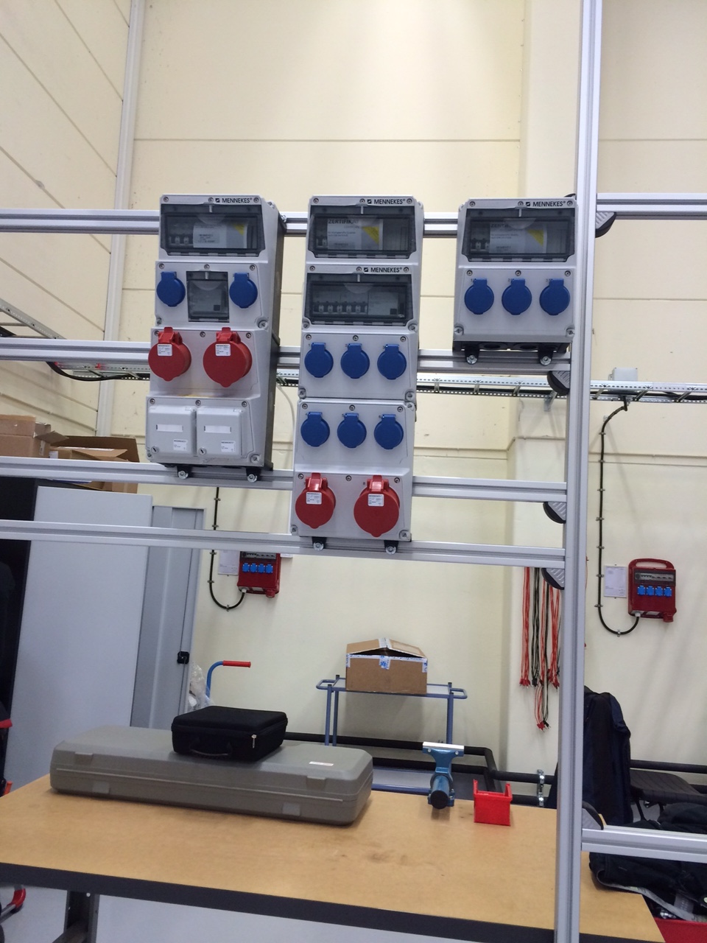
Sample environment utility supply requirements
Box_1 – 2 x [5 x 25 mm²] & 4 x Cat.6 Ethernet
Box_2 – 2 x [5 x 25 mm²]
Box_3 – 1 x [5 x 10 mm²] , UPS
Boxes including RCD (30mA) and cut out switches :
Box 1 : MENNEKES 950004
Box 2 : MENNEKES 940018
Box 3 : MENNEKES 920003
All boxes are regarding IP44 class.
Electrical Supply for one subset
The instrument cave, sample area, preparation area
and nearest area around the shielding with
electronic racks are all on the same ground.
Notes:
Present experience: fragemtnation, only partly supporting all topics …
New approach …mainaining balance; bringing it colse to the user

Slide 4
Sample environment utility supply
requirements
Brief description of the schematic drawing:
1) Cooling water control, Red
2) Technical gases, Orange
3) He recovery, Black
4) Pump exhaust (rough vacuum) , Violet
5) Compressed air, Light Blue
6) Galvanic (electrical isolated) contacts for apparatus, Grey
7) PLC, Dark Blue
8) PLC interface (hard-/software) to EPICS , Green
Notes:
Present experience: fragemtnation, only partly supporting all topics …
New approach …mainaining balance; bringing it colse to the user

Slide 5
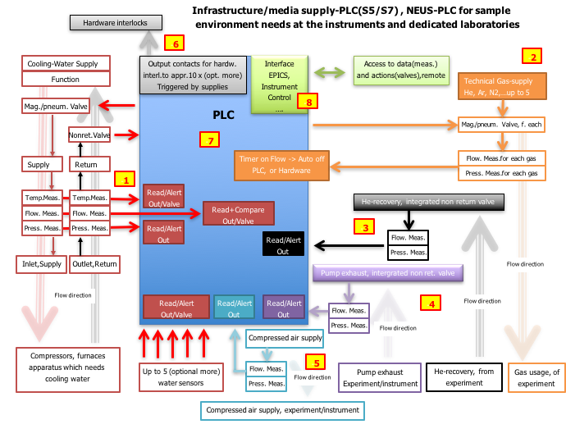
Sample environment utility supply
requirements
Brief description of the schematic drawing:
1) Cooling water control, Red
2) Technical gases, Orange
3) He recovery, Black
4) Pump exhaust (rough vacuum) , Violet
5) Compressed air, Light Blue
6) Galvanic (electrical isolated) contacts for apparatus, Grey
7) PLC, Dark Blue
8) PLC interface (hard-/software) to EPICS , Green
Notes:
Present experience: fragemtnation, only partly supporting all topics …
New approach …mainaining balance; bringing it colse to the user

Slide 6
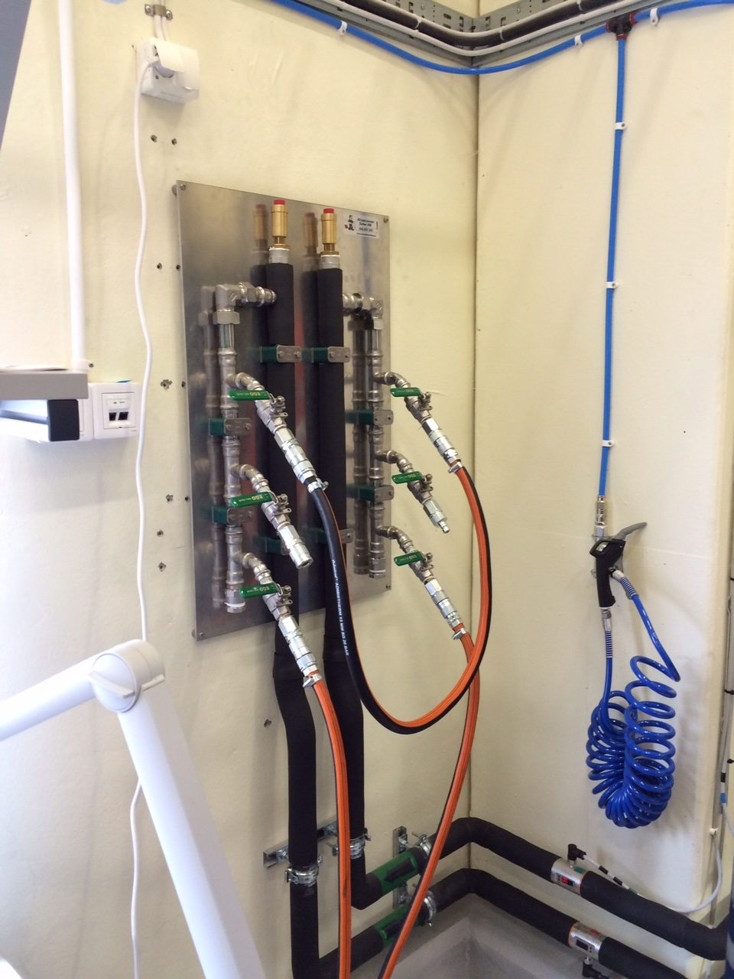
Sample environment utility supply requirements
Cooling water supply for one subset
Leak detection by NEUS-PLC
[ Non Electrical Utility Supplies – PLC ]
Ball valves , 1 each
Cold outlet to SES device (Pin)
Connectors , Stainless Steel
Warm inlet from SES device (Socket)
Purpose/flow | Position | Type | Supplier
CV = 1.17 ~16-17 l/min | Cold outlet to SEE device | LP-007-2-WR521-01-2 | Walther-Precision
CV = 1.17 ~16-17 l/min | Warm inlet from SEE device | LP-007-0-WR521-01-2 | Walther-Precision
Notes:
Present experience: fragemtnation, only partly supporting all topics …
New approach …mainaining balance; bringing it colse to the user

Slide 7
Sample environment utility supply requirements
Notes:
Present experience: fragemtnation, only partly supporting all topics …
New approach …mainaining balance; bringing it colse to the user

Slide 8
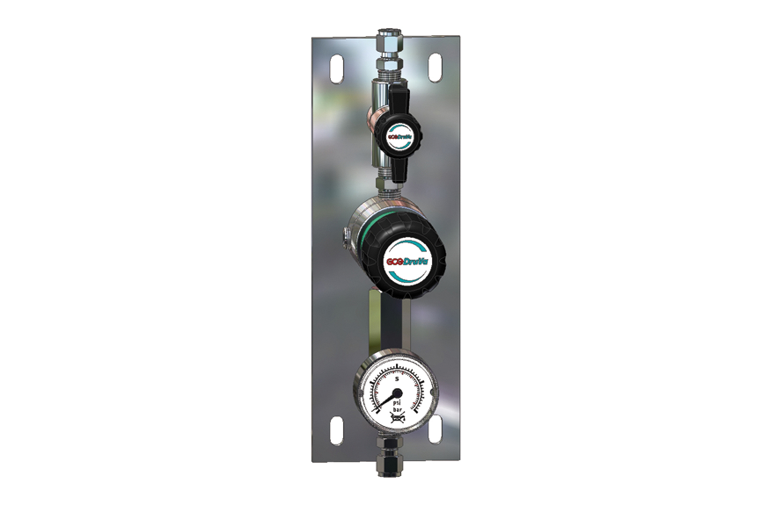
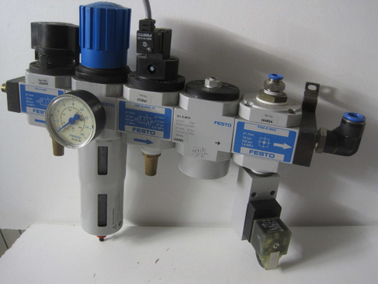
Sample environment utility supply requirements
Central connection point
Gauge
Central connection
point
Flowmeter
Valves
Connectors
Exhaust
HE recovery
Details in discussion
Compressed air processing unit
Gas supply
Patch panel for electrical signals , Details in discussion
Notes:
Present experience: fragemtnation, only partly supporting all topics …
New approach …mainaining balance; bringing it colse to the user

Slide 9
Sample environment utility supply requirements
Compressed air processing unit
Non-spill flat face coupling CBI
Temperature management, fluids
Gas supply
MCR-coupling fur compressed air/inert gases, save , up to 10 bar.
Notes:
Present experience: fragemtnation, only partly supporting all topics …
New approach …mainaining balance; bringing it colse to the user

