Slide 1
SEE Alignment Systems Update
Malcolm Guthrie
www.europeanspallationsource.se
6 March, 2018

Slide 2
Sample environment mounting and alignment
Key goals:
Enable possibility of sub-mm reproducibility in mounting
Enable transferability between instruments and offline stations (e.g. for SXL or other pre-alignment)
Cover both floor and flange mount instruments
Support distinct levels (with adapters) to cover broad range of equipment dimensions

Slide 3
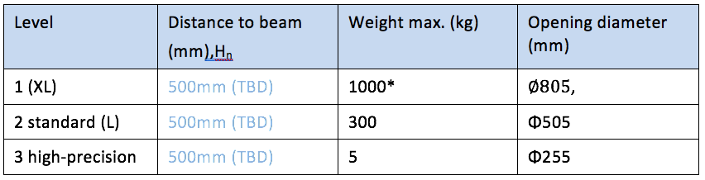
Flange mount
Level 1 (largest envisaged SEE)
Flange to sample distance = 600mm
Maximum mass 1000 kg
Largest SEE ø = 800mm

Slide 4
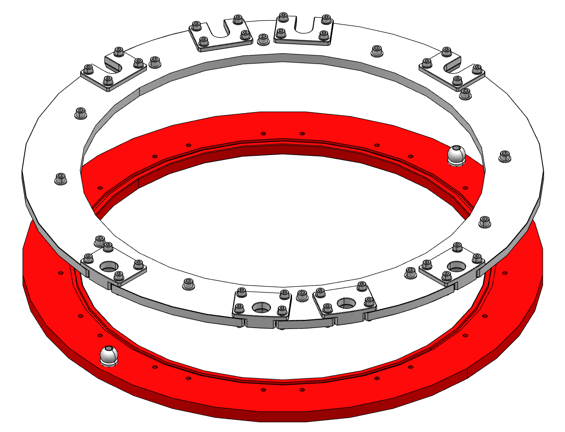
Flange mount
SEE flange
SAD is responsible
One for each SEE
SAD controls precision
Instrument adapter
“Shared” component: SAD defines O-ring, alignment pins and bolt holes. Instrument defines everything else.
One per instrument
Instrument controls precision

Slide 5
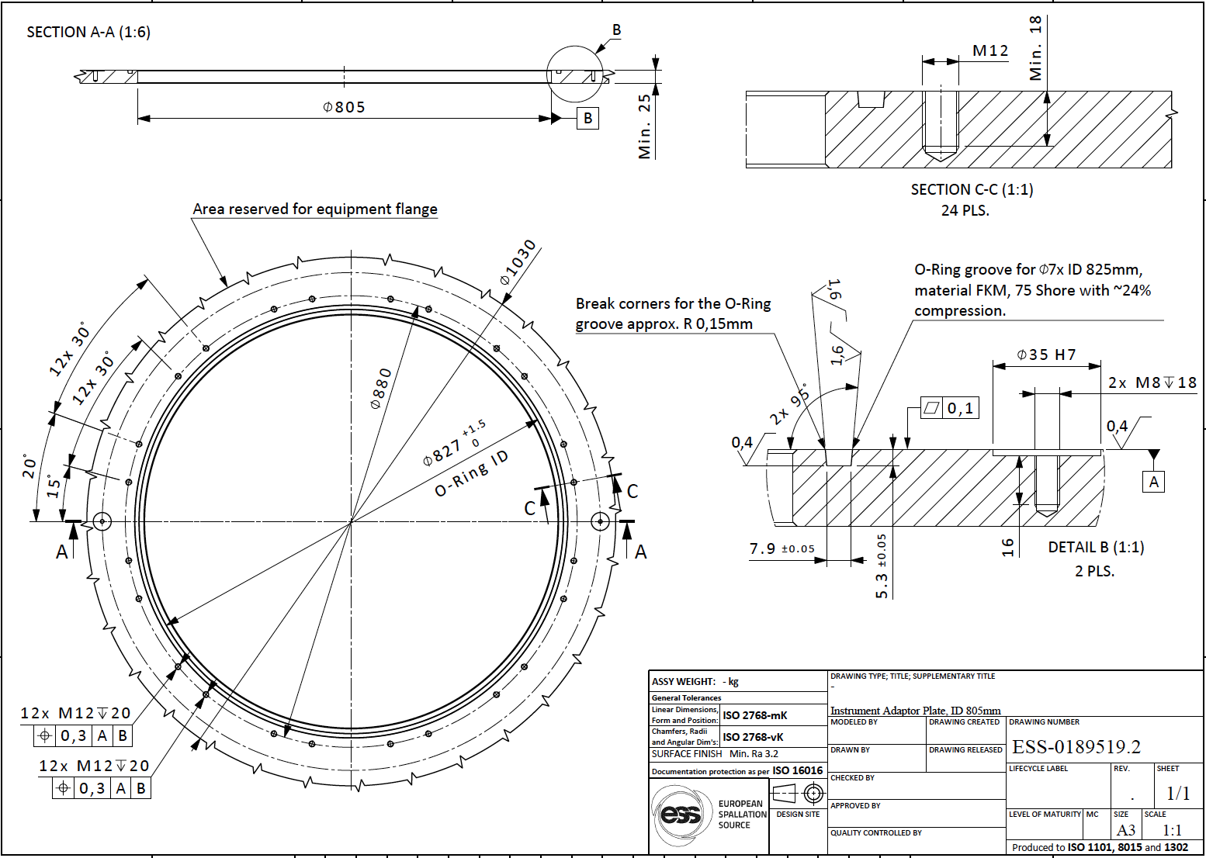
Flange mount

Slide 6
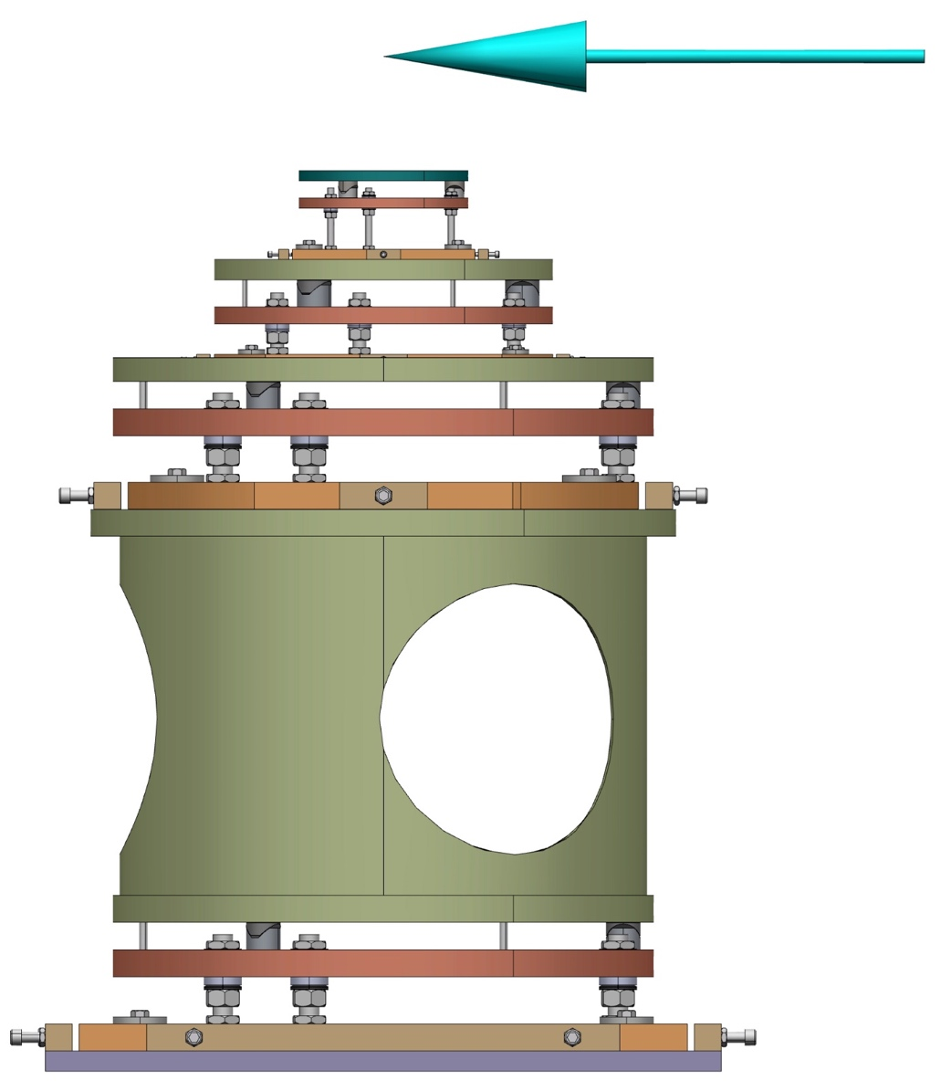
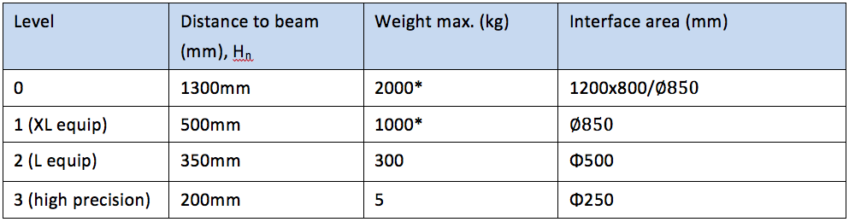
Floor mount
Oops!
(last night!)

Slide 7
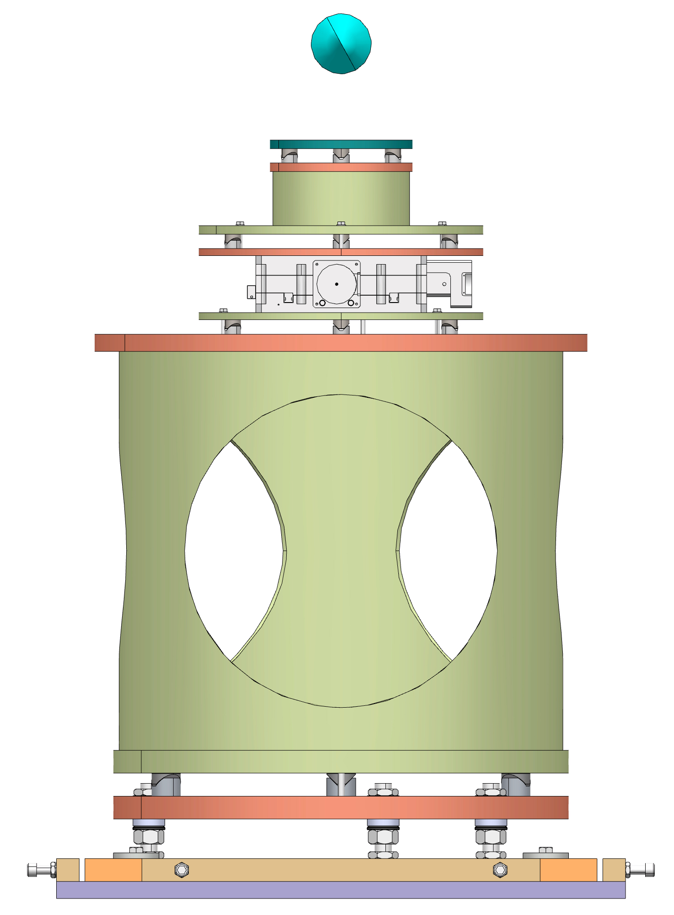
Floor mount

Slide 8
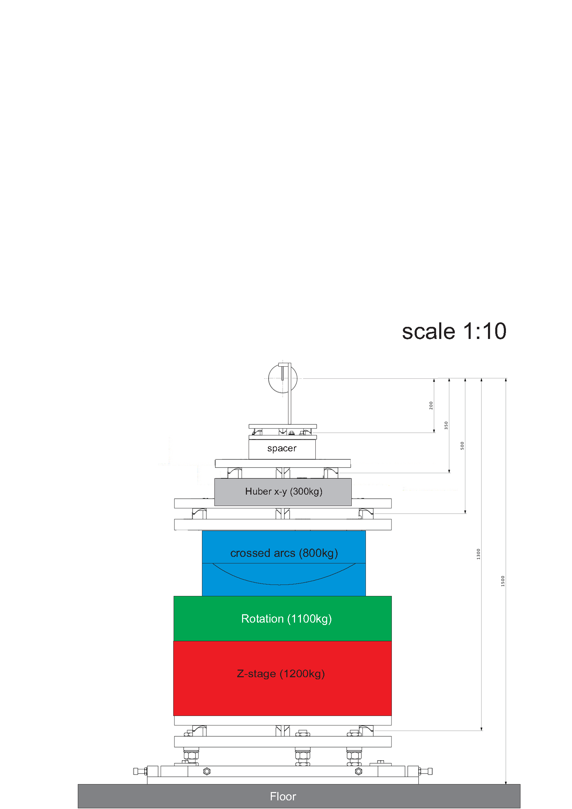
Level 3: Van Can

Slide 9
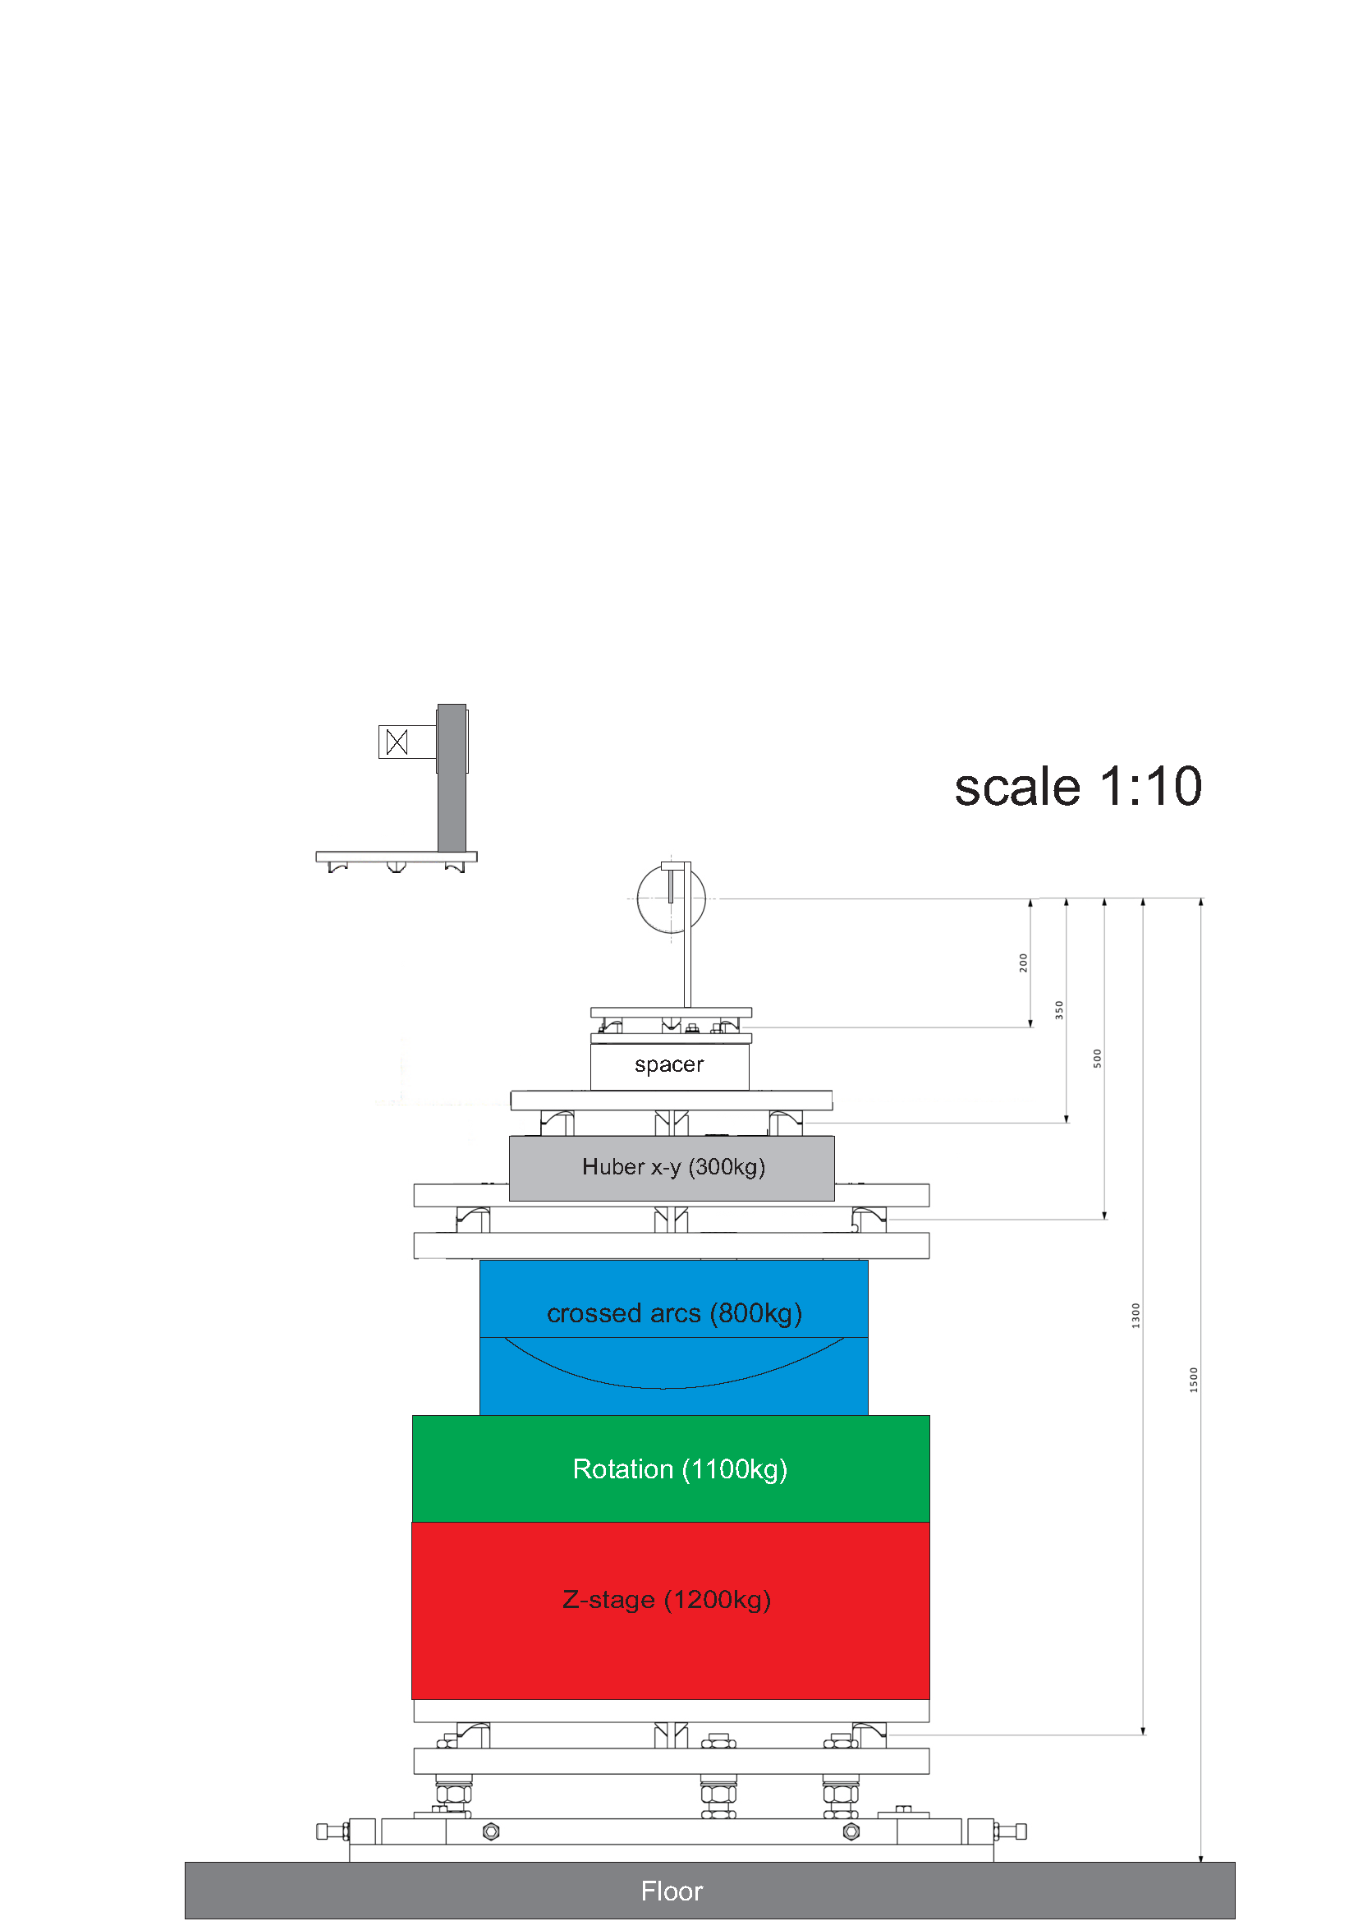
Level 3: DAC

Slide 10
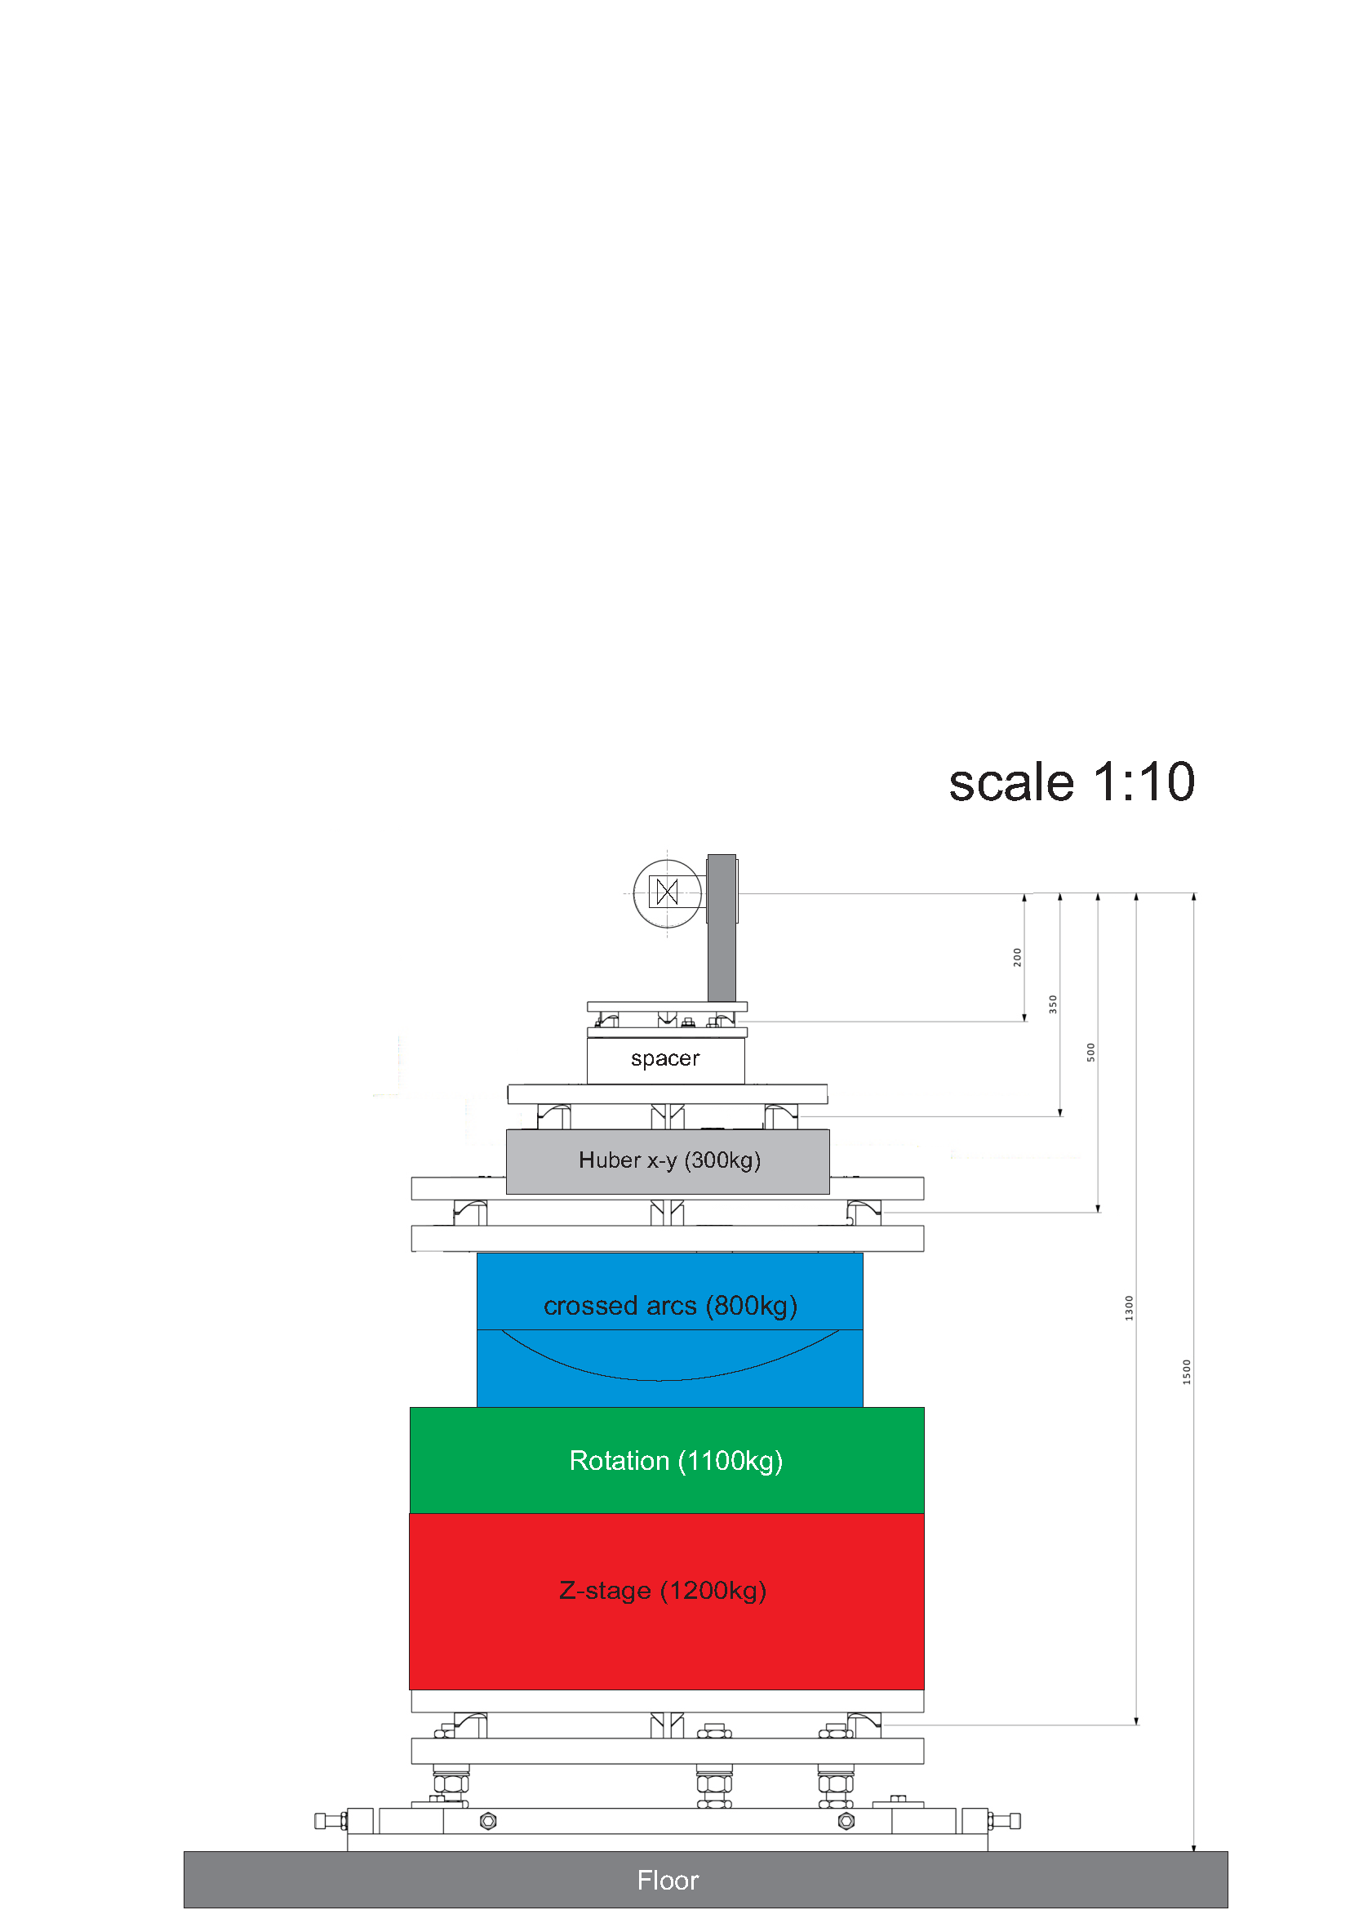
Level 3: DAC

Slide 11
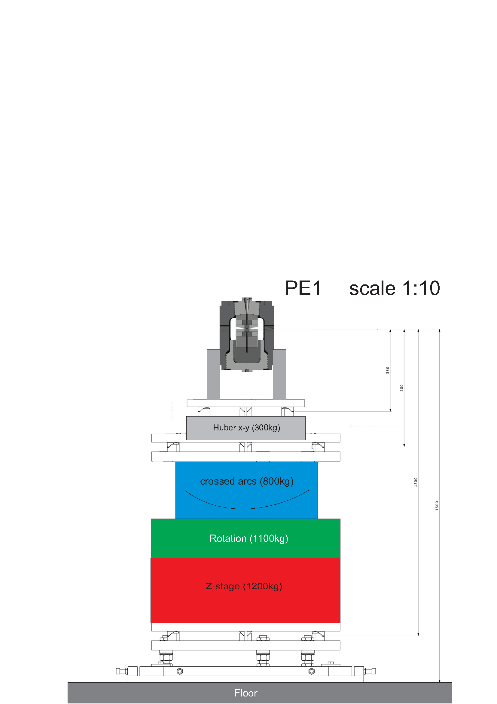
Level 2: PE cell

Slide 12
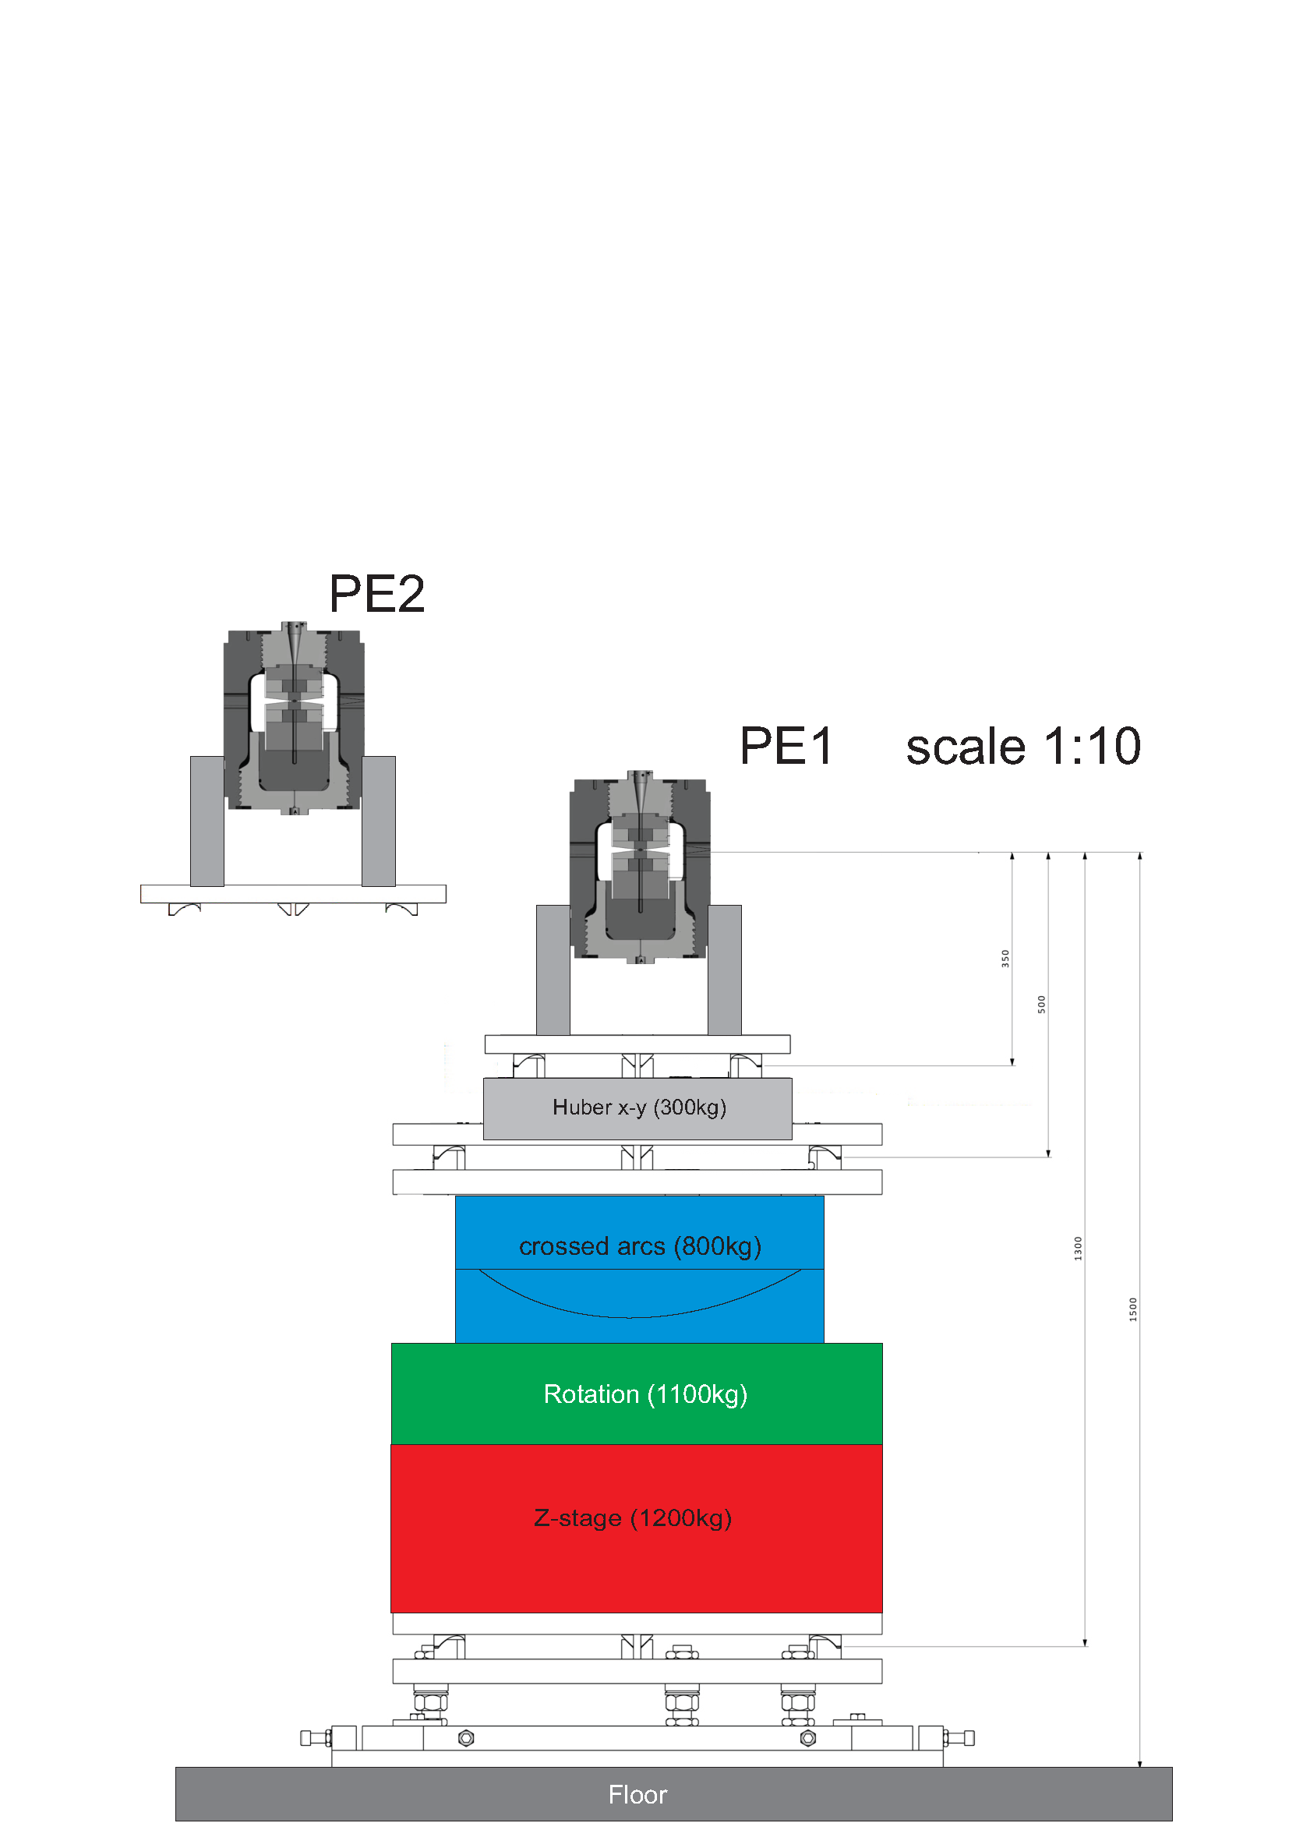
Level 2: 2nd PE cell

Slide 13

Level 2: 2nd PE cell

Slide 14
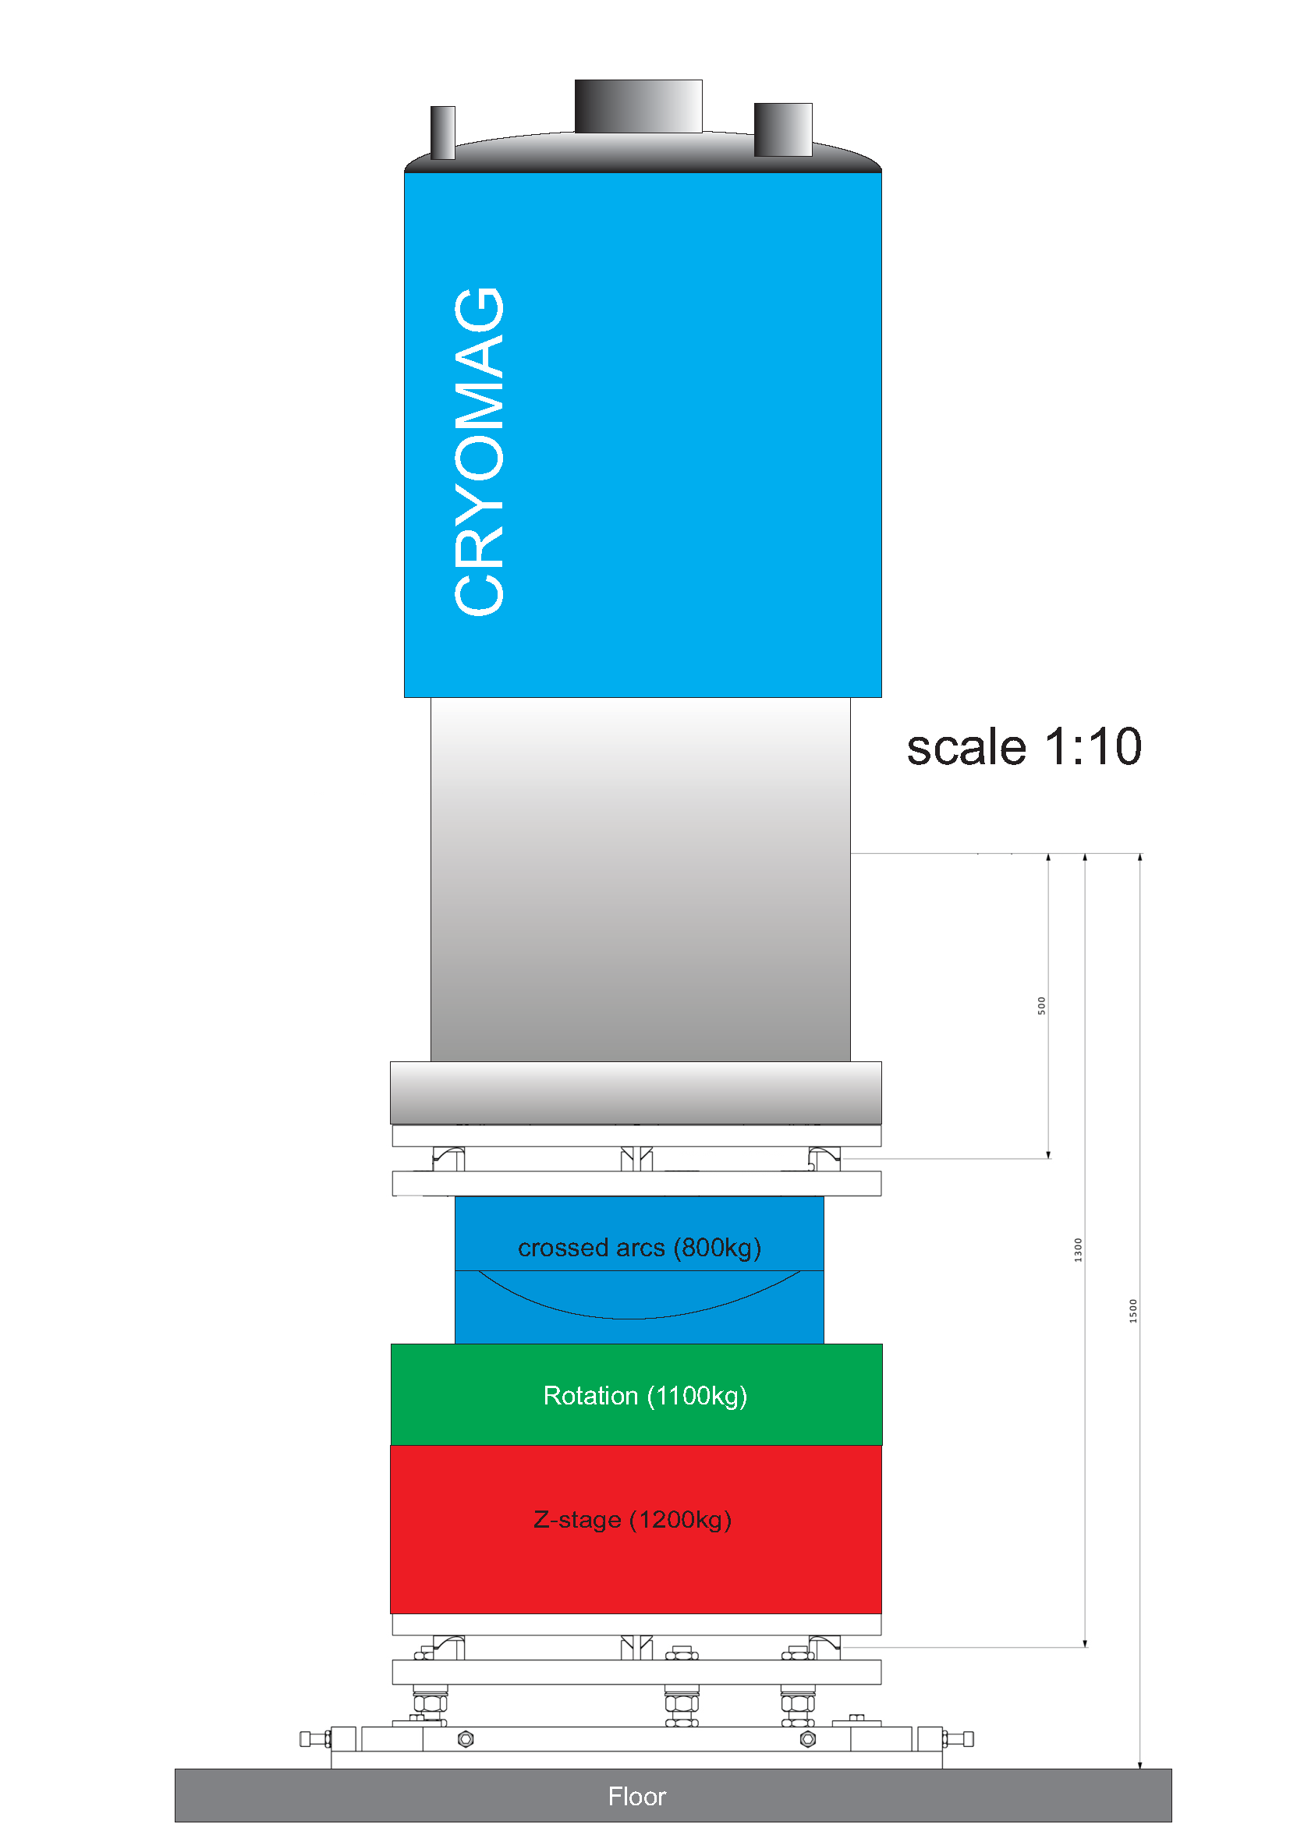
Level 1: cryomag

Slide 15
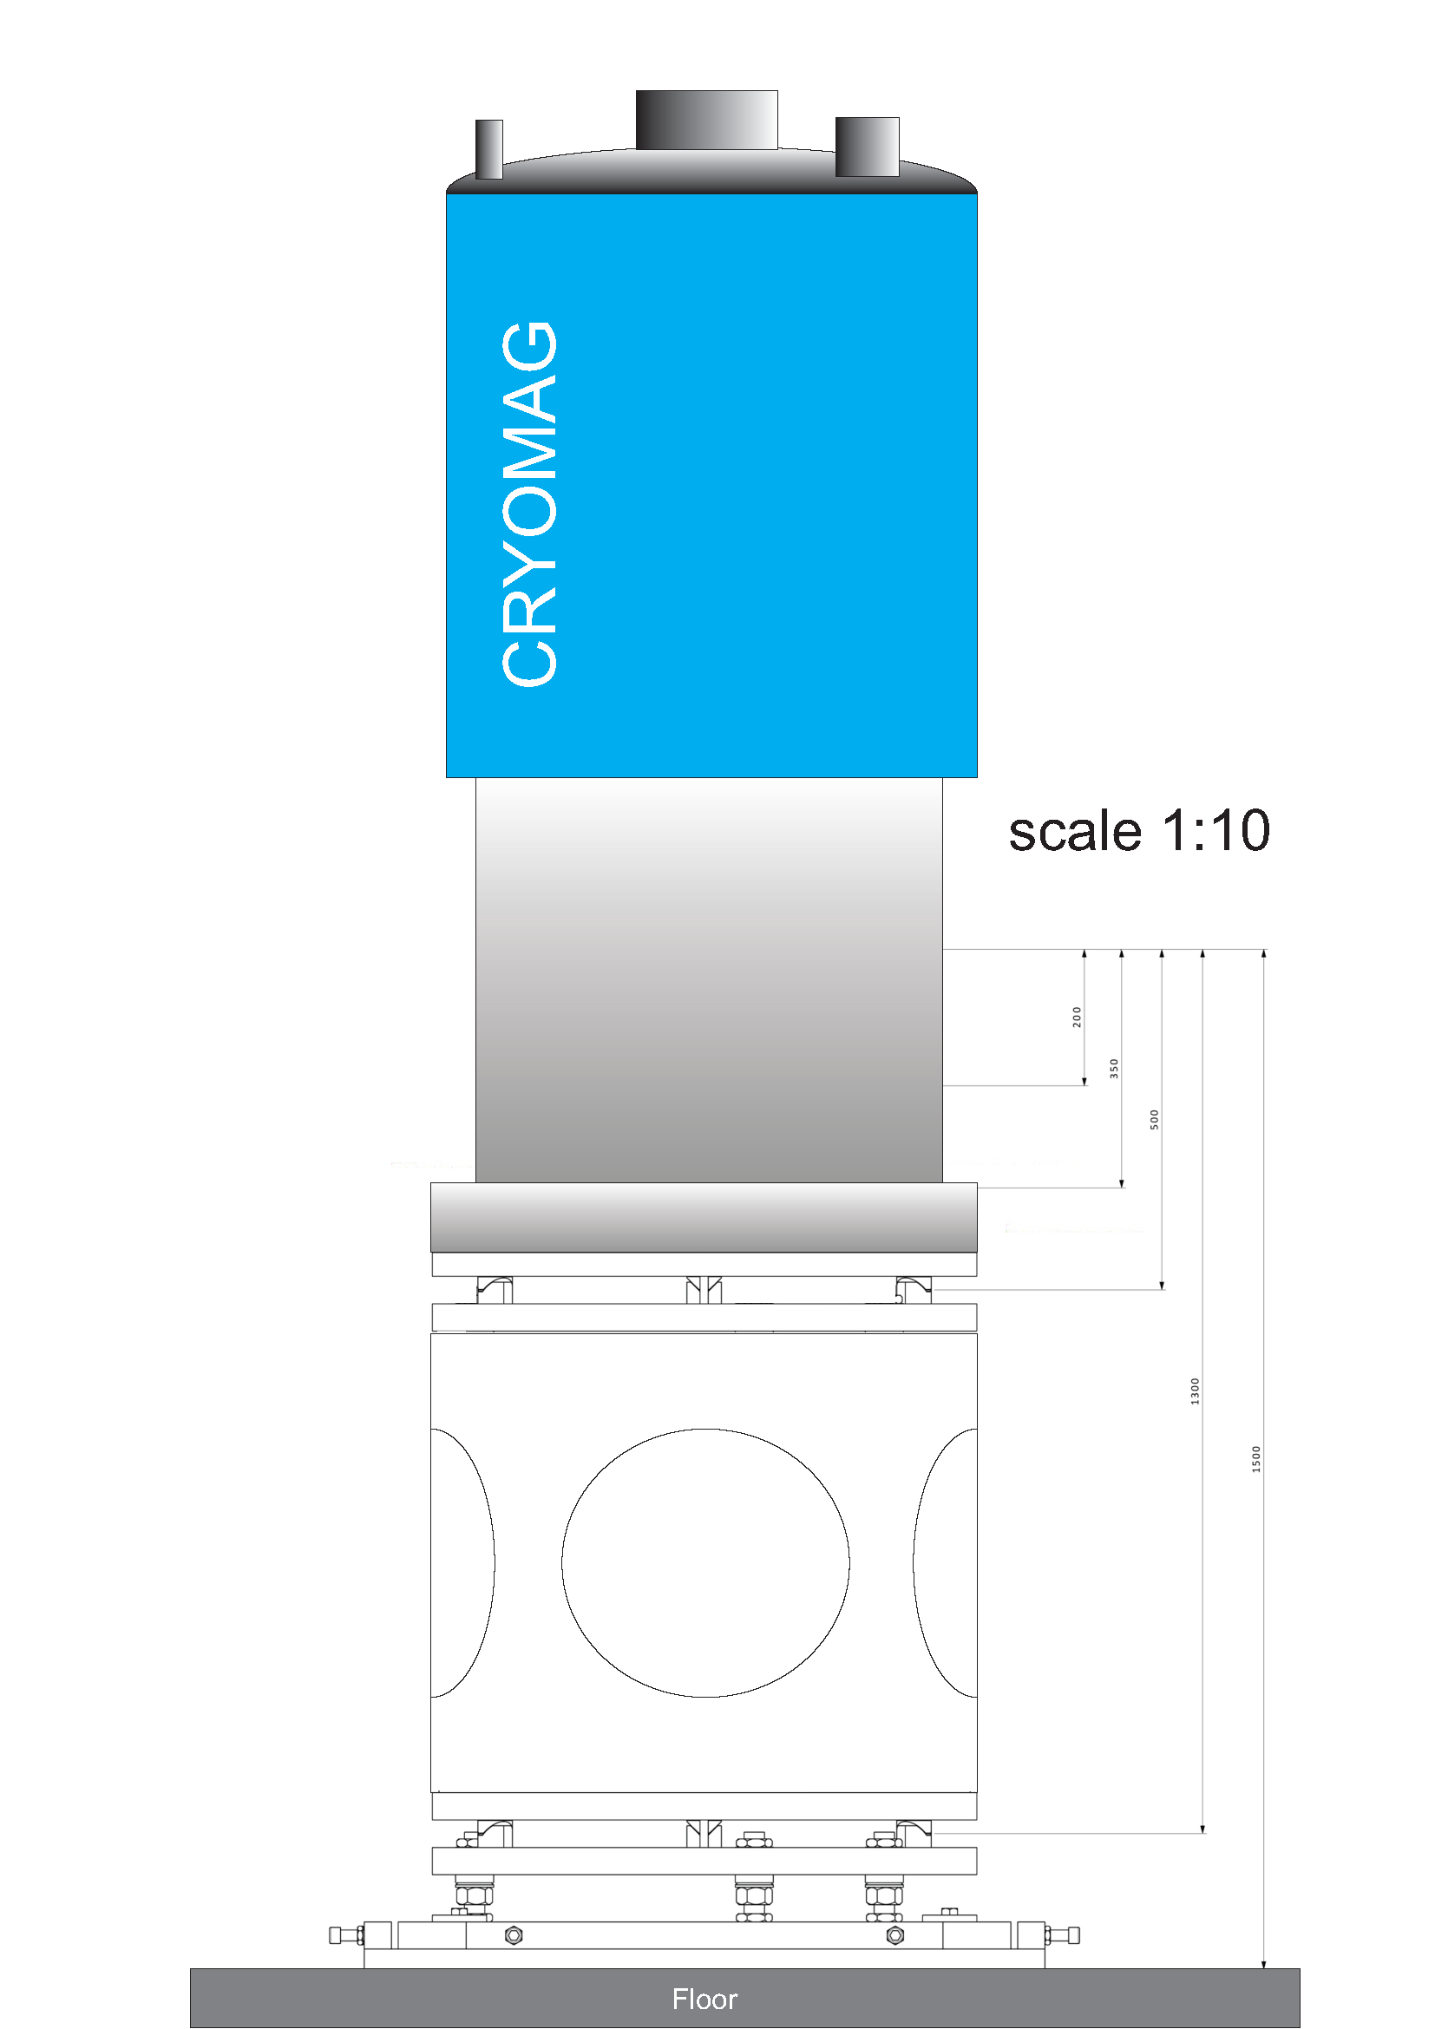
Level 1: cryomag (no stage)

Slide 16
Flange-mount
Level 1: cryomag (no stage)

Slide 17
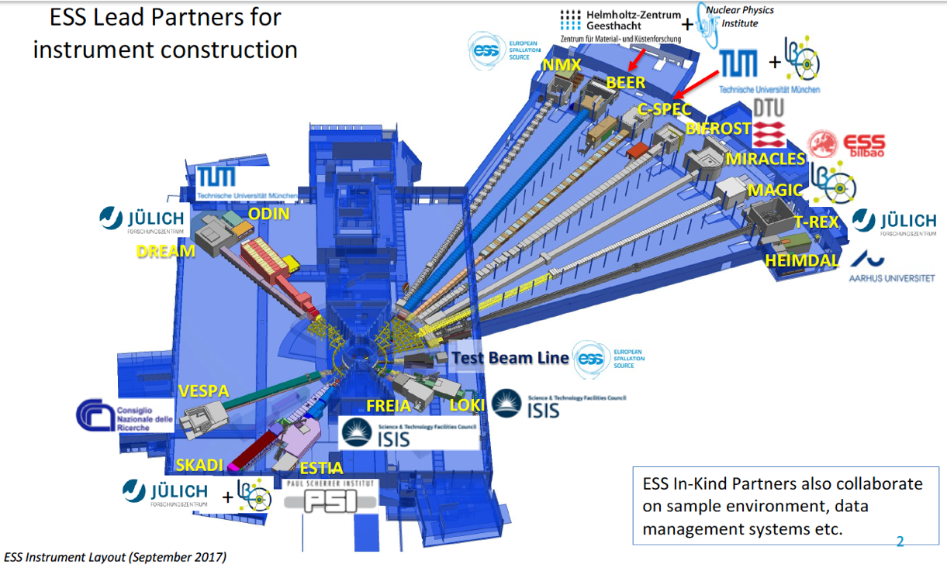
Single-crystal alignment
Possibility: Laue station on Test Beamline
Within budget:
  Basic Linear stages
  Shielding and PPS
  A few detectors (self-made prototypes from detector group)
Might be feasible to create orientation station for little cost.

