Slide 1
Safety infrastructure (exhaust), Radiological Zoning, PSS
www.europeanspallationsource.se
STAP Users and Samples
March 6-7, 2018

Slide 2
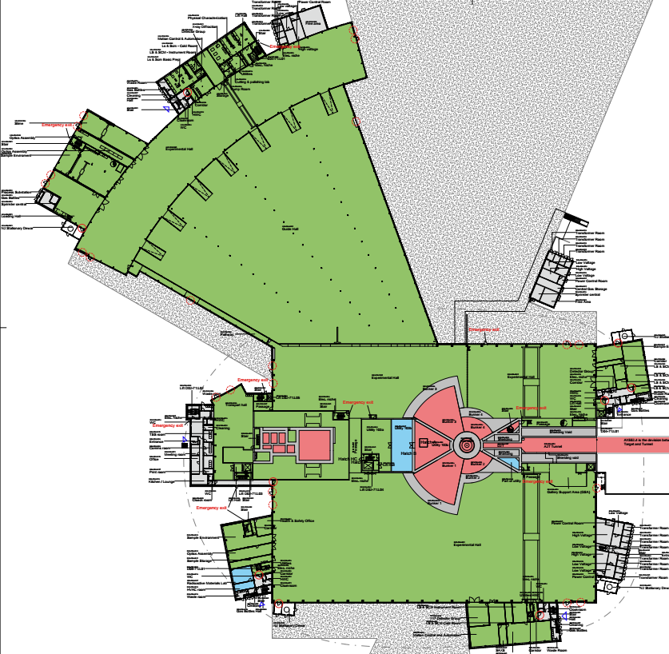
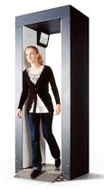
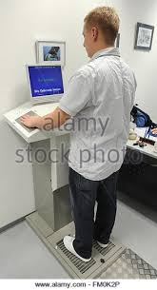
Zoning of the experimental hall/labs – one zone for all
Supervised zone (no contamination)
Unrestricted controlled zone
Restricted controlled zone
Highly restricted controlled zone
FLEXIBLE ZONING
access control,
radiation monitor.
Entrance to supervised area controlled by badge readers (assures dosimetry is issued, training is done)
Exit of supervised zone:
- portal monitors AND/OR
- hand-and-foot monitors
Rad. Mat.
Lab. RML

Slide 3
Personal Safety System (PSS)
Interlock system for experimental caves
  Protects personnel from entering an area with prompt beam
  Will protect from hazards coming from permanently installed components
  Will not include sample environment equipment (temporarily installed components)
  Need to add a “SAD” interlock on cave door or find similar engineering solutions
Experimental
Cave -
Closed
Shutter
sample
beamline
Shielding with active
Personal Safety System (PSS)
Experimental
Cave –
Open
Shutter
beamline

Slide 4
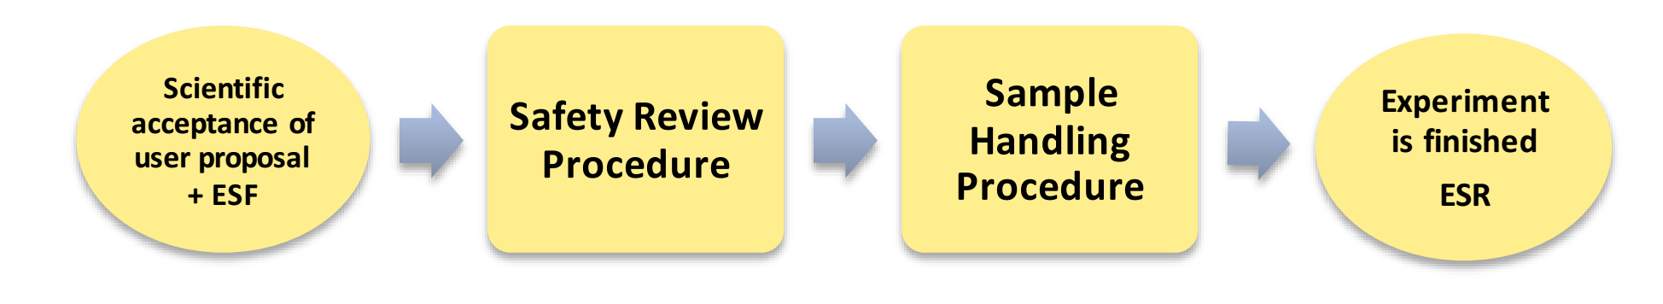
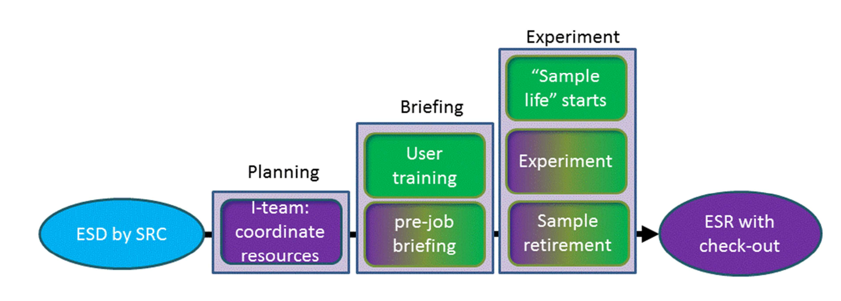

Sample management at ESS
Sample management procedure
Safety review determines admin/engineer. controls for samples/sample handling in labs/at instruments

Slide 5
SAD provisions for chemistry/ sample environment on instruments
Provisions for (limited) sample preparation on instruments
    Conventional ventilation in preparation areas
Provisions for in-situ experiments with gases and other hazardous materials
    Containment ventilation in experimental caves
Provisions for sample environment on instruments
  to handle hazardous equipment (laser, magnetic field, high pressure, electrical…)

Slide 6
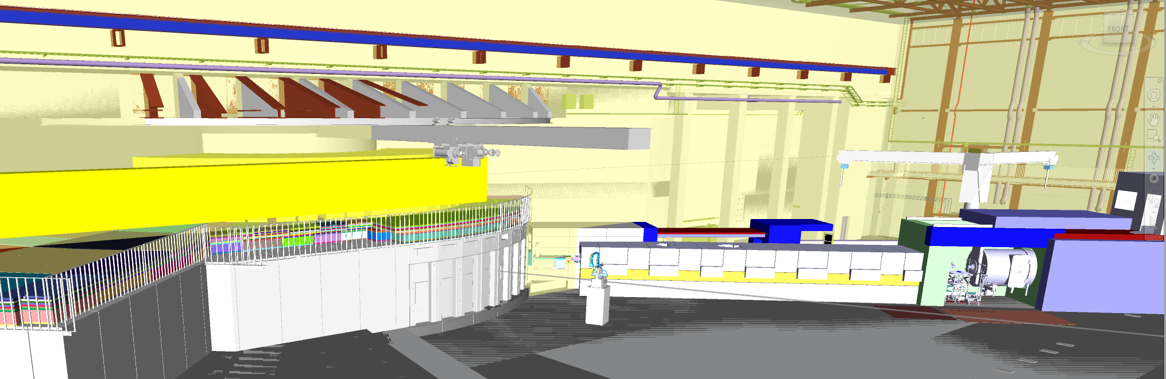

Containment ventilation in the experimental hall
Ventilation meant for the experimental caves as
  exhaust for vacuum pumps that pump on the sample area/sample (especially highly activated materials)
  exhaust for gas flow through sample area/sample and decomposition experiments (in-situ)
Status: currently discussing requirements for ventilation with CF;
  KF 100; routing will change due to conflict with experimental hall crane

Slide 7
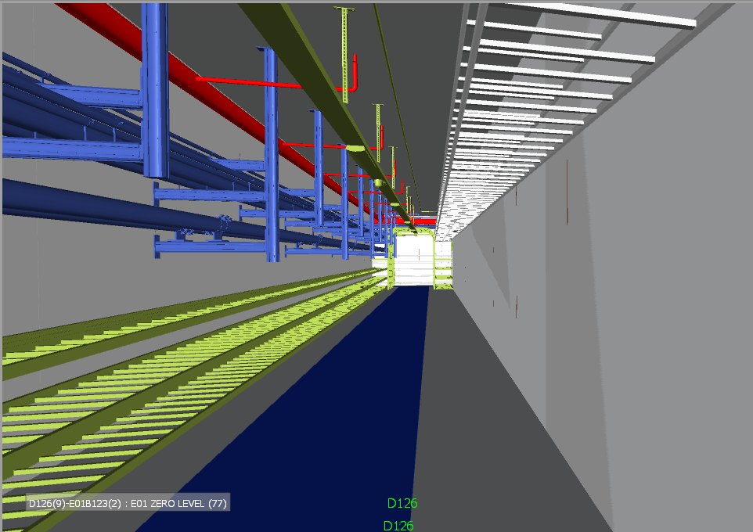
Conventional ventilation in the experimental hall
Ventilation meant for normal chemical hazards, used for
  exhaust for fume hoods in instrument labs (next to instruments)
  exhaust for gas cylinders/flammable cabinets on instruments
  exhaust for sautering (permanent workstation)
Status: will have a design review in March
Galleries with
Utilities - serving
all exp.halls

Slide 8
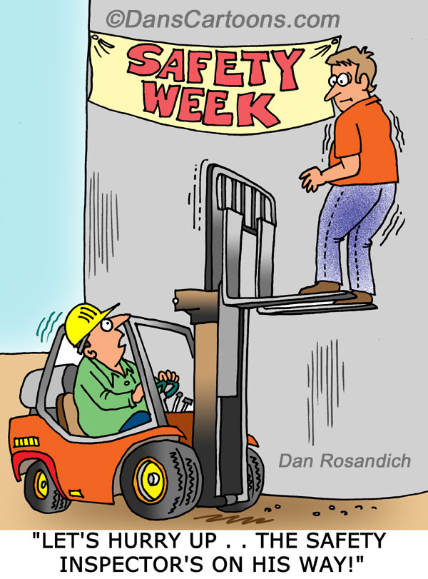
QUESTIONS?
We are working closely with the ESH department at ESS
+ rules for safety are suitable for our work
- time spent for writing documentation

