Slide 1
RML: hazard analysis, layout, workflow, access dates
www.europeanspallationsource.se
STAP Users and Samples
March 6-7, 2018

Slide 2
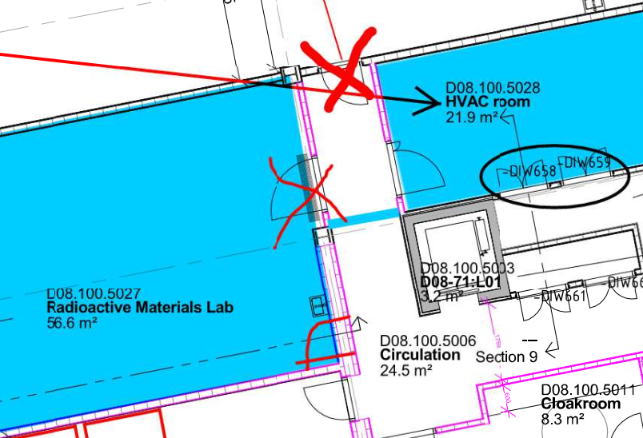
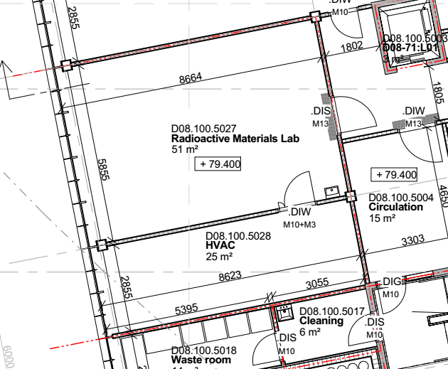
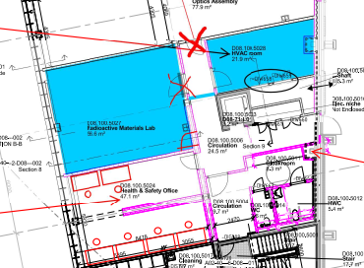
RML: changes to location due to seismic requirements
HVAC room
21.9 m²
Radioactive
Materials Lab
56.6 m²

Slide 3
RML equipment and current model
2 glove boxes supplied by Estonia:
  one dry box for sensitive samples
  one reaction box for air-sensitive materials, synthesis
gamma spectrometer (SULF procurement)
equipment for water analysis (ESS Target, partnership?)
Fume hood and storage
Fume hood and storage
Glove box
Glove box
Changing
area
Mobile Island
(gamma spec)
H/F
56.6 m²
Fume hood and storage
Fume hood and storage
Benches &shelves

Slide 4
RML – status and planned work
Inventory of rad lab (V. Caillot, seconded from ILL)
  Design of HVAC (needed now by CF!)
  Hazard analysis (Fire) for the RML permit (Swedish Radiation Safety Authority)
  Security for laboratories/hall
Sample handling in RML (H. Ramsig)
  Access through user program: experimental safety review
  Access outside user program: ESS work hazard analysis
  Coordination of hazardous experiments through RML team

Slide 5
Access dates
RML will be finished before beam on target
  RML will provide service to ESS for testing water/equipment/activation foils from target/accelerator
  RML will provide service to user program for actinide research and highly activated samples
  RML will be the only lab during ESS construction phase that can handle activated materials from the start
RML documentation will be done summer 2018
  Inventory/sample handling/hazard analysis
  Later: more details on scheduling of experiments

