Slide 1
DEMAX Update On Activities (Bio, Chem, Xtal)
Anna Leung
www.europeanspallationsource.se
4 March, 2018

Slide 2
Outline
Lab spaces and equipment
Activities – Bio Deuteration: SINE2020, Interreg, technician with LP3
Activities – Xtal: SINE2020, Interreg
Activities – Chem Deuteration: SINE2020 and the DEUNET, VR (PhD, postdoc), Masters Thesis project
Summary – current situation

Slide 3
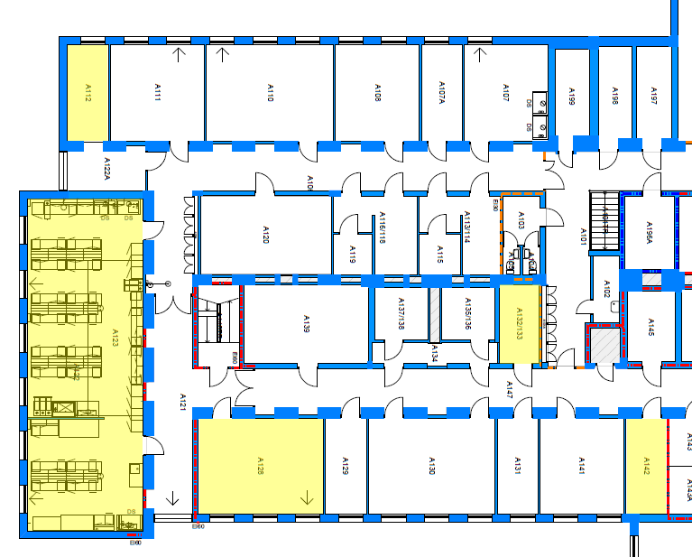
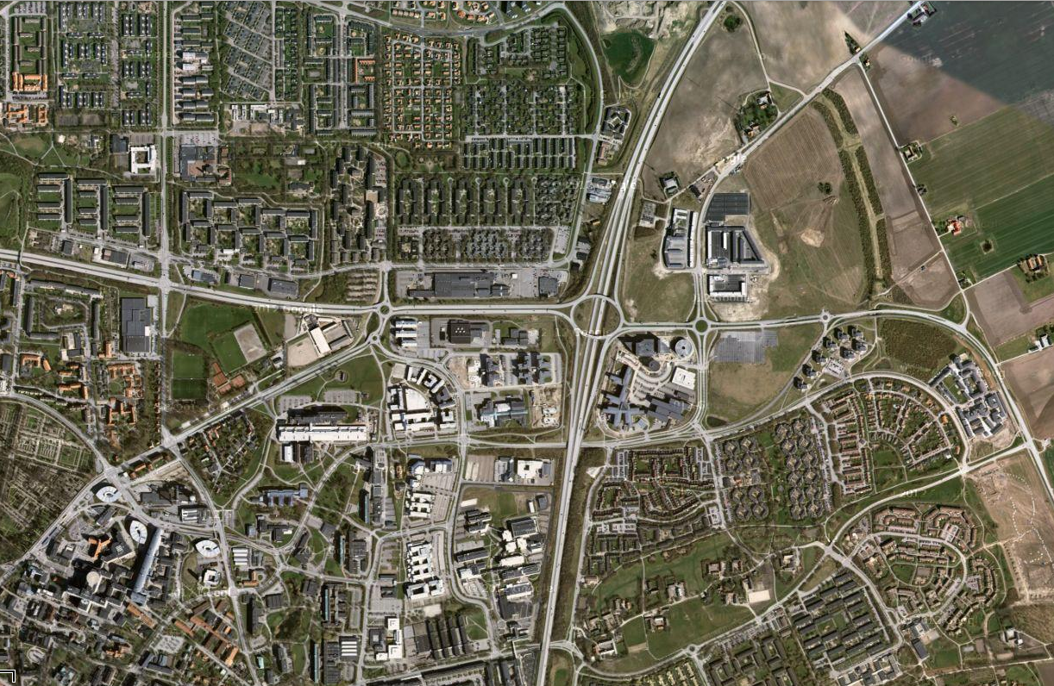
Lab Spaces 1
Biological deuteration & crystallisation – shared/distributed space within Biology Dept, LU
MAX IV ESS
Medicon Village
Notes:
Five year agreement with LP3 to be housed in their labs within the Biology Department at Lund University.

Slide 4
Lab Spaces 2
Chemical deuteration – five year rental agreement with Medicon Village (MV) currently under negotiation
90 m² general laboratory with 8 fumehoods and 4 office cubicals plus one office (2 people)
Includes use of Medicon Village’s dedicated hydrogen lab, Milli-Q water, house vacuum; allows access to, at additional cost: gases, dry ice, liquid nitrogen through MV and an NMR spectrometer via agreement with co-tenant
MAX IV ESS
Medicon Village
Notes:
Some of which are significant such as the NMR cost

Slide 5
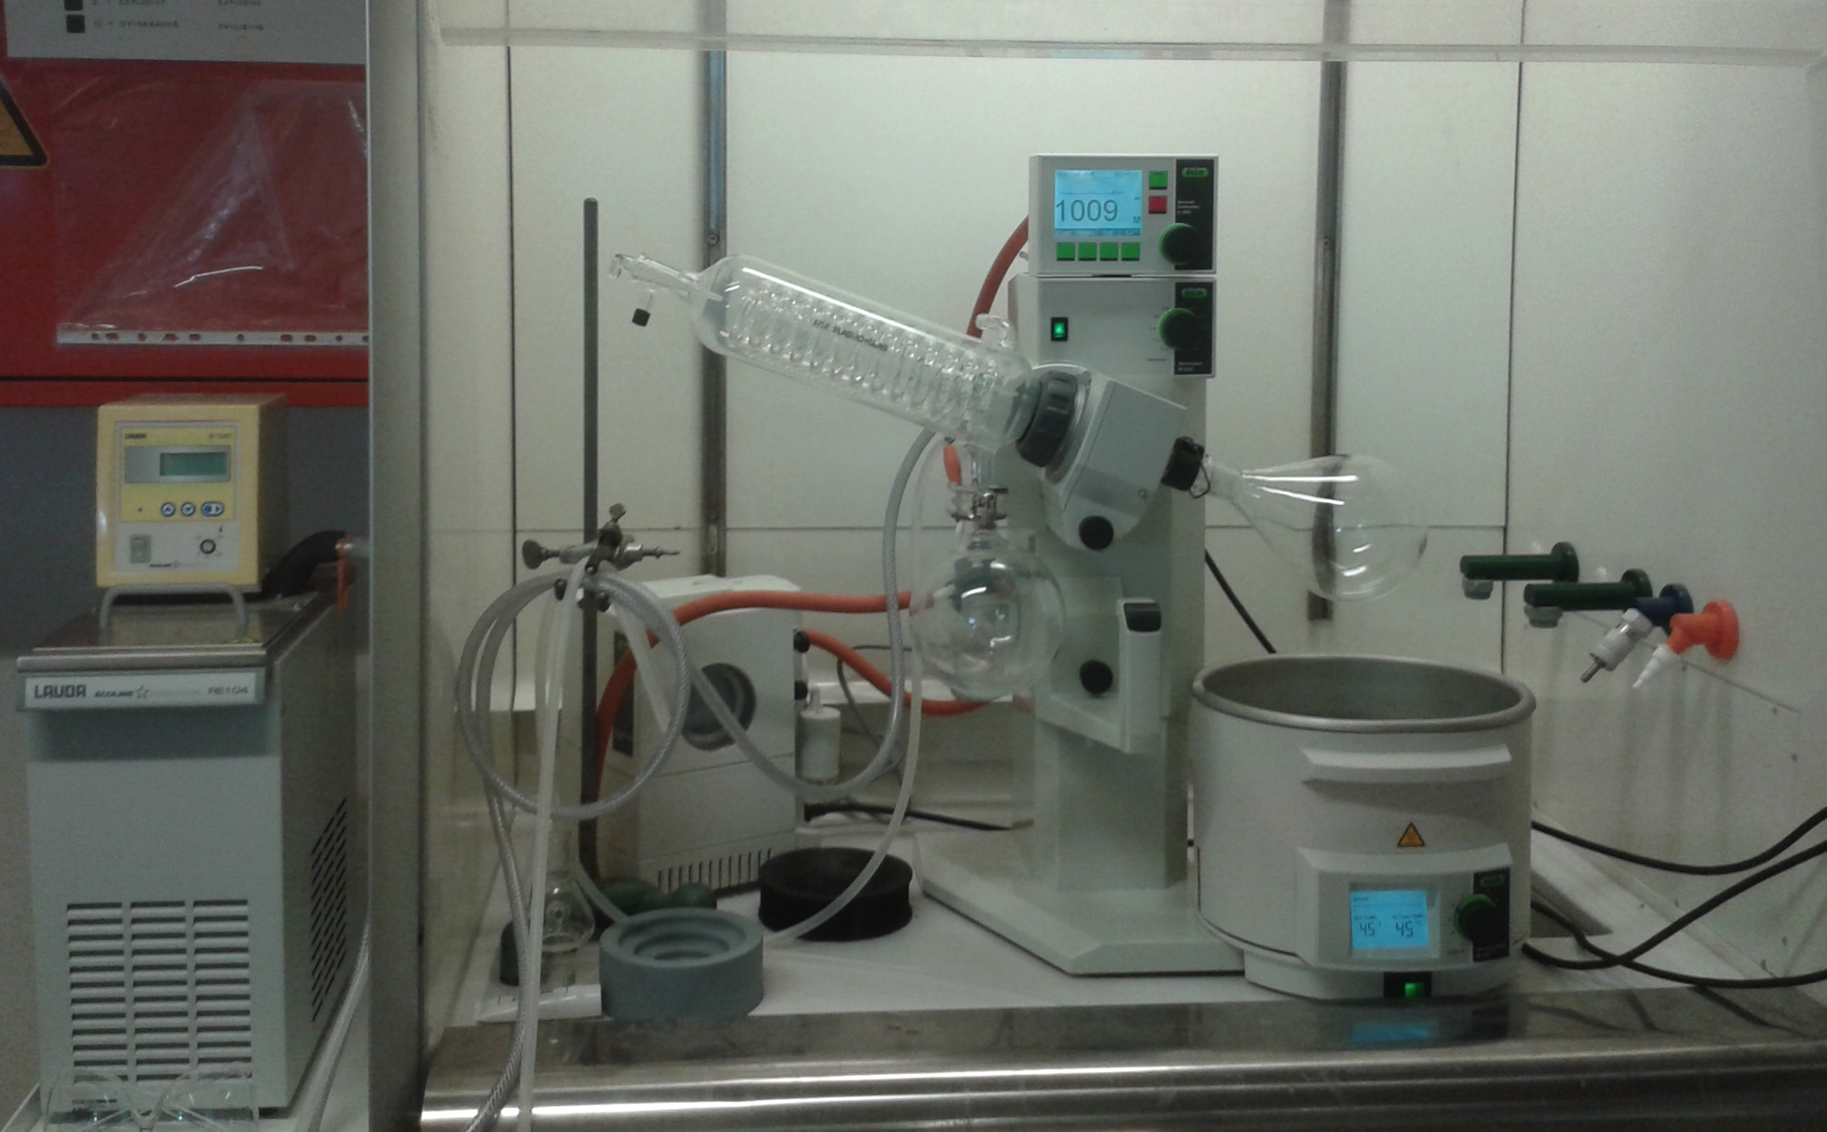
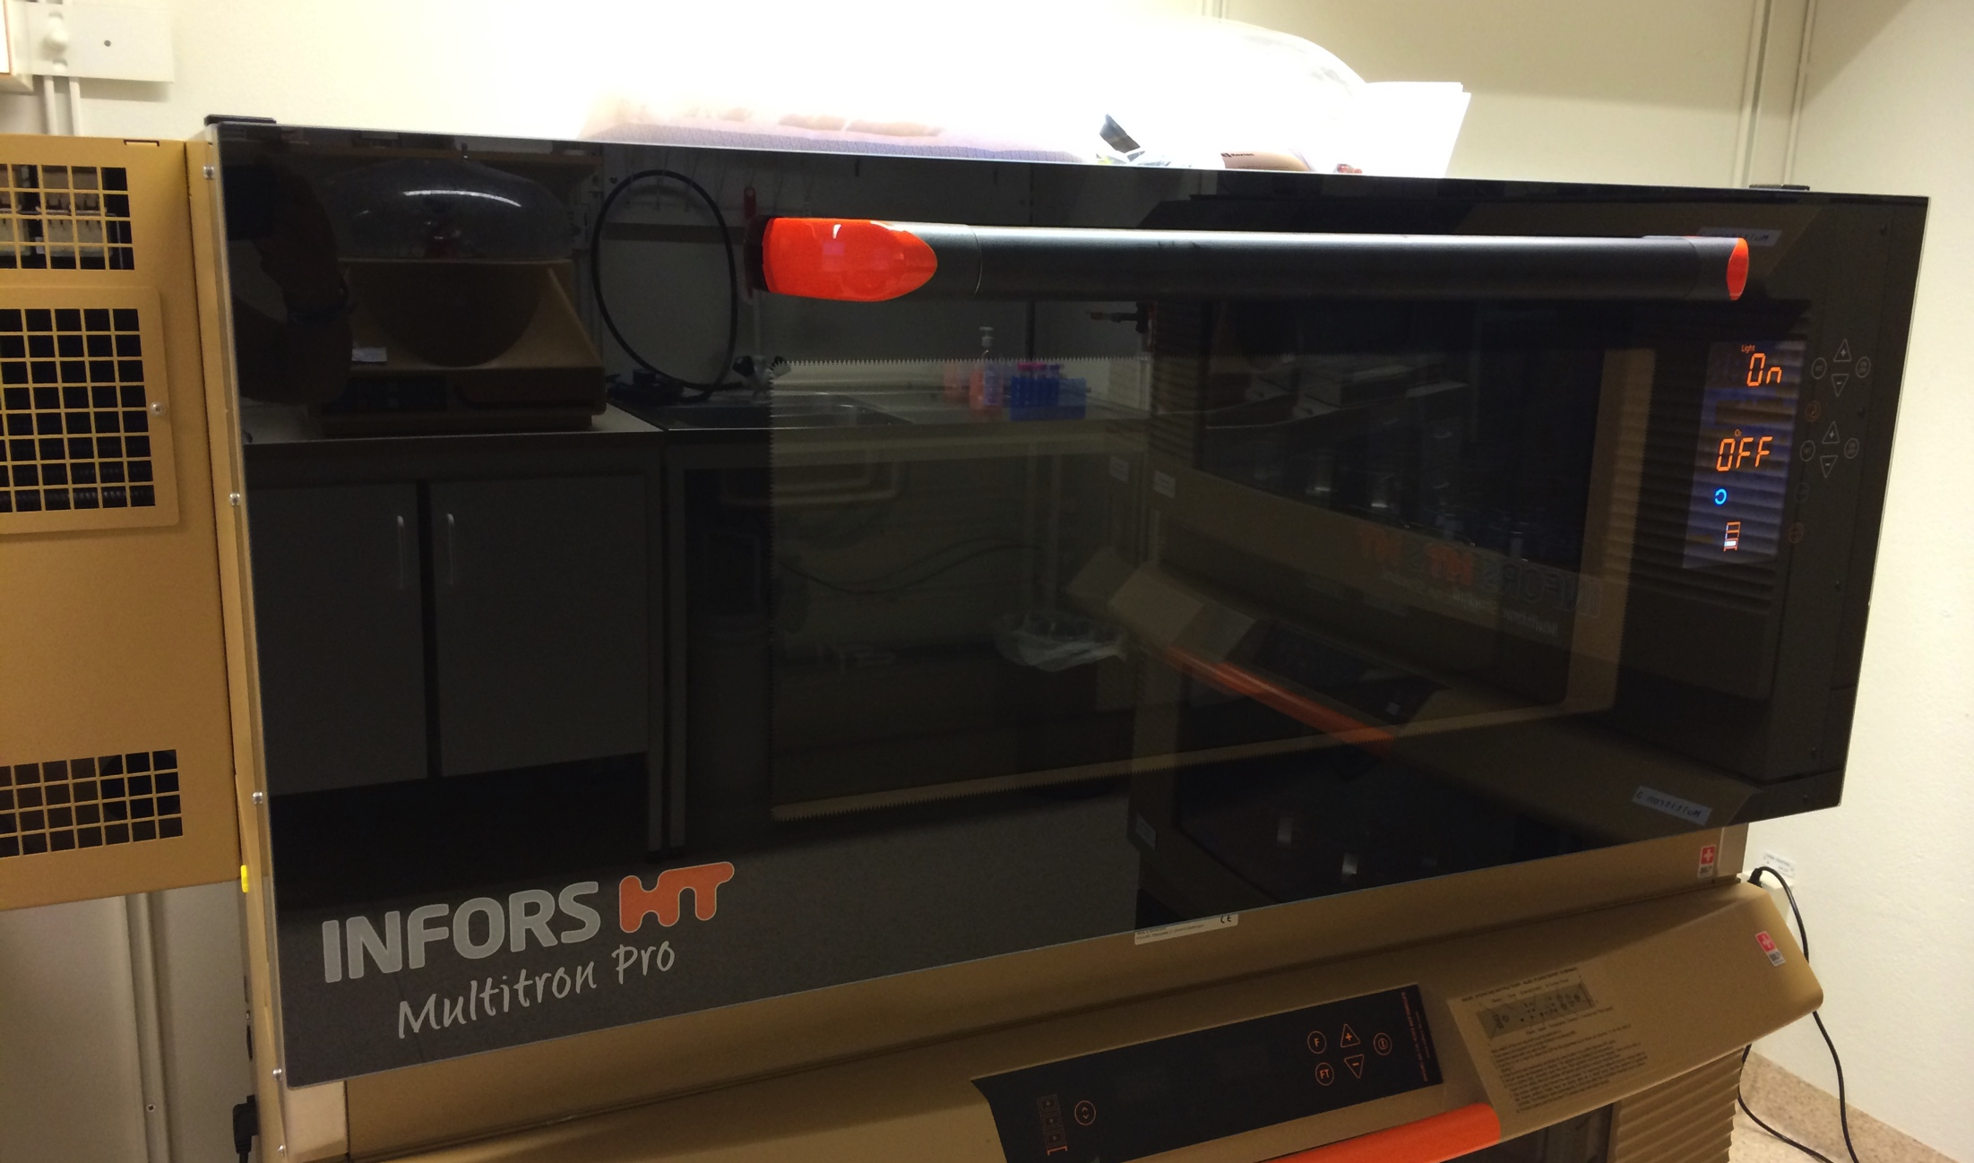
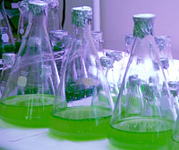
Biodeuteration: Equipment
Through agreement with LU, DEMAX has access to: milli q water, gases, LN2, general lab equipment, protein production & characterization equipment
DEMAX owns incubators, protein purifiers, rotavap, UV/Vis spec etc and pays for shipping, mass spec, consumables etc.
Current capabilities, competence: culture algae & bacteria in D₂O, harvest biomass, prepare some biomaterials from that (proteins, lipids/fats, crude biomass)
Notes:
SDS-PAGE (electrophoresis), differential scanning fluorimetry, dynamic light scattering

Slide 6
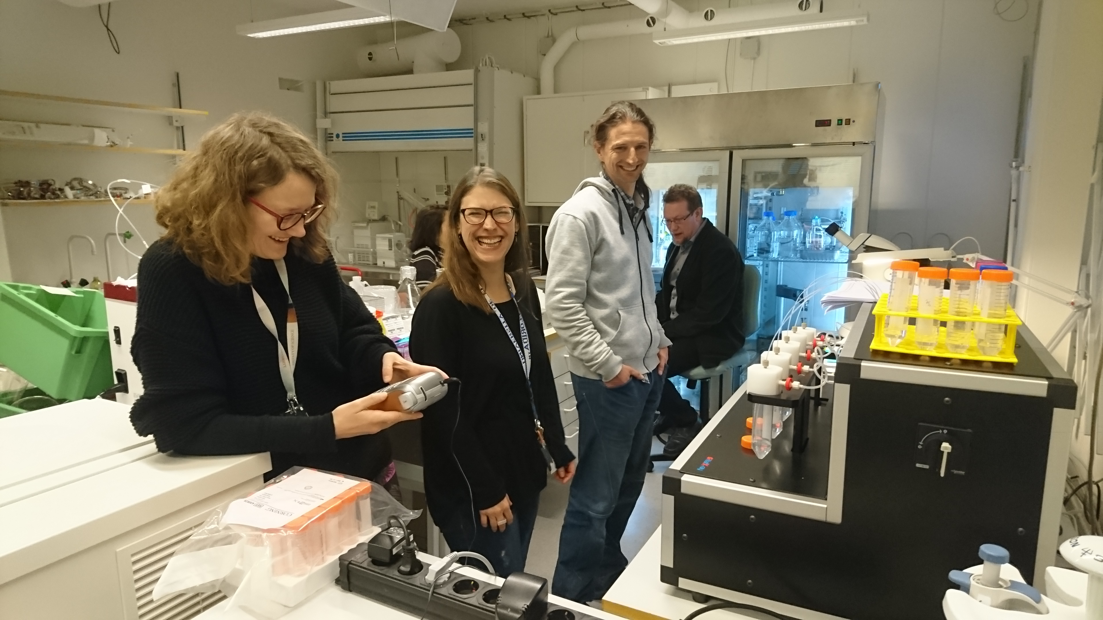
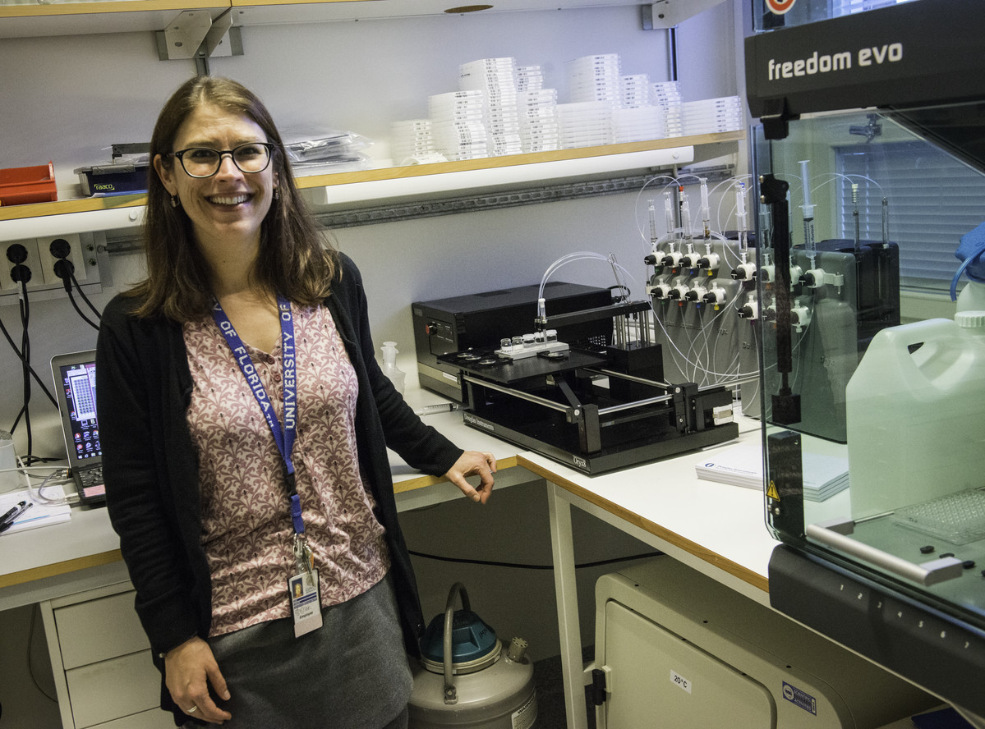
Crystallisation: Equipment
Housed at LU alongside biodeuteration
DEMAX owns specialised equipment (Oryx8, Optocrys, incubators, cryo equipment etc.)
Current capabilities, competence: everything for protein crystallisation
Notes:
In-kind contributions. Lipidic cubic phase dispenser; oryx8 protein crystallisation screening robot; opticrys dialysis crystallisation device;

Slide 7
Chemical Deuteration: Equipment
In addition to the facilities accessed through Medicon
Village, DEMAX owns: analytical to semi-preparative
HPLC, GC-FID, flash column chromatography, freeze dryer, rotary evaporator, rotating bed reactor, nanodrop,
centrifuges, general glassware and equipment
Current capabilities, competence: deuterated
chemical synthesis; purification and analysis; small
molecule extraction/separation/characterisation from biomass
→ which allow us to prepare perdeuterated molecules which should be in high demand in initial operations and useful for the first ESS instruments in 2023

Slide 8
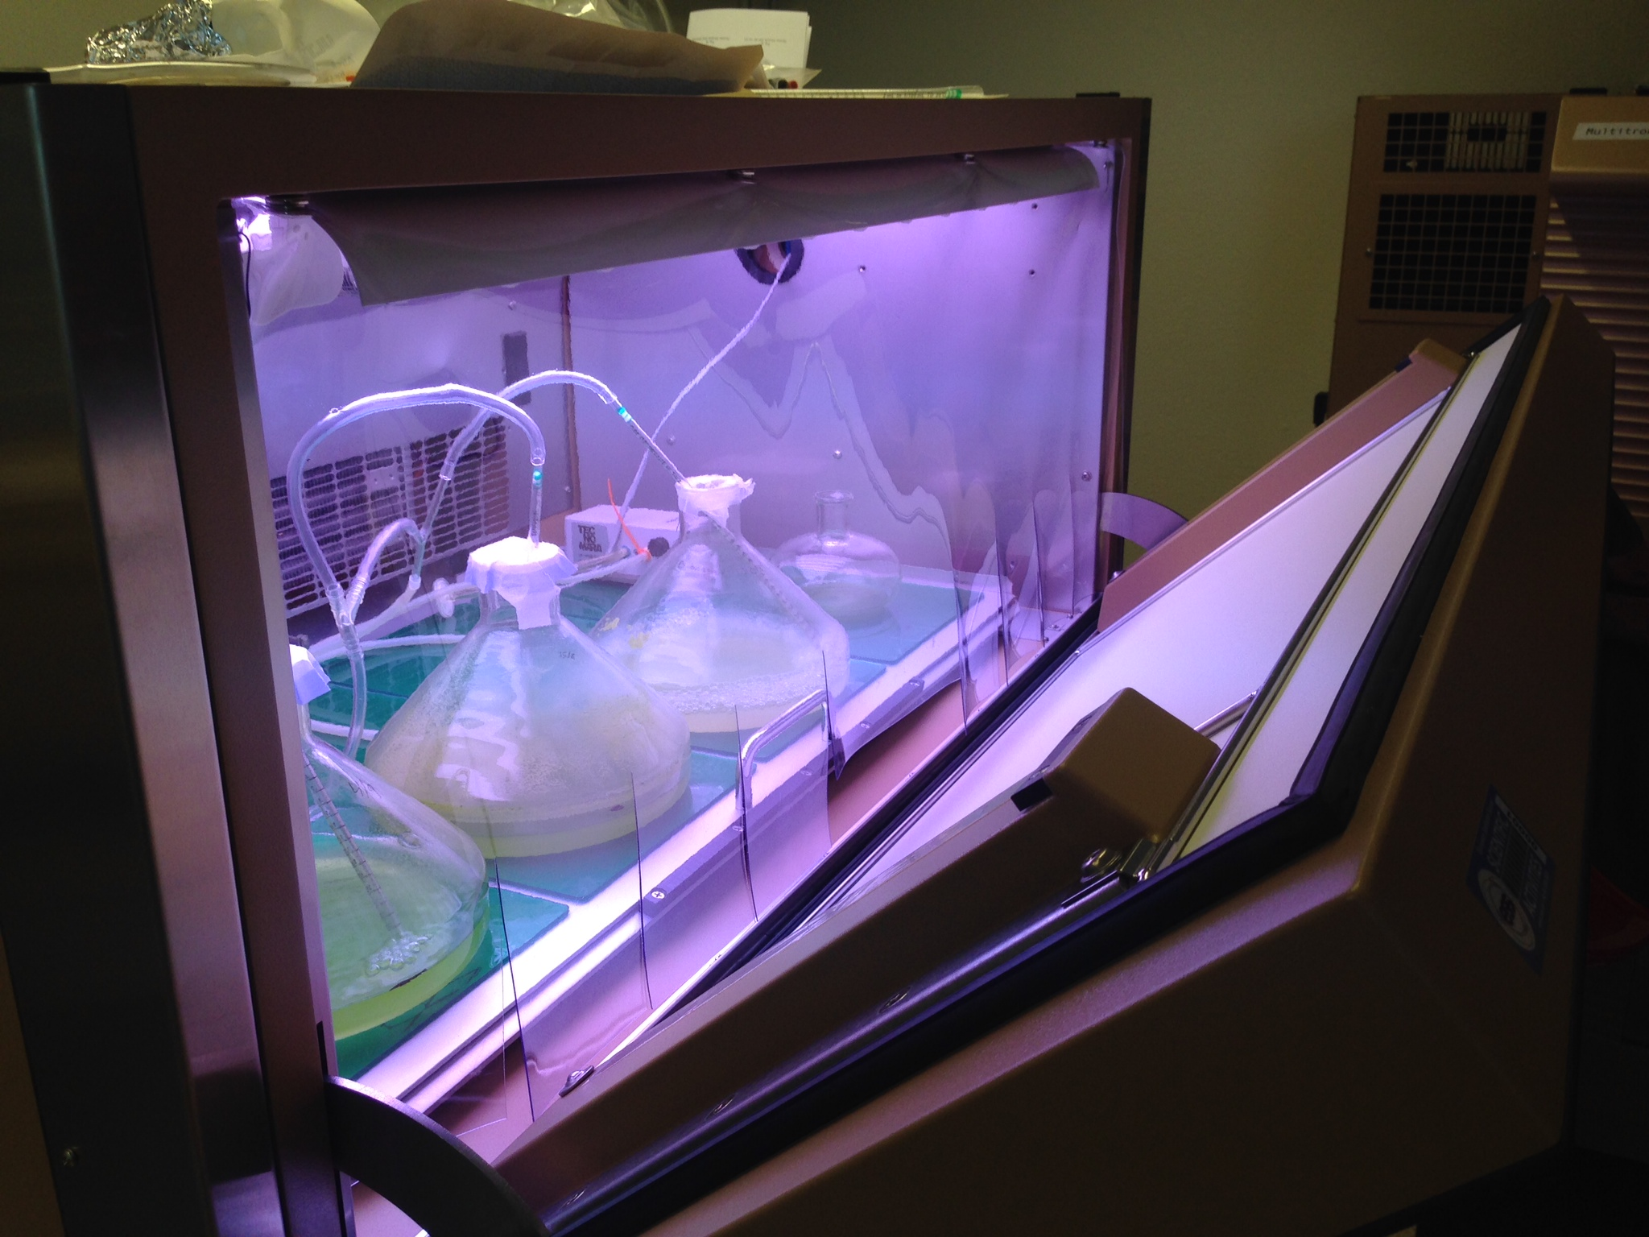
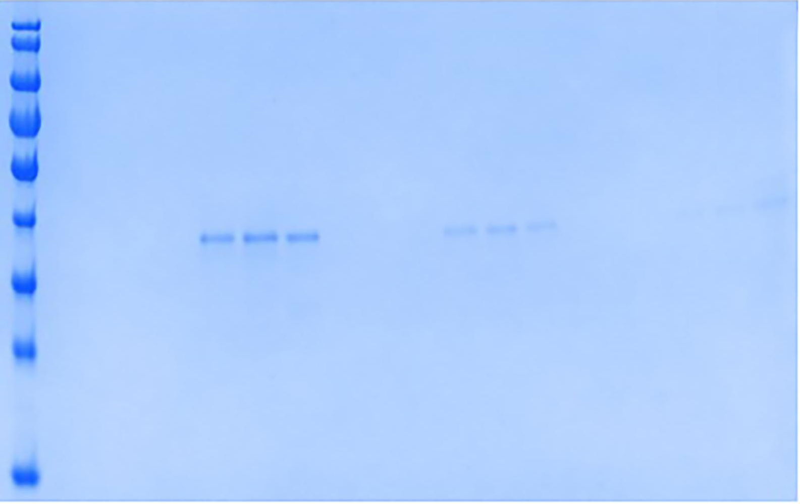
BioDeuteration: Activities
Optimized culture conditions in bacteria, algae; protein perdeuteration & yield; biophysical characterisation of proteins
4 Projects delivered in 2017 (external $: MAX4ESSFUN, SINE2020)
*We can deliver & characterise: (per)deuterated protein, biomass
*SANS (Loki, Skadi), NR (Estia, Freia), NPX (NMX)
MW marker
M9
ModC1
M9
ModC1
M9
ModC1
20 g
20 g
20 g
20 g
20 g
20 g
glycerol
10 g
10 g
10 g
10 g
10 g
10 g
5 g
5 g
5 g
5 g
5 g
5 g
180 -
16h
4h
1h
Manuscript under revision (Arch Biochem & Biophys): "Protein perdeuteration for neutron crystallography: cell culture media, protein thermostability, and crystallization behavior" – Koruza et al.
130 -
95 -
72 -
55 -
43 -
34 -
26 -
17 -
Notes:
Biomass (algal, bacteria)

Slide 9
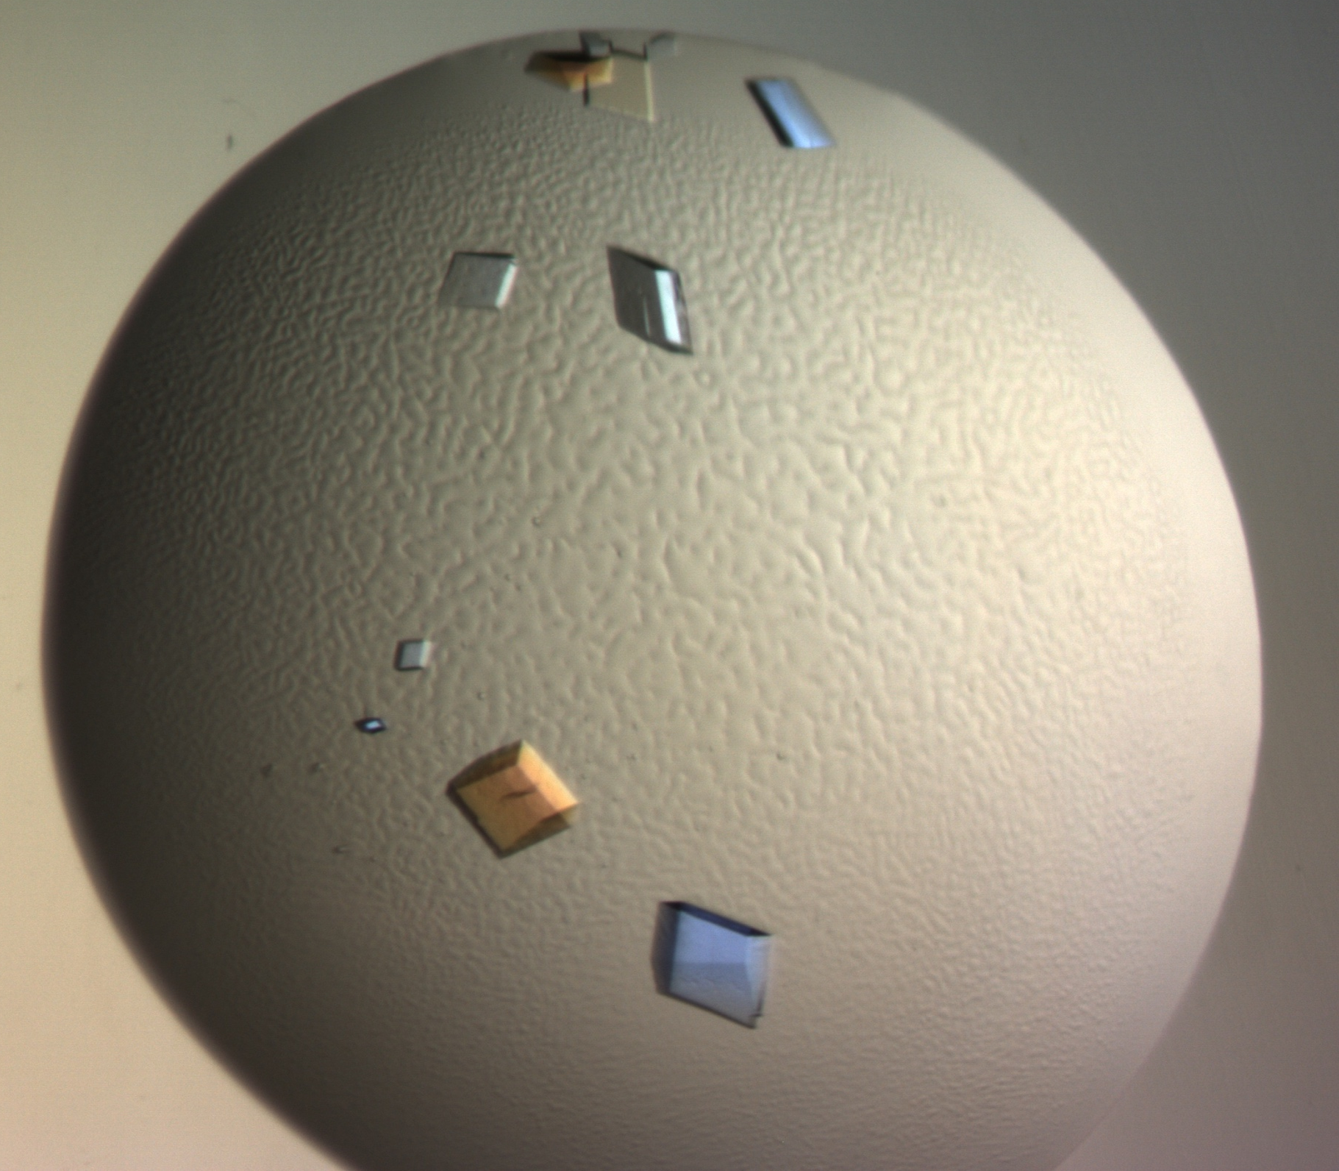
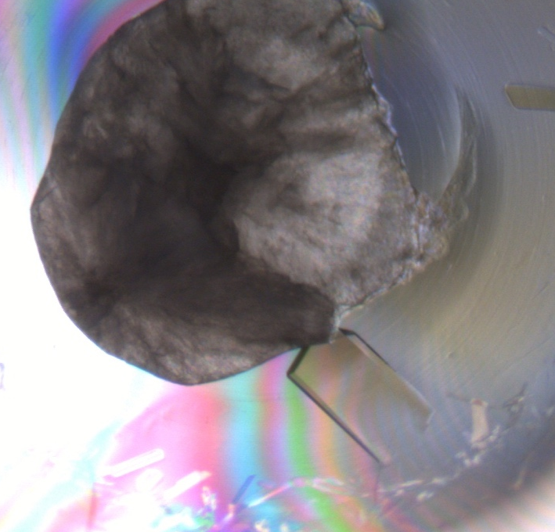
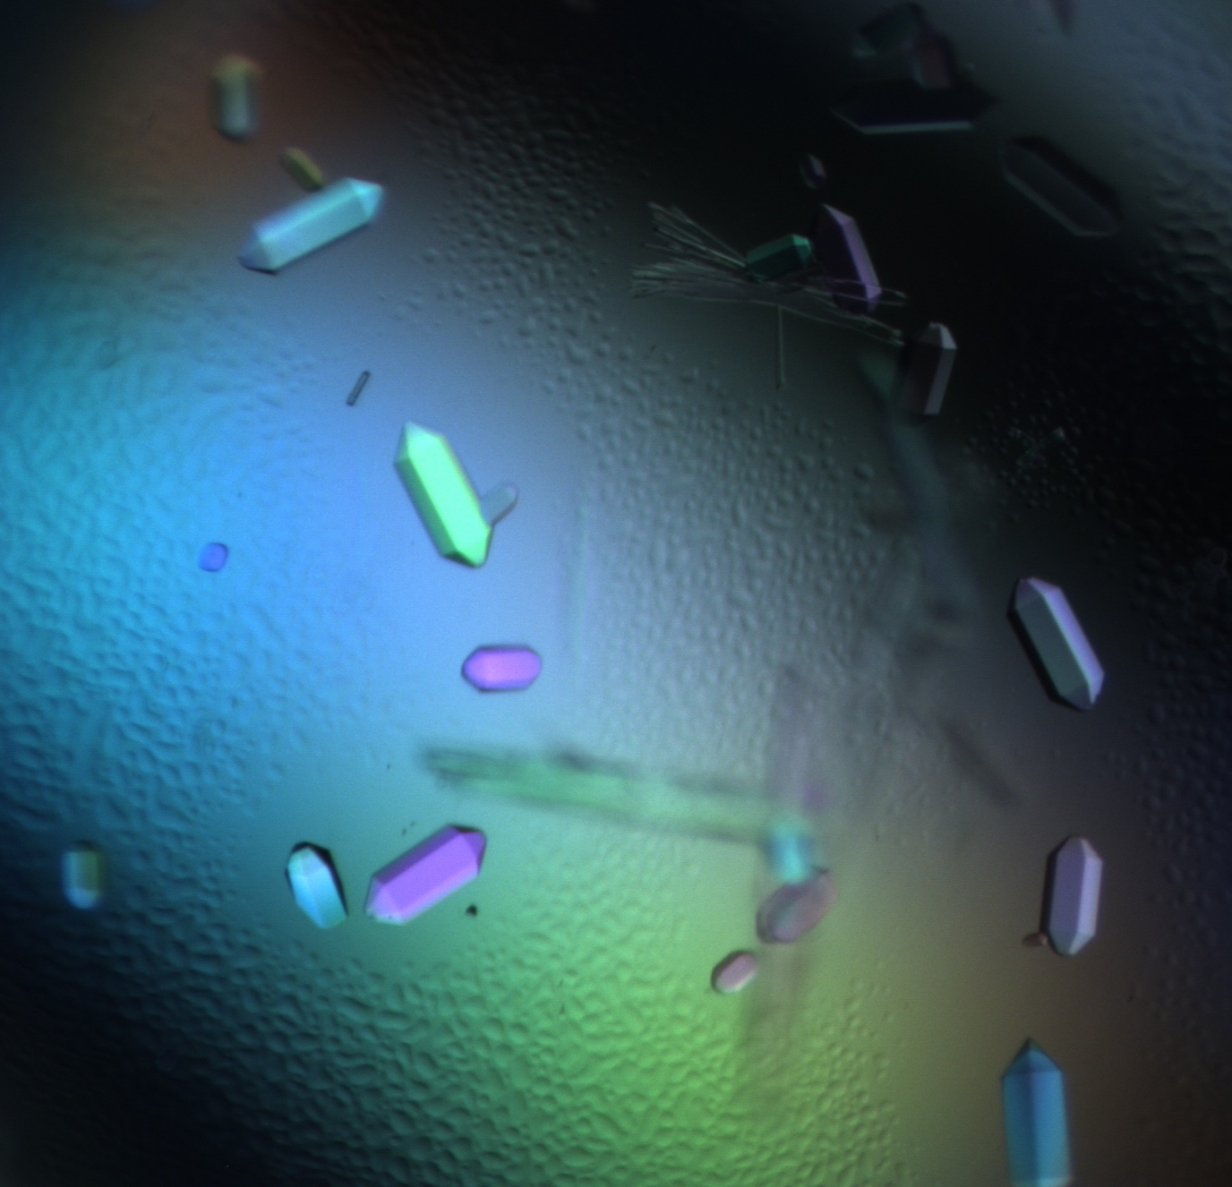
Crystallisation: Activities
Procedures and methods established, lab heavily used
5 Projects delivered (MAX4ESSFUN, SINE2020)
We can deliver & characterize protein crystallization (incl X-ray data collection)
*Can be used for NPX (NMX)

Slide 10
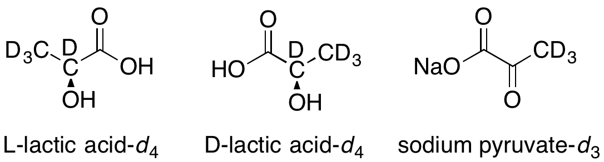
Chemical Deuteration: Activities
At the DEULAB, ESS:
The ESS synthesis of perdeuterated enantiopure
lactic acid has been completed; poly(lactic acid)
synthesis continues at FZJ;
Work continues to optimise the growth, extraction and purification of perdeuterated lipids and other small molecules from biomass (with ILL, LP3);
VR: Robin Delhom (Postdoctoral scientist), Manuel Orozco (PhD student) - both based at LU
Oliver Bogojevic (Masters Thesis project): Immobilised enzymes for the synthesis of deuterated molecules
Notes:
RD: Deuteration of pathogenic yeasts for lipid biomass production.
Purification and quantification of lipid extracts on a preparative scale.
Studies of lipid membranes linking lipid composition and membrane structure to features like antifungal resistance.
MO:

Slide 11
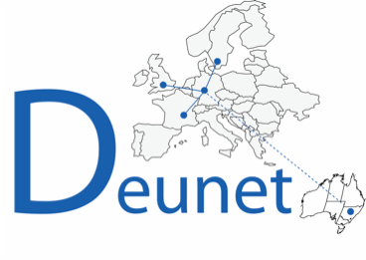
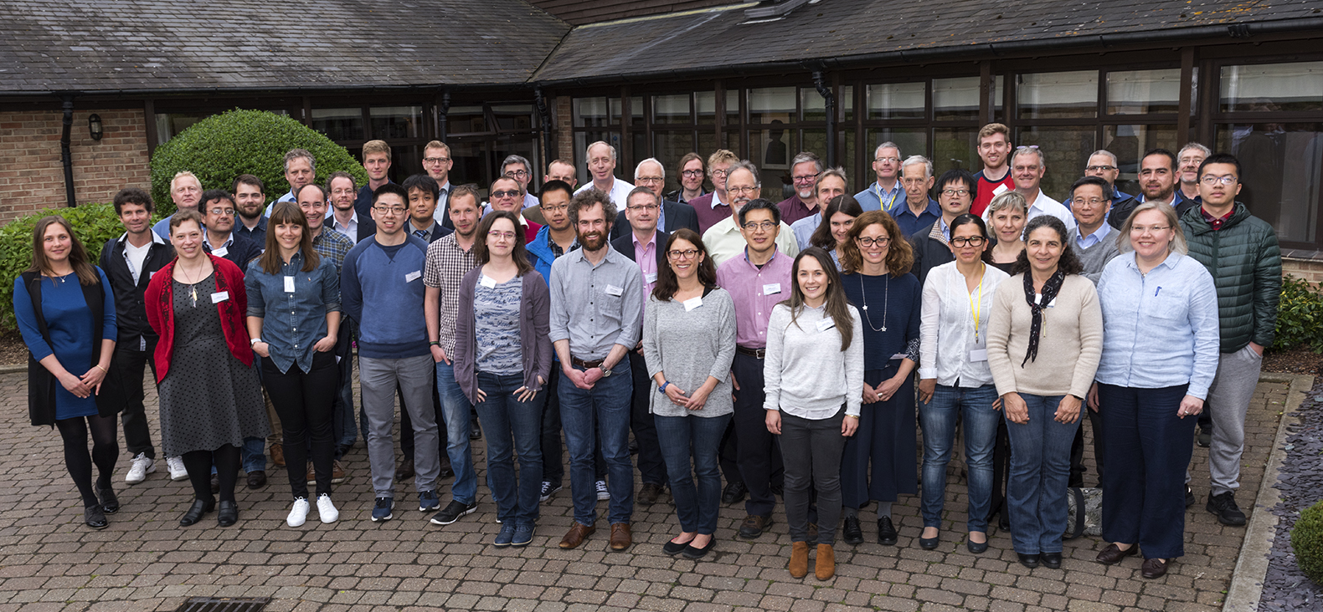
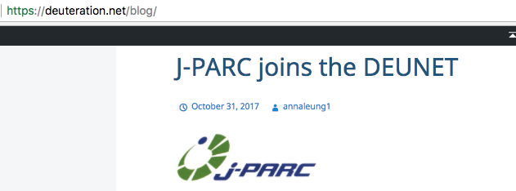
Within the DEUNET:
The European Neutron Scattering
Community has been surveyed to
assess which deuterated molecules
are most needed;
The DEUNET co-hosted its first User
Meeting, in conjunction with STFC in
May 2017;
J-PARC, JPN has joined the DEUNET;
DEUNET Advisory Board members
(Jian Lu, Peter Holden, Karen Edler)
joined the DEUNET members meeting
on Monday 5th March 2018

Slide 12
Summary – current situation
 | Biodeuteration | Crystallisation | Chem Deuteration
Lab space | Good | Good | Good
Equipment | Cap Ex complete | Good – need microscope, incubator (2019, 20k€) | OK – need Parr reactor(s), MS (100k€)
Staff | 0.4 ZF 0.3 FTE @ LP3 | 0.4 ZF 0.2 FTE @ LP3 | 1 AL, 0.5 HWK Part-time MSc
Notes:
This is all DEMAX funding. Zoe is between bio and cryst and ½ a tech split . 1 full technician bio 2019. 1 full time tech 2020 cryst and Zoe will take this is 2019. 1.5 DEMAX funding plus half from SINE?

