Slide 1
Mechatronics and Software Integration Progress
Anders Pettersson
Andreas Hagelberg
Niklas Ekström
Scientific Activities Division
SE–STAP 2018 March 16

Slide 2
Introduction: Sample Environment Control structure
Integrated Control Systems Division
(ICS) contribution:
EPICS integration
Engineering UI
Archiver
Network booting
Data Management and Software
Centre (DMSC) contribution:
ECS NICOS integration
User interface
Scripting
Data collection
etc
Plug and Play
Network
Timestamp
SES
EPICS
SECoP
ECS
MESI provide:
Control hardware
PLC
Algorithms/Logic
Sequences
Coordinating ICS/DMSC efforts
SECoP:
SINE2020
Providing a standard protocol

Slide 3
2017/2018 setbacks and progress
What happened in 2017
Erik D left (SECoP resource)
Michael W left (main DMSC interface)
David B left (main ICS interface)
…
Niklas Ekström Started (MESI, SECoP and software)
Andreas Hagelberg Started (MESI, Electronics and integration)
Matt C started at DMSC (main DMSC interface)(Q1 2018)
ICS situation still shaky..

Slide 4
STATUS: EPICS (by Integrated Control Systems Division ICS)
Progress in 2017
LakeShore 336 calibration curve download + curve selection
Full network booting + IOC startup available/tested
2 systems running on test hardware (Fitlet mini-PC)
Managed to integrated spectrometer proprietary driver
Plans for 2018
Plug and Play
Integration tools/code accessibility
save and restore
calibration/configuration handling
system stability
network booting (or not…)

Slide 5
STATUS: Experiment Control System ECS (NICOS) (by Data Management and Software Centre DMSC)
Progress in 2017
Demo with 3 SE devices integrated into ECS (simple integration)
Scripting tested
“User PC” setup in Utgård
Plans for 2018
Restarting SES integration into NICOS
NICOS to be available as easy client deployment
SECoP on ECS side
Start to collect requirements

Slide 6
STATUS: SECoP Project
Progress in 2017
We have recovered lost ground (Q1 2018)
Old demos restarted (Q1 2018)
Plans for 2018
New in-house implementation development started
Protocol more formalized -> Good starting point
Metadata discussion to start Q2->
Full speed ahead.

Slide 7
STATUS: SES integration, system “handover”
Handed over integration to FLUCO:
Integrated JULABO F25HL Water heater cooler circulator
Integrated LakeShore 12 channel Temperature monitor
Handed over integration to Target User:
CCR SES, Integrated LakeShore336, Lesker Ion Vacuum gauge, (Spectrometer).
Operations deployment
Enables testing to provide input for further improvements.

Slide 8
Integration Projects: Overview
JULABO F25-HL Circulator
LakeShore 336 Temperature Controller
Lab CCR SES
LESKER KJLC 354 vacuum gauge
OceanOptics QEPro Spectrometer
LakeShore224 Temperature monitor
KEPCO BOP502D Bipolar Power Supply
NE 1600 6 channel syringe pump
NE 100X 1 channel syringe pump
NE9000G Peristhaltic pump
Utgård SE Utilities PLC
PACE5000 Pressure controller
Scanning system
LOKI (VR) inline system
HPLC Knauer AZURA P 6.1L
Anton-Paar Densitometer
Ocean Optics Spectrometer
Orange Cryostat
Cameras for Kinematic Mounting
Huginn SANS Temp Controller Integration (with PLC)
“Baseline”
“Baseline”
“Baseline”
“Baseline”
“Baseline”
Close to “Baseline”
Close to Baseline
Not started
Not started
“Baseline”
Just started
Just started
LOKI (VR) inline system
Not started
Started
Not started
In progress
“Baseline”
Not started
More on its way!
EA Power Supply
Function generator
Resistor decade
AC suceptability
Flexiprobe(?)
Pulse Probe laser..
…

Slide 9
Development:MESI
Patch panel (to be used in mock-up cave)
>20 individual PID/PWM control loops on PLC
Touch screen for SES (RaspberryPi)
First PLC motion axis control loop based on analog input signal (kinematic mounting setup)
AUTOSTAT Project, semi automated Cryostat.

Slide 10
STATUS: Robotics
“Restarting” robotics
Heimdal small project on robotic arm (MESI involved)
VR project, inline sample flow/ robotic handling (MESI involved)
MC&A project (ESS robotics baseline) (MESI observer)
MESI will try to setup a ESS forum for robtics:
SE Robotics
ESS robotics

Slide 11
MESI Challenges
Getting up to speed with DMSC
Surviving the ICS (temporary..) resource crash
“Steer” controls infrastructure (ICS/DMSC) to suit SES
Provide a structured and functional “local” (SAD-SE ownership) control system approach.
Provide sufficient resources for SES integration
Find resources for robotics..

Slide 12
FIN
Thank YOU for your attention!
And ICS, DMSC and MC&A are highly acknowledged for their LARGE part, and good cooperation, in this development work!
Additional acknowledgement to MC&A for the work on robotics!

Slide 13
Pre-site Workshop Utgård upgrade, ready Q2 2018
3 workstation desks + 1 hotdesk
2 soldering stations
2 project benches
Full network access offices<->Utgård (+VPN from outside)
Equipping Integration workshop: tools, electronic components, Cables, connectors, assortment cabinet, Industrial PC’s (mini-PC, RaspBerryPI(for test), PLC + modules, switches, racks, crates etc..

Slide 14
Training
In-house EPICS training
Deep end code dive in SECoP
Programmable Logic Controller (PLC) training (Beckhoff)
ISIS visit (ESS ECP meeting + SE/facility tour)

Slide 15
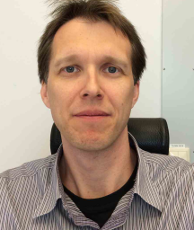
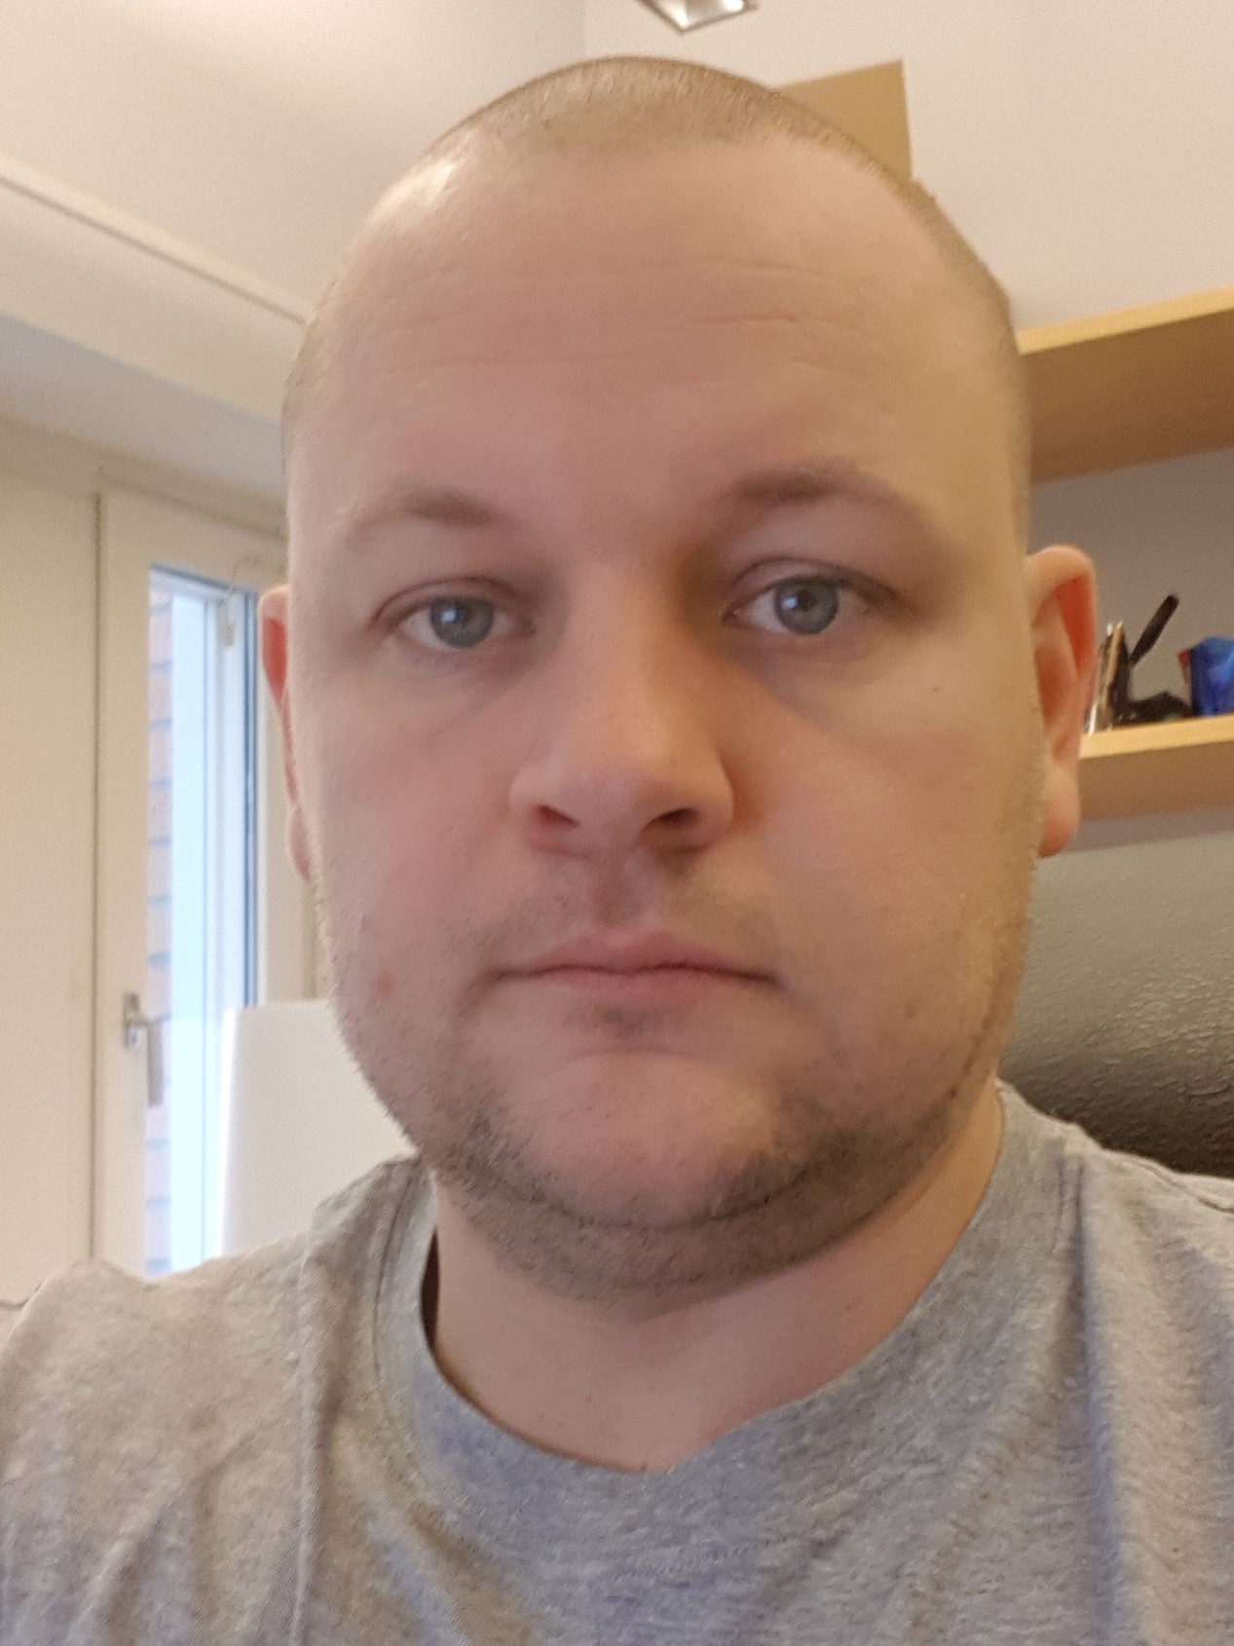
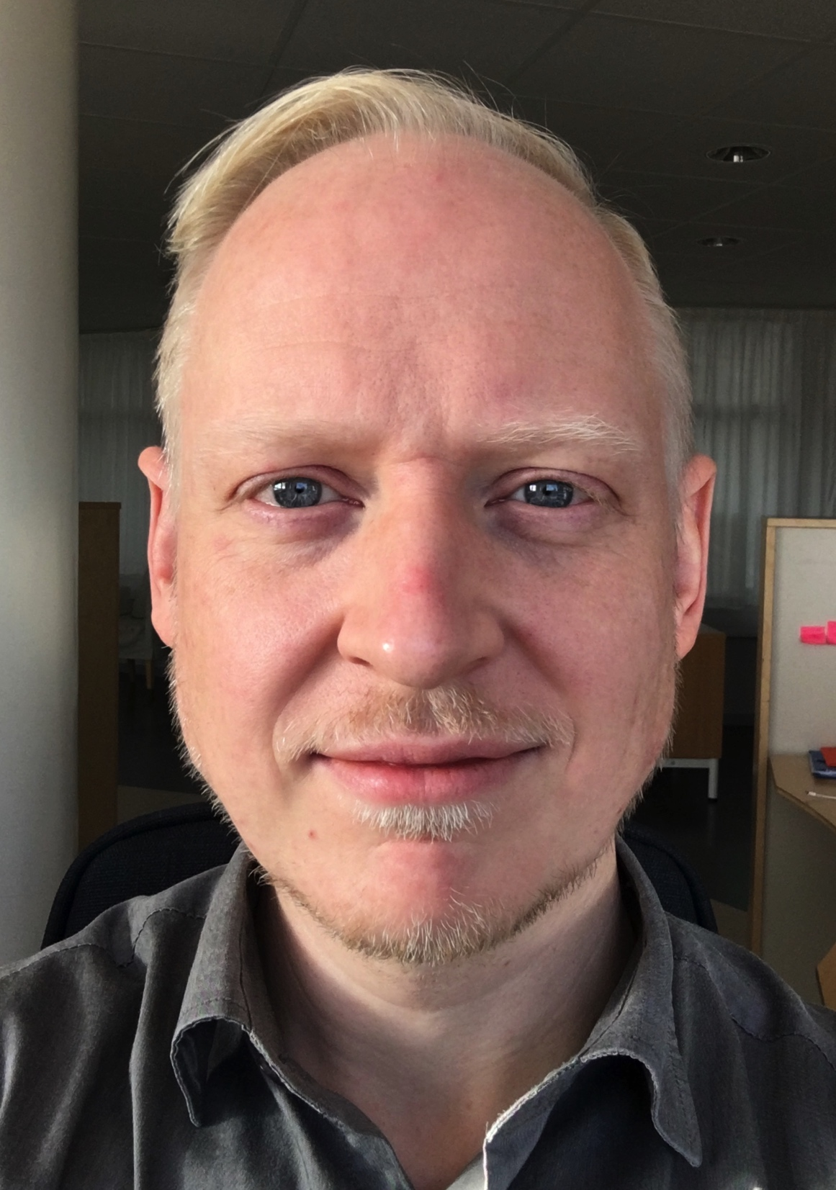
The Team
Science Support Systems
Scientific Coord.
User Office
Temperature
Field
High Pressure
Mech. Proc.
Fluids incl. gases,
vapor, compl. fl.
Deuteration
Crystallization
Sample handling
general labs
Sample Environ.
Syst. Integration
3 Integration Engineers
SAMPLE ENVIRONMENT

Slide 16
MESI competences
SECoP
Software
Networks
Electronics
PLC
EPICS
Integration
Mechatronics
Workshop
Motion -> MC&A
EPICS -> ICS
ECS(NICOS) -> DMSC
SES -> SAD-SE
XXX -> ???
Instrument Interfaces
Planning
Robotics

Slide 17
Integration progress 2017: examples
LakeShore 336 calibration curve download + curve selection
Full network booting + IOC startup available/tested
2 systems running on test hardware (Fitlet mini-PC)
Managed to integrated spectrometer properitory driver
3 SE devices integrated into ECS (simple integration)
First SE PLC integration to EPICS tested.

Slide 18
Patch panel
Potentially based on 19inch rack form factor
Spec’ed according to reference document
Prototype build in progress
Functional prototype to be installed (2 sided) in mock-up cave.

Slide 19
What has been achievend 2017
Instrumnet interaction
planning
Budget
Control structure

Slide 20
Envisaged SE Control System Structure: Device level
PLC = Programmable Logic Controller
IOC = Input Output Controller (EPICS)
EPICS = Experimental Physics and Industrial Control System
High level logic
User scripts. High level abstractions.
ESS Experiment Control System - ECS
User Interface
Mid level logic
Complex setups
User scripting / High level abstractions
Mid level logic
Safety critical functions
Data aggregator/Experiment Control/Data management etc.
EPICS ChannelAccess/pvAccess (ICS)
Low level logic
Drivers
ESS Timing System
Safety Switch
EPICS/SECoP
Industrial computer for each device
Can use instrument control rack/pc
Motion control supported by MC&A
Industrial PLC used as toolbox for development and implementation of demanding systems.
EPICS very capable in drivers to different SEE
IOC
Drivers
PLC
SEE
SEE
SEE
IOC
UPS
SEE
Stand alone SEE setup

Slide 21
Envisaged SE Control Infrastructure: Facility level
PLC = Programmable Logic Controller
IOC = Input Output Controller (EPICS)
ALL instruments WILL be connected to EPICS (the control system backbone)
Instrument A
SE Equipment
Control rack
Industrial PC
EPICS IOC (control software)
Local graphical Interface (EPICS/CSS)
Utility supplies controls (PLC)
ICS services
EE modules on NFS server
Instrument B
SE Equipment
Mini-PC
EPICS IOC (control software)
EPICS
Network boot
User Control PC
NICOS2 – Experiment Control System
Scripting
Plotting
High level logic/abstractions
Data
Archiver
DK

Slide 22
Prototype setup SE Control Infrastructure: Facility level
PLC = Programmable Logic Controller
ECS = Experiment Control System
Utgård SE Workshop
JULABO circulator
SE PLC control test crate
Utility supplies controls (PLC)
EE modules on NFS server
Hydrogen lab
CCR setup
T controller + compressor
Vacuum Gauge (LESKER)
Spectrometer (Ocean optics)
EPICS
ECS
NICOS2
ESS HQ/ESSIIP
NICOS2
Scripting
Plotting
Data
Archiver

Slide 23
Robotics Strategy for SAD SE
Goals:
Robotics shall be used to enable instruments to increase sample throughput and beam time utilization
Robotics shall be used to reduce required human interaction
Robotics shall support the experiments preparation work in the labs
Implementation & Organisation:
The robotics platform should enable mobile setups as a part of the sample environments pool (travelling among instruments)
Needs to be easily integrated into the instrument (mechanical, control)
Every instrument needs to prepare for this (volume, interfaces)
Work will mainly be done by in-kind projects
We still need to define which competency we need here at ESS

Slide 24
Staffing, in-kind and budget
Current staff:
Anders Pettersson ( Mechatronics engineer, 50% SAD 50% ICS)
Erik Dahlbäck (Software/electrical engineer, SINE2020 2 yrs, 2016 May -> )
Recruitments:
New position Q2 2017, Profile : Hands on mechatronics/electronics with software skills
New position later 2017, Profile: mechatronics/integration with network and coding skills
Steady state:
3.5 FTE (+0.5 50% ICS)
Planned In-kind:
Control system integration and logic (PSI)
Outfitting site MESI workshops
Budget during construction:
Total 2.2M€
personnel | 17 | 18 | 19 | 20 | 21 | 22 | 23
Scientific engineer | 0.5 | 0.5 | 0.5 | 0.5 | 0.5 | 1.0 | 1.0
Scientific engineer (ICS) | 0.5 | 0.5 | 0.5 | 0.5 | 0.5 | 0.5 | 0.5
SINE2020 | 1 | 0.5
Technician | 1 | 2 | 2 | 2 | 2 | 2 | 2

Slide 25
What’s in the pipeline
Camera alignment + motorized centring device
Syringe pumps, Oscilloscope, function generator
Plan integration effort of SEE suite with ICS and DMSC
Support instruments in detailed design
Integration of inherited HZB wet cryostat

Slide 26
Development projects and next steps
The AUTOSTAT project, a semi-automatic wet cryostat
PLC control crate (proprietary, open source, etc)
Defining a patch panel
PLC control for Peltier cryostat project
Explore the possibilities and limitations of current control structure
ESS SEE at HZB test beamline

Slide 27
Questions for STAP
Anything overlooked
Focus on the right things?
Oscilloscope, lab equipment
Core or new development (in construction phase)?
wireless signals in caves?
Timer functions on cooling water? (auto close after exp.)
More SE robotics focus or is an AUTOSTAT better value for money?
Do we need to log data at the instrument SEE preparation area?
Early use case for high precision time stamp?!
Trusting the network, using disked/diskless systems
Planning, avoid integration peak – early SEE?

Slide 28
2017
What happened in 2017
Erik D left (SECoP resource)
Michael W left (main DMSC interface)
David B left (main ICS interface)
…
Niklas Ekström Started (SECoP and software)
Andreas Hagelberg Started (Electronics and integration)
Matt C started at DMSC (main DMSC interface)(Q1 2018)

Slide 29
The Team
Science Support Systems
Scientific Coord.
User Office
Temperature
Field
High Pressure
Mech. Proc.
Fluids incl. gases,
vapor, compl. fl.
Deuteration
Crystallization
Sample handling
general labs
Sample Environ.
Syst. Integration
Sample environment organized in platforms
3 Integration Engineers
SAMPLE ENVIRONMENT

