Slide 1
PREMP update
Malcolm Guthrie
www.europeanspallationsource.se
2 March, 2018

Slide 2
Sample Environment Suite for PREMP

Slide 3
Sample Environment Suite for PREMP
Focus on construction project
Trigger instrument – first to require SES
Typically requested for cold commissioning
All trigger instruments are in Long Hall
Notes:
Raman 41.6k (could de-scope to ruby only) ~ 15k (saving 26k)
Portable laser 100k (could swap for MP SEE).
Corrosive gas already removed. 15k

Slide 4
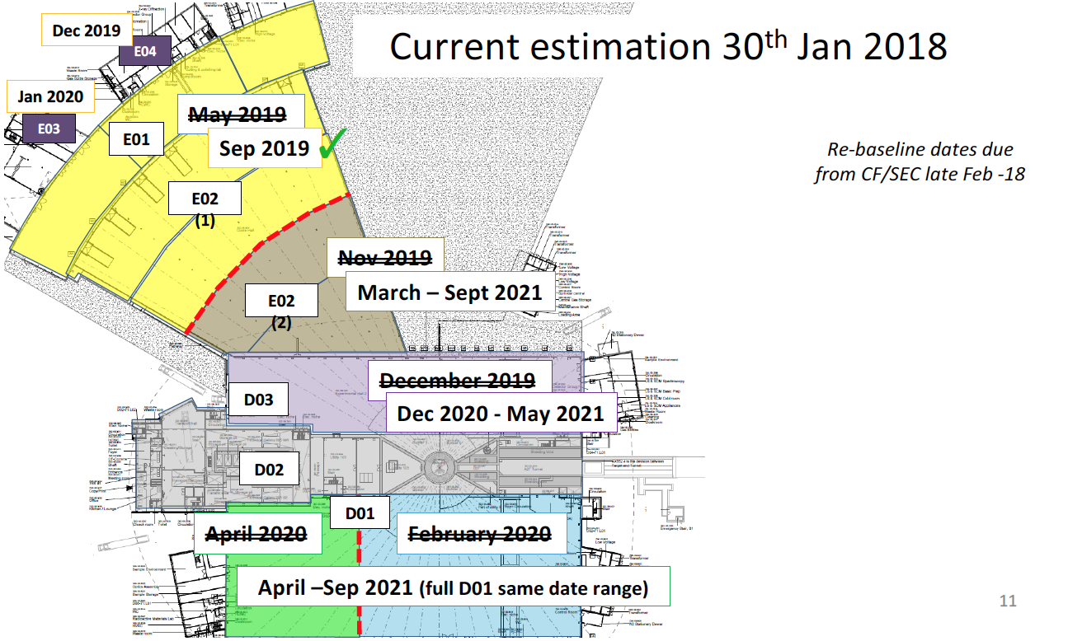
Rebaselining
Impacts - (Provisional!)
Long Hall
Cold comm. delay ~ 4 months
Hot comm. delay ~ 10 months
D03
12-18 months cold comm. delay
D01
12 months cold comm. delay

Slide 5
Schedule example: PE systems
Generic:
Prelim. design
Detailed. design
Procurement, integration,
certification
Cold comm.
Hot comm.
ready
Detailed. design
Procurement, integration,
certification
Cold comm.
Hot comm.
Schedule 2017
BOT
PE
Access E03/E02
MAGIC (trig)
Det. Des.
Proc./Mfg
Installation, cold comm.
Hot comm.
ops.
18
19
20
21
22
23

Slide 6
Schedule example: PE systems
Generic:
Prelim. design
Detailed. design
Procurement, integration,
certification
Cold comm.
Hot comm.
ready
Detailed. design
Procurement, integration,
certification
Cold comm.
Hot comm.
Schedule 2017
BOT
PE
Access E03/E02
MAGIC (trig)
Det. Des.
Proc./Mfg
Installation, cold comm.
Hot comm.
ops.
18
19
20
21
22
23
PE SES
Det. Design
Proc.
Installation
Cold
hot
Sign TA
w/ LLB
SES project steps:
Installation: control systems, safety, trainining, certification (CE-marking),
Cold comm: Checking system integrates with instrument
Hot comm: testing background, collimation, shielding

Slide 7
Schedule example: PE systems
Generic:
Prelim. design
Detailed. design
Procurement, integration,
certification
Cold comm.
Hot comm.
ready
Detailed. design
Procurement, integration,
certification
Cold comm.
Hot comm.
Schedule 2018 (Provisional!)
Part. Access E02
PE
BOT
Access E03
Full Access E02
MAGIC (trig)
Det. Des.
Proc./Mfg
Installation, cold comm.
Hot
ops.
18
19
20
21
22
23
PE SES
Det. Design
Proc.
Installation
Cold
hot
Sign TA
w/ LLB
No significant change in delivery
Extended period for installation cold comm.
Very rushed hot comm.
Strategy may be hot-commissioning activities at other spallation sources

Slide 8
Update preMP
Inst specific BEER not yet progressed (2019)
  €300k for stress rig
  No clear strategy yet for remaining €300k in budget
    stir welding (€200k) dilatometer (€400k)
  Chalmers furnace project started (PD hired)
Non inst—specific.
  Recognise need to expand Pool (need IK partner or collaborator!)
  €40k “Generic stress-strain rig”. Do we want it? Should start project in 2018. Who is potential IK partner?
  Other items (Equip list for OPS and external funds)
  Upcoming Nordforsk meeting (2-3 May, Denmark)
  http://chem.au.dk/en/research/conferences-and-workshops/neutron-and-synchrotron-sample-environment-workshop/
Advice:
  €100k for portable laser heating could be re-directed to MP.

Slide 9
Update PREmp
Held community workshop in Lund (July 2017)
  Broadly sanctioned pressure plan
  Highlighted need for a <5 GPa <1K cell
  Highlighted need for >= 0.7 GPa liquid cell
Preliminary design finished for most SES
Close to finalising agreement on LLB IK deal
Clear priority to focus on safety and quality (CE-marking) for high-pressure SES.

Slide 10
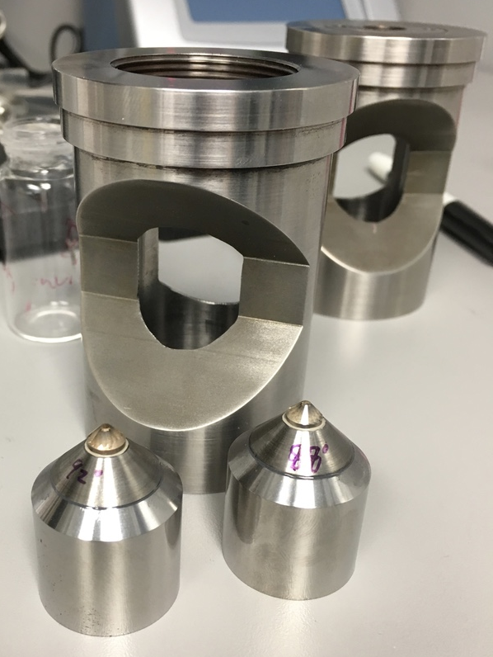
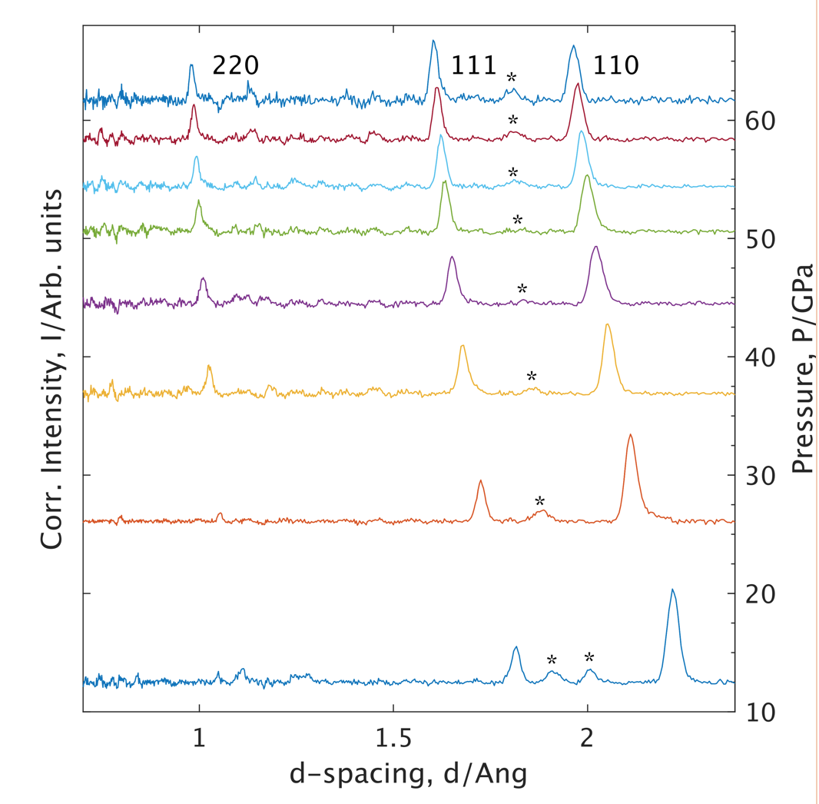
Activities 2018 – Continued DAC advances
“Day 1 target science”
  diffraction: light molecular systems D₂O,ND₃,CD₄ ; superconductors; magnetism
  Spectroscopy: exotic quasiparticles, superconductivity
  SANS*: polymers, food science, high press biology
New cells have large aperture enabling SXL diffraction and wider Q-range. And internal clamp system for low T
Powder diffraction now possible up to 60 GPa
Angström cluster proposal for “SANS DAC”

Slide 11
Activities 2018 - LLB IK
Primarily establishing baseline capabilities:
7kbar gas (and liquid?)
2 GPa clamp
20 GPa PE cells (standard anvils)
  Anvil development separate
Also gas loading (for PE and smaller cells)
And specialised cryostat for P cells (spec not fixed)

Slide 12
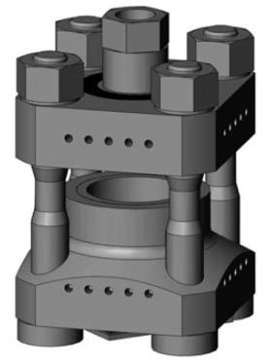
Activities in 2018
Quality – Safety
  Define requirements for CE marking (metallurgy, testing, safety factor, calculations…)
  Develop safety (risk assessement, training, integration inc control software)
Based around V3 Paris-Edinburgh press & hydraulic system

