Slide 1
GEM-based neutron detectors including beam monitors
G. Croci^{3,1,2}, A. Muraro¹, G. Grosso¹, E. Perelli Cippo¹, G. Claps⁴, F. Murtas⁴, M. Rebai^{2,4}, M. Tardocchi¹, C. Höglund^{5,6}, L. Hultman⁶, J. Birch⁶, S. Schmidt⁶, L. Robinson⁶, R. Hall-Wilton^{6,7} and G. Gorini^{3,4}
¹Istituto di Fisica del Plasma (IFP-CNR) – Via Cozzi 53, 20125 Milano, Italy
²INFN – Sez. Di Milano-Bicocca – Piazza della Scienza 3, 20126 Milano, Italy
³Dipartimento di Fisica, Università degli Studi di Milano-Bicocca –
Piazza della Scienza 3, 20126 Milano, Italy
⁴INFN – Laboratori Nazionali di Frascati –Via Fermi 40, 0044 Frascati, Italy
⁵European Spallation Source ESS AB, P.O. Box 176, SE-221 00 Lund, Sweden
⁶Department of Physics, Chemistry and Biology (IFM), Thin Film Physics Division,
Linköping University, SE-581 83 Linköping, Sweden
⁷Mid-Sweden University, SE-851 70 Sundsvall, Sweden

Slide 2
GEM-based neutron detectors under development:
BAND-GEM
bGEM beam monitor
Multi-GEM neutron converter

Slide 3
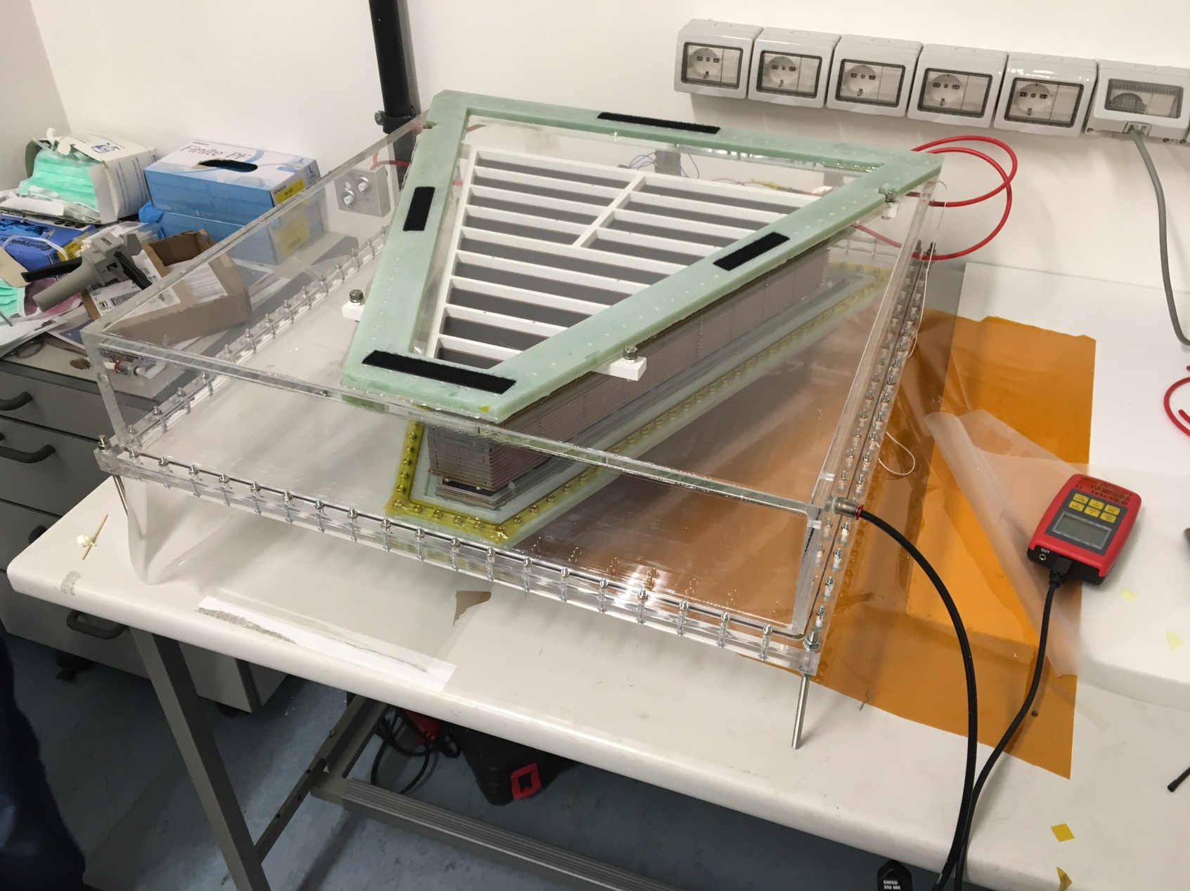
BAND-GEM Full Module Completed!
Under test

Slide 4
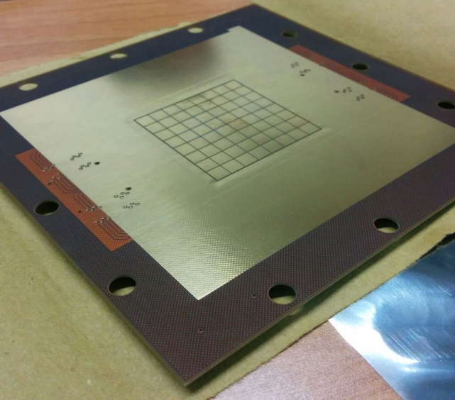
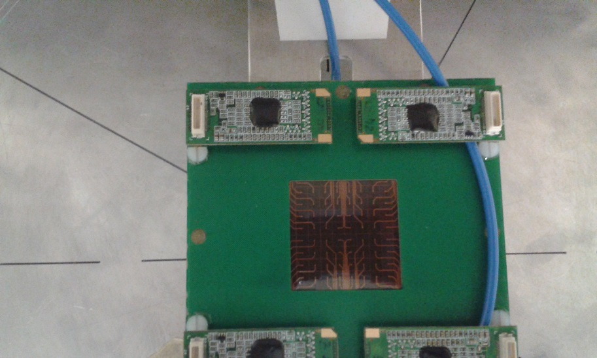
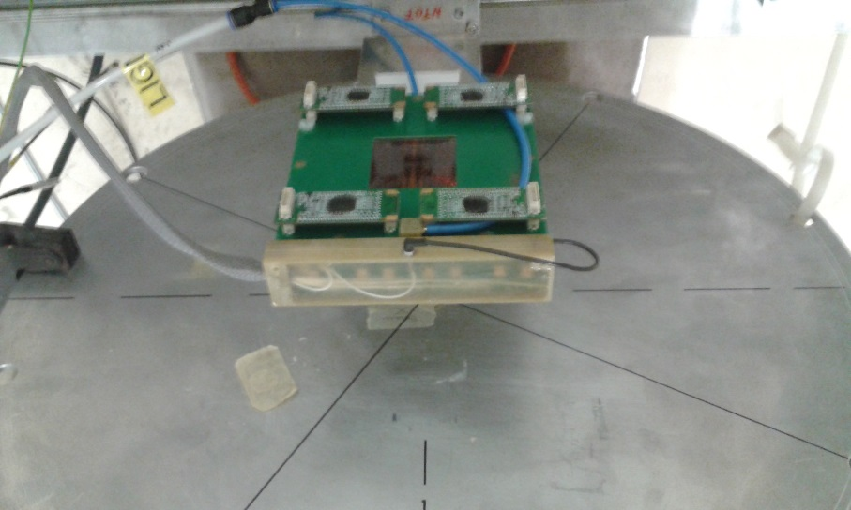
GEM Beam Monitor
GAIN
DRIFT
p
Kapton
Pads
pads on kapton
Mylar 12 um
Triple GEM
3 mm
Low Material Budget !
Electronics out of the beam

Slide 5
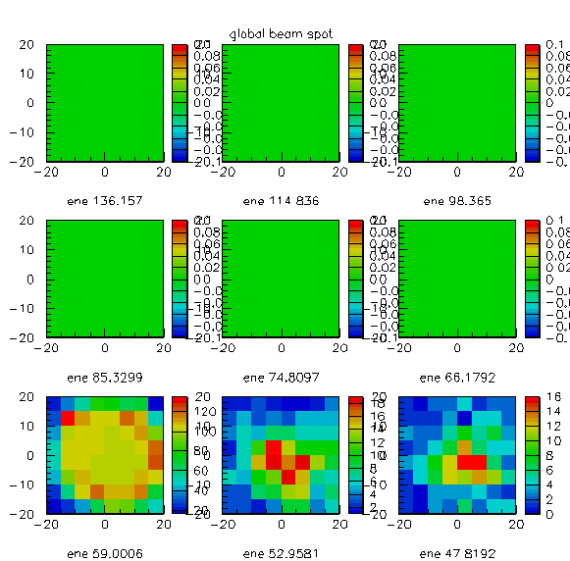
Fast neutron Beam monitor : nTOF gamma flash
The GEM detector with its FPGA-based acquisition can measure the particle flux map in time slices of 100 ns starting from the CERN-PS trigger.
100 ns
200 ns
300 ns
400 ns
500 ns
600 ns
At 700 ns the gamma flash appears
700 ns
800 ns
900 ns

Slide 6
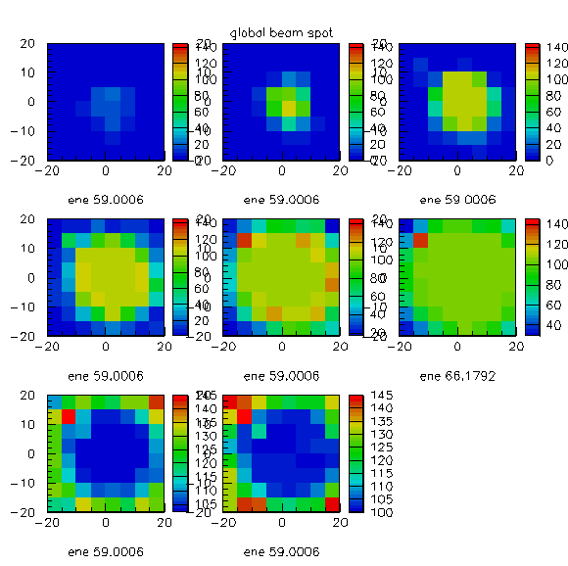
Beam monitor : gamma flash vs detector gain
780 V
810 V
840 V
By changing the triple-GEM gain the detector becomes more sensitive to the gamma flash.
Exceeding the working point at 900 V
the detector’s bins at the center appear saturated
870 V
900 V
930 V
960 V
990 V

Slide 7
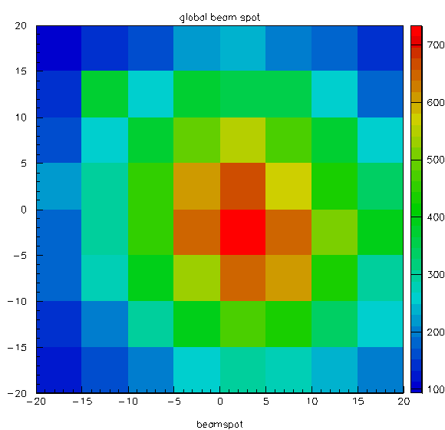
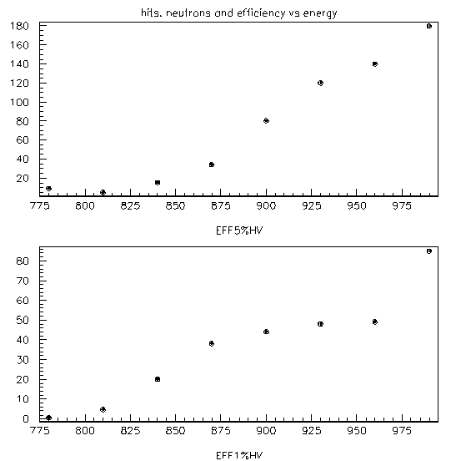
Beam Monitor : fast neutron efficiency (nTOF)
40 mm
5 MeV
mm
Efficiency 10⁻⁴
40 mm
1 MeV
mm

Slide 8
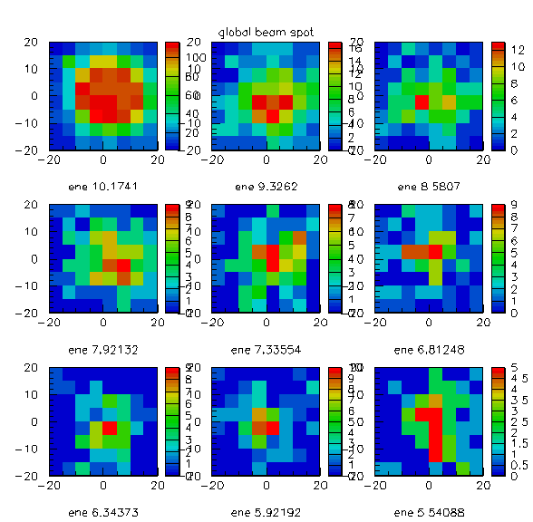
Beam Monitor : fast neutron beam spot (nTOF)
20 min acquistion time
The FPGA based program is able to create the
pictures of the beam spot in the different energy ranges
Here the 9 energy slices ranging from 10 to 5 Mev
For the neutrons peak the detector is not saturated

Slide 9
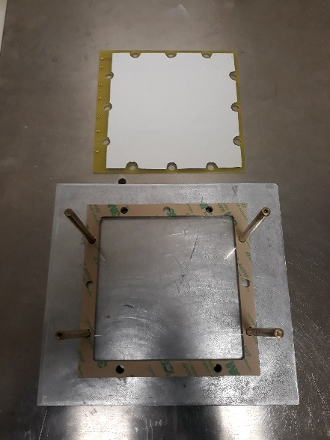
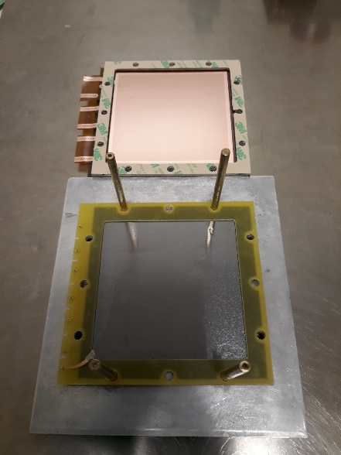
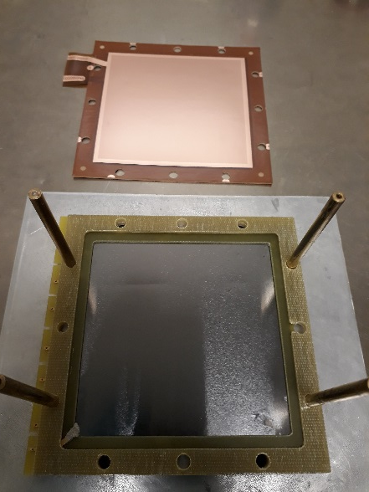
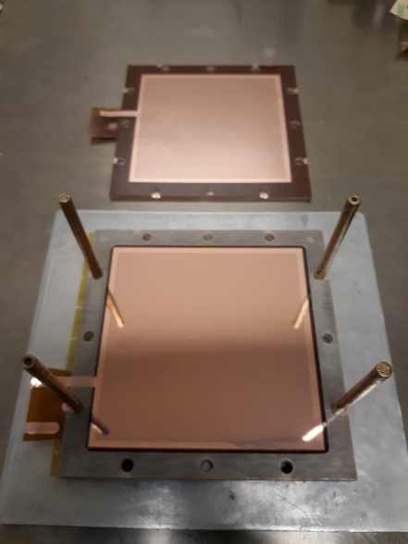
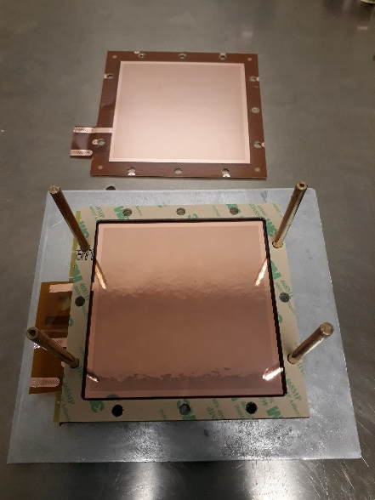
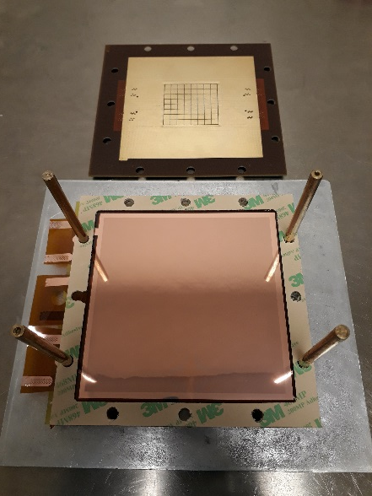
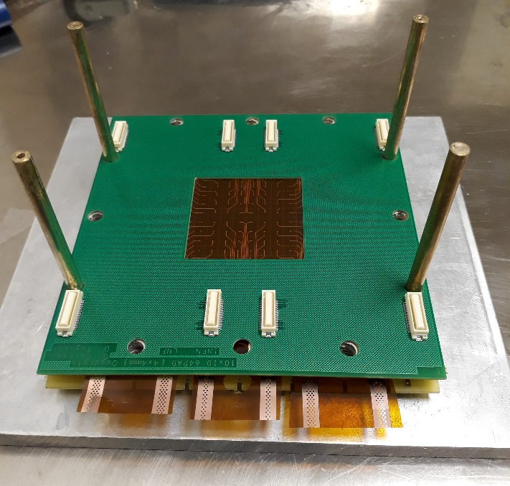
Low mass thermal neutron beam monitor
1 µm natB4C deposited on 35 µm Al foil (as cathode)
Kapton Pads
To be tested in the coming months

Slide 10
Multi-GEM neutron converter
3GEM
GAIN
DRIFT
α
α
Thermal Neutron
N layers of
1 µm ¹⁰B₄C
pad readout
pad readoout
α
Triple GEM
Multi-GEM converter
Triple GEM
Borated GEM foils
50 µm

Slide 11
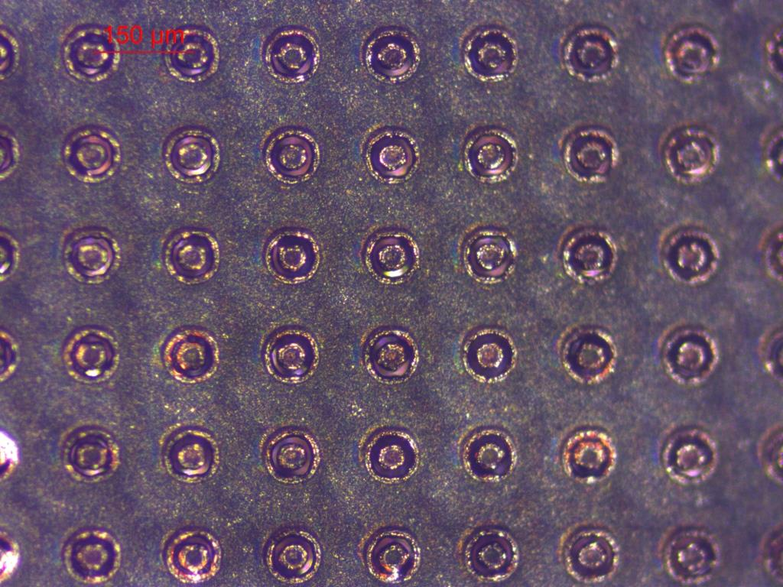
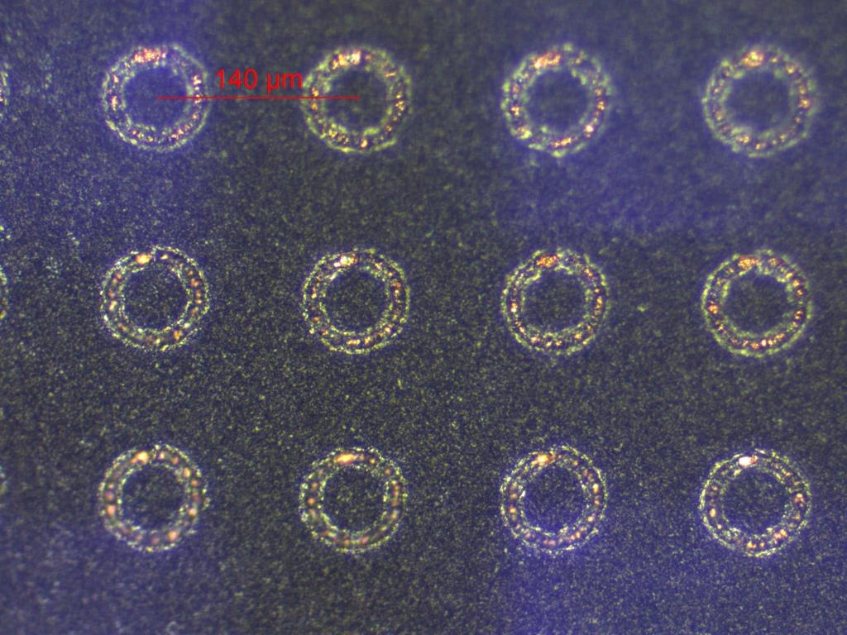
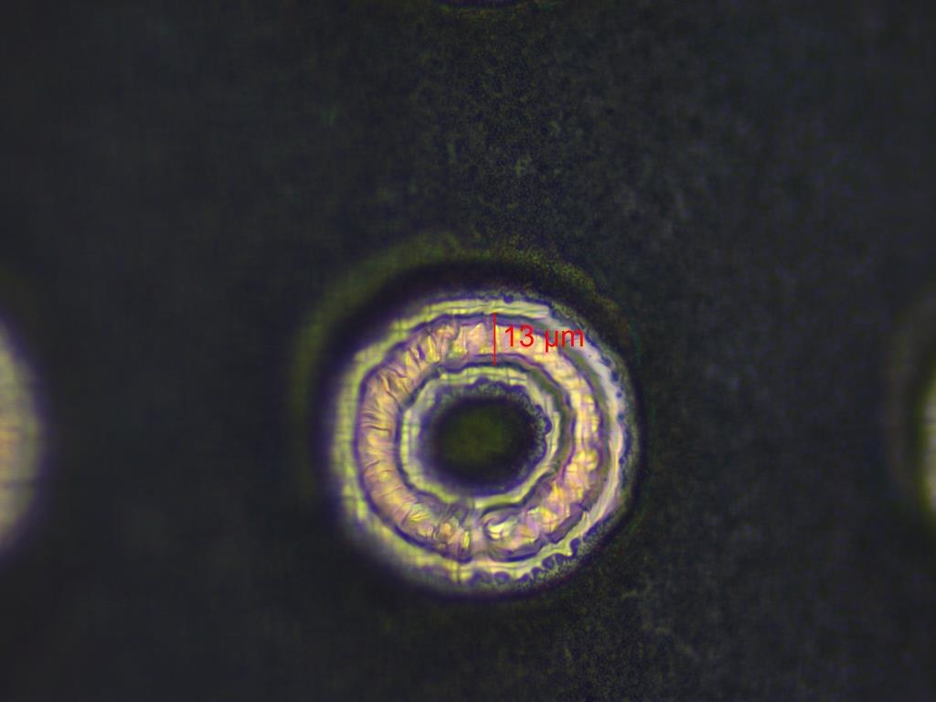
Some pictures....
We are trying to produce GEM foils from B4C-coated foils

Slide 12
Conclusions
Low mass neutron beam monitors to minimize beam attenuation
Fast neutron low mass beam monitor successfully realized and tested
64 channels, based on CARIOCA
Thermal neutron beam monitor built, will be tested soon
64 channels, based on CARIOCA
New beam monitors can be equipped by a larger number of channels thanks to the new develpment of the GEMINI electronics
Finer spatial resolution
Larger areas

Slide 13
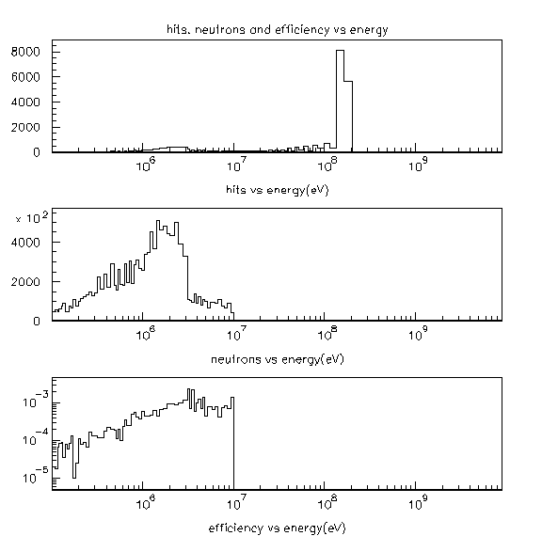
Efficiency vs energy at nTOF
Gamma flash
Neutron distribution expected
(7 10¹² Protons on target)
10 MeV
Efficiency vs Energy
1 MeV

