Slide 1


Detector rate estimate for the BIFROST instrument
Milán Klausz
Milan.Klausz@esss.se
HAS Centre for Energy Research
European Spallation Source ESS ERIC
BUTE Institute of Nuclear Techniques
Detectors and Data Acquisition for Instruments Meeting, Paris, 12 February 2018

Slide 2
Outline
BIFROST Instrument
Simulation Tools
Simulation Model
Results
Outlook

Slide 3
Outline
BIFROST Instrument
Simulation Tools
Simulation Model
Results
Outlook

Slide 4

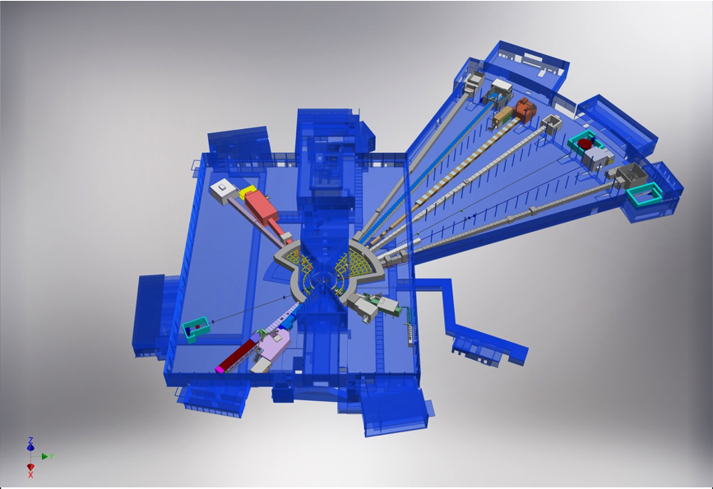











ESS - Instruments
+
Nuclear Physics Institute
NMX
BEER
+
C-SPEC
BIFROST
MIRACLES
MAGIC
ODIN
T-REX
DREAM
HEIMDAL
LoKI
VESPA
FREIA
SKADI
ESTIA
+

Slide 5
Location of BIFROST
BIFROST

Slide 6
Beam transport and conditioning system
Curved guide section
Copper blocks
4 choppers (PSC, FOC, FOC, BC)
Option to use full ESS pulse

Slide 7
Scattering Characterization System
Filtering system
  Beryllium filter
  Radial collimator
Secondary spectrometer tank
  Vacuum vessel
  Analyzers
  Detectors and electronics
  Crosstalk shielding
  Tank positioning system

Slide 8
Scattering Characterization System
Secondary spectrometer tank
  Vacuum vessel
  Analyzers
  Detectors and electronics
  Crosstalk shielding
  Tank positioning system

Slide 9
Outline
BIFROST Instrument
Simulation Tools
Simulation Model
Results
Outlook

Slide 10
Simulation Tools - Options
Guide
Sample + analyzers
Detectors

Slide 11

Simulation Tools - Options
Guide
Sample + analyzers
Detectors

Slide 12
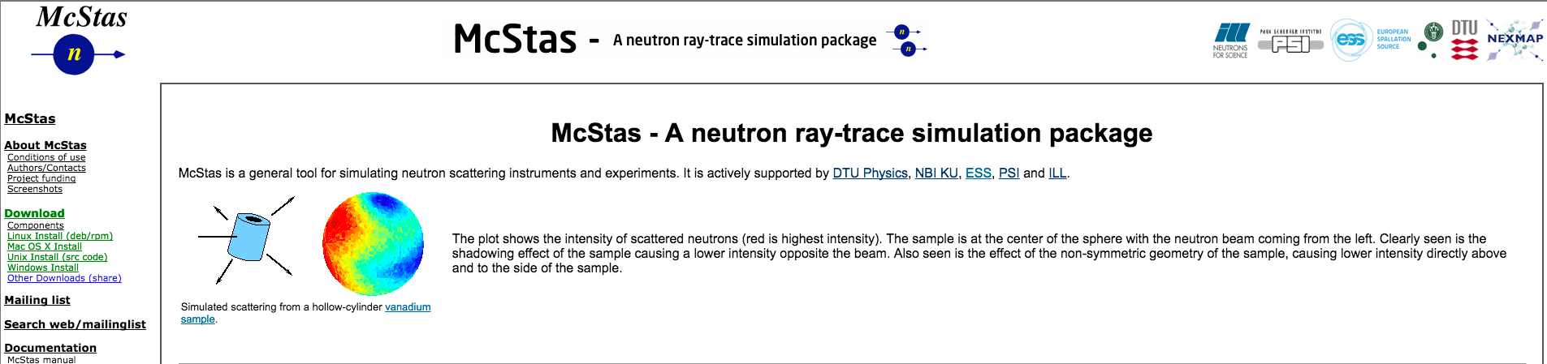
Simulation Tools: McStas
  Simulation of neutron scattering instruments and experiments
  Monte Carlo ray-trace algorithm
  Cross-platform, open source
  Version 2.4.1 (Jun. 26, 2017)
  Collaboration:
    DTU Physics
    University of Copenhagen
    Paul Scherrer Institute
    Institut Laue-Langevin
Source: http://mcstas.org/

Slide 13

Simulation Tools - Options
Guide
Sample + analyzers
Detectors

Slide 14
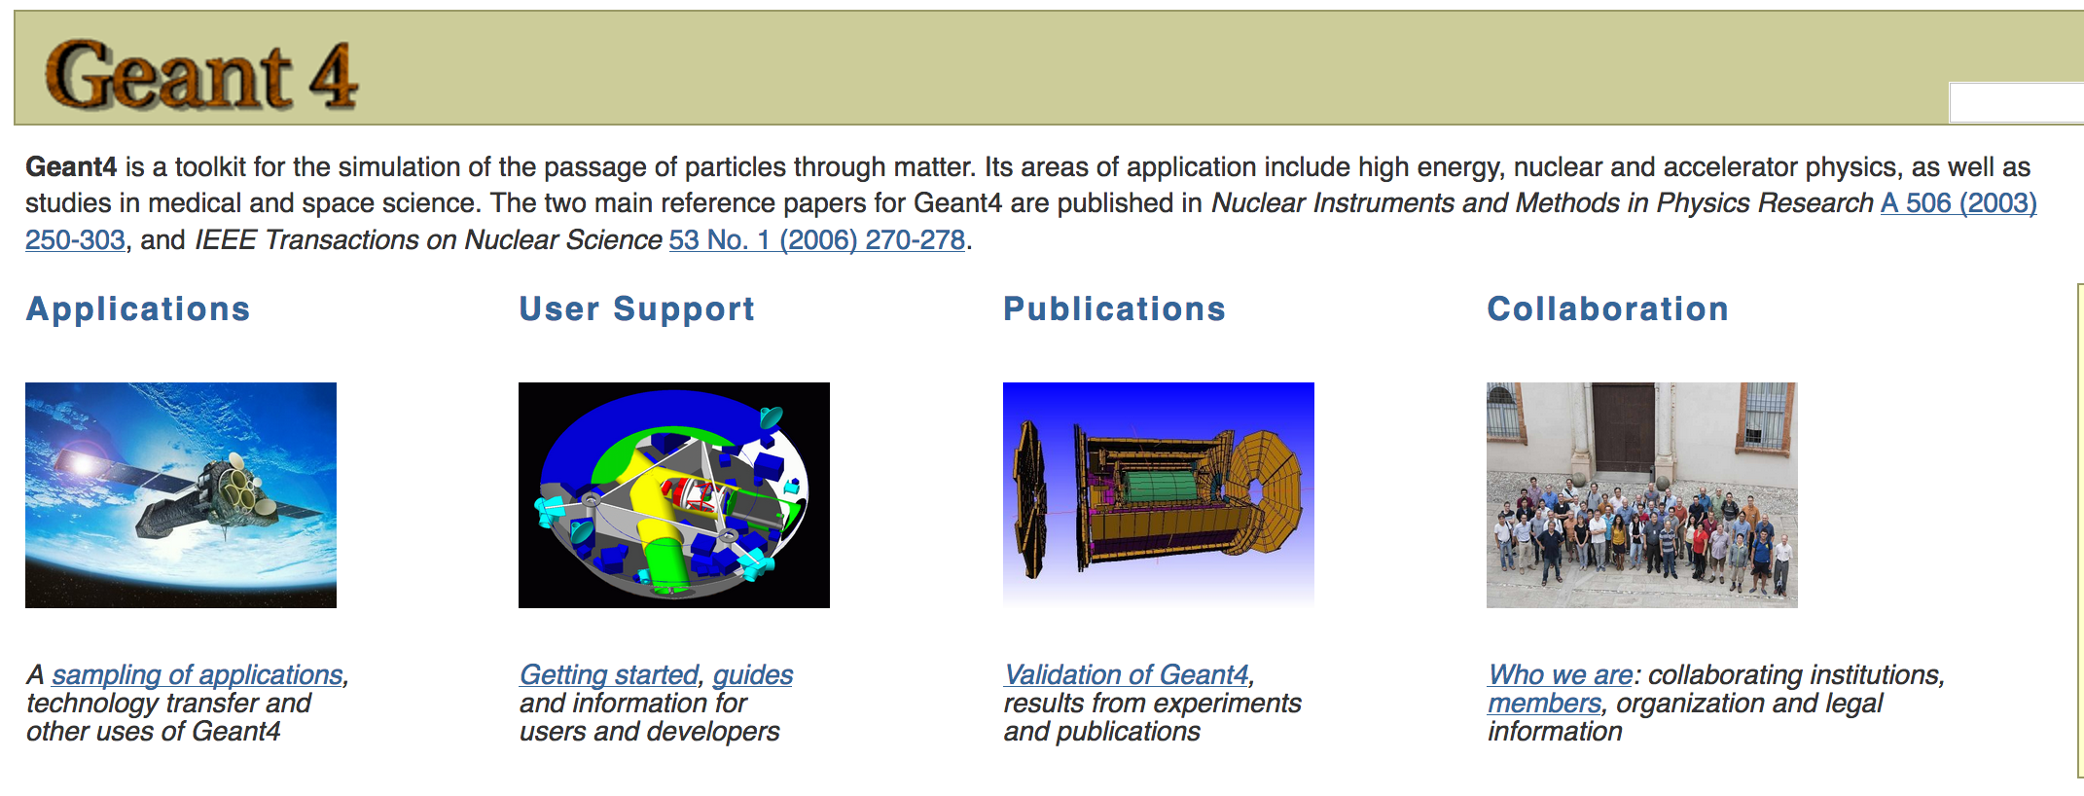
Simulation Tools: Geant4 + DG Framework
  General purpose
  Developed in CERN
  Application in various fields
  Detector Group Framework
    Code repository + build system
    Tools, issue tracker, wiki
    Geant4, C++, Python, Mercurial
Source: http://geant4.cern.ch/

Slide 15
Simulation Tools - Options
Guide
Sample + analyzers
Detectors

Slide 16
Simulation Tools - Options
Guide
Sample + analyzers
Detectors
Source: https://mctools.github.io/ncrystal/

Slide 17
Simulation Tools - Options
Guide
Sample + analyzers
Detectors

Slide 18

Simulation Tools - Options
Guide
Sample + analyzers
Detectors

Slide 19
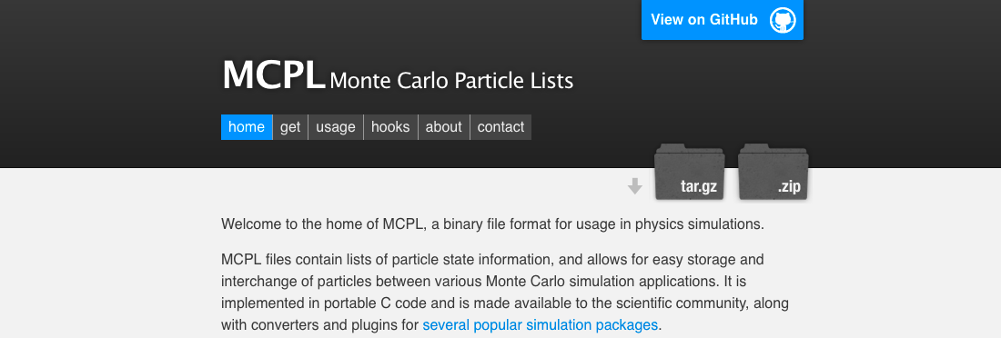
Monte Carlo Simulation: MCPL
  Monte Carlo Particle List
  Binary format
  Open source
  Compatible MC tools
    McStas
    McXtrace
    Geant4
    MCNP6, MCNPX
Source: https://mctools.github.io/mcpl/

Slide 20
Simulation Tools - Options
Guide
Sample + analyzers
Detectors

Slide 21
Simulation Tools - Options
Guide
Sample + analyzers
Detectors
+
NCrystal
+

Slide 22
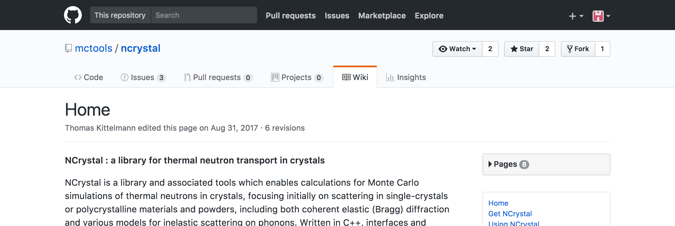
Simulation Tools: NCrystal
  Library + tools for thermal neutron transport in crystals
  Cross-platform, open source, v0.9.4
  Multiple interfaces (Geant4, McStas, …), validated results
  Collaboration:
    Xiao Xiao Cai (DTU, ESS)
    Thomas Kittelmann (ESS)
  Supported by:
    BrightnESS (No 676548)
Source: https://mctools.github.io/ncrystal/

Slide 23
Simulation Tools: NCrystal
  Enables Monte Carlo simulation of neutrons in crystals
  Single-crystals
  Polycrystalline/powder materials
  Coherent elastic (Bragg) diffraction
  Includes ”background” (inelastic/incoherent)
    harmonic approximation
    incoherent approximation
    Debye approximation
Source: https://mctools.github.io/ncrystal/

Slide 24
Simulation Tools: NCrystal
  Written in C++
  Direct usage from C, C++, or Python code
  Command-line tools
  Components available for McStas and Geant4
Source: https://mctools.github.io/ncrystal/

Slide 25
Simulation Tools - Options
Guide
Sample + analyzers
Detectors
+
NCrystal
+

Slide 26
Outline
BIFROST Instrument
Simulation Tools
Simulation Model
Results
Outlook

Slide 27
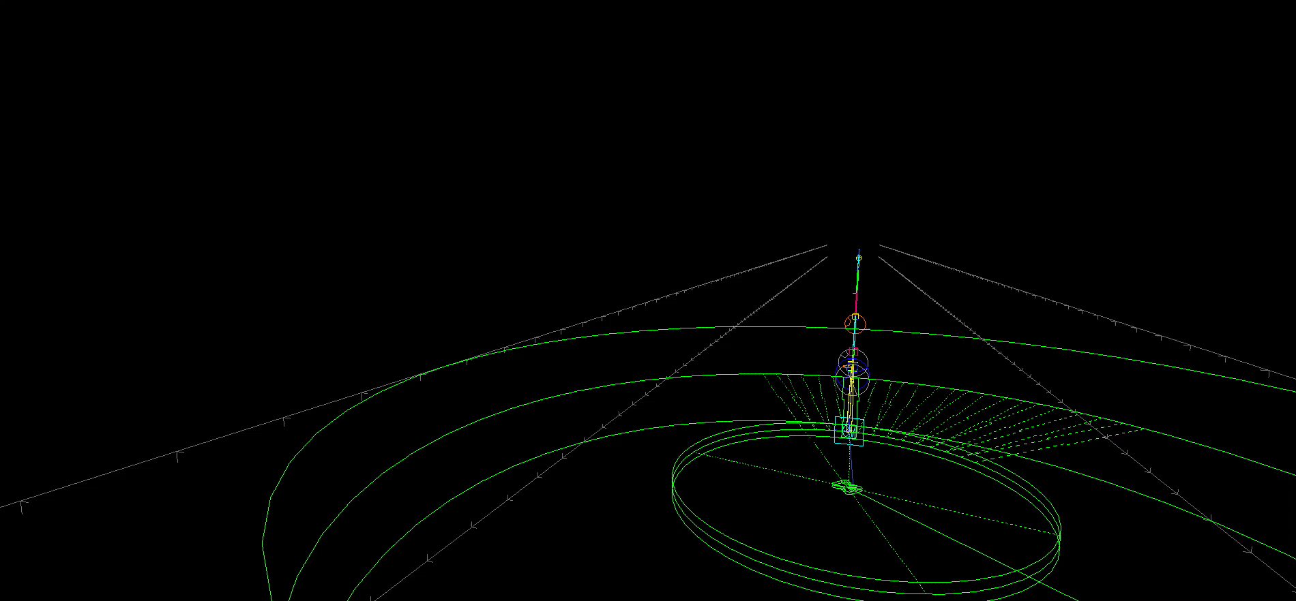
McStas Model – Full Instrument

Slide 28
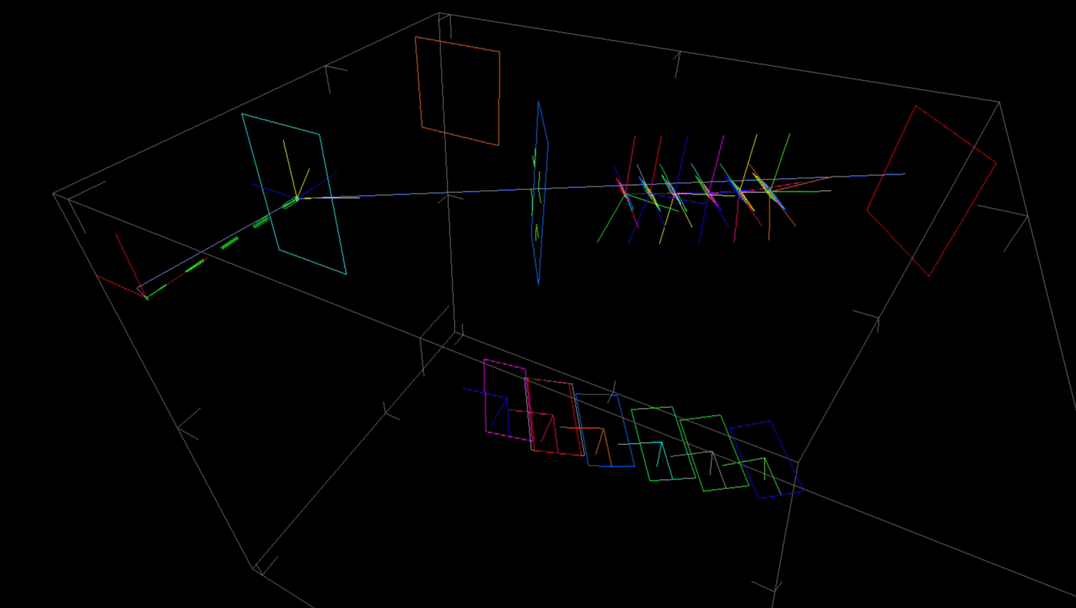
McStas Model – Analyzer-Detector system

Slide 29
Outline
BIFROST Instrument
Simulation Tools
Simulation Model
Results
Outlook

Slide 30
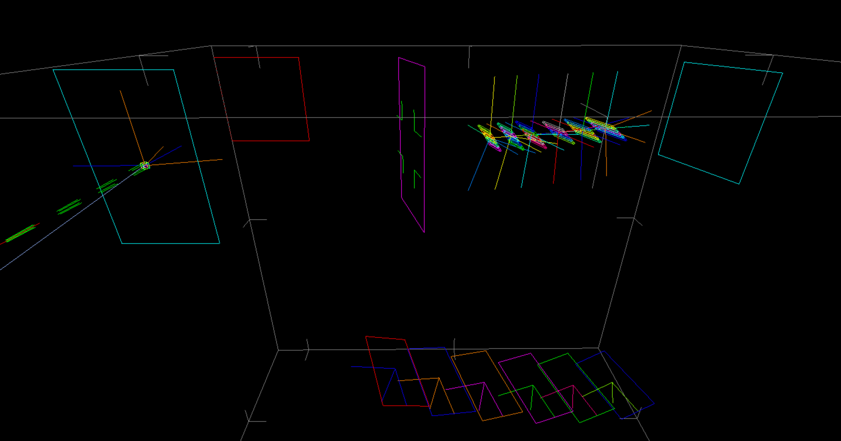
TODO

Slide 31
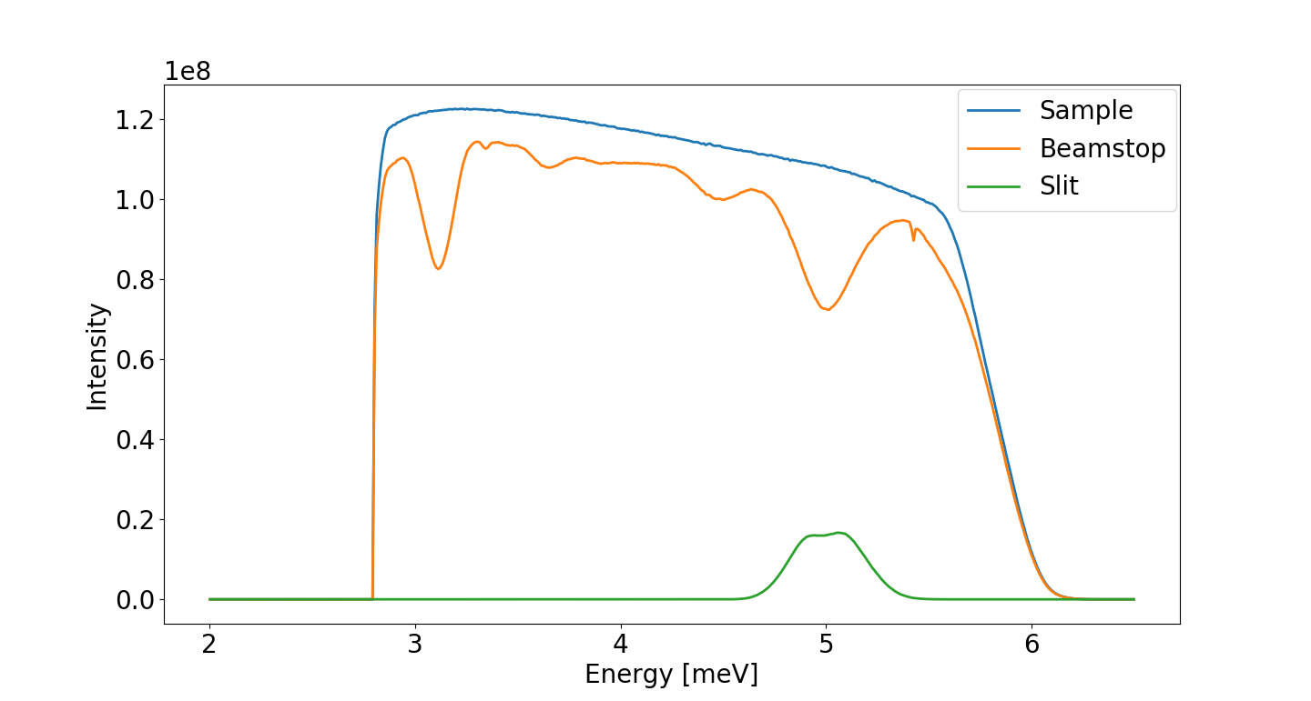
Change of energy spectrum on sample

Slide 32
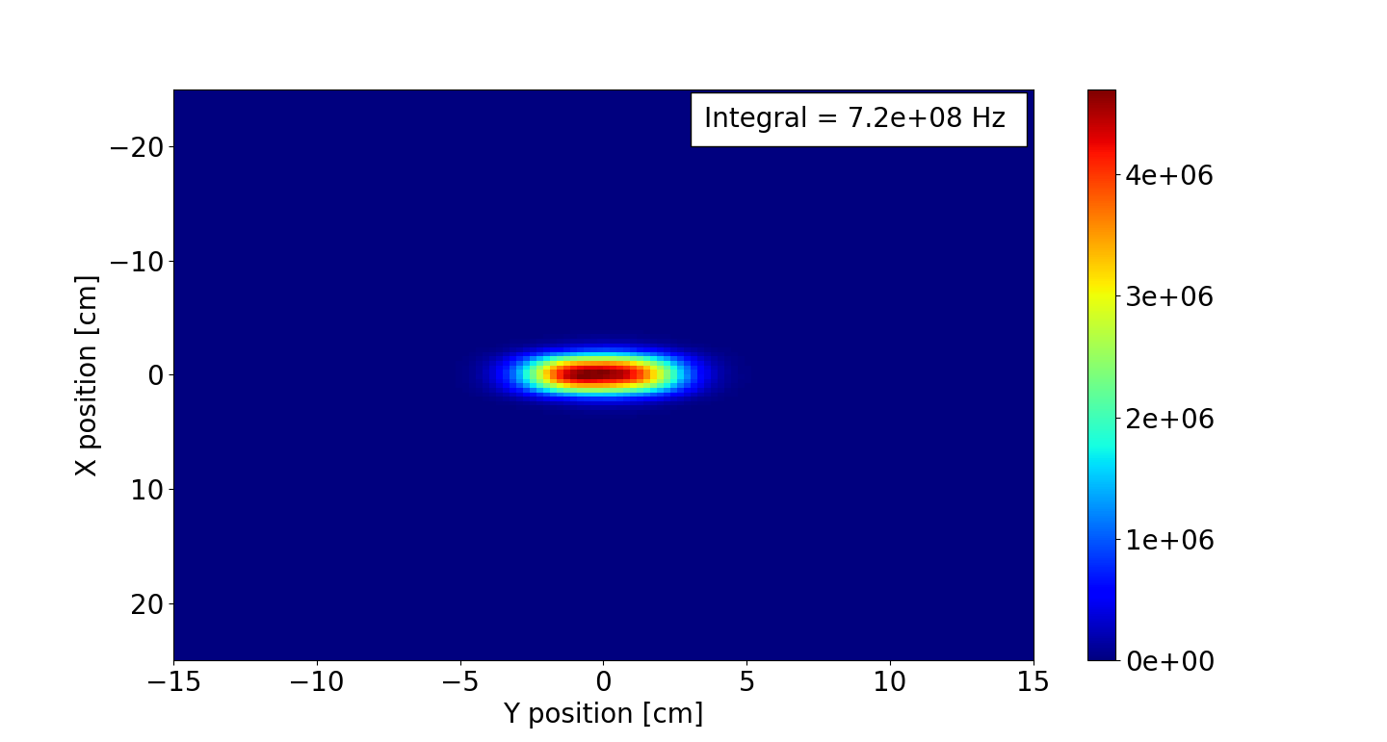
Position on slit

Slide 33
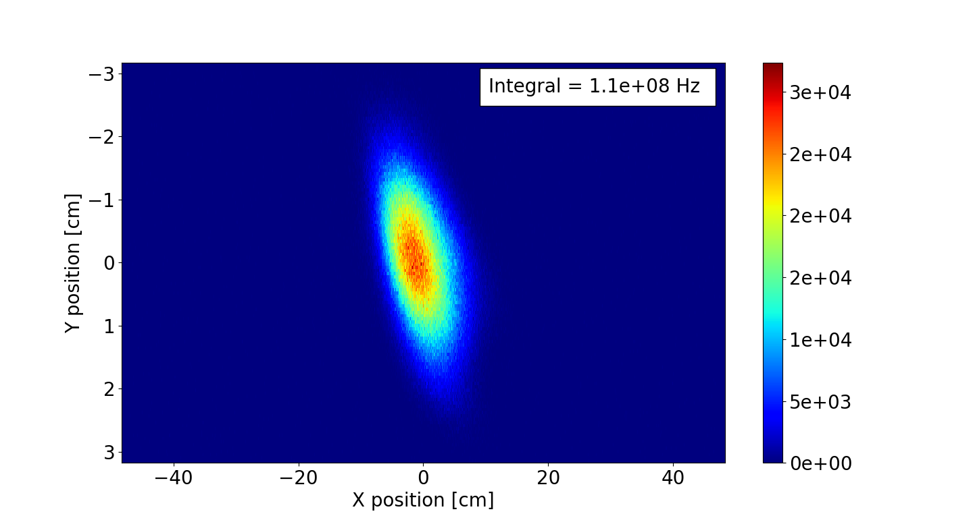
Position on detector

Slide 34
Position on detector

Slide 35
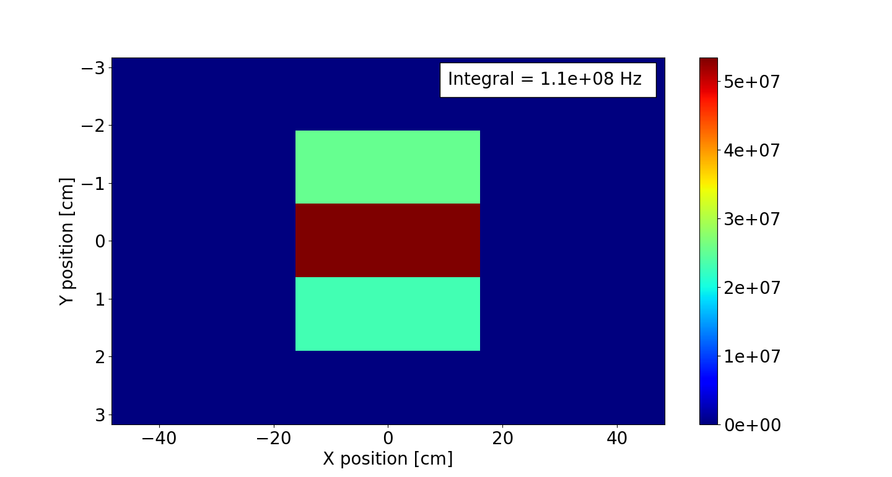
Time averaged incident rate

Slide 36
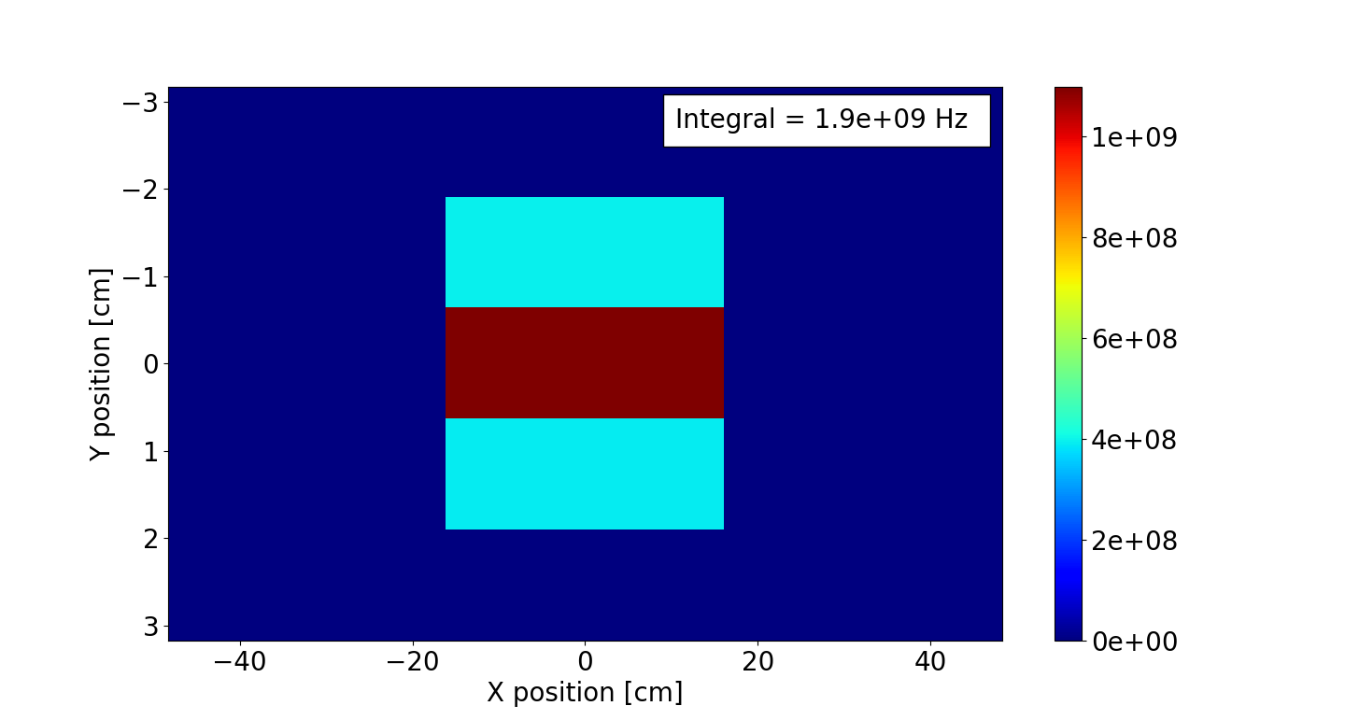
Peak instantaneous incident rate

Slide 37
Preliminary results
Parameters:
  Sample: Y₂O₃ single-crystal, hkl=2,-2,-2 (d_{hkl} = 3.0724 Å)
  size = (1.5 cm)³, mosaicity = 60 acrmin
  Analyzer: thickness = 2 mm, mosaicity = 10 arcmin
  Source power = 5 MW
  PSC opening time = 5 ms (full ESS pulse)
Time averaged incident rate on one He tube: 5e7 Hz
Peak instantaneous incident rate on one Tube: 1e9 Hz

Slide 38
Outline
BIFROST Instrument
Simulation Tools
Simulation Model
Results
Outlook

Slide 39
Cross-check and Detector simulation
Guide
Sample + analyzers
Detectors
+
NCrystal
+

Slide 40
Acknowledgments
Rasmus Toft-Petersen, Fatima Issa
Thomas Kittelmann, Xiao Xiao Cai, Peter Willendrup
Kalliopi Kanaki, Richard Hall-Wilton
Data Management&Software Centre (DMSC)
Thank you for your attention!

Slide 41
Secondary spectrometer tank - Analyzers

Slide 42
Secondary spectrometer tank - Analyzers

Slide 43
Scattering Characterization System
Filtering system
  Beryllium filter
  Radial collimator
spectrometer tank
  Vacuum vessel
  Analyzers
  Detectors and electronics
  Crosstalk shielding
  Tank positioning system

Slide 44
Secondary spectrometer tank - Detectors
Crosstalk shielding
  Prevent crosstalk between channels
Detectors and electronics
  He-3 tubes
  Approx. 2x analyzer length

Slide 45
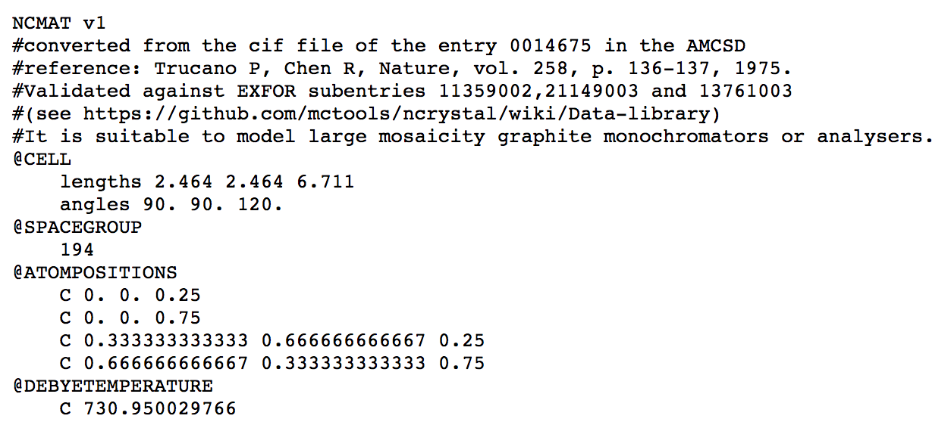
Ncrystal - Data library and validation

Slide 46
Ncrystal - Data library and validation

