Slide 1


Mechanical Engineering for Detectors at the ESS Detector Group
Michail Anastasopoulos
Lead Detector Design Engineer
on behalf of the Detector Systems Services Section (DG)
Notes:
Add contact person for each technology
Add reference to other talks
Possible additions to embla capabilties

Slide 2
Outline
Intro to the ESS DG Mechanical and Technical Teams
Scope
Teams
Facilities and capabilities
The work so far
Multi-Grid development for CSPEC and T-REX
Multi-Blade development for ESTIA and FREIA
Gd-GEM detector for NMX
SoNDe detector for SKADI
Macro-Structure B10 based test detectors
3D printing availability
Next steps
Conclusion

Slide 3
Scope of Mechanical and Technical DG Teams
Design and build test detectors and demonstrators
Operate facilities to assist in detectors development
Deliver complete detector systems for instruments
Support and provide know-how to in-kind partners
Interface management for in-kind partners with other parts of NSS and ESS and other in-kind partners
Operate and maintain detectors throughout their lifetime
Design - Integrate - Support

Slide 4
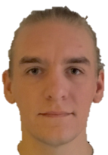
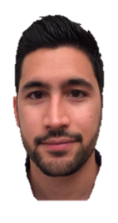



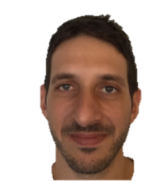
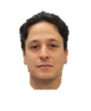


Detector Systems Services Section:
Mechanical and Technical DG Teams
Mechanical Engineers:
Michail Anastasopoulos
Isaak López-Higuera
Ioannis Apostolidis
Technicians:
Anders Lindh Olsson
Edgars Karnickis
Nicholai Mauritzson
Alessio Laloni
Richard Ammer
Technicians:
Anders Lindh Olsson
Edgars Karnickis
Nicholai Mauritzson
Alessio Laloni
Richard Ammer
Section Leader:
Judith Freita Ramos
Notes:
Shall I put titles? Include Judith?

Slide 5
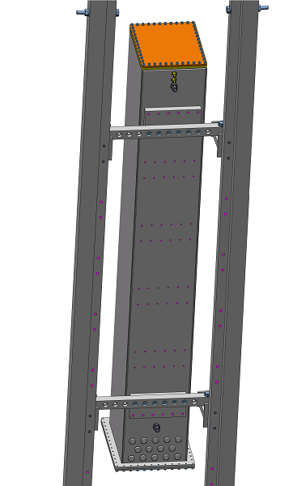
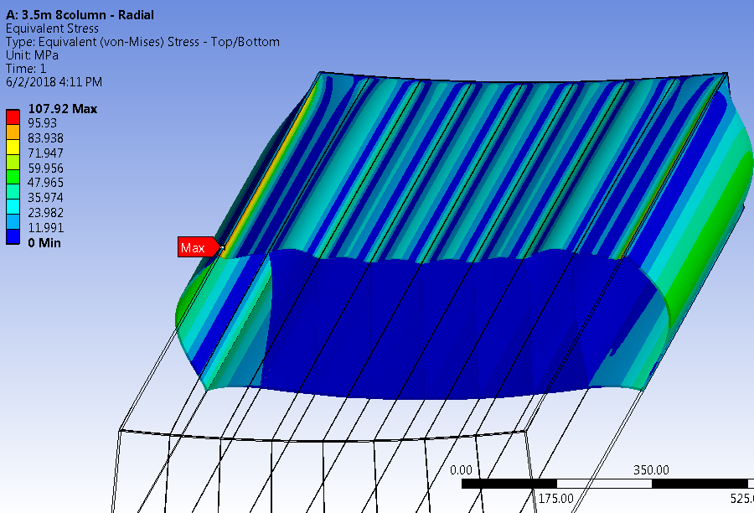
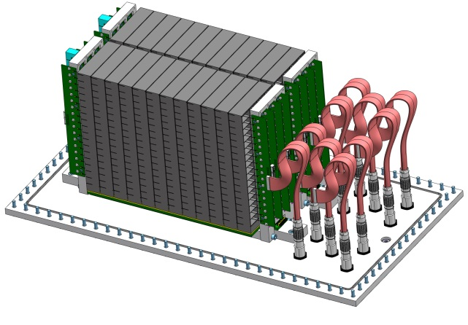
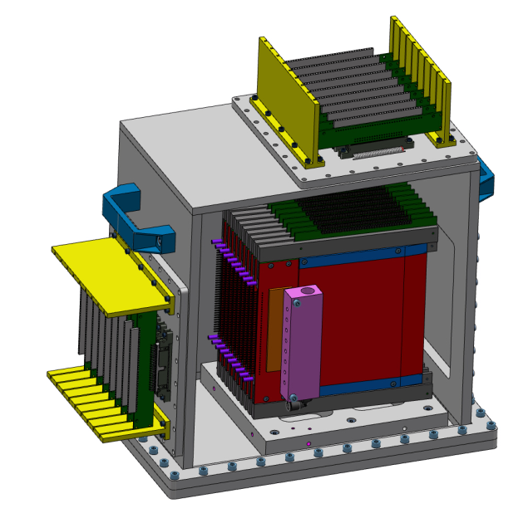
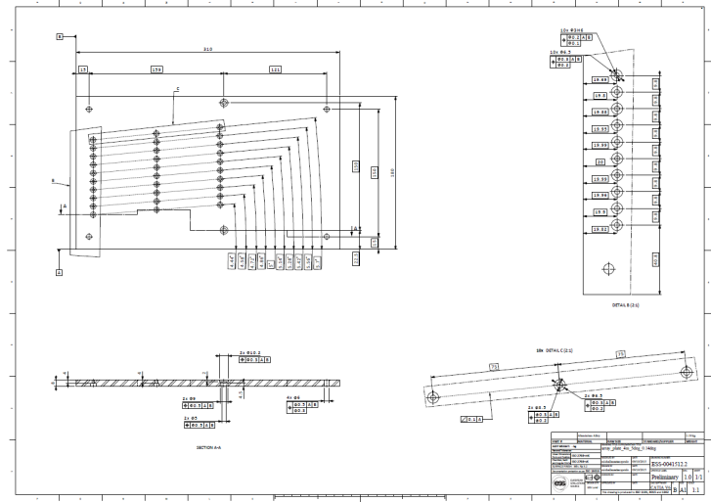
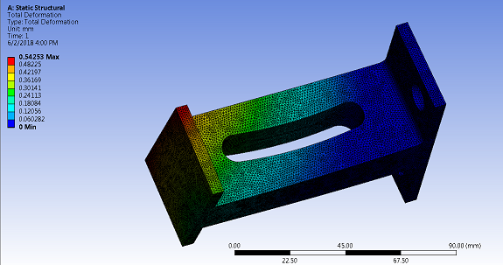
Mechanical capabilities
In-house expertise
Mechanical Design
Integration
Simulation and Analysis
Drawings and fabrication

Slide 6
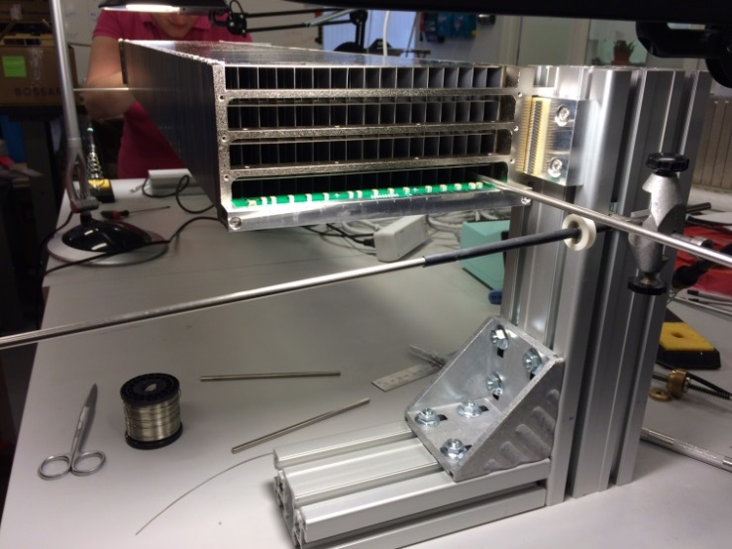
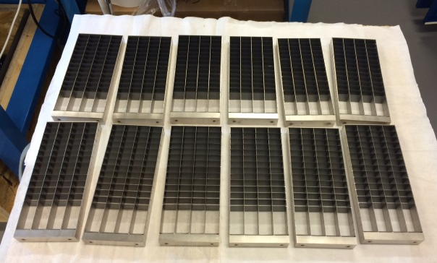
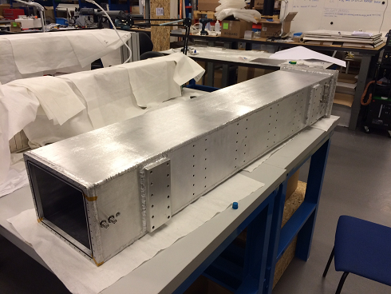
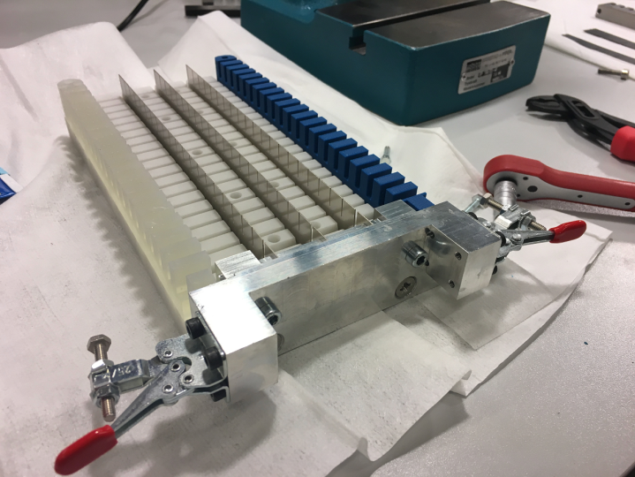
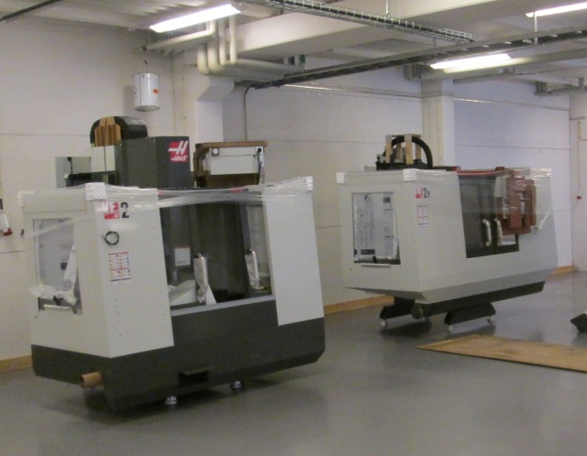
Facilities and technical capabilities
EMBLA workshop
Small-scale machining (milling, cutting)
Standard parts (fasteners, raw materials)
Mechanical testing
Micro TIG welding
3D printing

Slide 7
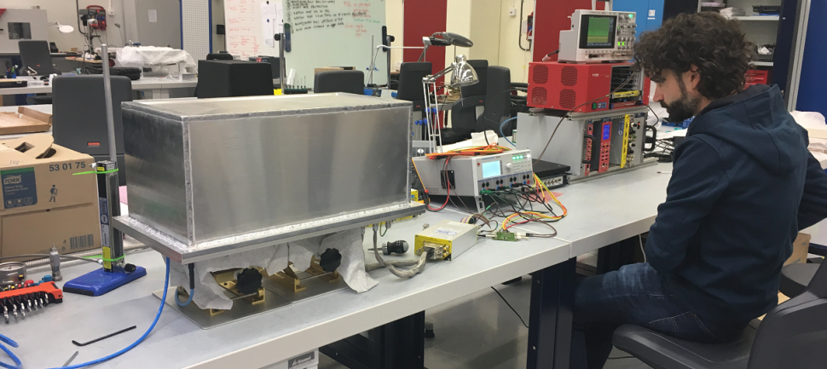
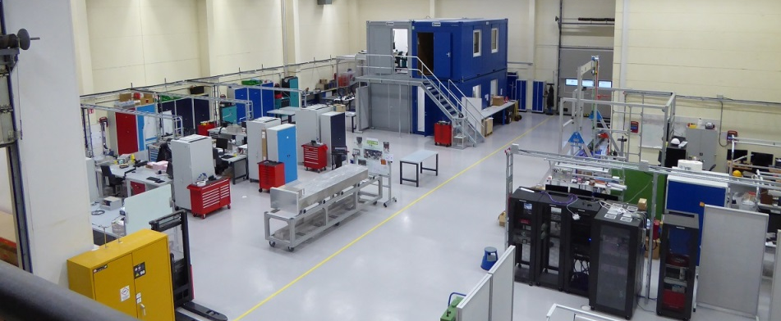
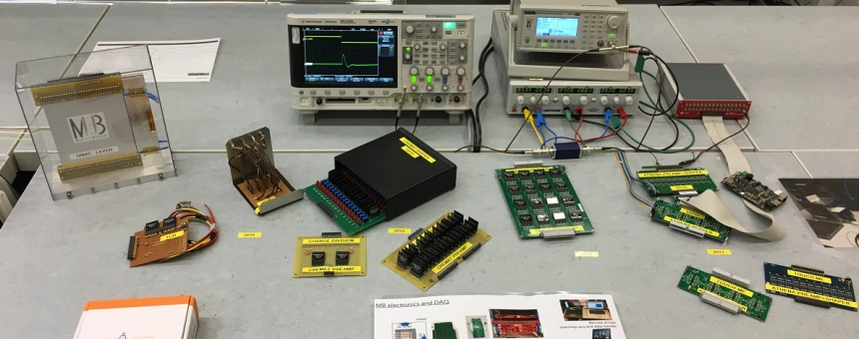
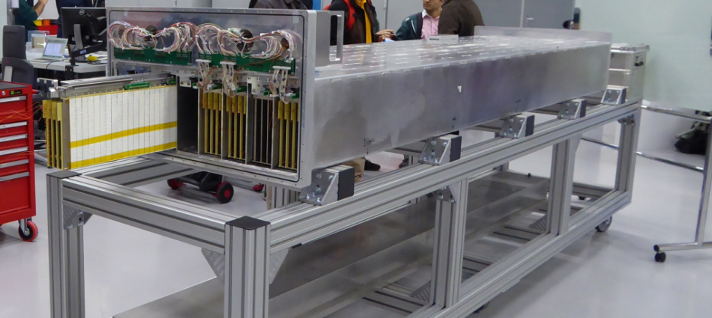
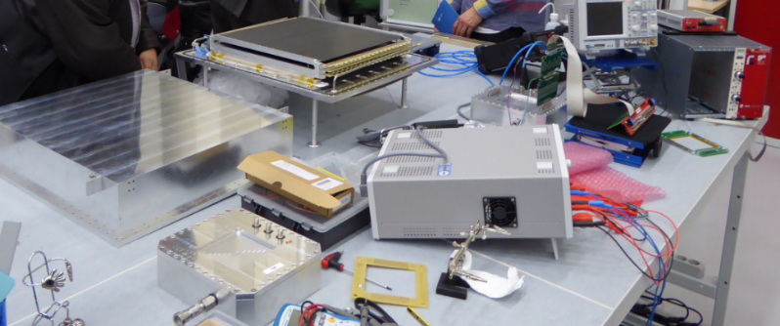
Facilities and technical capabilities
Utgard
Detectors assembly
Detectors testing
Soldering
Collaborative projects for readout systems and event formation

Slide 8
Work so far

Slide 9
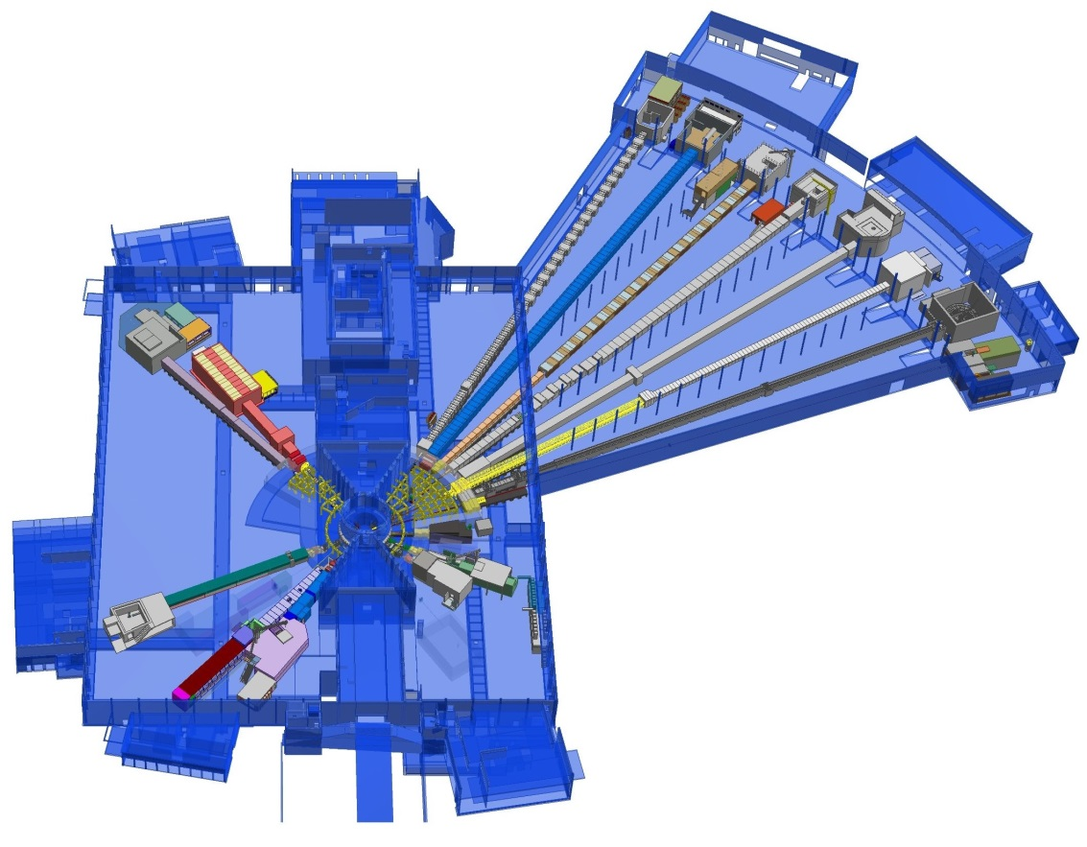
Multi-Blade
Multi-Blade detector technology for ESS instruments
The Multi-Blade will be used in the reflectometers ESTIA and FREIA
 | FREIA | ESTIA
Wavelength | 2.5-12 | 4-10
Sample-detector | 3m | 4m
Max instantaneous flux kHz/mm2 | 100-200 | 100-500
Size x (mm) y (mm) | 300 300 | 500 250
Detector requirements:
High instantaneous rate capability: 100 kHz/mm²
High spacial resolution: 0.5mm
FREIA
ESTIA
Instruments layout at ESS

Slide 10



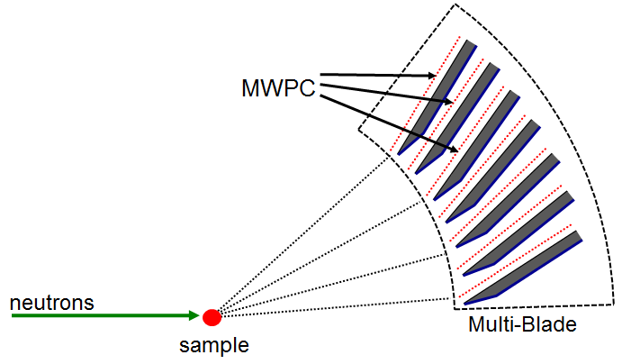
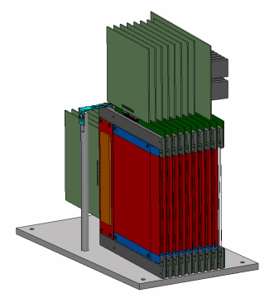
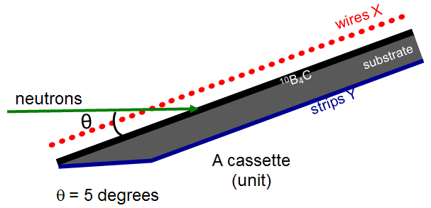
Multi-Blade
How it works: Basic mechanics
Radial arrangement (R= 4m) and 5˚ inclination
Coated converter with ”knife” edge
Concept introduced in 2005 at ILL
Proof of concept in 2012
n
Cassette assembly

Slide 11
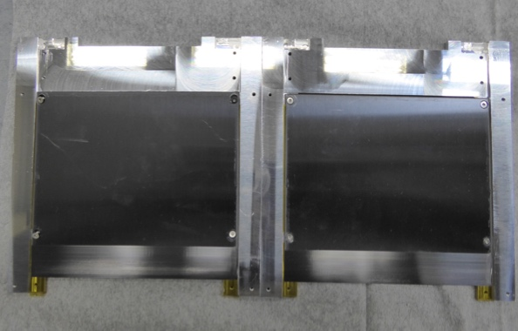
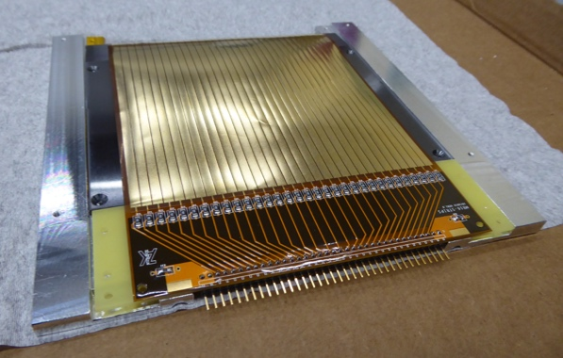
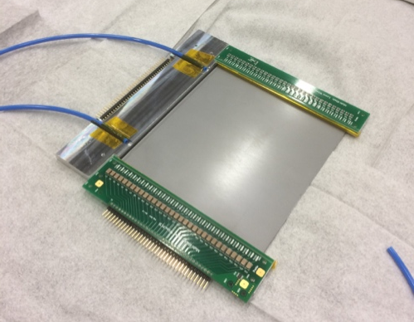
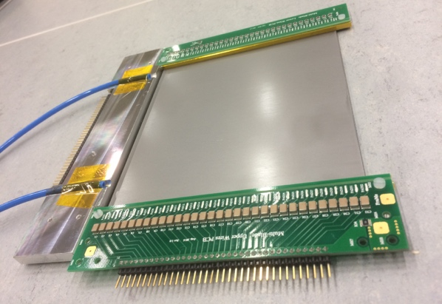
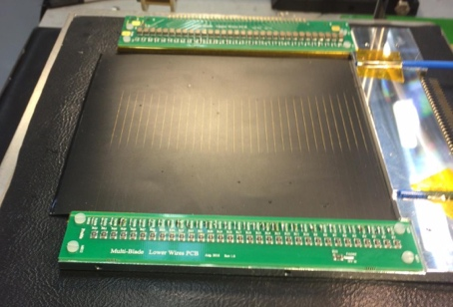
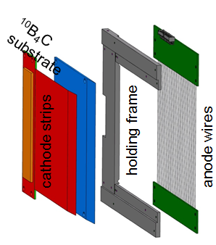
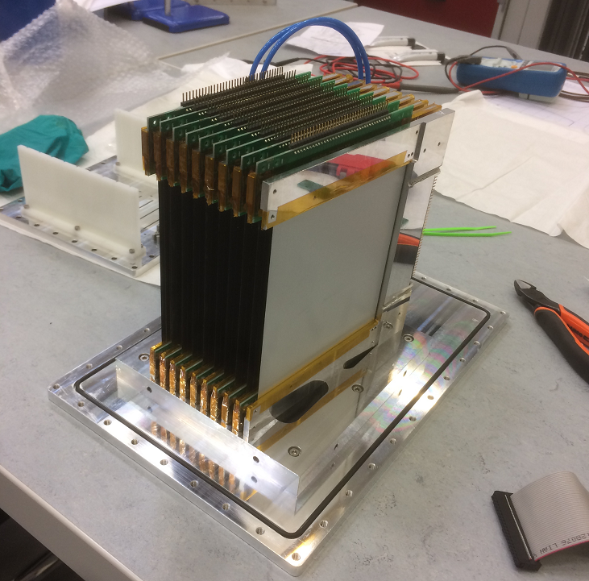
Multi-Blade
How it works: Cassette assembly

Slide 12
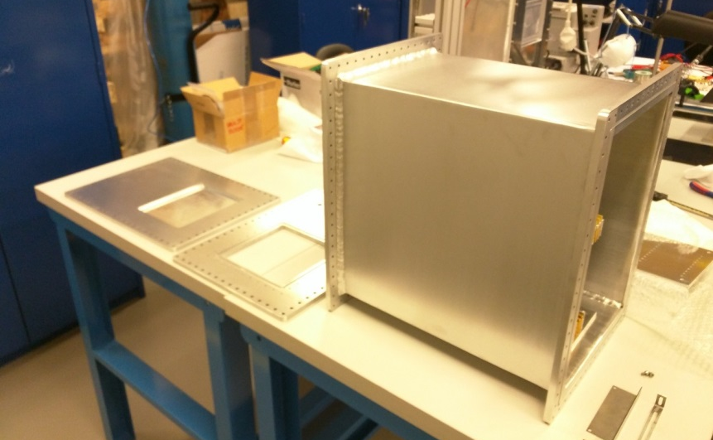
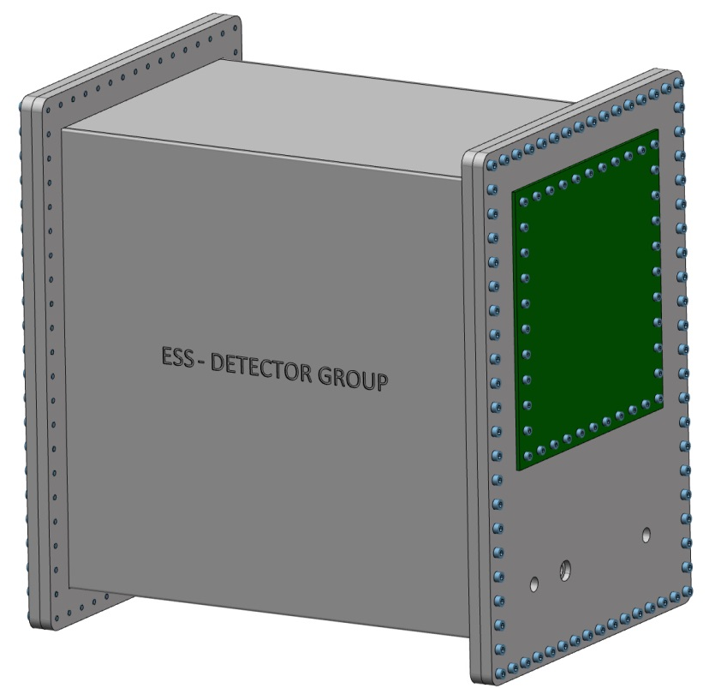
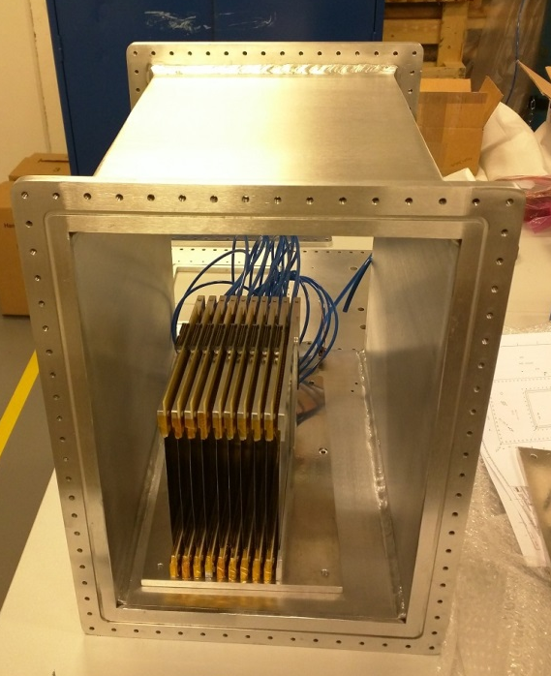
Multi-Blade demonstrators
MB15
First demonstrator at ESS
100x140mm active area
Overall size 440x430x320mm
Verify alignment
Discover clashes

Slide 13
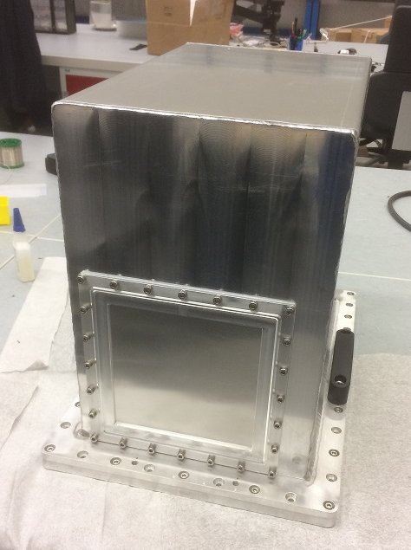
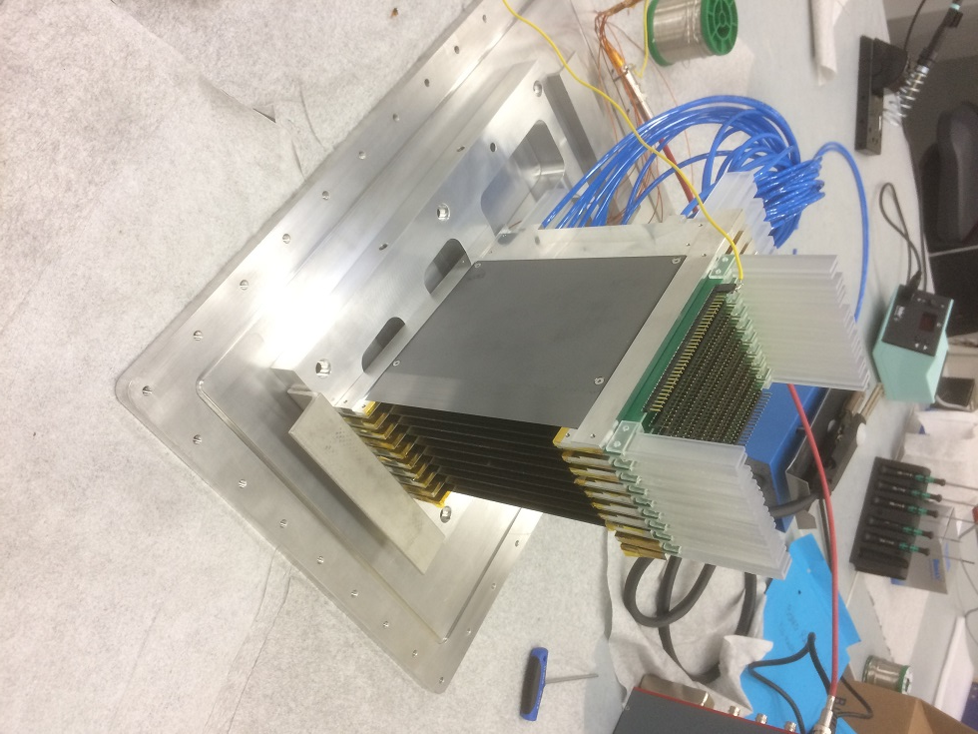
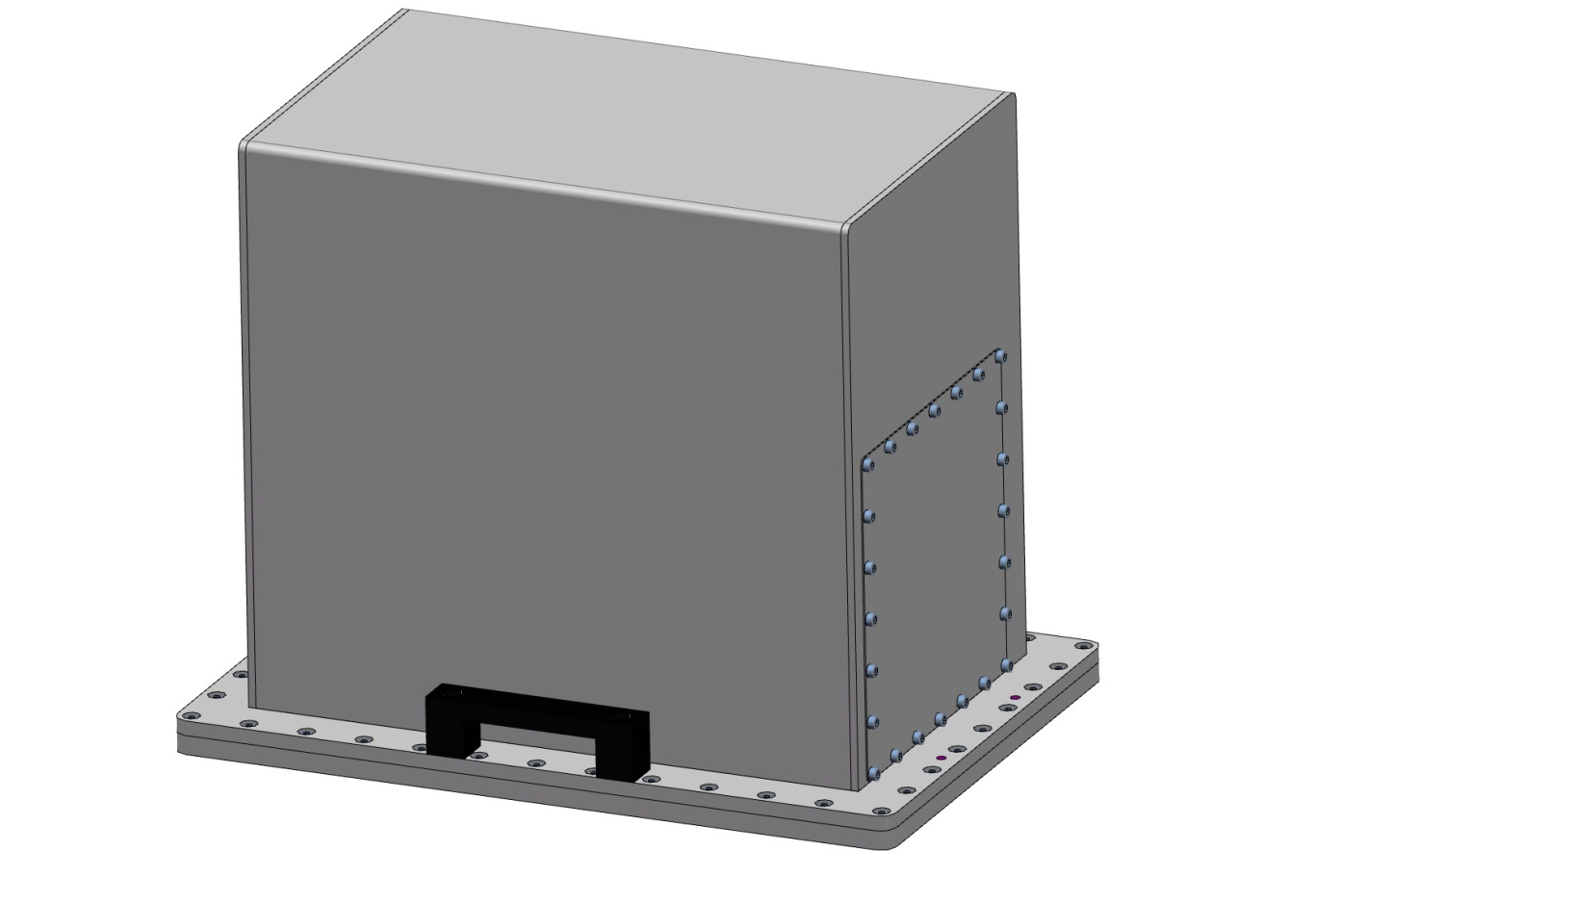
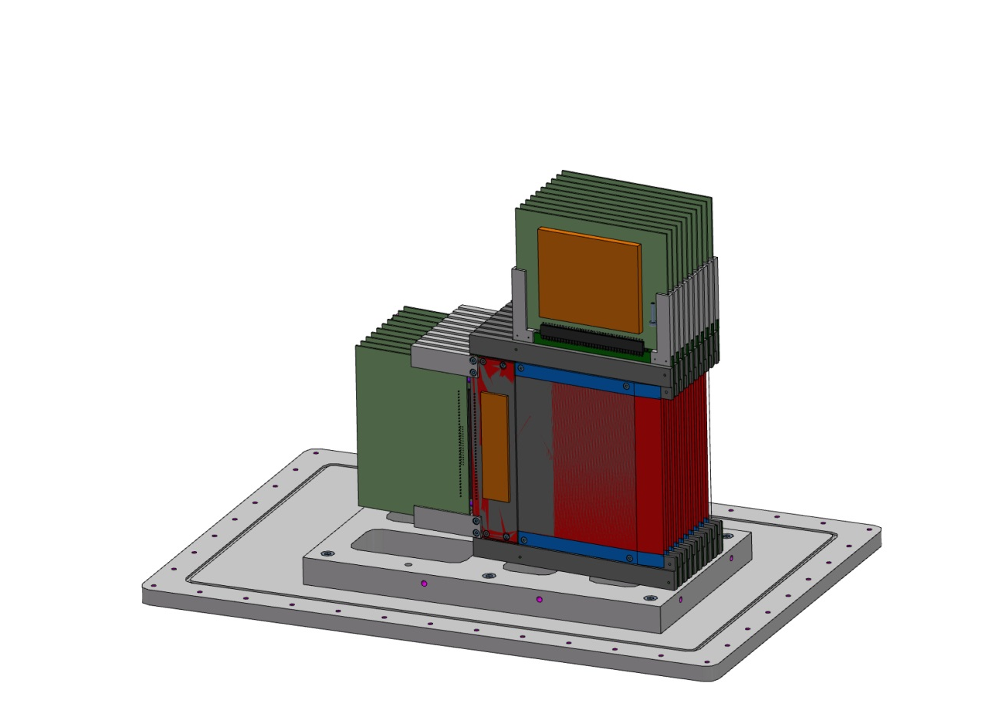
Multi-Blade demonstrators
MB16
360˚ access to the cassettes
Interchangeable windows (0.5, 1, 2mm)
Overall size 340x500x400mm
Integrate improvements upon MB15 (rails)

Slide 14
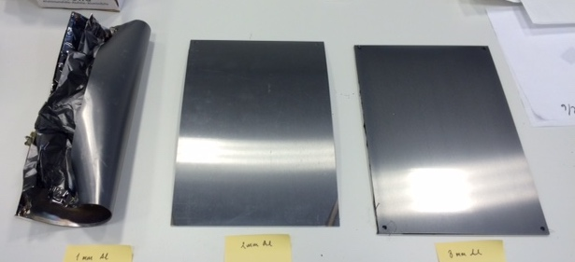
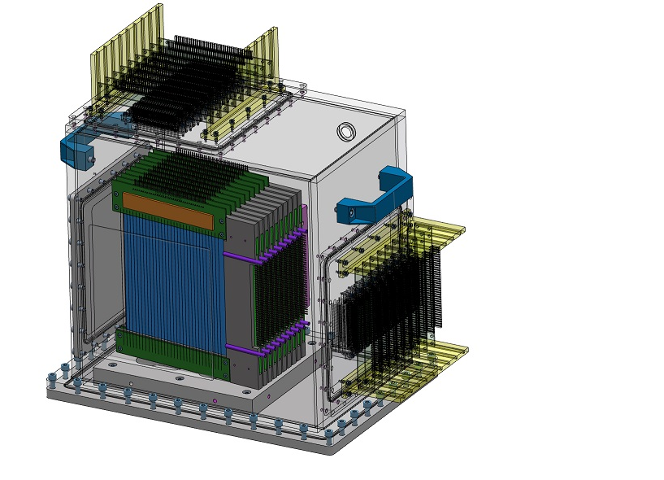
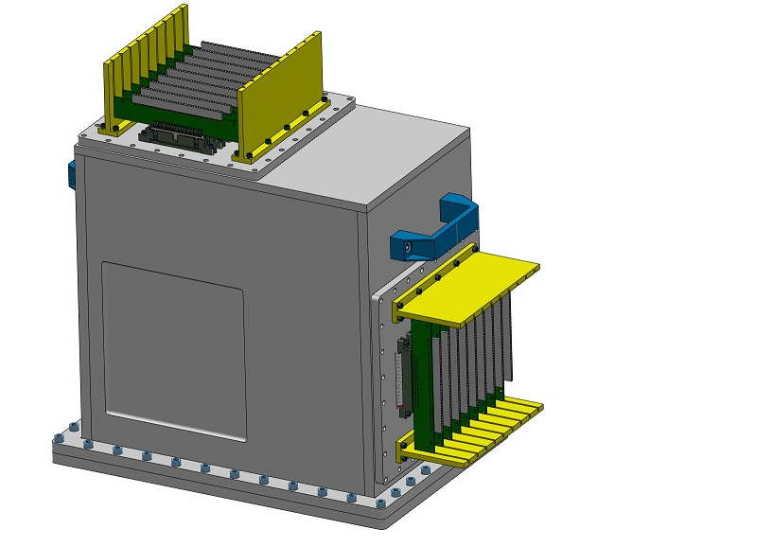
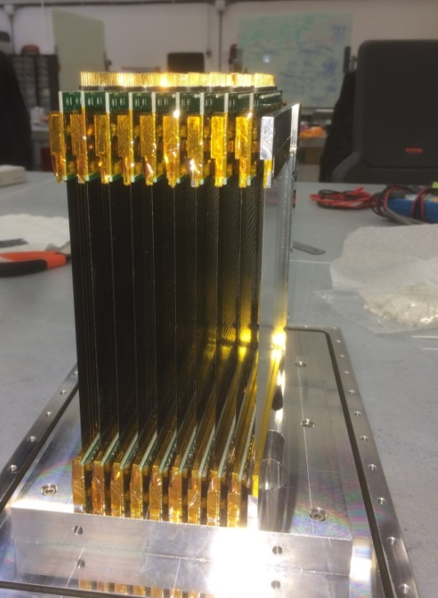
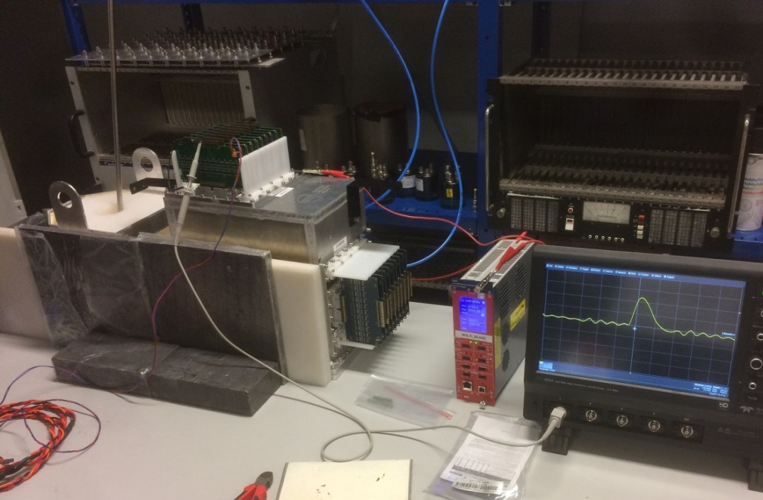
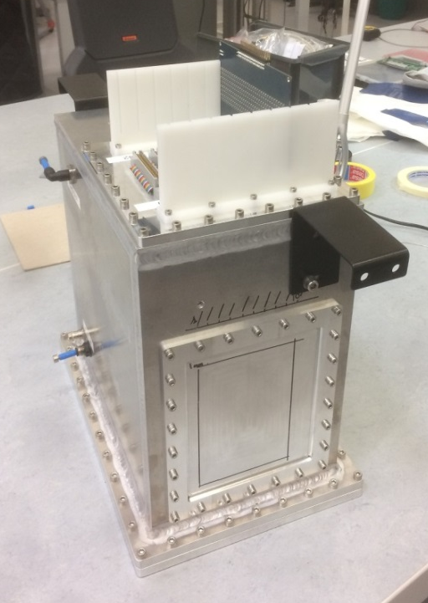
Multi-Blade demonstrators
MB16SS (compact)
More compact: 340x230x380mm
Relocate electronics outside of the vessel (easy access, less pollution of Ar & heat)
Replace Al with Titanium for the blades (improve post-coating flatness)

Slide 15
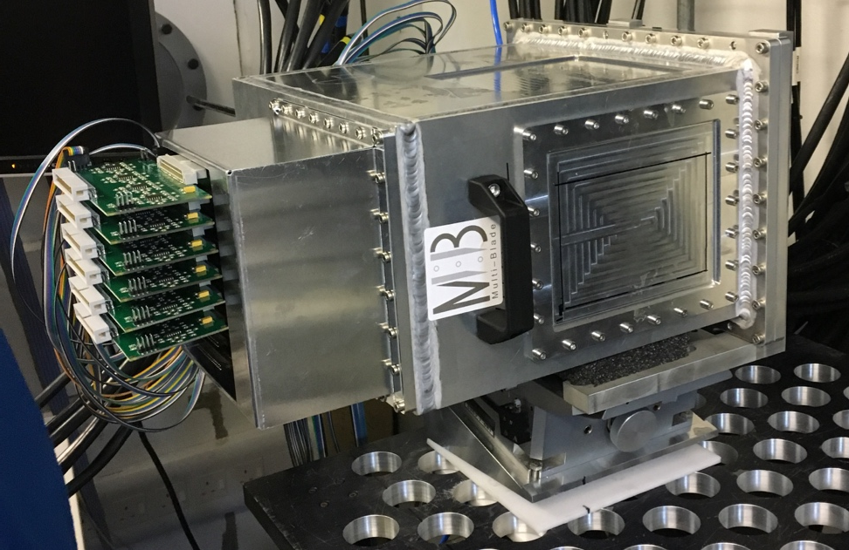
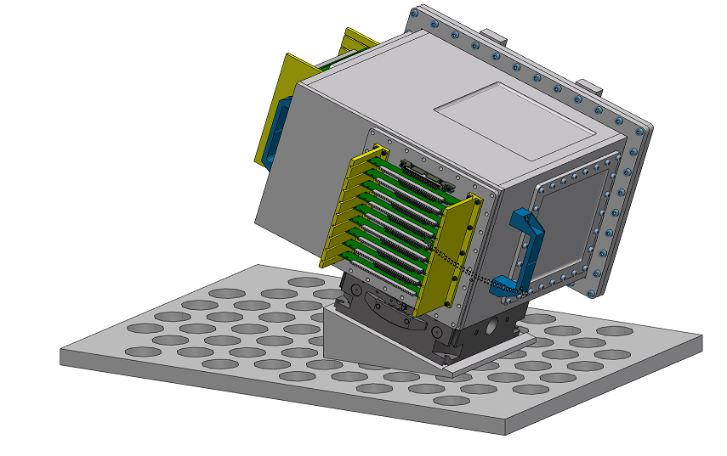
Multi-Blade demonstrator
MB16SS and test at RAL
Tested at RAL, in a horizontal reflectometer
Use of a goniometer, ±18˚ of rotation
MB16SS
Set up for the test at RAL
N beam
Wedge
Goniometer
18˚
Table
2.3m
sample
3D concept
Installation for the test at RAL

Slide 16
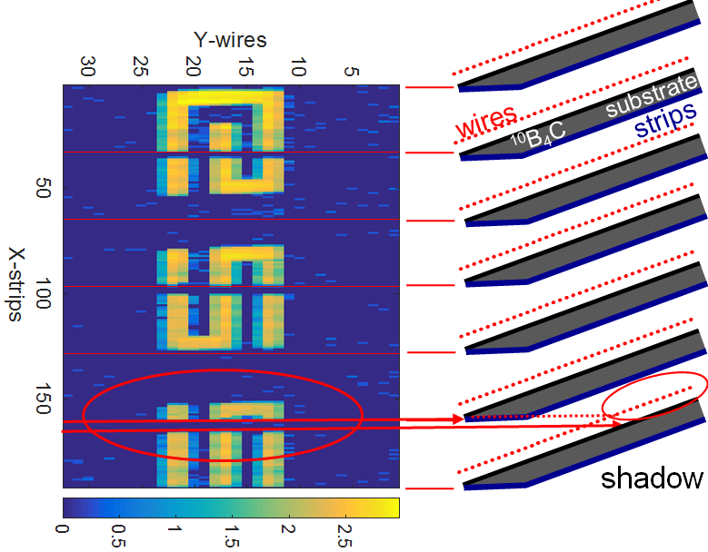
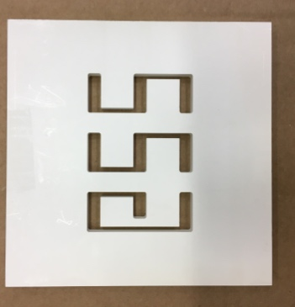
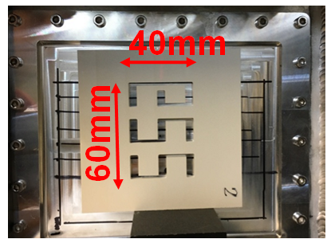
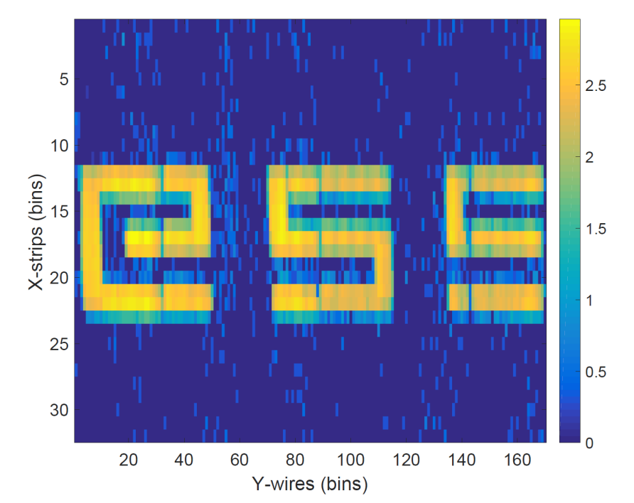
Multi-Blade demonstrator
MB16SS and test at RAL
BNi mask
Tests in real Reflectometry environment (CRISP) successful
Scientific results well reproduced
Ready to up-scale for ESTIA/FREIA

Slide 17



Multi-Grid
Multi-Grid detector technology for ESS instruments
CSPEC
The Multi-Grid technology will be used in the spectrometers: CSPEC and T-REX
T-REX
 | CSPEC (cold) | T-REX (thermal/bispectral)
Sample-detector distance | 3.5m | 3m
Typical initial λ, Å (meV) | 2 to 15 Å (20 to 0.36 meV) | 0.7 to 6.4 Å (160 to 2 meV)
Detector coverage, deg | -30 to 140 +-26 | -30 to 150 -15 to +25
Detector area | 29m2 | 21m2
Instruments layout at ESS

Slide 18


Multi-Grid
How it works: The Grid
Invented by the ILL and jointly developed by the ILL and ESS
Grid
Column assembly
Layer thicknesses for cold spectrometer optimization used at MG.CNCS and applies to CSPEC(16 blades):
7 blades 0.5μm,
7 blades 1.0μm,
3 blades 1.5μm
n
For thermal optimization 20 blades total:
4 blades 1.0μm,
10 blades 1.25μm,
6 blades 2.0μm.

Slide 19

Multi-Grid
How it works: column assembly
n

Slide 20




Multi-Grid demonstrator
MG24 iterations
MG24: First demonstrator
MG24.Copper: Test with low α
MG24.T: Optimized for thermal neutrons
MG24.Alu foil: Test with foil window

Slide 21








Multi-Grid
MG test in CNCS at SNS
2 columns of 48 grids
3mm thickness window
Detector area 1150x185mm²

Slide 22





Multi-Grid
MG test in CNCS at SNS
He3
MG
He-tubes
MG
Successful operation for 12 months
Matched 3He detectors performance (spatial and energy resolution etc.)

Slide 23


Multi-Grid demonstrator
MG.SEQ: Installation proposal at SNS in the SEQUOIA instrument
Test with thermal/epithermal neutrons
First large area detector under vacuum
Mounted in the lower bank ~5m and 25˚ from sample
˞ 1m² of detection area
View of SEQUOIA instrument with MG.SEQ in green
SEQUOIA instrument

Slide 24



Multi-Grid demonstrator
MG.SEQ: Installation proposal at SNS in the SEQUOIA instrument
Original design: 9 columns, 40 grids, 1m x 1m 3mm window
Wedges for column orientation
Reinforce vessel with rods due to pressure-thickness-size combo
Structural verification via simulation
Telescopic slides used for column access
n

Slide 25


Multi-Grid demonstrator
MG.SEQ: Installation proposal at SNS in the SEQUOIA instrument
Switch to 3x smaller 3 column vessels (closer to CSPEC design)
4mm window, no need for internal stiffeners
Close-up of vacuum interface

Slide 26

Multi-Grid for CSPEC
Design for instrument
Up-scale of everything: Address issues not present on demonstrators
Design for higher specs of size, pressure, heat, maintenance
Integrate electronics and vacuum interfaces for a complete ”ready-to-install” system
CSPEC in hall (W3)
Cave and vacuum tank

Slide 27

Multi-Grid for CSPEC
Design for instrument
Several options explored for detector arrangement (8, 4, 2 columns per vessel) and vessel geometry (radial, rectangular, trapezoid)
Trade-off between: dead-space, grid size, structural rigidity, coating capabilities
Verify concepts against realistic manufacturing possibilities within a reasonable cost
Physics
Engineering
Manufacturing
early vessel concept
Concept
Final design

Slide 28

Multi-Grid for CSPEC
Design for instrument
Final detector configuration: 2 MG columns per vessel (column width: 153.5mm)
26 vessels radially arranged (R=3.5m) covering ~135°, 4m high (active: 3.5m)
Electronics and vacuum interface at the bottom and back for easier access

Slide 29





Multi-Grid for CSPEC
Design for instrument
Mounting and installation system inside the tank under development
Finalize details and approve interfaces
Detail manufacturing approach
Installation system
linear guides
Alternating high-low configuration to minimize dead-space
Currently suggested vacuum interface

Slide 30





Gd-GEM Detector for NMX
High resolution detectors (position res <= 200μm)
No fixed detector geometry
Keep read-out chips safe from irradiation
Services need to be portable and move around together with the detectors
In-kind development with CERN
gadolinium foil
aluminium frame
  Gd cathodes attached via ultrasonic welding
  Complete detector

Slide 31




B10 based test detectors
Simple setup to study quality of Boron coatings, gas mixtures, anode wire planes, etc.
Evolution to more capable variants
V1 – 5 counter, 1 read-out channel per counter for basic testing
3D model
FRMII demonstrator with modifications for new electronics and wire frame design to facilitate detector assembly & maintenance
V2 - 64 channel
Notes:
Check status with Irina

Slide 32


SoNDe 2x2 Demonstrator
400 modules, 64 channels per module
Group individual detectors in 2x2 enclosures (light-tight, bring electronics and DAQ together)
Form an independent, portable test unit
Under development
  3D model of concept solution
  As 3D printed (and painted)

Slide 33


3D printing
  Evaluation of test pieces/designs
  Custom or one-off items (repairs/replacements)
  Mockups to help understand complex geometries
  Actual parts used in detectors
  BCN3D Sigma 3D printer (filament)
  Form 2 3D printer (SLA)
Notes:
Photo of printers

Slide 34






3D printing
  wire aligner tests
  PCB supports
  custom holder
  SoNDe 2x2 concept
  Jalousie concept
  Board cases
Notes:
Photo of printers

Slide 35
What’s next
Notes:
Annual Review slides: 5, 7, 12, 13, 23, 28, 33,

Slide 36
Next steps
Complete remaining demonstrators of different classes
Set up testing for actual instrument solutions
Focus on interfaces and integration
Move to design for construction and installation

Slide 37
Conclusion
Mechanical and Technical teams offering detectors expertise and knowledge
Facilities equipped and running for in-house work
Provide support and know-how from consulting to complete detector system design
We welcome all mechanical and technical detector projects from instrument teams
Come and talk to us!

Slide 38
THANK YOU
Horizon 2020 grant agreement: 676548

