Slide 1
Data Acquisition Update from DMSC
Tobias Richter
Data Management Group – Experiment Control and Data Curation (ECDC)
Detectors and Data Acquisition for Instruments Meeting
February 2018 (IKON 14 satellite)

Slide 2
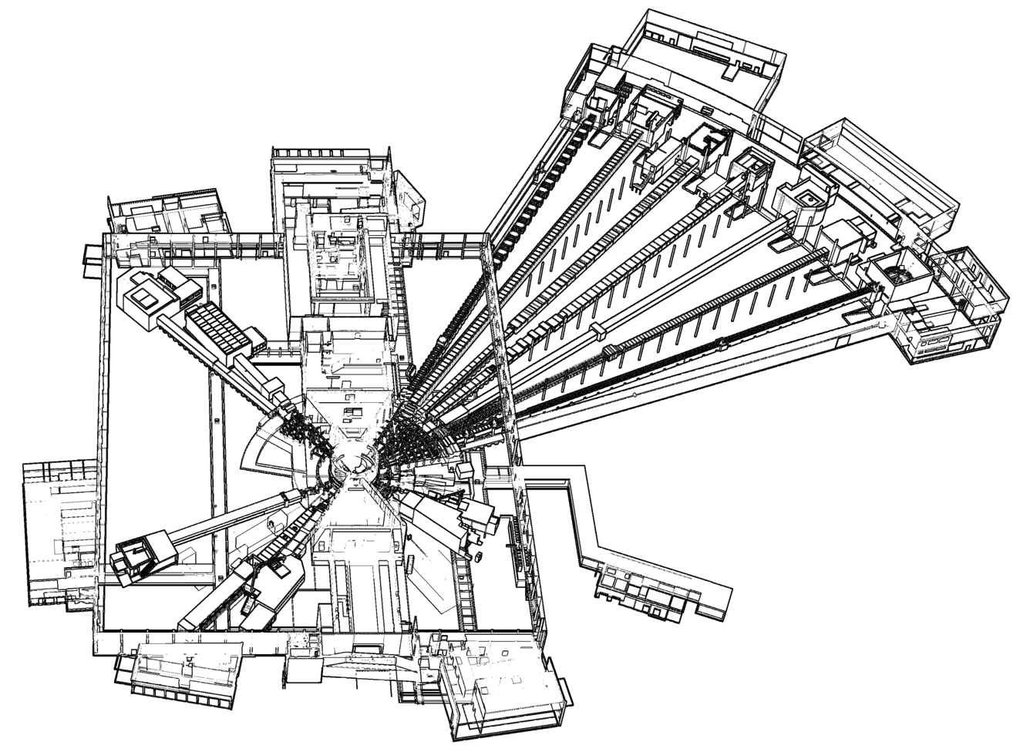










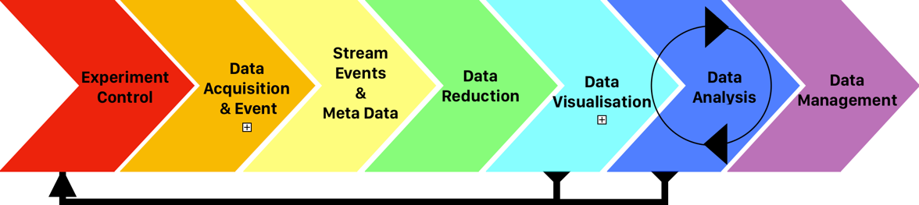

DMSC
NMX
BEER
TO DO:
Scientific
computing
for this
CSPEC
BIFROST
MIRACLES
MAGIC
ODIN
T-REX
HEIMDAL
DREAM
LoKI
VESPA
SKADI
FREIA
ESTIA

Slide 3

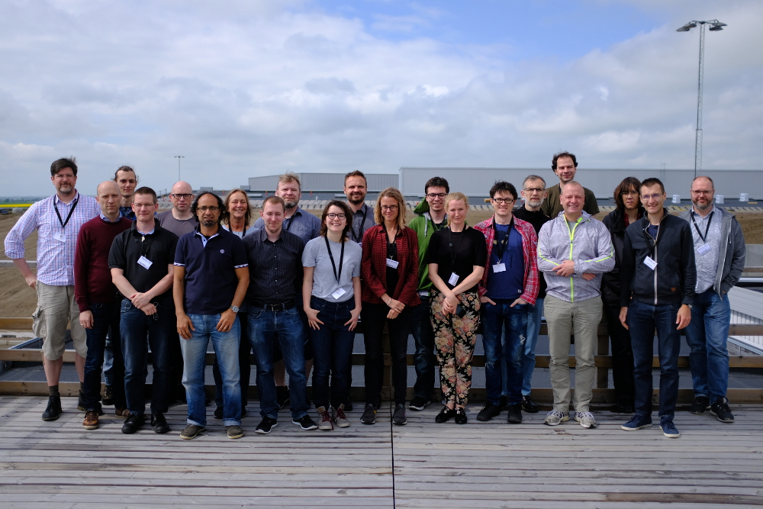
Data Management and Software Centre
Provide world leading scientific software and
scientific computing support for ESS
Scientific Software development
Experiment control
Data acquisition system
Data reduction, analysis & modelling
Data Centre Operations
Dual location - Lund & Copenhagen
Data management and curation
User Programme Support
Data scientists
User office software
Remote access to data and software tools
Stream Events
&
Meta Data
Experiment Control
Data Acquisition
& Event Formation
Data Reduction
Data Visualisation
Data Analysis
Data Management

Slide 4
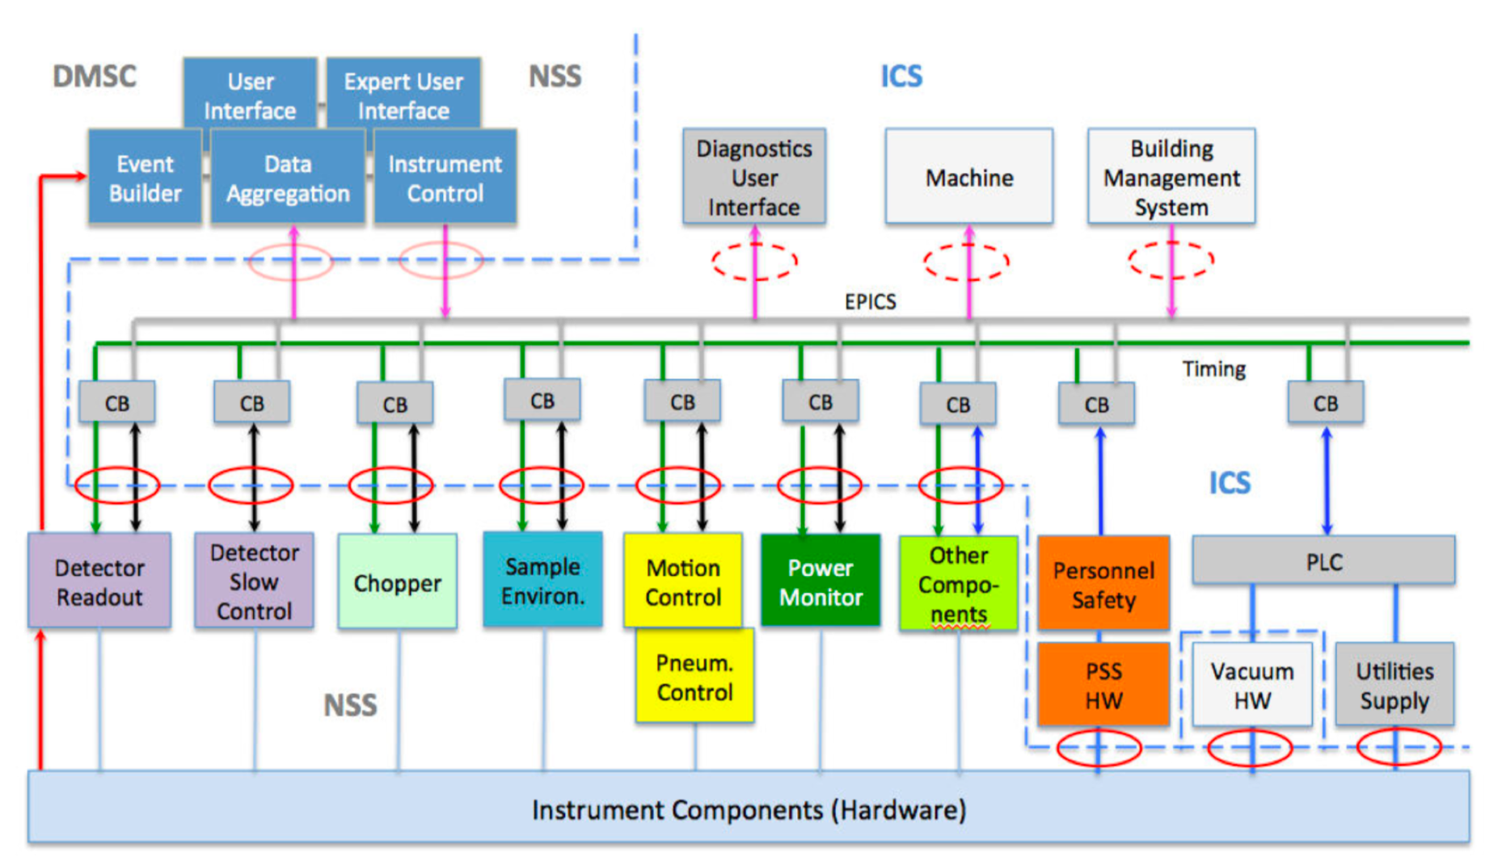
ESS Controls and Readout Architecture

Slide 5

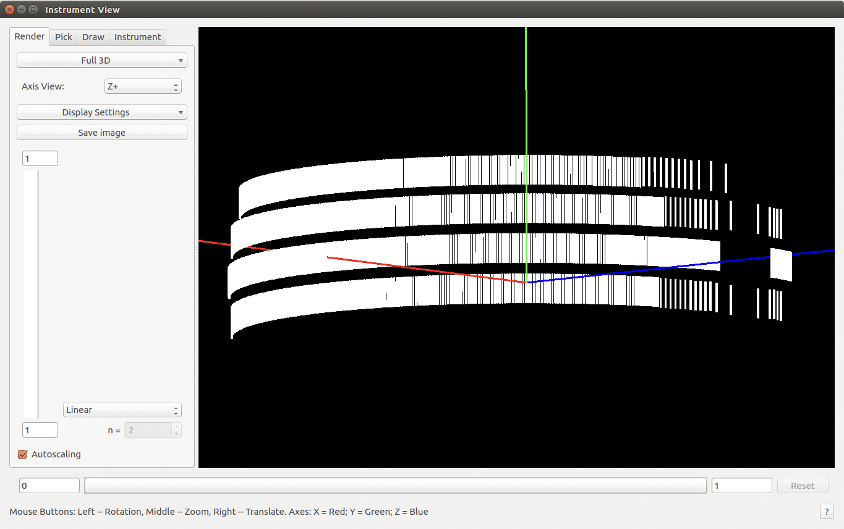
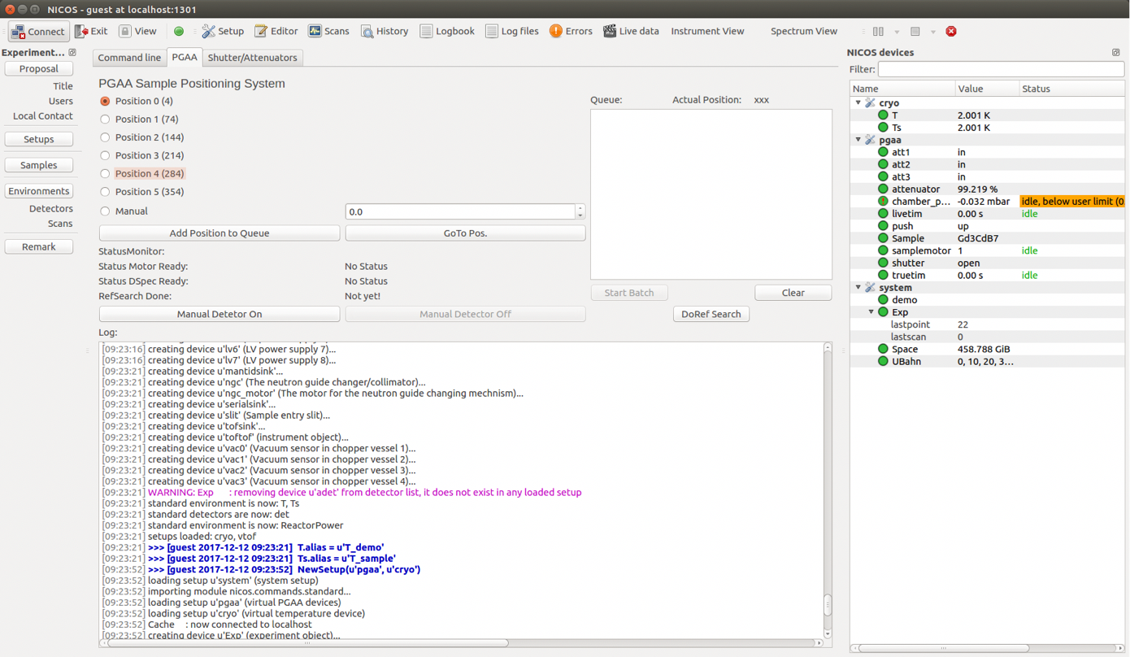
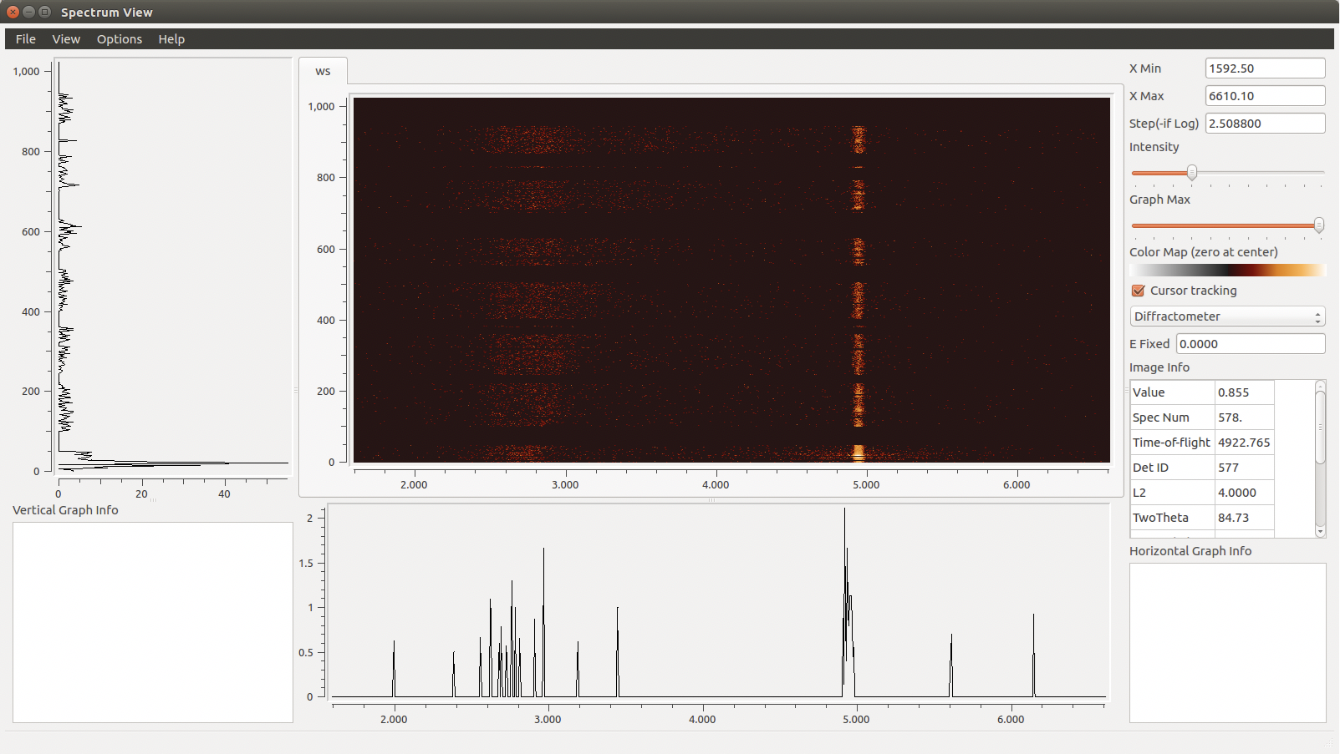
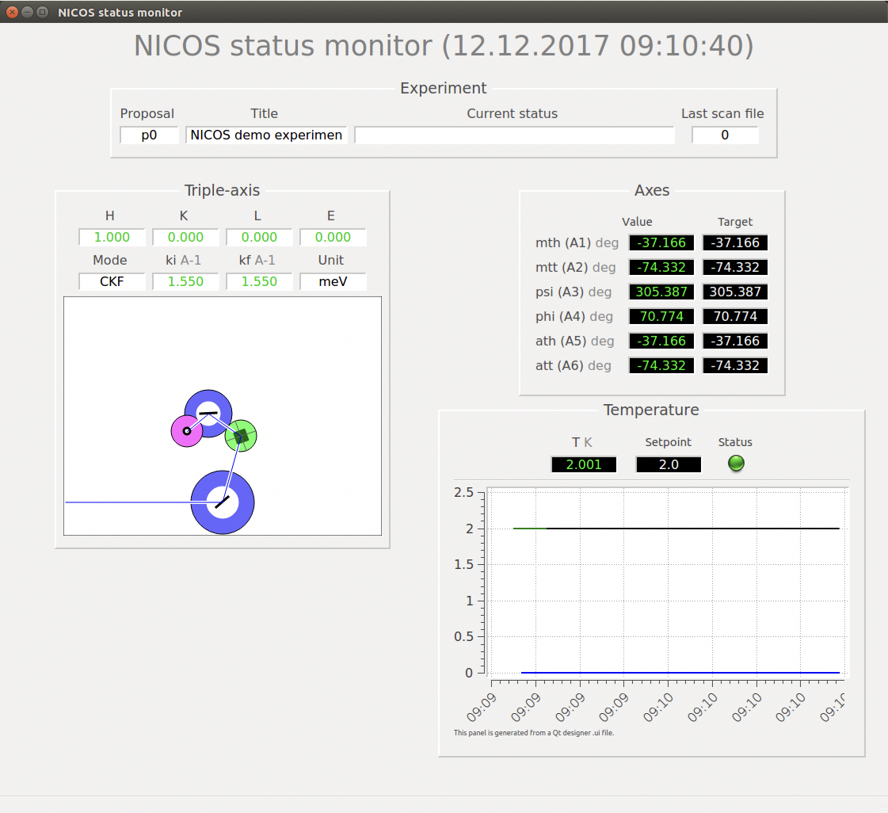

Experiment Control – NICOS
Feature complete and customizable
Acts as a high level interface to low level EPICS controls
Python CLI
Qt GUI

Slide 6

Instrument Readout Architecture
Instrument Hardware
DMSC Hardware
Detector Backend
Event Formation Unit
MRF
100 GB/s fibre
Detector Backend
Event Formation Unit
NeXus File Writing
Data Aggregation (Kafka)
Chopper
Live Feedback
EPICS
EPICS Bridge
MRF
Motion
BrightnESS is funded by the European Union’s Horizon 2020 research and innovation programme under grant agreement No. 676548

Slide 7
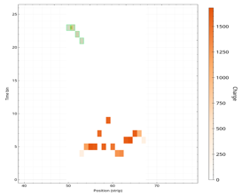
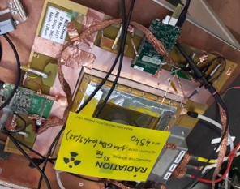


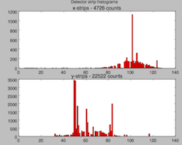
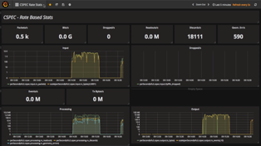
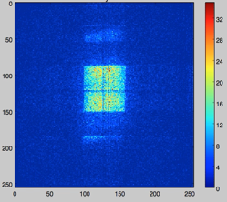
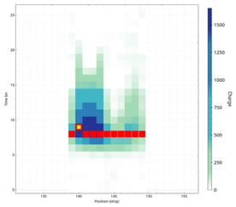
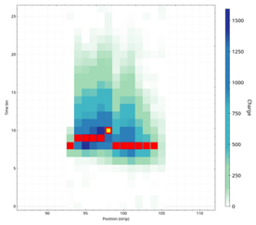
Detector Readout & Event Formation
Event formation
Detector and readout
Aggregation
Live View
Readout Master
Coincidence building and location refinement in software
Successfully demonstrated for a number of prototypes
More information in the next talk by Morten
Gd-GEM
ICS / MRF Timing
Monitoring & Diagnostics

Slide 8
Utgård @ last IKON
Detector Hardware
Processing of SONDE, Multi-Grid, GEM

Slide 9


Full Integration Tests at HZB V20
ICS Chopper Group
Detector Group DMSC
DETECTOR GROUP CONTROL & TIMING DEMONSTRATOR
ADC
TEST
STATUS
DATA
TIMING
CONTROL
JTAG
POWER
First Session – November:
Demonstration of Timing
Chopper low level control and operations
Readout of TDC values and beamline metadata
Second Session – January:
EPICS and NICOS control of
chopper and beamline
Readout of monitors through DG system
Processing and storing of event data
Future: Wavelength Frame Multiplication,
Sample Environment, Motion Control

Slide 10



Control and Readout
Source Chopper
Front Monitor
Mini chopper
Back Monitor
Reactor
EPICS Forwarder
V4
Timing system
DETECTOR GROUP CONTROL & TIMING DEMONSTRATOR
ADC
TEST
STATUS
DATA
TIMING
CONTROL
JTAG
POWER
File writer
Kafka
EFU

Slide 11
V20 Summary
Chopper and its control (CHIC) are performing as expected
NICOS has high level control of the chopper and most V20 equipment
Monitors acquire useful data
DG readout electronics capture the signals correctly
EFU can process the data sensibly
Data Streaming with Kafka and
HDF5/NeXus file writing works
We have gained better understanding of the devices from the data captured
Timing works in principle
Better idea of priorities for future tasks

Slide 12
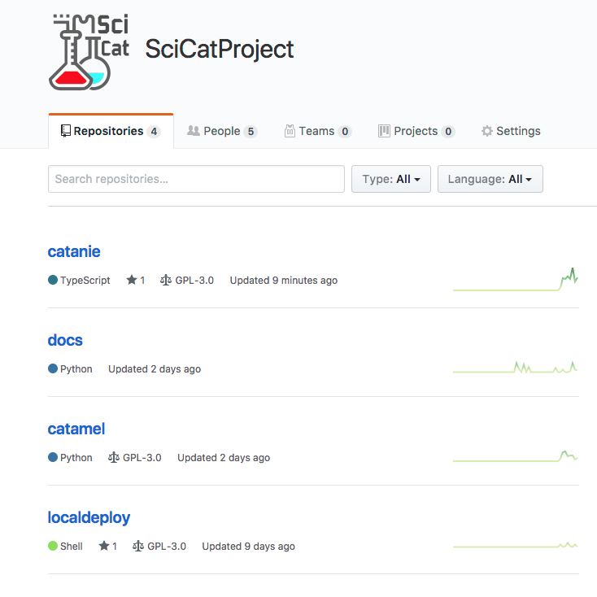
Data Curation
All raw data will be stored as NeXus and preserved long term.
Metadata catalogue to support FAIR data principles and implement the ESS Data Policy is being developed by:
  DMSC
  PSI (in kind & use at SLS)
  MAX IV
Code is available up on Github

Slide 13
Any questions or concerns?

