Slide 1





T-REX: Vacuum Tank and Detector Integration Status
Nicolò Violini, Tadeusz Kozielewski, Jörg Voigt, Earl Babcock, Zahir Sahli, Helmut Soltner, Günter Kemmerling, Klaus Bussmann, Frank Suxdorf, Thomas Brückel, Andreas Wischnewski
Andrea Orecchini, Alessandro Paciaroni, Marco Zanatta, Pietro Tozzi, Francesco Sacchetti
Hans Kämmerling,
Mario Koenen,
Achim Heynen
Detectors and Data Acquisition for Instruments Meeting - Paris, 12th February 2018

Slide 2
Outline
T-REX instrument overview
Requirements for Detectors
Vacuum tank design status
Detectors vacuum/mechanical integration

Slide 3
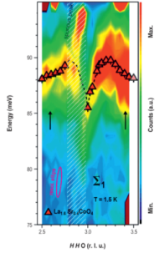
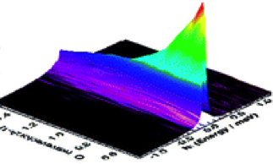
T-REX: INS for a broad community
small energy gaps, excitations in the parent compounds of high T_{c} SC,
excitations into the Stoner continuum.
Conductivity is governed by coupling mechanism between between phonons and ion diffusion
QENS: ps to ns dynamics governs biological functionality

Slide 4
T-REX unique with 5D mapping
50 % detector coverage
in 1st day
Polychromatic experiments
162m <336 Hz
108m <252 Hz
2 meV < Ei < 160 meV
@ 2MW ESS:
  (3x 4-SEASONS, 6xIN5 ) x n.of useful RRM spectra
Bispectral:
  Neutron guide optimised for
  thermal
  Cold extraction does not
  compromise thermal
Chopper cascade:
  Flexible configuration
  Resolution → flux
  < 24 RRM pulses
40 m
32 m
+Provision of T0 at 19 m

Slide 5
Functional Requirements
Scattering Characterization System
Sample-detector distance: 3 m ± 1 mm
Large solid angle: vertical -15° to +25°
horizontal +1° to +70° (project scope)
Minimum angle: 1°
Time resolution (FWHM): ≤ 5 µs
PSD Positional resolution (FWHM): 20 mm x 20 mm x 10 mm
Detection Efficiency: ≥ 70 % at 1.8 Å
average 74 %, 1.6 Å < λ < 5 Å
Count Rate: <10⁴ Hz/cm²
Neutron Selectivity: <10⁻⁶ gamma detection prob.
Noise: <10⁻⁴ events/s/cm²
Vacuum ≤ 10⁻⁶ mbar
Prevention of secondary scattering
~ 20 m²
-36° to +144° (full scope)

Slide 6
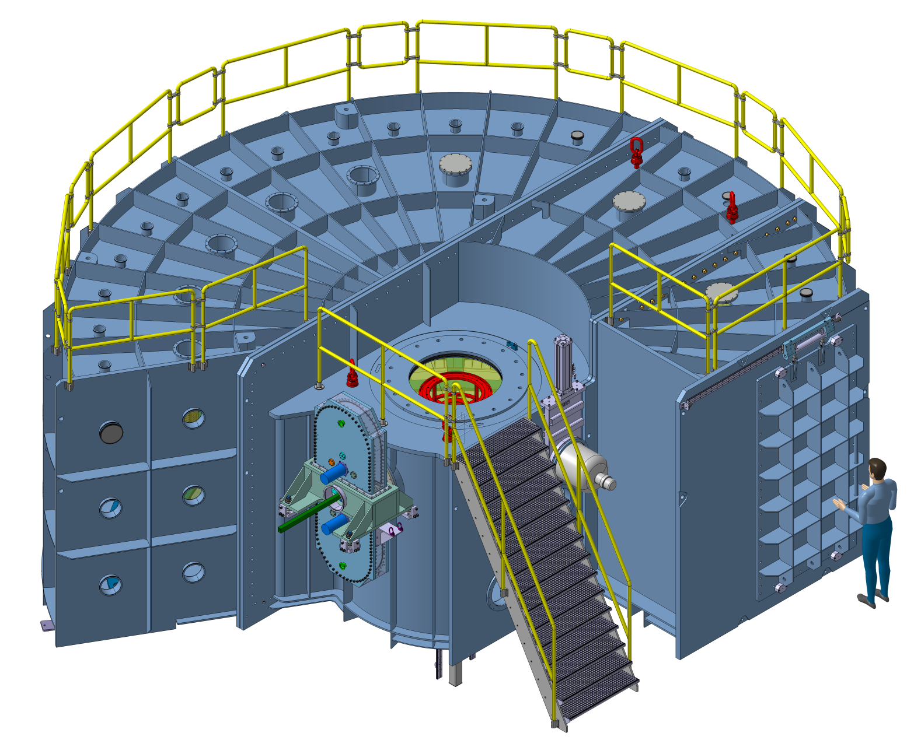
Detector vacuum vessel - Status
Status: iteration with FEM calculations on final design, working on tender docs and specs for TG3
31.03.18 open call for tender
31.10.18 contract signed
Q3.19 completion of manufacturing
(tbd) Q4.19 – Q3.21 delivery at ESS
Allocated budget seems OK
Open questions/discussions:
Integration of primary beam collimators
Sample change system tests
Detectors Design + vacuum interface + utilities + installation/maintenance strategy
Design and Procurement of vacuum system

Slide 7
Detector vacuum vessel – Design characteristics
10⁻⁶ mbar
Stainless steel 10 mm
50 T of material
Height 3250 mm
Diameter 8500 mm
Volume 85m³
Magnetic req.
2m R from sample (may be too expensive)
Access from lateral door
Inside:
Primary collimator,
Holding field,
PASTIS / SEE,
Radial collimators,
Detectors,
Get lost tube, beam stop

Slide 8
Vacuum system for Detector Vessel
pumps
4 roots
3 turbo
1 screw
1 cryo
< 2 h to restore

Slide 9
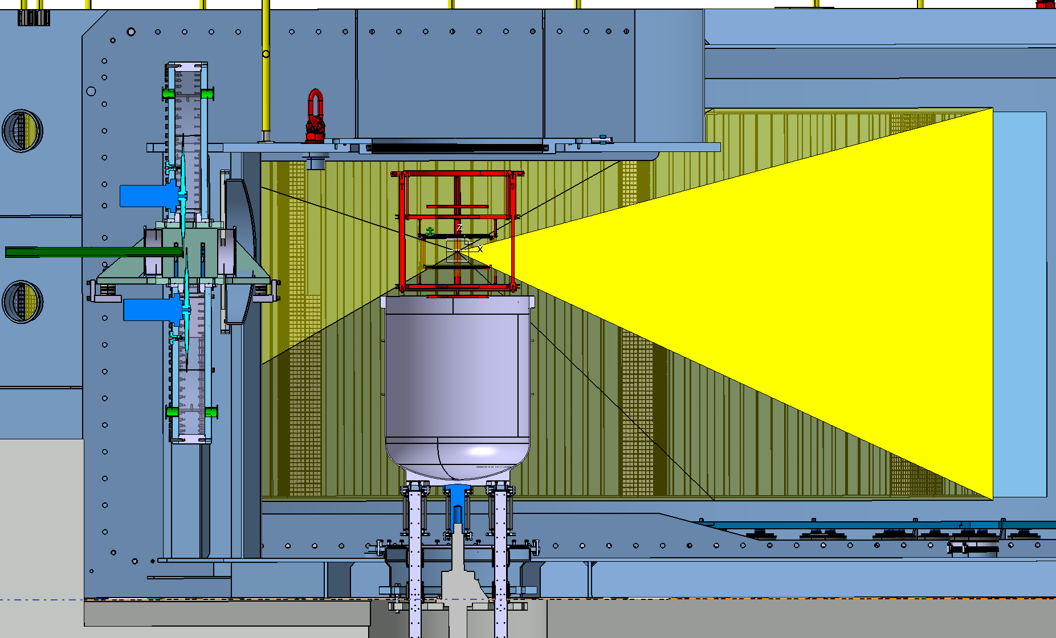
Sample exchange system
Enables faster sample/SEE change
Mechanically decoupled
Design+construction work is done independently
Need for a sealing test

Slide 10
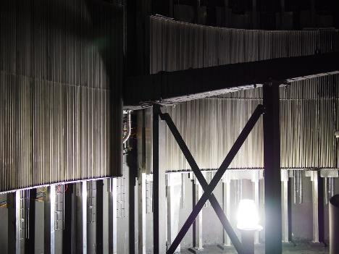
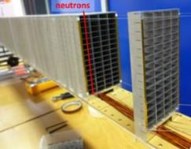
Multi-GRID detectors (baseline)
MG @ CNCS
Size = half of “8-pack” module
Installation June-July 2016
Test at spectrometer
Operation for 6+ months
Side-by-side comparison to ³He
User experiments
Prototype under construction
20-24 ¹⁰B₄C layers
6 x 1 µm, 10 x 1.25 µm, 4 x 2 µm
to reach 45-48% efficiency @ 1Å
Fairly compares to ³He at 6 bar
Pure Al frames

Slide 11
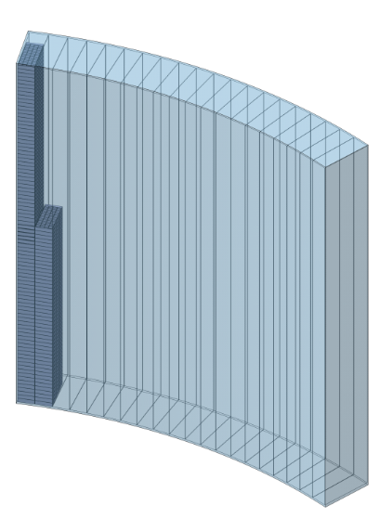
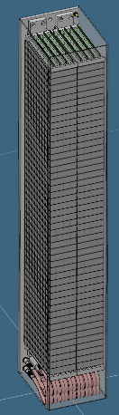
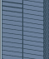
Multi-GRID detectors (baseline from TG2 Mar ’17)
Full scope needs
100 modules = 5 banks x 20 modules
Project scope
40 modules = 2 banks x 20 modules
20 columns
96 rows
CNCS
prototype
2mm gap
1mm gap

Slide 12
Detectors Vacuum integration box

Slide 13
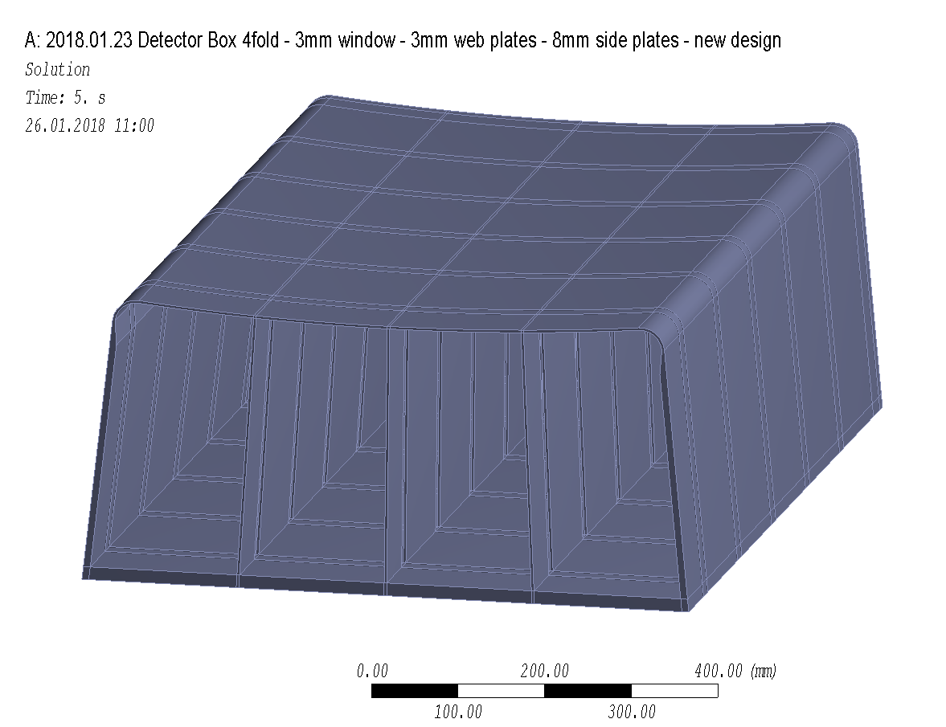
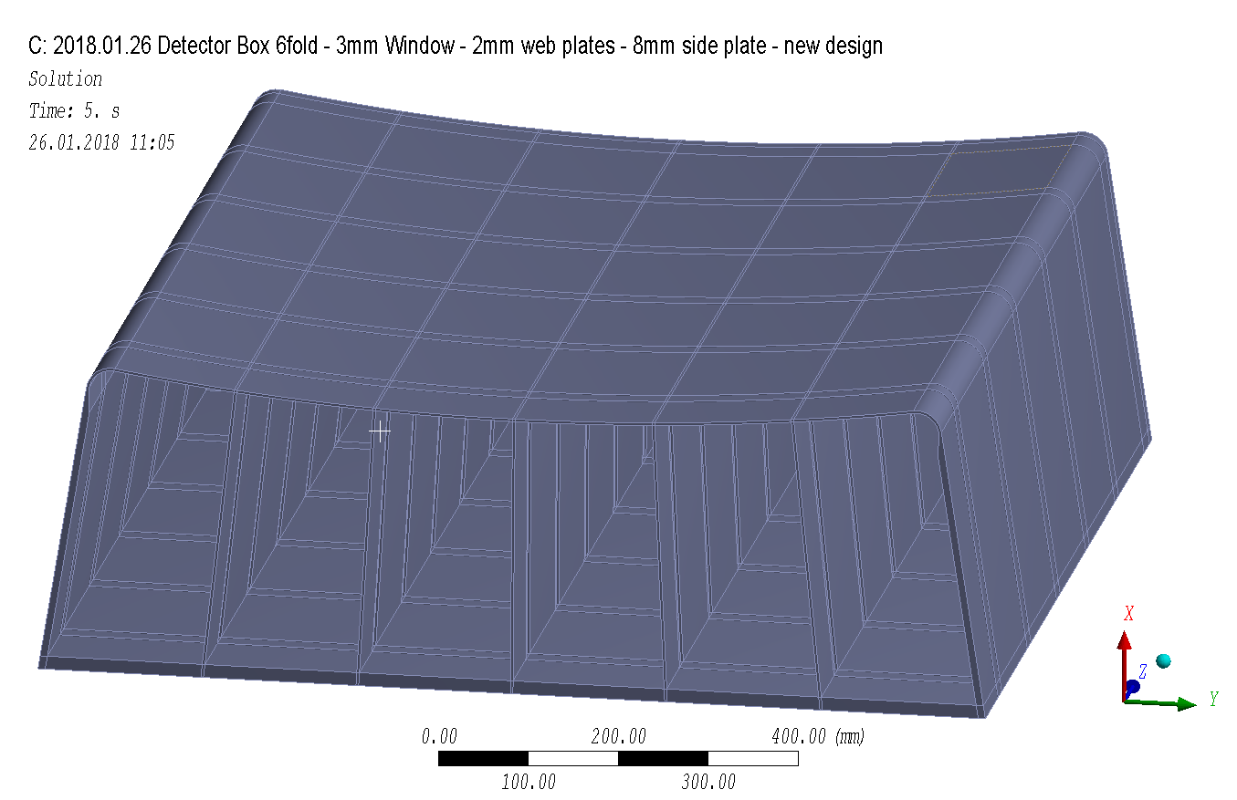
Detectors Vacuum integration box
window
web plates
side plates
4 columns per box (A and B)
6 columns per box (C and D)

Slide 14
Detectors Vacuum integration box
Investigated layouts
The preliminary stress analysis was performed for 4 different layouts:
4-columns per box, 3 mm web plates, 8 mm side plates
4-columns per box, 2 mm web plates, 8 mm side plates
6-columns per box, 2 mm web plates, 8 mm side plates
6-columns per box, 2 mm web plates, 10 mm side plates
++ option C, the influence of neighboring, closely mounted :
1 mm gap between neighboring boxes
1 bar pressure gradient
A detailed stress proof according to design rules to be applied was not yet done.

Slide 15
Material Properties
Considered aluminum alloy: AlMg4.5Mn0.7
Elastic modulus: 70 GPa
Poisson’s ratio: 0.33
Yield stress: 125 MPa
Tensile strength: 275 MPa
Strain to rupture: 15%
Weld properties coefficient: 1.0
Joint coefficient: 0.85
Stress Criteria Sm: 83.3 Mpa
Yield point for limit analysis: 70.83 Mpa (= 0.85 · Sm)

Slide 16
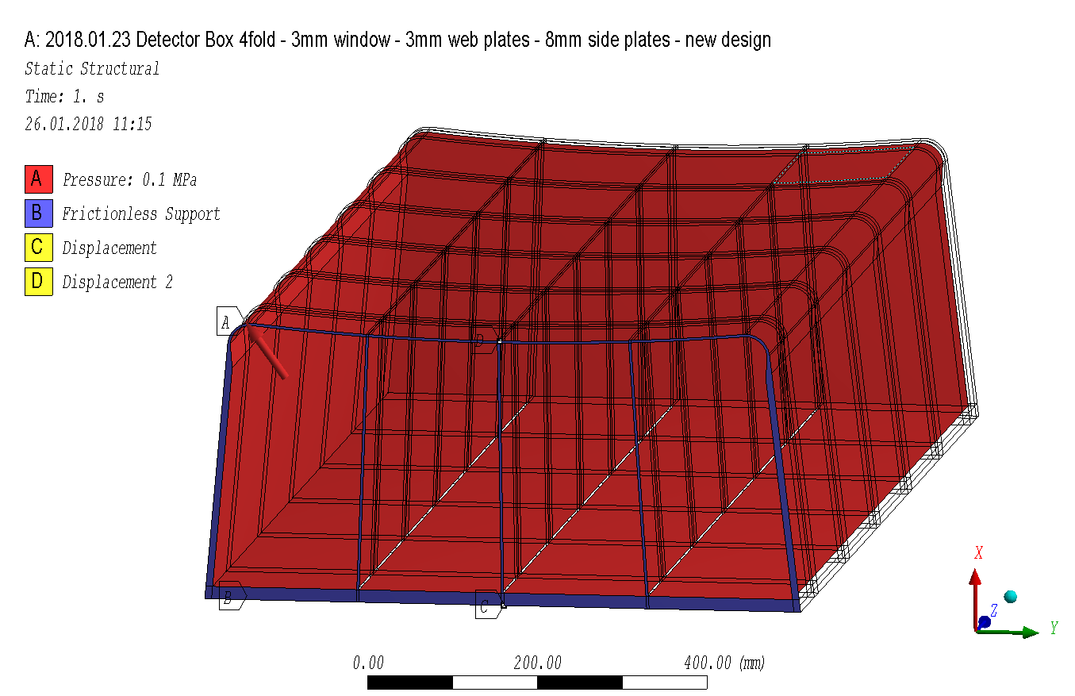
Loads
B: symmetry conditions for ½ model
C / D: only used to numerically fix the model

Slide 17
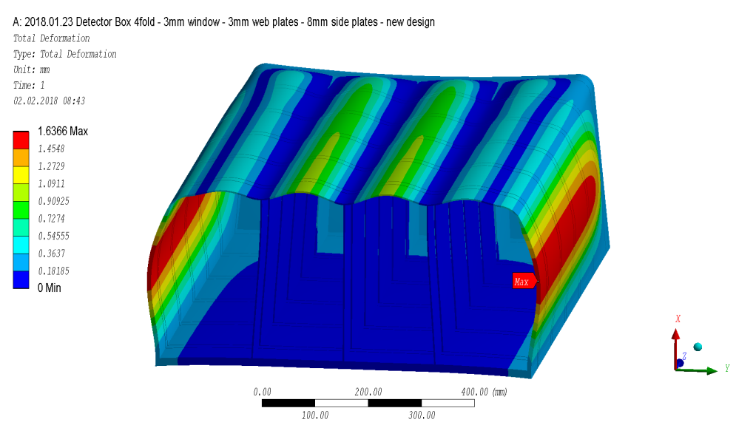
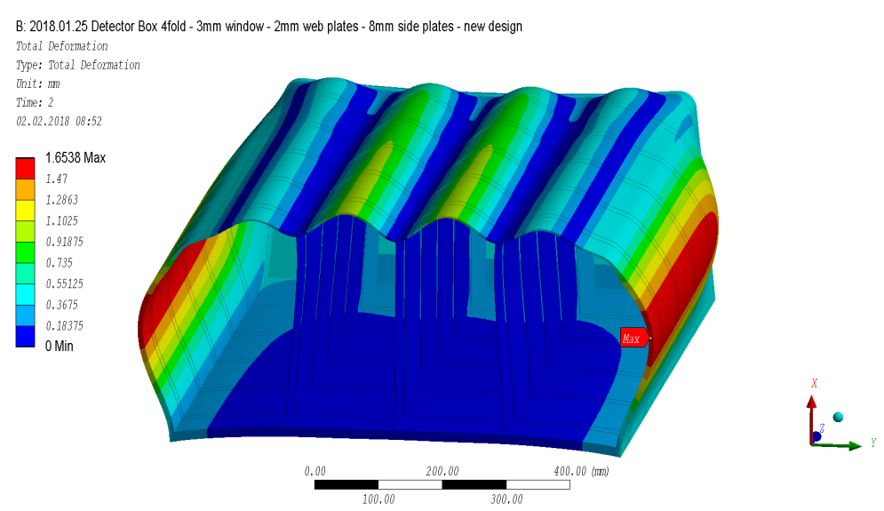
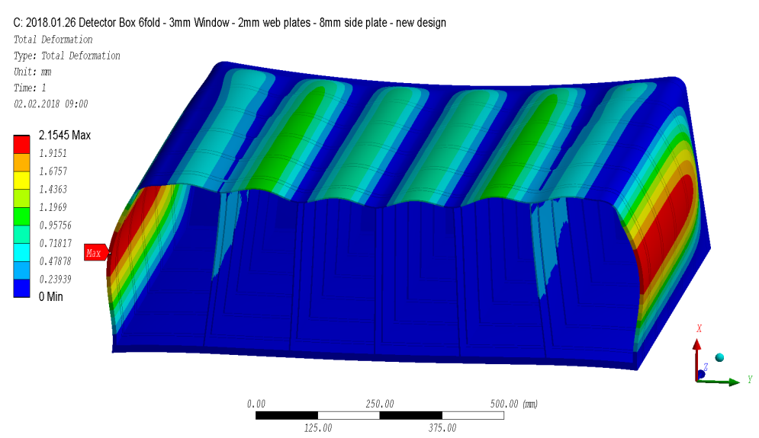
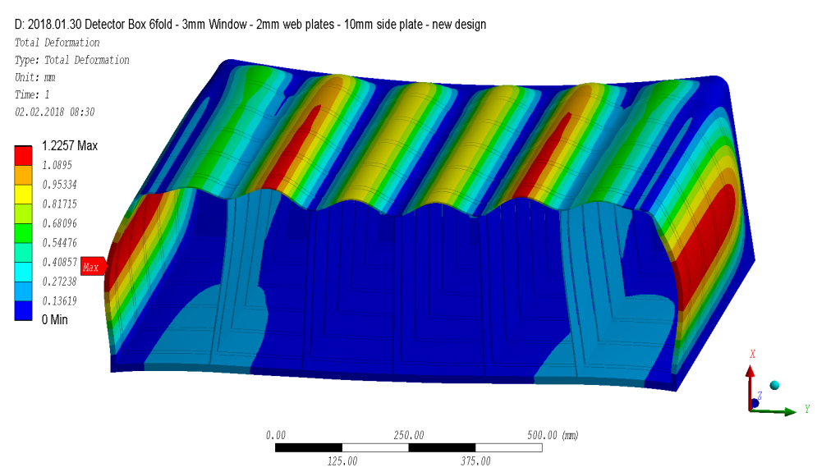
Results - deformations

Slide 18
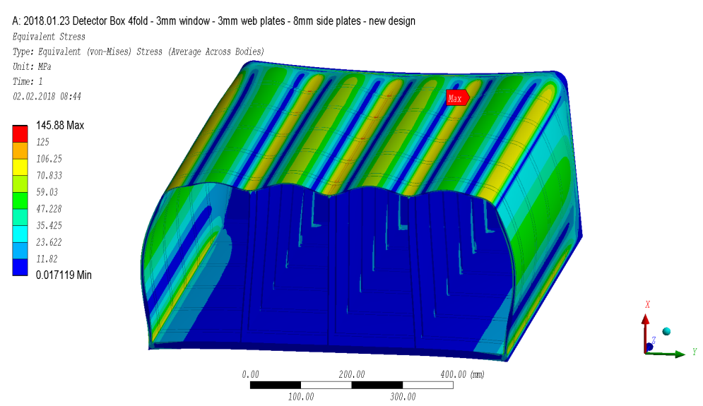
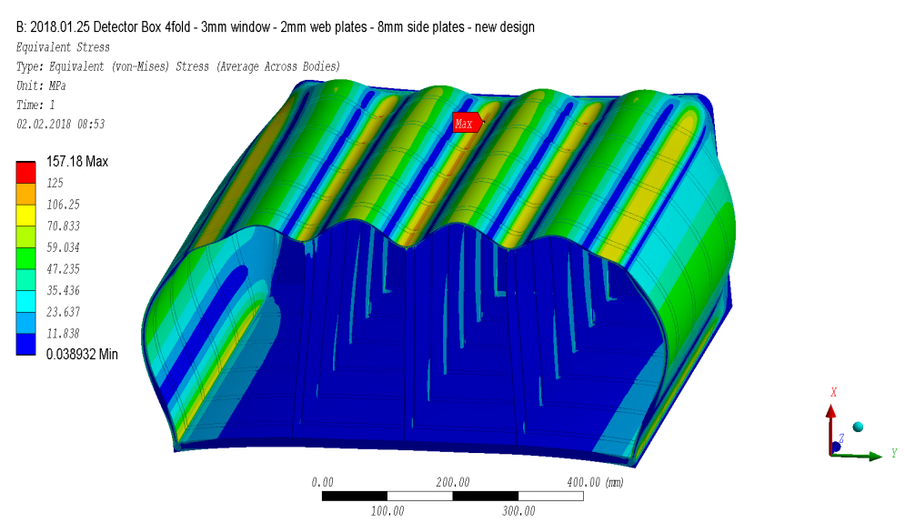
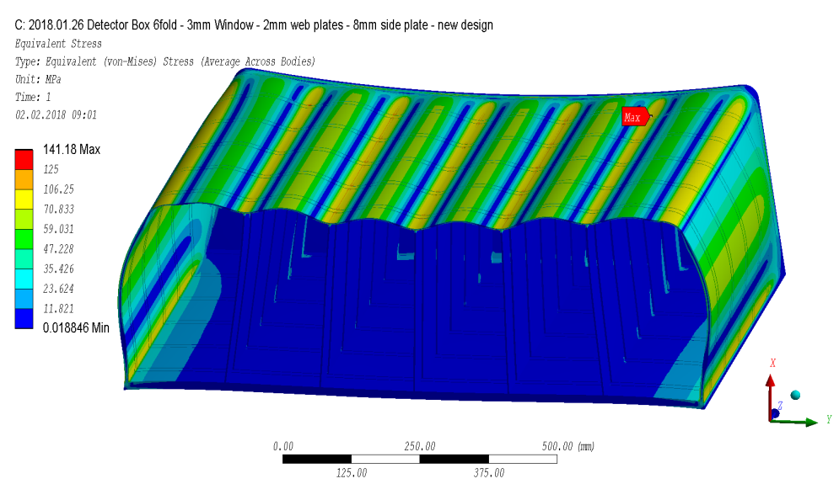
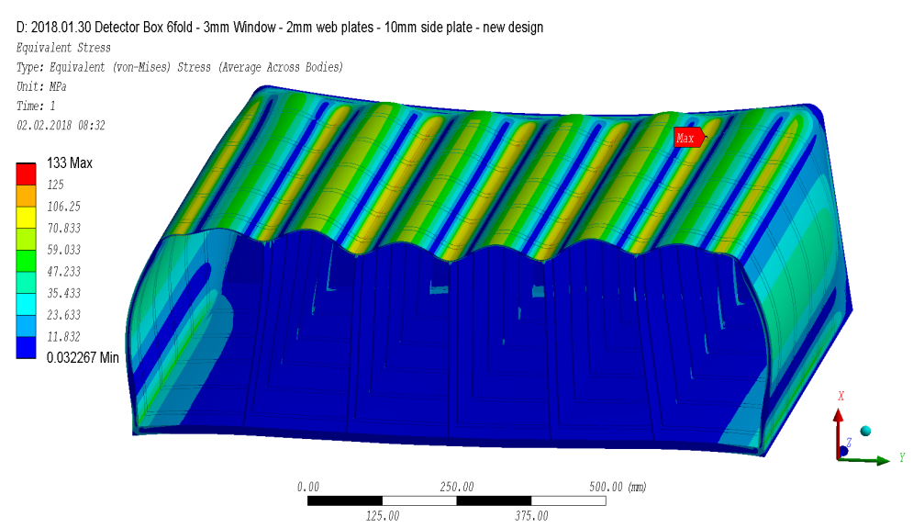
Results – elastic stresses

Slide 19
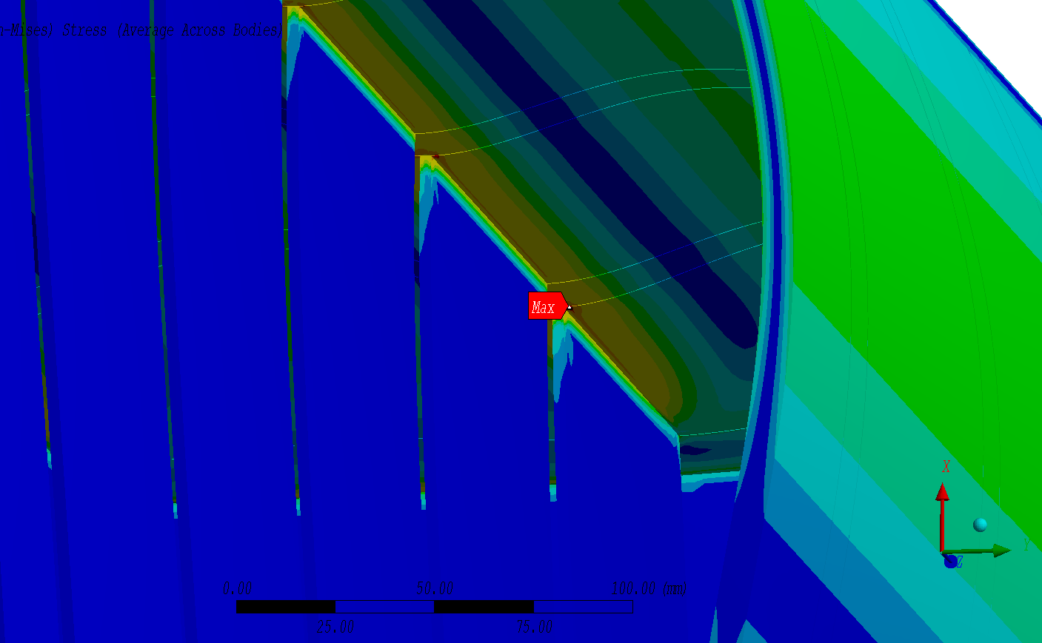
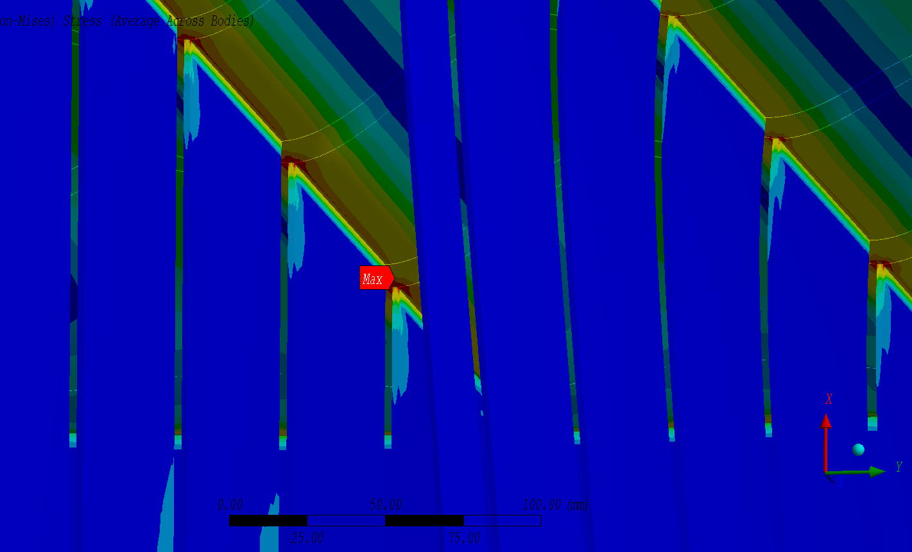
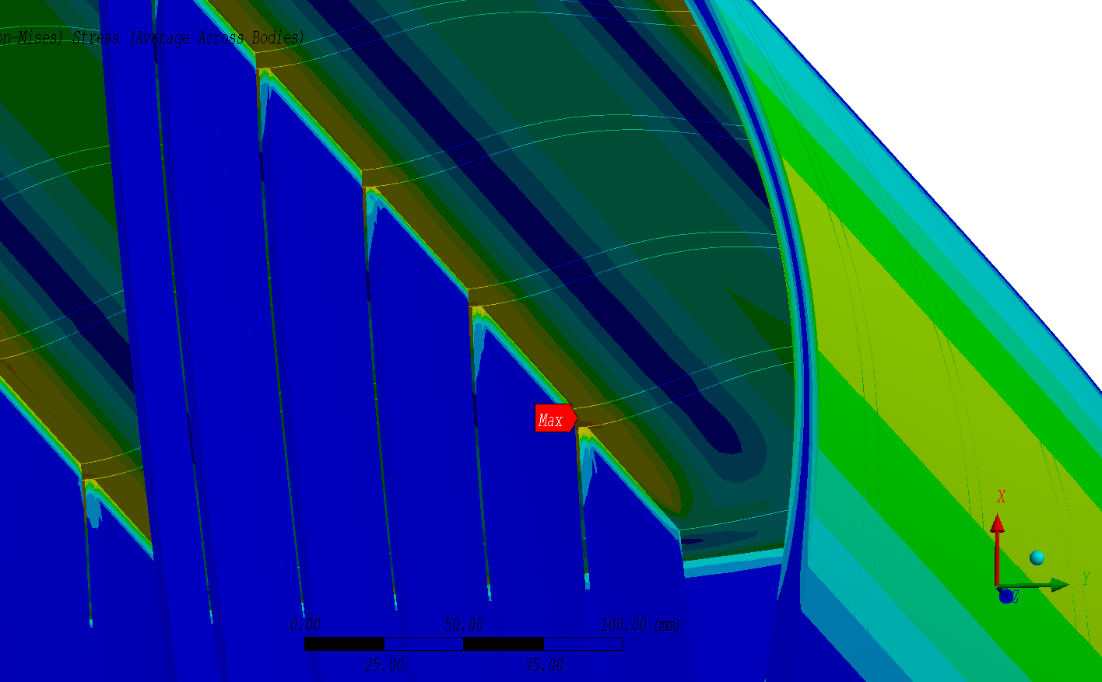
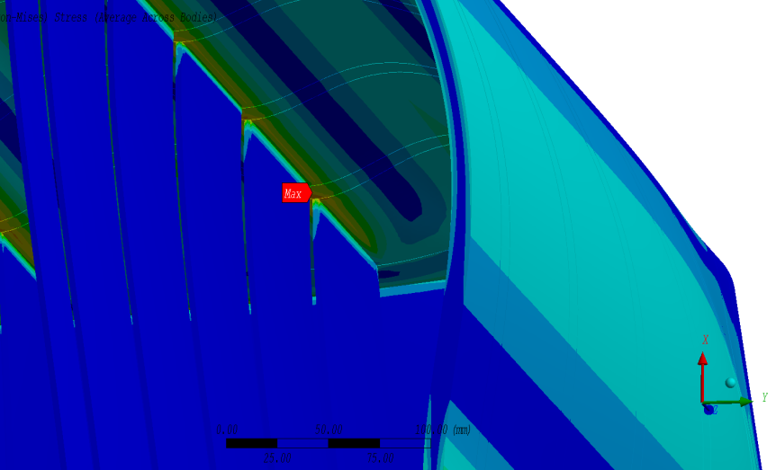
Results – elastic stresses (details)

Slide 20
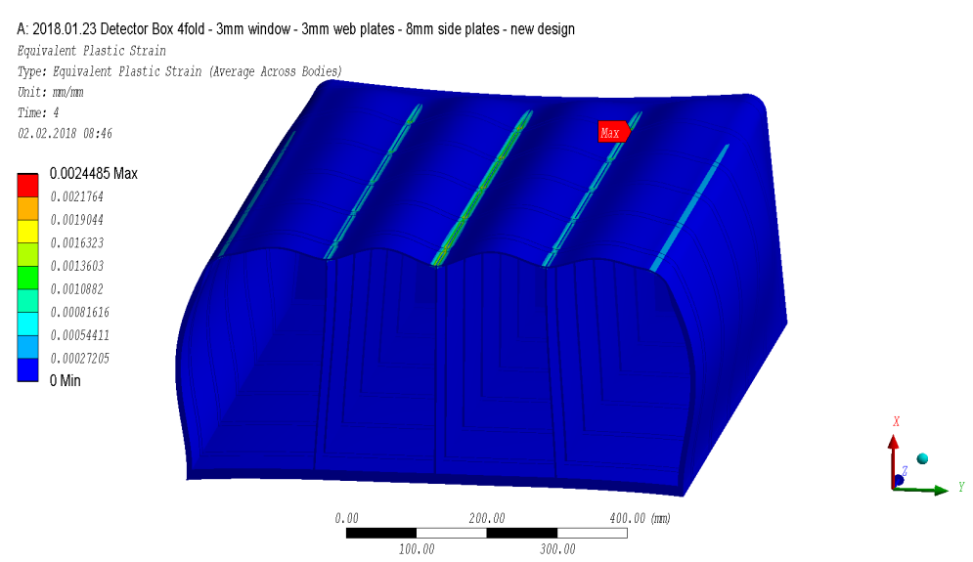
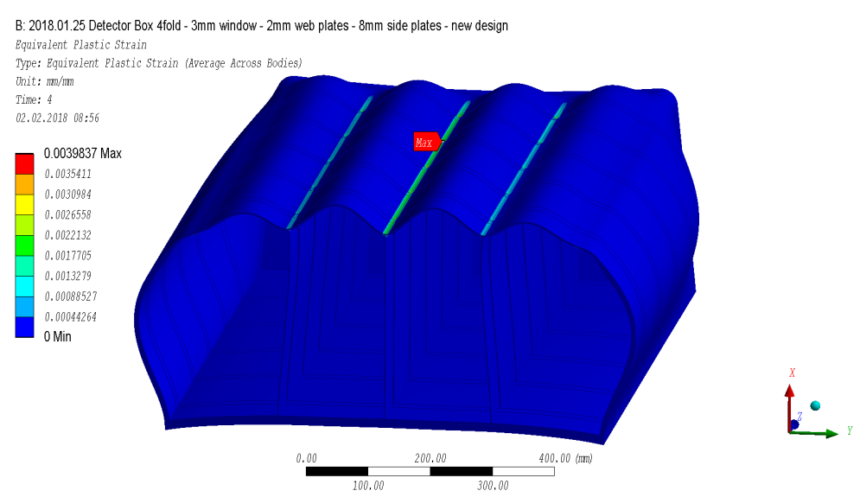
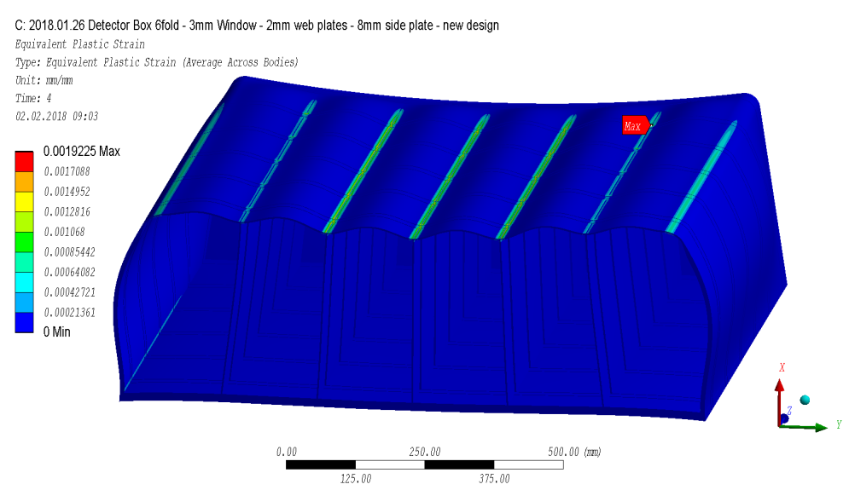
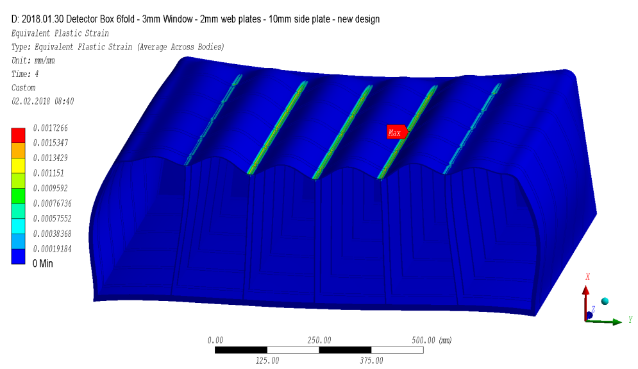
Results – plastic strains for limit analysis with R_{L}=70.83 MPa

Slide 21
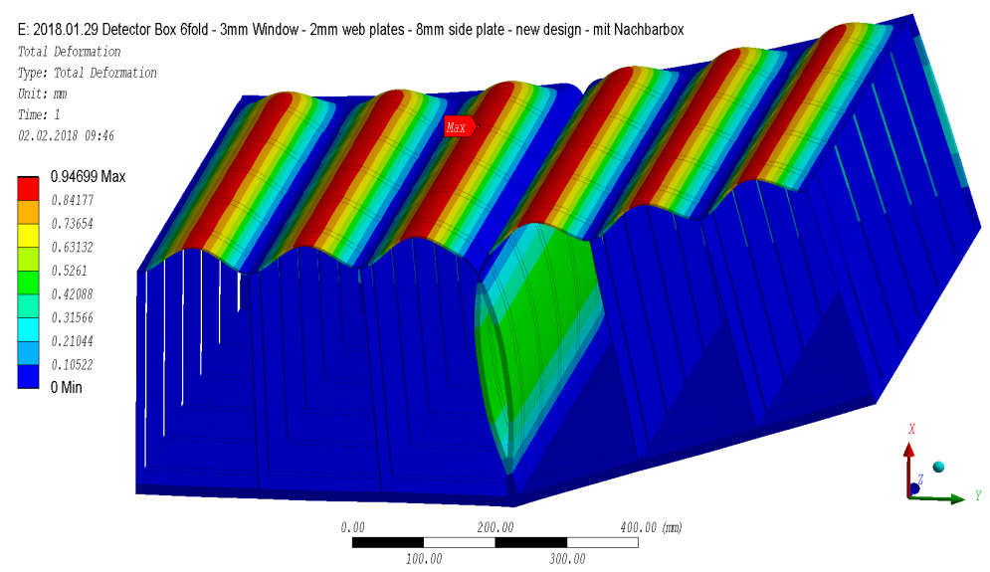
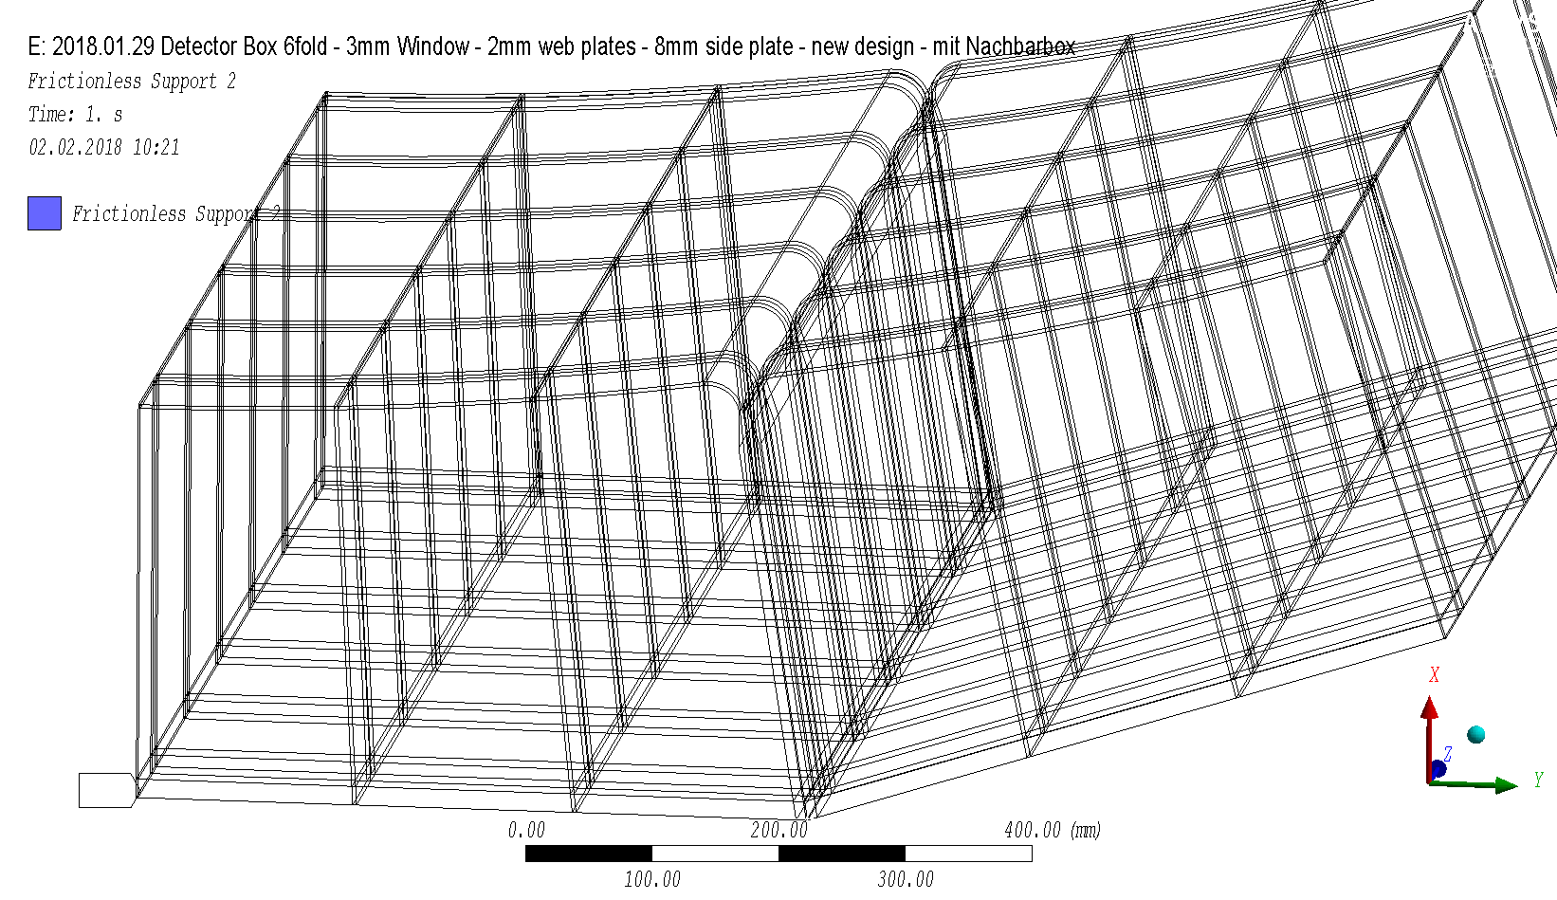
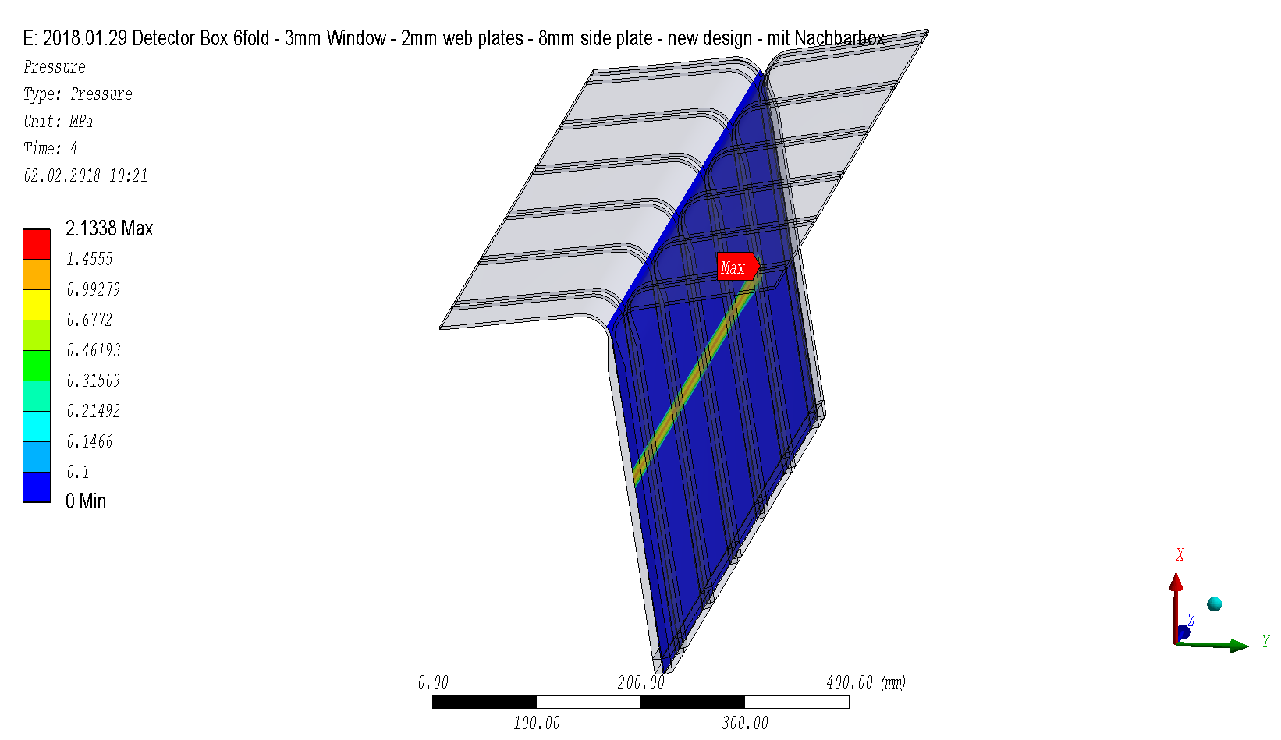
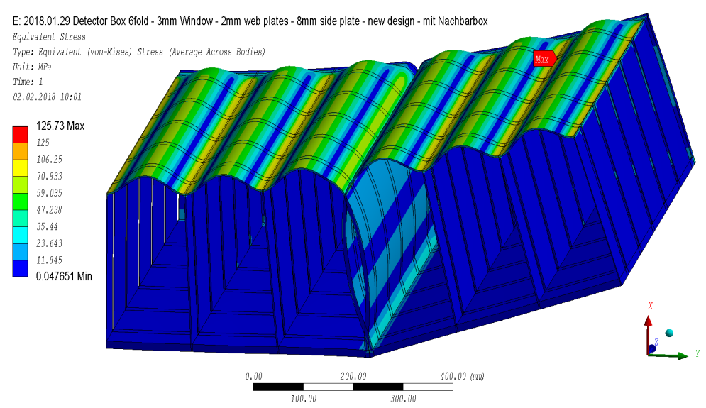
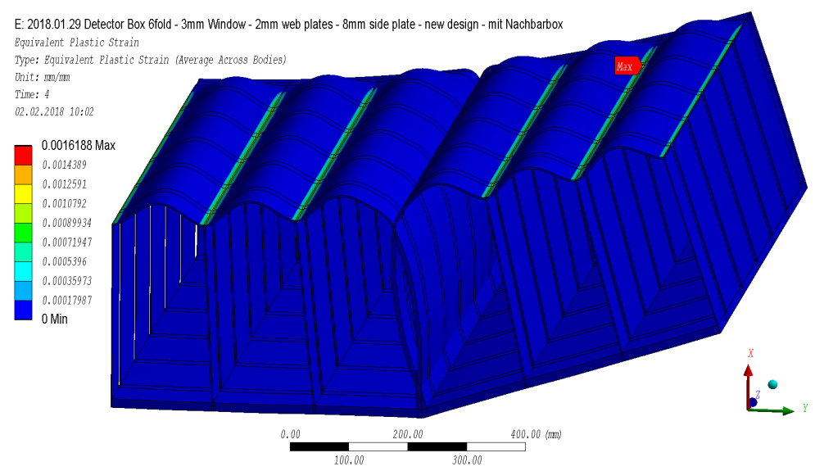
Neighboring boxes – 1mm gap
Deformations, mm
Contact pressure, MPa
symmetry
0.5mm – closed gap
Elastic stresses, MPa
Plastic strain (limit analysis), mm/mm

Slide 22
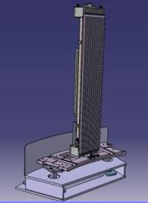
Mechanical Integration of the boxes
TOPAS
Design

