Slide 1

Updates from the ESS
Detector Coatings Workshop
in Linköping
Carina Höglund
Linda Robinson
Chung Chuan Lai
Per-Olof Svensson
Detector Group, European Spallation Source ERIC
carina.hoglund@esss.se

Slide 2
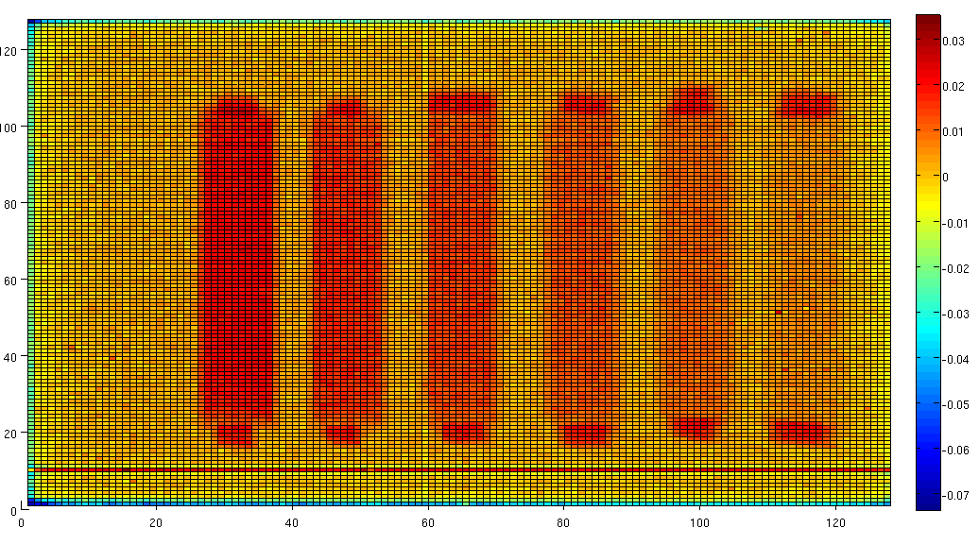
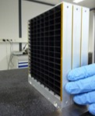
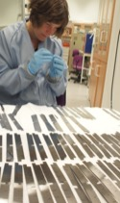
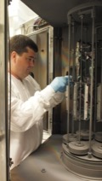
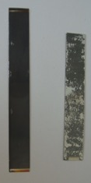
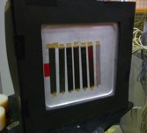
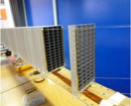
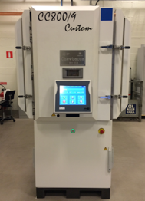
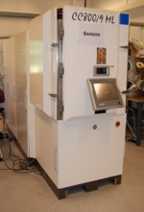
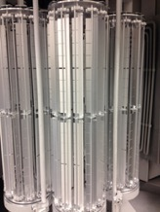
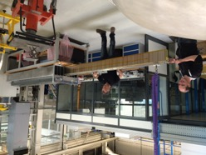
From Samson to Chewbacca
Agrees with
simulations
First prototype
(100 blades)
2011: 2m long
demonstrator
(1200 blades)
¹⁰B₄C
2010: First tests in Samson
Si
1 μm
Process shown to be mature
enough for upscaling
2014: IN5 segment
(27000 blades)
2014:
Chewbacca

Slide 3
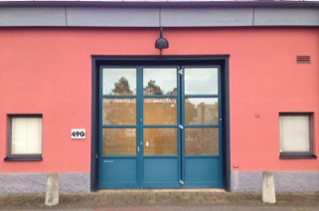

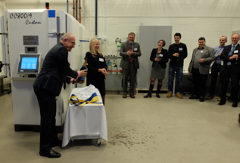
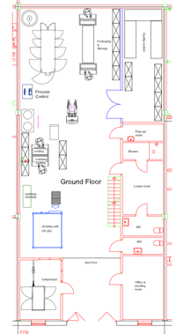
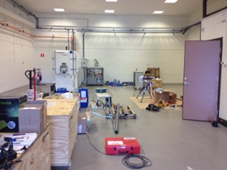

Upscaling 2014-2017
3
”ESS”
LiU
First steps towards full production
➔ good experience ➔ Move 2017

Slide 4
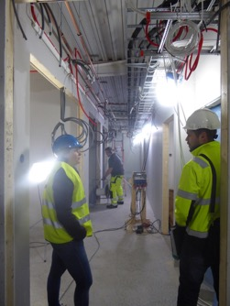
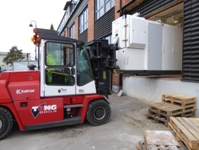
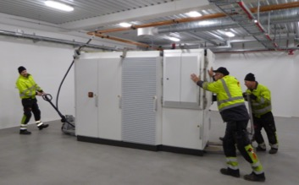
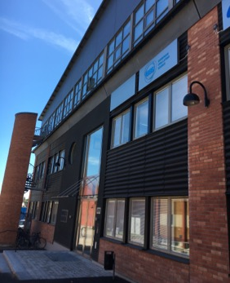
New coating facility
ESS facility near Linköping University
Moved March 2017
Industrial thinking and production
line for ESS needs until 2025

Slide 5
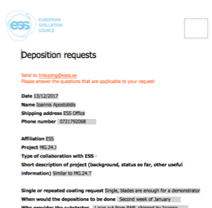
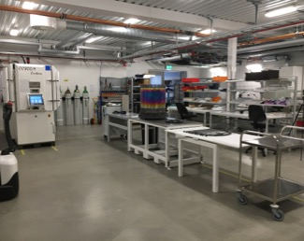
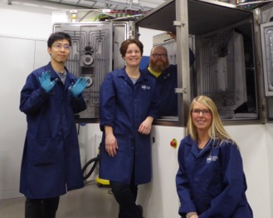
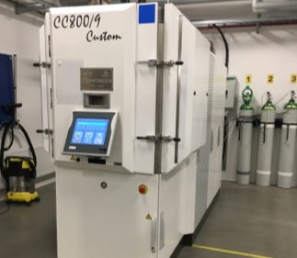
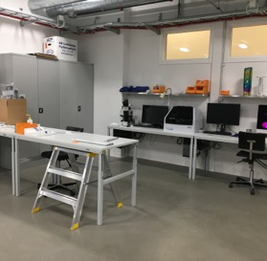
Industrial production

Slide 6
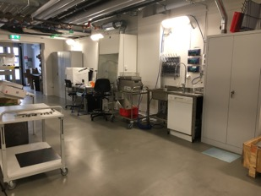
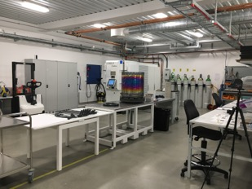
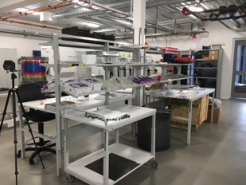
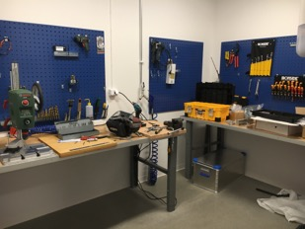
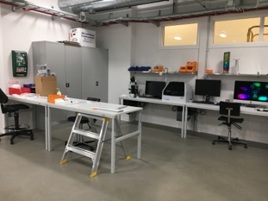
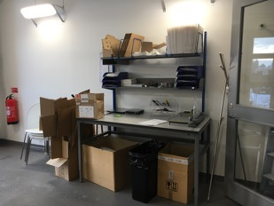
The coating workshop
Cleaning
Mounting
Preparing
Modifying
Quality check
Packing

Slide 7
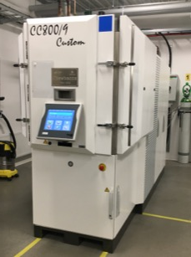
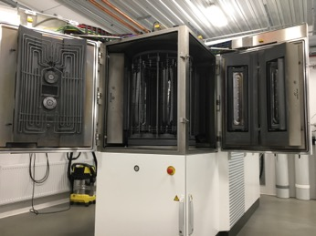
About Chewbacca
Chewbacca:
CemeCon CC800/9 batch loading system
DC magnetron sputtering
Up to four ¹⁰B₄C targets (50 cm height)
1-, 2-, 3-fold rotation
∅ 2-5 cm
∅ 64 cm
∅ 13 cm

Slide 8
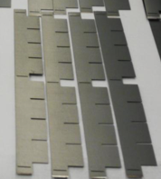
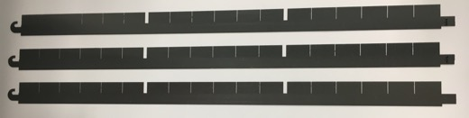
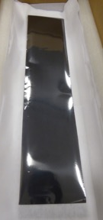
Coating capacity
3-fold rotation (2 depositions per day):
Multigrid: 480 blades/batch ➔ 960 blades/day
(IN5) ➔ 3.9 m² coating/day
~38 cm height ➔ Uniformity ± 10%
CSPEC: 330 blades/batch ➔ 660 blades/day
➔ 5 m² coating/day
~46 cm height ➔ Uniformity ± 15-20%
➔ ~3000 m²/year are possible
2-fold rotation (3 depositions per day):
10 x 45 cm²: 10 samples/batch ➔ 30 samples/day
➔ 2.7 m² coating/day
~45 cm height ➔ Uniformity ± 15%

Slide 9
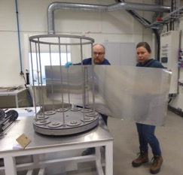
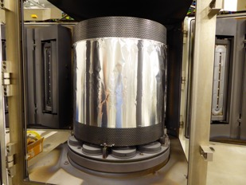
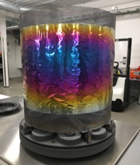
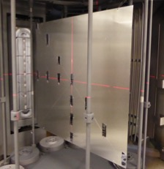
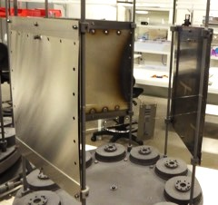
Large area substrates
(in a batch loading system)
Wrapping ➔ 1-side coated ➔ ~50 x 200 cm²
Flat plates ➔ 2-side coated ➔ ~60 x 60 cm²
1-side coated ➔ ~35 x 35 cm² x 3
Thickness heat map

Slide 10























Collaborators since 2014

Slide 11
☺
¹⁰B₄C coating (detector) requirements:
High quality ¹⁰B₄C coatings
and
Industrial scale production
and
Cheaper than pre-2009 ³He price
and
Neutron detection efficiency as good as ³He
Notes:
Thin film requirement

Slide 12
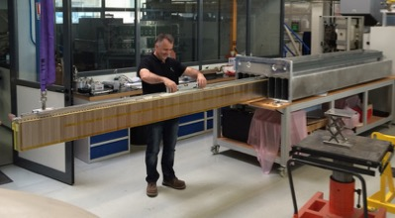

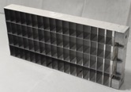
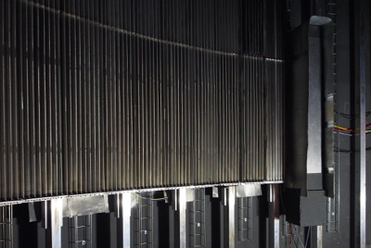
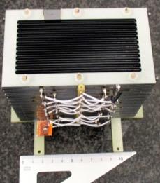
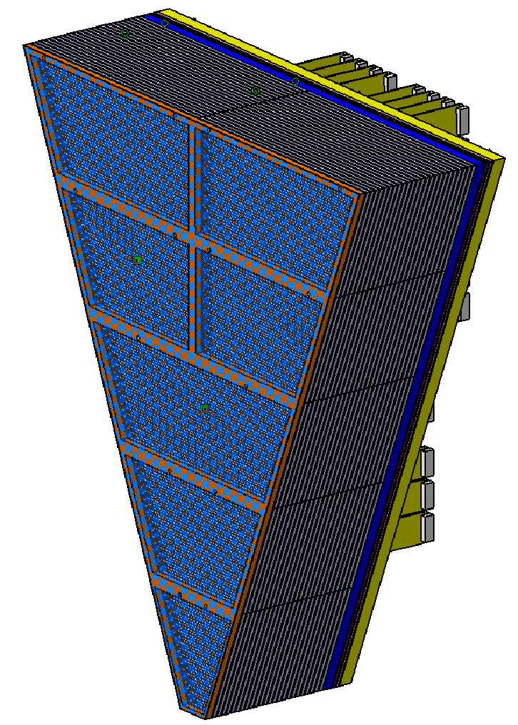
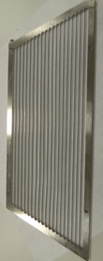
Prototype examples
MultiGrid
MultiBlade
BandGEM
He-tubes
MG

Slide 13
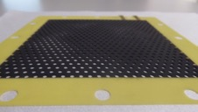
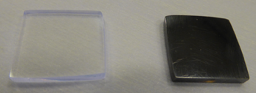
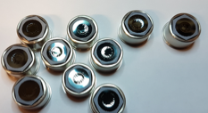
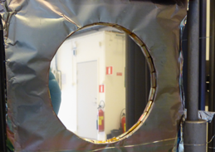


Collaborators challenge us!
13
Coating on temperature sensitive substrates
No substrate bending when 1-side coated
Coat inside frames without bending
Cleaning of substrates to be coated

Slide 14








Sometimes we fail…
14
Expanding
Bending
Wrinkling
Melting
Dirtiness
Overheating
Flaking
Flaking

Slide 15















Our thin film toolbox
Advanced
diagnostics
techniques
Materials theory
Various
deposition techniques
Scalable
industrial
production
processes

Slide 16


What we can provide
High quality ¹⁰B₄C coatings for neutron detector applications
  Minimized residual stress
  Radiation hard
Substrates like Al, SS, Si, Al₂O₃, Ni, Cu, glass, etc
  ~80 at.% ¹⁰B
  Substrates like FR4, G10, Kapton, Teflon, sandwich structures, etc
  Low temperature ¹⁰B₄C deposition
Flat substrates even though 1-side coated
  Coatings inside frames with ~80 at.% ¹⁰B
¹⁰B₄C depositions with tailored resistivity

Slide 17

Thank you
for your
attention!
carina.hoglund@esss.se

Slide 18
High quality ¹⁰B₄C coatings with
DC magnetron sputtering
Required property | Result | OK?
Good adhesion | > 1 μm on Al, Si, Al₂O₃, etc | ☺
Low residual stress | 0.09 GPa at 1 μm ¹⁰B₄C on Si | ☺
High density | 2.45 g/cm³, 97% of bulk | ☺
High ¹⁰B content | 79.3 at.% of ¹⁰B | ☺
Amount of impurities
¹⁰B₄C
1 μm
Si
Patent SE 535 805 C2
EU patent applications ongoing
C. Höglund et al., J. Appl. Phys. 111, 104908 (2012)
Notes:
Coatings materials properties

Slide 19


Neutron radiation hardness
(collaboration LiU-ESS-FRM II)
As-deposited
10¹⁴ n/cm²
As-deposited
10¹⁴ neutrons/cm²
➔ No influence on adhesion, composition, morphology, structure, etc
0.000156 % of the ¹⁰B atoms were consumed
Lifetime of ¹⁰B atoms with 10⁸ n/cm²/s is >20 000 years ☺
C. Höglund et al., Rad. Phys. Chem. 113, 14 (2015)
Notes:
Radiation hardness

Slide 20
DCMS vs. HiPIMS
For low temperature?
20
HT: High pressure, higher residual stress ➔ Applied HT process optimal
LT: High pressure, lower residual stress ➔ Good adhesion at LT
Schmidt, Höglund et al., J. Mater. Sci 51, 10418 (2016)

