Slide 1
Straw tubes for LoKI
Davide Raspino
IKON14
12-02-2018

Slide 2
Outline
Multiplexing readout
Method
Performance
Position corrections
Electronics
New preamps
Mechanics
Single unit
On the instrument

Slide 3
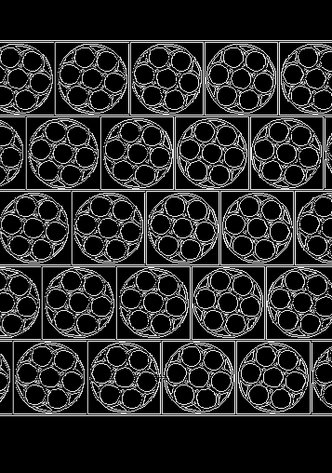
Multiplexing
n
1 m² detector with straw tubes
5 layers
1400x2 preamp + ADC Chs
1 m² with 8 mm ⊘ ³He
120x2 preamp + ADC Chs

Slide 4
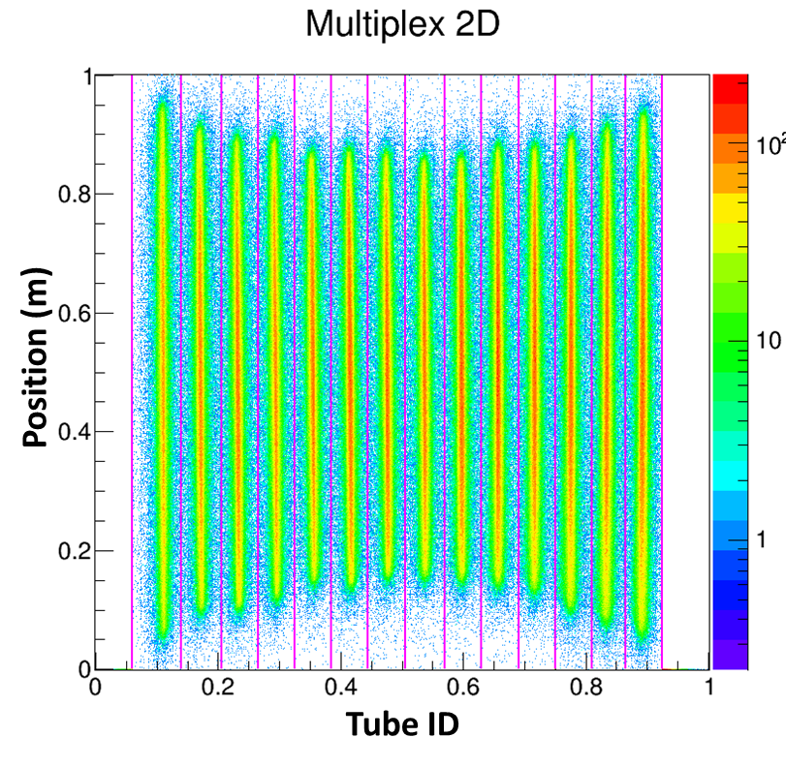
Multiplexing

Slide 5
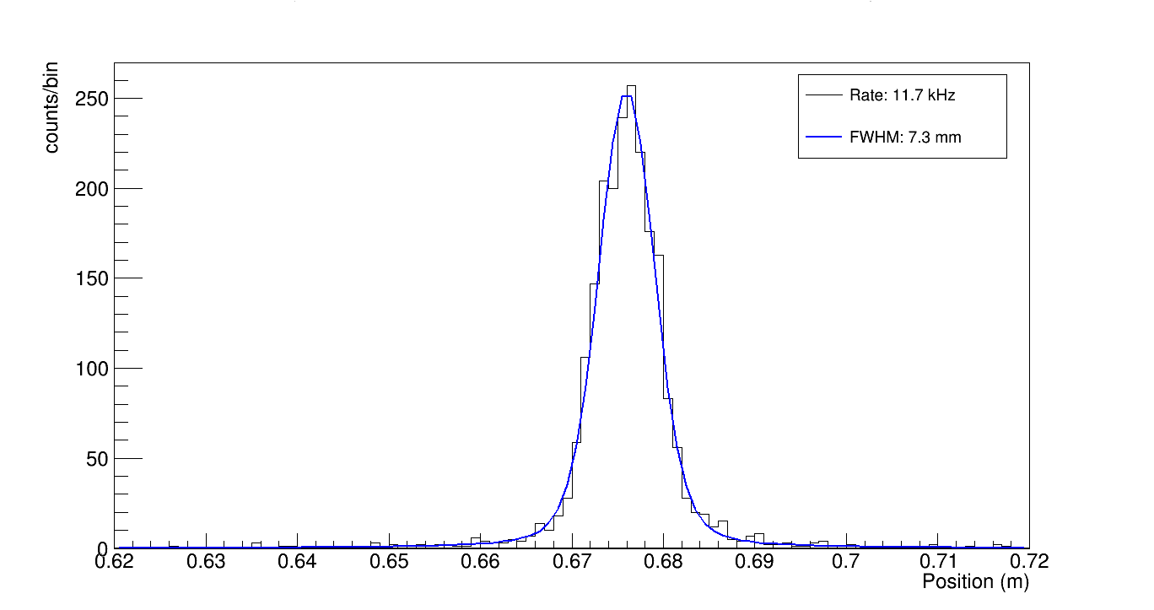
Position Resolution
Cd
Cd
BCS | Pos. Res. FWHM (mm) | Rate/BCS (kHz)
1 | 7.1 | 10.0
2 | 7.3 | 10.9
3 | 7.8 | 11.9
4 | 6.7 | 12.2
5 | 7.2 | 11.4
6 | 7.6 | 12.2
7 | 7.3 | 11.7

Slide 6
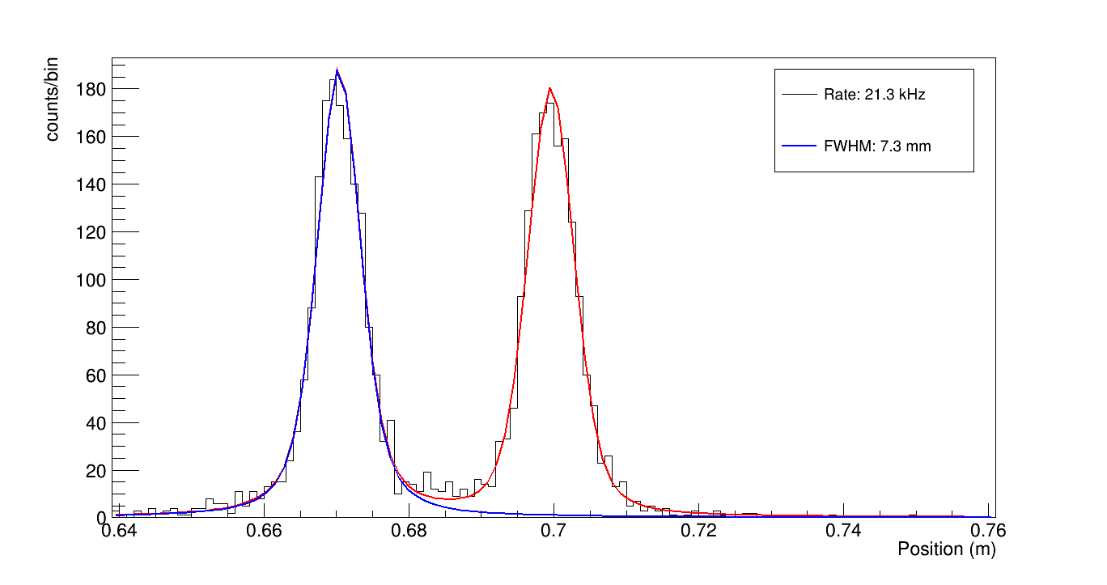
Position Resolution
Cd
Cd
Cd

Slide 7
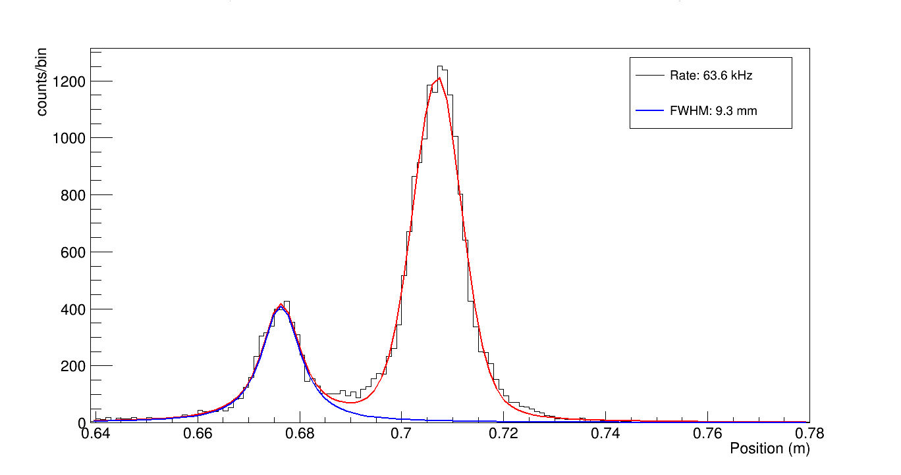
Position Resolution
Cd
Cd
Cd

Slide 8
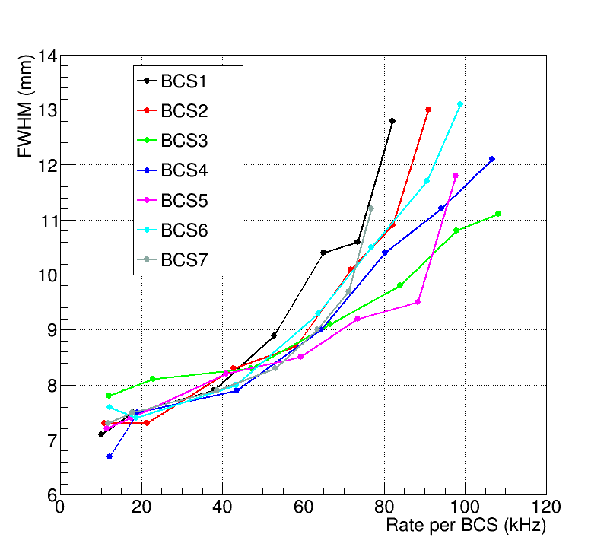
Position Resolution vs Neutron rate
HT = 1000 V
HT = 1000 V

Slide 9
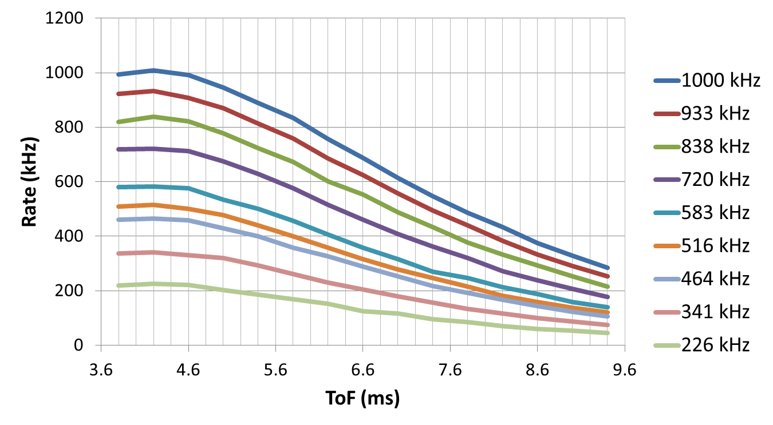
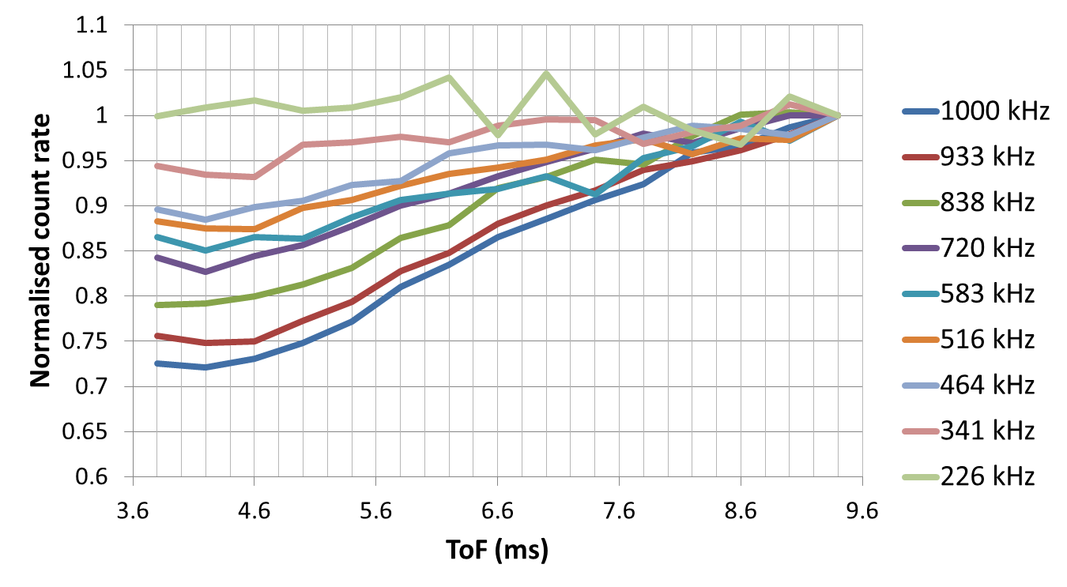
Count Rate
Cd
Cd

Slide 10
Count Rate Loss
~5% loss
every 200 kHz/1” tube
Detected Rate

Slide 11
Position Corrections
Cd
Cd
Cd
Cd
Cd
Cd

Slide 12
Position Corrections
Cd
Cd
Cd
Cd
Cd
Cd

Slide 13
Position Corrections

Slide 14
Position Corrections
(mm)
Corrections vs Measured position
Corrected image
(mm)

Slide 15
Performance
Multiplexing 7x straw tubes reduce the number of Preamps/cables and ADCs by a factor 3.5
Position resolution of 8 mm FWHM up 300 kHz/1” tube and of 10 mm FWHM up to 500 MHz/1” tube (at 1000 V)
Count rate loss ~10% at 400 kHz/1” tube (detected rate)
Position correction very similar to the one needed for ³He tubes, few percent of the length of the tubes
All the shown position calculation used the position correction described

Slide 16
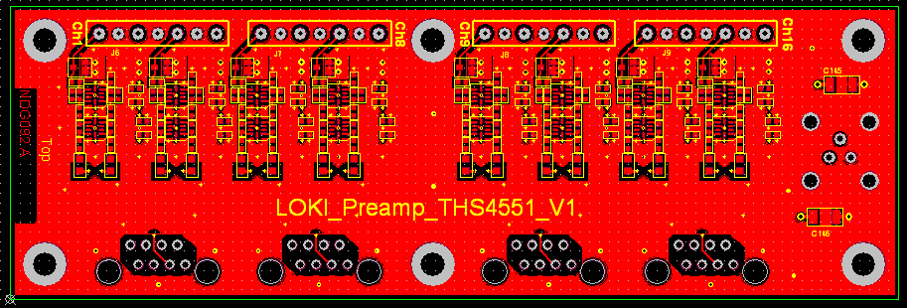
Front End Electronics
16 chs preamp board
PCB size 115x38 mm²
Fully differential
Output connector → Ethernet
Noise lower than the ones use for the test shown here
Lower gain to allow to work at higher HT
Higher input impedance→ Position correction
Power dissipation: 220 mW – 14 mW/ch
Erik Schooneveld

Slide 17
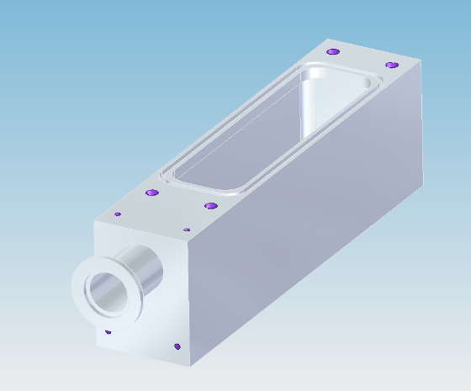
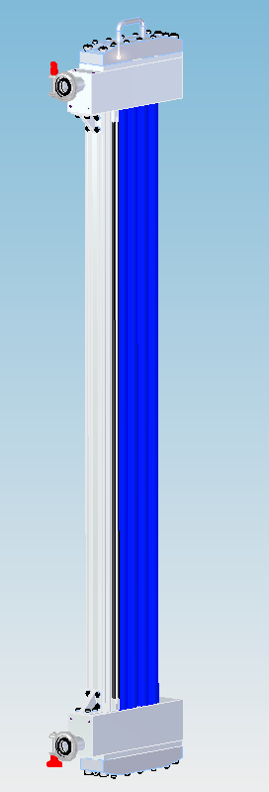
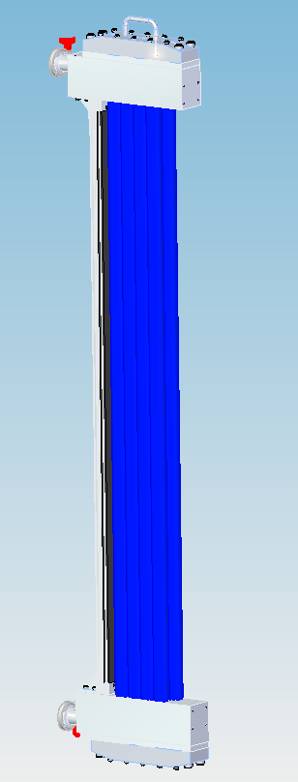
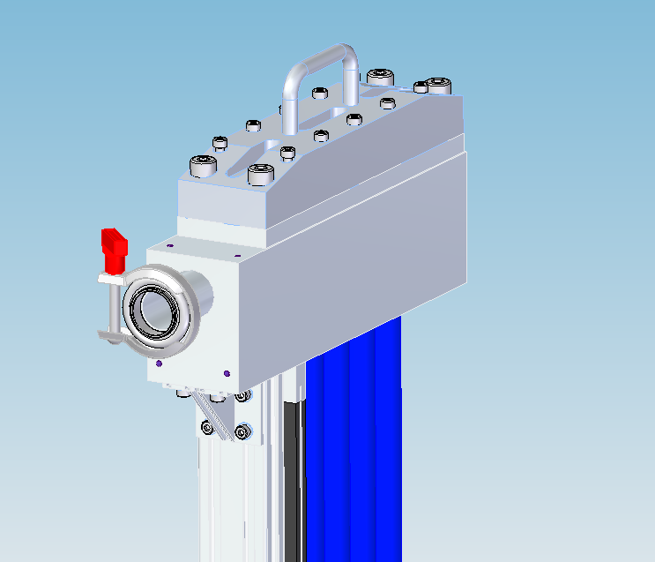
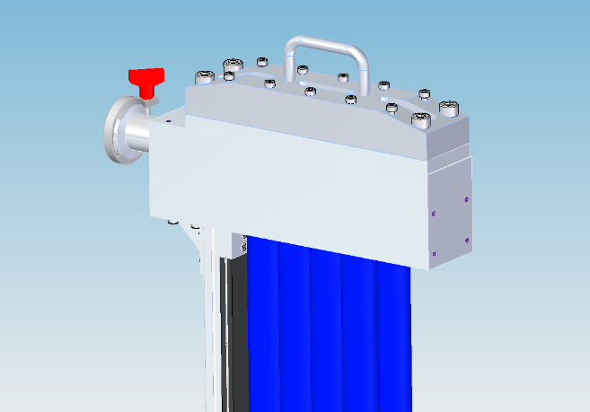
Mechanics
Anton Orszulik

Slide 18
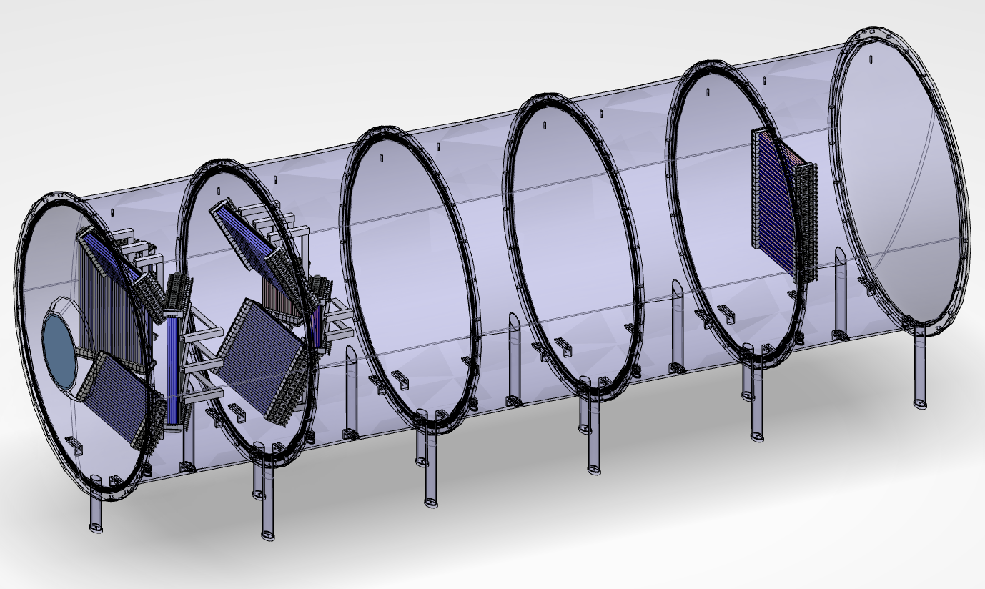
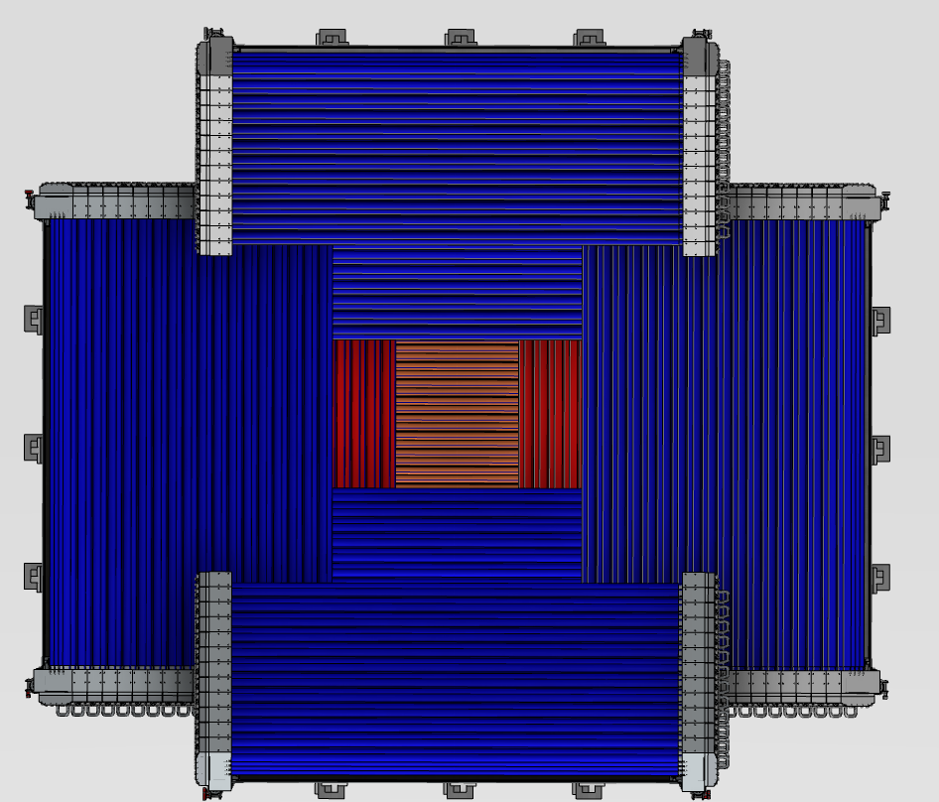
Straw tubes on LoKI
Detector Area (m²) | 9.09
Solid angle (sr) | 1.7
n. Panels | 9
Pack types | 3
Tube lengths (m) | 0.53,1,1.4
Federico Masi

