Slide 1




Beam Monitors
Fatima Issa, Steven Alcock , Richard Hall-Wilton, Anton Khaplanov, Scott Kolya, Vendula Maulerova ,
Thanks for the detector group at ISIS and SNS
Thanks to the instruments team for their inputs
Thanks to the manufacturers for their openness
www.europeanspallationsource.se
18-02-11

Slide 2
Outline
Why Beam monitors?
Beam monitors market survey
Mechanical integration (BM on chopper)
Parasitic methods for monitoring the beam
Beam monitors at V20 at HZB
Beam monitor requirements per zone
Guidelines for Beam monitors at ESS
Summary
Notes:
This talk will be an update to what has been presented during last IKON focusing on waht are main challenges per zone with their relative (potential) solutions
this slide follows on from what was presented at the last IKON. It is an update.

Slide 3
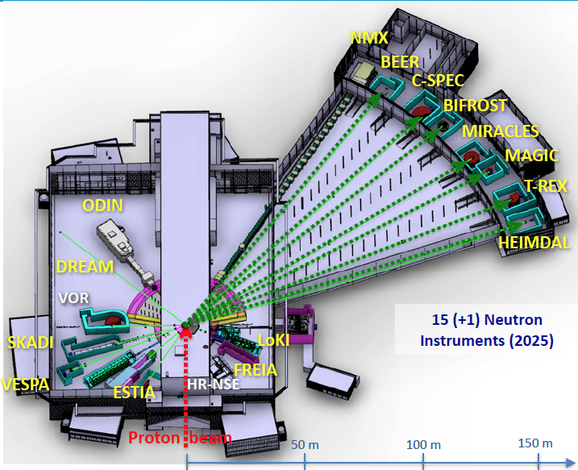
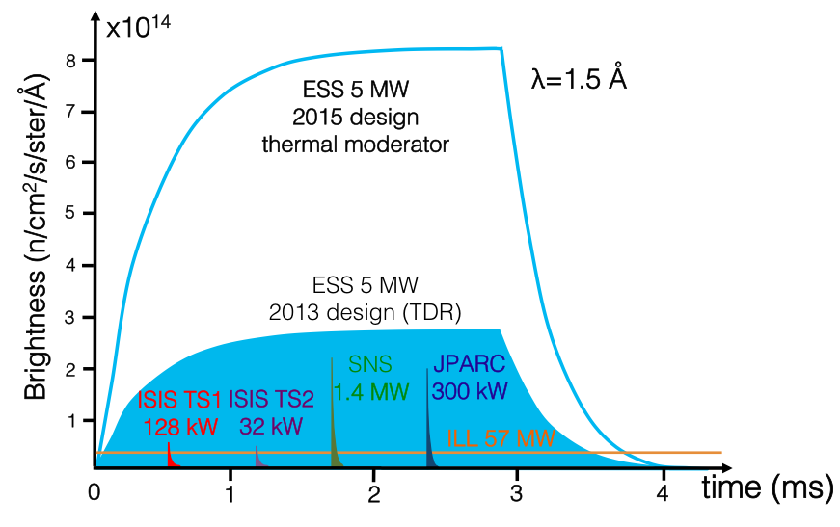
ESS instruments
long-pulse and high neutron flux at ESS
Many advancements in the instrument performance
longer neutron guides, complex neutron optics and complex chopper systems

Slide 4
Beam Monitor
Sample
source
neutron guide
chopper

Slide 5
Beam Monitor
Sample
Sample
source
source
neutron guide
chopper
Beam monitor

Slide 6
Beam Monitor
Sample
source
neutron guide
chopper
Window 1
Window 2
Beam monitor
Incident beam
Transmitted beam
scattered
Beam monitor
Beam monitor with low attenuation and high transmission factor

Slide 7
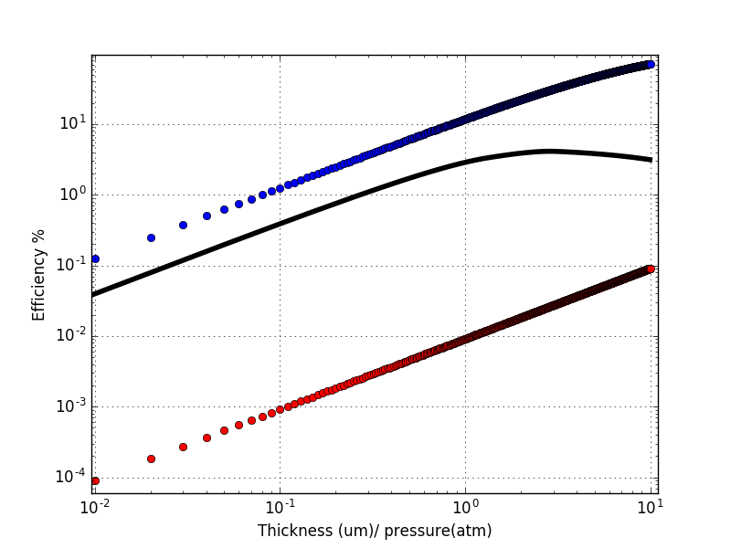
Beam Monitor
Nuclear reactions used for thermal neutron detection
Beam monitors are thermal neutron detectors with relatively low efficiency which can vary from
10⁻⁶ to 10⁻¹ depending on the instrument requirements
¹⁰B
³He
¹⁴N
Thickness 1cm at 1.8A
¹⁰B is in um in transmission mode, ¹⁴N and ³He is bar-cm thickness
Notes:
Lookup table to know what is needed for a certain efficiency

Slide 8
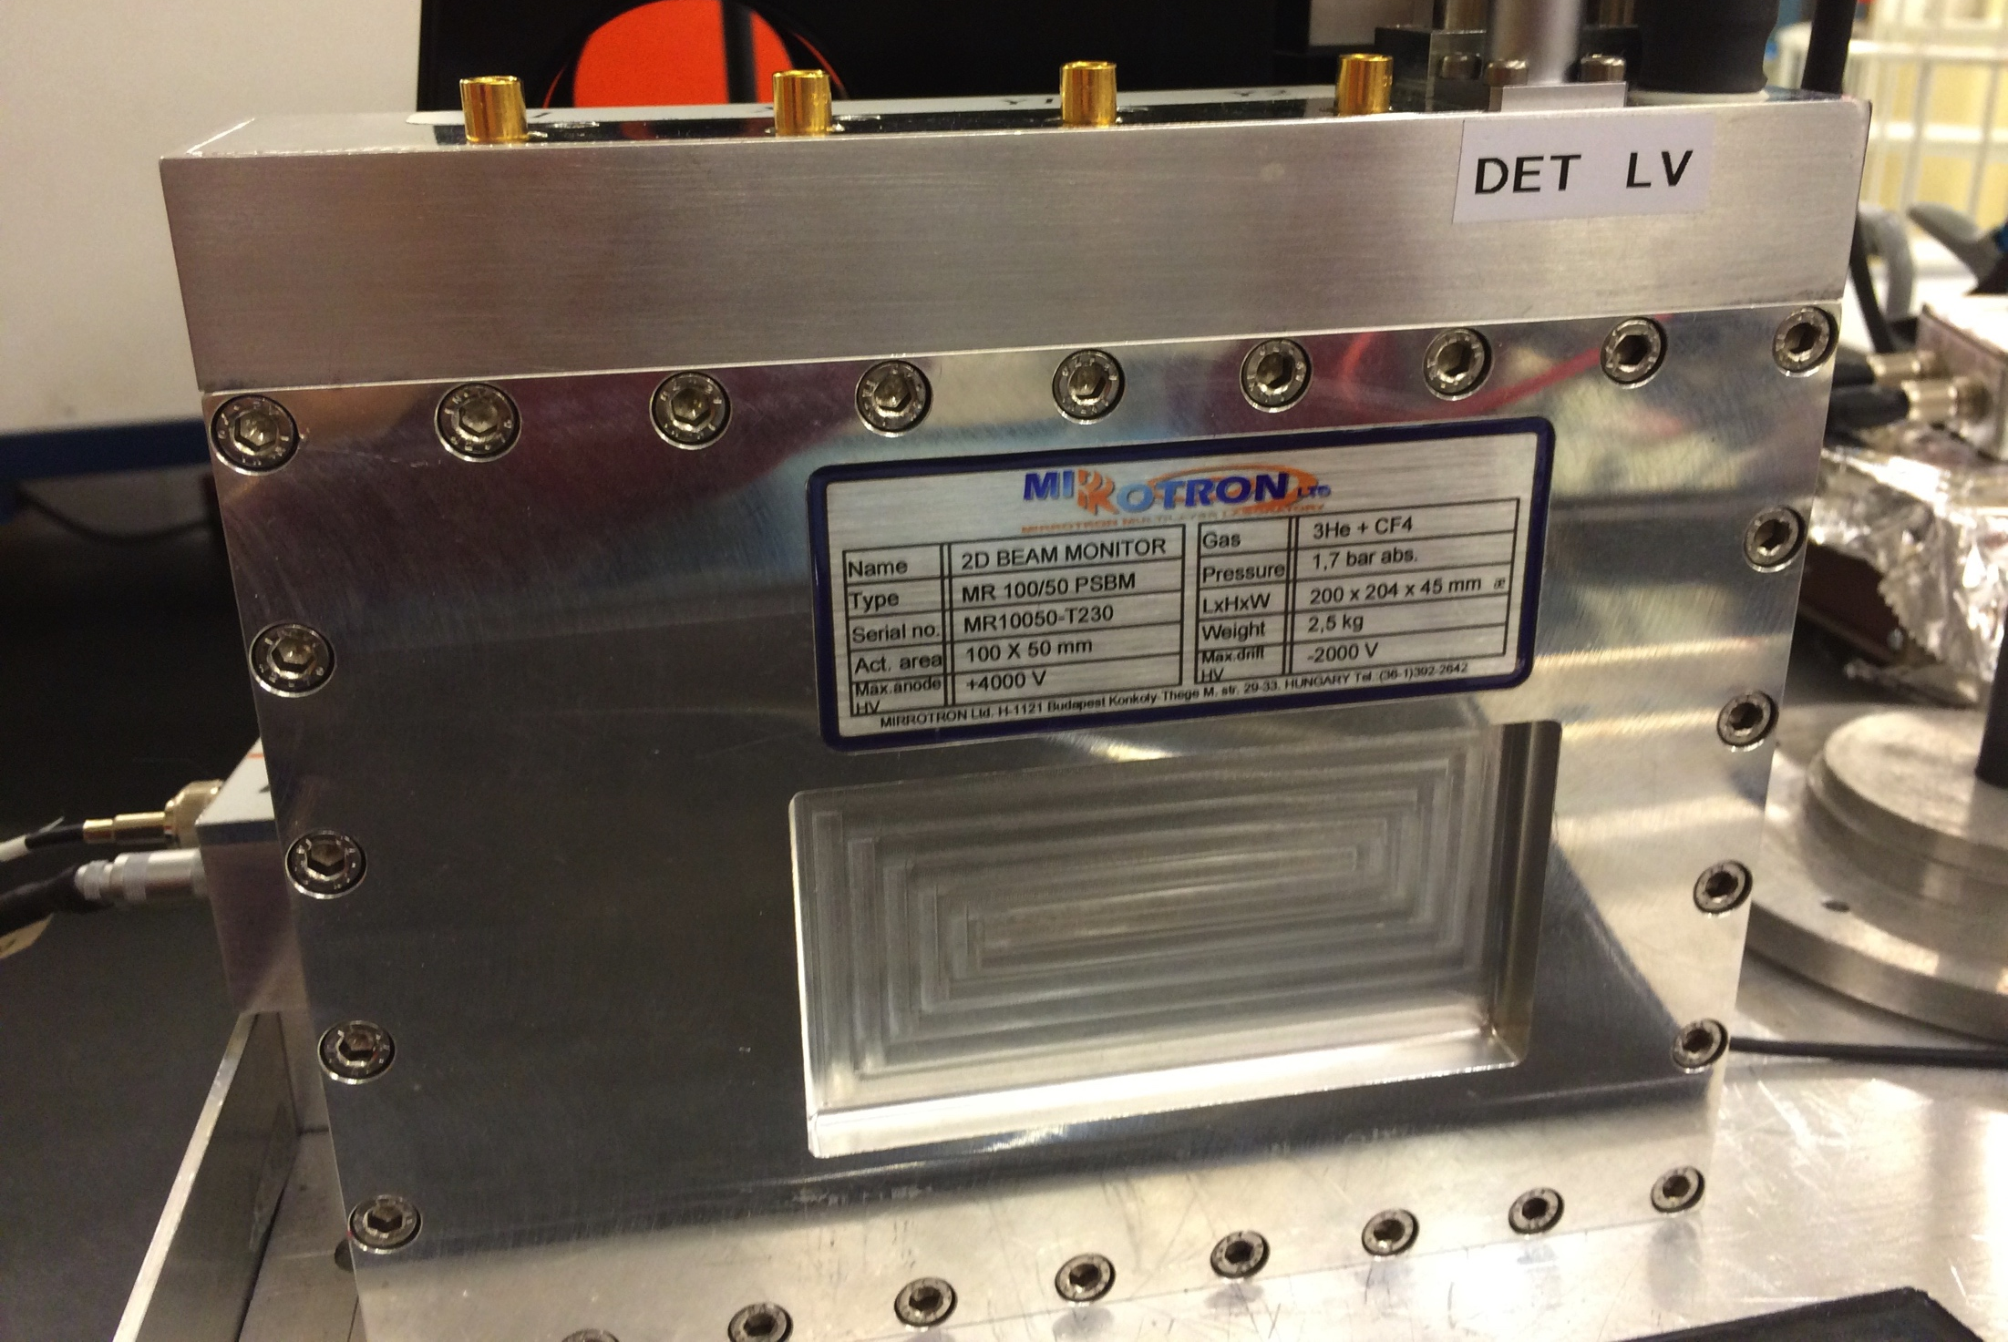
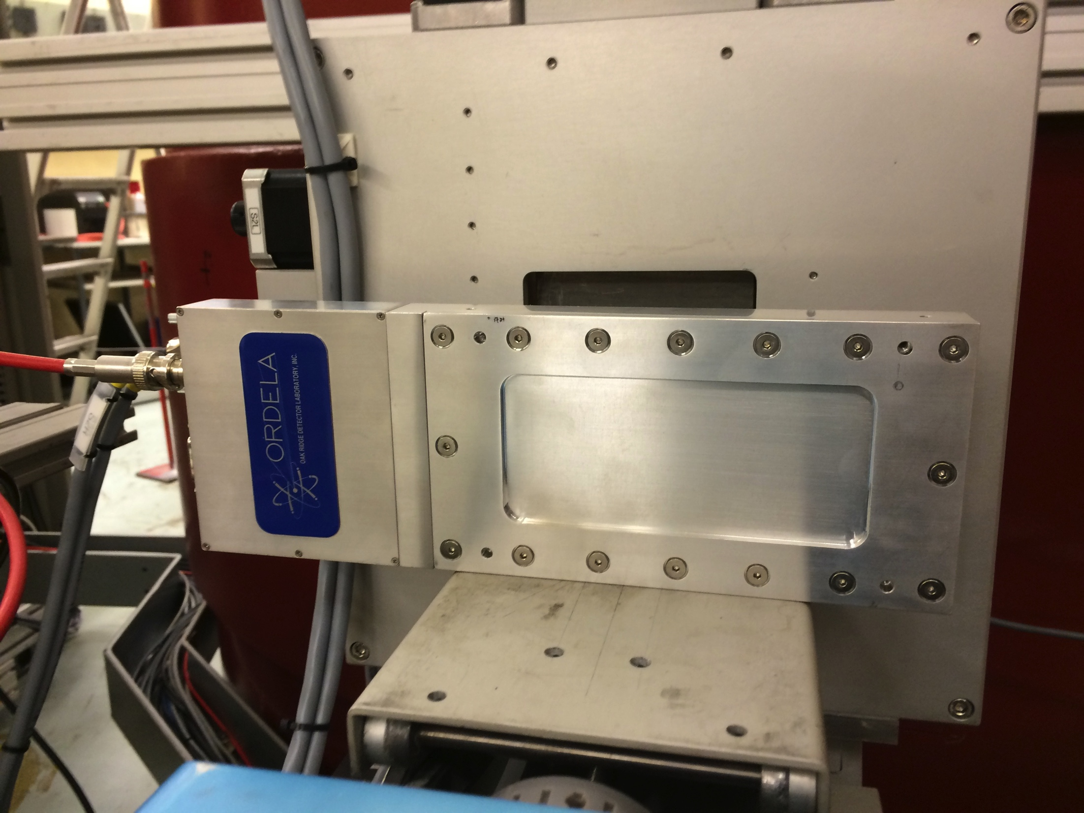

Types of Beam Monitor available today
MWPC from Mirrotron MWPC from Mirrotron Fission chamber from LND
MWPC from ORDELA GEM from CDT Scintillator from Quantum detector
https://indico.esss.lu.se/event/870/ https://indico.esss.lu.se/event/781/
Notes:
What we have done so far we tested several types of BM from different vendor and we evaluted them. MWPC from …

Slide 9
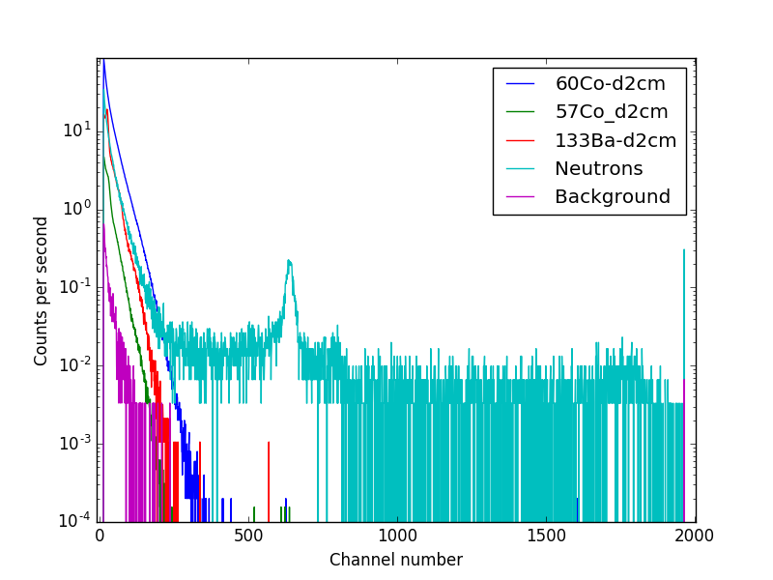
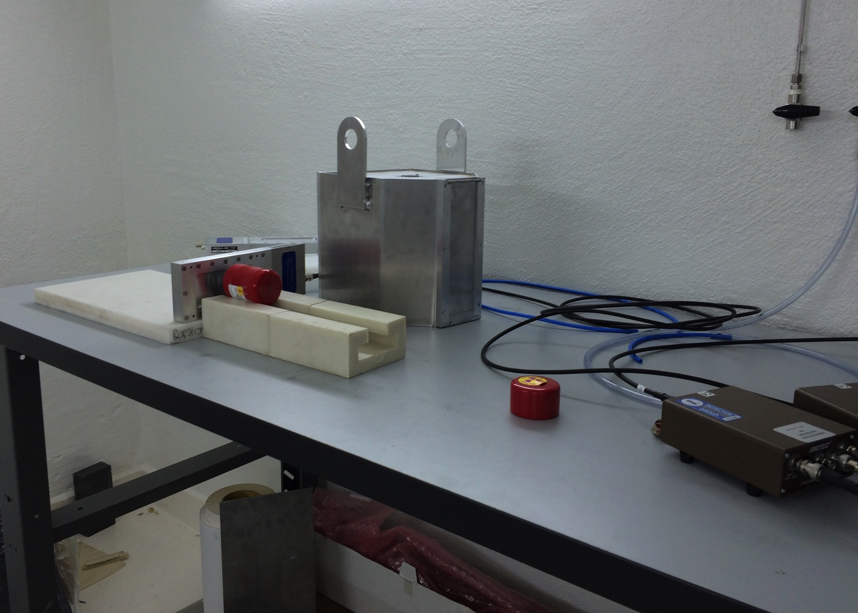
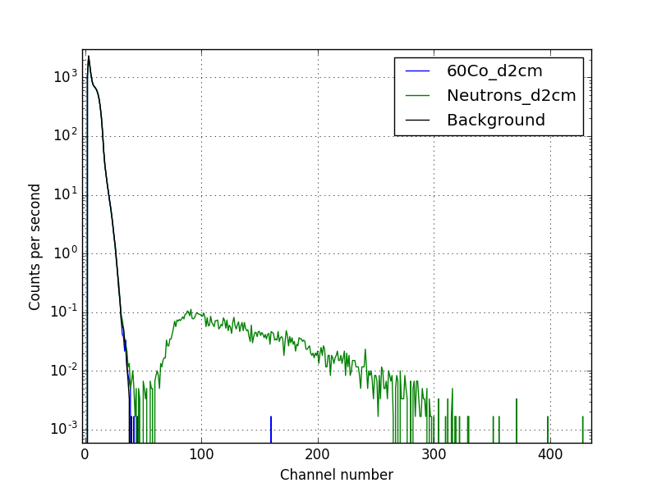
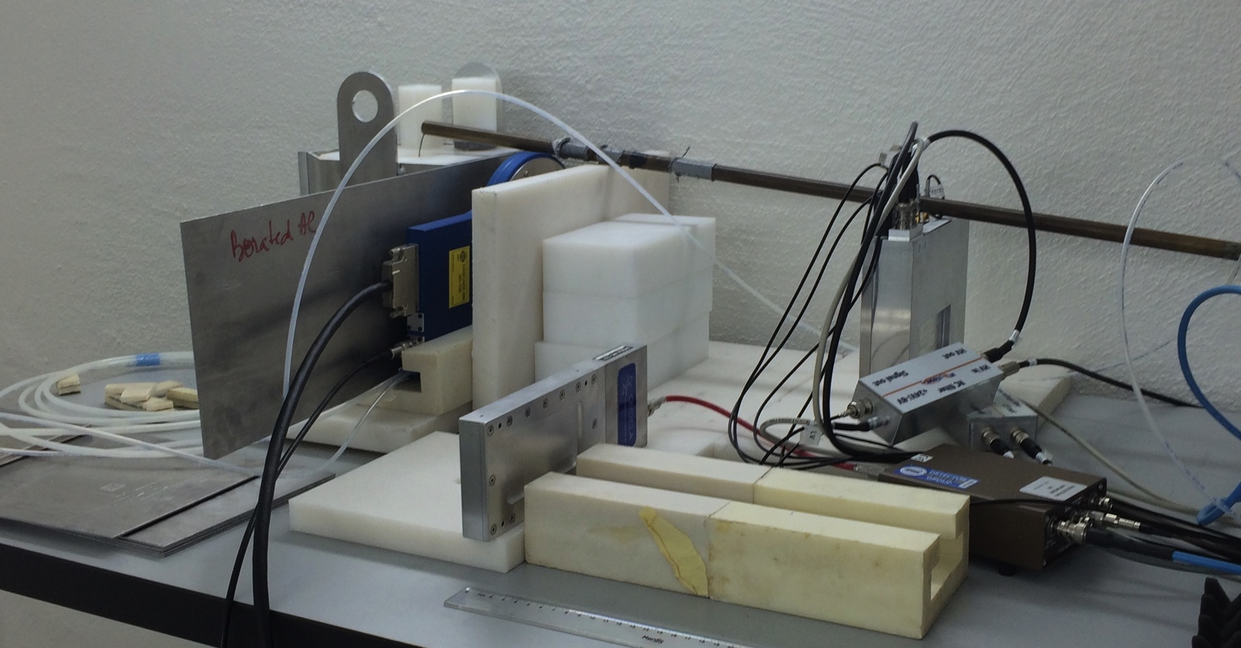
Beam Monitors-Gamma sensitivity measurement
MWPC from Mirrotron
Gamma source
source | Gamma energy KeV | Gamma intensity %
⁵⁷Co | 122 | 85.6
 | 136 | 10.7
¹³³Ba | 30-35 | 117
 | 80 | 36
 | 276 | 7
 | 303 | 18
 | 356 | 62
 | 384 | 9
⁶⁰Co | 1173 | 100
 | 1332 | 100
Beam monitor
neutron source
Fission chamber from LND
Beam monitor
Gamma sensitivity studied with three gamma sources with low, medium, and high energy

Slide 10
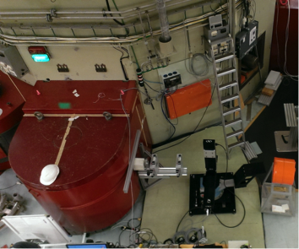
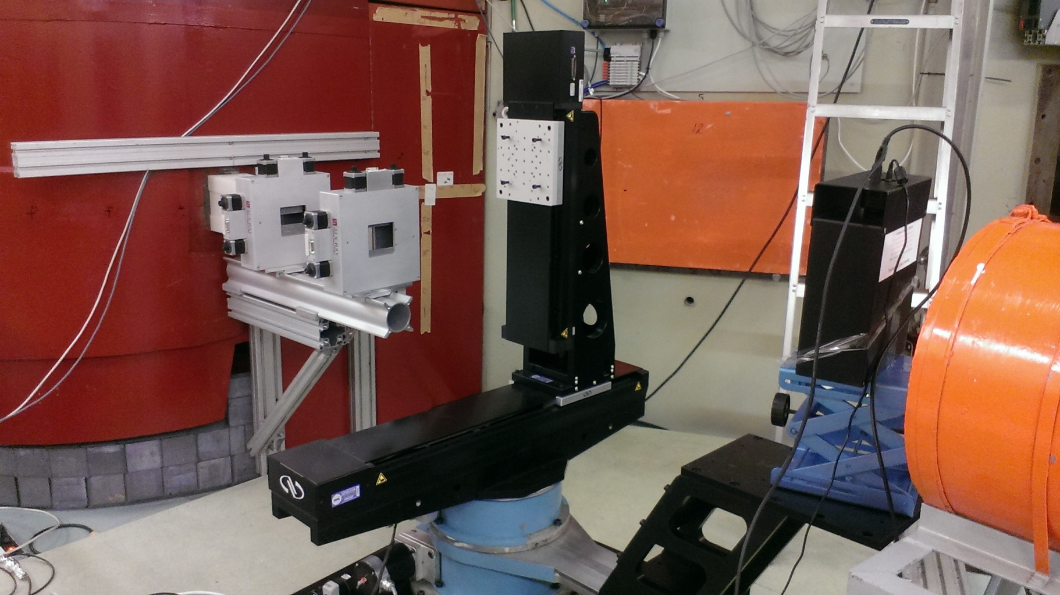
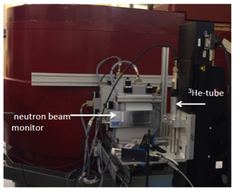
Beam Monitors- Neutron measurement at R2D2
Slit 1
Slit 2
Peak wavelength (Å)
400 2.00
911 0.878
711 1.12
511 1.54
822 0.943
311 2.41
933 0.804

Slide 11
Beam monitors-main results
 | MWPC | MWPC | MWPC BM-100X50 | 2D-MWPC | 2D-GEM | Scintillator | Fission chamber
supplier | ORDELA | ORDELA | Mirrotron | Mirrotron | CDT | Quantum detector | LND
Isotope used for neutron capture | ³He | ¹⁴N | ³He | ³He | ¹⁰B | ⁶Li | ²³⁵U
Gas pressure mbar | Partial pressure 6,0795 | Partial pressure 81,06 | Partial pressure 6,5 | Partial pressure 0.4 | Total pressure 100 | ------ | Total pressure 1013,2
Filled gas | ³He+⁴He +CF₄ | N+CF₄ | ³He+CF₄ | ³He+CF₄ | Ar/CO₂ | -------- | P10
Active Area (mm²) | 114 x 51 | 114 x 51 | 100 x 50 | 100 x 50 | Diameter 100 mm | 28 x 42 | Diameter 108.0 mm
Applied voltage (V) | 850 | 850 | 1300 | Anode at -3500V Drift at 1500V | -1000 | 650 | 300
Measured attenuation % at 2.4Å | 4.5 | 4.4 | 2.5 | 7.3 | 10.6 | 0.4 | 3.8
Calculated attenuation % at 2.4Å | 4.05 | 4.05 | 2.05 | 4.5 | 6.9 | 0.1 | 2.4
Measured Efficiency at 2.4Å | 1.2x10⁻³ | 2x10⁻⁵ | 1.1x10⁻³ | 1.5x10⁻⁴ | 3x10⁻² | 5x10⁻³ | 10⁻⁴
Supplier Efficiency at 1.8 Å | 10⁻³ | 10⁻⁵ | 10⁻³ | 1.5x10⁻⁴ | 3x10⁻² | 10⁻⁴ | 10⁻⁴
Scattering (%) | 3.9 ± 0.4 | 3.8±0.4 | 4±0.9 | 9±1 | 10.3±0.7 | 0.74±0.2 | 3.8±0.3
Beam monitor characterization → Customization to match specific requirements

Slide 12
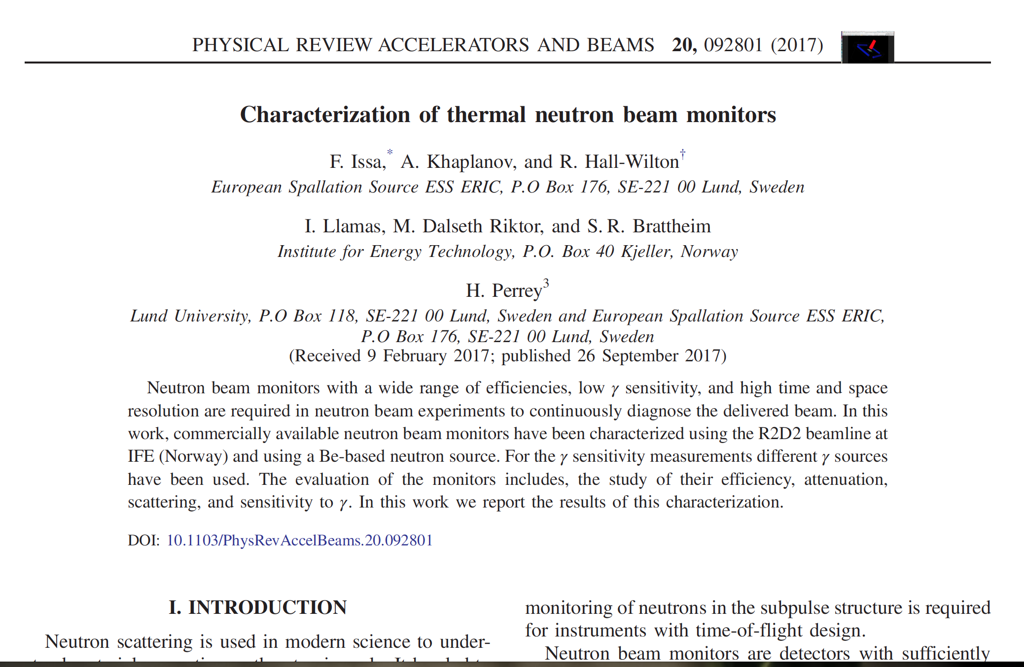
Horizon 2020 grant agreement 676548
https://journals.aps.org/prab/abstract/10.1103/PhysRevAccelBeams.20.092801

Slide 13
Outline
Why Beam monitors?
Beam monitors market survey
Mechanical integration (BM on chopper)
Parasitic methods for monitoring the beam
Beam monitors at V20 at HZB
Beam monitor requirements per zone
Guidelines for Beam monitors at ESS
Summary

Slide 14
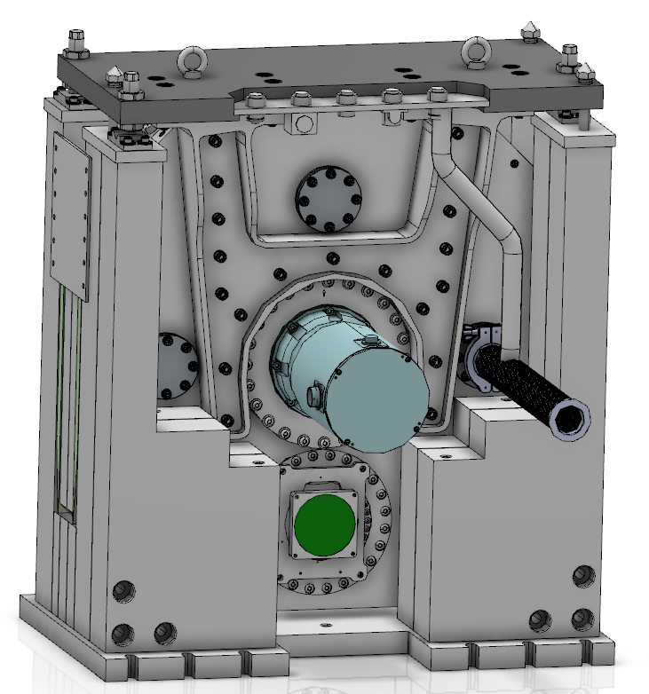
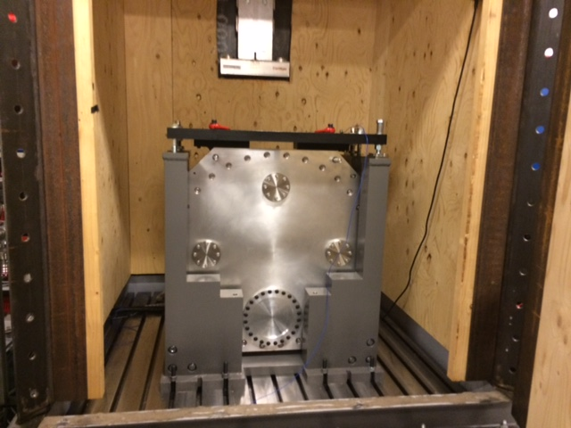
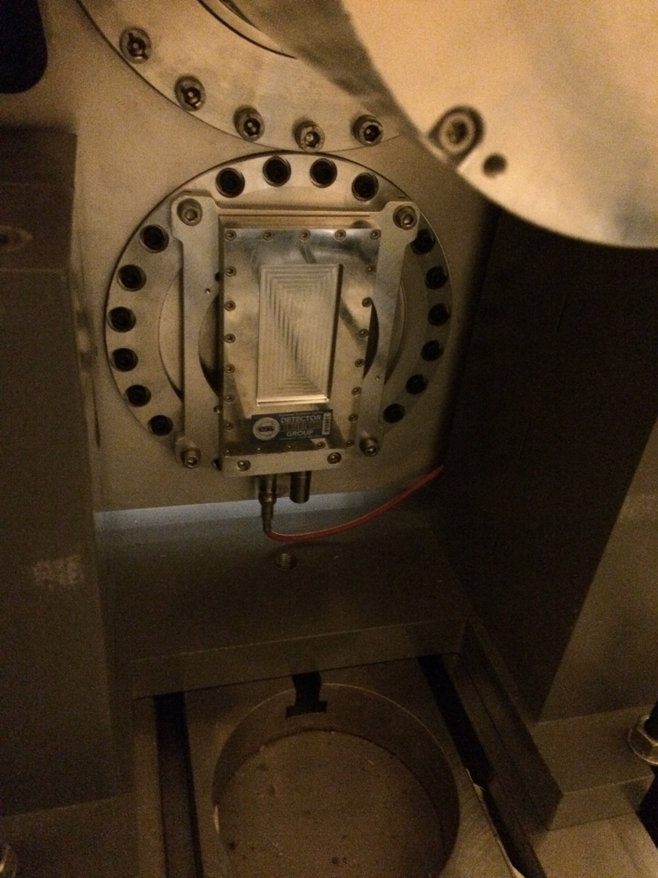
Mechanical integration: Reminder
The chopper can run up to 22 Hz
BM at the backside of the chopper @Embla
** Thanks for Niko and Andrés from Chopper Group

Slide 15
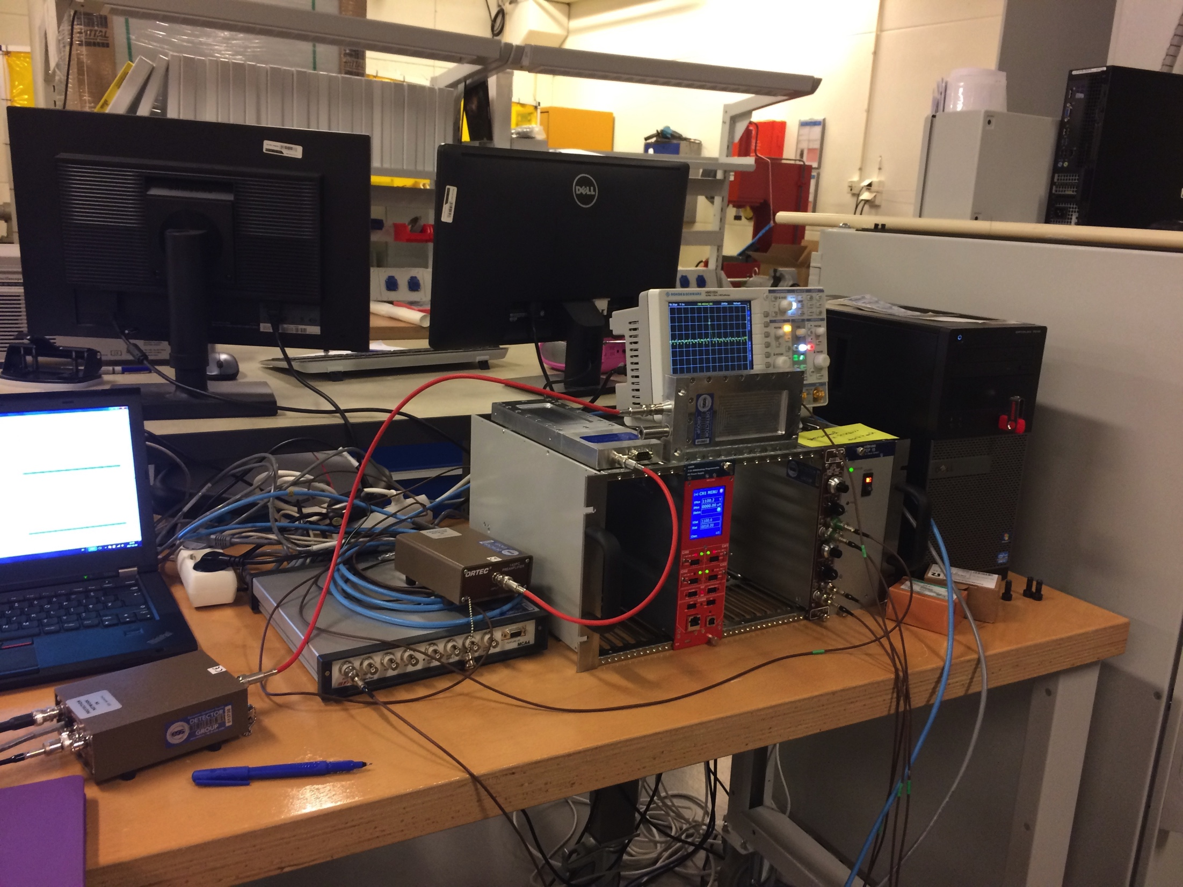
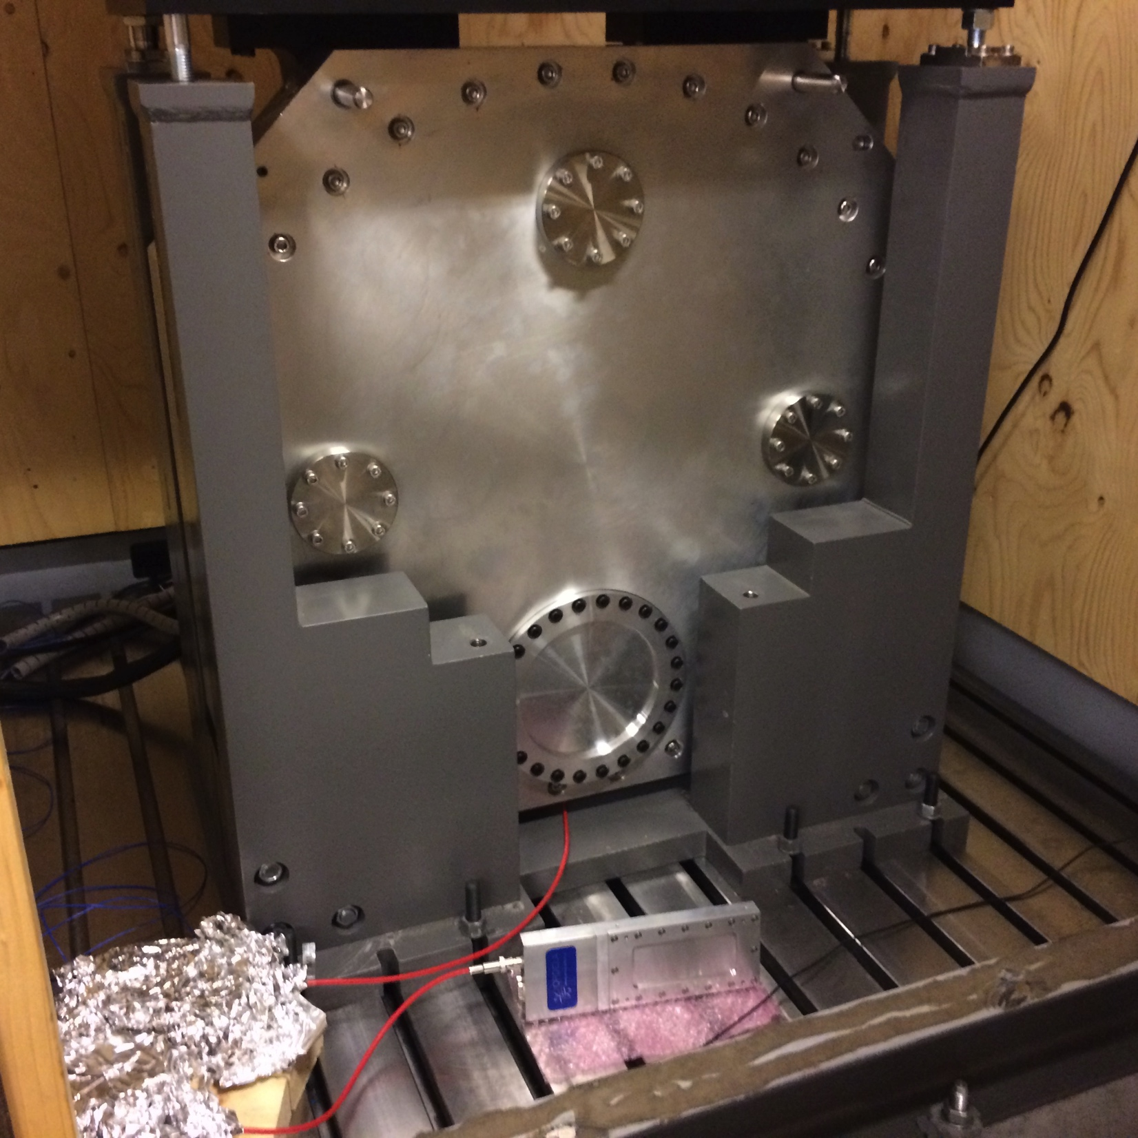
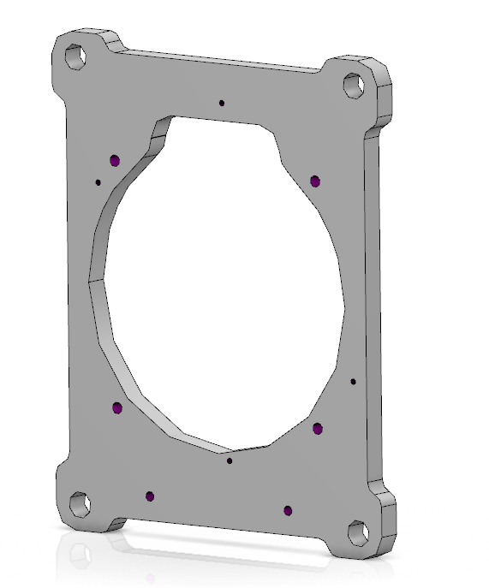
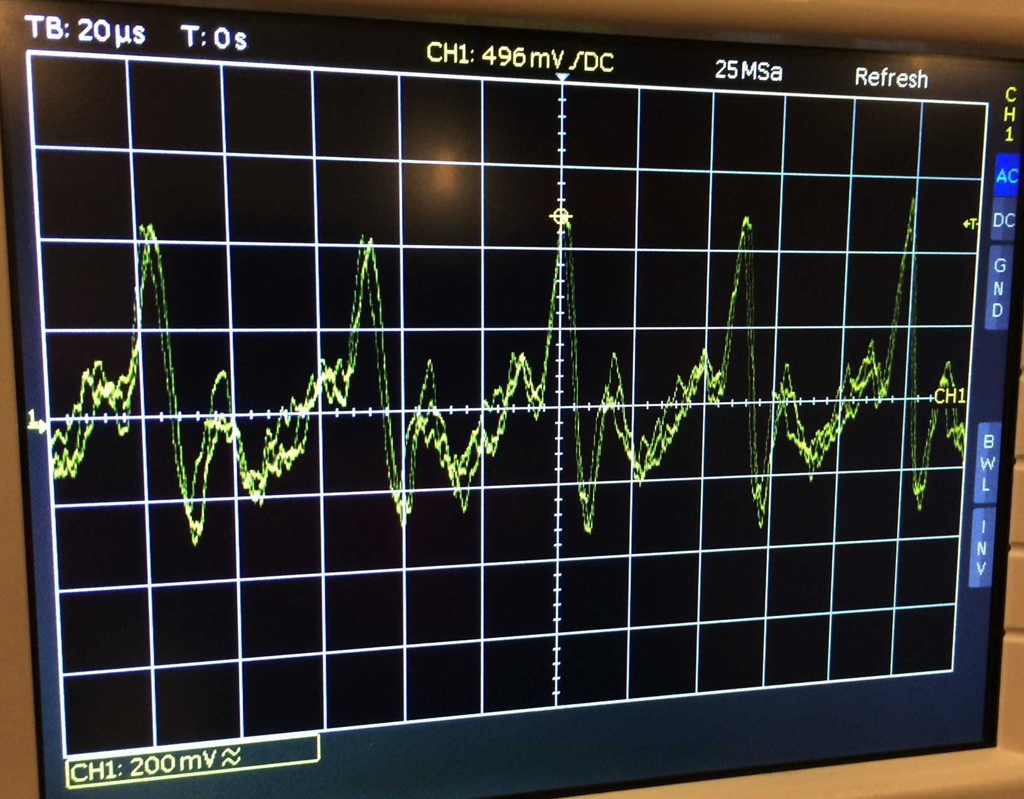
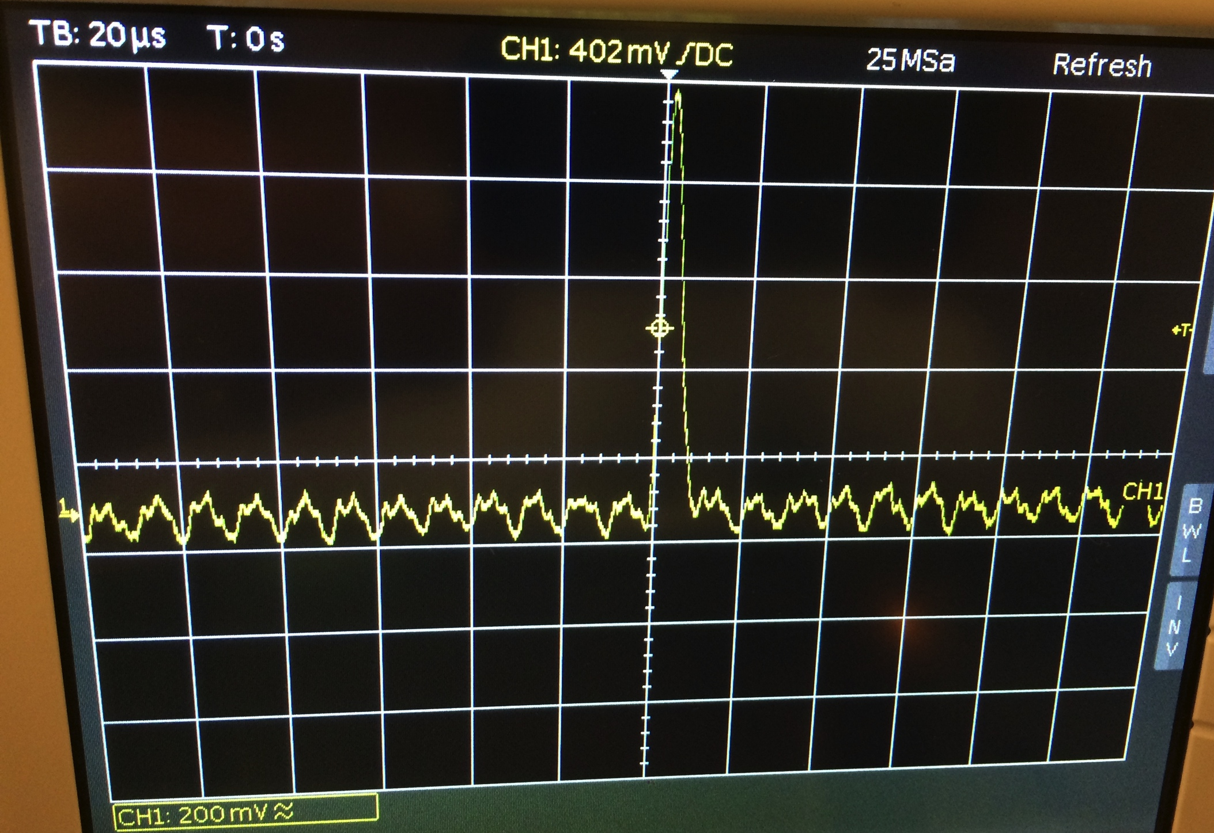
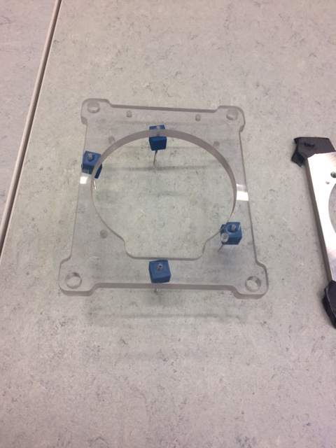
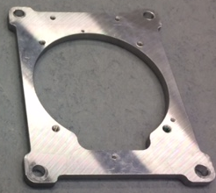

Mechanical integration: Reminder
The BM should be electrically isolated from the chopper.
Grounding is important follow grounding guidelines
ESS-0147271
BM
Preamp
&shaper
MCA
Electrical contact → Significant noise
** Thanks for Niko and Andrés from Chopper Group

Slide 16
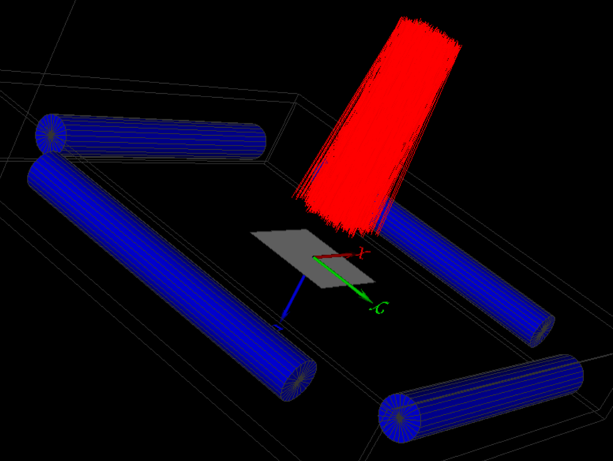
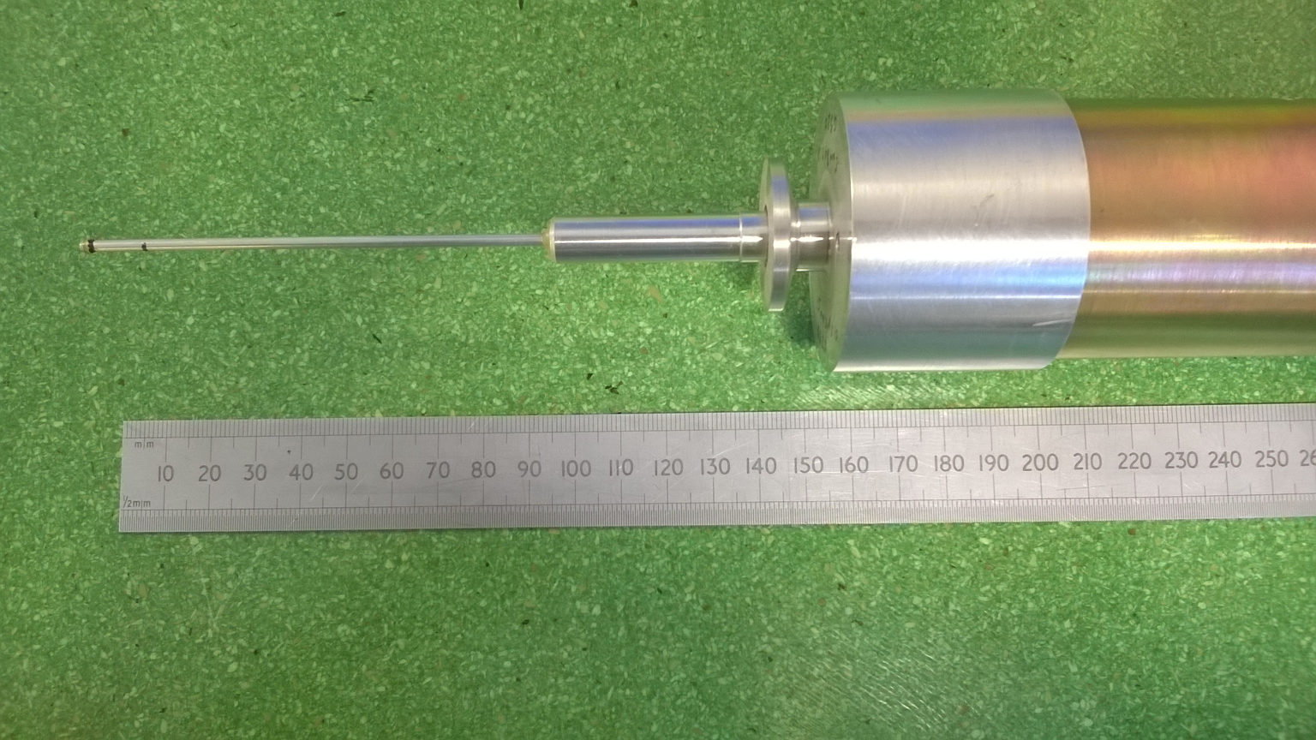
Looking for solutions …..
In the Bunker area
In the Instrument Guideline
Vanadium foil
Fiber monitor used at ISIS
Gamma detector
Ionization chamber form CDT
Gamma detector close to a chopper
Incident beam

Slide 17
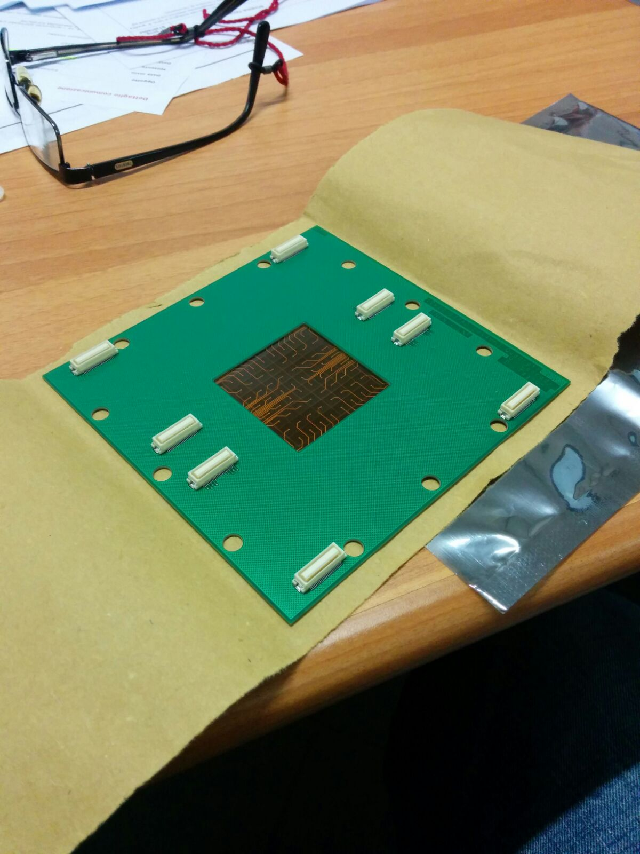
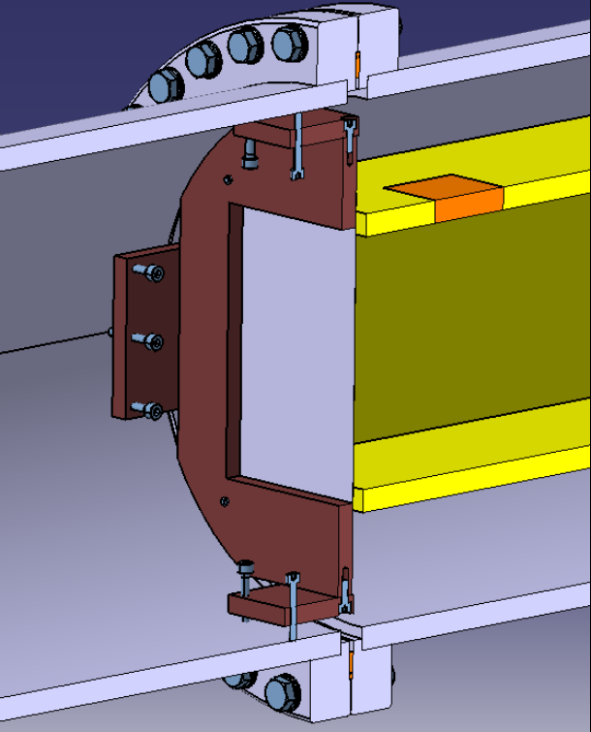
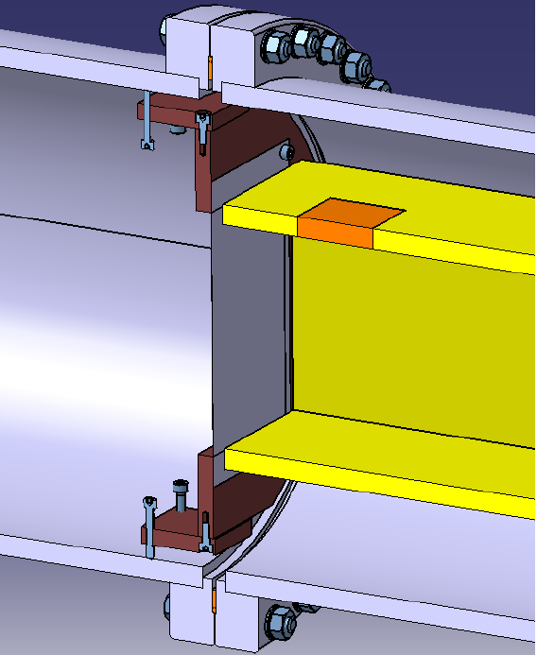
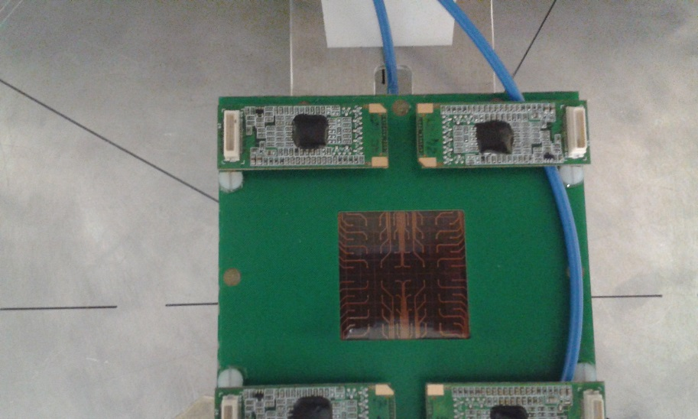
Looking for solutions …..
Silicon detector with LiF in beam prototype on MIRACLES
Low Mass Beam Monitor
Electronics out of the beam

Slide 18
Outline
Why Beam monitors?
Beam monitors market survey
Mechanical integration (BM on chopper)
Parasitic methods for monitoring the beam
Beam monitors at V20 at HZB
Beam monitor requirements per zone
Guidelines for Beam monitors at ESS
Summary

Slide 19
Beam monitor for chopper diagnostics
Fibre beam monitor used at LET at ISIS
Aluminum tube is about 3 mm in diameter.
Small rods of GS glass scintillator, each about 10 mm in length and 0.5 mm in diameter
The fibres are about 0.5mm diameter and are protected by sitting in a thin Aluminium tube just a couple of mm across
to check chopper timing and that they are opening and closing exactly when they should be
Vacuum compatiable
The LET ‘fibre’ monitors are not off-the-shelf-options :
They are very fragile and difficult to make.
2) The cost of precision guide-apertures often outweighs the benefits realised.
3) parts/spares are not off-the-shelf
**Info from Niko and Nigel and Robert Bewley and Daniel Pooley Thanks!

Slide 20
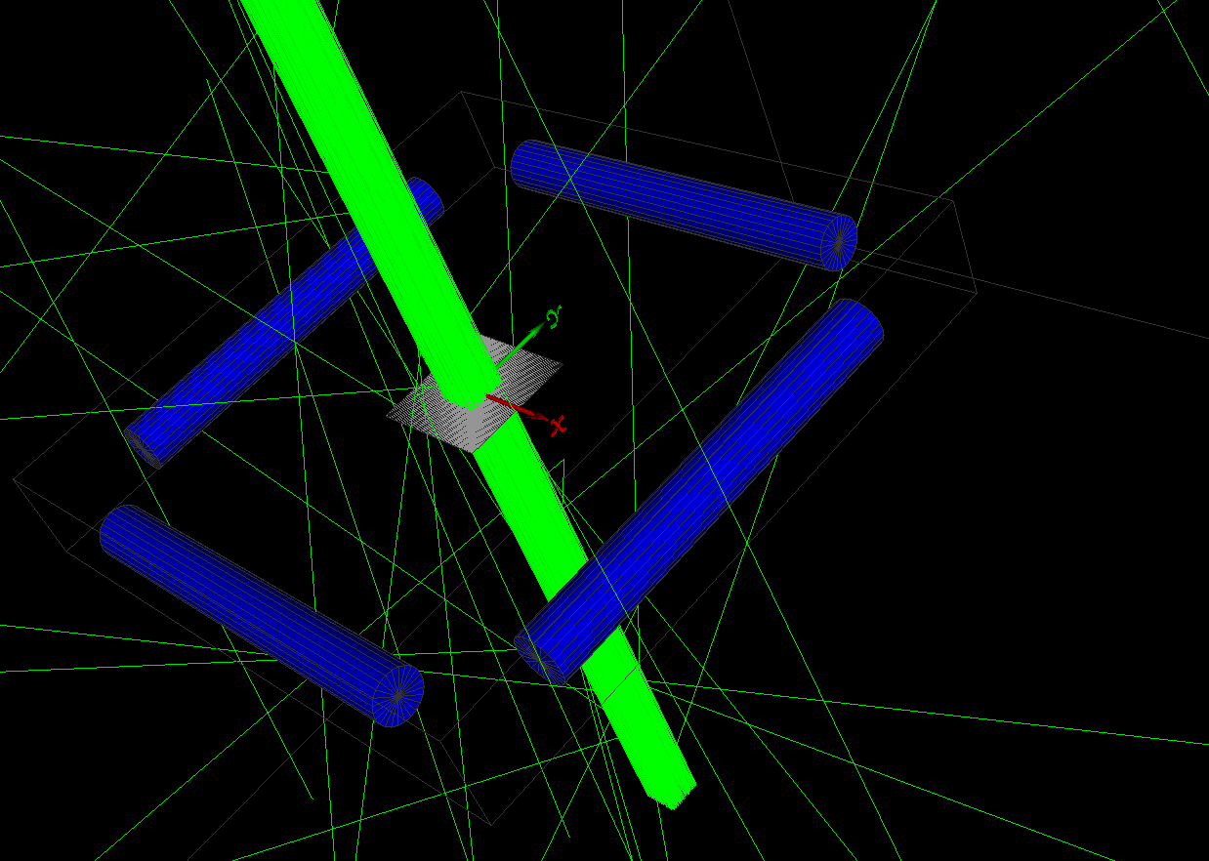
Parasitic methods for monitoring the beam
Very preliminary Geant4 simulation
Time resolution is not great, as currently implemented
as a white beam monitor, or to get phasing of a slow band width chopper is fine.
Detectors are placed away from the radiation environment
A project has just started with a master student, timescale 18 months ,
→ Looking for improved geometry and simple engineering solutions:
make the foil and detector dimensions smaller → reduce time uncertainty with simplified engineering
**Info from Nigel and Robert Bewley and daniel pooley Thanks!

Slide 21
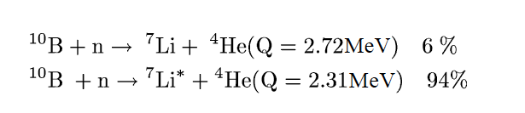


Parasitic methods for monitoring the beam
Using Gamma detector
Using the boron layer on the chopper disc → information about the chopper rotation → this is done using a gamma detector outside the beam.
Gamma detector
$$γ$$
Incident neutron beam
$γ$ energy= 0.48MeV
Notes:
Another way is no matterial at all in the beam u take the advantage that ur chopper is already coated with B

Slide 22
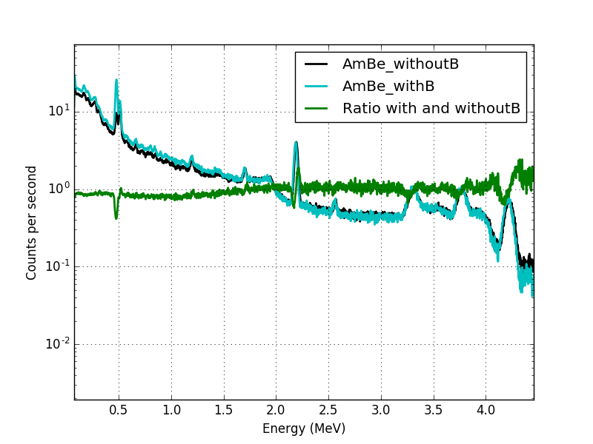
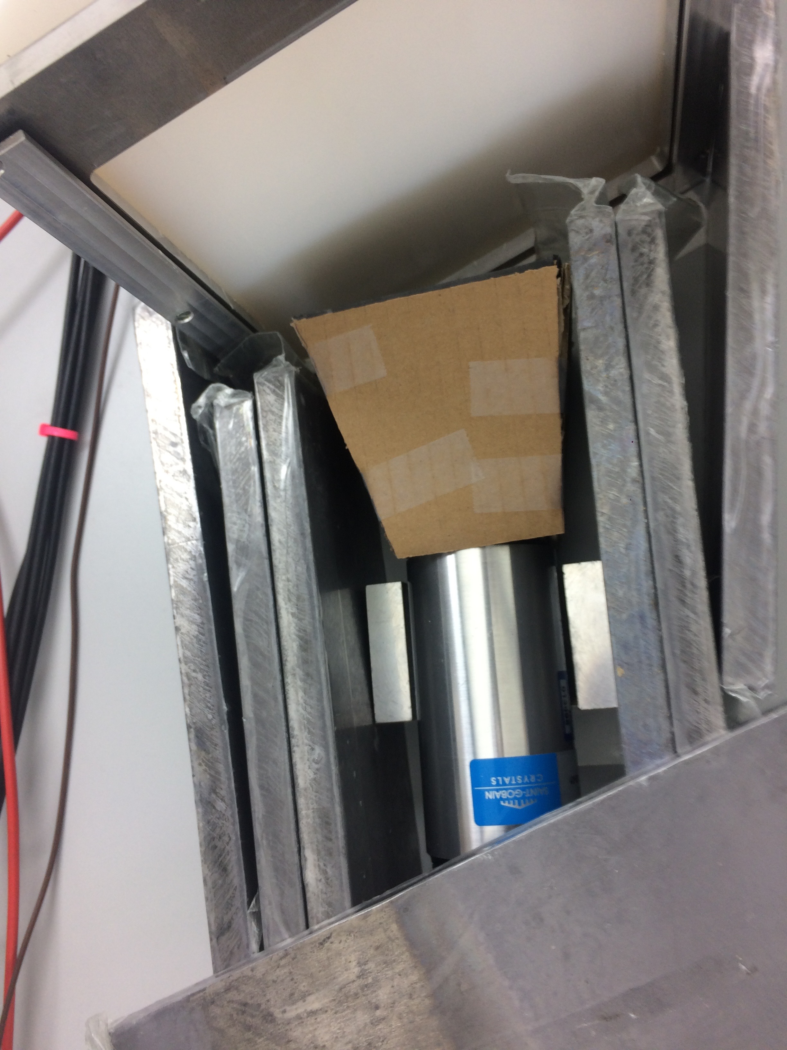
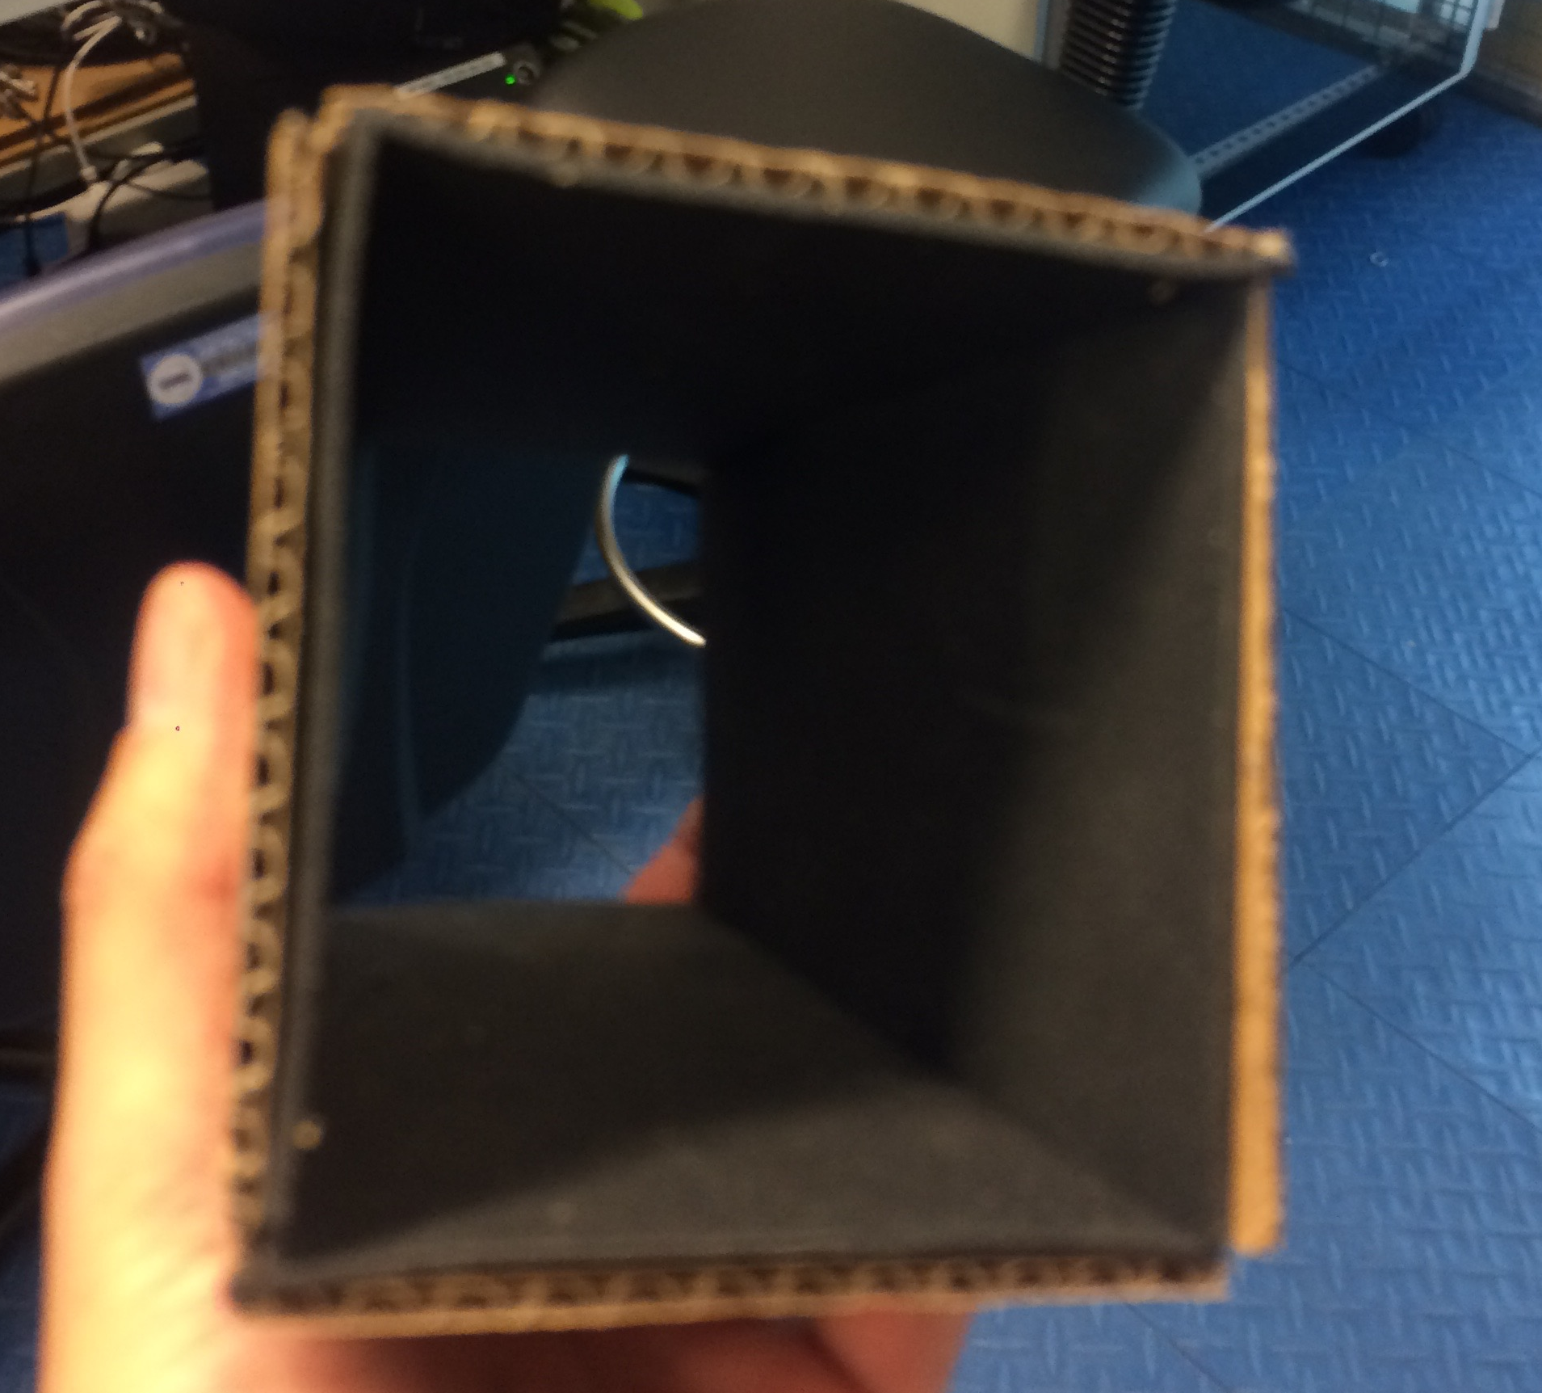
Parasitic methods for monitoring the beam
LaBr scintillator detector from Saint-Gobain is surrounded by a mirrobor 2mm (80% B4C)
A gamma peak at 480 keV can be recognized in the presence of boron
Boron carbide
The gamma peak at 480 keV can be recognized in the presence of different gamma sources
Notes:
Very rough measurement was performed at SF using n sources to make sure this makes sense ..

Slide 23
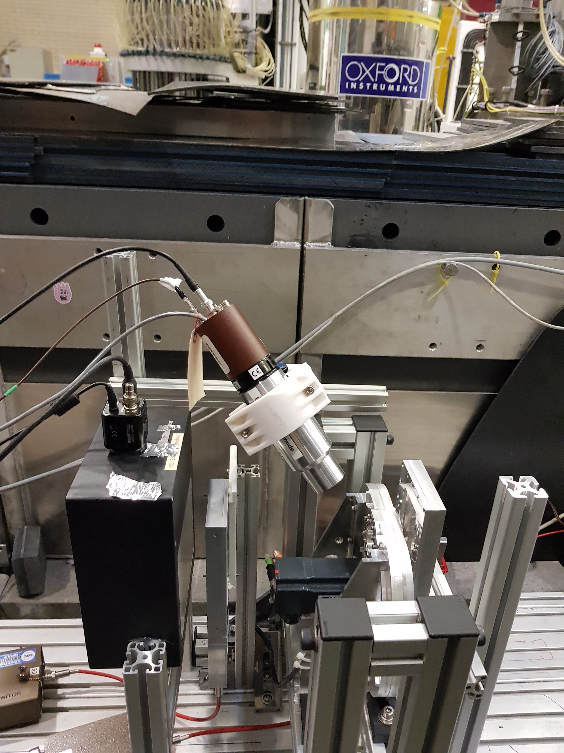
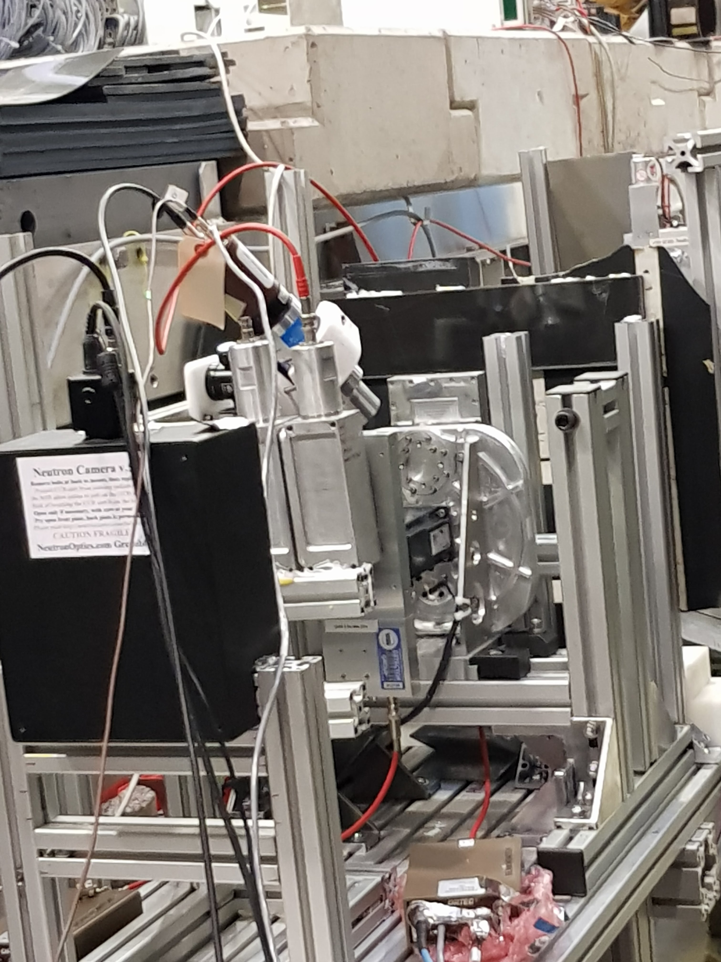
Parasitic methods for monitoring the beam at V20 HZB
ESS Mini chopper
LaBr gamma detector, no shielding, no optimization of scintillator or chopper
A mini chopper coated with Boron used in the beam
LaBr gamma detector used for detecting the gamma peak from the ¹⁰B interaction
One beam monitor was placed before and another one after the mini chopper for the V20 integration test
** Thanks for Niko and Andrés from Chopper Group

Slide 24
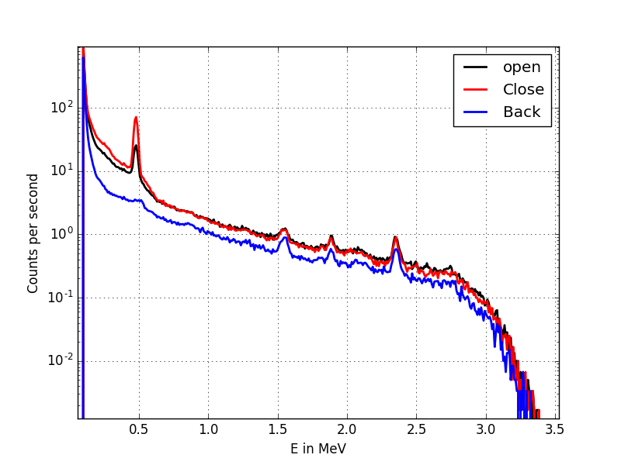
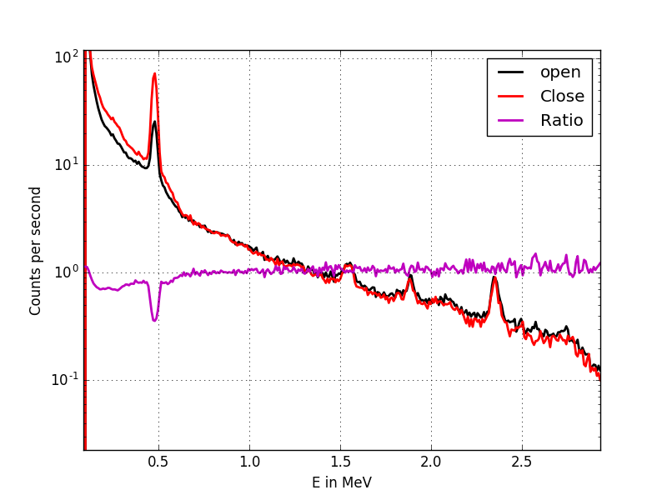
Parasitic methods for monitoring the beam at V20 HZB
At V20 at HZB
Very preliminary
A gamma peak at 480 keV can be recognized when beam is on
The peak intensity increases by ~ 3 times when chopper is closed → proof of concept
ESS will continue on this:
* Proof of concept paper by summer and Realistic performance/cost/engineering (timescale 12-18 months)

Slide 25
Outline
Why Beam monitors?
Beam monitors market survey
Mechanical integration (BM on chopper)
Parasitic methods for monitoring the beam
Beam monitors at V20 at HZB
Beam monitor requirements per zone
Guidelines for Beam monitors at ESS
Summary

Slide 26
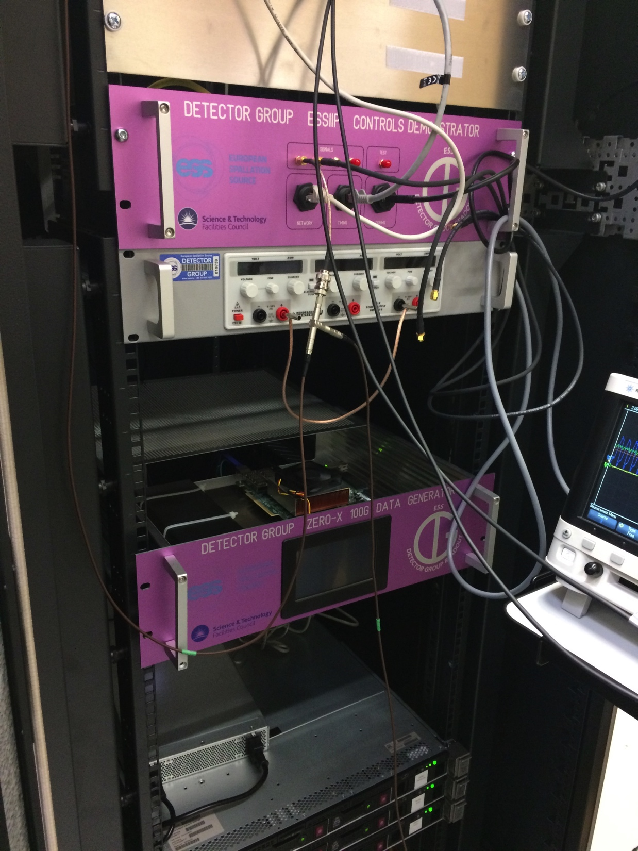
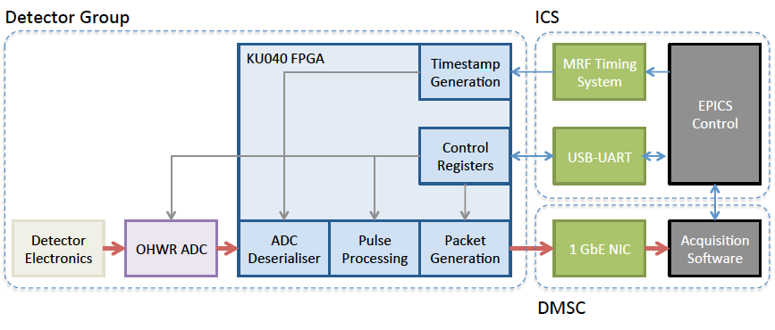
Beam monitor electronics
Timing EPICS
DMSC
Beam monitor
Front end
AMP
DAQ
Event formation
example
Work done by: Steven, Scott (DG) Tobias and Janos (DMSC)
Notes:
So now what is a beam monitor as a system is the detector itself with electronics ..

Slide 27
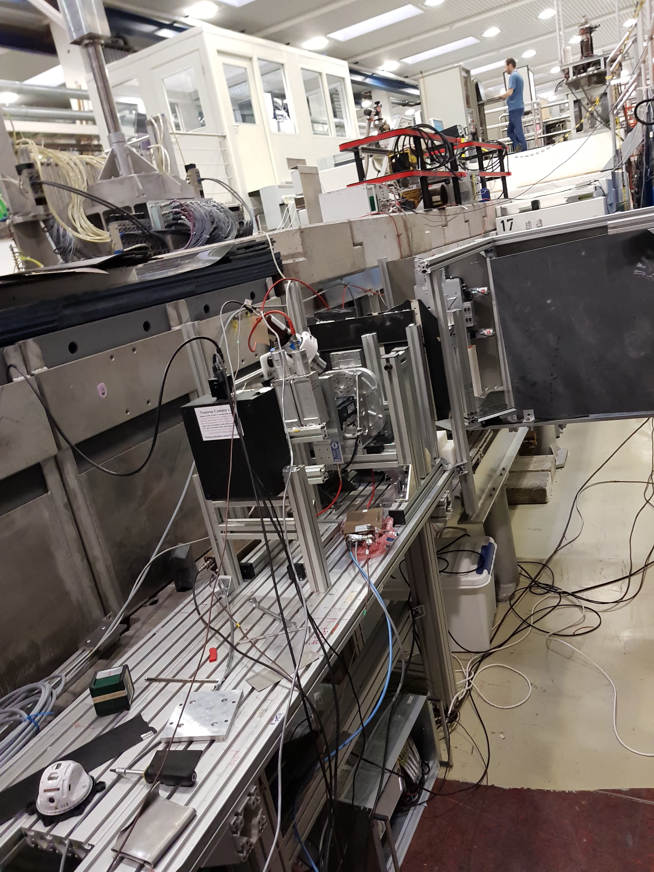
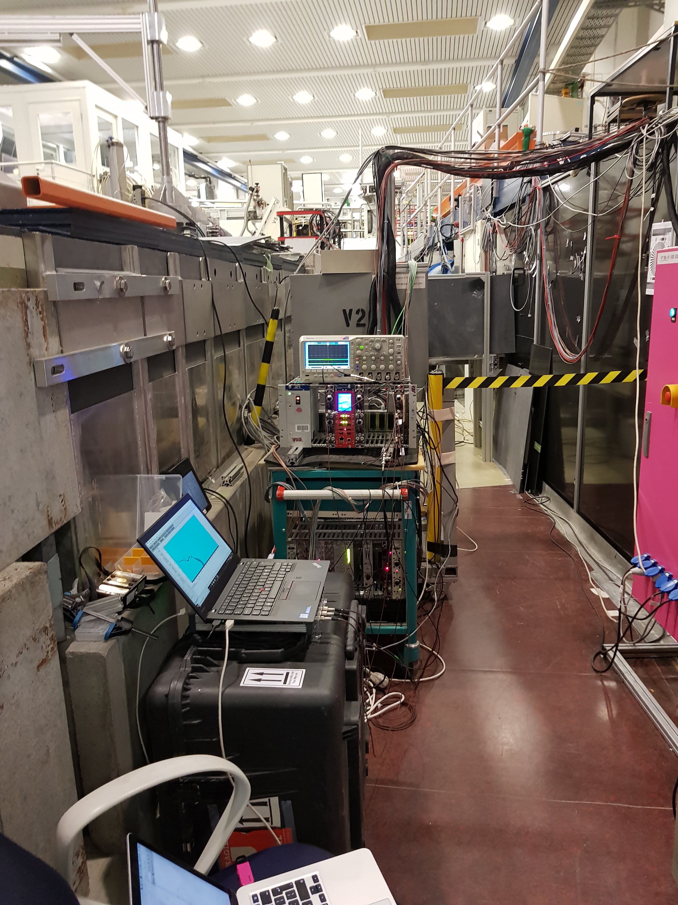
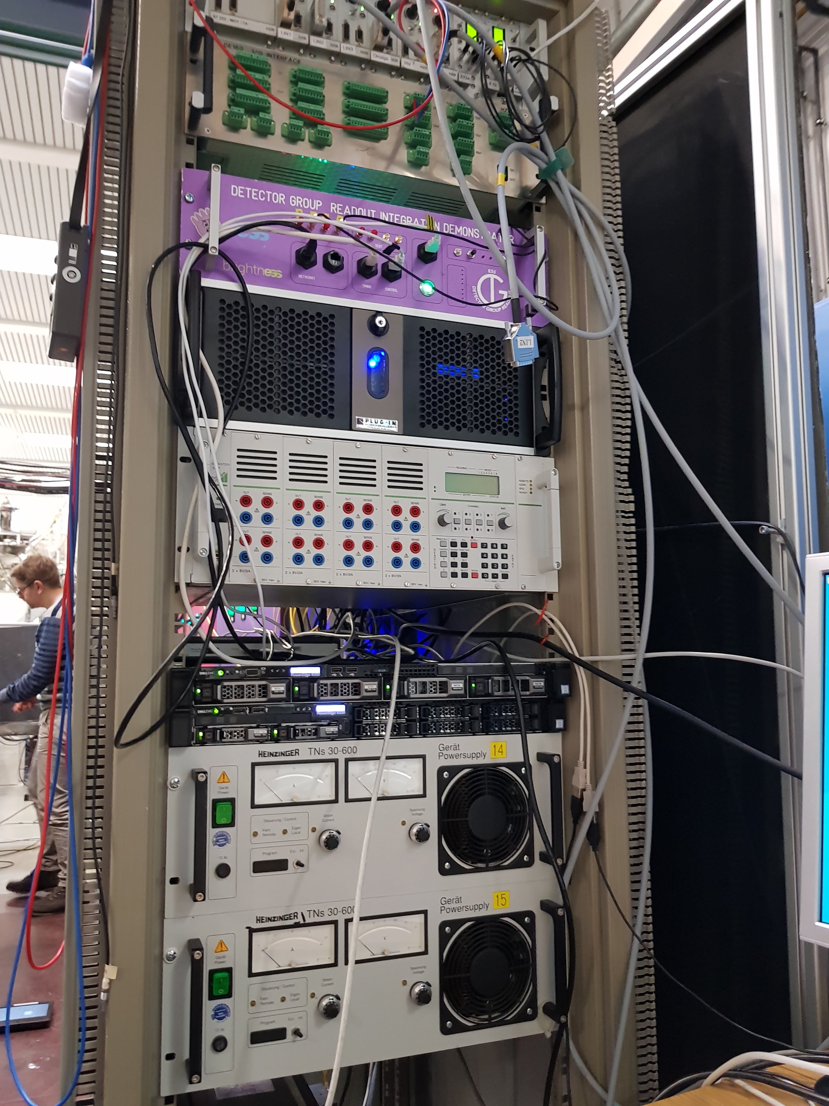
V20 test at HZB
Timing EPICS
DMSC
Beam monitor
Front end
AMP
DAQ
Event formation
BM electronics several options (for more details see Scott talk at IKON13):
Integration Demonstrator (Done)
Talin
Talin ++
Standard detector readout
DMSC and ICS

Slide 28
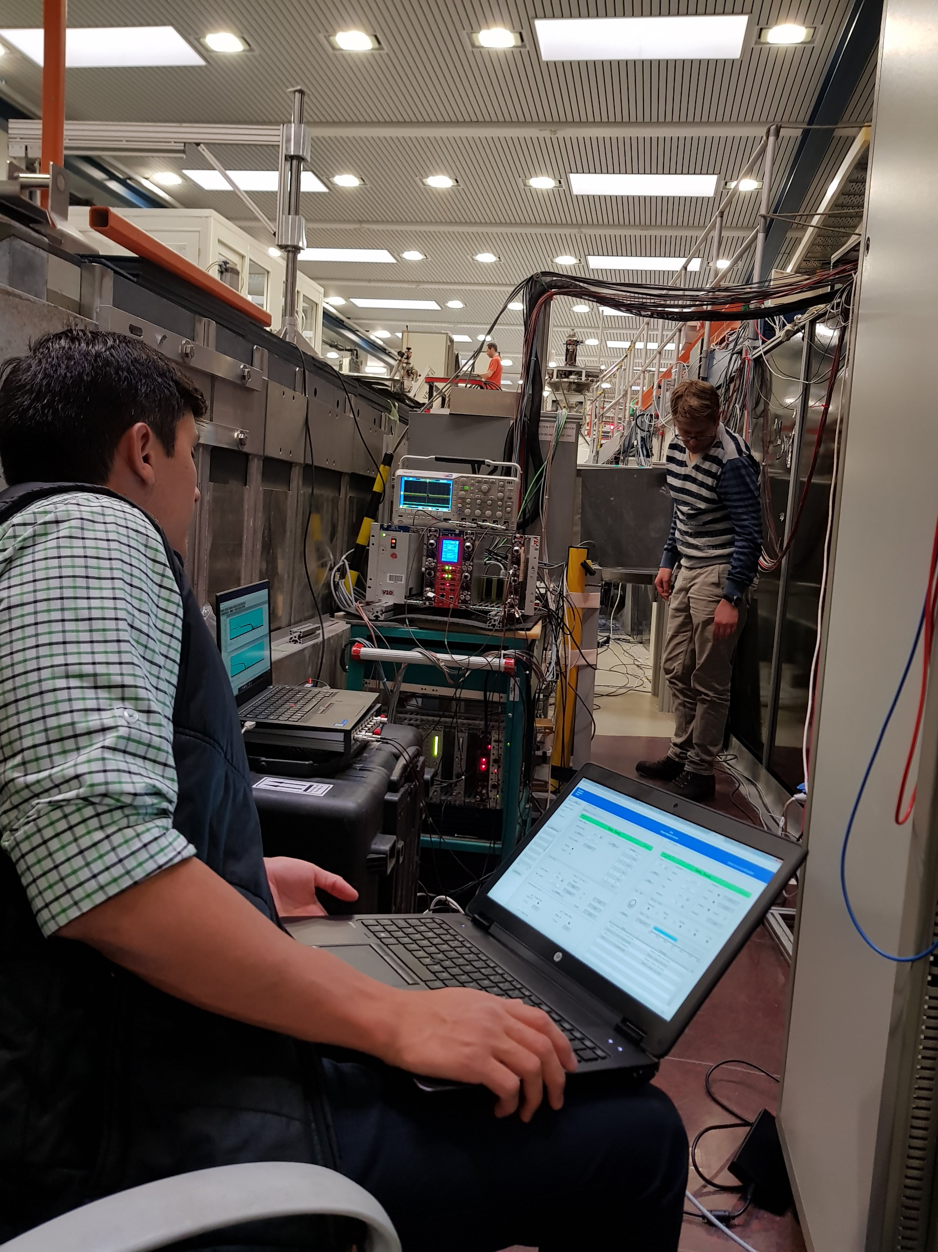
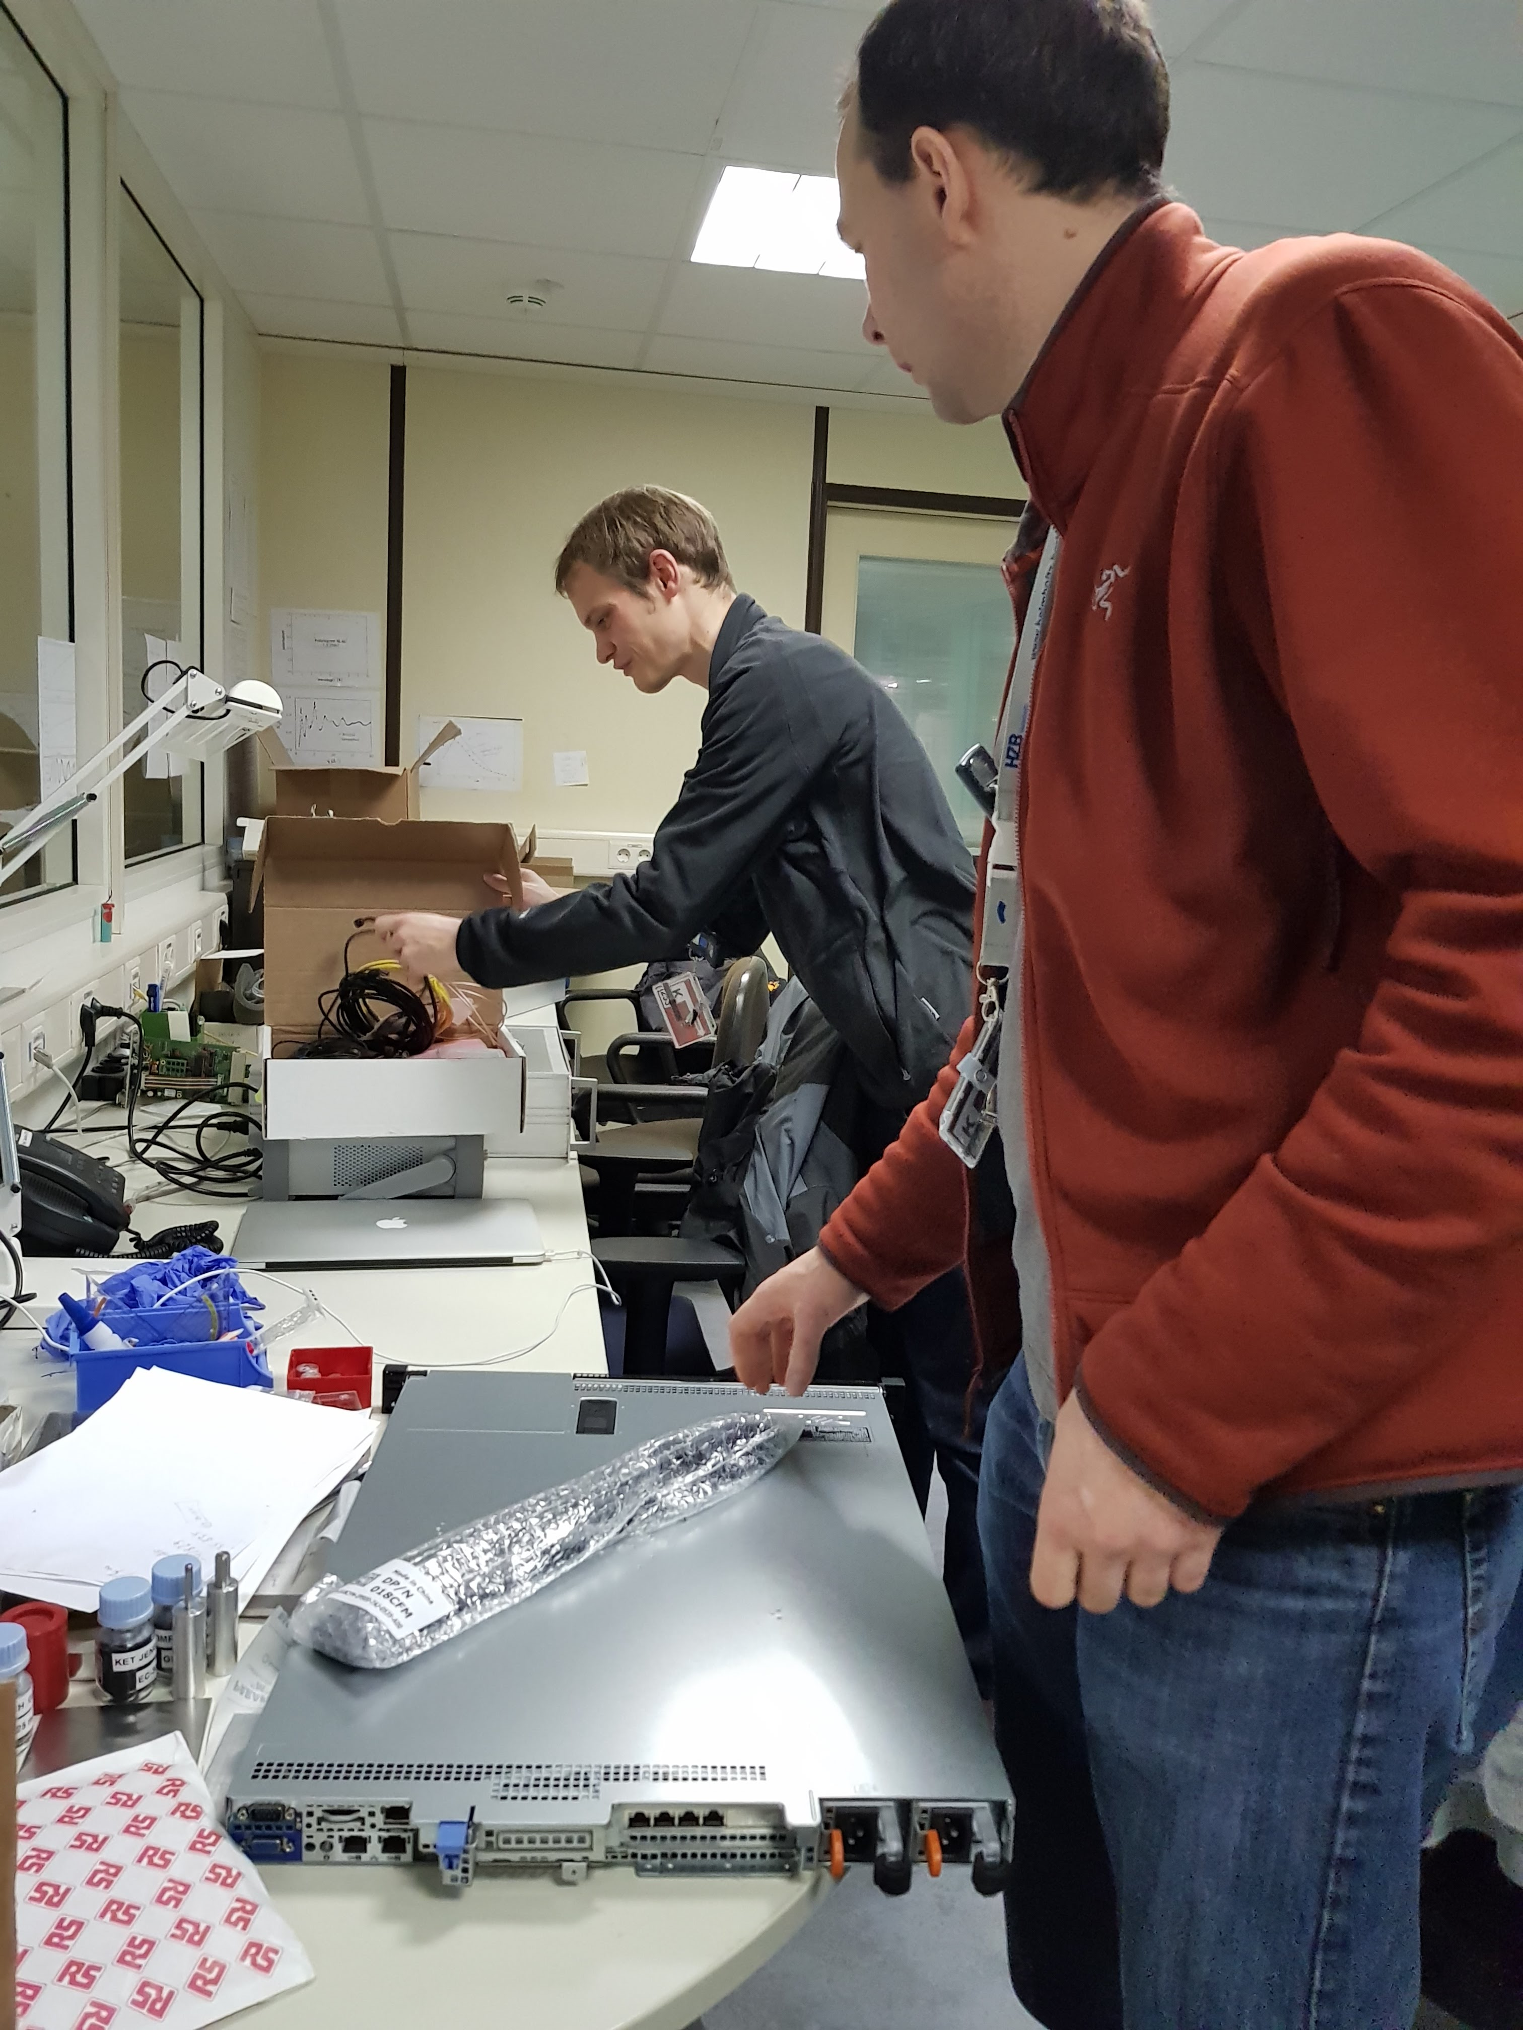
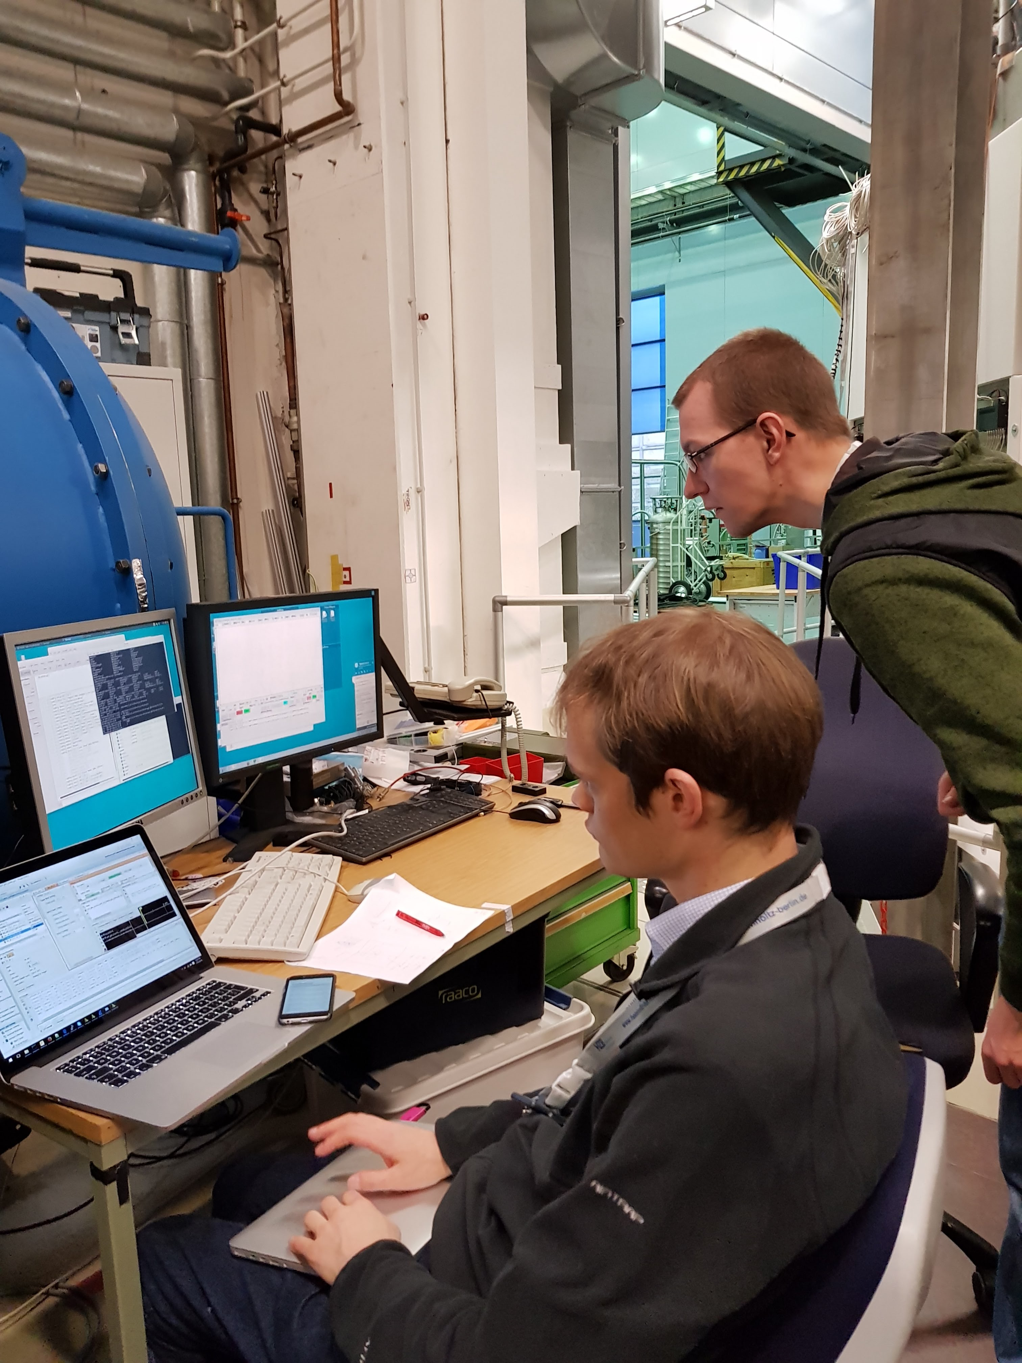
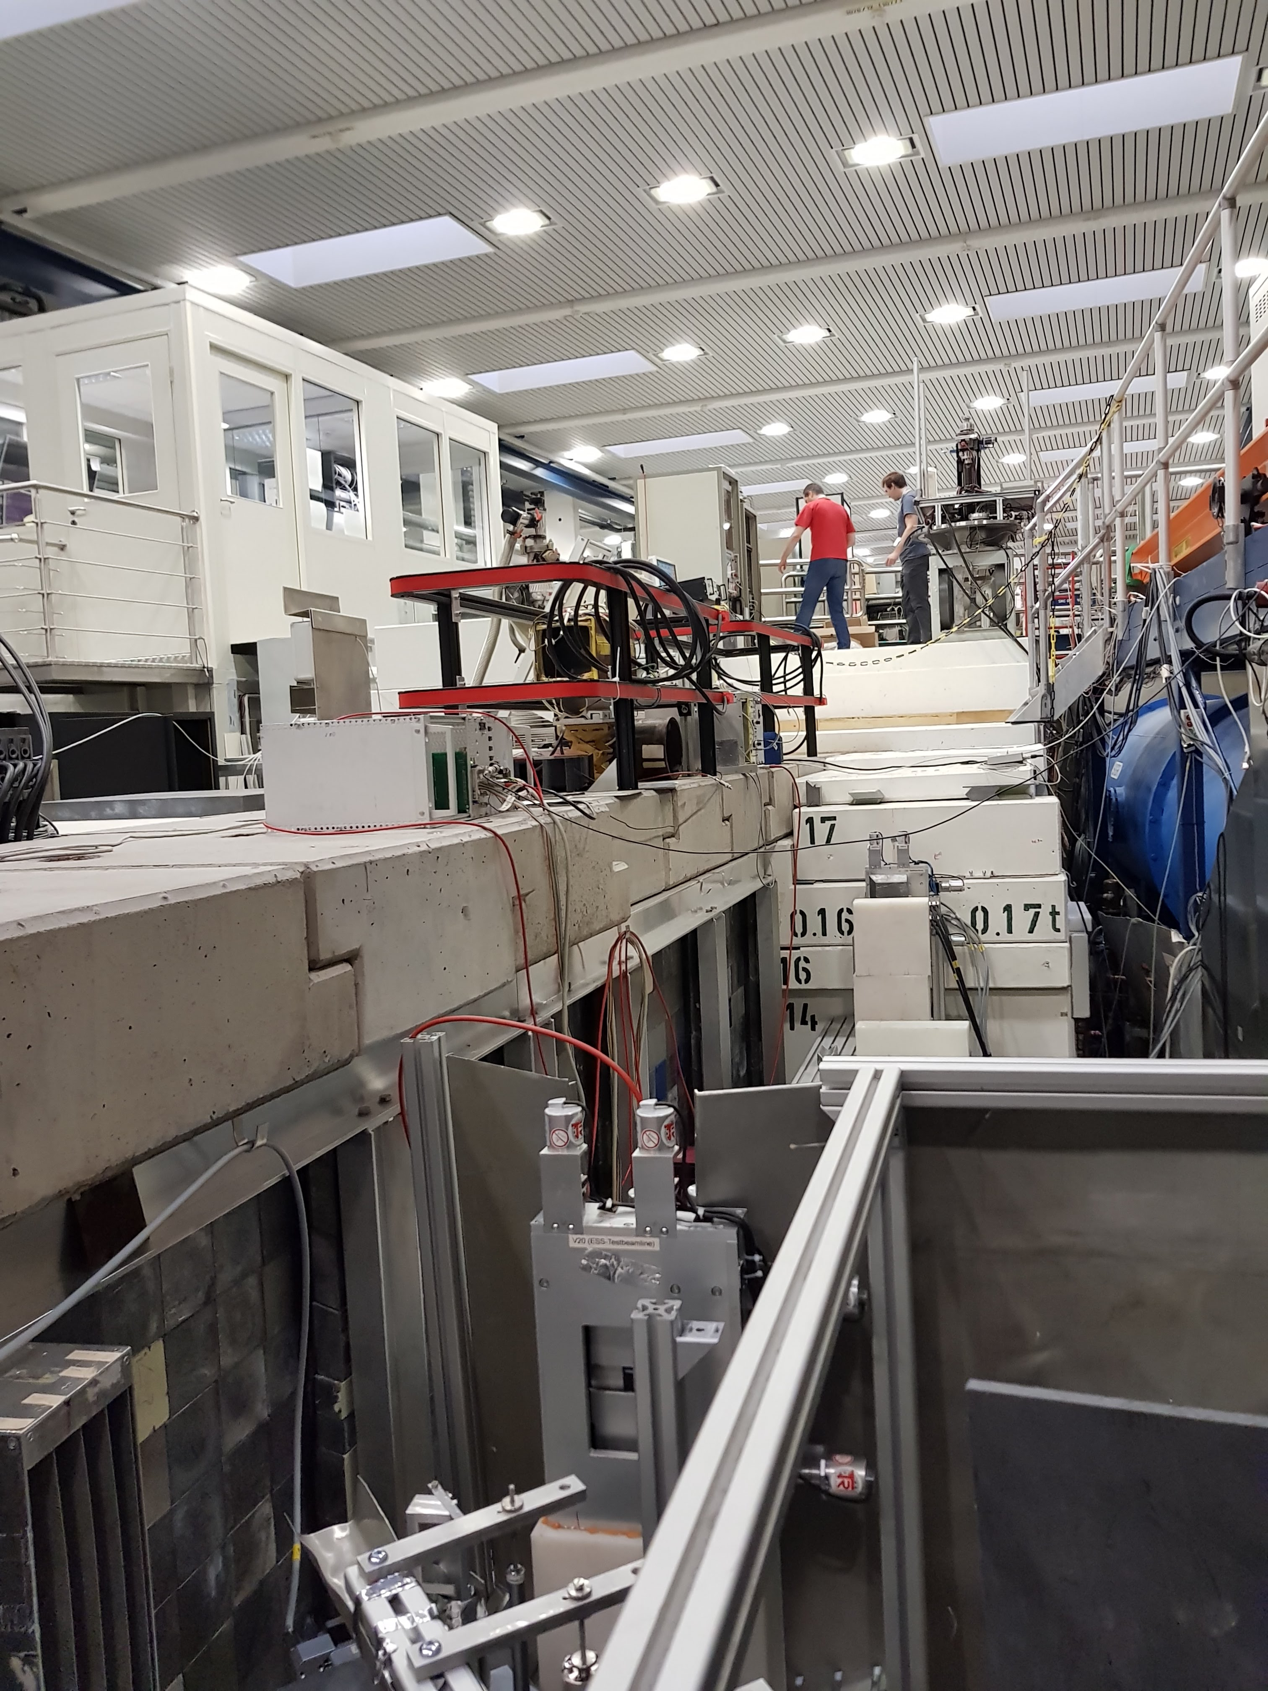
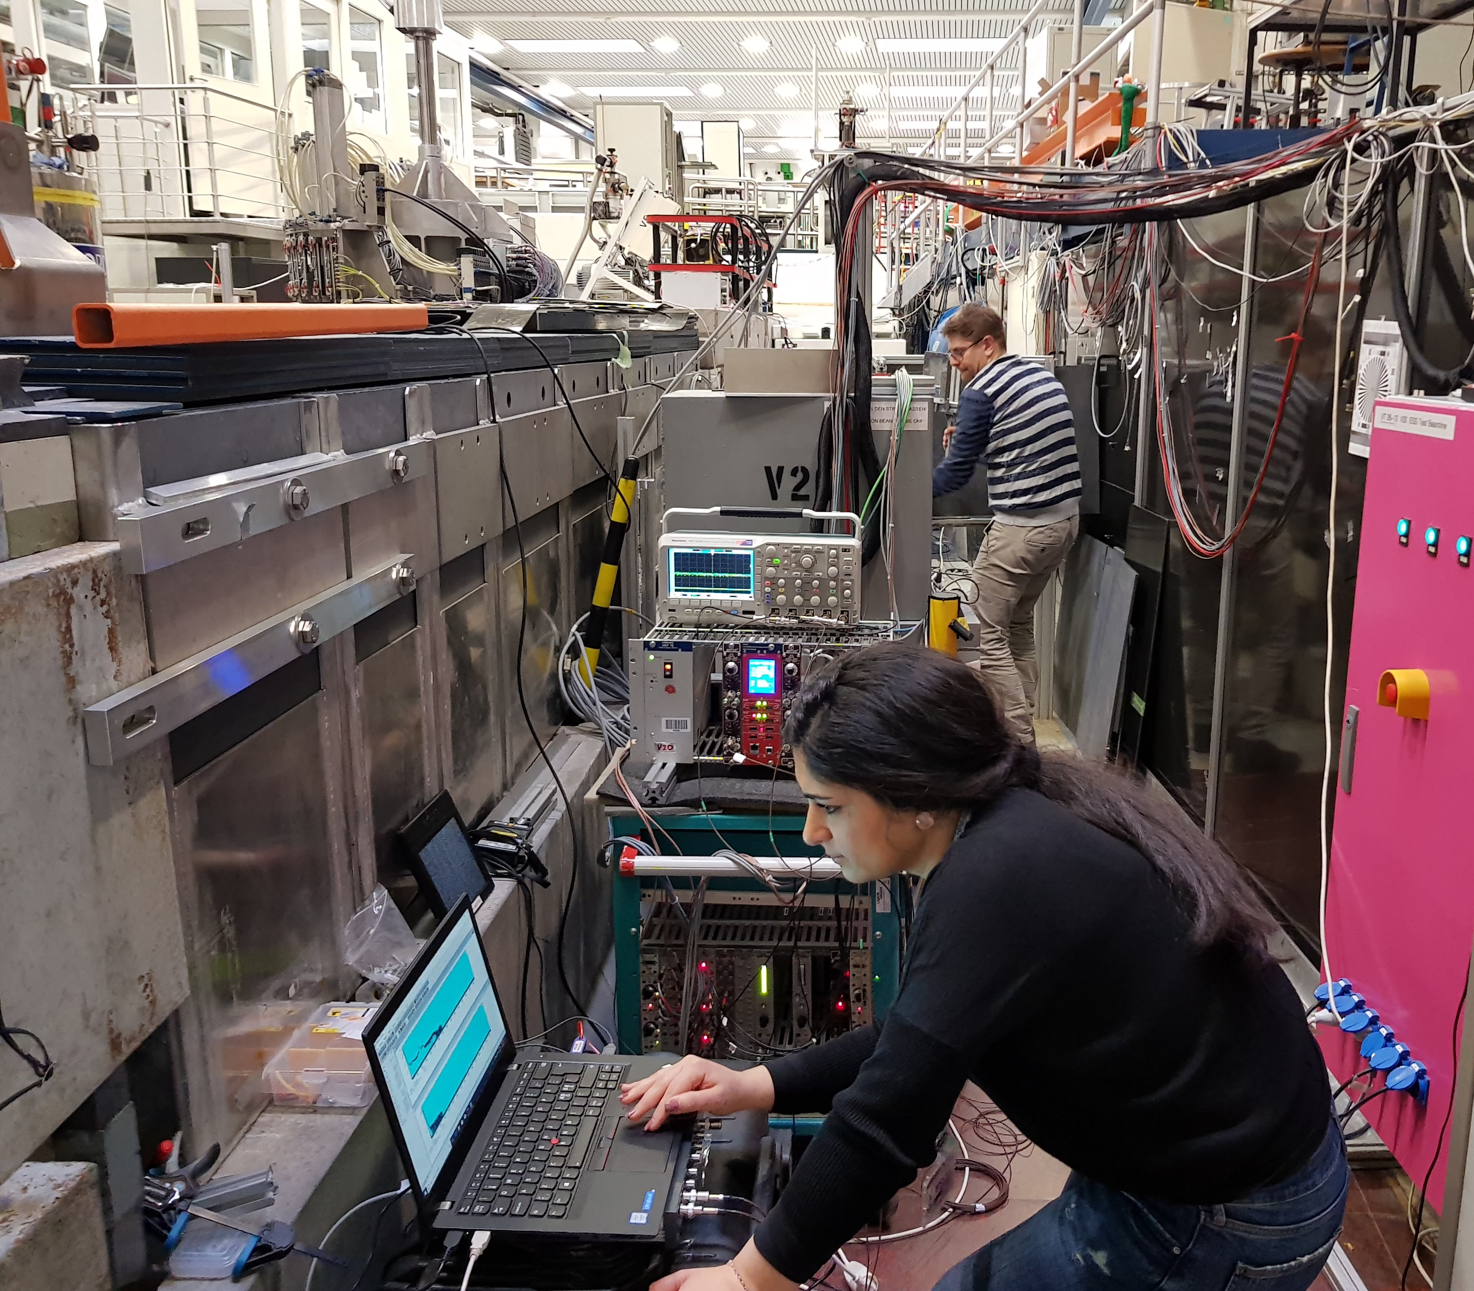
V20 test at HZB
V20 test at HZB-Berlin:
Detector Group
Chopper Group
DMSC
ICS
System integration shown
Successful test:
DMSC produced time-of-flight spectra based on the D.G. readout from the beam monitors,
and Diagnose chopper using two BMs
For more details See Chopper group talk on
Wednesday 14 Feb at the Plenary session at 10:00

Slide 29
Outline
Why Beam monitors?
Beam monitors market survey
Mechanical integration (BM on chopper)
Parasitic methods for monitoring the beam
Beam monitors at V20 at HZB
Beam monitor requirements per zone
Guidelines for Beam monitors at ESS
Summary

Slide 30
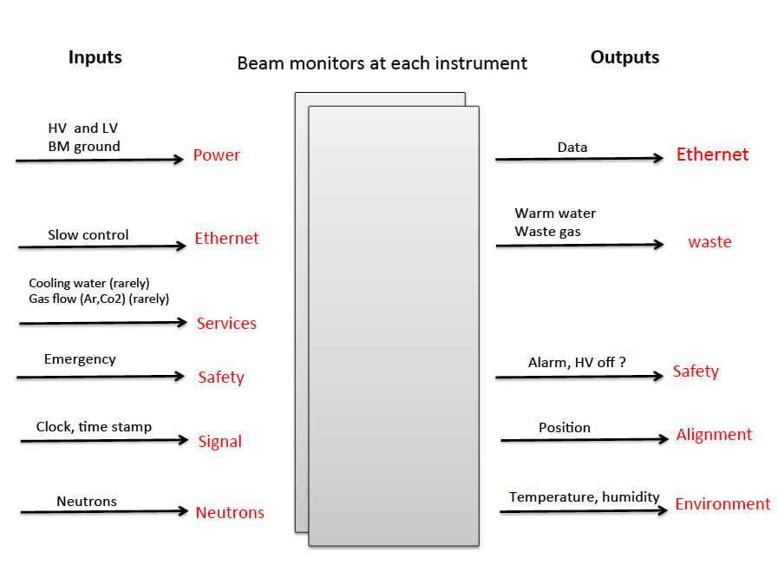
Beam monitor system Integration
rarely
rarely
alignment
Mechanical

Slide 31
Facility maintenance and operation Requirements
No access to the bunker or guides just for BM maintenance
Environmental requirement (rate, humidity, temperature,..)
Commissioning
Dynamic Range
Diagnose flux lost
Stability
BM system
Data mining
Reliability
Flux along the beam line
Cross-Calibration
T0 information
Radiation hardness
(lifetime >10years @ normal flux)
Notes:
..

Slide 32

Beam monitor requirements
Instruments | Number of BM | Time resolution (μs) | Position resolution | Area (cm x cm) | Beam size mm x mm | Flux (n/cm².s) | Pulse duration (ms) | Vacuum/air
LKOI | 2 or 3 for normalization | 100 | None | TBD | NM | NM | 53 to 63 | vacuum
 | 2 for diagnostics | 100 | None | TBD | NM | NM |  | vacuum
FREIA | 2 for normalization | Same as wavelength resolution | None | 2.5 x 4 | NM | NM |  | air
 | One behind each chopper pair for diagnostics | Same as chopper resolution | None | As small as non absorbing | NM | NM |  | vacuum
MIRACLES | 1 for normalization | 10 μs | None | 5x5 | Size of the final neutron guide | Highest flux on sample 5x10⁶ |  | vacuum
 | 2 for diagnostics | 10 μs | None | up to 12x12 | Beam guide size |  |  | vacuum
VESPA | 1 for normalization | 15-20 μs | None | TBD | 35 x 35 | ….. | TBD | Vacuum (preferable)
 | 3 or4 for diagnostics | 50-100 μs | None | TBD | 35 x 35 to 50 x50 | …… | TBD | Vacuum (preferable)
HEIMDAL | 1or 2 for normalization | 10 μs | 0.2 mm x 0.2 mm | 4 x 4 | NM | 10⁷ to 2x10⁹ n/s/full area |  | air
 | 2 for diagnostics | 100 μs | None | Up to 10 x 10 cm | NM | 3x10⁸ to 5x10⁹ n/s/full area |  | vacuum
CSPEC | 1 for normalization | <2μs | 2 mm | 2.2 x 4 cm | 22 x 4 | 6x10 ⁷ to 6x 10⁹ n/s/Å/cm² | NM | vacuum
 | 4 for diagnostics | 10 and 200 | 3mm | Up to 11.1 x 12 cm | 70 x 55 to 111x 120 | 6x10 ⁷ to 6x 10⁹ n/s/Å/cm² | NM | vacuum
T-REX | 1 for normalization | 1 μs | 1x 1 mm | 1.5 x 3 | 15 x 30 | 10¹⁰ | 0.1 ms | vacuum
 | 2 for diagnostics | 2 μs | 1x 1 mm | 6 x 8.5 | 60 x 85 | 10¹⁰to 10¹¹ | 1 ms to 0.5 ms | air
BEER | 1 for normalization | 10 μs | None | 50 x 100 mm² | Max 40x 80 | 10⁷ to 10⁹ |  | air
 | 1 for diagnostics | 10 μs | None | 25 x 85 mm² | 20 x 80 |  |  | Vacuum
BIFROST | 2 for normalization | 100 us | Optional | 5 x 5 | 40 x 40 | 10⁷ to 10¹⁰ | Btw 0.1 and 3 ms | air
 | 2 for diagnostics | none | none | 4 x6 and 12x12 | 30x50 and 100x100 | 10⁷ to 10¹² | Btw 0.1 and 3 ms | air
NMX | None for normalization | non | Non |  | None | …….
 | 3 for diagnostics | <1ms | 1-2 mm | 5 x 5 | 45 x 45 at choppers 30 x30 at end of guide | ………. |  | air
ESTIA | 0-1 for normalization | 1 μs | Not evaluated | > 6 x 6 | > 60x60 | <10¹⁰ n/s | Sufficient statistics needed 10⁴ cts/bin | vacuum
 | 4 for diagnostics | 1 ms | < 1mm | 4 x4 and 2x4 | 20 x 15 and 20 x 30 | 10¹⁰ to 10¹² n/s | No specific statistics needed | vacuum
ODIN | 1 for normalization | 100 | Maybe 1 mm | Max 10 x10 | 4 x 4 | 10¹¹ | 60 to 120 ms
 | 2 for diagnostics | 100 | Maybe 1 mm | Max 10x 10 | 3 x 8 and 10x10 | 6x10¹⁰ to 3 x10¹⁰ | 20 to 40 and 35 to 70
Notes:
To start understanding we started by filling in this table very basic requirments like beam zize, flux, time resolution position resolution , vacuum or not …all based on this document u have seen this

Slide 33
Beam monitor requirements
Time resolution : 1 μs to 1ms
Position resolution: 0.2mmx 0.2mm up to 3 mm
Flux on each monitor: 10⁷ n/s/cm² up to 10¹² n/s/cm²
Beam size: 2x 15 mm up to 111x120 mm
Active area: 15x 30 mm up to 120x120 mm
Instruments with no Position sensitive BM: LOKI-FREIA-VESPA-BEER-BIFROST
Majority of BM are in vacuum: LOKI-MIRACLES- VISPA- CSPEC-ESTIA-ODIN
Main concern: attenuation, scattering, enough statistics per measurement
Preliminary
This is based on what we received from the instrument team
See Rasmus’ talk on BIFROST from last IKON → this is the level of details to be considered we need this level of details

Slide 34
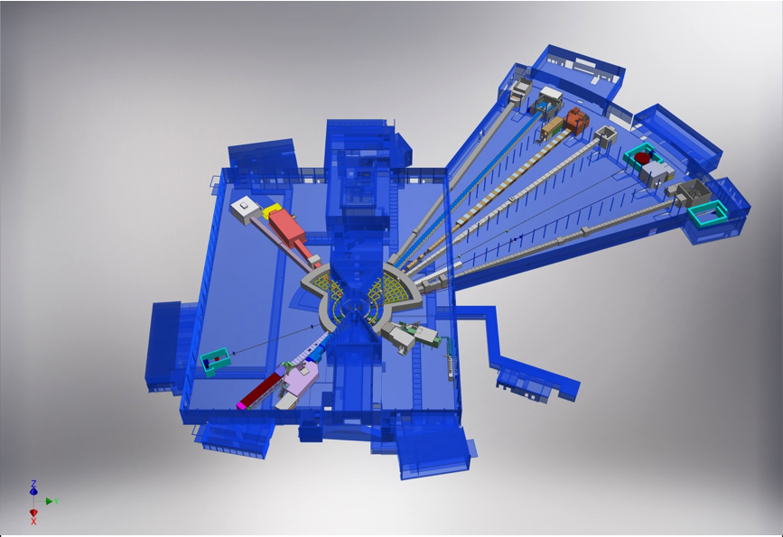
Beam monitors per zone
BEER
Close to the sample
NMX
C-SPEC
BIFROST
MIRACLES
MAGIC
ODIN
T-REX
DREAM
HEIMDAL
Instrument Guideline
LoKI
VESPA
FREIA
Bunker area
SKADI
ESTIA
Notes:
To better understand the requirements for 15 instrumentswe have to have to divide this per zone and deal with it per zone. Instead of looking for all the requiremnts at one time because instrument have some similar challenges per zone like in the bunker, along the guide and close to the sample, similar challenges but not nesscacerly the same

Slide 35
Beam monitors per zone
mechanical integration
attenuation
attenuation
scattering
scattering
radiation hardness
Saturation
Challenges
Bunker area
Guideline
Sample area
n-camera
Beam stop
“Position sensitive” Transmission BM
“Flux” BM
“Flux” BM
“Position sensitive” BM
F(x,y)
Flux (x,y,t)
F(t) F(t) F(x,y,t) F(t) or F(x,y,t)
10¹⁰ - 10¹² n/cm².s
10⁷- 10¹⁰ n/cm².s
Neutron Flux at various locations
Very different challenges and requirements

Slide 36
Beam monitors per zone
Instrument | Bunker | Guideline | Sample | Camera | Transmission
LOKI | 0 | 2 | 2 | 1 | 2
C-SPEC | 1-2 | 2 | 1 | 1 | 1
T-REX | 0? | 2? | 1 | 0 | 0
NMX | 0 | 2 | 1 | 1 | 0
BEER | 1 | 0 | 1 | 1 | 0
HEIMDAL | 1 | 1 | 1-2 | 0 | 0
ODIN | 2 | 1 | 1 | 0 | 0
ESTIA | 2? | 1? | 0? | 1 | 0
FERIA | ? | ? | 1-2 | 0 | 0
BIFROST | 1 | 1 | 1-2 | 1 | 1
MIRACLES | 0 | 1 | 1 | 1 | 1
VESPA | 2 | 1 | 1 | 0 | 1
SKADI | 0 | 1 | 1 |  | 0
Preliminary based on
BM requirement document
and TG2 documents
Partially updated

Slide 37
Beam monitor in the Bunker
Instrument | Bunker | Time resolution (us) | Position resolution (mm x mm) | Beam size (cm x cm) | Local Instantaneous Neutron flux (n/cm².s)
LOKI | 0
C-SPEC | 1-2
T-REX | 0?
NMX | 0 | No | No | 3 x 4.5 | 1x10¹¹
BEER | 1
HEIMDAL | 1
ODIN | 2 | 100 | No | 3 x 8 | 1.4 x10¹²
ESTIA | 2?
FERIA | ?
BIFROST | 1
MIRACLES | 0
VESPA | 2 | 10 | Yes | 4. x 4. | ~13 x10¹¹
SKADI | 0
Waiting for update

Slide 38

Beam monitor in the Bunker
Challenges for this region:
radiation hardness, durability, maintainability, background (fast and gamma), Neutron flux
Purpose:
facility monitoring, flux monitoring in time, commissioning, data mining
Preliminary recommendation:
ionization chamber , GEM or fission chamber
Things to be solved/proven:
Radiation hardness, Flux and dynamic range
Disadvantages:
Accessibility,
Bunker area:
is the area with highest radiation:
fast neutron flux are the same intensity 10¹¹ -10⁹ n/s
Once you lose line of sight, the fast neutron fluxes are down to 10^3 or 10^4 / s.
80 MGray per year for Gamma
→ 10¹⁸ n/year.

Slide 39
Beam monitor in the guideline
Instrument | Guideline | Time resolution (us) | Position resolution (mm x mm) | Beam size (cm x cm) | Local Instantaneous Neutron flux (n/cm².s)
LOKI | 2
C-SPEC | 2
T-REX | 2?
NMX | 2 | <1ms | 1-2 mm | 4.5 x 4.5 | 5x10¹¹ -1x10⁹
BEER | 0
HEIMDAL | 1
ODIN | 1 | 100 | No | 10 x 10 | 7 x10¹¹
ESTIA | 1?
FERIA | ?
BIFROST | 1
MIRACLES | 1
VESPA | 1 | 10 | Yes | 5.5 x 5.5 | ~8 x10¹⁰
SKADI | 1 | 1 | 1 x 1 | 3x3 | 3 x10¹⁰
Waiting for update

Slide 40

Beam monitor in the guideline
challenges for this region:
attenuation, number of gaps, mechanical integration, cost
purpose:
facility monitoring, flux monitoring , chopper diagnostics and commissioning
our preliminary recommendation:
Passive monitors (Vd, gamma detector close to a chopper, fibre monitors as the one at LET,
Si detectors coated and LiF foil in the beam)
Things to be solved/proven:
Performance, mechanical integration(gaps), cost
Disadvantages:
time resolution, take beyond proof of concept to engineered item
The instrument guideline contains
Choppers, guideline section → constrains on mechanical integration

Slide 41
Beam monitor near the sample
Instrument | Sample | Time resolution (us) | Position resolution (mm x mm) | Beam size (cm x cm) | Local Instantaneous Neutron flux (n/cm².s)
LOKI | 2
C-SPEC | 1
T-REX | 1
NMX | 1 | <1ms | 1-2mm | 3 x3 | 2X10⁹
BEER | 1
HEIMDAL | 1-2
ODIN | 1 | 100 | No? | 4 x 4 | 7 x10¹²
ESTIA | 0?
FERIA | 1-2
BIFROST | 1-2
MIRACLES | 1
VESPA | 1 | 10 | 3 x 3 | 3. X 3. | 3.5 x10¹⁰
SKADI | 1 | 1 | 1 x 1 | 1x 1 | 7 x10⁹
Waiting for update

Slide 42
Beam monitor near the sample
challenges for this region:
attenuation, mechanical integration, cost , PSD, scattering, specific material, wide range of wavelengths and fluxes
purpose:
facility monitoring, science, problem solving, alignment, (varied), normalization
our preliminary recommendation:
depends a lot on requirements, can be position sensitive or not
Very dependent upon individual needs of instrument+ use case per monitor
Things to be solved/proven:
Need a detailed set of requirement+ use case per monitor
Disadvantages …

Slide 43
Beam monitor after the sample “Transmission monitor”
Instrument | Transmission | Time resolution (us) | Position resolution (mm x mm) | Beam size (cm x cm) | Local Instantaneous Neutron flux (n/cm².s)
LOKI | 2
C-SPEC | 1
T-REX | 0
NMX | 0 under consideration | <1ms | No | 0.5x 0.5 | 2X10⁹
BEER | 0
HEIMDAL | 0
ODIN | No | No | No | ? | ?
ESTIA | 0
FERIA | 0
BIFROST | 1
MIRACLES | 1
VESPA | 1 | 10 | 3 x3 | 3. X 3. | 3.5 x10¹⁰
SKADI | 0
Waiting for update

Slide 44
Beam monitor after the sample “Transmission monitor”
challenges for this region:
Backscattering, radiation hardness
purpose:
Science , alignment, Transmitted flux on the sample
our preliminary recommendation:
depends a lot on requirements, might be the rear detector can handle this
Things to be solved/proven:
Away from sample
Disadvantages:
Backscattering to be eliminated

Slide 45
Outline
Why Beam monitors?
Beam monitors market survey
Mechanical integration (BM on chopper)
Parasitic methods for monitoring the beam
Beam monitors at V20 at HZB
Beam monitor requirements per zone
Guidelines for Beam monitors at ESS
Summary

Slide 46
Beam monitor Guidelines
Accessibility/reliability | Radiation hardness materials
Mounting | If along the chopper or the guide →electrically isolated
Movement | Not preferable option. Not in bunker, prefer not in guide. Needs very good justification if needed Mounting and positional reliability should be considered and cable rotation has to be reviewed Continuity of diagnostics? Enable data mining
Gas/cooling | Probably BM as sealed system. Gas/cooling complicated to integrate Needs very good justification if used
Failure/maintenance | Whenever possible parasitic maintenance → component should be reviewed and qualified for reliability and availability Desire no access for BM maintenance only
Electronics | BM will have standard backend electronics for maintenance and integration reasons
Racks | Racks maybe separated from detector rack maybe per grounding zone
Data | Event mode expected as default mode
Fission chambers | Preliminary recommendation →only in or around the bunker region not close to the sample because of fast neutron emission. Before losing line of sight to moderator and out of line of sight to sample. (main disadvantage of the fission chamber is that in addition to the desired fission products three fast MeV neutrons on average and MeV gamma radiation are produced during thermal fission) (flux of 10¹⁰ n/s → emission of 10⁵ n/s fast neutrons)( assuming fission chamber efficiency 10⁻⁵) Use of 235U is allowed by sustainable of material.

Slide 47
Minimum information to be collected
Activation /materials | Specific material as specified by who ? Magnetic or non magnetic ?
Location | Bunker /Guideline/near sample
Mounted | On chopper / on guide,..
Flux and beam size | Technology used
Mechanical constrains | Minimum afforded gap
Vibration | On a high speed chopper ??
Number of counts per bin | Efficiency/ accuracy of measurement?
Medium | Vacuum / air → thickness of window?
….. | …….

Slide 48
Minimum information taken before monitor build…
Info from
ISIS Neutron Detector Group
Level of detail here much greater than the level of detail presently provided to us

Slide 49

Beam monitors requirements versus Power ramp-up ?
Example from SNS
2006: Beam monitor requirements range over six orders of magnitude in neutron count rate
2009: Beam monitor requirements range over nine orders of magnitude in neutron count rate
Severe challenges: wide range of collimations and power ramp-up → Beam monitors with different requirements
Purchase many beam monitors ? Or adjusting beam monitor efficiency once per year not more??
Monitors needed at commissioning might be different to monitors needed at full power due to dynamic range?
Maybe we have some time to get this right.
** info from Technical Specifications Beamline 4 Reflectometer Beam Monitors

Slide 50

Guidelines for Neutron Beam monitors at ESS
“Draft started”
Expected by summer 2018

Slide 51
Summary
Market Survey on what is available
Mechanical integration →No electrical contact between BM and choppers
A new project has been started (timescale 18 months) for simulating, testing and engineering the Vanadium monitor
Preliminary results from V20 test has been presented → Engineered solution on timescale of 18 months
BM in the bunker → Radiation hardness → GEM/ionization chamber/ fission chamber could be used
BM in the Guidelines → Low attenuation/ limited gap → Parasitic methods could be used
BM near sample → low attenuation, scattering, wide flux range → Depends a lot on each instrument requirements
High level of detailed information will be needed
For facility maintenance → Preliminary recommendations min 3 BM per instrument (Bunker, Guideline, sample)
Guidelines for neutron beam monitors at ESS will be available in summer 2018

Slide 52
THANK YOU
Special thanks to :
Detector group at ISIS ( Nigel and Robert Bewley and Daniel Pooley) and SNS (K. Berry)
Chopper Group at ESS ( Niko and Andrés)
Instruments team for their inputs

