Slide 1
EFU and You the path to a successful detector integration
Morten Jagd Christensen
European Spallation Source
Data Management and Software Centre (DMSC)
Copenhagen

Slide 2
Topics
System architecture - detector data path
ESS Data Management and Software Centre (DMSC)
What DMSC provides
Efficient detector integration
Summary

Slide 3
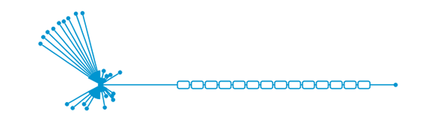




System data flow
instruments
detectors
event formation
aggregator
nexus writer
storage
inst1_det1
inst1_det2
...
instN_detM
EFUs
“There are also corresponding flows for experiment control and non-event data”

Slide 4
Event formation
detectors
event formation
inst1_det1
... , (t_{n}, p_{n}), (t_{n+1}, p_{n+1}), ...
EFUs
“Event formation essentially delivers
a stream of (time, pixel) tuples.”

Slide 5
DMSC

Slide 6

DMSC
ECDC
DRAM
DST
ADMIN

Slide 7

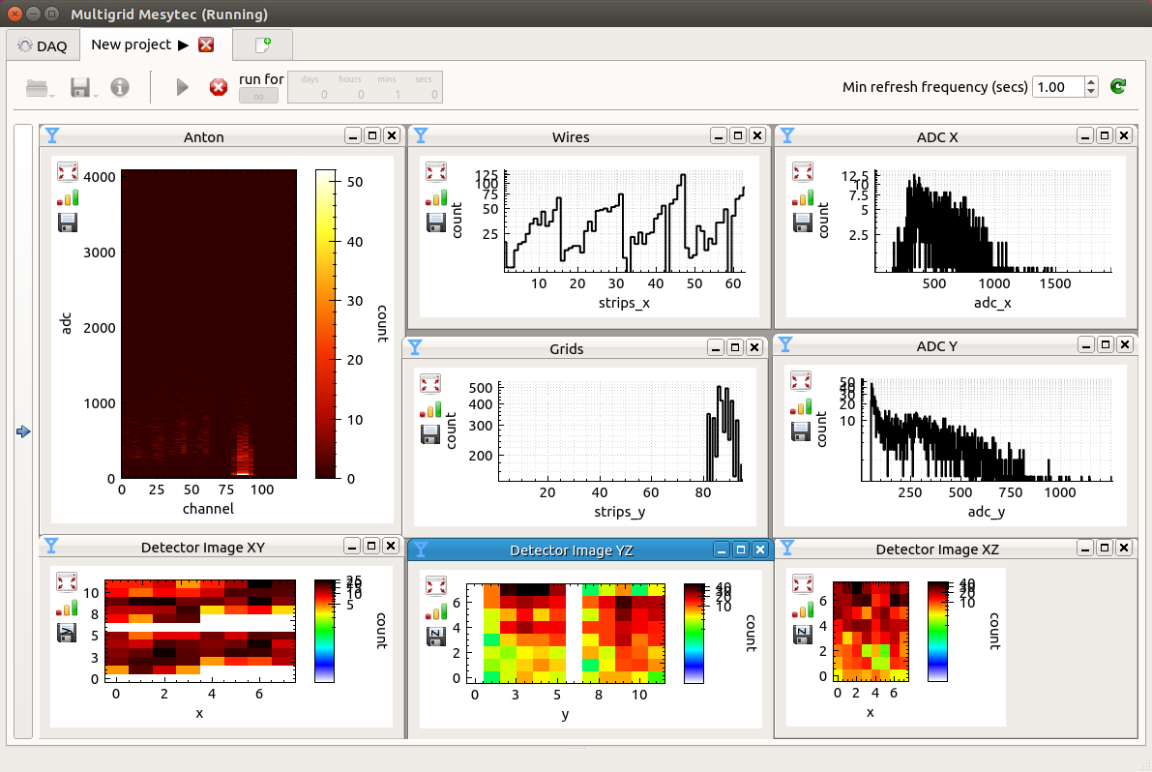
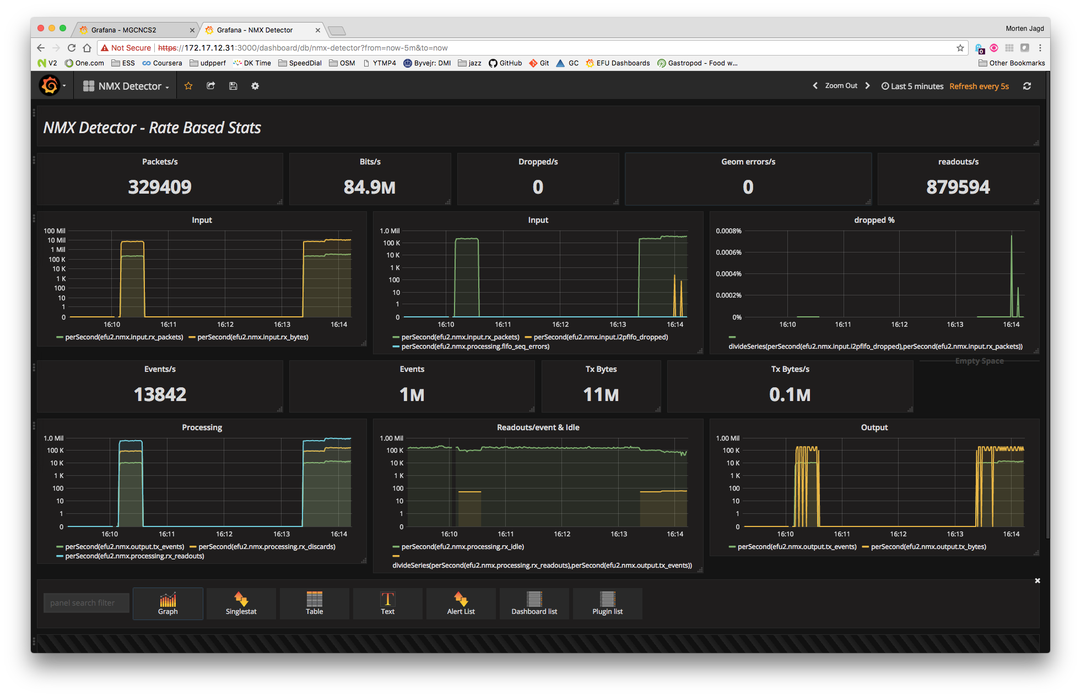
DMSC/DG Responsibilities
Experiment Control and Data Curation
Tobias Richter
Provides software for
Instrument and readout control
Readout data reception and parsing
Event Formation calculations
Fast sample environment
Data aggregation
Nexus file writing
Detector commissioning tools
Live detector statistics

Slide 8
Interfaces
Producer
220V AC @ 50Hz
Consumer

Slide 9
Three Important EFU interfaces
detector
readout system
event formation
logical geometry
data format
EF algorithm
P0
readout
P1
EFU
EFU
EFU
P2

Slide 10
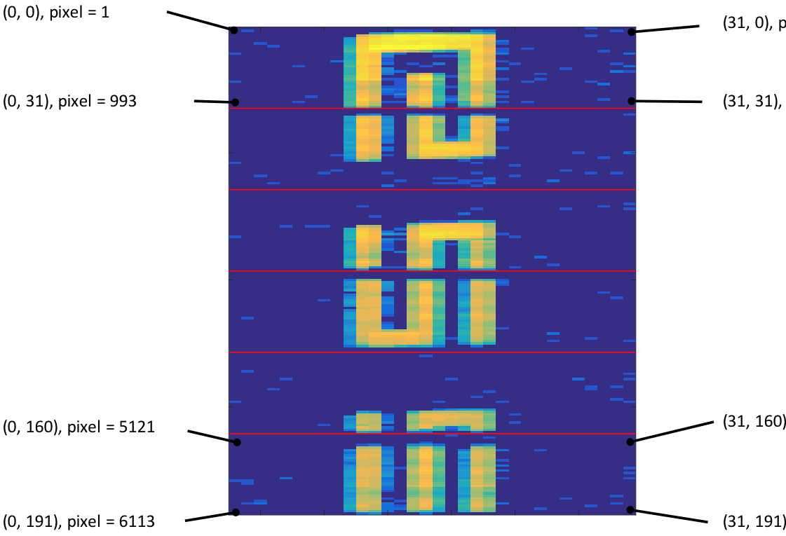
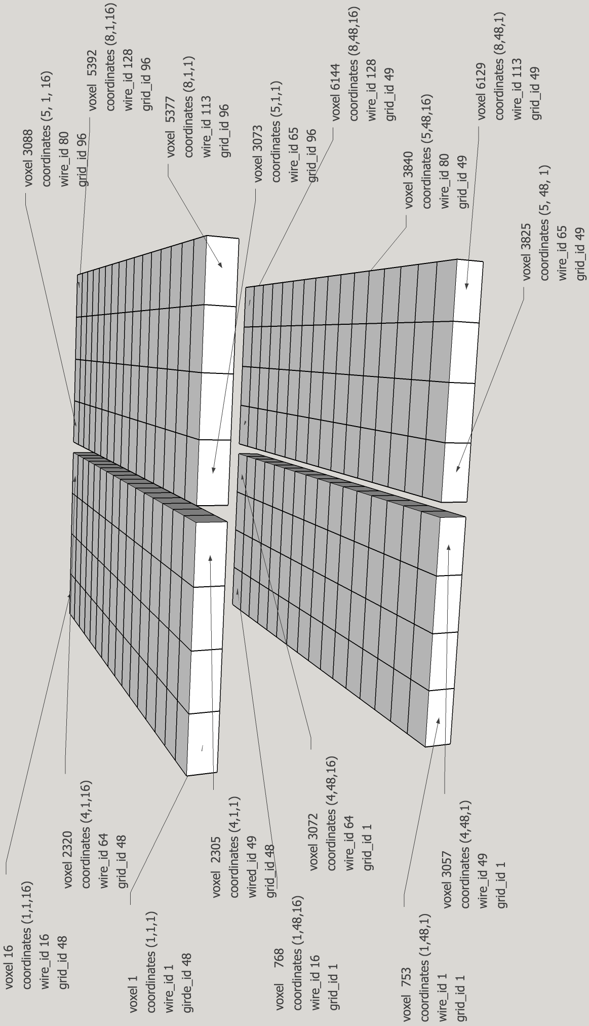
Logical Geometry

Slide 11
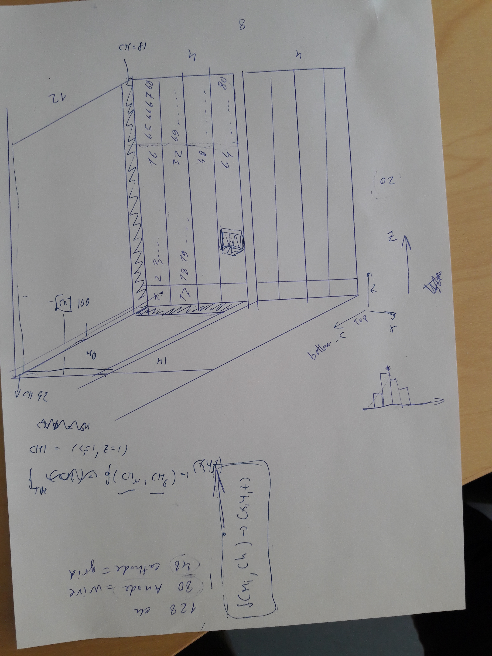
Digital Geometry

Slide 12
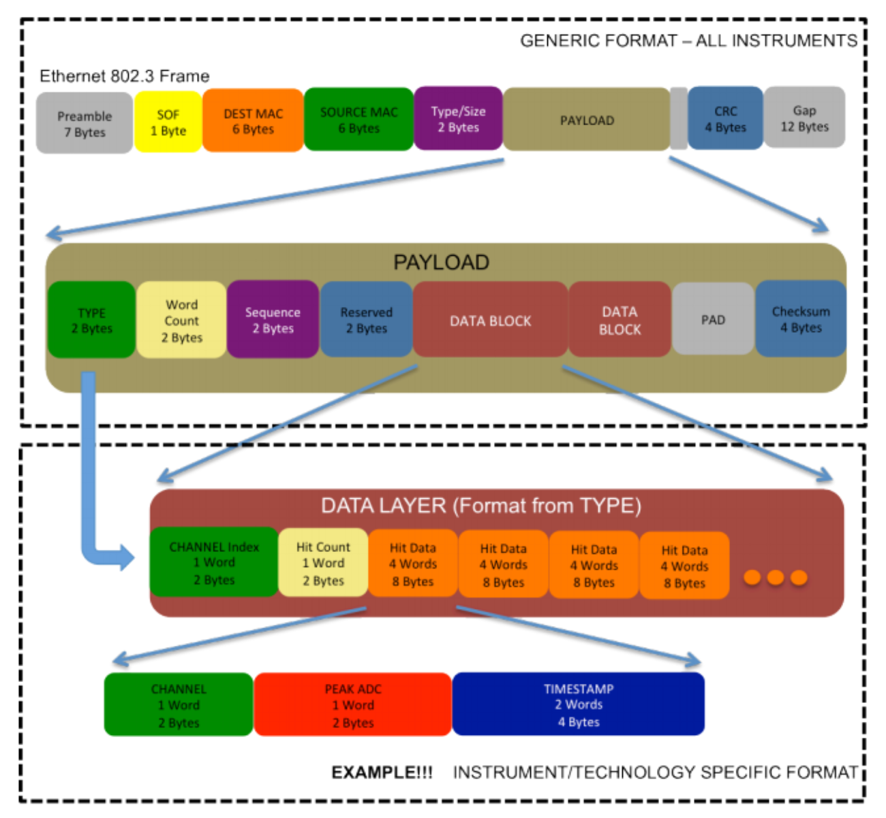
Readout Formats

Slide 13
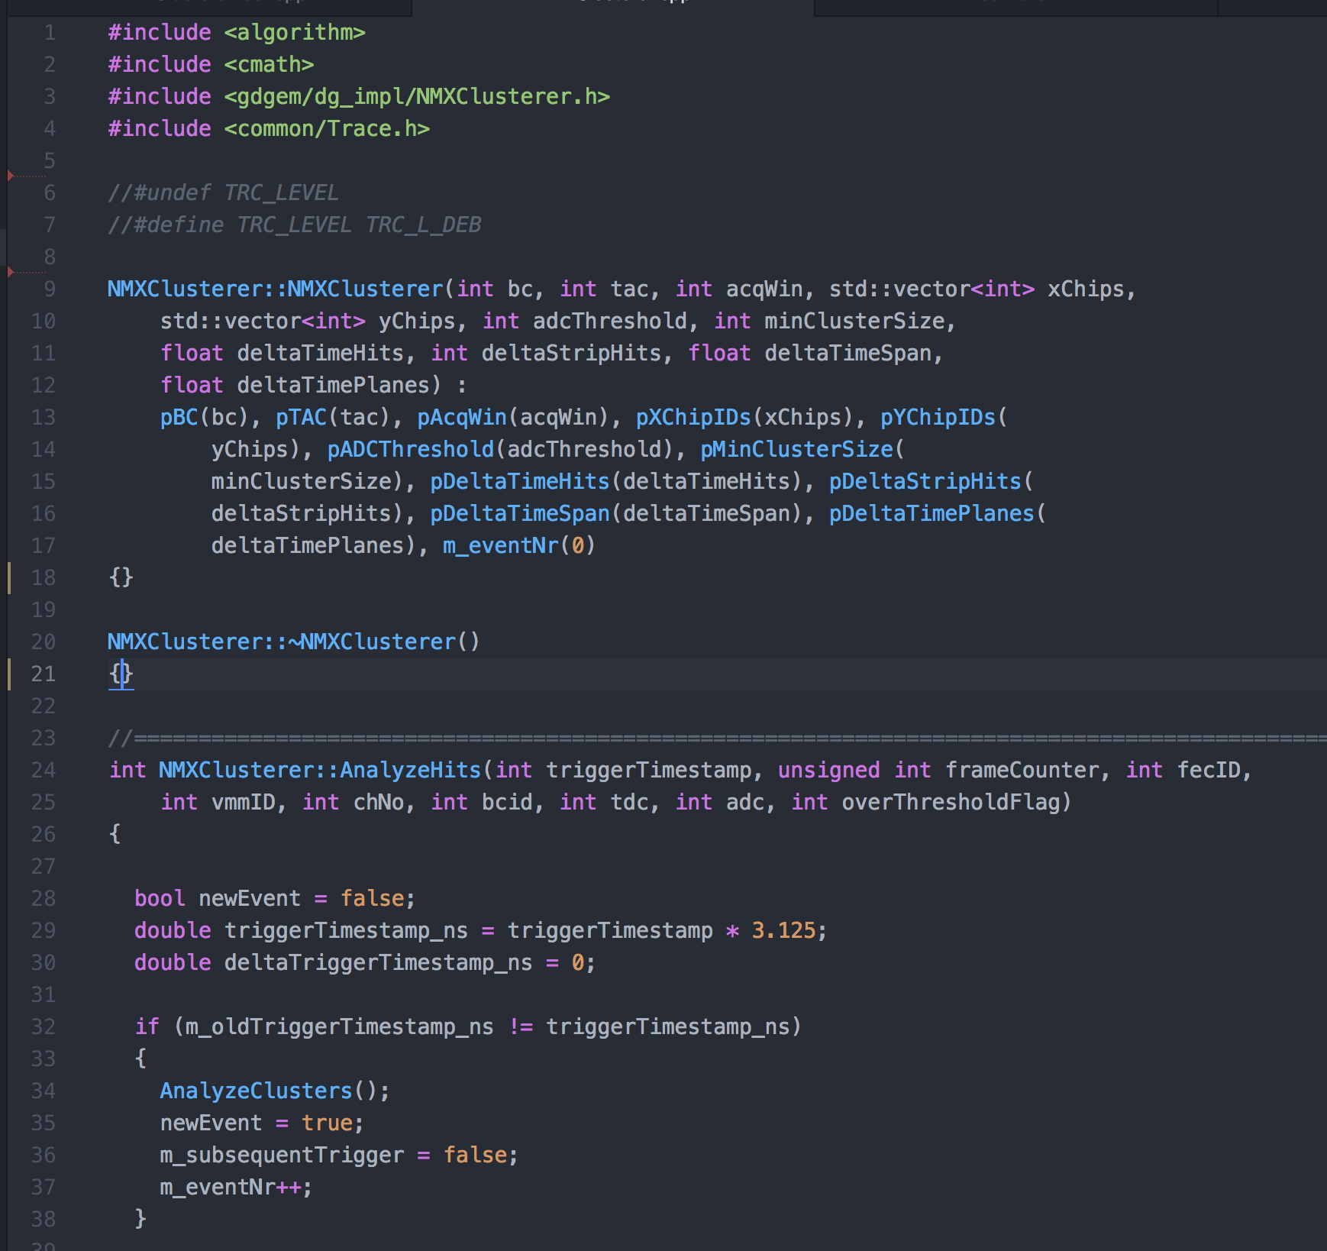
Algorithms
Algorithm Description
Email, paper, report, whiteboard walk-through
Prototype implementation
C, C++, Matlab, Python
Analyzed reference data
Text/binary files, wireshark captures, C or C++ arrays

Slide 14
Data Path
Geometry
  specify logical geometry in terms defined by ECDC
  specify physical geometry DRAM
Integration model ESS
  specify inner data format (https://tinyurl.com/y9ppkofy) with DMSC
Custom integration
  integrate with ESS timing system
  specify complete readout data format and encapsulation
  specify packet sizes, data rates, little endian
  specify addressing (IP and UDP)
Event formation
  specify algorithm for event formation
  consider how this can be scaled up/parallelized

Slide 15
Summary
Get in touch with us as early as possible
  preferably today ;-)
Feed the pipeline
  we need dates and deadlines for planning, see DMSC Wiki: (https://tinyurl.com/ybloos74)
  Priority and planning w. DG
Keep an eye on the interface
  Provide the necessary documentation
  the more accurate the faster we can deliver

Slide 16
References
Geometry definitions
ESS Generic Geometry Definitions - tinyurl.com/yaetmq6c
Detector Specific Defintions (multigrid) - tinyurl.com/y7m7x2rm
Readout
Protocol and Encapsulation - tinyurl.com/y9ppkofy
Collaboration
Dates and Opportunities - tinyurl.com/ybloos74
DMSC
ECDC Wiki - confluence.esss.lu.se/display/DMSC/Data+Management+Group
Source code on Github - https://github.com/ess-dmsc

Slide 17
The End

Slide 18
