Slide 1
ESS Cryogenic Distribution System
for Lund Test Stand 2
Responses to CDR and TRR1 Committees’ recommendations
J. Polinski
CDS-LTS2 Installation Rediness Review
12 Jan 2018 ESS, Lund, Sweden

Slide 2
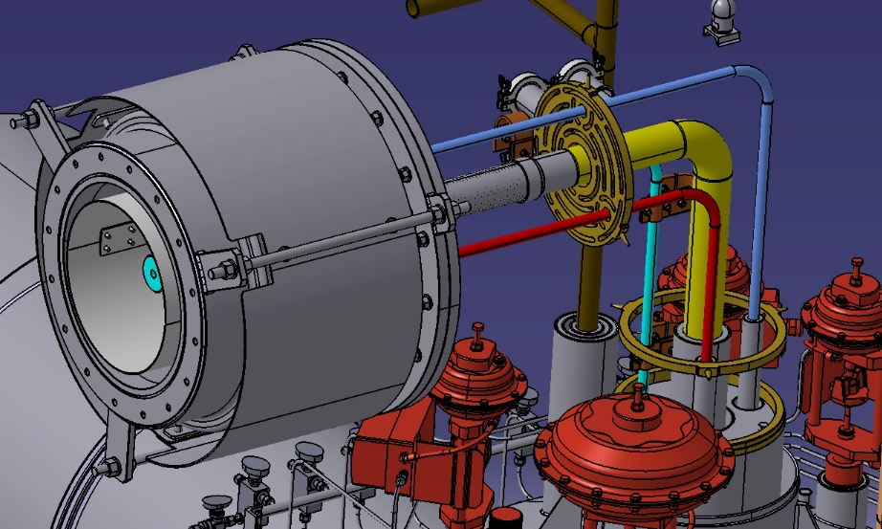
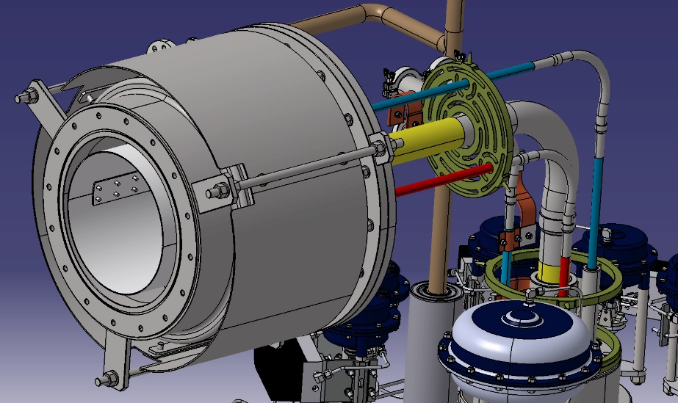
Requirement 2. WP5 will check (in both the tunnel and test stand cases) that there are not excessive forces on the interface between the cryomodule and the CDS. If these exist, WP5, WP11 and WUST must work together to optimize the design of the design of the jumper connection between the CDS and the cryomodule.
Metal hoses on He Suuply, TS supply and TS return lines have been added in the Jumper Connection.
Before modification
After modification

Slide 3
Requirement 3. Review the loading of the frames on the building pillars to ensure that they are acceptable. If reinforcement of the pillars is needed that is in ESS scope.
Last version of the report has been provided to ESS on 11th of Dec 2017. No ESS comments to this version so far.

Slide 4
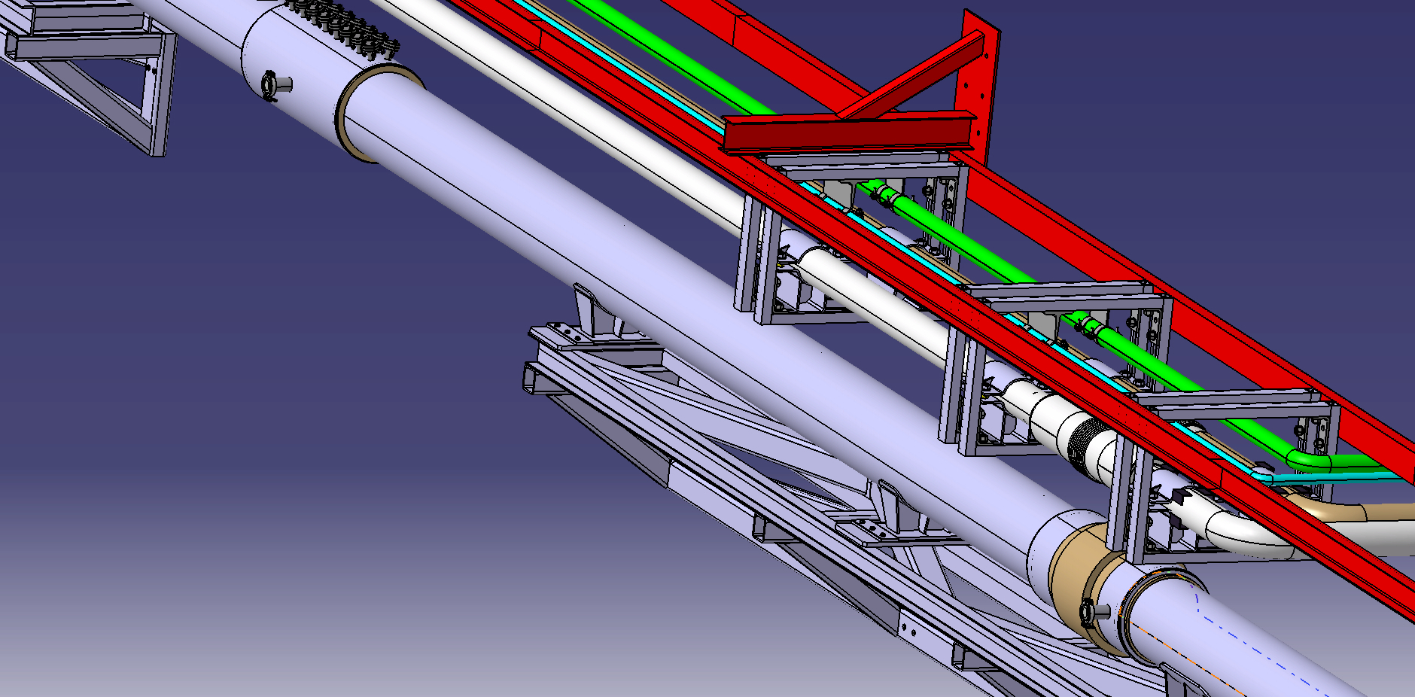
Requirement 4. Add a vacuum pumping port and KF DN40 control ports for the insulating vacuum tothe design. The location of the line vacuum pumping system and the number of vacuum ports and associated instrumentation ports will be proposed by ESS.

Slide 5
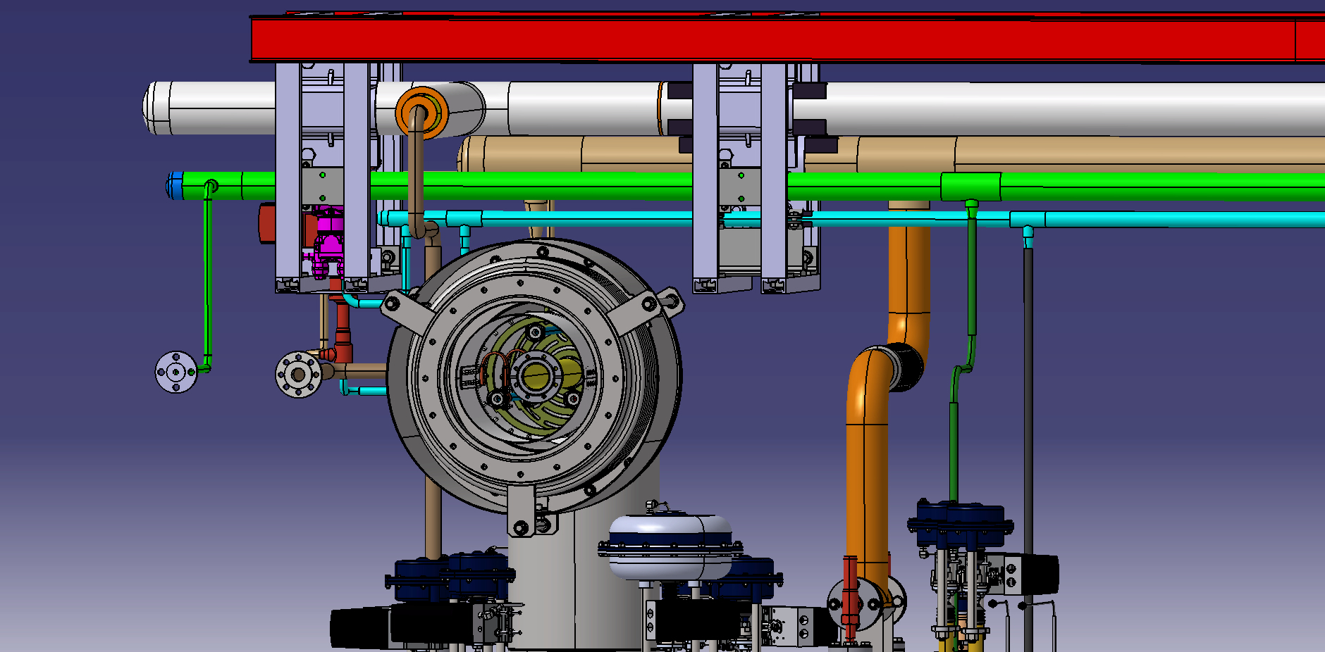
Requirement 7. Make the connections between the auxiliary process pipes, cryomodules and valve box flanged rather than welded

Slide 6
Requirement 8. Determine whether drilling of holes in the pillars and the floor is in the ESS scope or in the WUST scope.
It is agreed that the drilling of holes in the pillars and the floor is in the WUST scope. The WUST sub-contractor (Kriosystem) will perform this operation.

Slide 7
Requirement 10. ESS shall review with WUST the heat leak calculations to check the results. The heat leak to the He supply line should be lower.
Requirement 11. The control valve heat leaks shall be adjusted to take into account the expected heat stationing of the valves to the 50 K thermal shield.
The report was updated in the middle 2017, but it has been missing to provide to ESS for the comments.

Slide 8
Requirement 12. Use the ESS approved vacuum instrumentation standard (ESS Vacuum Specification) for the vacuum instrumentation.
It is agreed that the signal from the vacuum gauge will be in 0-10V standard.

Slide 9
Requirement 14. A final solution for a radiation resistant pressure transducer must be achieved. This applies to the tunnel and test stand CDS and the cryomodules.
It is agreed to use Honeywell Model Super TJE

Slide 10
Requirement 17. Cable information and electrical diagrams shall be provided to ESS by TRR1
Electric diagrams have been updated on 20ty of Dec 2017. For the cable list there are still some missing information from the ESS side.

Slide 11
TRR recommendations for LTS2
ESS and WUST should agree in August on a schedule for early installation of the CDS-TS2. Based on this, an IRR and start date can be agreed upon. - DONE
WUST and KrioSystem should start to complete the WSCP prior to August. - DONE
WUST and Kriosystem will need to establish a formal coordinate system that they measure and align against and communicate that to the ESS Survey Group – to be done
ESS will provide the required fiducials and survey balls to KrioSystem for the alignment surveys during construction. – numer of the fidutial and delivery time to be provided by KS
ESS Survey Group will attend the measurements of the first valve box. - OK
KrioSystem should show by calculation that the mixture of He and Nitrogen used in the combined pressure and leak test will provide a signal sensitive enough to verify the minimum required leak rate. - to be discussed
Add a lock on HV60 to prevent operation when shield circuit is pressurized. An additional safety valve at each valve box might be needed. Also add (ESS) a local pressure gauge so that operators can determine the pressure present before operating the valve. - to be discussed
WUST and its sub-contractor KrioSystem shall communicate to the Area Supervisors, via the WSCP, their needs for equipment, services and trainings for the installation phase. - DONE
ESS would like to witness a number of tests mutually agreed upon with WUST - OK
WUST will propose a detailed cost estimate for making the required changes to the interface to TICP. – to be done

Slide 12
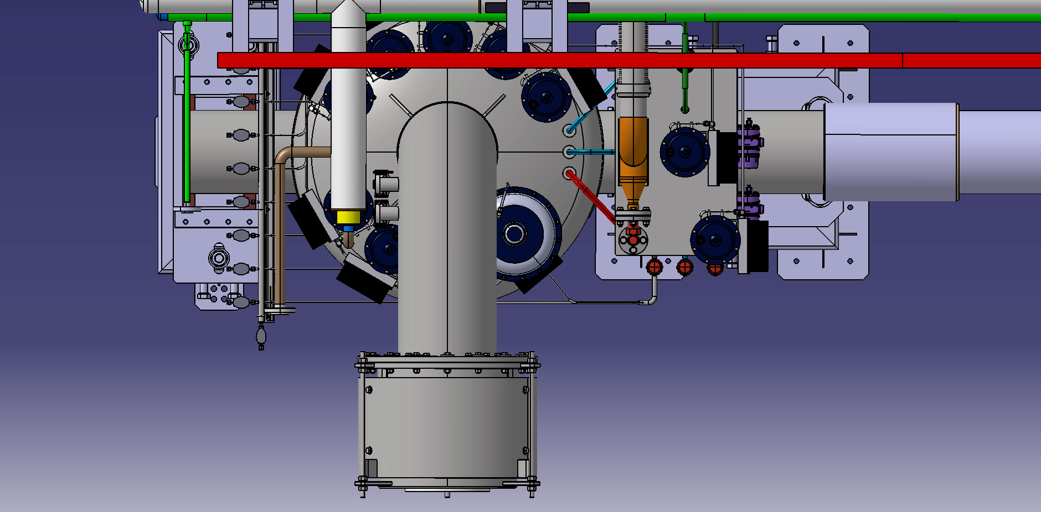
TRR recommendations for LTS2
11. WUST shall investigate ways {such as angling the valve} to eliminate the interference of the valve removal with the CDS-TS2 jumper connection.

Slide 13
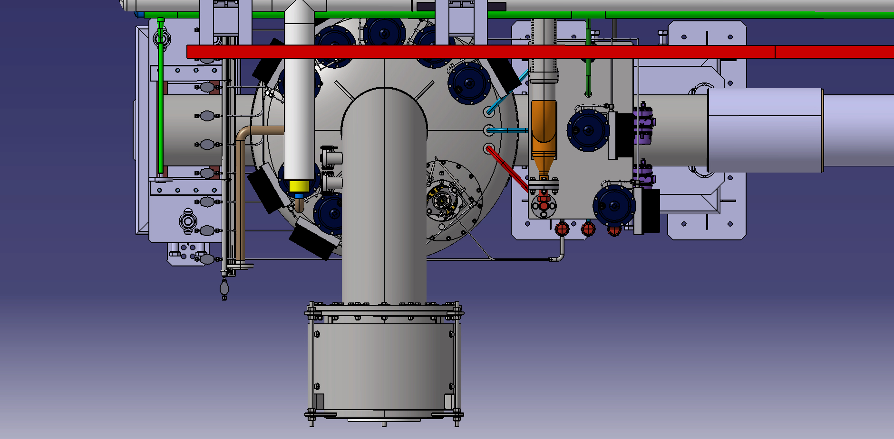
TRR recommendations for LTS2
11. WUST shall investigate ways {such as angling the valve} to eliminate the interference of the valve removal with the CDS-TS2 jumper connection.

Slide 14
Thank you for your attention!

