Slide 1
ESS Cryogenic Distribution System
for Lund Test Stand 2
CDS-LTS Design Modifications
Influence to Risk Analysis
Agnieszka Piotrowska
CDS-LTS2 Installation Rediness Review
12 Jan 2018 ESS, Lund, Sweden

Slide 2
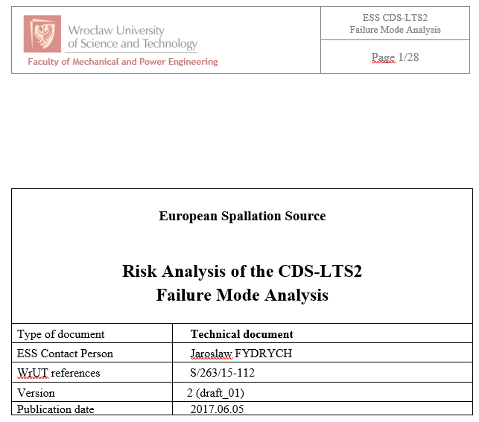
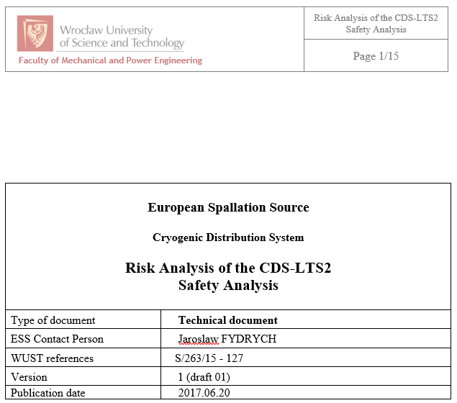
Introduction
Identification and classification of all potential failure modes of the Cryogenic Distribution System for Lund Test Stand 2
Identification and classification of the failure modes of the CDS-LTS2 which consequences can lead to risk for a personnel

Slide 3
Introduction
DATA
Identification and classification of all potential failure modes of the Cryogenic Distribution System for Lund Test Stand 2
Identification and classification of the failure modes of the CDS-LTS2 which consequences can lead to risk for a personnel

Slide 4
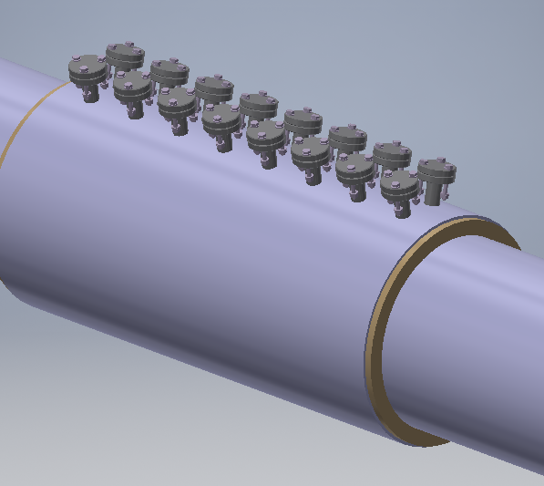
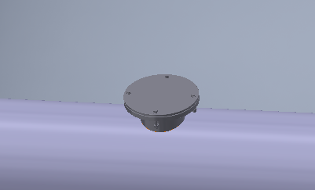
Modifications in LTS2 CTL
Reduction of the Vac. Vessel SV size and increase of SV number from 3 to 50
Before modification
After modification

Slide 5
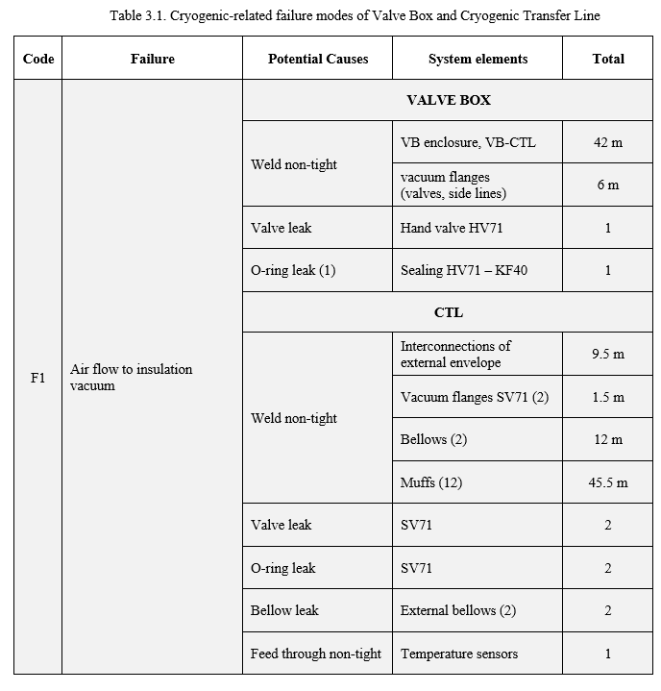
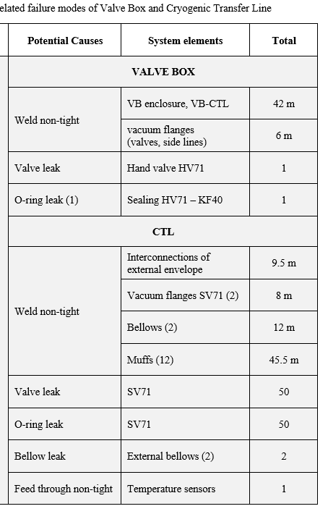
Failure Analysis update
Before modification After modification

Slide 6
Failure Analysis update
Before modification After modification

Slide 7
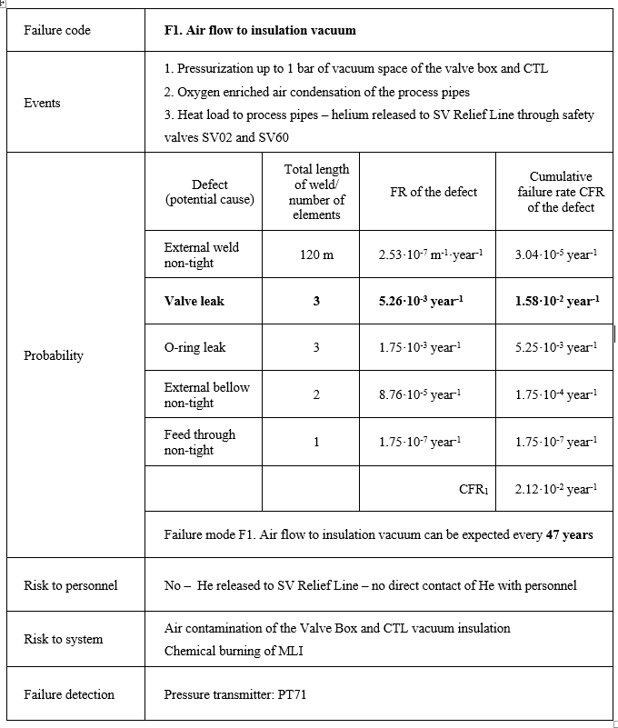

Failure Analysis update
Before modification After modification

Slide 8
Failure Analysis update
Before modification After modification

Slide 9
Failure Analysis update
Before modification After modification

Slide 10
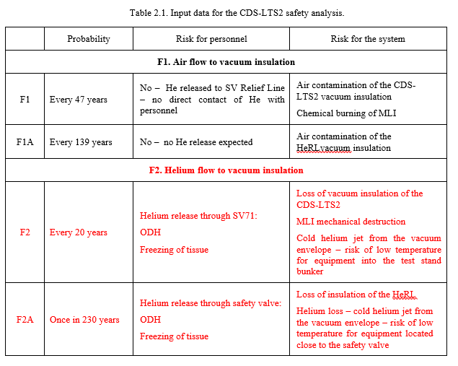
Safety Analysis update

Slide 11
Thank you for your attention!

