Slide 1

Wroclaw 10.01.2018
CDS-LTS2 Assembly
Positioning, alignment strategy and assembly steps
Maciej Matkowski
Project Manager
maciej.matkowski@kriosystem.co.pl
CRYOGENICS IS OUR PASSION
www.kriosystem.com.pl

Slide 2
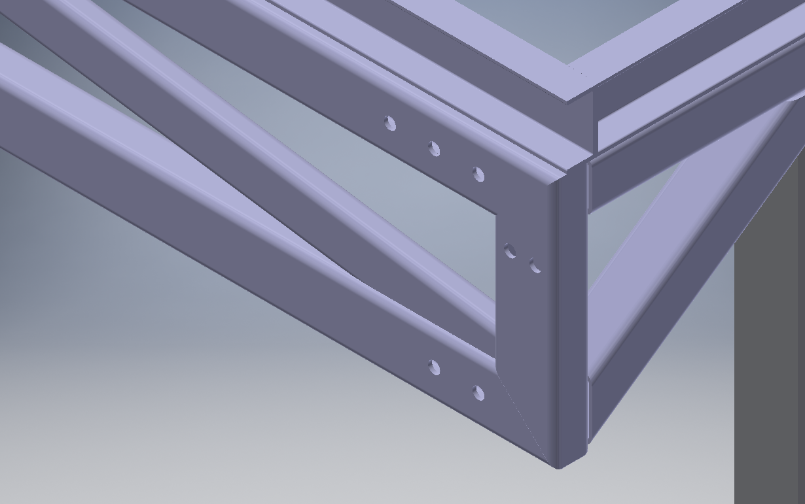
Drilling
We expect to have marked Reference points or level for mounting the bracket frames
We will prepare a plate with holes to make a proper drilling.
www.kriosystem.com.pl

Slide 3
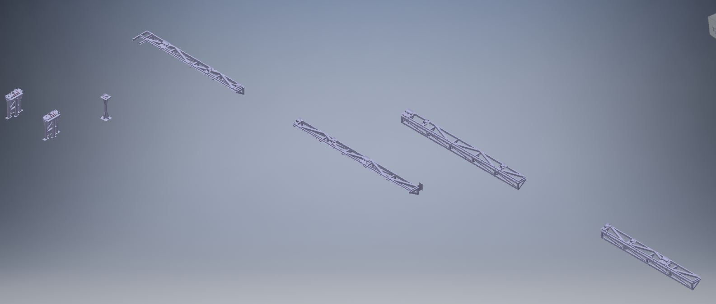
Supports assembly
www.kriosystem.com.pl

Slide 4
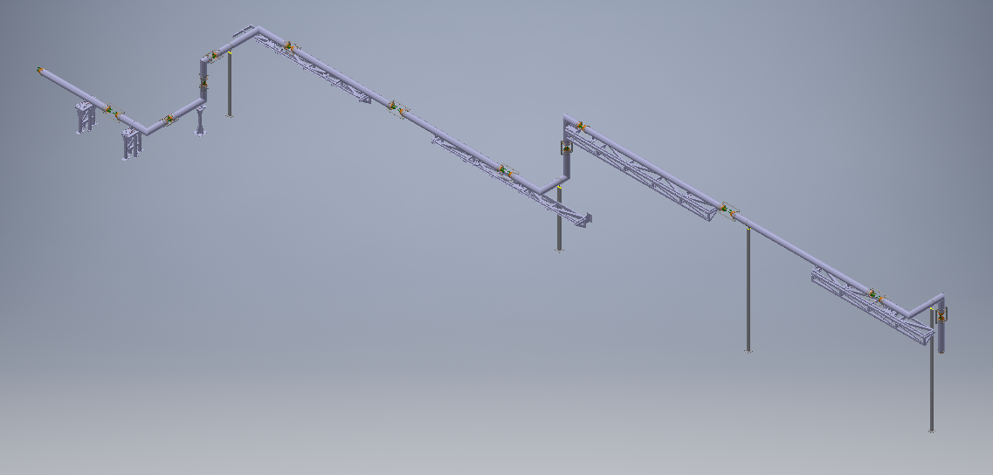
CDS Line positioning and alignment
www.kriosystem.com.pl

Slide 5
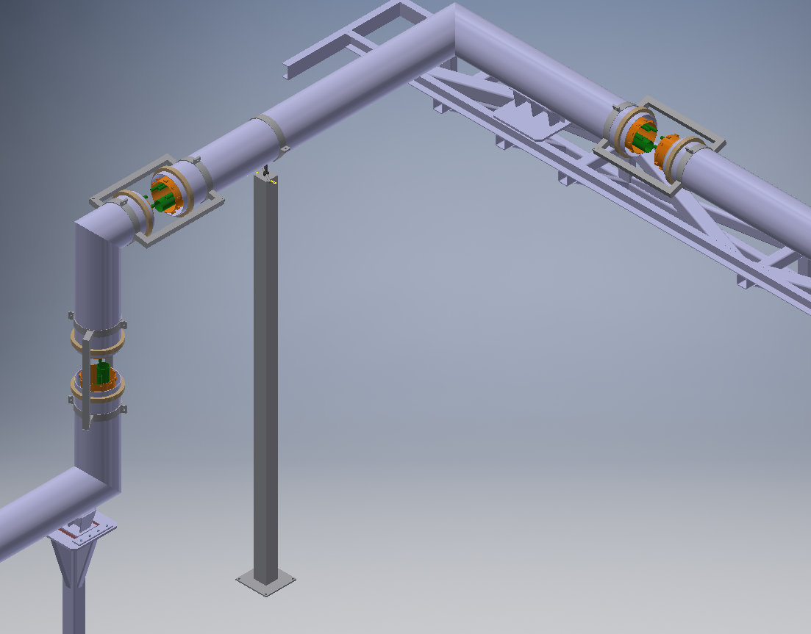
CDS Line positioning and alignment
www.kriosystem.com.pl

Slide 6
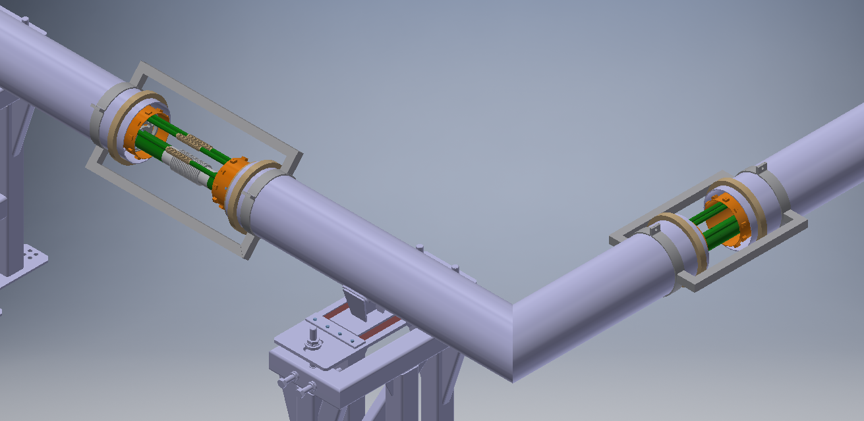
Welding process pipes
VT, X-Ray, pressure and leak tests
MLI wrapping
www.kriosystem.com.pl

Slide 7
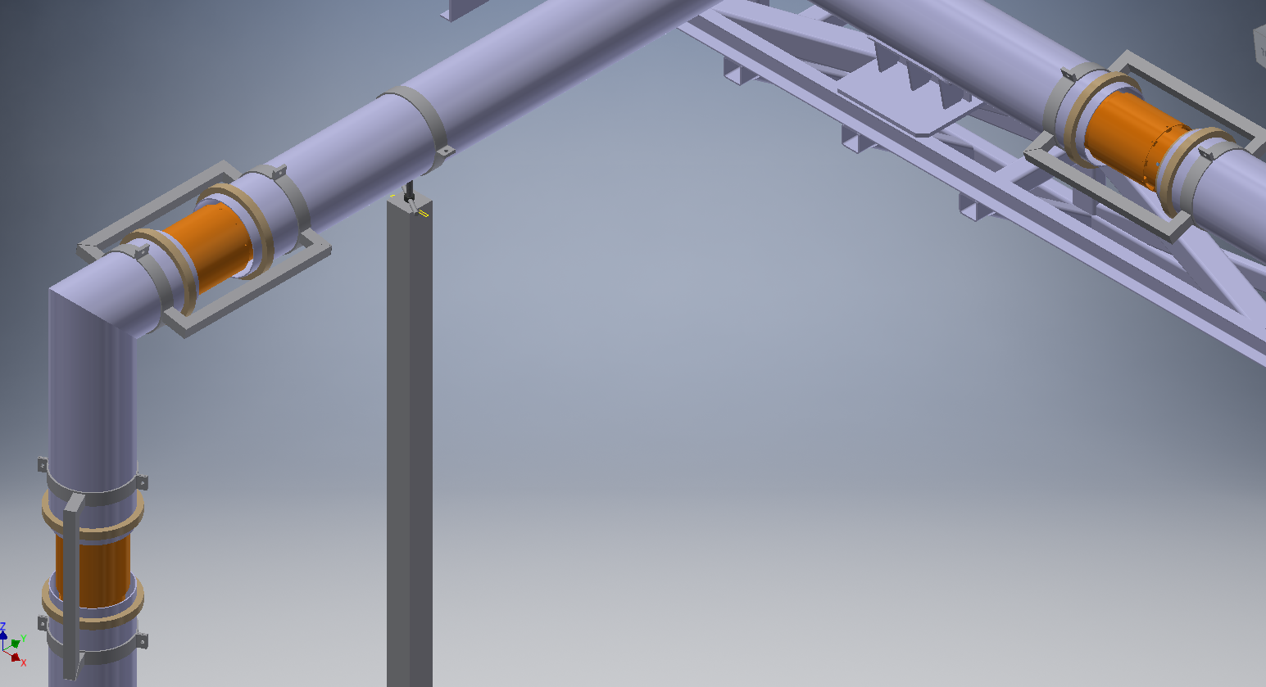
Thermal shield assembly and MLI wrapping
www.kriosystem.com.pl

Slide 8
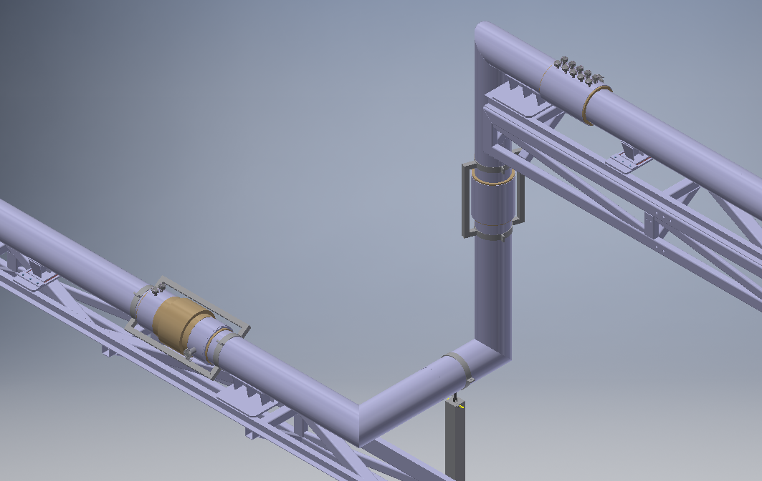
OJ assembly
Tests
www.kriosystem.com.pl

Slide 9
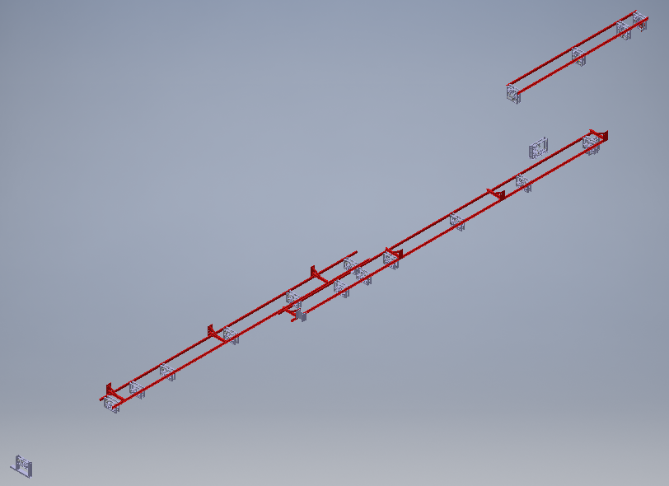
Aux Supports assembly
www.kriosystem.com.pl

Slide 10
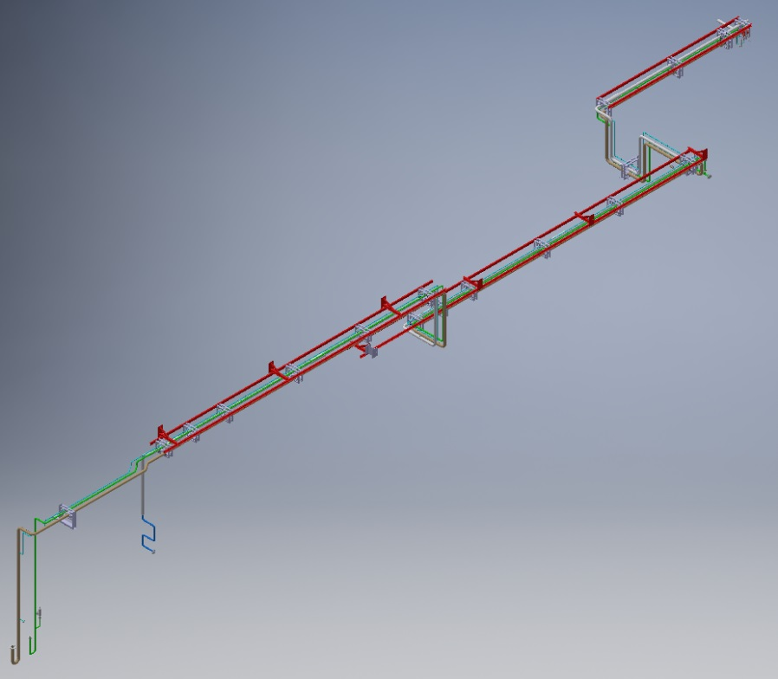
Assembly and welding aux lines
Tests of aux lines
www.kriosystem.com.pl

