Slide 1
ESS Cryogenic Distribution System
for Lund Test Stand 2
CDS-LTS design modifications and responses to ESS observations on 3D models
J. Polinski, J. Skrzypacz, P. Jaszak, B. Chomiuk, C. Blach¹
¹- Kriosystem, Wroclaw
CDS-LTS2 Installation Rediness Review
12 Jan 2018 ESS, Lund, Sweden

Slide 2
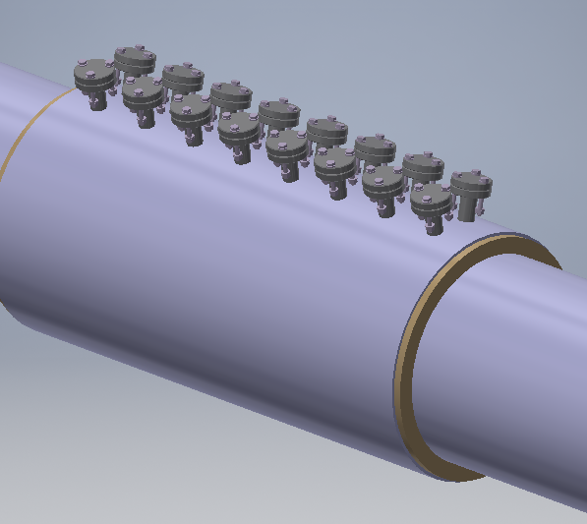
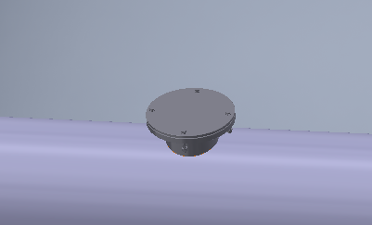
Modifications in LTS2 CTL
Reduction of the vacuum vessel safety plates size and increas of SV number from 3 to 50
Before modification
After modification

Slide 3
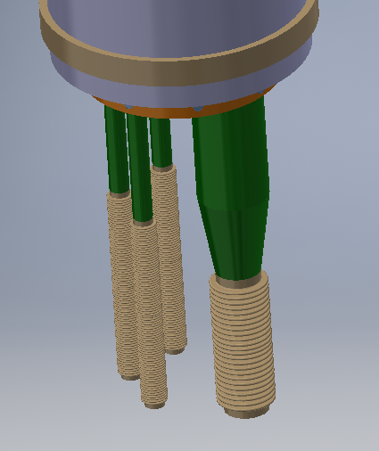
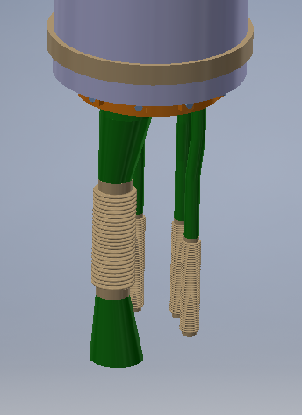
Modifications in LTS2 CTL
Adaptation of CTL Module 0 connection to the existing terminal in the TICP. Reduction of DN65 (VLP) line has changed from symmetric to asymmetric. DN15 pipes will be bending.
Before modification
After modification

Slide 4
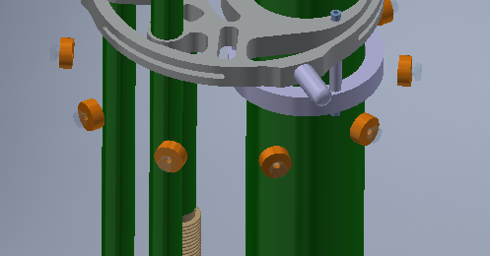
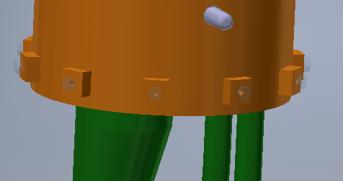
Modifications in LTS2 CTL
Modification of the TS muff fixation elements at the CTL interconnections
Before modification
After modification

Slide 5
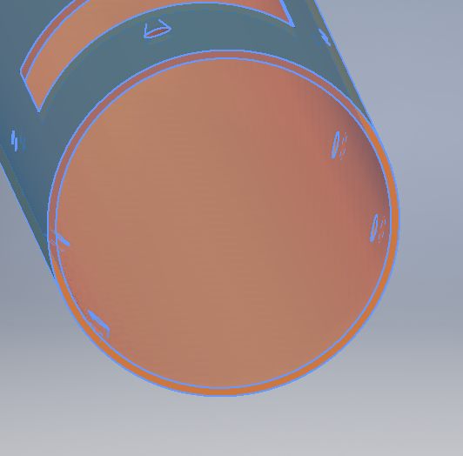
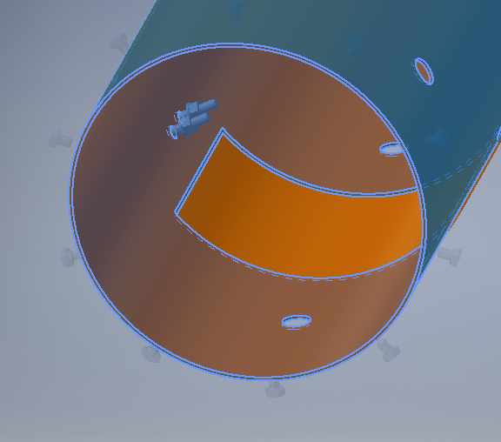
Modifications in LTS2 CTL
TS wall thickness has been chaged from 5 to 2 mm
Before modification
After modification

Slide 6
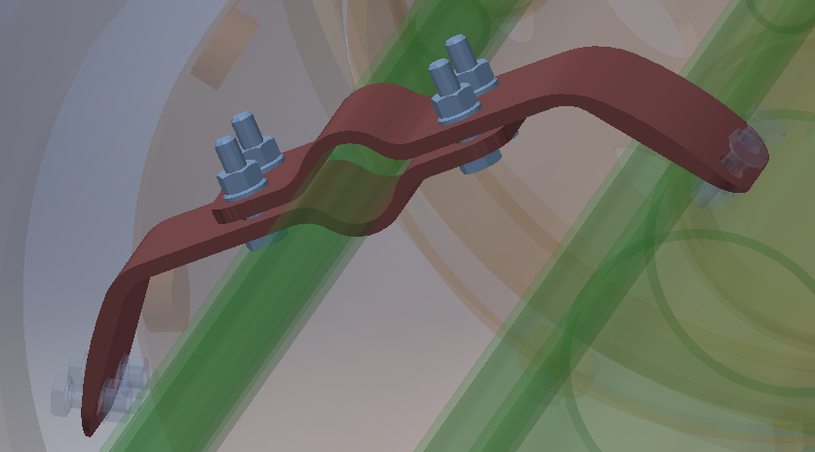
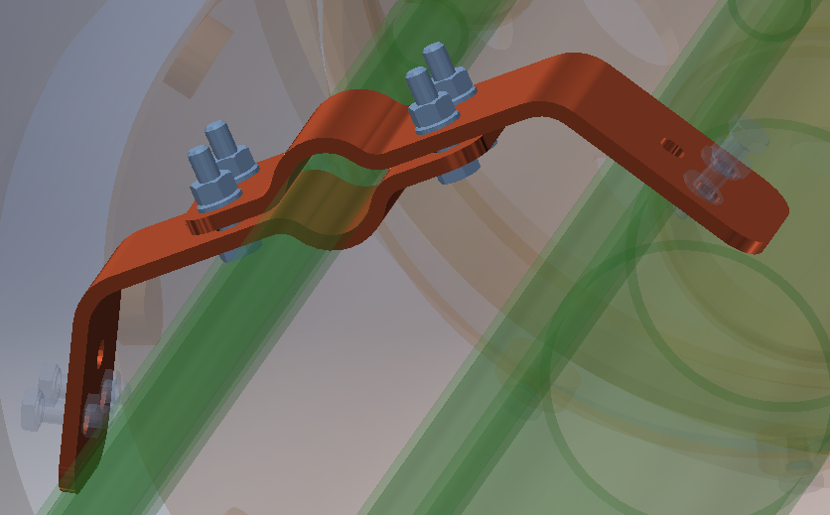
Modifications in LTS2 CTL
Rigid thermal bridges design has been modified to fit into the production techniques
Before modification
After modification

Slide 7
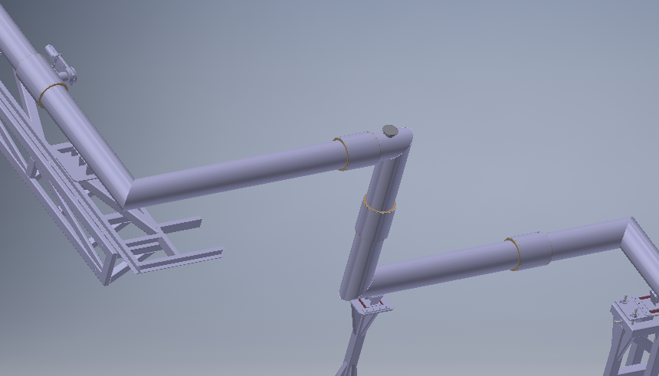
Modifications in LTS2 CTL
The module, that penetrates the bunker, has been split into two parts in order to make an module assembly possible.
After modification

Slide 8
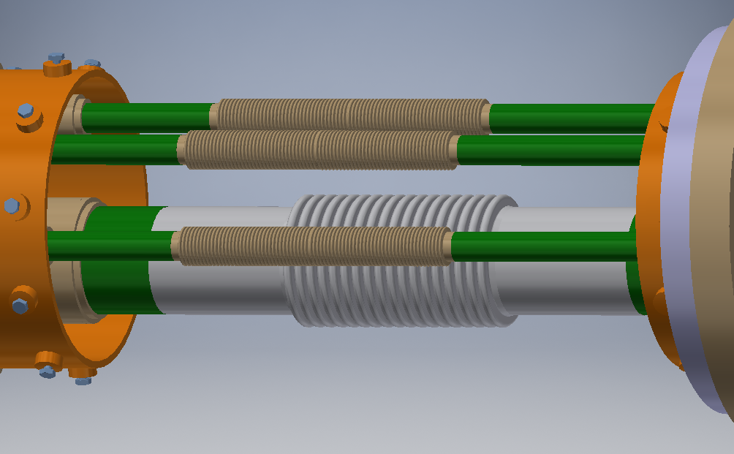
Modifications in LTS2 CTL
Internal bellows length has changed as the final bellows manufacturer is different than the manufacturer considered during the design process.
After modification

Slide 9
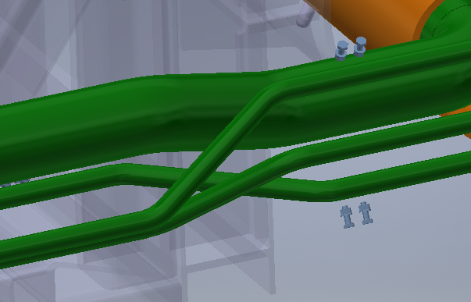
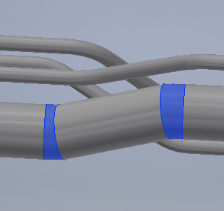
Modifications in LTS2 CTL
Design of the process pipes in Module 4 has been change. The pipes bends have been replaced with standard elbows elements
Before modification
After modification

Slide 10
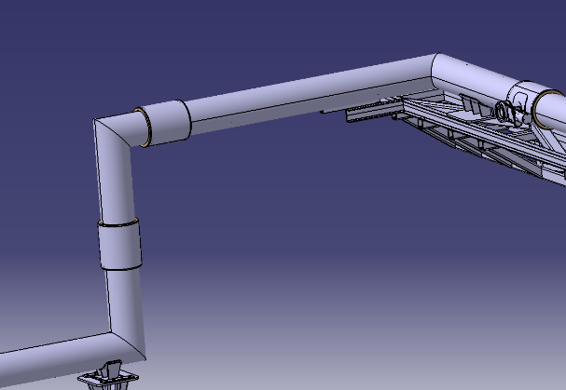
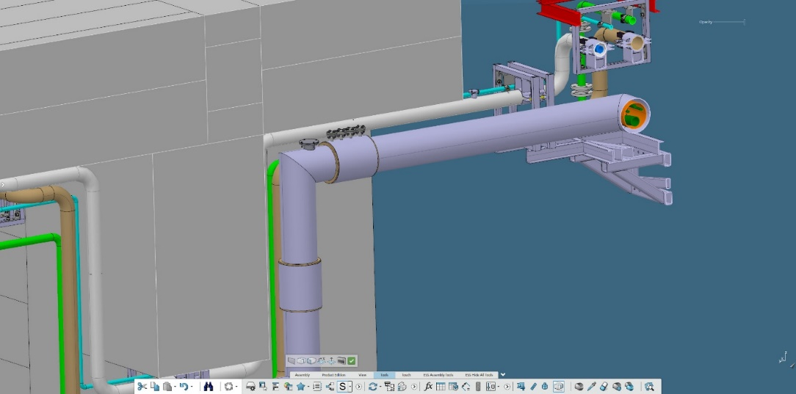
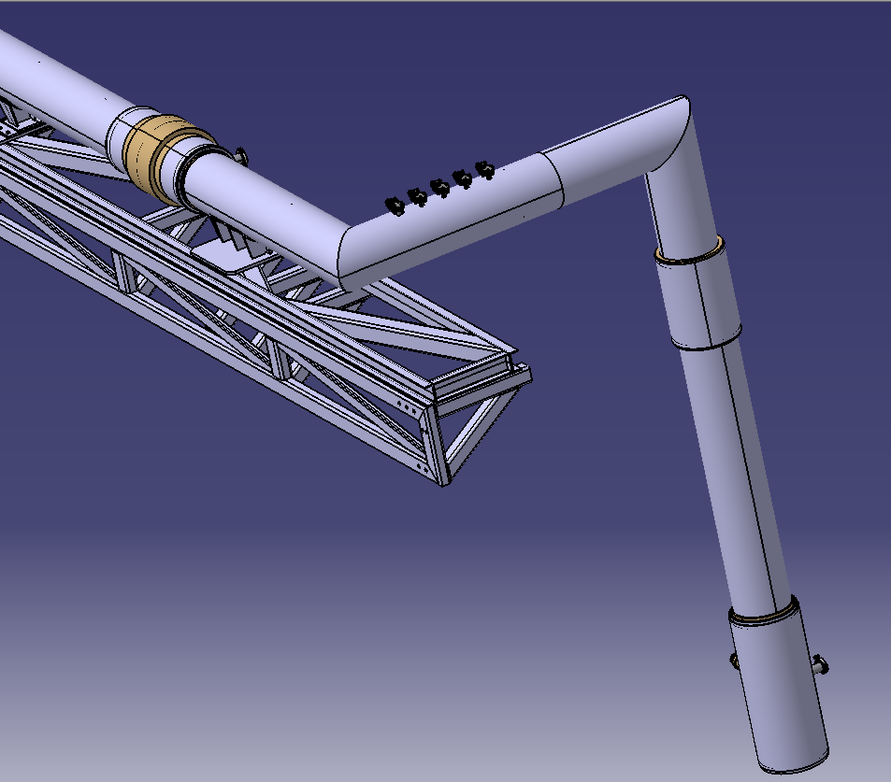
Modifications in LTS2 CTL
The safety plates have been moved from the bunker chicane to the other module
After modification
Before modification

Slide 11
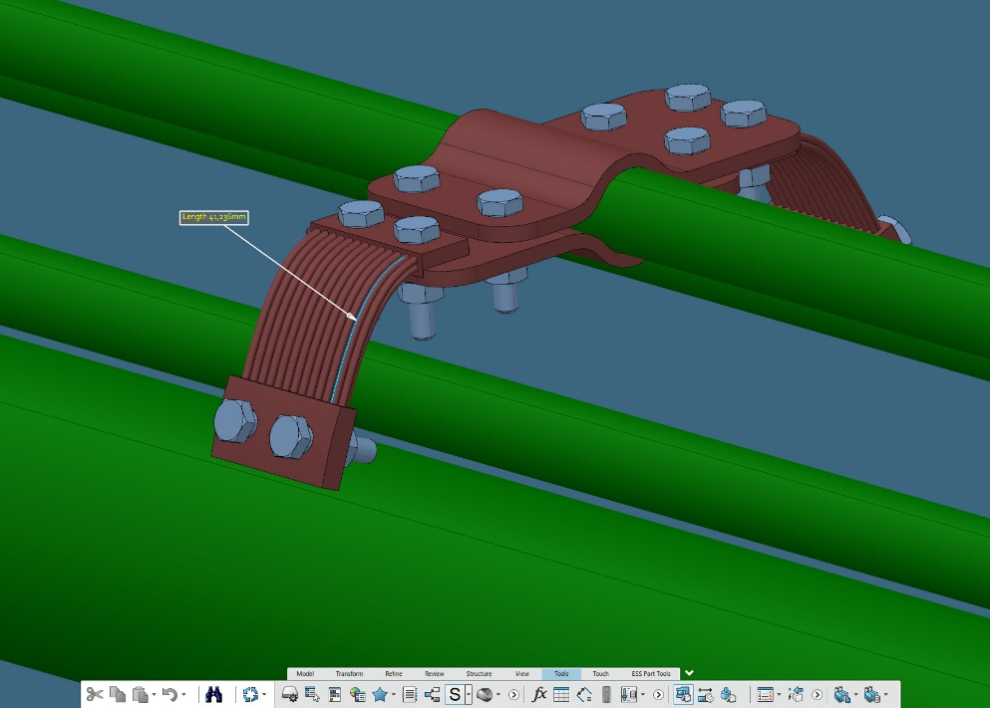
Modifications in LTS2 CTL
The total length of the thermal bridge braids in the CTL TS return line has been enlarged from 41 to 70 mm. The braids will be squeezed during the installation in order to fit the length into existing holes in the TS. This should also increase the braids flexibility.
Before modification

Slide 12
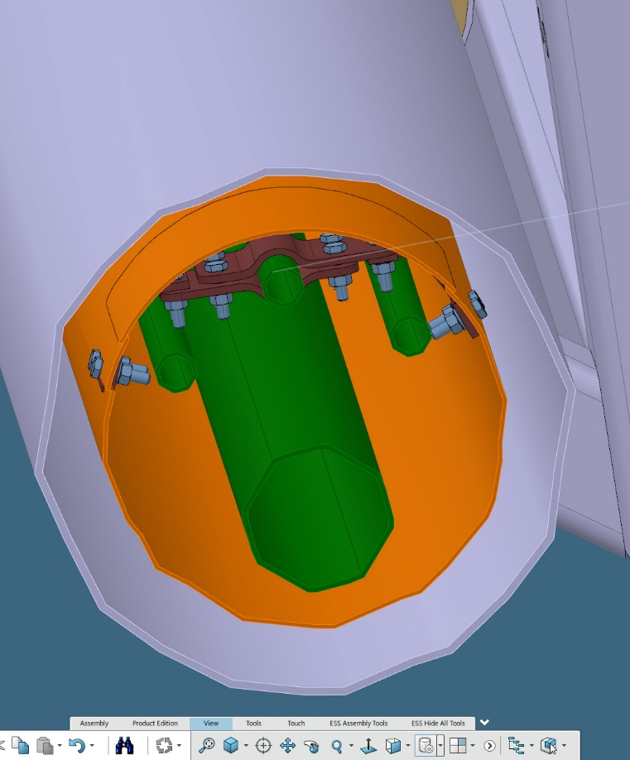
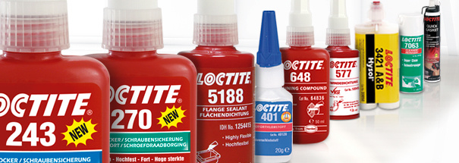
Modifications in LTS2 CTL
The bolts at the connections between the TS return line and the thermal shield will be protected against self-unscrewing with LocTite

Slide 13
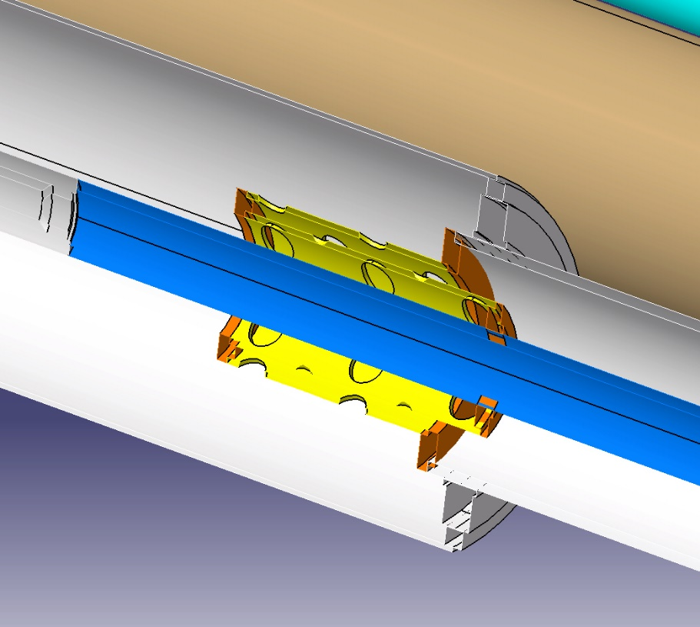
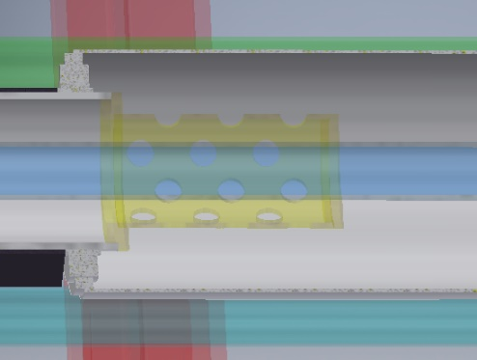
Modifications in LTS2 Aux Lines
He Recovery Line
Fixing suport design has been changed in order to reduce freezing risk on the vacuum envelope
Before modification
After modification

Slide 14
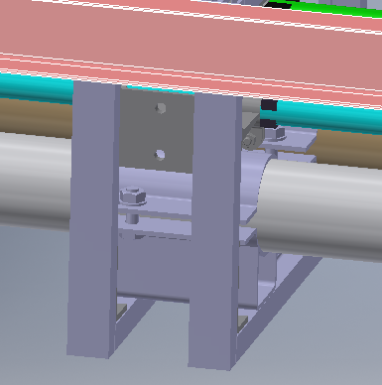
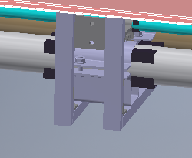
Modifications in LTS2 Aux Lines
He Recovery Line
Additional L-bars have added next to both sides of the external fix supports
Before modification
After modification

Slide 15
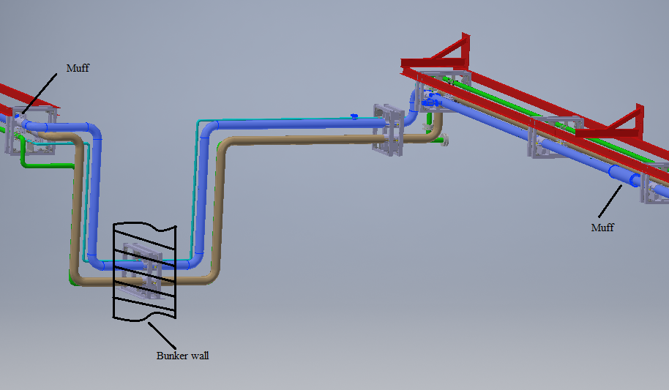
Modifications in LTS2 Aux Lines
He Recovery Line
Some modules have been spilt in to the small modules in order to make the installation easer
After modification

Slide 16
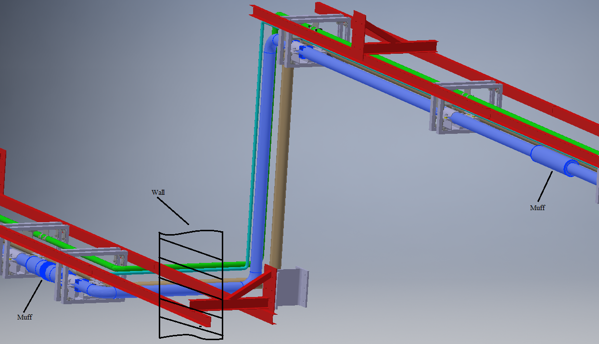
Modifications in LTS2 Aux Lines
He Recovery Line
Some modules have been splt in to the small modules in order to make the installation easer
After modification

Slide 17
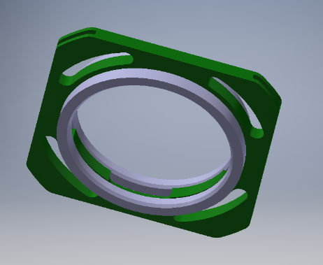
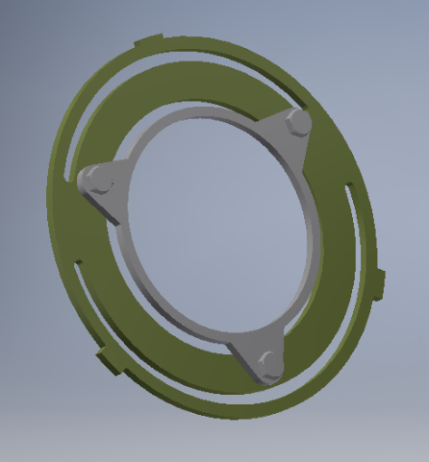
Modifications in LTS2 Aux Lines
He Recovery Line
Internal sliding supports have been redesign on order to optimize the production process. The CDS-LTS2 produder solution has been applied
Before modification
After modification

Slide 18
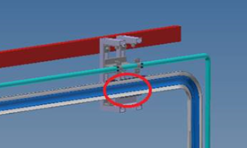
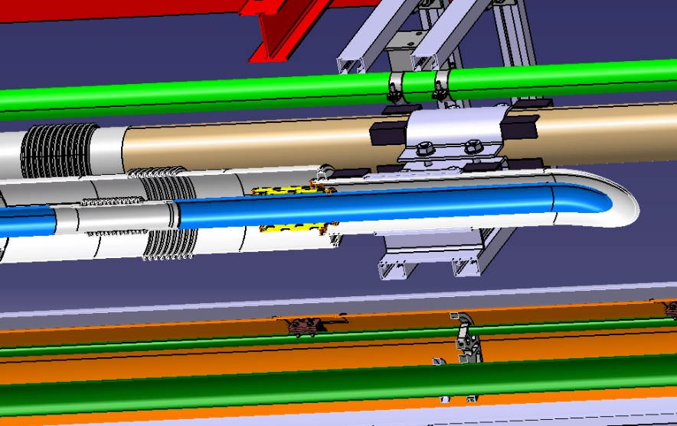
Modifications in LTS2 Aux Lines
He Recovery Line
One internal fix support were missing
Before modification
After modification

Slide 19
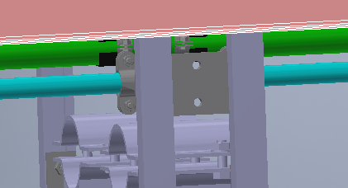
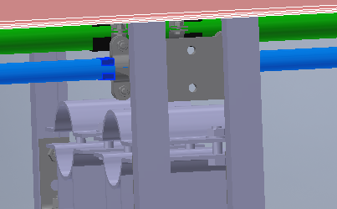
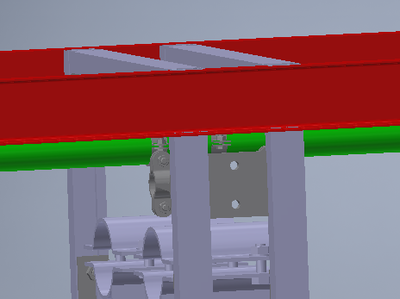
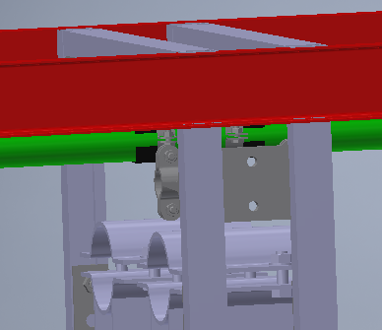
Modifications in LTS2 Aux Lines
SV relief, HP and Purge return Lines
Additional L-bars have added next to both sides of the external fix supports
Before modification
After modification

Slide 20
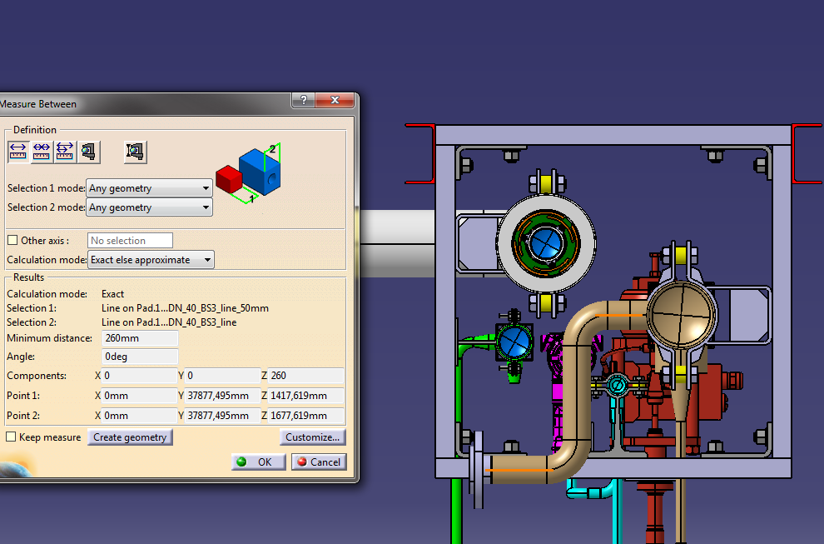
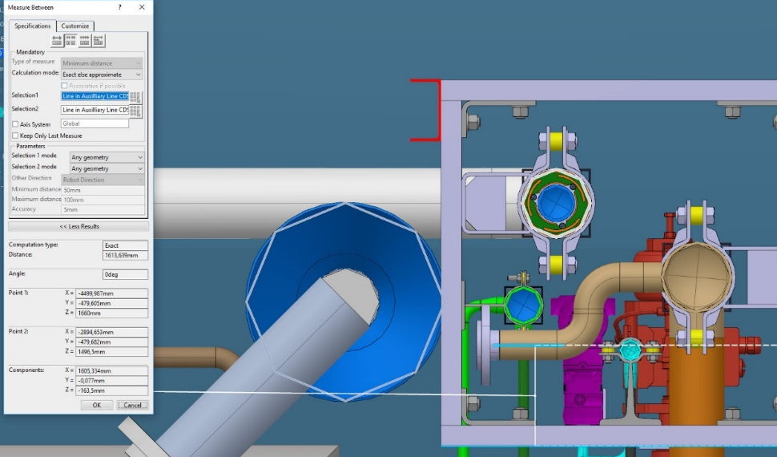
Modifications in LTS2 Aux Lines
The connection of the SV Relief line to the Cryo Module has been moved as per doc: „ESS observations on the CDS-LTS2 3D model”
Before modification
After modification

Slide 21
Modifications in LTS2 Aux Lines
„There are small misalignments in the CDS-LTS2 interfaces to TICP cold box auxiliary lines in the CXH, auxiliary lines in the TS2 bunker and the building pillars.”
The misalignments are in the range of from 0.418 to 2.1 mm, what is in the range of the installation tolerances.

Slide 22
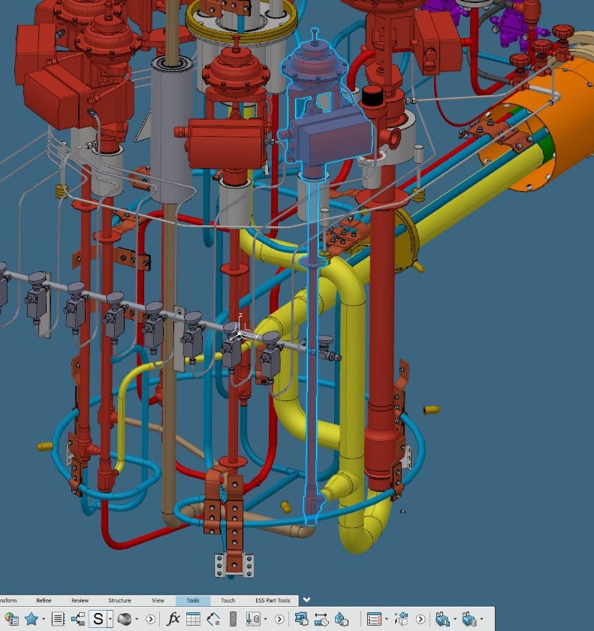
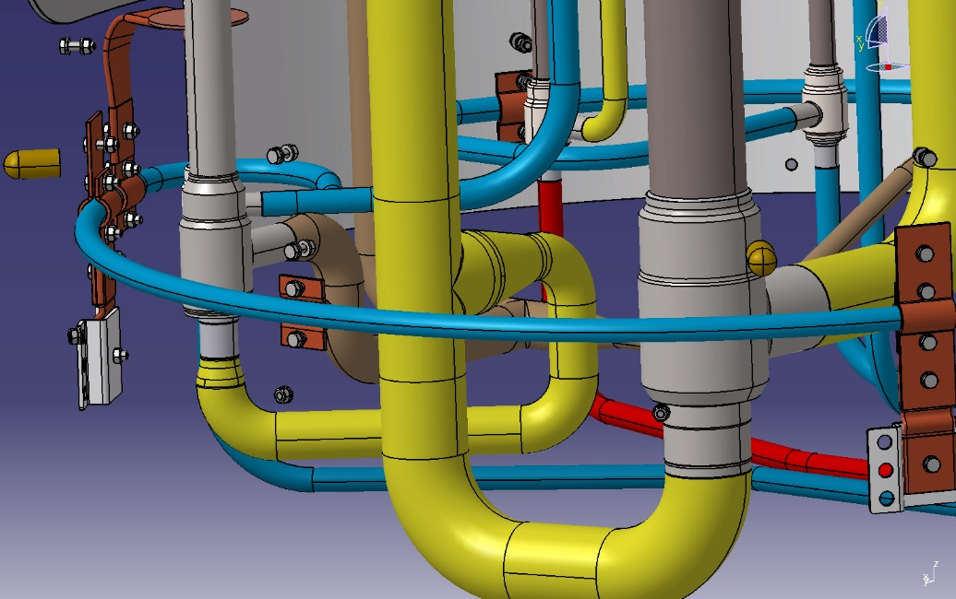
Modifications in LTS2 Valve Box
Based on doc: „ESS observations on the CDS-LTS2 3D model” the connection of the pipes to the CV-06 valve has been swapped in order to avoid a necessity of helium guard use.
Before modification
After modification

Slide 23
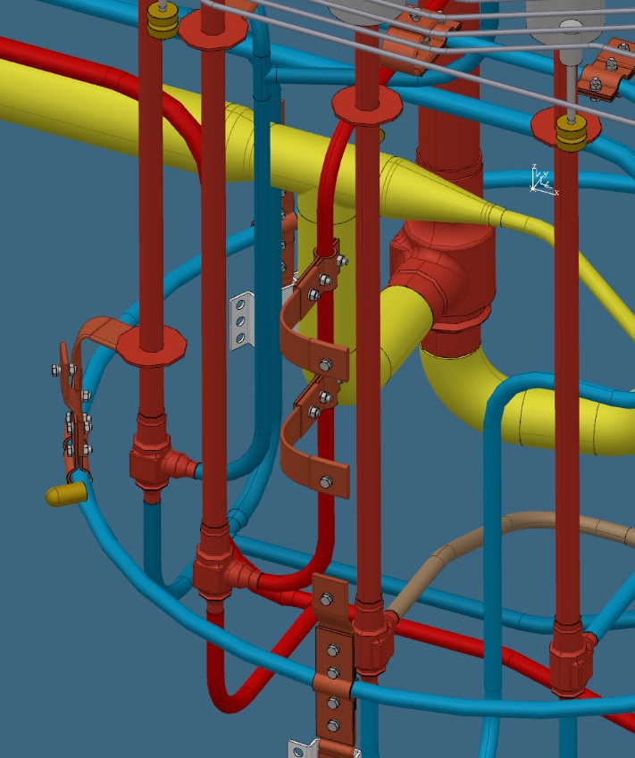
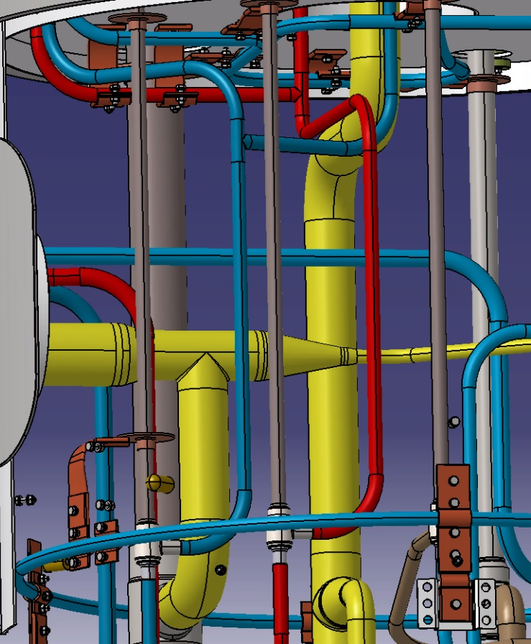
Modifications in LTS2 Valve Box
Based on doc: „ESS observations on the CDS-LTS2 3D model” the thermal anchoring has been moved from BC to SC line.
Before modification
After modification

Slide 24
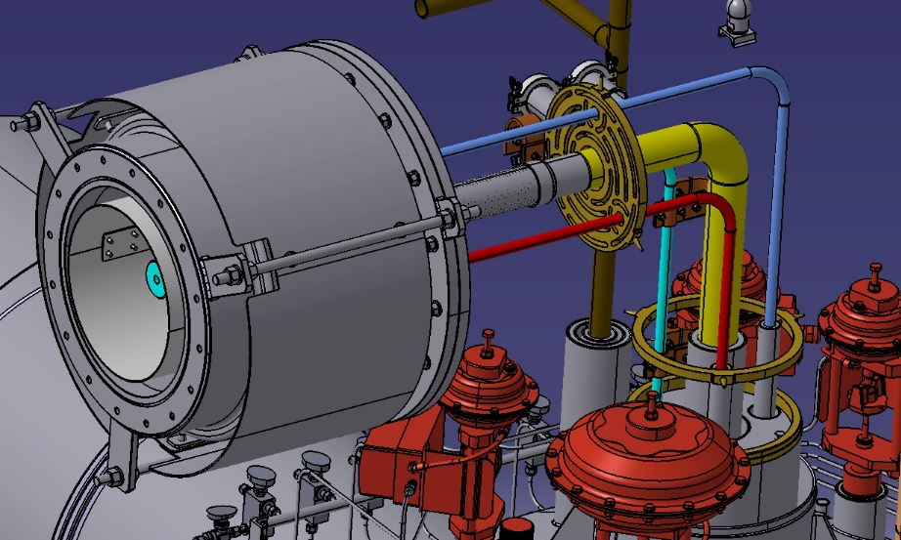
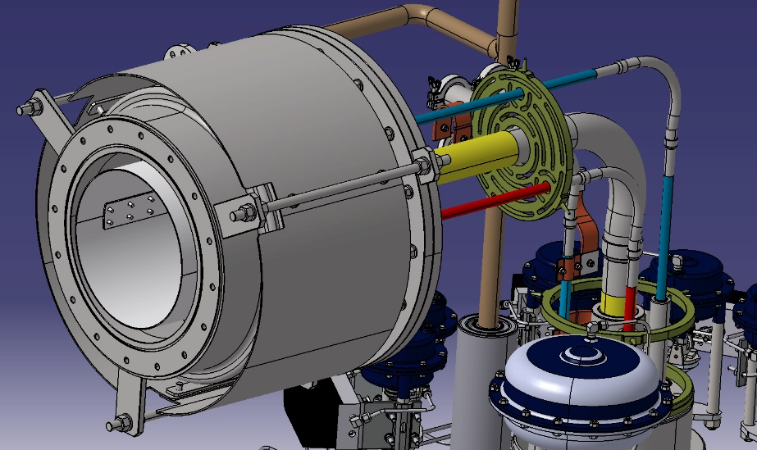
Modifications in LTS2 Valve Box
Metal hoses on He Suuply, TS supply and TS return lines have been added in the Jumper Connection. The m
Before modification
After modification

Slide 25
Thank you for your attention!

