Slide 1

Wroclaw 10.01.2018
ESS – CDS-EL and CDS-LTS2
Progress status
Maciej Matkowski
Project Manager
maciej.matkowski@kriosystem.co.pl
CRYOGENICS IS OUR PASSION
www.kriosystem.com.pl

Slide 2
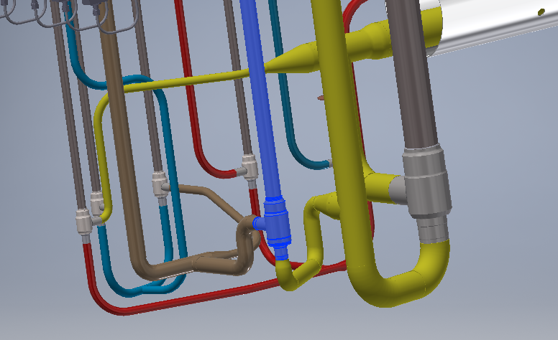
3 D Model
Changes due to flow directions and actual dimensions of the valves.
We have changed the 3 D Model of VB-LTS2
Routing of pipes connected to CV06 was changed
Connection to CV06 was changed
CRYOGENICS IS OUR PASSION
www.kriosystem.com.pl

Slide 3
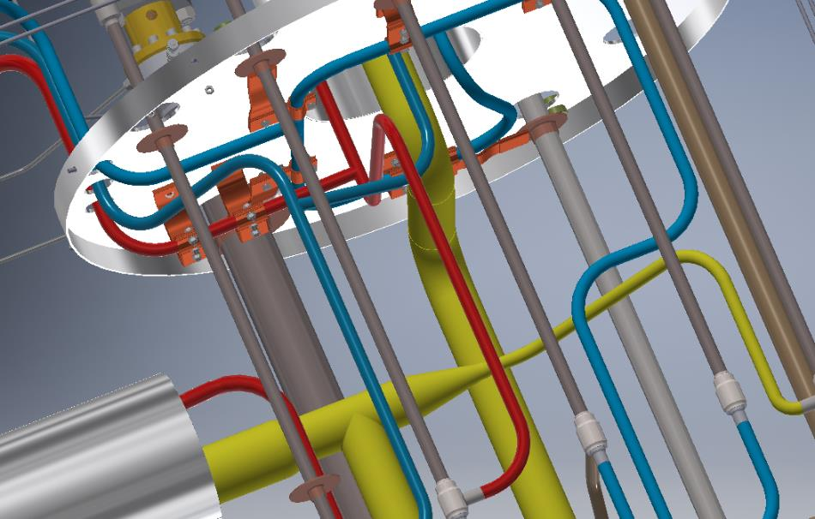
3 D Model
We have changed the 3 D Model of VB-LTS2
Localization of thermal briges on pipeline 8 BC was changed
CRYOGENICS IS OUR PASSION
www.kriosystem.com.pl

Slide 4
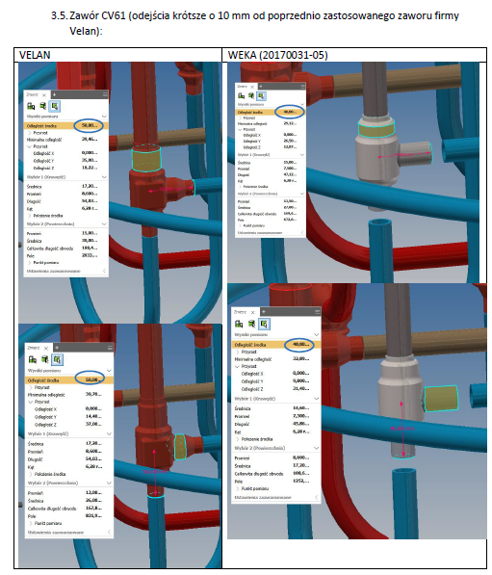
3 D Model
We have changed the 3 D Model of VB-LTS2
Some prepared pipes for VB-LTS2 we had to modify because of routing and valve dimensions was changed
CRYOGENICS IS OUR PASSION
www.kriosystem.com.pl

Slide 5
3 D Model
„WARM” side of the valvebox need to be design for:
Pressure transmitters (sizing and shapes)
Pressure Relieve Valves (dimensnsions, fittings and pipe connections)
CRYOGENICS IS OUR PASSION
www.kriosystem.com.pl

Slide 6
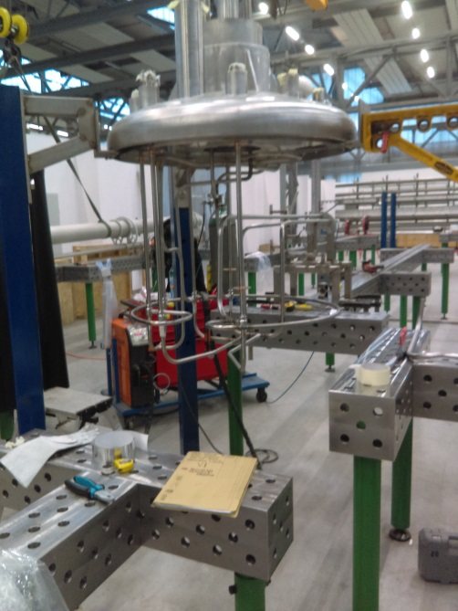
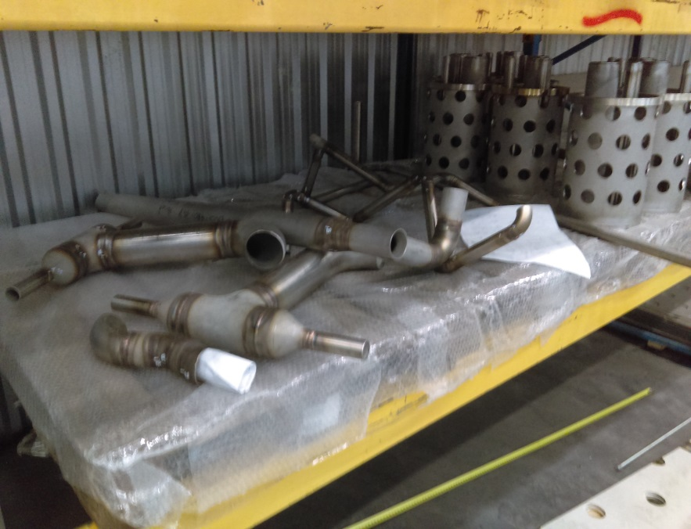
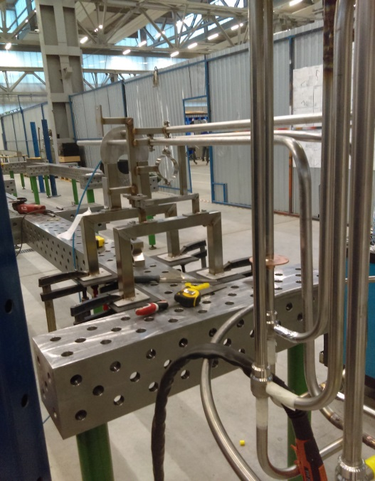
VB – LTS2 assemblly status
CRYOGENICS IS OUR PASSION
www.kriosystem.com.pl

Slide 7
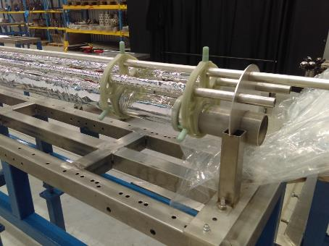
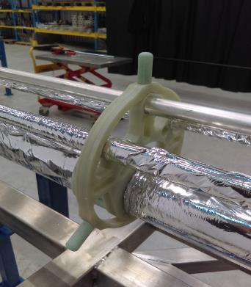
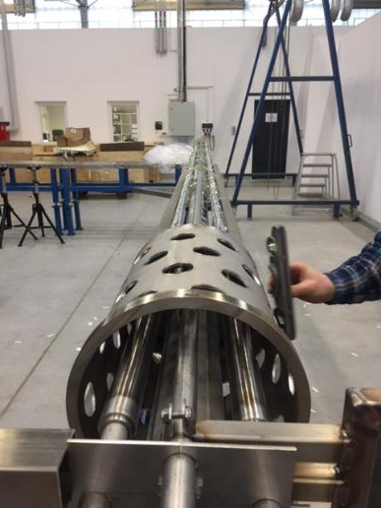
CDS – LTS2 line progress status
CRYOGENICS IS OUR PASSION
www.kriosystem.com.pl

Slide 8
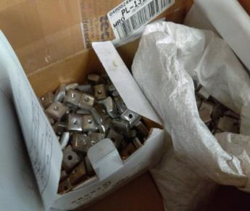
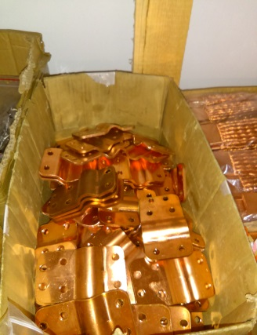
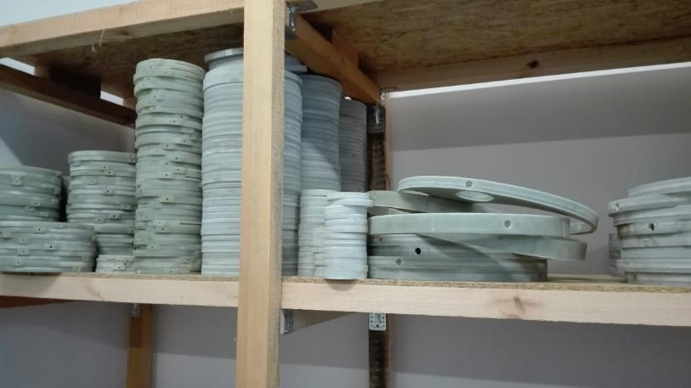
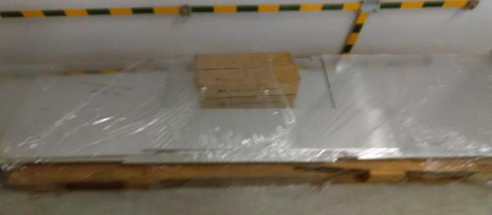
Other elements for CDS – LTS2
CRYOGENICS IS OUR PASSION
www.kriosystem.com.pl

Slide 9
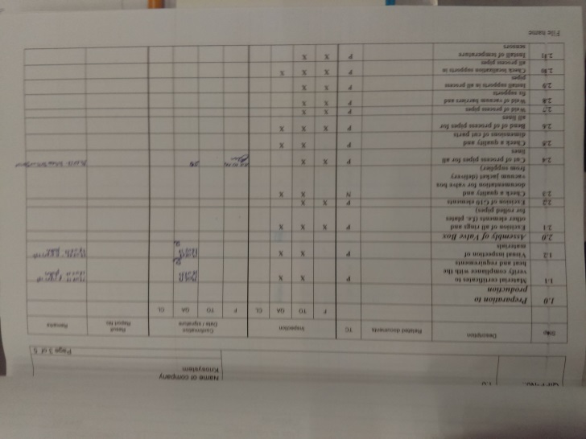
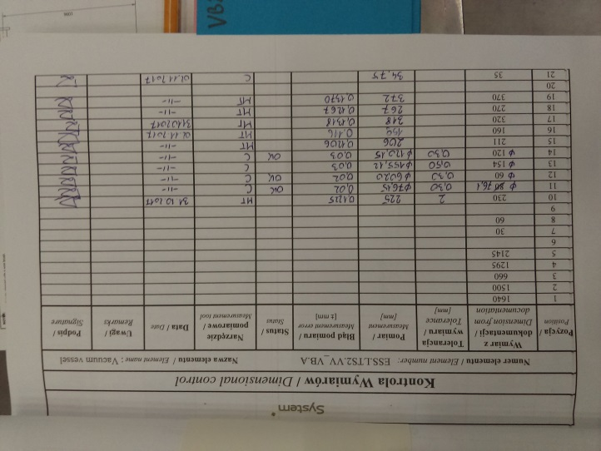
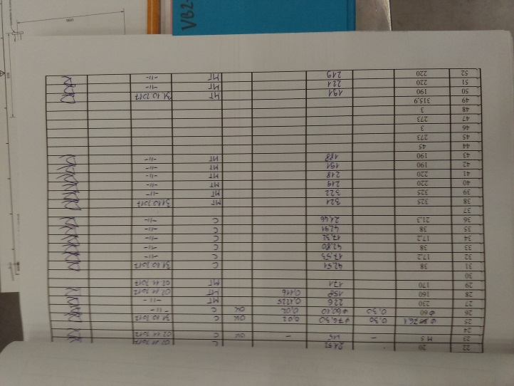
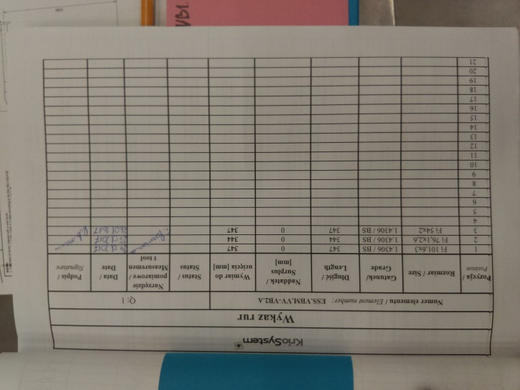
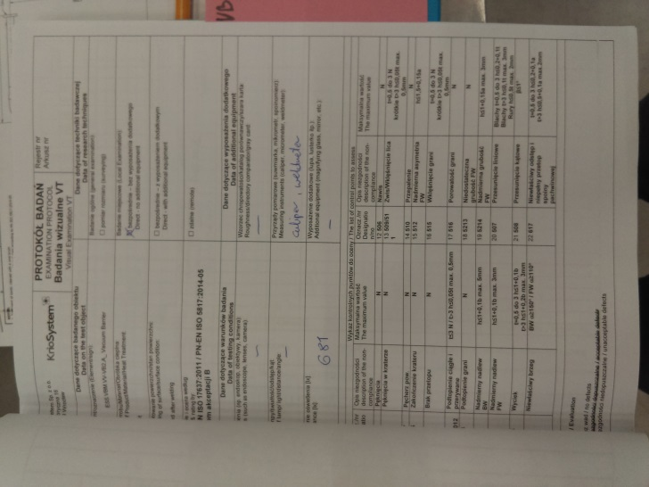
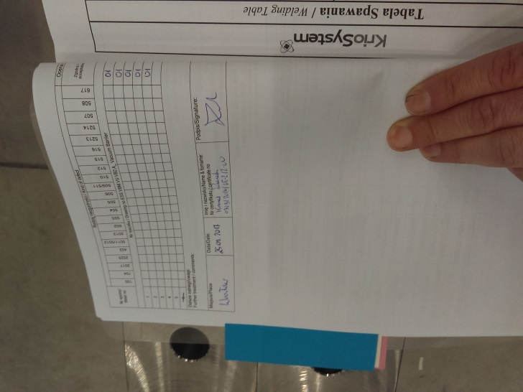
Verification raports
CRYOGENICS IS OUR PASSION
www.kriosystem.com.pl

Slide 10
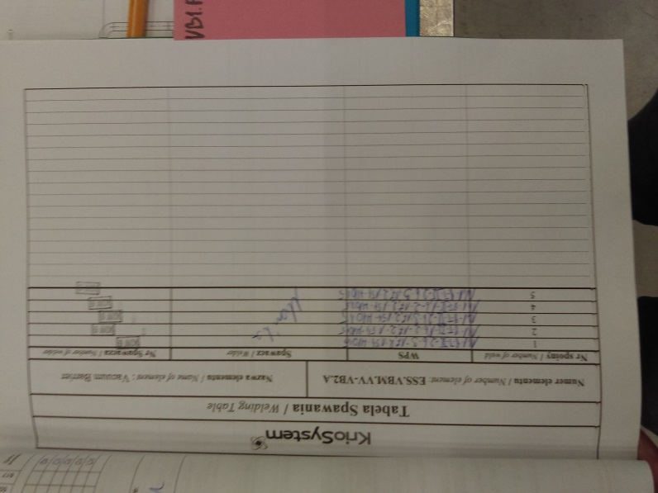
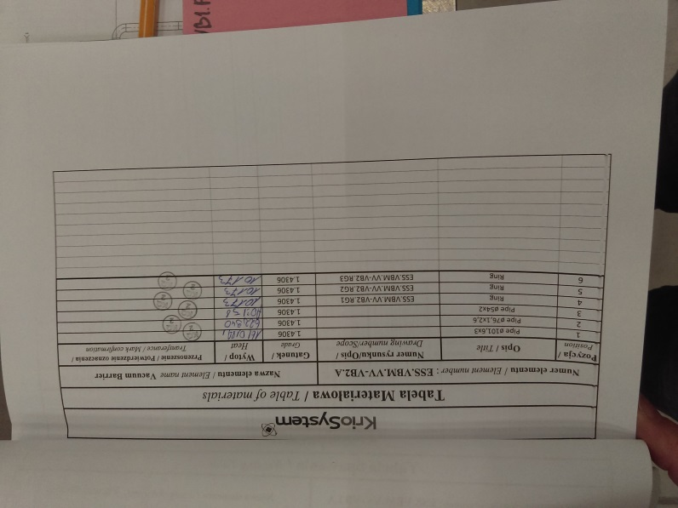
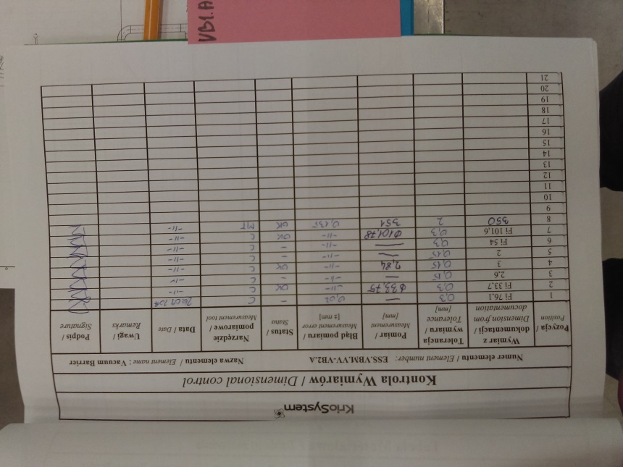
Verification raports
CRYOGENICS IS OUR PASSION
www.kriosystem.com.pl

Slide 11
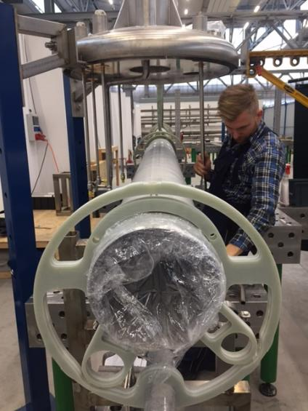
Other works- main system
CRYOGENICS IS OUR PASSION
www.kriosystem.com.pl

