Slide 1
PSS0 Scope
Stuart Birch
www.europeanspallationsource.se
8th February 2018

Slide 2
Introduction
PSS0 Scope
Standards

Slide 3
PSS0 Scope
After a set of meetings held in Mid 2017. Minutes ESS-0115443 and ESS-0121953 .
It was broadly agreed that Protection and Safety Systems group at ICS division will develop a personnel safety system for the commissioning and operation of the ISrc and LEBT test stand. This system is known as PSS0.
This was a new system which was added to the overall scope of PSS
The PSS team went to INFN-LNS Catania to see and witness the Ion source and LEBT test stand in operation.
From this visit report https://confluence.esss.lu.se/display/PS/PSS0
and any other available documentation, the strategy of the safety system was developed.

Slide 4
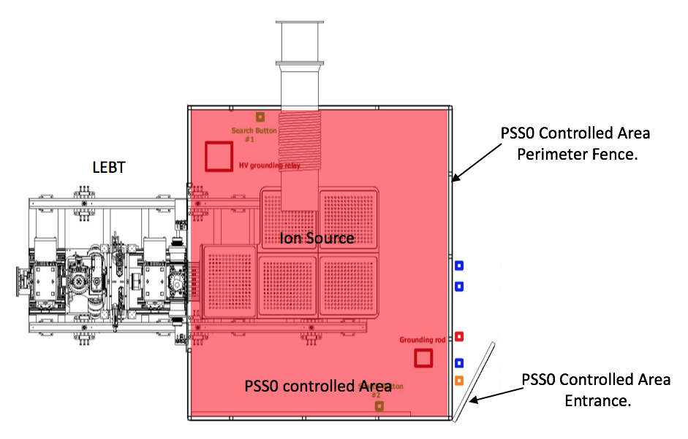
Scope
HV Safety Fence
Mitigation against electrical hazards for personnel arising from operating the “ISRC+LEBT” test stand
ICS/PSS will implement the functions needed to mitigate against the electrical hazards
HV platform
Access Gate

Slide 5
Standards
PSS0 safety system design will meet the following requirements:
SS 4364000 Swedish standard; Low voltage electrical installations - Rules for design and erection of electrical installations.
SS EN 50110-1:2013 European standard; Operation of electrical installations Part 1: General requirements.
IEC 61508 Functional safety of electrical/electronic/programmable electronic safety-related systems
IEC 61511 Functional safety - Safety instrumented systems for the process industry sector
PSS0 will not meet the following regulation requirements and standards:
SSMFS 2008-27 The Swedish Radiation Safety Authority’s regulations concerning operations at accelerators and with sealed radiation sources.
ESS-0018828 The official permit from the Swedish Radiation Authority – Special conditions.
Notes:
In relation to ssmfs 2008-27 we will not meet the standard because any radiation hazard have not been included in the pss0 analysis.
Official permit any safety SSC systems s and components no classification is carried out in accordance with ESS-0016468 and the GSO.

Slide 6
PSS0 Hazard and Risk Analysis
Stuart Birch
www.europeanspallationsource.se
8th February 2018

Slide 7
Introduction
PSS0 Concept and Scope
PSS0 Hazard and Risk Analysis
PSS0 Safety Requirements and their Allocation

Slide 8
Functional Safety IEC61508
From the Concept document ESS- 0217911
Title | Outputs | Document
Concept | Information concerning the EUC, its environment and hazards | ESS-0217911
Scope | Defined scope of the hazard and risk analysis. | ESS-0231390
Hazard and Risk Analysis | Description of, and information relating to, the hazard and risk analysis. | ESS-0229506
Safety Requirements and their Allocation | Specification of the overall safety requirements in terms of the safety functions requirements and the safety integrity requirements. Information on the allocation of the overall safety functions, their target failure measures, and associated safety integrity levels. Assumptions made concerning other risk reduction measures that need to be managed throughout the life of the EUC. | ESS-0231390
IEC 61508 lifecycle

Slide 9
Concept and Scope
Concept - ESS-0217911
The objective of the PSS0 Concept is to detail the system’s physical environment, the likely hazards and hazardous events arising from operation of the ISrc, LEBT and its accompanying equipment.
The Concept will also develop a high level of understanding of the equipment under control (EUC) sufficient to enable other lifecycle activities to be satisfactorily carried out
Scope - ESS-0231390
The objective of PSS0 Scope is to determine the boundary of the PSS0 controlled area and the Equipment Under Control (EUC), which will have an interface with PSS0.
The Scope will specify the scope of the hazard and risk analysis and detail the systems physical environment, the likely hazards, hazardous events arising from operation of the ISrc test stand and its accompanying equipment.

Slide 10
Hazard and Risk Analysis ESS-0229506
The Hazard and Risk Analysis is structured in three main analysis sections
The main objective of this hazard and risk analysis document is to describe the hazard and risk analysis techniques used for PSS0.
We use mainly qualitative methods to identify the hazards and perform risk analysis. As defined in the IEC 61508 standard
Identified hazards and initiating events are documented
and analysed using a Risk Matrix. PSS0 barriers and protection layers are listed
Hazard Register
Hazard Identification
Accident Analysis
PSS0 relevant hazards are identified
With representatives from EUC
Stakeholders and ES&H
Hazard and Risk Analysis
Progression from initiating event to consequences is performed qualitatively using Event Tree Analysis

Slide 11
Hazard Identification
Hazard Identification
The hazard identification (HAZID) involves brainstorming meetings between designer, system stakeholders, ES&H representatives, and operations personnel. The major findings, decisions and hazard ratings help to deliver safety compliance, and form the input to Hazard Register required by many licensing authorities.
Meetings:
Visit to Istituto Nazionale di Fisica Nucleare (INFN) Catania
  Purpose: to inspect electrical safety aspects of ISrc and LEBT.
  Result: Defined requirements and design proposals for PSS0
Ion Source HV safety fence and PSS0 design review meeting
  Purpose: to review design of Ion Source HV safety fence and preliminary design of PSS0.
  Result: Assumptions for Ion Source HV safety fence and boundaries of PSS0 were defined.
  Preliminary design of PSS0 was approved.
Official HAZID meeting for PSS0
  Purpose:Reference and agree all high voltage hazards on the Isrc and LEBT Test Stand.
  Result: PSS0 hazards, hazardous situations and initiating events were identified.

Slide 12
PSS0 Hazard Identification HV hazards
Equipment / System | Voltage | PSS0 Hazard / Justification
Ion source high voltage platform | 75kV | Yes.
Ion source isolation transformer to supply power to all devices on HV platform | 400V AC | No. For any activity within ISrc fenced area (e.g. cleaning, maintaining, etc.) the Lockout Tag-out (LOTO) procedure will be carried out, and adjacent low voltage live parts will be covered. This was agreed with Accelerator Division
LEBT Repeller electrodes | 3,5kV | No. The Repeller electrodes use standard insulated BNC safety high voltage connectors. All cable terminations and live parts will be protected with proper insulation material. The insulation prevents any access/accidental contact with live parts.
LEBT chopper | 10kV | No. The HV cable will be terminated inside the box above the chopper. There is no specific electrical hazard associated with the chopper, as there is no live part easily accessible by the operators.
LEBT Faraday cup | 2kV | No. LEBT Faraday cup is inside the enclosure and it’s not reachable. It also uses standard insulated BNC safety high voltage connectors.
LEBT Emittance measurement unit (EMU) | 1,5kV | No. LEBT EMU is inside the enclosure and it’s not reachable. It also uses standard insulated BNC safety high voltage connectors.
Turning off incoming power (or a mains input power failure) of the isolation transformer can result in failure of multiple devices on the HV platform that are connected to ground/earth.

Slide 13
Hazard Register
Hazard Register
The conclusion and decisions from the hazard identification served as inputs to create the PSS0 Hazard register.
It summarizes all initiating events and provides qualitative assessment of hazardous scenarios against Conventional safety risk matrix.

Slide 14
Hazard Register
Hazard
Hazard id: PSS_Hazard_003,IE_01
Hazard: Electrical Hazard
Initiating Event
IE: A person enters into the PSS0 controlled area whilst HV is energised
Consequence: Hazardous
Existing Barriers
Barriers and procedures: Mechanical sequence of the key exchange
PSS0 Function Required?
PSS0 safety Functions
Likelihood: 1/yr
Screening: In
Check the risk matrix with barriers and procedures in place
PSS Safety Function Required? Yes
Protection:
Prevent Access by locking the access gate whilst HV power supply is energised
Alert Personnel outside the PSS0 controlled area when HV is energised
Monitor position of the access gate
List all Human actions to give input to human reliability Study.

Slide 15
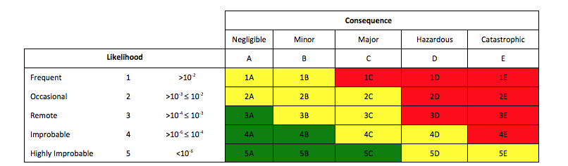
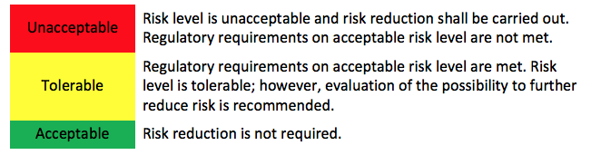
Risk Matrix
The PSS team have developed a risk matrix for conventional hazards
*
*

Slide 16
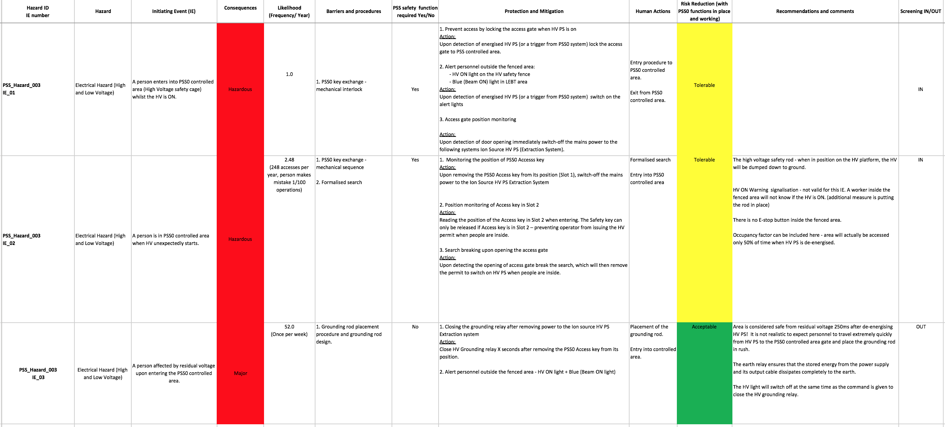
Hazard Register

Slide 17
Hazard Register
Hazard | Initiating Event (IE) | Consequences
Electrical Hazard (High and Low Voltage) | A person enters into PSS0 controlled area (High Voltage safety cage) whilst the HV is ON. | Hazardous
Electrical Hazard (High and Low Voltage) | A person is in PSS0 controlled area when HV unexpectedly starts. | Hazardous
Electrical Hazard (High and Low Voltage) | A person affected by residual voltage upon entering the PSS0 controlled area. | Major

Slide 18
Hazard Register
Likelihood (Frequency/ Year) | Barriers and procedures | PSS safety function required Yes/No | Protection and Mitigation | Human Actions
1.0 | 1. PSS0 key exchange - mechanical interlock | Yes | 1. Prevent access by locking the access gate when HV PS is on Action: Upon detection of energised HV PS (or a trigger from PSS0 system) lock the access gate to PSS controlled area. 2. Alert personnel outside the fenced area: - HV ON light on the HV safety fence - Blue (Beam ON) light in LEBT area Action: Upon detection of energised HV PS (or a trigger from PSS0 system) switch on the alert lights 3. Access gate position monitoring Action: Upon detection of door opening immediately switch-off the mains power to the following systems Ion Source HV PS (Extraction System). | Entry procedure to PSS0 controlled area. Exit from PSS0 controlled area.
2.48 (248 accesses per year, person makes mistake 1/100 operations) | 1. PSS0 key exchange - mechanical sequence 2. Formalised search | Yes | 1. Monitoring the position of PSS0 Accesss key Action: Upon removing the PSS0 Access key from its position (Slot 1), switch-off the mains power to the Ion Source HV PS Extraction System 2. Position monitoring of Access key in Slot 2 Action: Reading the position of the Access key in Slot 2 when entering. The Safety key can only be released if Access key is in Slot 2 – preventing operator from issuing the HV permit when people are inside. 3. Search breaking upon opening the access gate Action: Upon detecting the opening of access gate break the search, which will then remove the permit to switch on HV PS when people are inside. | Formalised search Entry into PSS0 controlled area
52.0 (Once per week) | 1. Grounding rod placement procedure and grounding rod design. | No | 1. Closing the grounding relay after removing power to the Ion source HV PS Extraction system Action: Close HV Grounding relay X seconds after removing the PSS0 Access key from its position. 2. Alert personnel outside the fenced area - HV ON light + Blue (Beam ON light) | Placement of the grounding rod. Entry into controlled area.

Slide 19
Hazard Register
Risk Reduction (with PSS0 functions in place and working) | Recommendations and comments | Screening IN/OUT
Tolerable |  | IN
Tolerable | The high voltage safety rod - when in position on the HV platform, the HV will be dumped down to ground. HV ON Warning signalisation - not valid for this IE. A worker inside the fenced area will not know if the HV is ON. (additional measure is putting the rod in place) There is no E-stop button inside the fenced area. Occupancy factor can be included here - area will actually be accessed only 50% of time when HV PS is de-energised. | IN
Acceptable | Area is considered safe from residual voltage 250ms after de-energising HV PS! It is not realistic to expect personnel to travel extremely quickly from HV PS to the PSS0 controlled area gate and place the grounding rod in rush. The earth relay ensures that the stored energy from the power supply and its output cable dissipates completely to the earth. The HV light will switch off at the same time as the command is given to close the HV grounding relay. | OUT

Slide 20
Hazard Identification
Accident Analysis
The hazardous scenario progression leading to a consequence is logically presented using the Event Tree Analysis (ETA) method.
The qualitative ETA is performed and will be used for assessment of safety instrumented functions

Slide 21
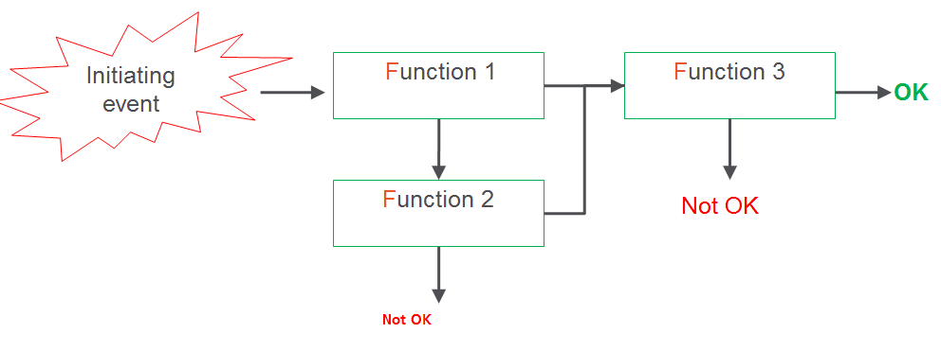
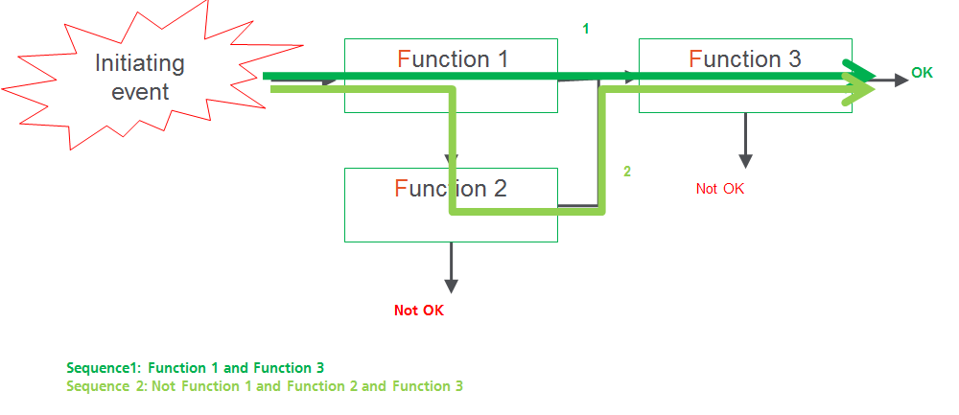
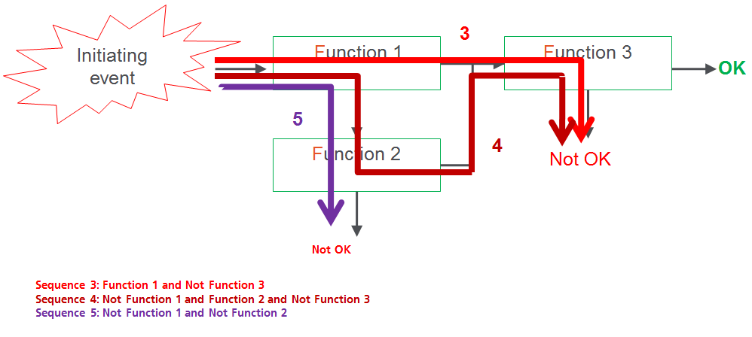
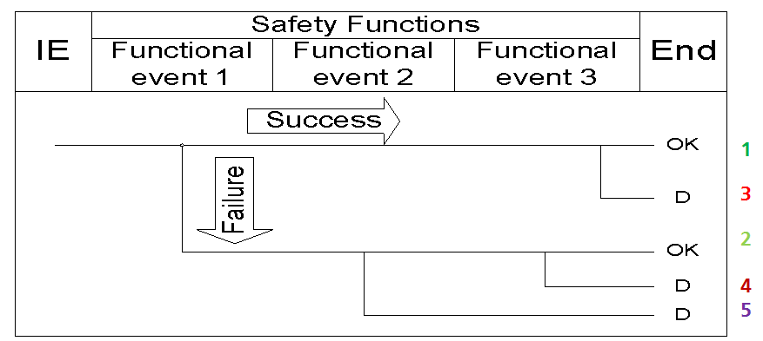
ETA

Slide 22
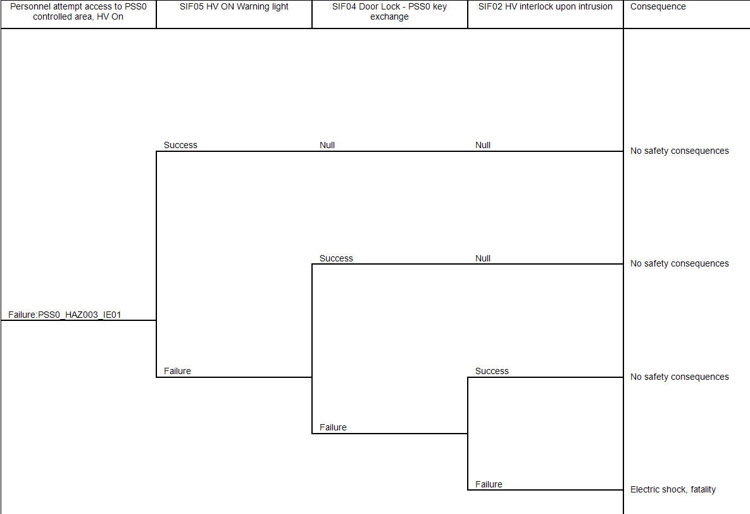
ETA Initiating Event 1

Slide 23
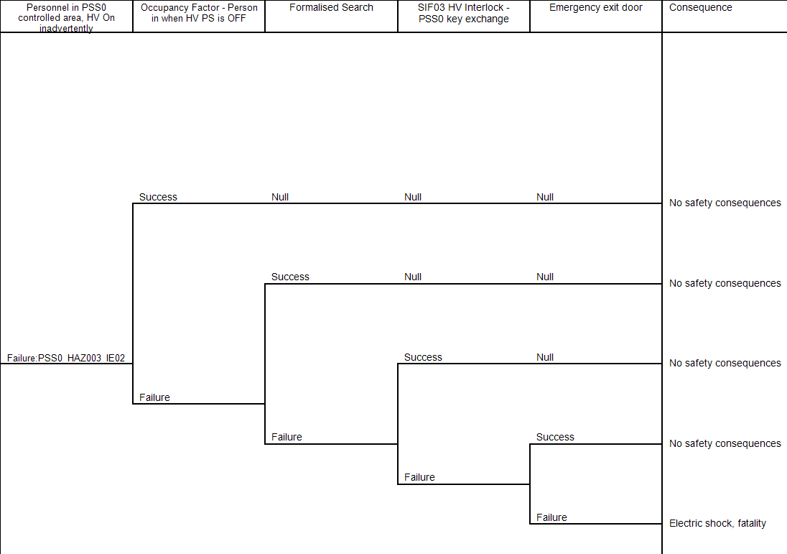
ETA Initiating Event 2

Slide 24
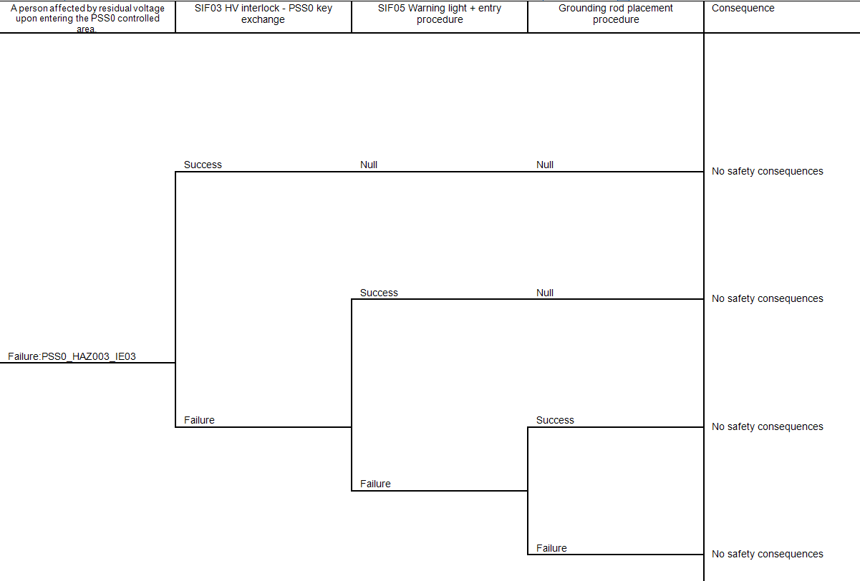
ETA Initiating Event 3

Slide 25
PSS0 Safety Requirements and their Allocation ESS-0231390
The objective this document is to identify required levels of risk reduction, expressed in terms of SILs, and to verify that the corresponding SIFs meet these targets.
This report documents the:
Determination of the potential frequency and consequence of agreed hazards;
Determination of the risk reduction provided by other measures and the resulting risk gap, if any;
Assignment of SIL requirements for SIFs to any resulting risk gaps in accordance with IEC 61508 [2] and IEC 61511 [3];
Verification of SIFs against SIL requirements in terms of random hardware reliability and minimum architecture;
Recommendations for addressing any shortfalls.

Slide 26
Target Risk
For the PSS0 SIL study, a target risk of 1.0E-06 per year was applied as the target for a single employee fatality, as per the PSS0 Hazard Register.

Slide 27
PSS0 Safety Requirements and their Allocation
Safety Requirements and their Allocation
Safety Integrity Level Determination
Safety Integrity Level Verification
Assumptions

Slide 28
Safety Instrumented Functions
SIF ID | SIF | Description
SIF01 | High Voltage Power Supply emergency stop | Switch-off high voltage power supply upon pressing the emergency stop button.
SIF02 | HV interlock upon intrusion to PSS0 controlled area | Switch-off high voltage power supply upon detecting the intrusion (access gate in open position).
SIF03 | HV interlock – PSS0 key exchange | Switch-off HV PS upon removing the Access key from Slot 1 and ensure the HV platform is grounded. Ensure that HV cannot be started if Safety key is not in place.
SIF04 | Door lock – PSS0 key exchange | Prevent access by activating the access gate lock upon removing Access key from Slot 2.
SIF05 | HV ON warning light | Alert personnel around PSS0 controlled area that HV PS is on by activation HV ON warning light and additionally, activate area blue light in LEBT area.
SIF01 was designed to prevent equipment damage in cases of fire or explosion. It is not used for personnel protection and not taken as safeguard for the electric shock hazard. Therefore it has been excluded from any further assessment.
SIF05 is not a SIF by definition, as it does not put the system in a safe state. However, this function is provided by PSS0. It will be treated as part of administrative control and excluded from any further assessment.

Slide 29
SIL determination
The assignment of SIL targets was achieved using the Layers of Protection Analysis (LOPA) technique.
Safety integrity applies to the Electrical / Electronic / Programmable Electronic (E/E/PE) SIF and external risk reduction facilities.
It is a measure of the likelihood of those systems satisfactorily achieving the necessary risk reduction.
Once the tolerable risk has been set, and the risk reduction estimated, the safety integrity requirements for the SIFs can be allocated in terms of PFD or PFH.

Slide 30
LOPA Low Demand
Identify hazards (which can be addressed by the implementation of a SIF)
Rank the severity of the consequences of the specified hazard
Identify initiating events and estimate their frequency using operating experience where applicable, data sources such as FARADIP, and engineering judgement
Identify Conditional Modifiers. For example, occupancy, probability of shock and vulnerability
Identify Independent Protection Layers (IPLs), which prevent the hazardous event from occurring
Determine the likelihood of occurrence

Slide 31
LOPA High Demand
Identify hazards
Rank the severity of the consequences of the specified hazard
Identify Conditional Modifiers. For example, occupancy, probability of shock and vulnerability
Identify Independent Protection Layers (IPLs), which prevent the hazardous event from occurring
Determine the Target Risk Frequency (/hr)

Slide 32
SIL Verification
The random hardware reliability assessment was performed using isograph FaultTree+ software package, which utilises the Fault Tree Analysis (FTA) method

Slide 33
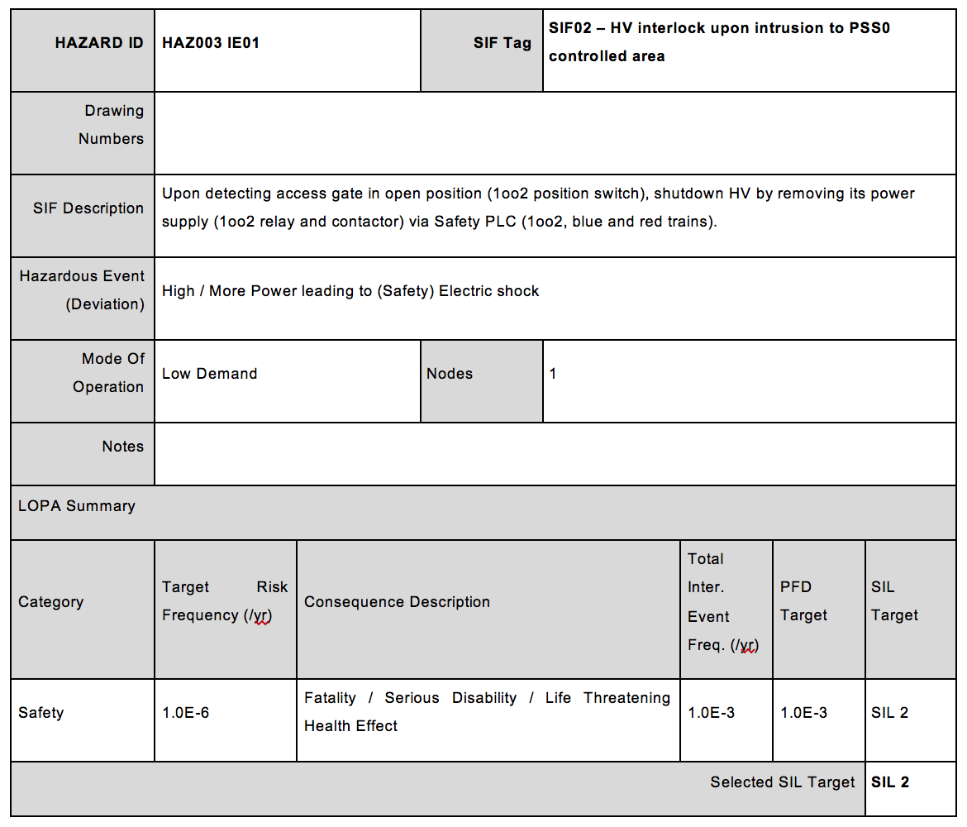
LOPA worksheets SIF2

Slide 34
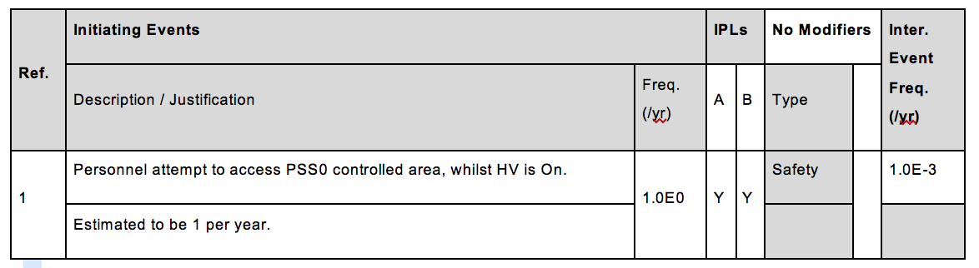
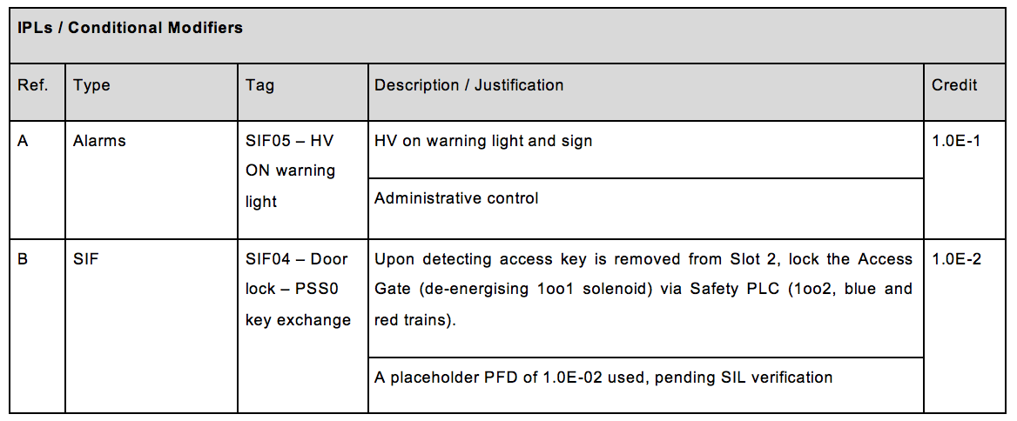
SIF2 initiating events

Slide 35
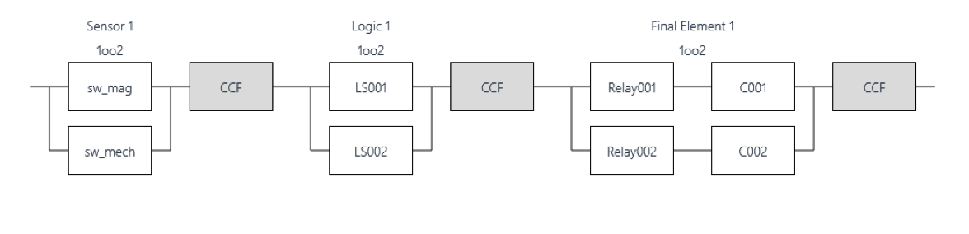
SIF2 RBD

Slide 36
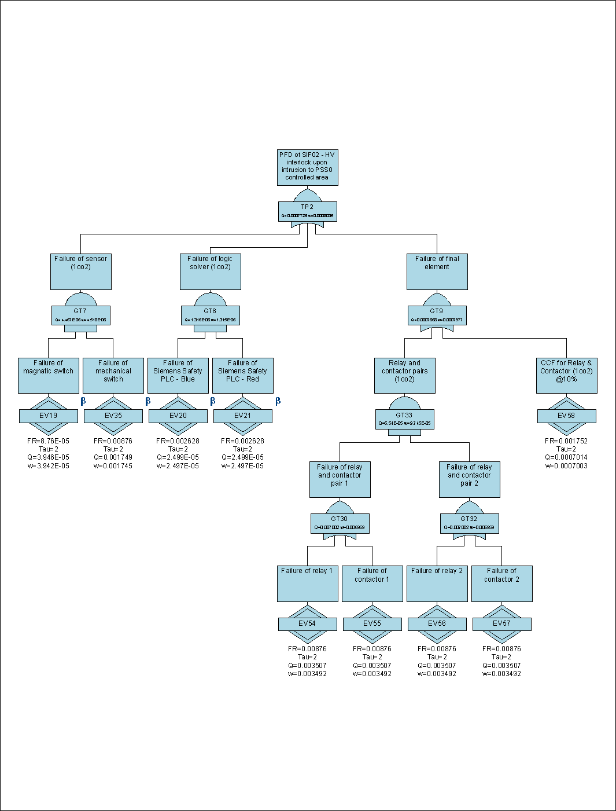
SIF2 FTA
The FTA shows the achieved PFD for SIF02 is 7.7E-04. This falls into SIL 3 band.

Slide 37
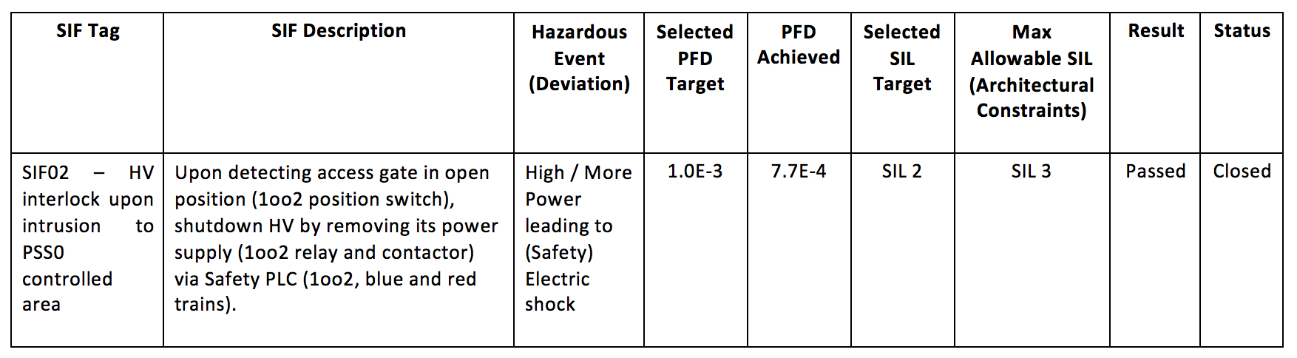
Summary of results LD

Slide 38
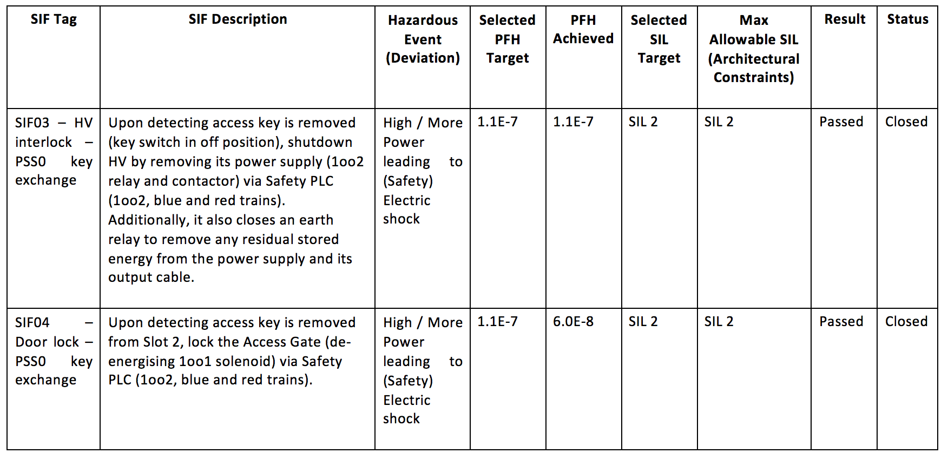
Summary of results HD

Slide 39
ETA HAZ003 IE01

Slide 40
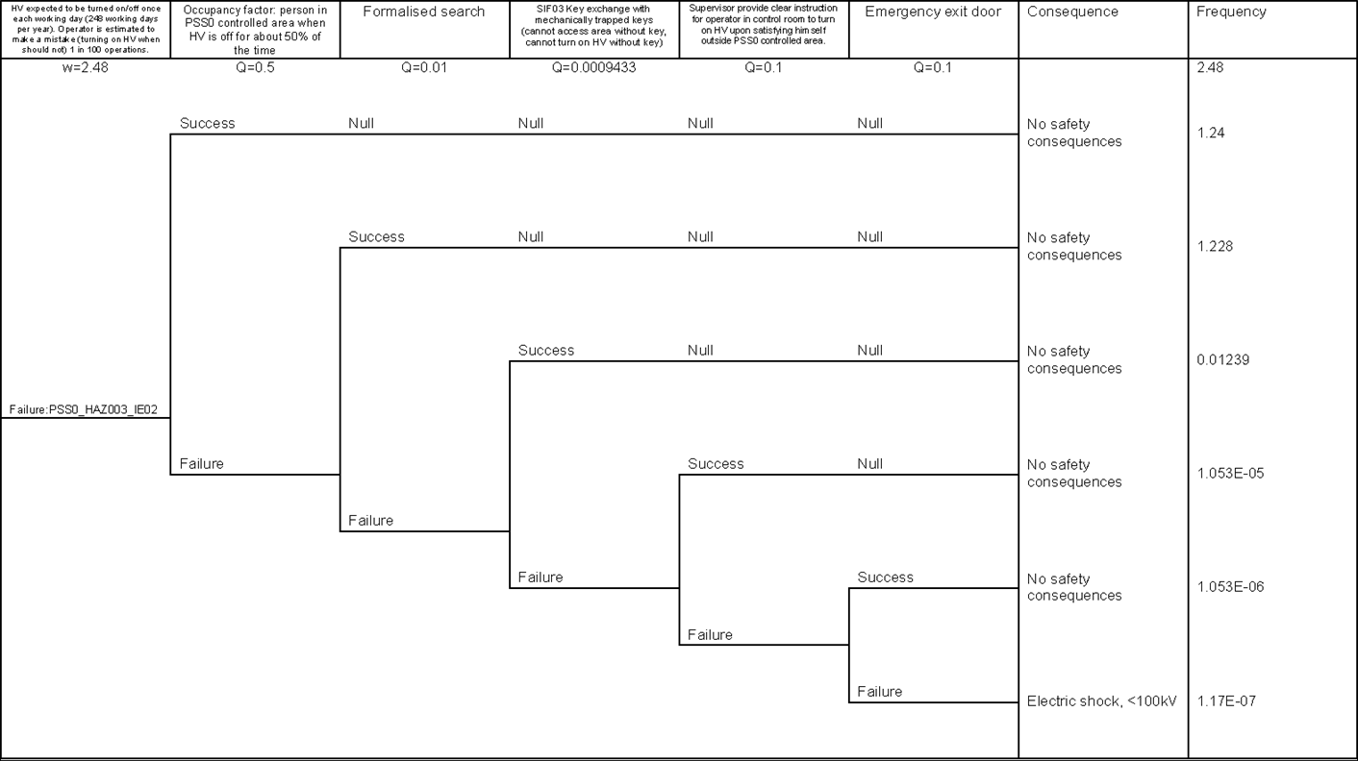
ETA HAZ003 IE02

Slide 41
ETA HAZ003 IE03

Slide 42
Conclusion
All assessed SIFs meet their required SIL determined by the LOPA, in terms of achieved PFD or PFH and the architectural constraints assessment.
For the emergency exit to be an effective layer of protection, it is recommended to implement a HV ON warning within the PSS0 controlled area.

Slide 43

Questions

Slide 44
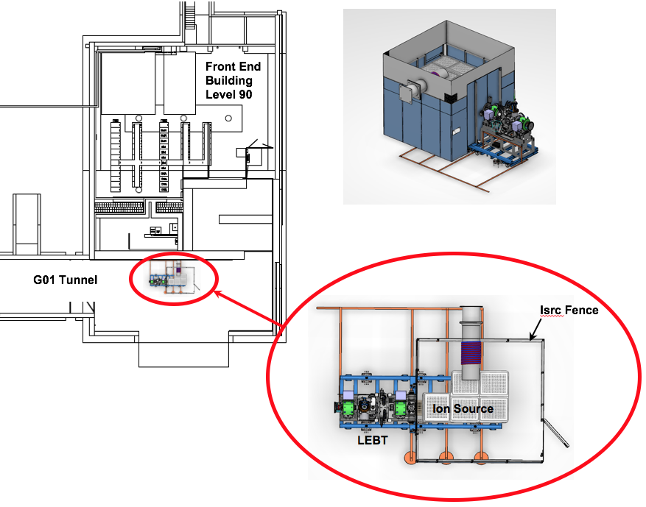
Scope

Slide 45
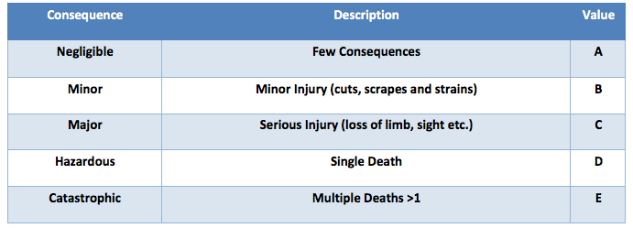
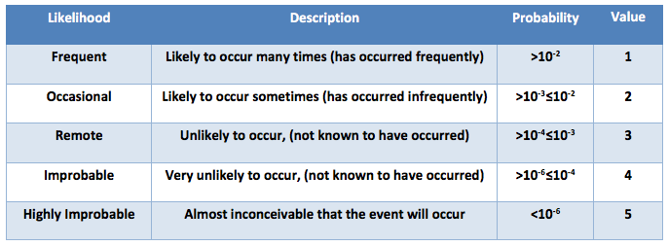
Risk Matrix (extra Slide)

