Slide 1
Ion Source and fence designed for it
Øystein Midttun
Ion source and LEBT system leader
www.europeanspallationsource.se
8 February 2018

Slide 2
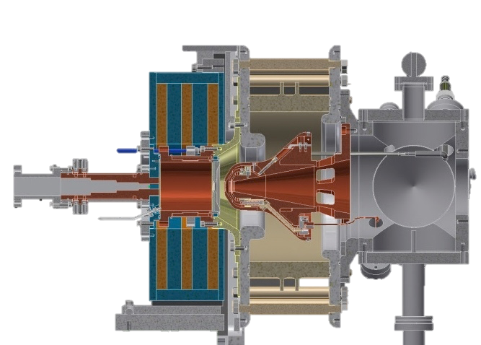
The ESS proton source is a microwave discharge ion source
High voltage insulator
Extraction aperture
Extraction electrodes
Plasma chamber
Waveguide
Pumping ports
H₂ gas injection
Solenoid magnets
50 cm
2

Slide 3
Picture from the inside of the high voltage platform

Slide 4
Ion source and low energy beam transport

Slide 5
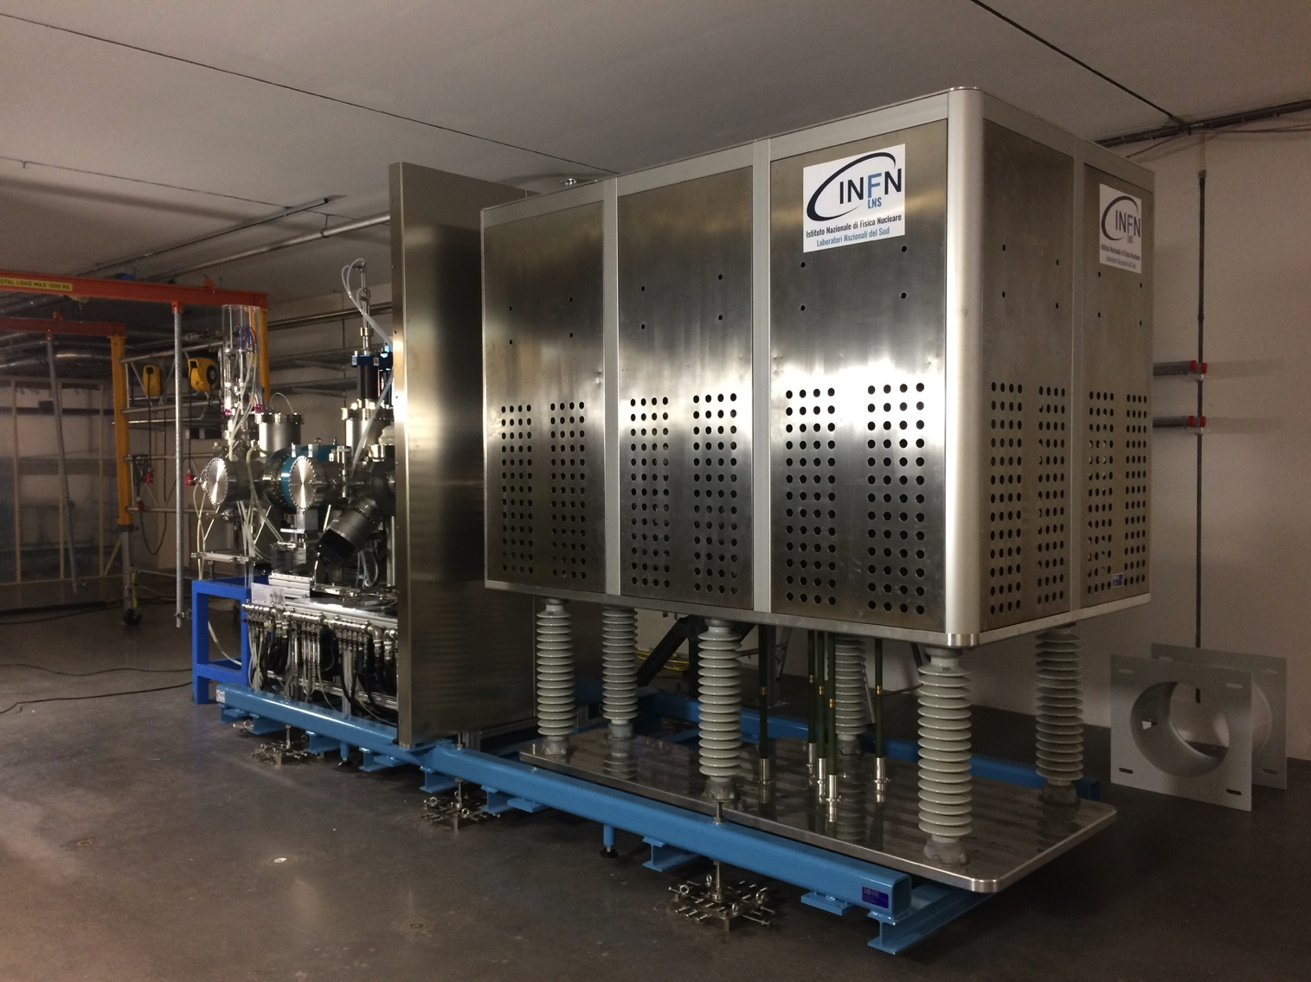
We have designed a high voltage safety fence with two main functions
1: protect against the 75 kV of the high voltage platform
75 kV

Slide 6
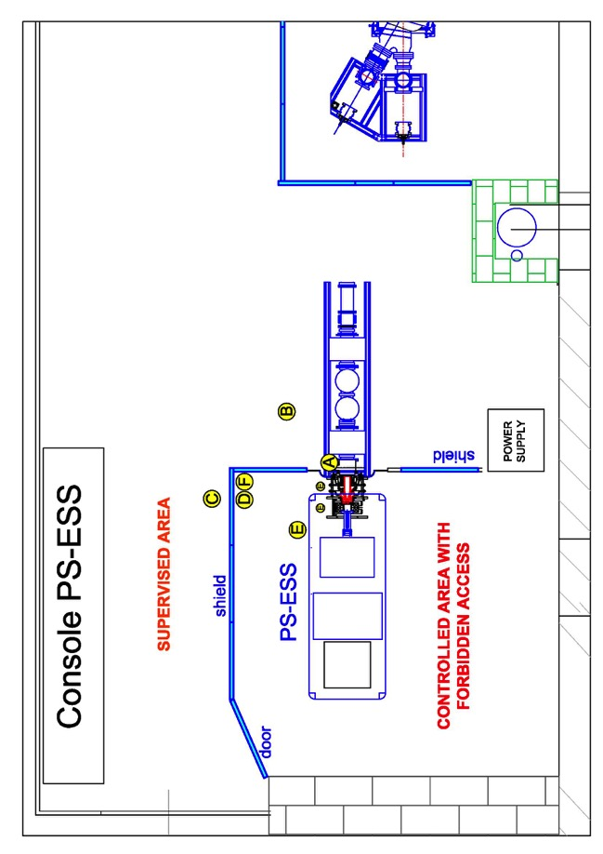
We have designed a high voltage safety fence with two main functions
2: protect against x-ray coming from the ion source during beam extraction
Measurements at ion source test stand, INFN-LNS
2 mm lead shielding around the ion source
Radiation level below
natural background
Normal operation:
< 15 µSv/h
Maximum observed:
380 µSv/h
Measured dose rate levels
above natural background
Report: PS-ESS radioprotection report 30.03.17, ESS-0114736
fig 5

Slide 7
X-rays were only measured with the beam on
The x-rays originate from back streaming electrons (up to 75 keV) from the beam line to the ion source
Plasma alone is not sufficient to produce a measurable amount of x-rays
No beam -> no x-rays
No high voltage -> no beam

Slide 8
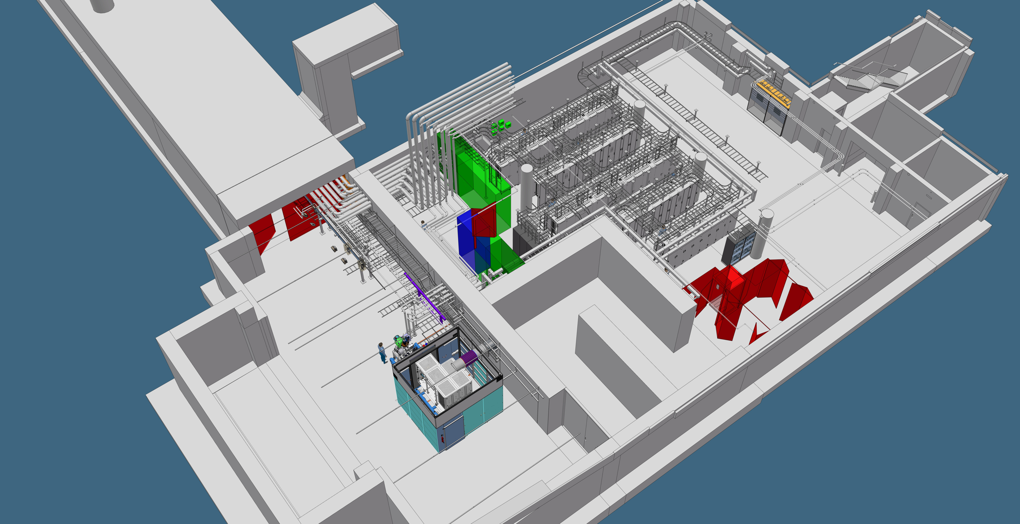
Our goal is to safely run the ion source while there is access to the accelerator tunnel
Ion source commissioning can take place at the same time as installation (of other stuff)
No access control to the tunnel needed
PSS0 will ensure that there no one can approach the HV platform while it’s on
By lead shielding the HV safety fence, the area outside can be classified as a public radiation zone

Slide 9
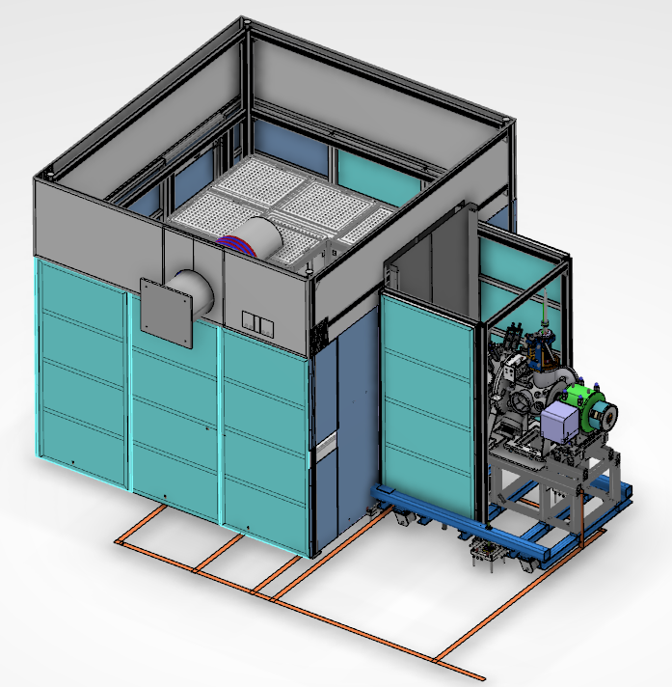
3D model of high voltage safety fence
1 m high stainless steel mesh (2 mm spacing, IP3x)
Floor-to-ceiling walls
Additional lead shielding
around the LEBT
2.5 m high, 2 mm thick
lead shielding
Cooling water inlet
for the ion source

Slide 10
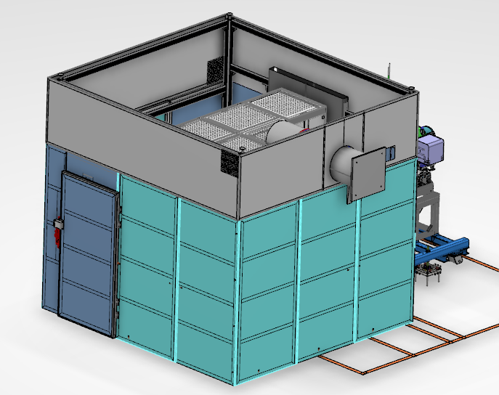
3D model of high voltage safety fence
Isolated 400 VAC
Fibre optic control cables
Safety door
PSS0
High voltage cable

Slide 11
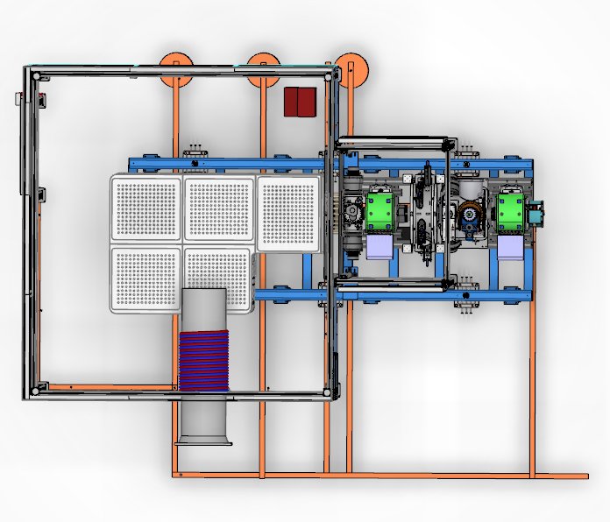
Top view of high voltage safety fence
Connection to grounding
mesh in the floor
Entrance
Connection to
wall grounding
Ion source
water cooling

Slide 12
Ion Source and fence designed for it
Description of the HV protection cage: ESS-0122281

