Slide 1
PSS0 Design & Concept of Operations
PSS0 Critical Design Review
2018-02-08
Morteza Mansouri
Engineer for Safety Critical Systems
www.europeanspallationsource.se
18-02-07

Slide 2
Content
PSS0 Design and Standards
PSS0 Layout
PSS0 Interfaces with ISrc
PSS0 Equipment
PSS0 Architecture
PSS0 Concept of Operations
Summary

Slide 3
PSS0 Design and Standards
PSS0 will be built using two identical Siemens PLC and distributed I/O system with redundant sensors and actuators. This is also known as “two train system”; distinguished as “red train” and “blue train”.
Siemens S7-1500 Safety PLCs (S7-1518 F CPU) and ET 200 SP distributed safety and standard I/O modules will be used. (ESS-0237967)
As mentioned in previous presentation PSS0 design will satisfy the following criteria in compliance with IEC 61508:
Two train system
Failsafe
Redundancy
Diversity
Single failure
Common cause failure
Separation

Slide 4
PSS0 Design and Standards
PSS0 is a low- voltage protection and monitoring system. Therefore, the system electrical design is chosen to suit the requirements in SS-4364000 which is a Swedish standard for Low-voltage electrical installations - Rules for design and erection of electrical installations.
The system operation is chosen to suit the requirements in SS-EN 50110-1:2013 which is a European standard for operation of electrical installations.
This European standard is applicable to all operation of and work activity on, with, or near electrical installations. Theses are the electrical installations operating at voltage levels from and including extra-low voltage up to and including high voltage.

Slide 5
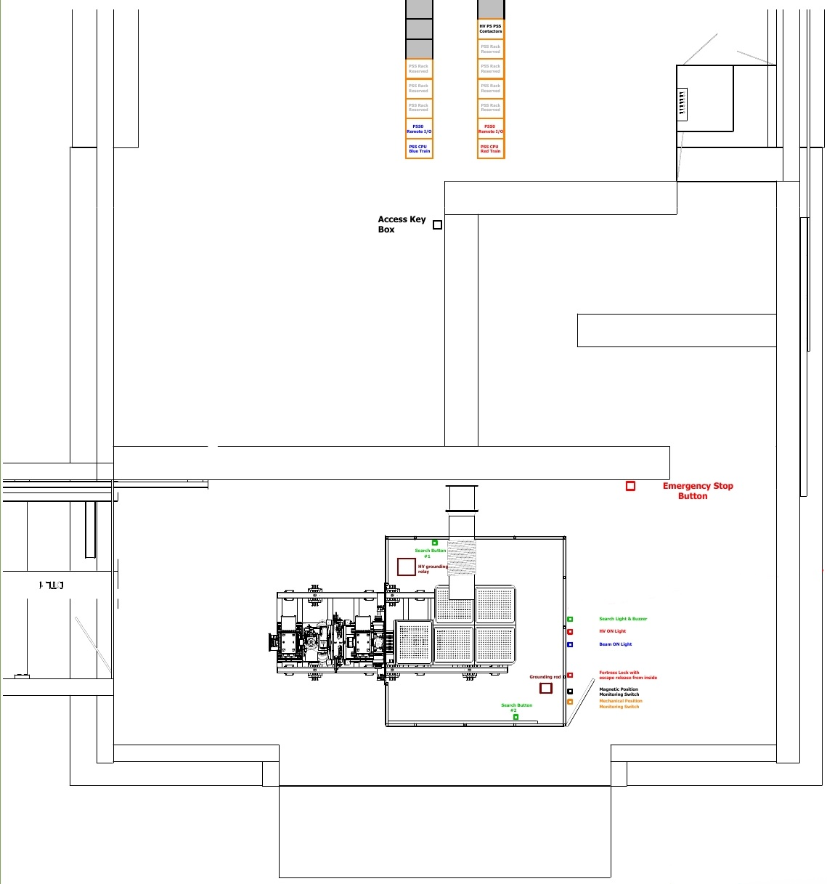
PSS0 Layout
PSS0 controlled area

Slide 6
PSS0 Interfaces with ISrc

Slide 7
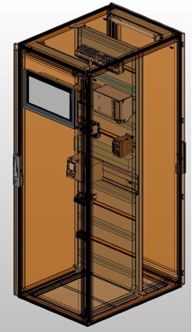
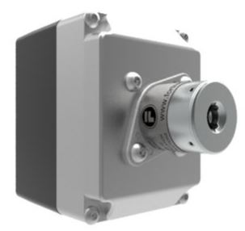
PSS0 Layout & Equipment
Key exchange box next to HV PS
PSS racks in FEB

Slide 8
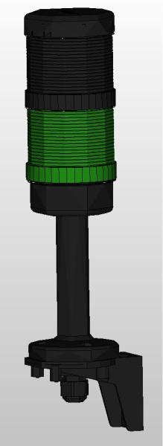
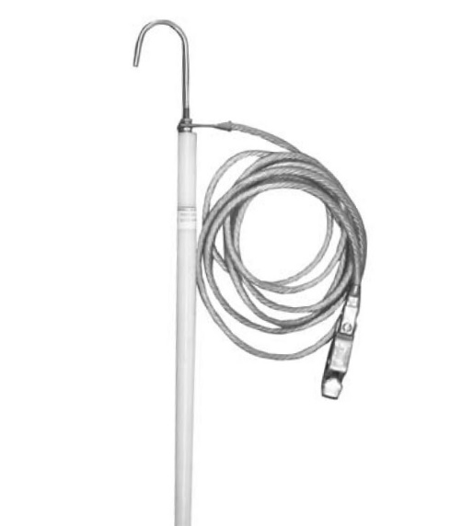
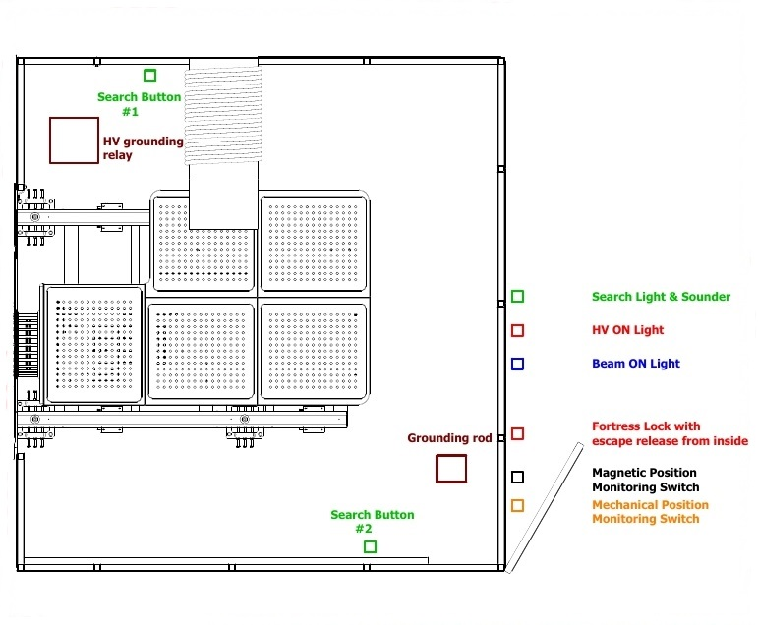
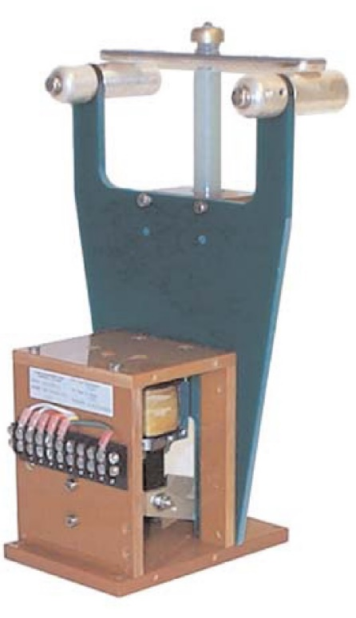
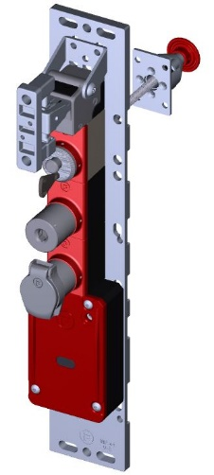
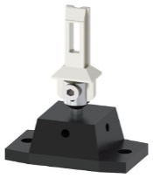
PSS0 Layout & Equipment
Position Monitoring Switches
Grounding rod
Grounding relay
Fortress Lock

Slide 9
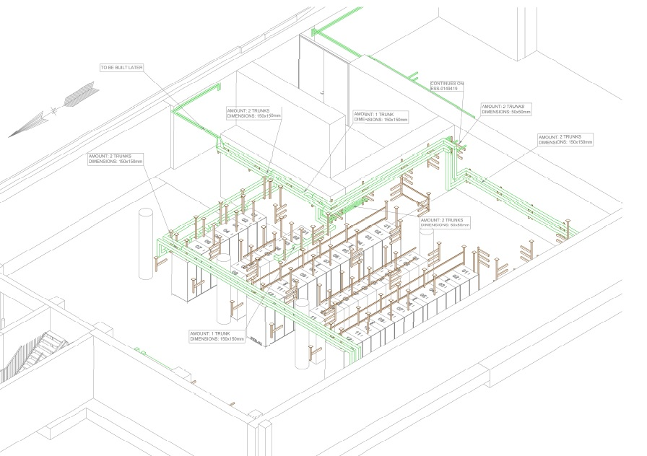
PSS0 Cable Routes & Cables
As part of safety requirements in accordance with IEC 61508:2010, the two independent PSS0 trains shoud be physically separated to reduce the possibility of the PSS0 being affected by the same external events.
Eddie Carse (ESS-0149416)

Slide 10
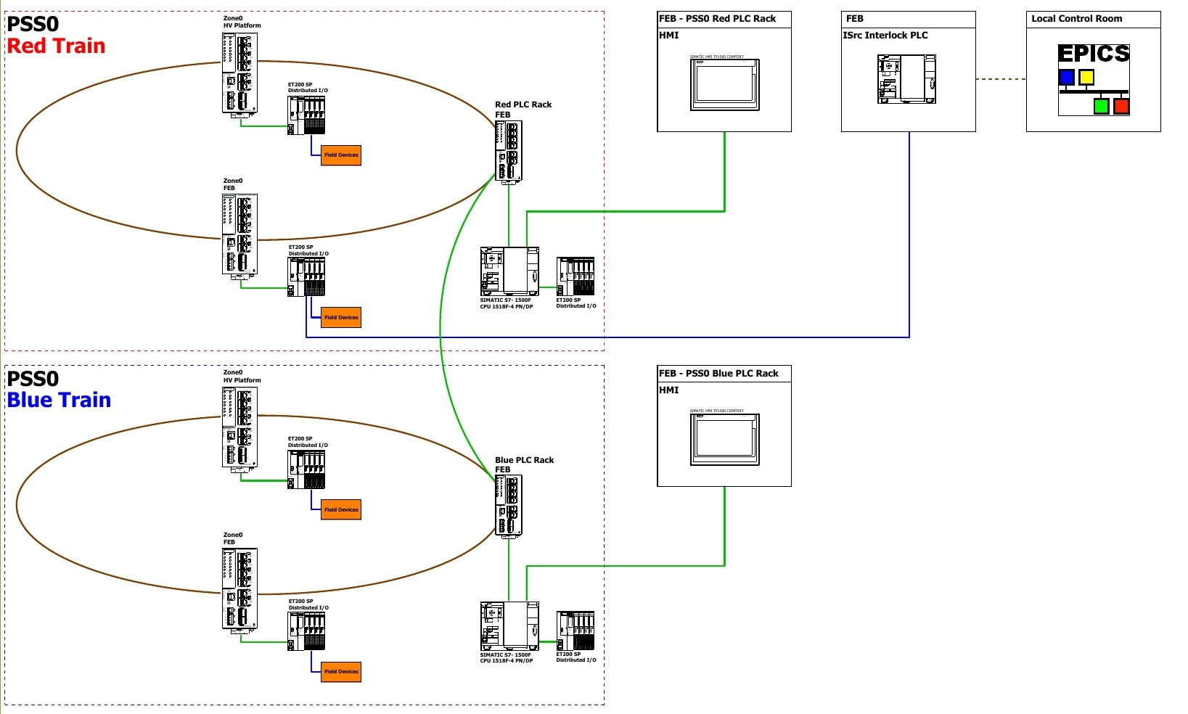
PSS0 Architecture

Slide 11
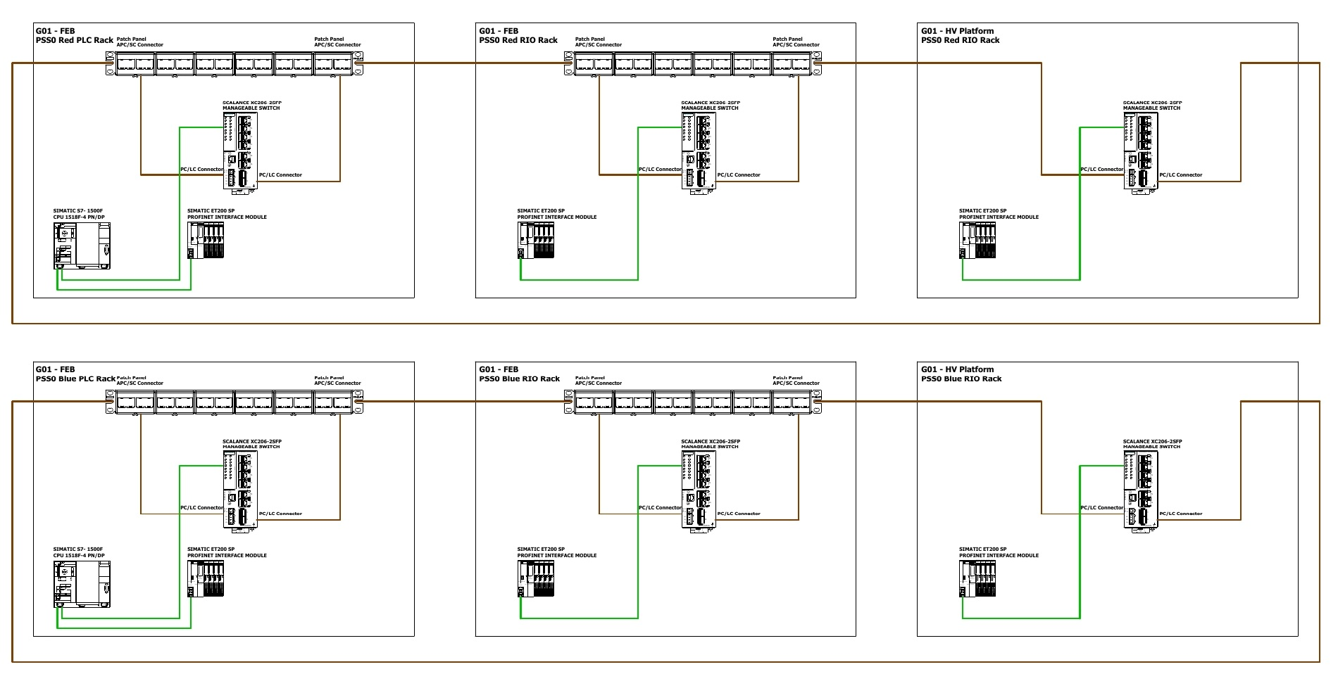
PSS0 Physical Topology

Slide 12
PSS0 Concept of Operations
The working procedure within ISrc fenced area is “dead working”.
As per EN 50110-1:2013 for dead working, five safety rules shall be implemented as essential requirements to ensure that the electrical installation at the work location is dead and secure for the duration of the work.
Disconnect completely
Secure against re-connection
Verify absence of operating voltage
Carry out earthing and short-circuiting
Provide protection against adjacent live parts
The authorization given by the nominated person in control of an electrical installation during work activities is a necessary condition.

Slide 13
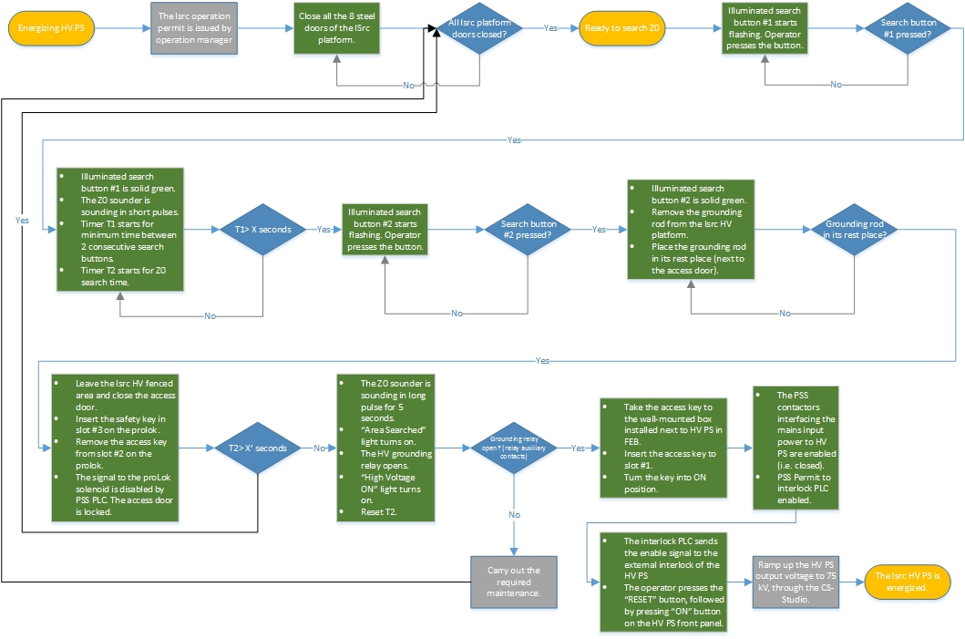
ConOps: Procedures to Energize HV PS

Slide 14
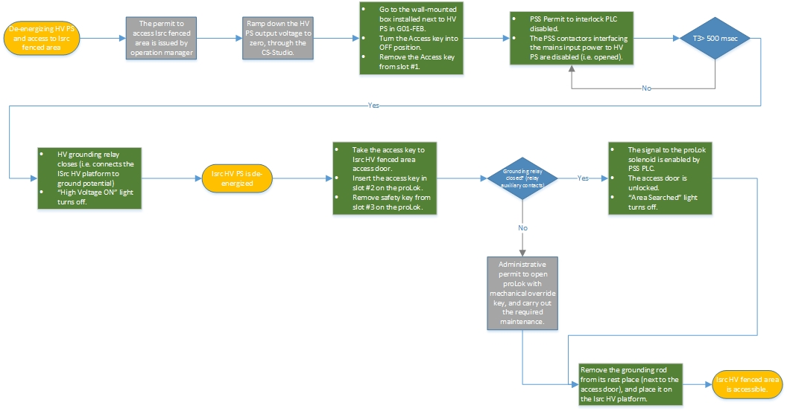
ConOps: Procedures to De-energize HV PS

Slide 15
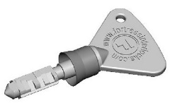
ConOps: Key Exchange Philosophy
G01-FEB
HV Power Supply
G01- accelerator tunnel
HV fenced area door
PSS contactors interfacing the mains incoming power of the HV PS open.
The grounding relay closes.
Solenoid ON
Door Open
Access Key: Ensures door cannot be opened without
this key. Access key is released by a separate unit in FEB.
Safety Key: Removed key ensures door cannot be locked
until operator returns from ISrc fenced area with the key.

Slide 16
De-energizing the HV PS and access to ISrc fenced area in case of emergency
In the case of emergency for example fire or risk of explosion in the ISrc and LEBT test stand area, an emergency stop button will be installed outside ISrc fenced area, and in the vicinity of the ISrc and LEBT test stand. The main objective of this emergency stop button is to provide means for quick intervention of operator(s) to de-energize the HV PS in the event of an incident that could jeopardize the integrity of the ISrc.

Slide 17
ConOps: Maintenance in ISrc HV platform
All the procedures such as Lockout Tag-out (LOTO), guidelines, work permits, etc. which are required to be followed by operators involved in cleaning, maintaining and setting up the equipment installed on the ISrc HV platform will be developed by AD.

Slide 18
Summary
PSS0 electrical circuit diagrams document (including details of electrical and mechanical design of PSS0 equipment and racks) is almost finished. (ESS-0151602).
The procedures/measures mentioned in PSS0 Concept of Operations document (ESS-0134492) shall be taken into account while developing an operation manual for the ISrc and LEBT test stand.

Slide 19
Thank you for your attention!

Slide 20
Procedures to Energize HV PS_1
1
2

Slide 21
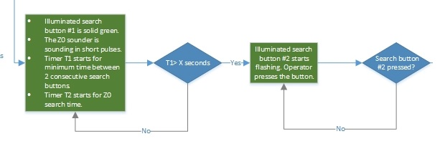
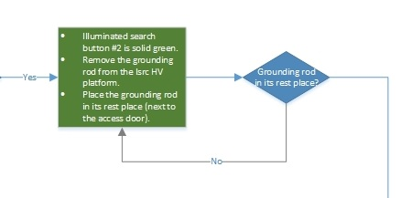
Procedures to Energize HV PS_2
3
4

Slide 22
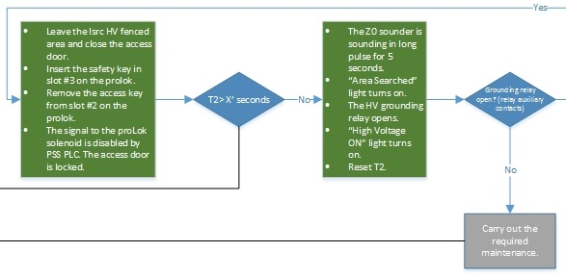
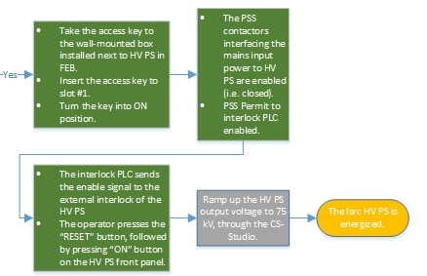
Procedures to Energize HV PS_3
5
6

Slide 23
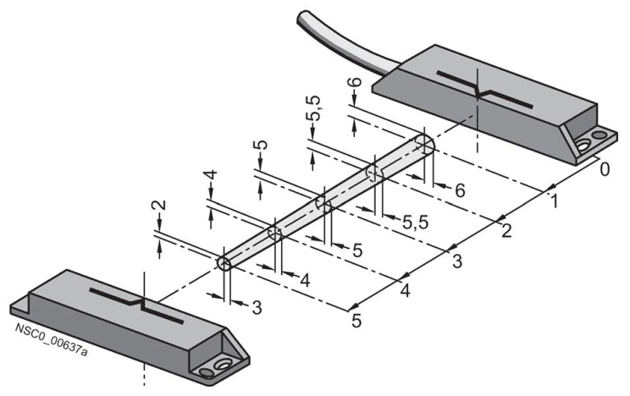
Non-contact magnetically operated safety switch
A magnetically operated switch comprises a coded switching magnet and a contact block (sensor unit).
Features:
Tamper-proof protective door monitoring
Small footprint
SIL 3 acc. to IEC 61508, achievable with single switch pair

Slide 24
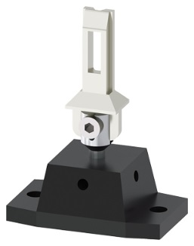
Mechanical Safety Switches with Separate Actuator
Positive opening →
The NC contacts of the switch are forced open mechanically, positively-driven and reliably by the plunger.
(an internal mechanism forcibly separates normally closed contacts and prevents them from welding together - allowing the safety circuit to open. Requirements in IEC 60947-5-1, Annex K prevent the reliance on spring action alone to separate the contacts.)

Slide 25
proLok (Solenoid Locking Safety Switches )
Features:
Spring locked (power to unlock)
Escape release from inside (mechanical push button to release door)
A special key to unlock the unit from outside (to be used by authorized personnel in case of emergency)

