Slide 1


  PSS0 Configuration Management,
  Verification and Validation (Yong Kian Sin)

Slide 2

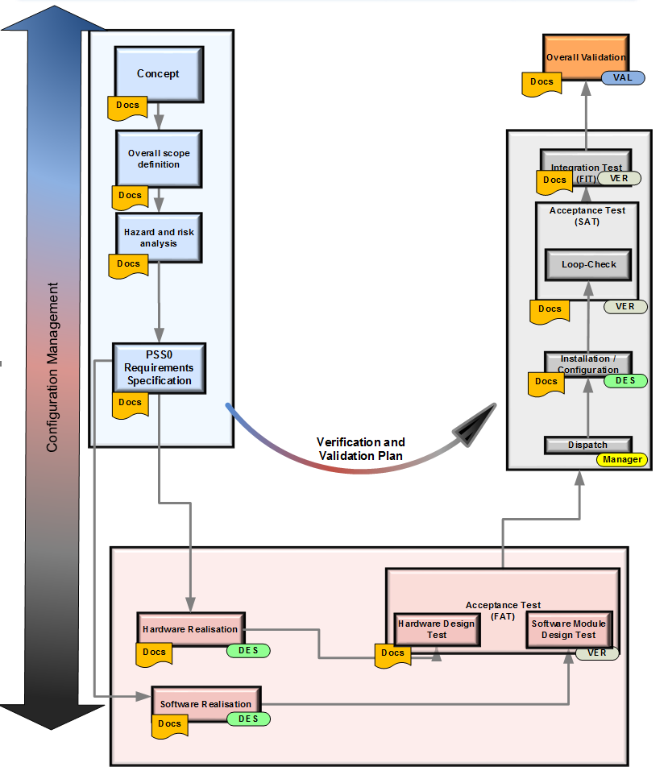
Lifecycle
Requirements
Validation
Integration
Design
Realisation

Slide 3

Configuration Management
Without
Welcome to the Dark side

Slide 4
Configuration Management
Requirements
Validation Test
Identify version of each software, hardware,
documents
Identify, track and report the status of items:
Change request
Non-comformity
Integration Test
Prevent unauthorized items entering into system
Design
Realisation

Slide 5
Configuration Management, How?
Passed
Passed
Failed
0009

Slide 6
Configuration Management, How?
Not safety relevant
Safety relevant

Slide 7

Design Change Request, How?
Second way of DCR
I want Change

Slide 8
Design Change Request, How?

Slide 9

Design Change Request
Impact Analysis
Which module impacted?
Which part of lifecycle need to be repeated?
Which hazard affected?
Classification
Minor (continuing, able to transit)
Medium (continuing, no transition)
Major

Slide 10
Design Change Request
Example | Modification Impact | Risk | Classification
Firmware update | Malicious firmware -> Heavy | Firmware update is implemented, the system supports such actions -> High | Major
Replacement of standard IO modules | Modules are checked for correct functionality by the supplier before release -> Light | module replacement may cause system shutdown -> High | Medium
EPLAN Drawing update due to typo in one page of the DI module | Changes only applied in the EPLAN drawing -> Light | Low | Minor

Slide 11
Design Change Request Approval
The safety relevant Change Request shall be approved before the implementation.
Approval shall be given by the PSS Change Control Board, which consists of:
- Work Package Manager
- Designer
- Verifier
- Functional Safety Manager (optional)
The decision shall be documented; comments by each member of the board can be added.

Slide 12
Verification
Items do not conform with the specification
Detect errors
Verified the identity of the items

Slide 13
Validation
Overall check
Ensure design meets the safety requirements
- Consistency of the requirements after PSS0 fully developed and tested

Slide 14
Verification and Validation
Requirements
Validation Test
Validation
Verification
Design
Integration Test
Realisation

Slide 15
Verification and Validation
Requirements
Validation
Design
Integration
Input Data | Safety Requirements Specification
Output Data | Requirements Specification Verification Report
Realisation

Slide 16
Verification and Validation
Requirements
Validation
Design
Integration
Input Data | Software Architecture Hardware Architecture System Architecture Requirements Specification
Output Data | Software Architecture Verification Report Hardware Architecture Verification Report
Realisation

Slide 17
Verification and Validation
Input Data | Safety Requirement Specification Hardware Design Hardware Documentation HW Config TIA Portal
Output Data | Hardware Design Test Report
Requirements
Validation
Design
Integration
Input Data | PSS0 Requirement Specification Software Module Design Software Documentation
Output Data | Software Module Design Test Report
Realisation

Slide 18
Verification and Validation
Input Data | Safety Requirement Specification Hardware Design Hardware Documentation HW Config TIA Portal
Output Data | Hardware Design Test Report
Requirements
Validation
Design
Integration
Input Data | PSS0 Requirement Specification Software Module Design Software Documentation
Output Data | Software Module Design Test Report
Realisation

Slide 19
Acceptance Test
Requirements
Validation
Acceptance Test (FAT, SAT, FIT)
Design
Integration
Realisation

Slide 20
Acceptance Test
Factory Acceptance Test (FAT)
With the final hardware
Without sensors or actuators
With hardware configuration
Site Acceptance Test (SAT)
Confirm the installation of the equipment with complete software integrated with sensors and actuators
Final Integration Test (FIT)
With updated software which improve from SAT
ALL punch list in SAT closed
Systems connected with PSS0 shall able to operate
Signal between PSS0 and other systems able to transfer

Slide 21
Validation
Requirements
Validation
Checking of completeness of the verification reports
Checking the state of the configuration list
Checking the state of Change Management
System will be tested against the Safety Requirement Specification
Design
Integration
Realisation

Slide 22



Slide 24
backup
Black box test
Testing, either functional or non-functional, without reference to the internal structure of the component or system.
Equivalence class
we select one representative of each class and test our program against it. It is assumed by the tester that if one representative from a class is able to detect error then why should he consider other cases. Furthermore, if this single representative test case did not detect any error then we assume that no other test case of this class can detect error. In this method we consider both valid and invalid input domains. The system is still treated as a black-box meaning that we are not bothered about its internal logic.
Boundary Value analysis
A black-box test design technique in which test cases are designed based on boundary values.

Slide 25
backup
Dynamic analysis
The process of evaluating behavior, e.g., memory performance, CPU usage, of a system or component during execution.
Static analysis
Analysis of software development artifacts, e.g., requirements or code, carried out without execution of these software development artifacts. Static analysis is usually carried out by means of a supporting tool.

