Slide 1
Accelerator NCFE Liaison Officer
Frank Hellström
2018-02-01

Slide 2

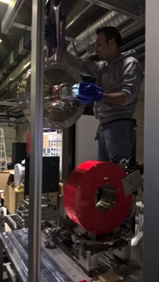
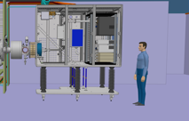

Tasks & responsibilities
Facilitate the communication between the ESS organization and the WU Partners
Up until now my WU Partners: INFN Catania for the ISRC & LEBT , INFN Legnaro for the DTL
Participate and communicate within external and internal WP3 teams and the Accelerator project
In cooperation with WU Partners plan, monitor and report performance and status of planned and actual activities and milestones

Slide 3
Tasks & responsibilities
What does this mean?
Done TA contracts (ISRC & LEBT and DTL)
Done and continuing with updates on schedules for ISRC & LEBT, DTL and MEBT (ESS Bilbao) including getting these updates into P6
Weekly Skype meetings with WU partners with (follow-up on action issues)
Getting monthly reports from Partners, compiling these with reporting to project management (P6)
Follow up of TA (including project management of DTL Workshop and other deliverables from ESS)
DTL cables into Cable DB (responsibility of WP3) on collaboration with the Partner
Preparation of WSCP (Work and Safety Coordination Plan) documents with related documentation incl. assembly and installation procedures
Be informed of how things are going at the Partner (and if any consequences to the project)
General ‘project management’ for my WU’s

Slide 4
Expectations & needs from MET
Engineering recourses when requested, example mechanical & electrical engineers for design of DTLW
Integration support as soon as a new 3D model is available from a WU partner
Support for ESS procedures, i.e. best practices to get procurement done quick & easy etc.

