Slide 1
BI/Vacuum Mechanical design
Presenter name
Presenters title
www.europeanspallationsource.se
29 January, 2018

Slide 2
Mechanical Design (future/current)
Beam instrumentation
LEBT NPM
DTL Faraday cups
Spoke beam stops
Medium beta beam stops
Tuning dump instrumentation (imaging/aperture monitors)
PBIP instrumentation (grid, aperture monitor)
NSW instrumentation (aperture monitor)
Stub integration
LWU Patch panels
MPS retrofitting
BLM supports
Vacuum
WP12
Lattice/Catia skeleton
Neutron guide inflatable seals
Coating chamber (ceramic seals, etc)
QA, metrology
NSS vacuum infrastructure
Target vacuum infrastructure
Dump/NSW to PBW

Slide 3
Support A
PLM/Engineering:
There must be a system/database in the future which allows programmatic (RESTFUL) access to data or else it will not be adopted by other groups
This will benefit ESS in the long run
Simulation group:
In the immediate to near-term future there is a strong need for simulation expertise/CPU cycles!
Have already organized a workshop with Jonathan and Emil for Fluka training
There are numerous insertable devices and areas in the tunnel which strongly need attention in order to mitigate damage and dosage calculation
Devices include Faraday cups, beam stops, scrapers, aperture monitors, imaging systems
Mechanical design:
There is an immediate need for at least 50-100% of a designer’s time for the next few months/year, for work related to vacuum and beam instrumentation

Slide 4
Support B/EPL Skeleton
Dmitri (fast wire scanner engineer):
We will have a mechanical engineer in house in the beam instrumentation group for 1 month soon, he is from CERN and knows how to do Catia macro programming
If there is anyone who has needs or questions from someone who has a deeper understanding of Catia macros, or has an existing macro that needs to be modified, it may be a good opportunity.
EPL Lattice/Skeleton
There are currently two ECOs waiting to be approved by Mamad
Catia skeleton insertion points for the HEBT/DogLeg/Tuning beam dump/A2T areas
Catia skeleton optical/BPM points

Slide 5
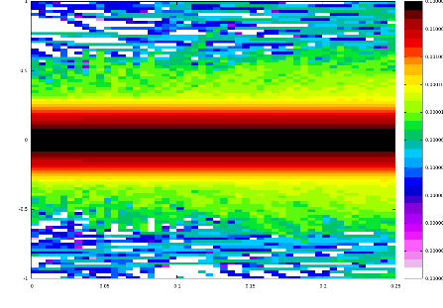
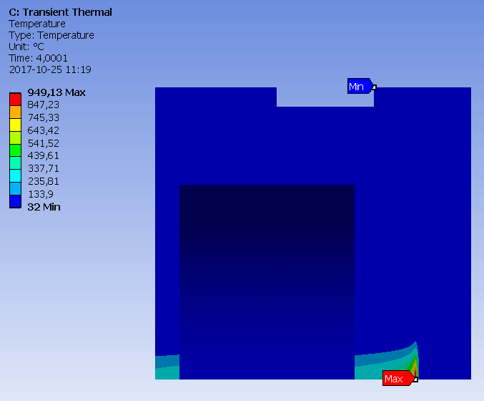
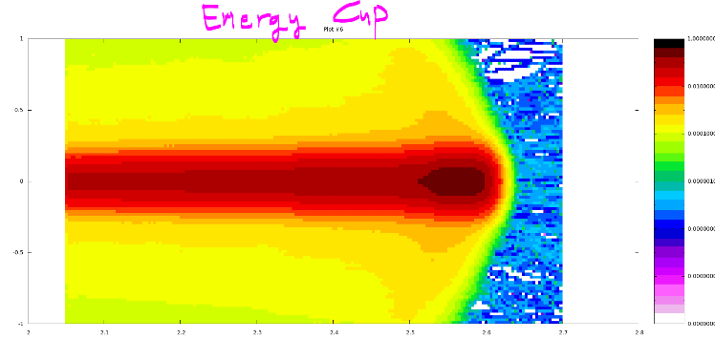
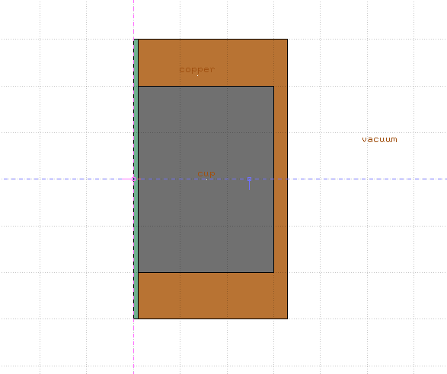
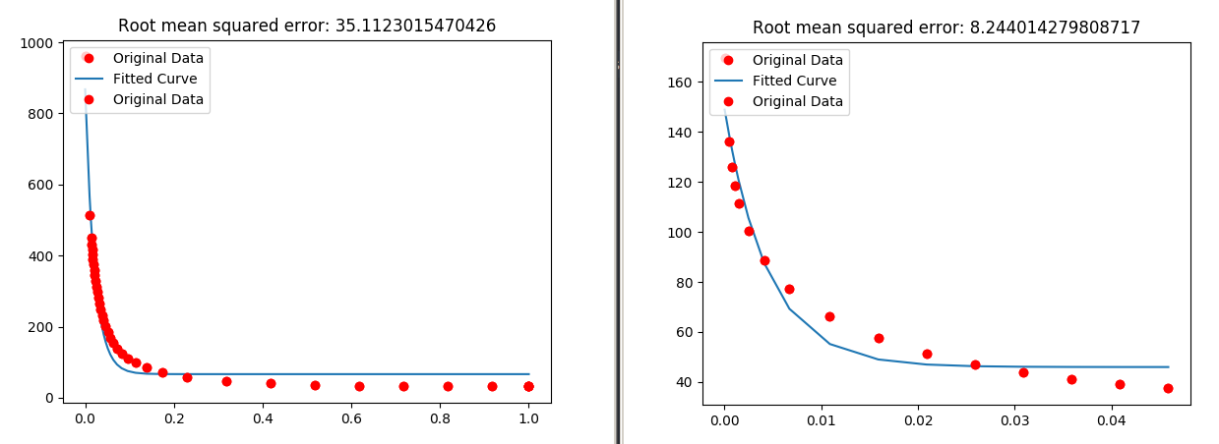
Tommy recent work (one example)
FLUKA
ANSYS
${Ae}^{−Bx}+C$
python

Slide 6
Thanks!
:-)

