Slide 1
MET section workshop
Dawid Patrzalek
Mechanical Design Engineer
www.europeanspallationsource.se
24 January, 2018

Slide 2
My main tasks and responsibilities
R&D
Handling meetings with external vendors
Performing design and construction of mechanical systems
Making detail design drawings
Performing structural calculations
Writing reports, procedures and specifications
Preapring and reviewing tender processes

Slide 3
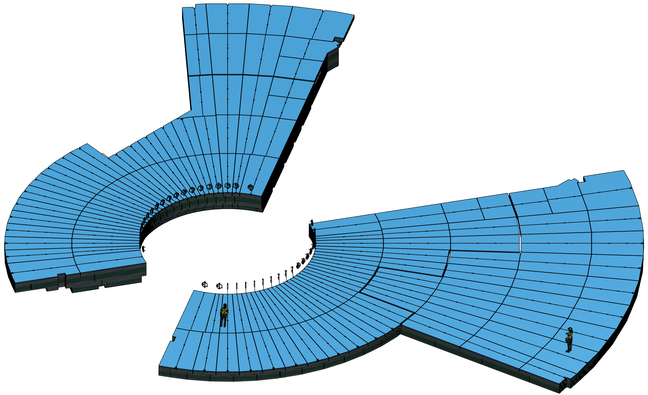
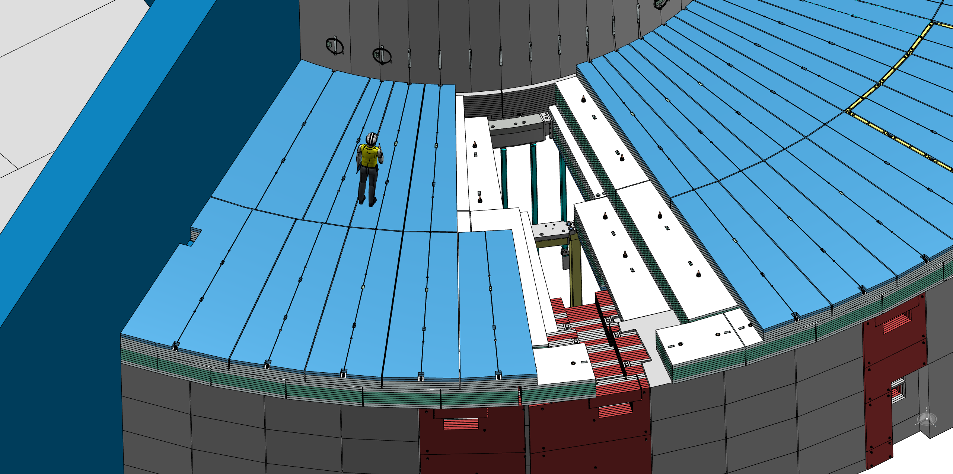
The Bunker Project
Statistics of the project, which is made of „just blocks”:
Total mass of the roof – 4529 t
Steel – 4010 t
HDPE – 519 t
Total quantity of the parts – 9176
Quantity of the unique parts – 800
Total quantity of the slabs – 4869
Quantity of the unique slabs – 753
Total quantity of the blocs – 443
Quantity of the unique blocks – 208

Slide 4
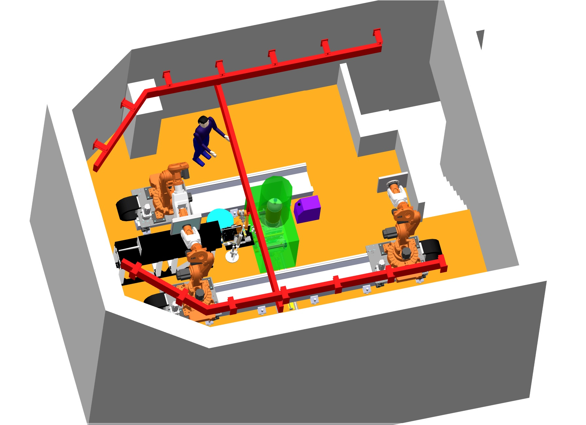
NMX Experimental Cave HVAC
HVAC requirements have to be specified
Preliminary HVAC solutions to be identified
Specification for a HVAC tendering process to be written

Slide 5
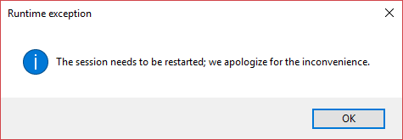
Expectations and needs from MET
The most important, core needs:
Unification of the MET section
Creation of a CATIA and PLM improvement plan/ process

Slide 6
Q&A

