Slide 1
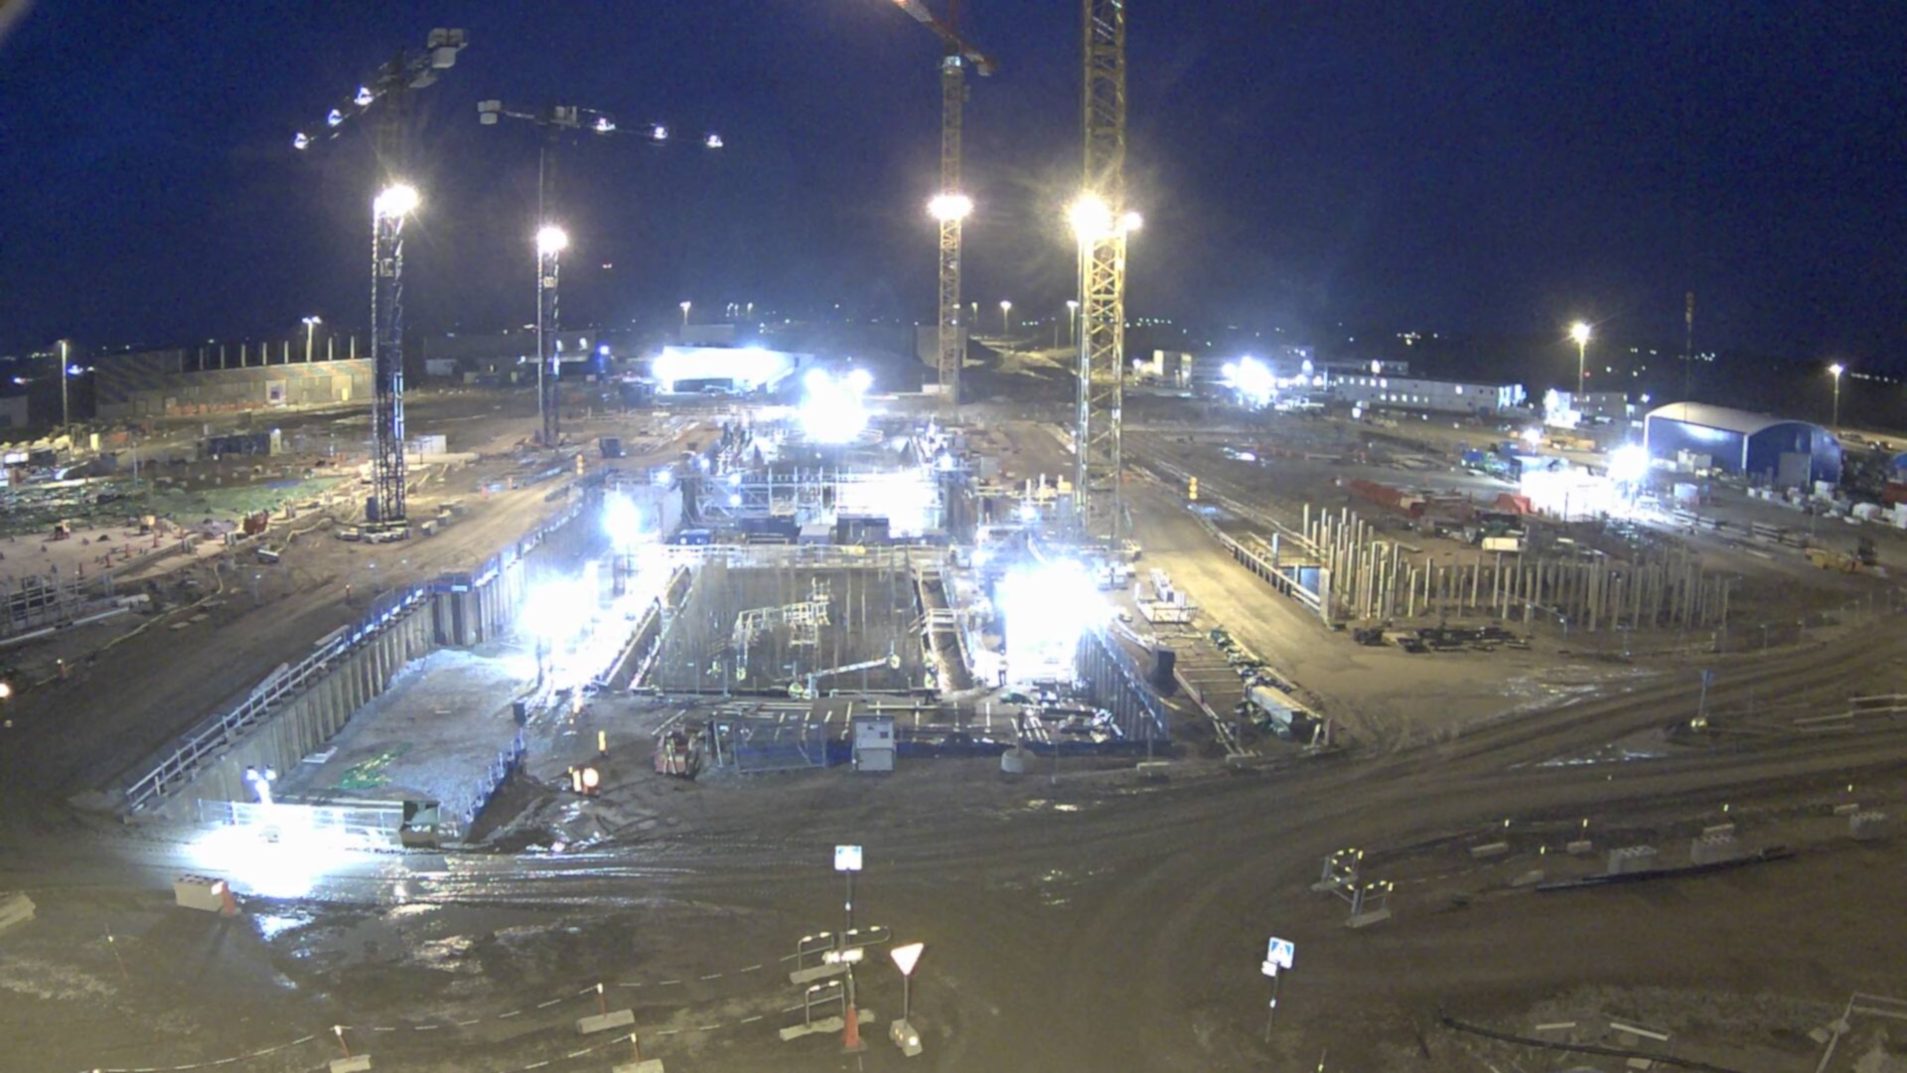

Mechanical Engineering & Technology
(MET)
Section Workshop #1
31-Jan & 01-Feb 2018
https://indico.esss.lu.se/event/975/
Dr. Eng. Nick Gazis
Section Leader
www.europeanspallationsource.se

Slide 2
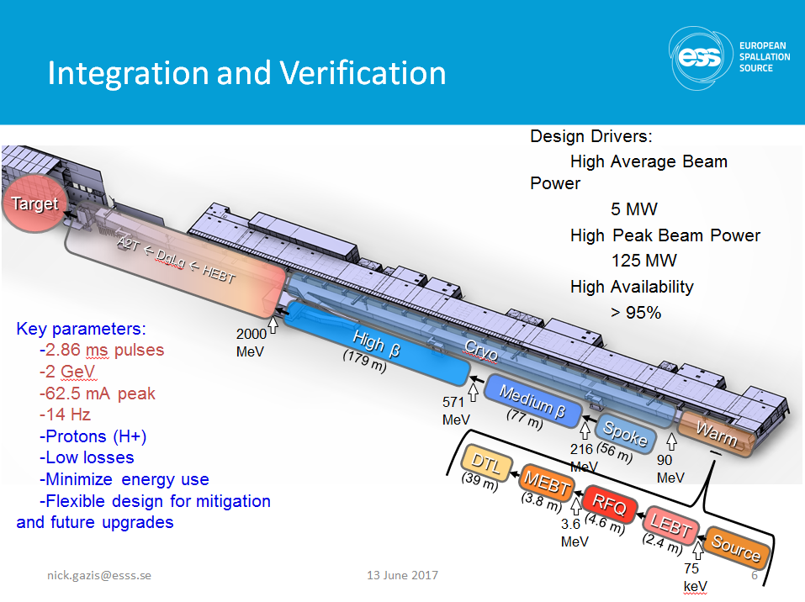
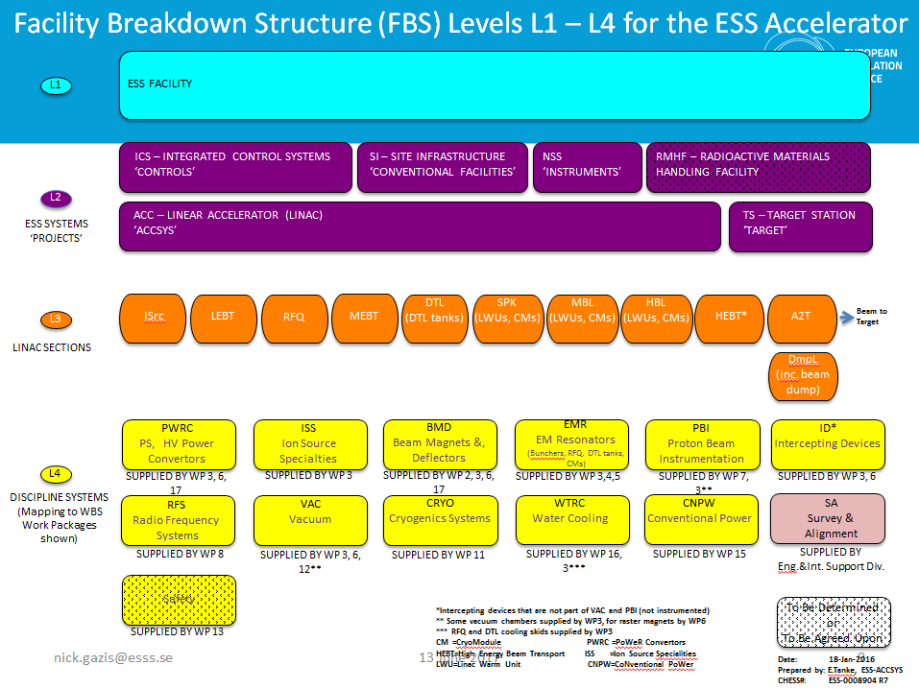
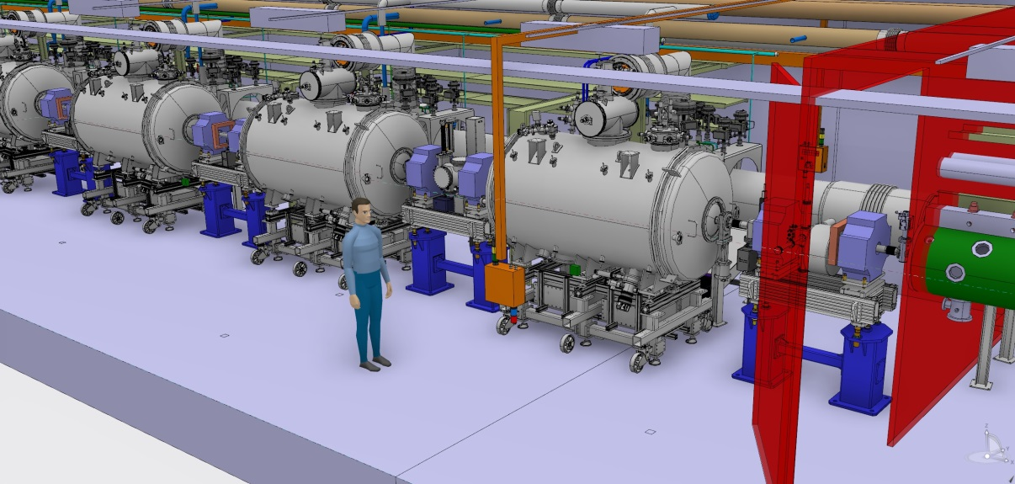
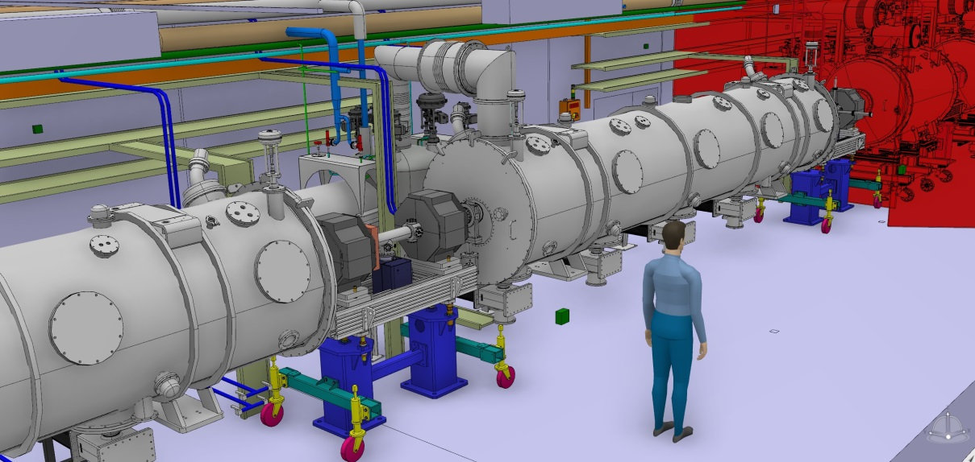
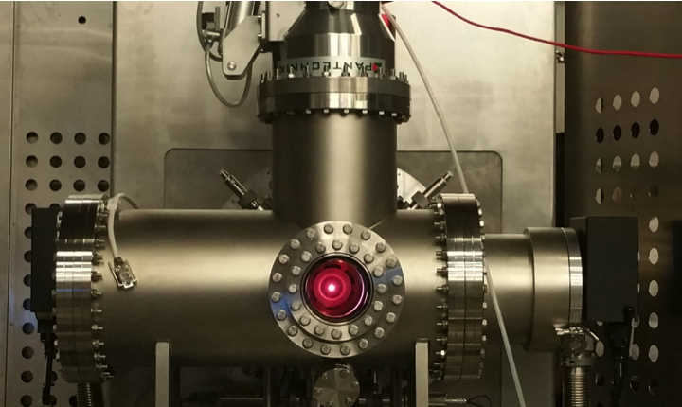
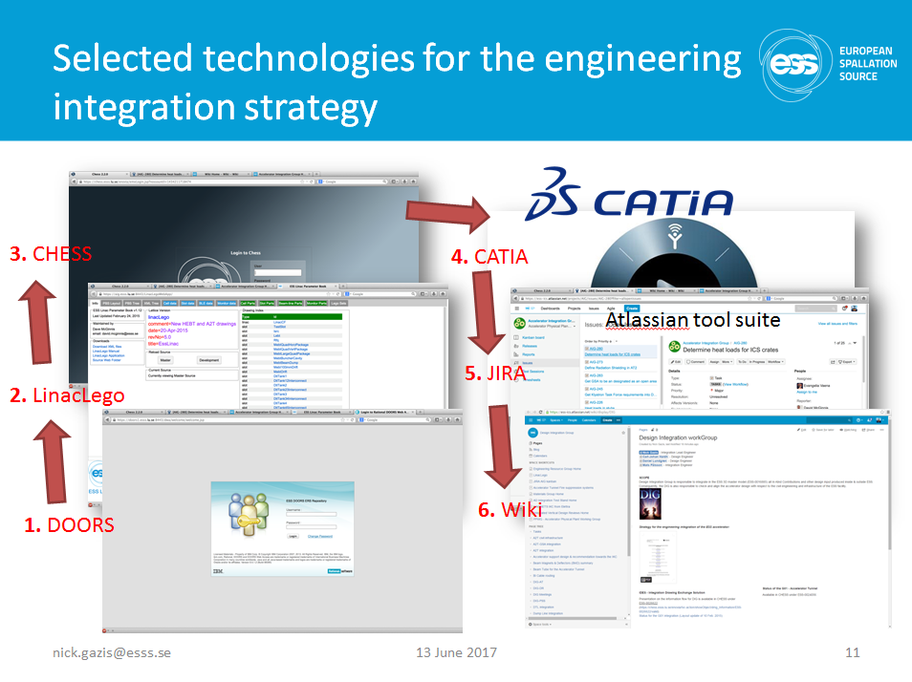
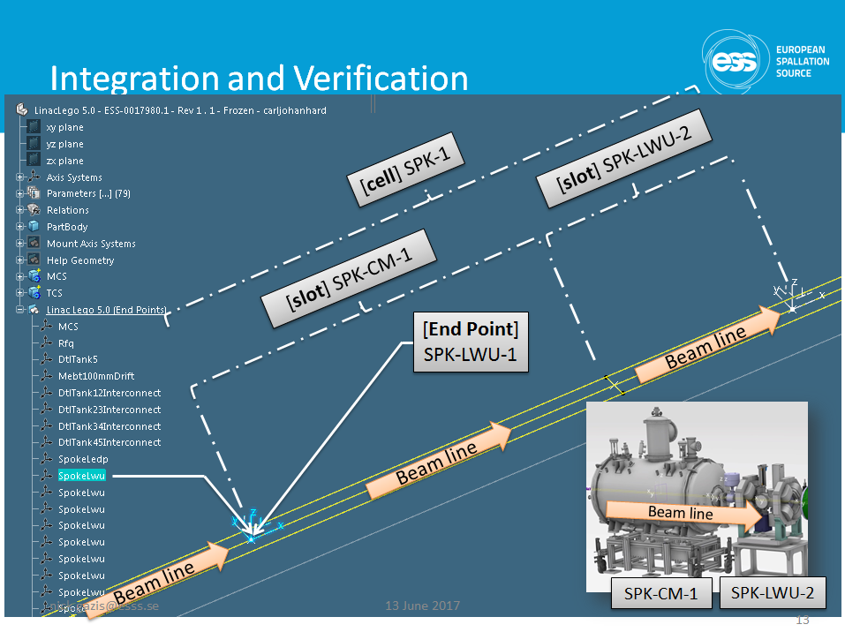
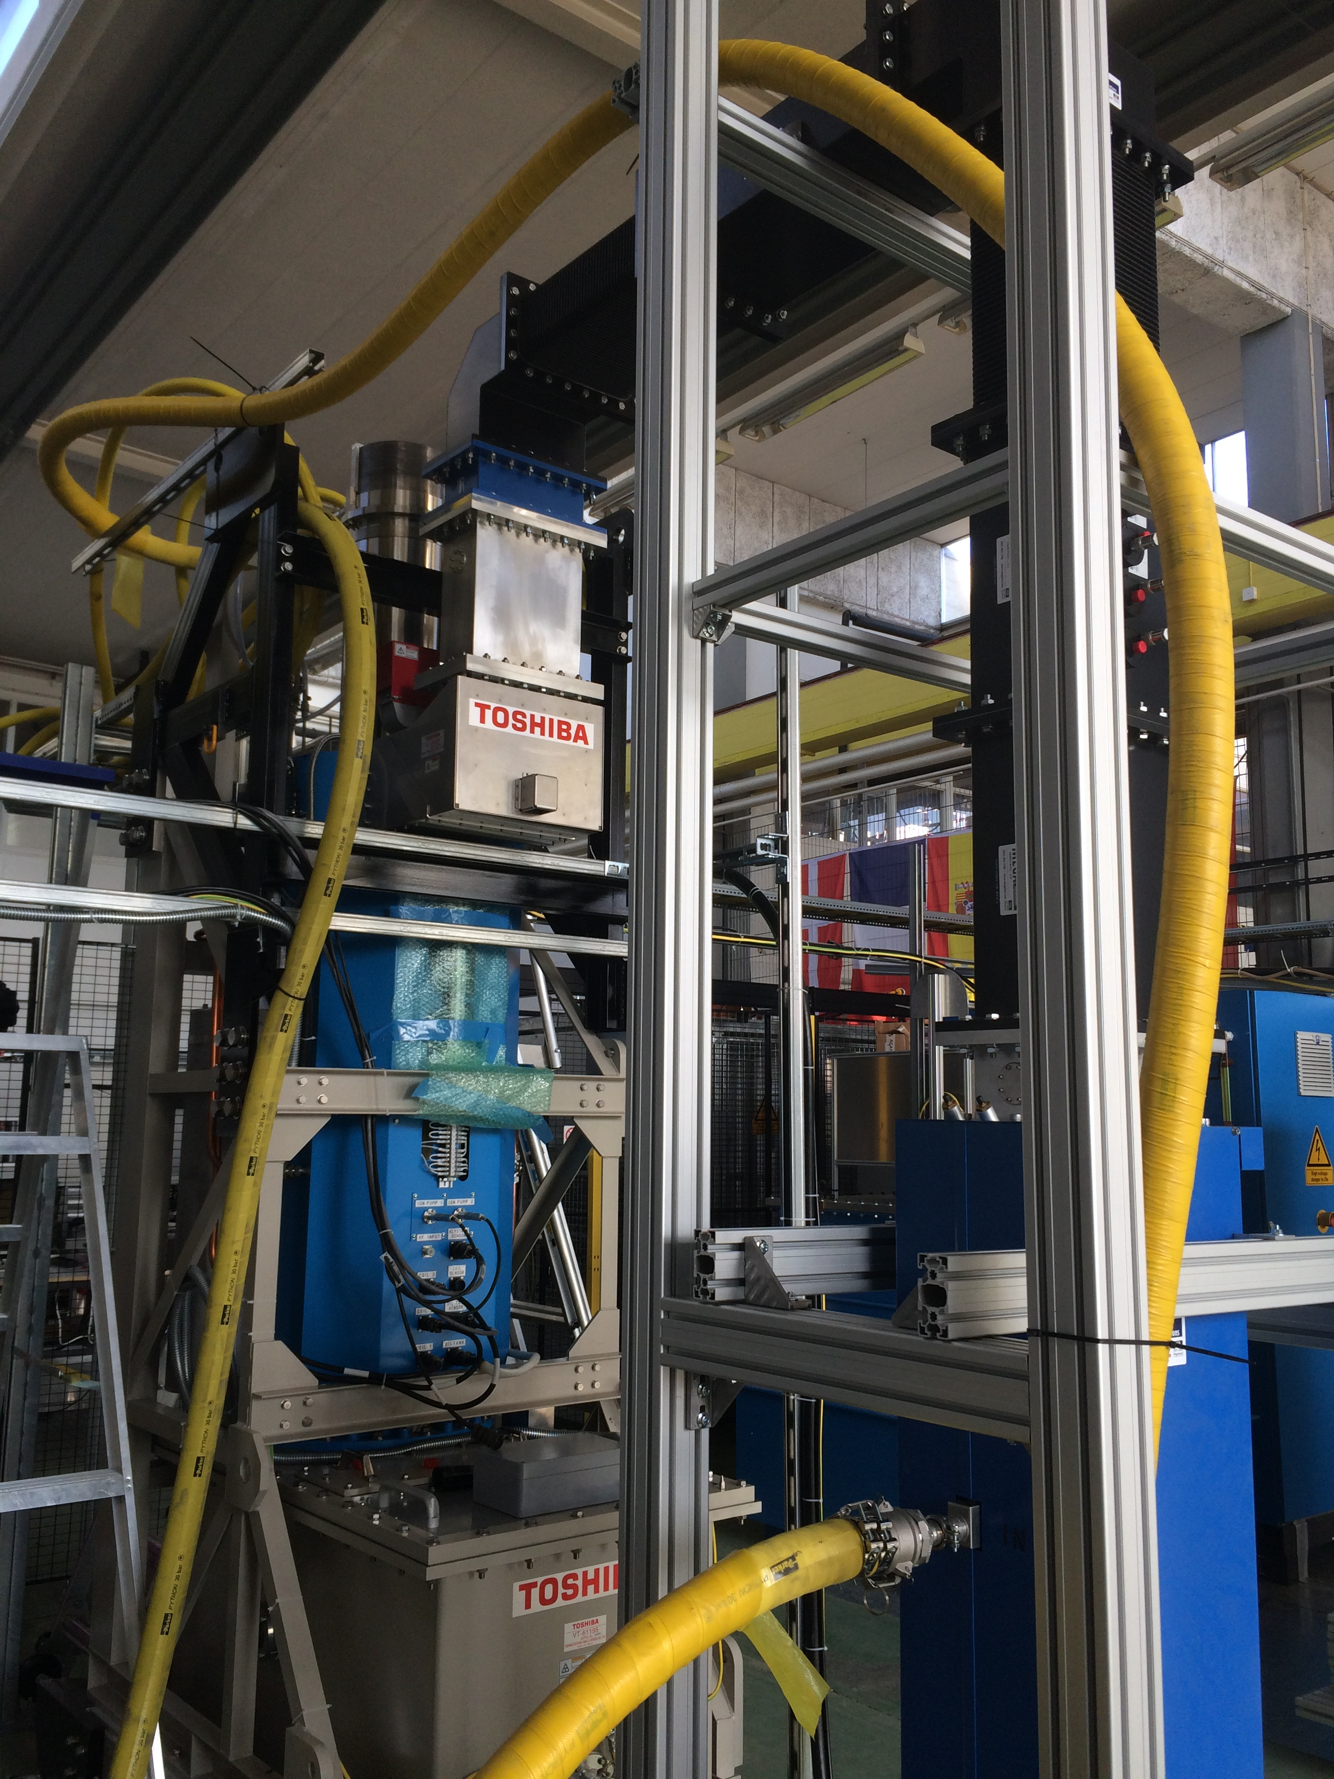
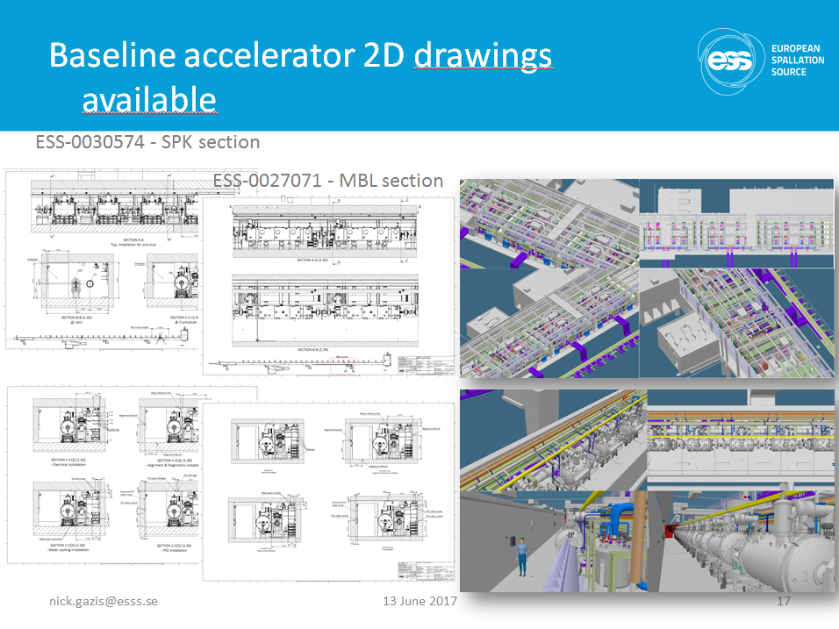
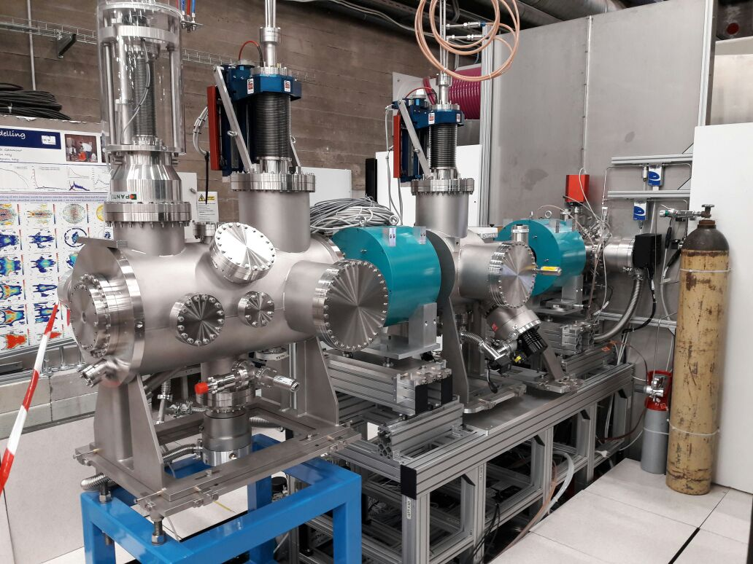
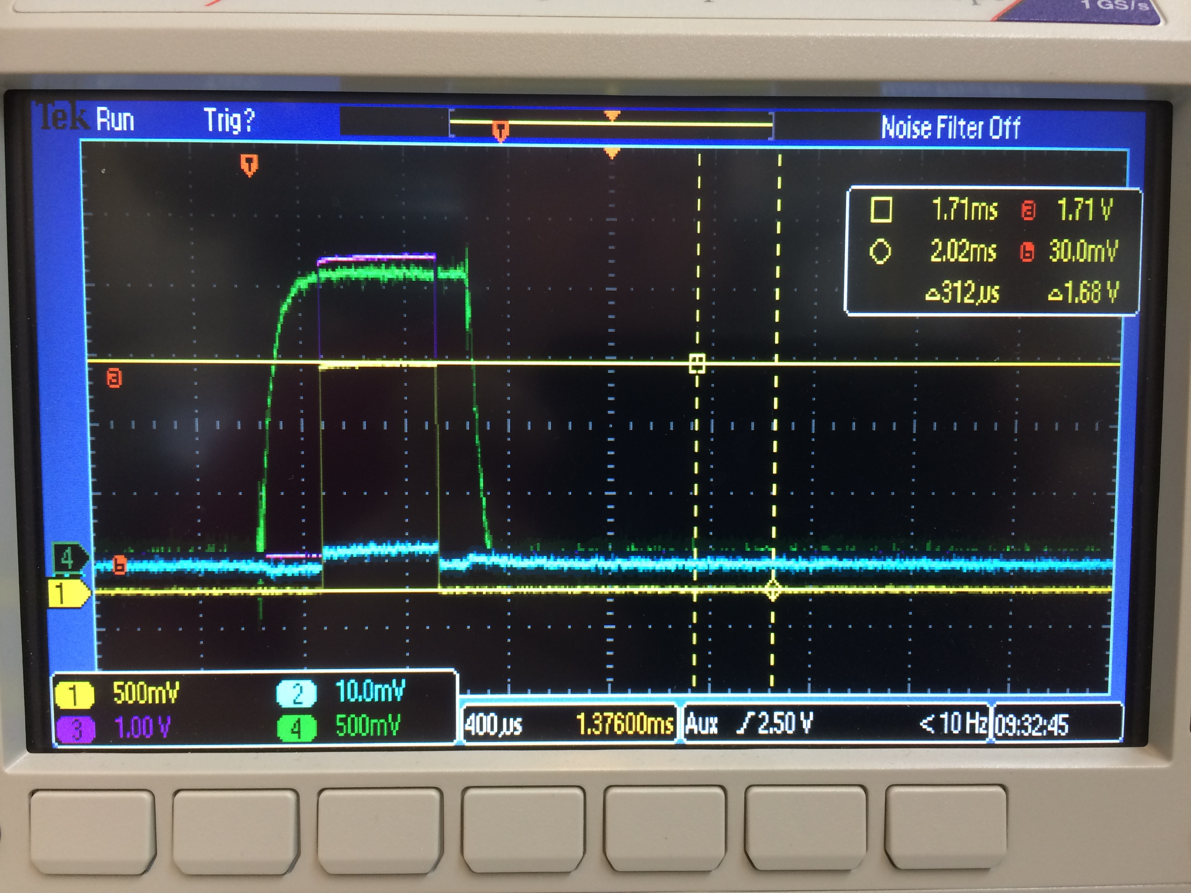
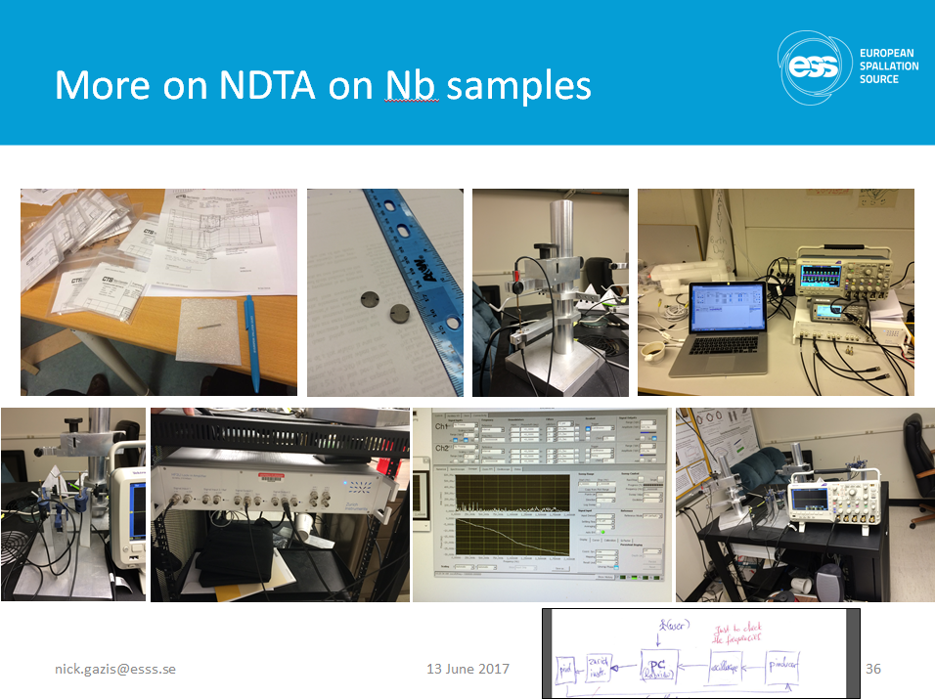
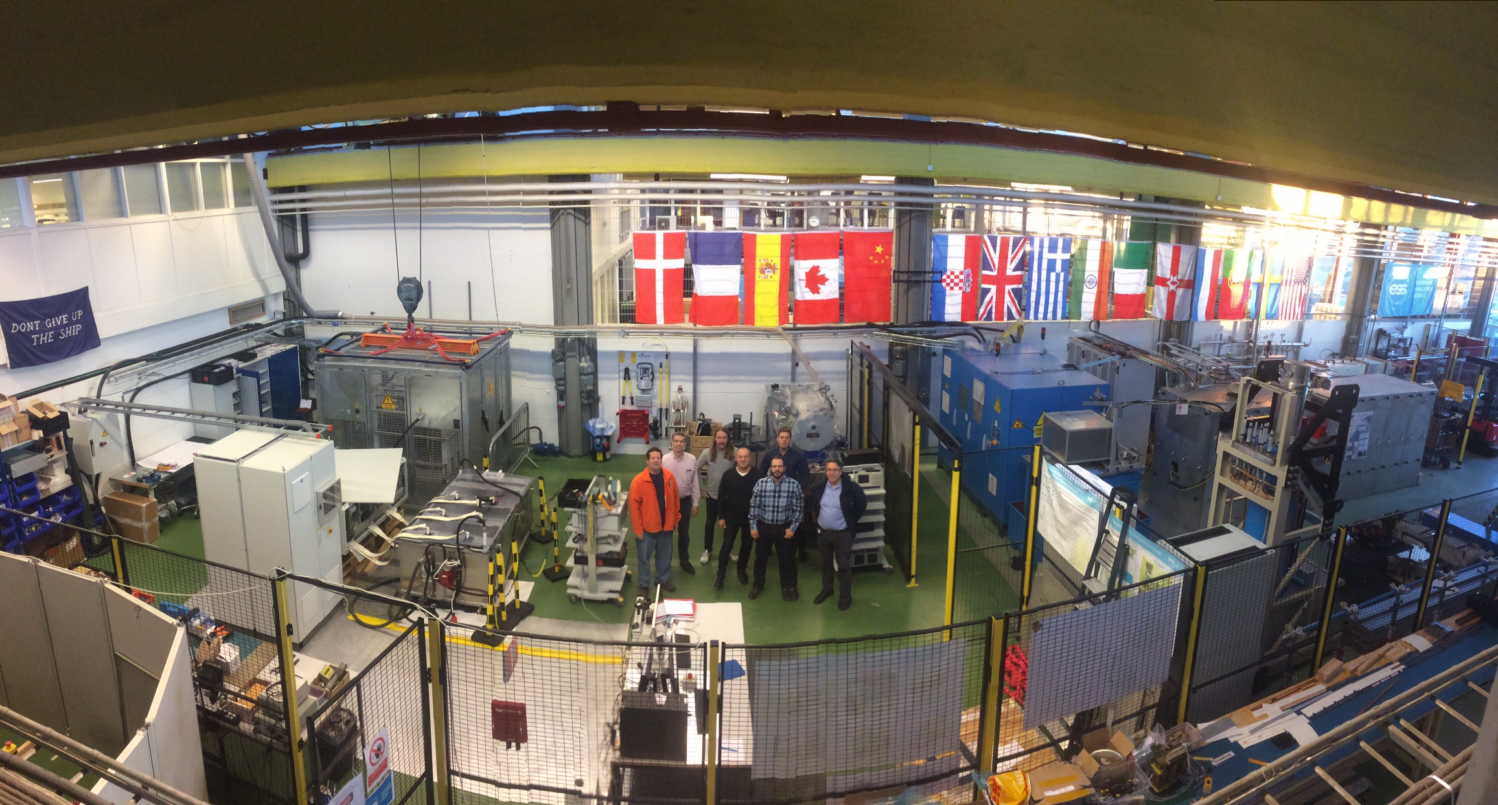
ESS projects (NG)
nick.gazis@esss.se
Mechanical Integration Lead Engineer
Accelerator design & requirements
Overall responsibility of 3D models for
tunnel (G01) and gallery (G02)
IKC design coordination and drawing
exchange through CHESS (IDES project)
Accelerator Installation Manager
Overall responsibility of cost, scope
& schedule of Accelerator Installation
Generation of accelerator installation maps
Generation of safety manual
for Accelerator Installation
On-going projects
Section Leader of Mechanical
Engineering & Technology (MET) section
Member of TS1 at LTH
Lead engineer of the Non-Destructive
Testing for Machines (NDTM) project

Slide 3
Section Tasks
nick.gazis@esss.se
MET Section tasks
  Design and engineering support on the ESS machines
  Develop mechanical engineering technology (e.g. CM design support, NDTM, other)
  Train and educate MET members according to the ESS projects’ needs
  Share and transfer knowledge for mechanical engineering within ESS (& also outside)
  Develop and maintain the ESS machine digital mock-up (EPL)
Needs from ESS projects - milestones for MET
  Create, maintain, function a mechanical design Core team (i.e. central design office)
  Create, maintain mechanical design processes (drawing tolerance standards, material properties, standard parts catalogue in CATIA and ESS Procurement contractors etc.)
  Create, maintain, function ISO drawings competence on ESS designs and reviews
  Emphasize and troubleshoot mechanical design technical issues
  Communicate requirements for support outside the section (to PLM, Integration, PIM and other)
Timeline of MET
  Coordinate a closer collaboration for the section people to share experience
  Core team meeting and section meeting/workshop
  Set & follow-up communication with PLM, PIM, Integration Groups for specified deliverables
What else?

