Slide 1
MET Section - Jarich Koning
Jarich Koning
www.europeanspallationsource.se
December 20 2017

Slide 2
About me
Mechanical engineering university of Twente – MSc in robotics 2003 - still in first half of life expectancy
Work experience:
Viro engineering (FEA, and design for ASML, Thales, Astron)
Institute Differ (diagnostics at Textor – FZJ, remote handling, VR and augmented reality with simulated haptic interaction, ITER (mechanical-optical design at diagnostics)
Currently at Heemskerk Innovative Technology, a SME specializing in Remote Handling and VR and care robotics). Completed projects e.g.:
Dutch Space (solar panels, cable systems, cryogenic proto, PLM)
ITER (supervisory control system, RH, Diagnostics)
Korean DA (ITER - RH)
European DA (ITER - RH, ITER - ECH system)
Partnered with Fagerström to ESS as RH advisor and system engineer on Target: MR plug handling, inner shielding handling, Casks concepts and handling for TW, MR, PBIP, PBW and shield blocks
Current project since ~2.5years is NBEX – next slide.

Slide 3
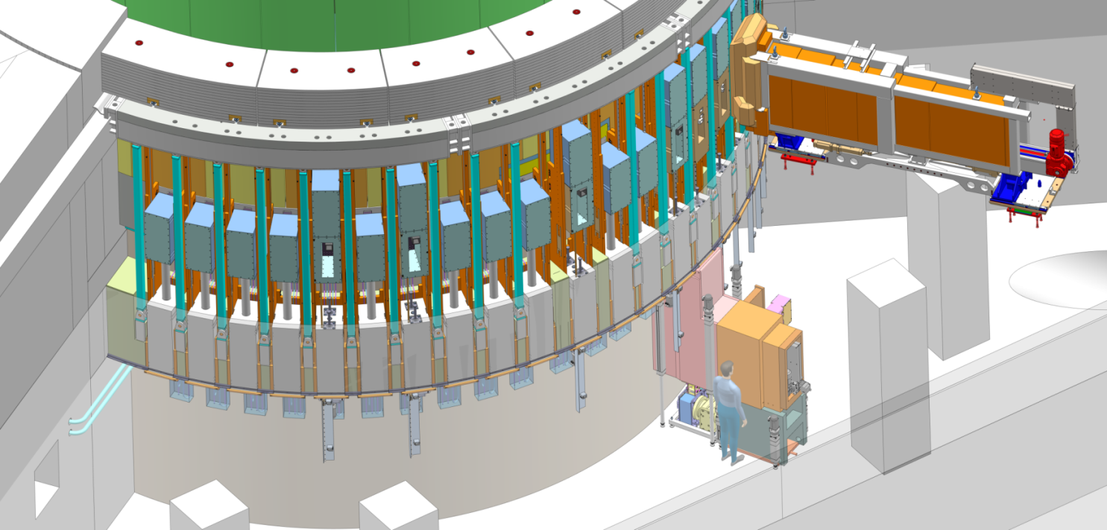
NBEX Neutron Beam Extraction System
Outside of Monolith and Monolith Basement, location of Light Shutter System
In Monolith, location of Neutron Beam Port Insert
Notes:
NBEX – a complex system where we need shielding, yet to have some peeking holes in there as well, need to position these peeking holes really well and move some 2t of that. On top of all that we need part remote, part operator-assisted handling of these components, and be able to cope with foreseeable malfunctions. All this in an area where radiation decreases from absolutely lethal to acceptable dose rates, also depending on system states.
For NBEX I set up the full structure with handling tools, light shutter design, NBW. I have worked with Bengt to redesign the NBPI and its handling, we cooperated on interface and design docs at PDR. End of 2016 the team grew with Naja, leading to an interim review last summer, further team growth with Mats Olsson and Johan Ohlsson coming to a first CDR just now in Dec 2017. WUL is changed to Lennart Astrom now.
During 2018 we will see more CDRs and test stands and prototypes coming in.

Slide 4
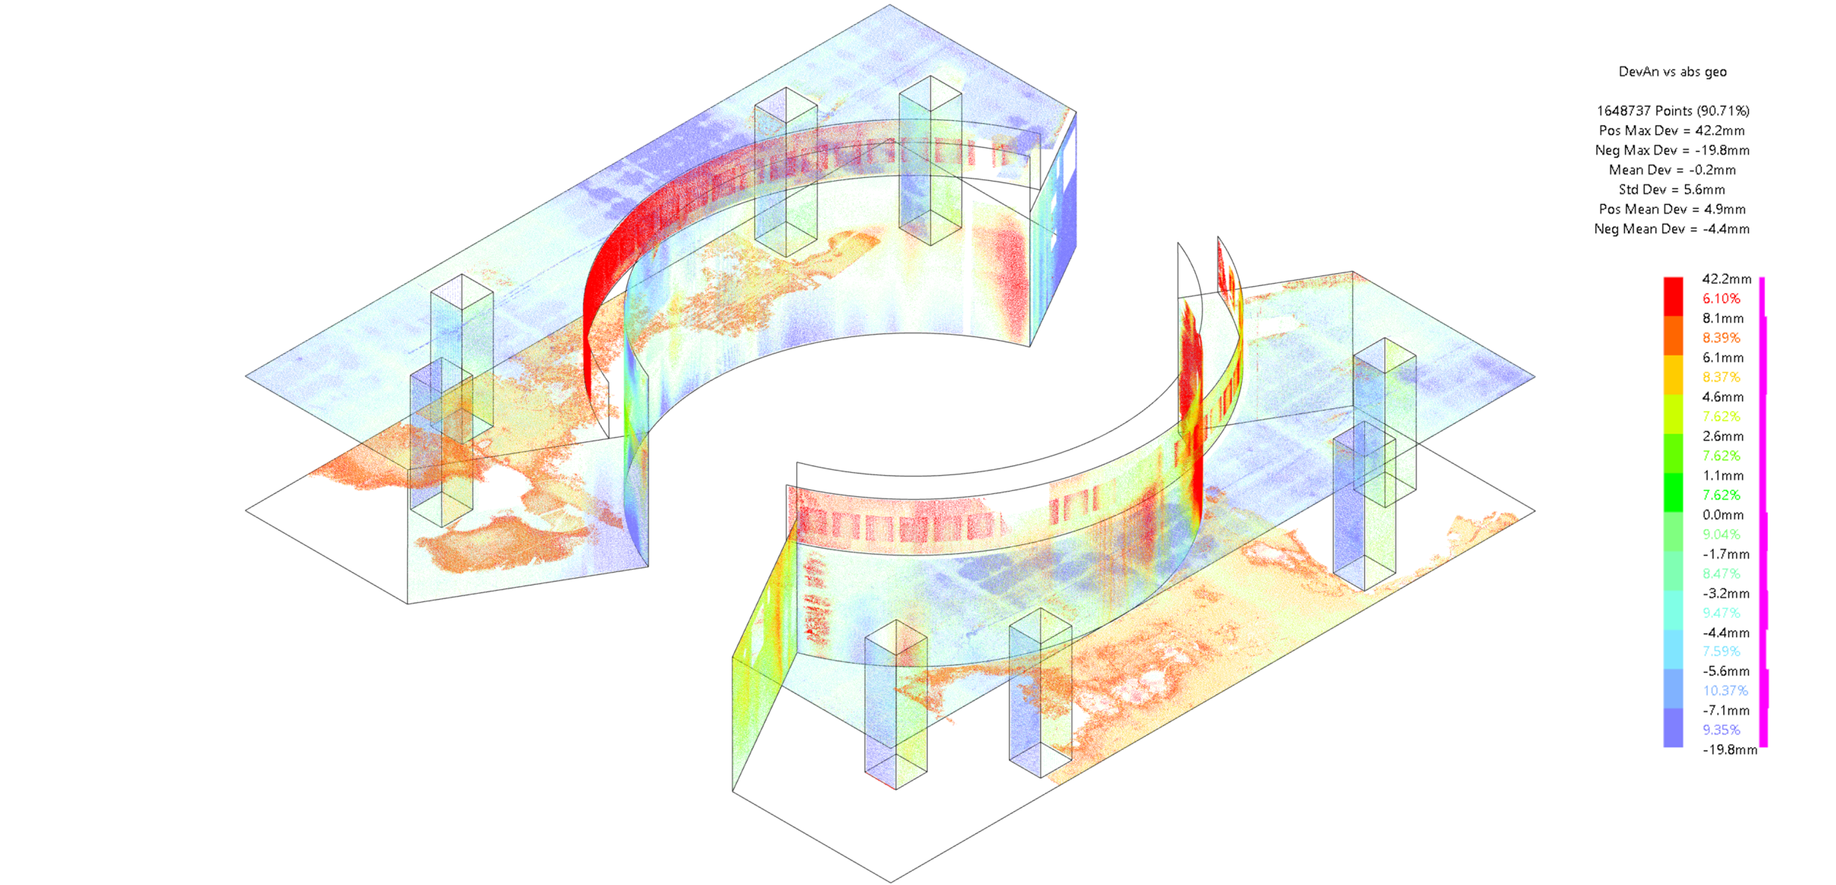
3Dscan and as-built geometry
Red=less concrete than model
Purple = more concrete than model
Lvl90 basement
Deviation analysis in Catia
Absolute measurements compared with nominal model
Notes:
Monolith puck, basement floor & ceiling, support pillars and R6 bunker floor edge
The concrete seems very well built, overall relative accuracy (form-accuracy) very good (~ ±5mm deviation to calibrated shape)
Overall absolute position wrt. model is also very good (~ ±10mm – kudos to Fabien et al)
Skanska seems to have ‘saved’ a few cubic centimeters on concrete as most deviations yield more air than nominal model
The floor seems a bit too low – as the scan of the floor is incomplete and unreliable as there was water on the rest of the floor, but it is safe to conclude that removing the water would show more lower areas.
The basement ceiling at the pillars is almost at 0, but bulges downward some 6mm between the pillars
All pillars are very accurate in dimensions (<5mm!), and placed within ±5mm (!)
The R6 edge is R6000-6010mm on NWS sectors, but 6010-6020 at E sector. So good for NBEX: a positive tolerance on the R6m as we requested! Senad’s R6 pillars structure should work out as the embedded plates for these are tight against the realized cylindrical concrete edge
The monolith puck is close to R5275mm nominal - a few locations close to floor are up to R5285.
Around ECHIR lid it is between R5255-R5280.
The 30deg walls are 0 to 10mm off

Slide 5
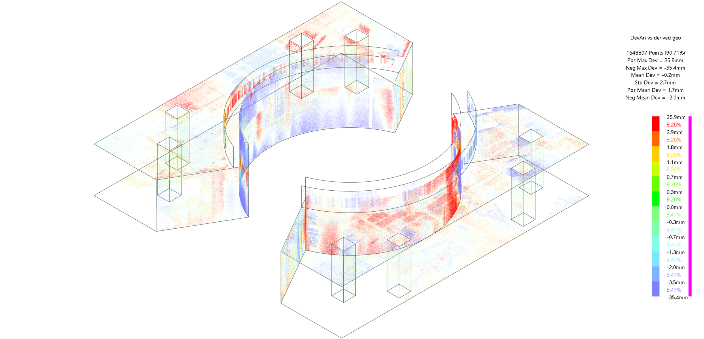
3Dscan and as-built geometry
Red=less concrete than model
Purple = more concrete than model
Reconstruction of simple geometry (planes/cylinders)
Measurements compared with reconstructed model

Slide 6
Core engineering values
My thoughts on core engineering values – could have more of:
Who knows what, like:
Combined steel/concrete structures
Cost efficient water-in-stainless-steel structures
Structural frames design (low-cost with off-the-shelf parts)
Specification surface treatments (TBY) for various areas
RCC-MRx compatible design (what and what not)
Working methods and implementing them over all engineers/designers, like:
Context/context-less links
Drafting annotations for production drawings
Handling 4D and state information in 3D model structure
Handling of non-native data (import, traceability)
Link to, and duplication of, information in Chess and Confluence
In-house projects need different organizational setup
Stable PLM, ERP, logistic and procurement organization
Document templates/framework supporting procurement
Hold internal design reviews by seniors
Notes:
4D: like handling tools at various locations in various states. Installation state(s) vs operational state. Open shutter vs closed shutter.

Slide 7
Some points on tooling
Bugs in Catia and in Catia<->Chess connection need real resolution instead of next-wave-of-new-things-with-new-bugs-and-old-ones-still-unresolved.
Workarounds cost time - some workarounds need other workarounds, costing more time
Support regularly suggests solutions that are blocked by other bugs
Hitting bugs, dealing with bugs but also long look-up and loading times, loses focus from primary tasks which is another time loss.
Support seems to think Catia works fine because they do not get complaints
Efficiency of working in a CAD/PLM environment seems not to be considered
ESS Workforce is not used to use video conferencing
Chess is an inefficient, cluttered interface to work with
Relation between confluence and chess is not clear. Some divisions engineer in confluence only

Slide 8
What about MET
Mechanical Engineering & Technology
What are the common, bonding factors?
Some people are not in MET although they seem to fit the scope
EPL maintenance, for instance?

Slide 9
Thank you!

