Slide 1
Mechanical Engineering & Technology (MET)
David Hugne
Mechanical Design Engineer
Sample Environment & Instrument Division
www.europeanspallationsource.se
January 2018

Slide 2
Responsibilities
Sample Environment
In collaboration with the scientists working at sample environment develop mechanical solutions for:
Floor mounted equipment
Top mounted equipment
Instrument Division
Designing the base plates for the instrument guides at the beginning of the beam line, inside the bunker, downstream from the monolith.

Slide 3
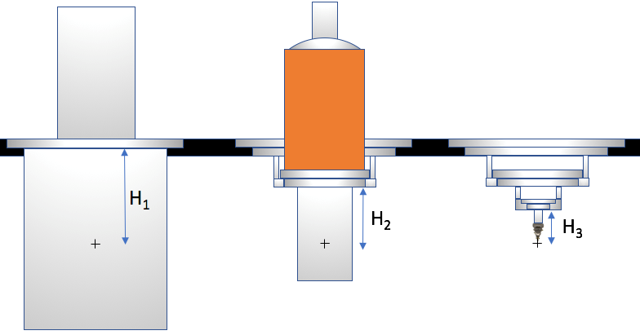
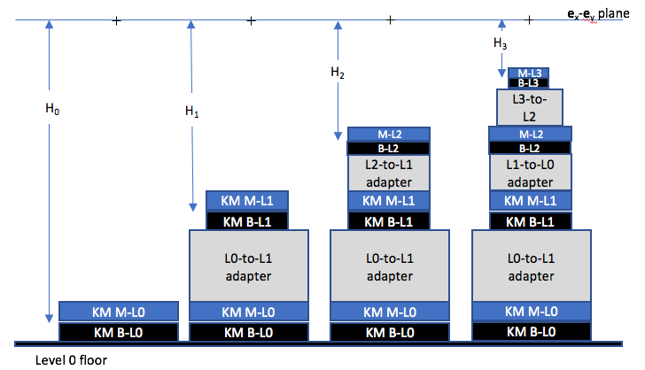
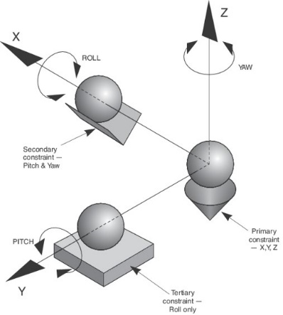
Sample Environment Top & Floor mounted instruments
- Top side installation of a standardized set of instrument flanges to the sample position inside a vacuum tank.
- Floor mounted test equipment at level 0,1,2 and 3.

Slide 4
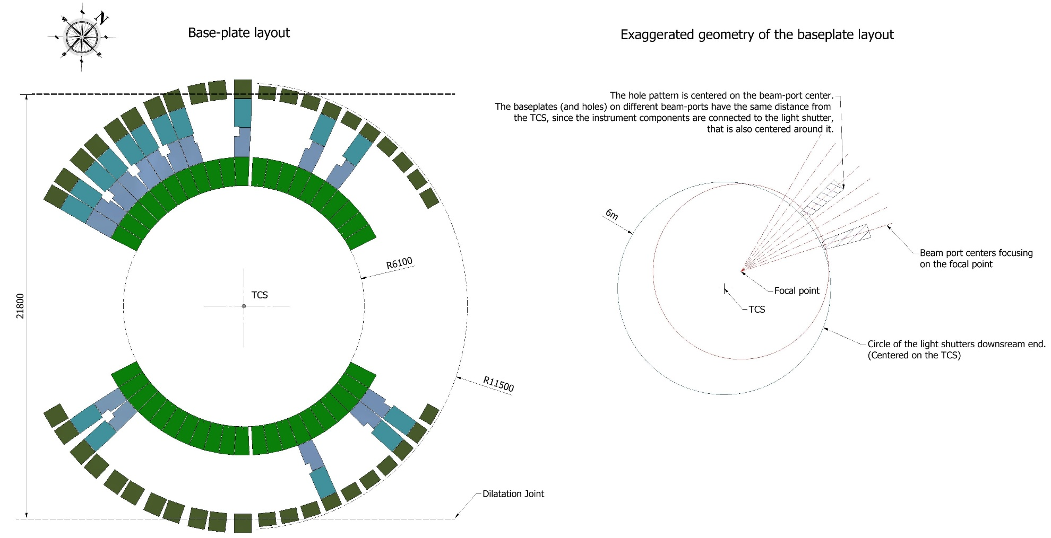
Instrument Division - Bunker Floor Base Plates
Scope:
Installation of instrument base-plates at the beginning of the beam-line, inside the bunker downstream from the monolith.
Stakeholders:
Target (Bengt Jönsson)
Bunker (Zvonko Lazic)
Instruments (Gabor Laszlo)
Chopper group (Erik Nilsson)
Use cases:
- Base for Insert Extraction Tool
- Base for Instrument components
- Base for future instruments
Reasons and requirements:
High radiation are to be expected at the area outside the monolith in the bunker area after some years of operation and we are therefore simplifying operations performed in this area and optimizing the time consumption.
All the components of the beam-line in the first 5m has to be removed in case of monolith insert installation at the neighboring monolith insert.
The kinematic mounts of the Monolith Insert Extraction Tool will be mounted on the base plates.
The additional purpose of the base-plates is to protect against ground shine.

Slide 5
Expectations and needs from MET
Improving the transparency /communications between the different work packs.
Support in finding persons with certain expertise in various areas.
CATIA V6 and PLM support and continuous implementation improvements.

