Slide 1
Robbin Petersson, PiMaCo AB trough ÅF
Started @ ESS June 2013 for former Chopper group.
Developed the first Chopper prototype, test equipment and a Bunker at workshop on Skiffervägen (gastelyckan)
Beginning of 2014 transferred to E&I support group.
Started working with Standard components.
Has in between done some smaller activities.
Fire test wall for S&Q
Piping work and Catia Building mock-up for Target
Space allocations of trays and equipment for ICS

Slide 2
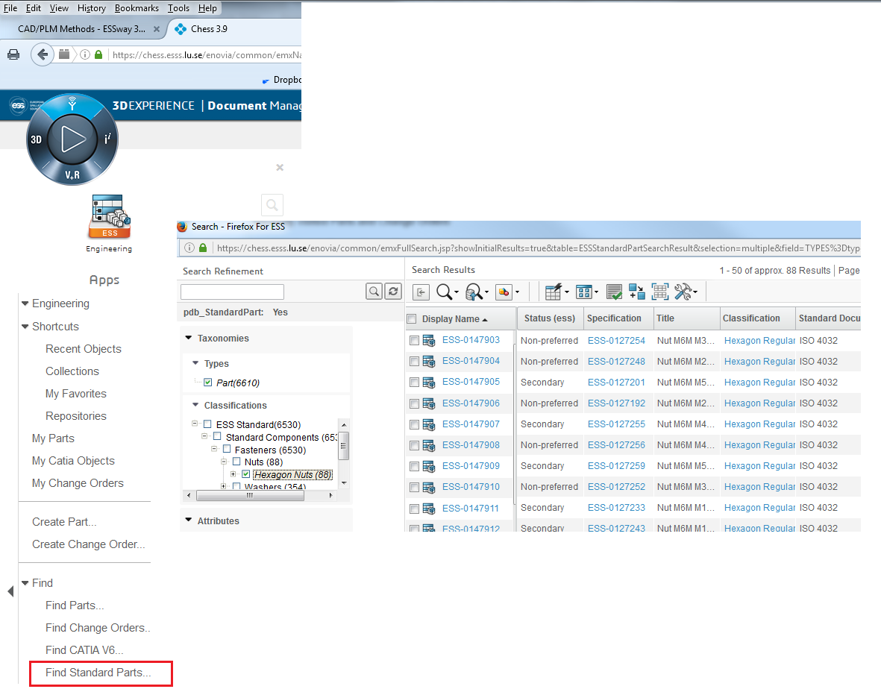
Standard Part Management
Some simple Standard part do exists right now
e.g. Hex Screws, Hex insert screws, nuts, washers and some pins.
More will come!
You can find them in Chess
Or
In Catia Catalog Browser, search for
“ESS Standard”

Slide 3
Standard Part Management
SNOW request for Standard components are developed, but not yet turned on (will come soon)
We are developing or own sit on ESS Inside under Support -> Engineering and Integration Support site
(Check it out mow and then, if it’s there)
Her will we gather info on our work progress etc.

