Slide 1
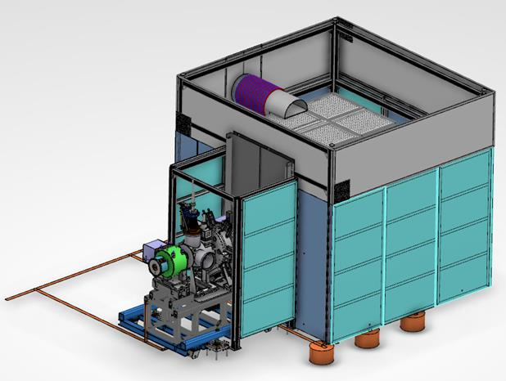
Safety Cage Ion Source

Slide 3
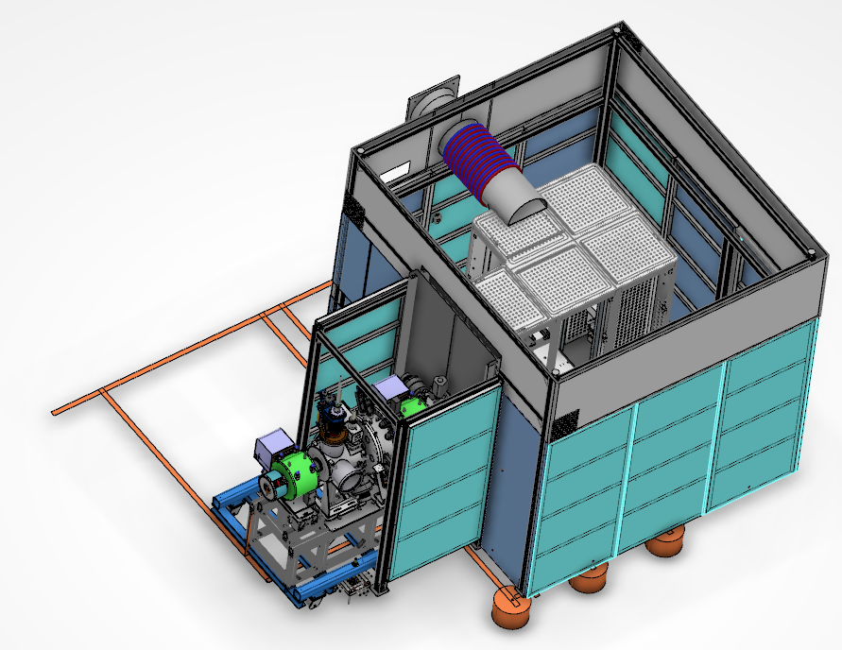

Slide 4
Spoke Cryomodule to Design Support stands and Alignment

Slide 5
Transport of the Cryomodules from CEA in Paris inside a Container on a Cradle

Slide 6
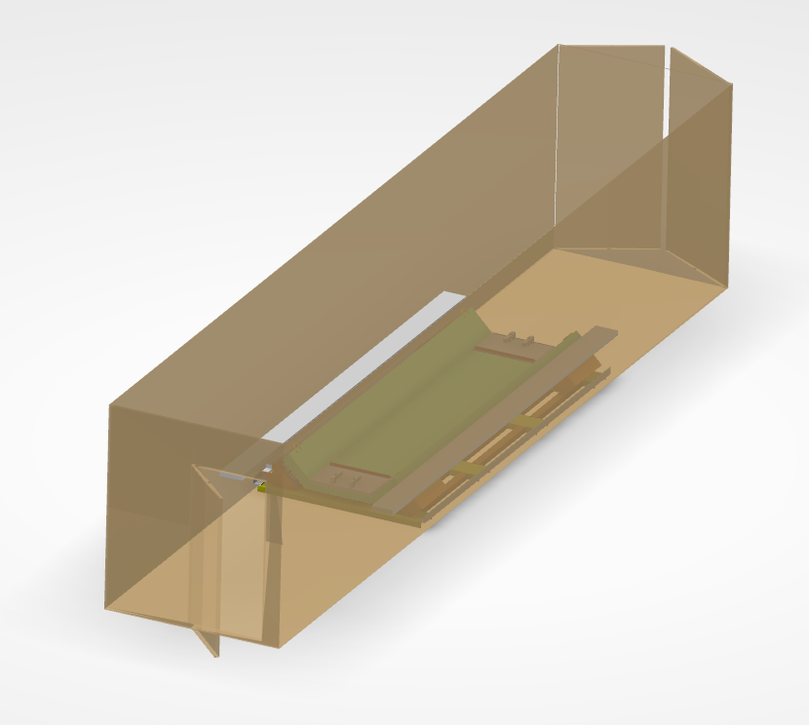

Slide 7
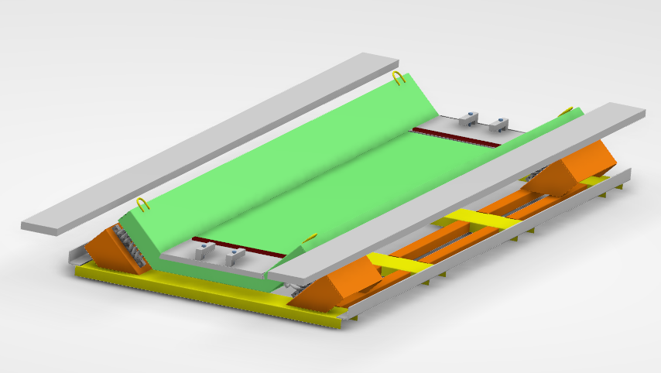

Slide 8
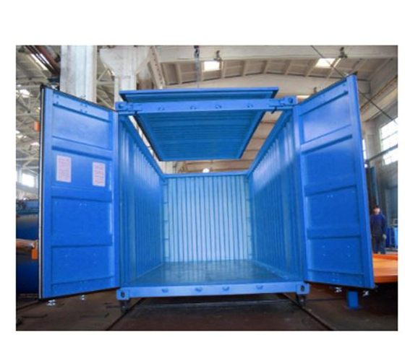

Slide 9
Trolley for the Cryomodule to handle it from the Container to Support stands. Involved in the Design from Tunga Lyft

Slide 10
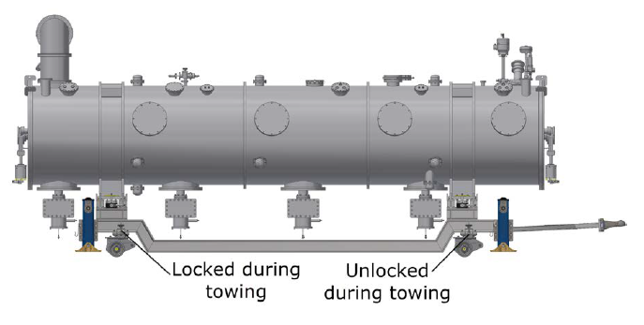

Slide 11
Support Stands with Alignment for Cryomodules in the Tunnel

Slide 12
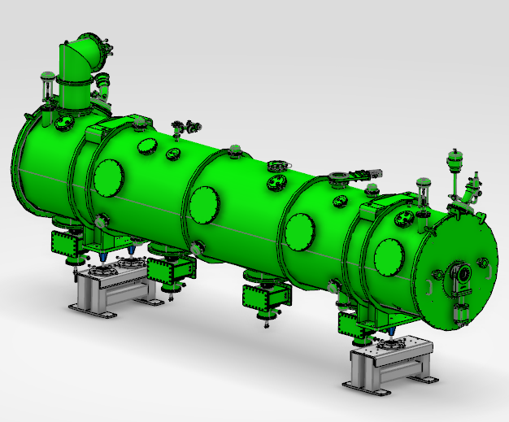

Slide 13
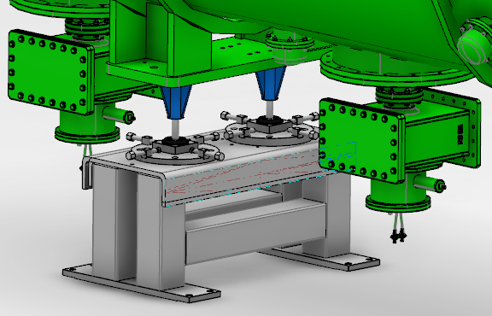
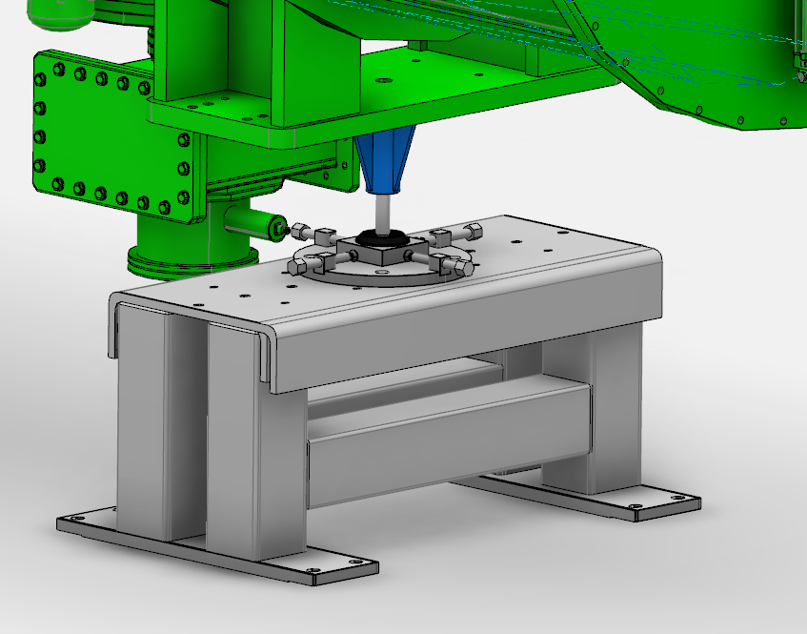

Slide 14
DTL – Workshop

Slide 15
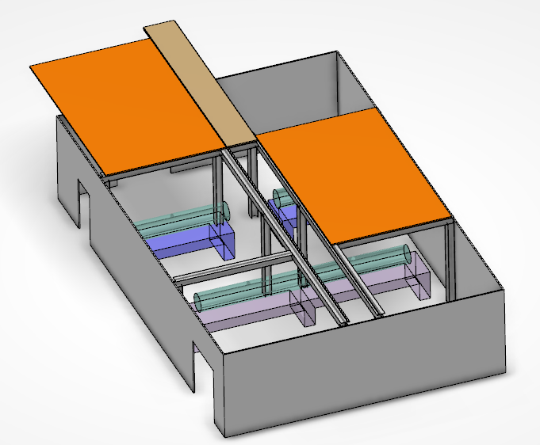

Slide 16
Needs Brainstorming Meetings Finalize Review and Release in PLM Divide out work Setup a Structure for How to do Right

