Slide 1
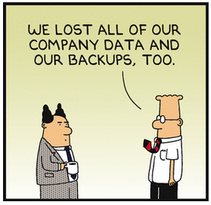
Catia Wishes to make work more efficient
BOM table
Must create accurate component lists.
Balloons must remain linked to the BOM.
Product table in assembly should be available to be used:
On a drawing to create manufacturing steps.
In an assembly to visualize assembly steps or variants of components
Standard components
Must have correct parameters so that the BOM can be filled out correctly.
Too many standard components in the database that is no longer valid.
Material library is not implemented yet in a useful manner.
Servers and the network needs to be more reliable.
Database errors linger in the Ticket list forever.

Slide 2
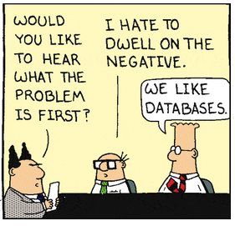
CHESS Wishes to make work more efficient
The way a document is sent out on a workflow should also be the way Catia files can be handled.
Skip the setting ”Approved” in Catia before you have to start a workflow.
Just set the Catia Model, Assy or Drawing to ”Review”.
Start the workflow. If something needs to be changed, just change the status in Catia to ”Temporary” and fix the issue.
Java is not working smoothly. Please change CHESS to something fast and useful like PHP.

